Slide 1

CS 352 Web
Lecture 5
http://www.cs.rutgers.edu/~sn624/352-F22
Srinivas Narayana

Slide 2

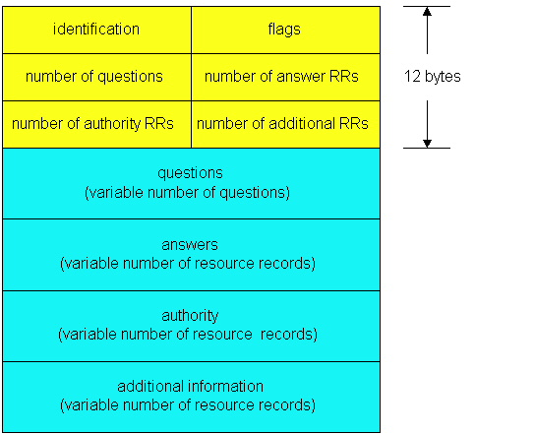
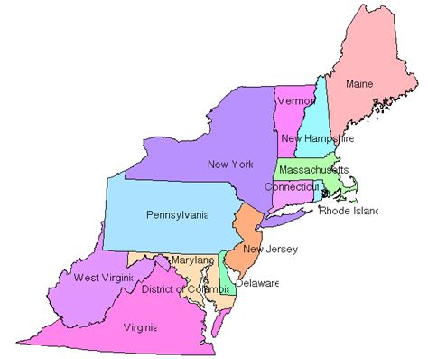
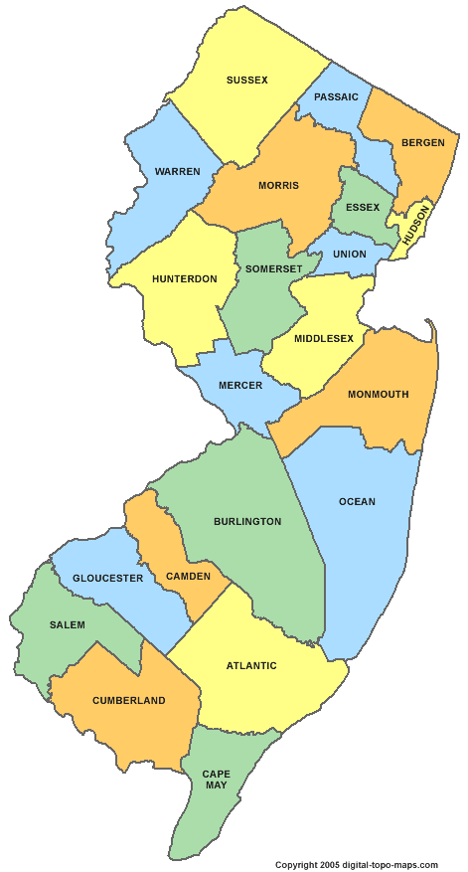
Review of concepts
Recursive queries
Domain Name System
Human readable names → IP addresses
Hierarchical, distributed database
Root server
TLD server
Authoritative name server
QR
OPCODE
Iterative queries

Slide 3
DNS Resource Records

Slide 4
DNS is a distributed database
DNS stores resource records (RRs)
(Incomplete) message format for each resource record (RR):
Class, type, name, value, TTL
You can read all the gory details of the message format at https://www.iana.org/assignments/dns-parameters/dns-parameters.xhtml

Slide 5
DNS records
Type=A
name is hostname
value is IPv4 address
Type=CNAME
name is alias name for some “canonical” (the real) name
e.g., www.ibm.com is really
www.ibm.com.cs186.net
value is canonical name
Type=AAAA
name is hostname
value is IPv6 address
Type=NS
name is domain (e.g. foo.com)
value is hostname of authoritative name server for this domain
Sometimes, you’ll see SOA record
Type=MX
value is name of mailserver associated with name
More complete info at https://www.iana.org/assignments/dns-parameters/dns-parameters.xhtml

Slide 6
DNS record types
dig –t <type> <domain-name>

Slide 7
DNS record example
NAME | Design.cs.rutgers.edu
TYPE | A
CLASS | IN
TTL | 1 day(86400)
ADDRESS | 192.26.92.30
RRs in response
to query
records for
authoritative servers
Information about nameserver
NAME | Cs.rutgers.edu
TYPE | NS
CLASS | IN
TTL | 1 day(86400)
NSDNAME | Ns-lcsr.rutgers.edu
DNS serves as a general repository of information for the Internet

Slide 8
Summary of DNS
Hostname to IP address translation via a global network of servers
Embodies several scaling principles
Partition through a hierarchy to silo query load
Replication to scale out at each level of hierarchy
Caching to reduce query load
Once you have a reliable DB, can implement many useful things on top!
Example 1: Scaling large web services, e.g., google search, by redirecting different clients to different servers (IP addresses)
Reliability, load balancing, performance optimization
Example 2: Associating certificates, keys (security info) with domain names
https://www.rfc-editor.org/rfc/rfc8162.html
https://datatracker.ietf.org/doc/draft-ietf-dnsop-svcb-https/00/

Slide 9
The Web

Slide 10
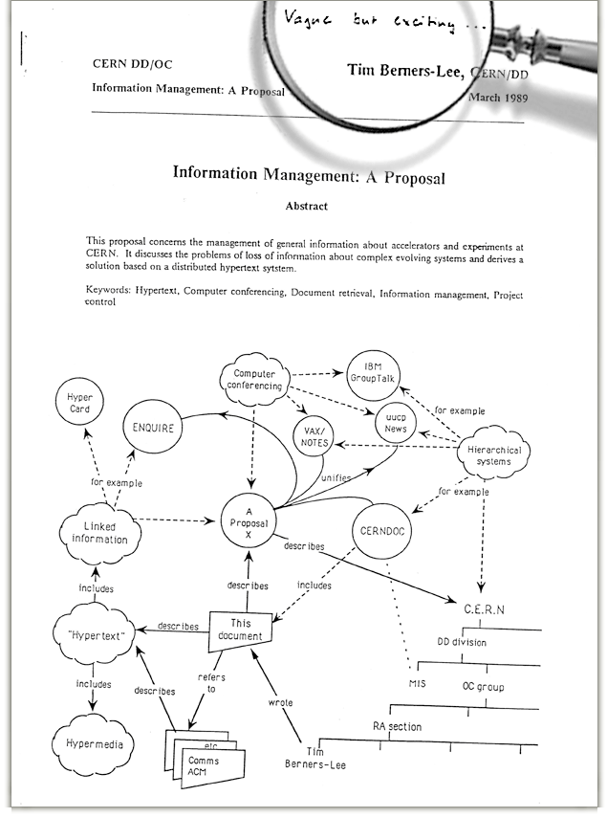
The Web: Humble origins
Tim Berners-Lee: a way to manage and access documents at CERN research lab
Info containing links to other info, accessible remotely, through a standardized mechanism.
“Hypertext”

Slide 11
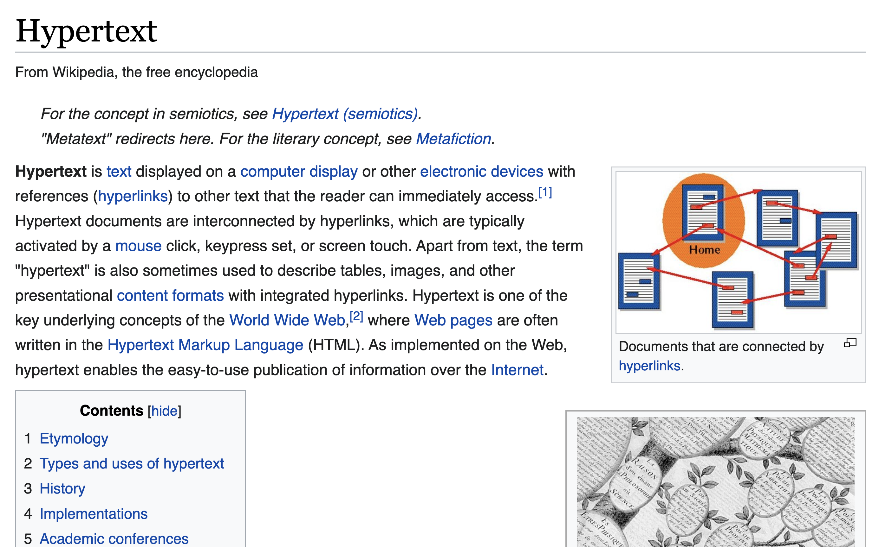
Web and HTTP: Terms
HTTP stands for “HyperText Transfer Protocol”
A web page consists of many objects
Object can be HTML file, JPEG image, video stream chunk, audio file,…
Web page consists of base HTML-file which includes several referenced objects.
Each object is addressable by a uniform resource locator (URL)
sometimes also referred to as uniform resource identifier (URI)
Example URL:
www.cs.rutgers.edu/~sn624/index.html
domain/host name
path name

Slide 12
HTTP Protocol

Slide 13

Client server protocol
Hostname | IP address
Cs.Rutgers.edu | 10.0.1.2
DNS
I want to browse cs.rutgers.edu
Host name
Server IP Address
HTTP application typically associated with port 80
clientIP, clientPort, server IP Address, 80
HTTP request
HTTP response
HTTP messages

Slide 14
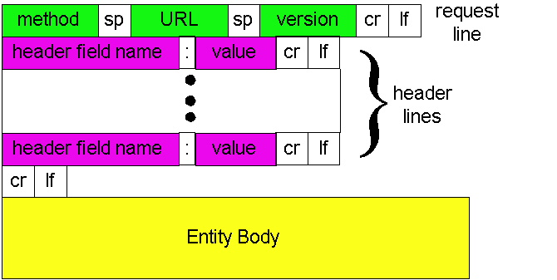
HTTP Request: Message Format
Type of request
Object/process
requested
Protocol version
Parameters influencing
the request
Data needed to fulfill request
http://www.w3.org/Protocols/rfc2616/rfc2616-sec14.html#sec14

Slide 15
HTTP messages: request message
ASCII (human-readable format)
request line
(GET, POST,
HEAD commands)
GET /352/syllabus.html HTTP/1.1
Host: www.cs.rutgers.edu
User-agent: Mozilla/4.0
Connection: close
Accept-language:en
(extra carriage return, line feed)
Header lines
Carriage return,
line feed
indicates end
of header

Slide 16
The URL
Universal Resource Locator: a way to name objects on server
But can also name an application process on the server!
Examples:
Data storage from data entered in web forms
Login pages
Web carts
Providing almost any service requires data handling by running code at the server
Not just rendering “static” resources

Slide 17
HTTP method types
GET
Get the resource specified in the requested URL (could be a process)
POST
Send entities (specified in the entity body) to a data-handling process at the requested URL
HEAD
Asks server to leave requested object out of response, but send the rest of the response
Useful for debugging
PUT
Update a resource at the requested URL with the new entity specified in the entity body
DELETE
Deletes file specified in the URL
and other methods

Slide 18
Uploading form input: GET and POST
POST method:
Web page often includes form input
Input is uploaded to server in entity body
Posted content not visible in the URL
Free form content (ex: images) can be posted since entity body interpreted as data bytes
GET method:
Entity body is empty
Input is uploaded in URL field of request line
URL must contain a restricted set of characters
Example:
http://site.com/form?first=jane&last=austen

Slide 19
Difference between POST and PUT
POST: the URL of the request identifies the resource that processes the entity body
PUT: the URL of the request identifies the resource that is contained in the entity body
https://tools.ietf.org/html/rfc2616

Slide 20
Difference between HEAD and GET
GET: return the requested resource in the entity body of the response along with response headers (we’ll see these shortly)
HEAD: return all the response headers in the GET response, but without the resource in the entity body
https://tools.ietf.org/html/rfc2616

Slide 21
Observing HTTP GET and POST

Slide 22
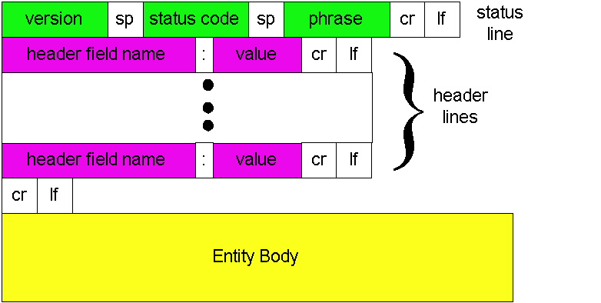
HTTP Response: General format
Unlike HTTP request, No method name
HTTP protocol version
used by server
Was request successful?
(or error condition)
Returned object data

Slide 23
HTTP message: response message
status line
(protocol
status code
status phrase)
HTTP/1.1 200 OK
Connection: close
Date: Thu, 06 Aug 1998 12:00:15 GMT
Server: Apache/1.3.0 (Unix)
Last-Modified: Mon, 22 Jun 1998 …...
Content-Length: 6821
Content-Type: text/html
data data data data data ...
response
header
lines
data, e.g., requested
HTML file in entity body

Slide 24
HTTP response status codes
In first line in server->client response message.
A few sample codes:
200 OK
request succeeded, requested object later in this message
301 Moved Permanently
requested object moved, new location specified later in this message (Location:)
403 Forbidden
Insufficient permissions to access the resource
404 Not Found
requested document not found on this server
505 HTTP Version Not Supported

Slide 25
Observing HTTP behaviors
wget google.com (or) curl google.com
telnet example.com 80
GET / HTTP/1.1
Host: example.com
(followed by two enter’s)
Exercise: try
telnet google.com 80
telnet web.mit.edu 80

