Slide 1

The Web (part 3)
Lecture 8
http://www.cs.rutgers.edu/~sn624/352-F24
Srinivas Narayana

Slide 2
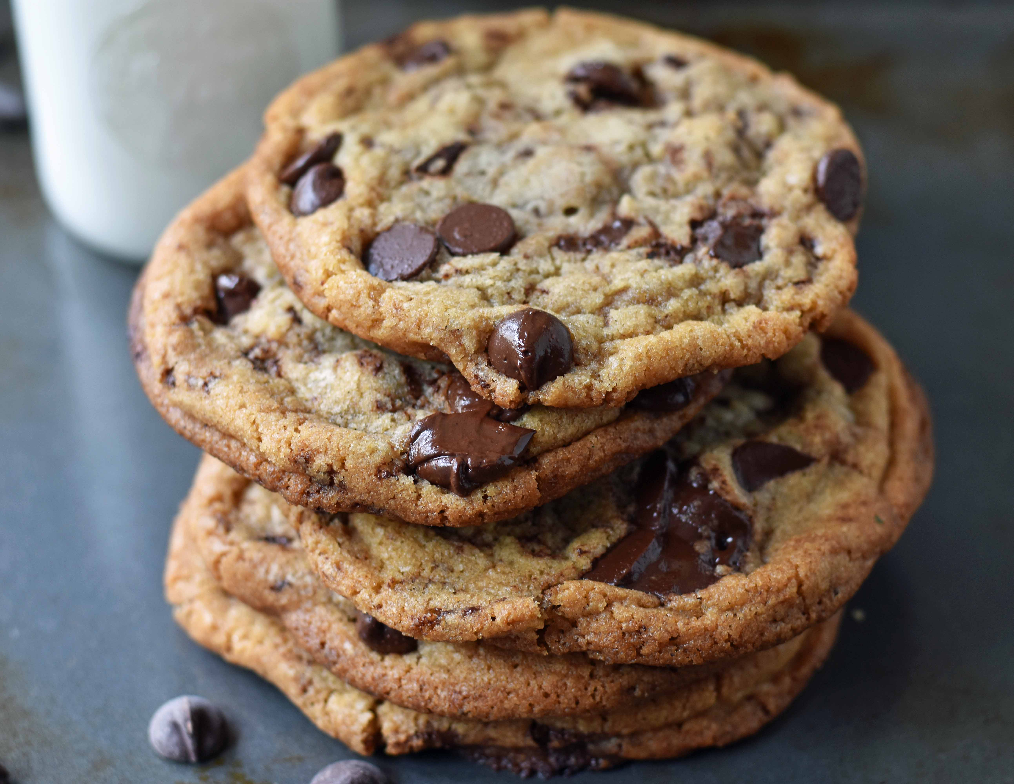
Cookies: Keeping user memory
client
server
Cookie is typically opaque to client.
Cookie file
http request msg + auth
server
creates ID
1678 for user
Netflix: 436
Amazon: 1678
http response +
Set-cookie: 1678
entry in backend
database
Cookie file
http request (no auth)
cookie: 1678
Netflix: 436
cookie-
specific
action
access
Amazon: 1678
Personalized http response
one week later:
access
Cookie file
http request (no auth)
cookie: 1678
cookie-
specific
action
Netflix: 436
Amazon: 1678
Personalized http response

Slide 3
How cookies work
Collaboration between client and server to track user state.
Four components:
cookie header line of HTTP response message
cookie header line in HTTP request message
cookie file kept on user endpoint, managed by user’s browser
back-end database maps cookie to user data at Web endpoint
Cookies come with an expiration date (yet another HTTP header)

Slide 4
Cookies have many uses
The good: Awesome user-facing functionality
Shopping carts, auth, … very challenging or impossible without it
The bad: Unnecessary recording of your activities on the site
First-party cookies: performance statistics, user engagement, …
The ugly: Tracking your activities across the Internet
Third-party cookies (played by ad and tracking networks) to track your activities across the Internet
personally identifiable information (PII)
Ad networks target users with ads; may sell this info
Scammers can target you too

Slide 5

PSA: Cookies and Privacy
Disable and delete unnecessary cookies by default
Suggested privacy-conscious browsers, websites, tools:
DuckDuckGo (search)
Brave (browser)
AdBlock Plus (extension)
ToR (distract targeting)
… assuming it doesn’t break the functions of the site
https://gdpr.eu/cookies/

Slide 6
Web Caching

Slide 7
Web caches
Web caches: Machines that remember web responses for a network
Why cache web responses?
Reduce response time for client requests
Reduce traffic on an organization’s access link

Slide 8
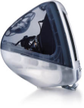
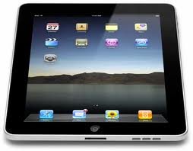
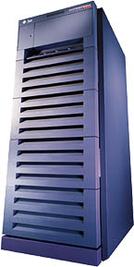
Web caching using a proxy server
You can configure a HTTP proxy on your laptop’s network settings.
If you do, your browser sends all HTTP requests to the proxy (cache).
Hit: cache returns object
Miss: obtain object from originating web server (origin server) and return to client
Also cache the object locally
Clients
Return cached object!
Web Server
(also called origin server in this context)
GET foo.html
GET foo.html
The Internet
Proxy Server
Store foo.html
on receiving response
Rutgers

Slide 9
Caching in the HTTP protocol
Cache/Client
server
Conditional GET guarantees cache content is up-to-date while still saves traffic and response time whenever possible
Date in the cache’s request is the last time the server provided in its response header Last-Modified
HTTP request msg
If-modified-since: <date>
object
not
modified
X-Cache: HIT
HTTP response
HTTP/1.0
304 Not Modified
HTTP request msg
If-modified-since: <date>
object
modified
HTTP response
HTTP/1.0 200 OK
Last-modified: <date>
DATA DATA DATA

Slide 10
Content Distribution Networks (CDNs)
A global network of web caches
Provisioned by ISPs and network operators
Or content providers, like Netflix, Google, etc.
Uses (overlaps with uses of web caching in general)
Reduce traffic on a network’s Internet connection, e.g., Rutgers
Improve response time for users: CDN nodes are closer to users than origin servers (servers holding original content)
Reduce bandwidth requirements on the content provider
Reduce cost to maintain origin servers

Slide 11
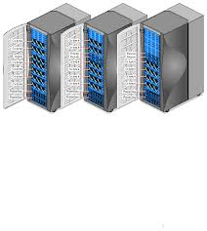
Without CDN
DOMAIN NAME | IP ADDRESS
www.yahoo.com | 98.138.253.109
cs.rutgers.edu | 128.6.4.2
www.google.com | 74.125.225.243
www.princeton.edu | 128.112.132.86
DNS
Clients distributed all over the world
Cluster of Rutgers CS origin servers (located in NJ, USA)
128.6.4.2
Problems:
Huge bandwidth requirements for Rutgers
Large propagation delays to reach users

Slide 12
Where the CDN comes in
Distribute content of the origin server over geographically distributed CDN servers
But how will users get to these CDN servers?
Use DNS!
DNS provides an additional layer of indirection
Instead of returning an IP address, return another DNS server (NS record)
Much like a response to any other iterative query
The second DNS server (run by the CDN) returns the IP address of the client
The CDN runs its own DNS servers (CDN name servers)
Custom logic to send users to the “closest” CDN web server

Slide 13
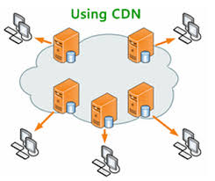
With CDN
DOMAIN NAME | IP ADDRESS
www.yahoo.com | 98.138.253.109
cs.rutgers.edu | 124.8.9.8 (NS record pointing to CDN name server)
www.google.com | 74.125.225.243
DNS reply
CDN Name Server (124.8.9.8)
NS record delegates the choice of IP address to the CDN name server.
Custom logic to map ONE domain name to one of many IP addresses!
DOMAIN NAME | IP ADDRESS
Cs.Rutgers.edu | 12.1.2.3
Cs.Rutgers.edu | 12.1.2.4
Cs.Rutgers.edu | 12.1.2.5
Cs.Rutgers.edu | 12.1.2.6
Popular CDNs:
CloudFlare
Akamai
Level3
…
12.1.2.3
CDN servers
12.1.2.4
12.1.2.6
12.1.2.5
128.6.4.2
Origin server
Most requests go to CDN servers (caches).
CDN servers may request object from origin
Few client requests go directly to origin server
Client

Slide 14
Seeing a CDN in action
dig +trace freshtohome.com
dig web.mit.edu (or) dig +trace web.mit.edu

Slide 15
Summary of HTTP
Request/response protocol
ASCII-based human-readable message structures
Enhanced stateful functionality using cookies
Improve performance using caching and CDN
Persistence and pipelining to improve performance
Simple, highly-customizable protocol
Just add headers
The protocol that is the basis of the web we enjoy today

Slide 16
Multimedia over the Internet

Slide 17




Internet Multimedia
Many applications on the Internet use audio or video
Comparison with traditional web/HTTP:
Cannot tolerate loss, but a little delay may be ok
Data used after the transfer is complete
Multimedia is more real-time
Performance during the data transfer matters
17

