Slide 1

The Web (part 3)
Lecture 8
http://www.cs.rutgers.edu/~sn624/352-F24
Srinivas Narayana

Slide 2
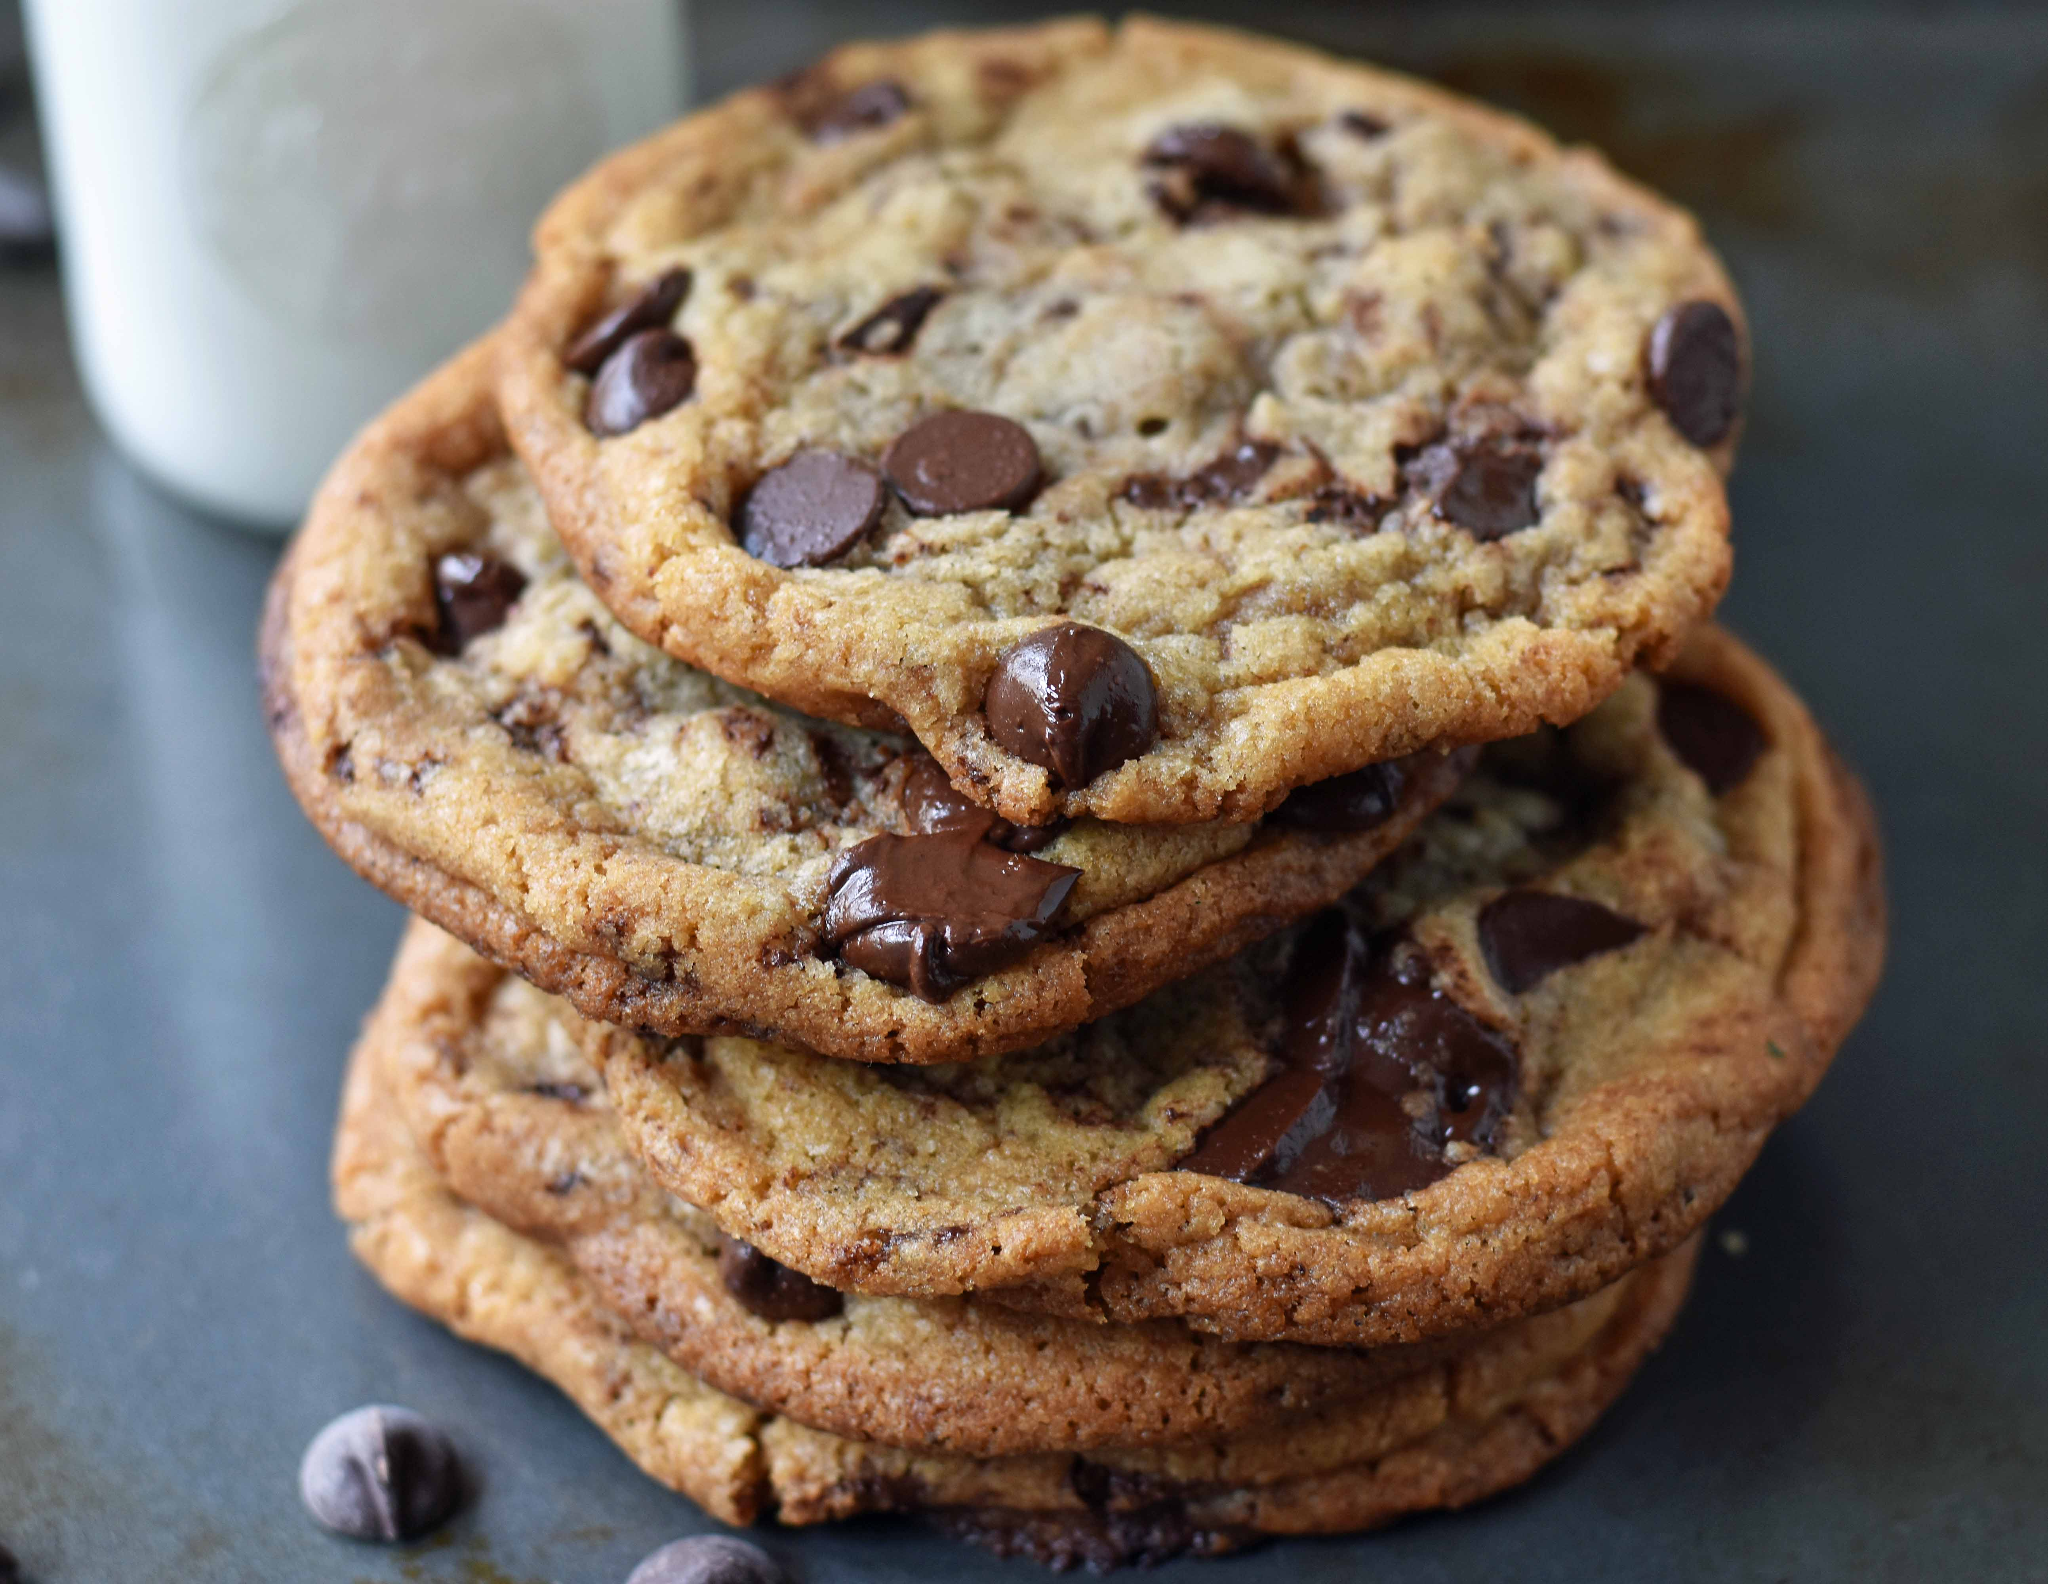
Cookies: Keeping user memory
client
server
Cookie is typically opaque to client.
Cookie file
http request msg + auth
server
creates ID
1678 for user
Netflix: 436
Amazon: 1678
http response +
Set-cookie: 1678
entry in backend
database
Cookie file
http request (no auth)
cookie: 1678
Netflix: 436
cookie-
specific
action
access
Amazon: 1678
Personalized http response
one week later:
access
Cookie file
http request (no auth)
cookie: 1678
cookie-
specific
action
Netflix: 436
Amazon: 1678
Personalized http response

Slide 3
How cookies work
Collaboration between client and server to track user state.
Four components:
cookie header line of HTTP response message
cookie header line in HTTP request message
cookie file kept on user endpoint, managed by user’s browser
back-end database maps cookie to user data at Web endpoint
Cookies come with an expiration date (yet another HTTP header)

Slide 4
Cookies have many uses
The good: Awesome user-facing functionality
Shopping carts, auth, … very challenging or impossible without it
The bad: Unnecessary recording of your activities on the site
First-party cookies: performance statistics, user engagement, …
The ugly: Tracking your activities across the Internet
Third-party cookies (played by ad and tracking networks) to track your activities across the Internet
personally identifiable information (PII)
Ad networks target users with ads; may sell this info
Scammers can target you too

Slide 5

PSA: Cookies and Privacy
Disable and delete unnecessary cookies by default
Suggested privacy-conscious browsers, websites, tools:
DuckDuckGo (search)
Brave (browser)
AdBlock Plus (extension)
ToR (distract targeting)
… assuming it doesn’t break the functions of the site
https://gdpr.eu/cookies/

Slide 6
Web Caching

Slide 7
Web caches
Web caches: Machines that remember web responses for a network
Why cache web responses?
Reduce response time for client requests
Reduce traffic on an organization’s access link

Slide 8


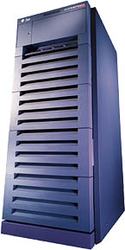
Web caching using a proxy server
You can configure a HTTP proxy on your laptop’s network settings.
If you do, your browser sends all HTTP requests to the proxy (cache).
Hit: cache returns object
Miss: obtain object from originating web server (origin server) and return to client
Also cache the object locally
Clients
Return cached object!
Web Server
(also called origin server in this context)
GET foo.html
GET foo.html
The Internet
Proxy Server
Store foo.html
on receiving response
Rutgers

Slide 9
Caching in the HTTP protocol
Cache/Client
server
Conditional GET guarantees cache content is up-to-date while still saves traffic and response time whenever possible
Date in the cache’s request is the last time the server provided in its response header Last-Modified
HTTP request msg
If-modified-since: <date>
object
not
modified
X-Cache: HIT
HTTP response
HTTP/1.0
304 Not Modified
HTTP request msg
If-modified-since: <date>
object
modified
HTTP response
HTTP/1.0 200 OK
Last-modified: <date>
DATA DATA DATA

Slide 10
Content Distribution Networks (CDNs)
A global network of web caches
Provisioned by ISPs and network operators
Or content providers, like Netflix, Google, etc.
Uses (overlaps with uses of web caching in general)
Reduce traffic on a network’s Internet connection, e.g., Rutgers
Improve response time for users: CDN nodes are closer to users than origin servers (servers holding original content)
Reduce bandwidth requirements on the content provider
Reduce cost to maintain origin servers

Slide 11
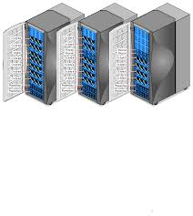
Without CDN
DOMAIN NAME | IP ADDRESS
www.yahoo.com | 98.138.253.109
cs.rutgers.edu | 128.6.4.2
www.google.com | 74.125.225.243
www.princeton.edu | 128.112.132.86
DNS
Clients distributed all over the world
Cluster of Rutgers CS origin servers (located in NJ, USA)
128.6.4.2
Problems:
Huge bandwidth requirements for Rutgers
Large propagation delays to reach users

Slide 12
Where the CDN comes in
Distribute content of the origin server over geographically distributed CDN servers
But how will users get to these CDN servers?
Use DNS!
DNS provides an additional layer of indirection
Instead of returning an IP address, return another DNS server (NS record)
Much like a response to any other iterative query
The second DNS server (run by the CDN) returns the IP address of the client
The CDN runs its own DNS servers (CDN name servers)
Custom logic to send users to the “closest” CDN web server

Slide 13
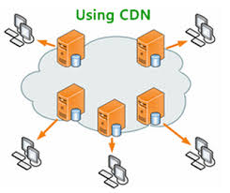
With CDN
DOMAIN NAME | IP ADDRESS
www.yahoo.com | 98.138.253.109
cs.rutgers.edu | 124.8.9.8 (NS record pointing to CDN name server)
www.google.com | 74.125.225.243
DNS reply
CDN Name Server (124.8.9.8)
NS record delegates the choice of IP address to the CDN name server.
Custom logic to map ONE domain name to one of many IP addresses!
DOMAIN NAME | IP ADDRESS
Cs.Rutgers.edu | 12.1.2.3
Cs.Rutgers.edu | 12.1.2.4
Cs.Rutgers.edu | 12.1.2.5
Cs.Rutgers.edu | 12.1.2.6
Popular CDNs:
CloudFlare
Akamai
Level3
…
12.1.2.3
CDN servers
12.1.2.4
12.1.2.6
12.1.2.5
128.6.4.2
Origin server
Most requests go to CDN servers (caches).
CDN servers may request object from origin
Few client requests go directly to origin server
Client

Slide 14
Seeing a CDN in action
dig +trace freshtohome.com
dig web.mit.edu (or) dig +trace web.mit.edu

Slide 15
Summary of HTTP
Request/response protocol
ASCII-based human-readable message structures
Enhanced stateful functionality using cookies
Improve performance using caching and CDN
Persistence and pipelining to improve performance
Simple, highly-customizable protocol
Just add headers
The protocol that is the basis of the web we enjoy today

Slide 16
Multimedia over the Internet

Slide 17




Internet Multimedia
Many applications on the Internet use audio or video
Comparison with traditional web/HTTP:
Cannot tolerate loss, but a little delay may be ok
Data used after the transfer is complete
Multimedia is more real-time
Performance during the data transfer matters
17

Slide 18
Digital representation of audio and video

Slide 19
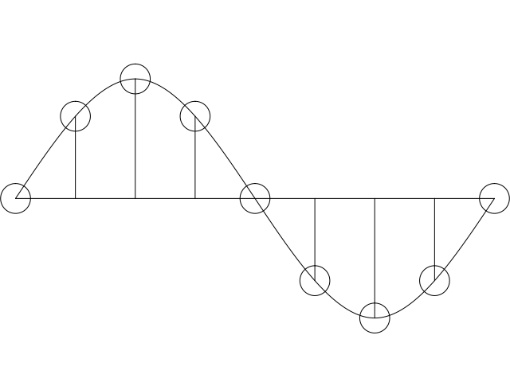
Digital representation of audio
Must convert analog signal to digital representation
Sample
How many times (twice the max frequency in the signal)
Quantize
How many levels or bits to represent each sample
More levels ➔ more accurate representation of signal
More levels ➔ more bits to store & need more bandwidth to transmit
Compress
Compact representation of quantized values
19

Slide 20
Audio representation
analog audio signal sampled at constant rate
telephone: 8,000 samples/sec
CD music: 44,100 samples/sec
each sample quantized, i.e., rounded
e.g., 2⁸=256 possible quantized values
each quantized value represented by bits, e.g., 8 bits for 256 values
quantization error
quantized value of
analog value
analog
signal
audio signal amplitude
time
sampling rate
(N sample/sec)

Slide 21
Audio representation
example: 8,000 samples/sec, 256 quantized values
Bandwidth needed: 64,000 bps
receiver converts bits back to analog signal:
some quality reduction
Example rates
CD: 1.411 Mbps
MP3: 96, 128, 160 Kbps
Internet telephony: 5.3 Kbps and up
quantization error
quantized value of
analog value
analog
signal
audio signal amplitude
time
sampling rate
(N sample/sec)

Slide 22

Video representation
Video: sequence of images displayed at constant rate
e.g., 30 images/sec
Appear continuous due to the stroboscopic effect
frame i
frame i+1

Slide 23
Video representation
spatial coding example: instead of sending N values of same color (all purple), send only two values: color value (purple) and number of repeated values (N)
Digital image: array of pixels
each pixel represented by bits
Encode luminance and color
Number of pixels: resolution
Coding: use redundancy within and between images to decrease # bits used to encode image
spatial (within image)
temporal (from one image to next)
Encoding/decoding algorithm
often called a codec
……………………...…
……………………...…
frame i
temporal coding example: instead of sending complete frame at i+1, send only differences from frame i (motion vectors)
frame i+1

Slide 24
Video codecs: terminology
Video bit rate: effective number of bits per second of the video after encoding
It depends on many factors
Resolution of each image: more pixels = more bits
Detail per pixel: more luminance & color detail = more bits
Amount of movement in the video. More movement = more bits
Quality of overall compression in the codec
Video bit rate is typically correlated with quality of perception
Higher bit rate == better to perceive

Slide 25
Bit-rates: terminology
Bit-rate of a video changes over the duration of the video
CBR: (constant bit rate): fixed bit-rate video
VBR: (variable bit rate): different parts of the video have different bit rates, e.g., changes in color, motion, etc.
For VBR, we talk about average bit-rate over video’s duration
Examples of average video bit-rates
MPEG 1 (CD-ROM) 1.5 Mbps. MPEG2 (DVD) 3-6 Mbps
MPEG4 (often used in Internet, < 1 Mbps)
In general, one Internet video stream takes up a few Mbit/s (more for HD)
https://blog.video.ibm.com/streaming-video-tips/what-is-video-encoding-codecs-compression-techniques/

Slide 26
Networking multimedia: 3 types
On-demand streamed video/audio
Can begin playout before downloading the entire file
Ful video/audio stored at the server: able to transmit faster than audio/video will be rendered (with storing/buffering at client)
e.g., Spotify, YouTube, Netflix
Conversational voice or video over IP
interactive human-to-human communication limits delay tolerance
e.g., Zoom, Google Stadia
Live streamed audio, video
e.g, sporting event on sky sports
Can delay a little, but must be close to the “live edge” of content

Slide 27
On-demand Video Streaming

Slide 28
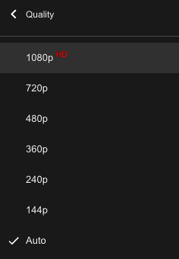
Streaming (stored) video
Media is prerecorded at different qualities
Available in storage at the server
Client downloads an initial portion and starts viewing
The rest is downloaded as time progresses
No need for user to wait for entire content to be downloaded!
Can change the quality of the content and where it’s fetched mid-stream
More on this soon

Slide 29


Streaming stored video
Constant bit rate video
Cumulative data (e.g. bytes)
Client
e.g., your phone
2. video
sent
video
recorded (e.g., 30 frames/sec)
3. video received,
played out at client
(30 frames/sec)
network delay
(fixed in this example)
time
streaming: at this time, client
playing out early part of video,
while server still sending later
part of video
Server
e.g. Netflix

Slide 30
Streaming stored video: challenges
Continuous playout constraint: once video playout begins at client, time gap between frames must match the original time gap in the video (why?)
But network delays are variable!
Clients have a client-side buffer of downloaded video to absorb variation in network conditions
Buffer also helps with user interactions: pause, fast-forward, rewind, jump through video

Slide 31
Scenario 1: Constant bit-rate video
constant bit
rate video
transmission
client video
reception
constant bit
rate video
playout at client
Cumulative data
variable
network
delay
buffered
video
client playout
delay
time
Client-side buffering with playout delay:
compensate for network-added delays and variations in the delay

Slide 32
Scenario 2: Small playout delay
constant bit
rate video
transmission
client video
reception
constant bit
rate video
playout at client
Cumulative data
variable
network
delay
buffered
video
client playout
delay
time
Playout delay that’s too small can cause stalls
There’s nothing in the buffer to show to the user

Slide 33

Client-side buffering, playout
buffer fill level, B(t)
variable fill
rate, x(t)
playout rate,
e.g., CBR r
video server
Client’s
buffer, size B_{max}
client
Most video is broken up in time into multiple segments
Client downloads video segment by segment
For example: a segment might be 4 seconds worth of video.

Slide 34
Client-side buffering, playout
buffer fill level, B(t)
variable fill
rate, x(t)
playout rate,
e.g., CBR r
video server
Client’s
buffer, size B_{max}
client
1. Initial fill of buffer until playout begins at t_{p}
2. playout begins at t_{p}
3. buffer fill level varies over time as fill rate x(t) varies (assume playout rate r is constant for now)

Slide 35
Client-side buffering, playout
buffer fill level, B(t)
variable fill
rate, x(t)
playout rate,
e.g., CBR r
video server
Client’s
buffer, size B_{max}
playout buffering: average fill rate (x), playout rate (r):
x < r: buffer eventually empties for a sufficiently long video. Stall and rebuffering
x > r: buffer will not empty, provided the initial playout delay is large enough to absorb variability in x(t)
initial playout delay tradeoff: buffer starvation less likely with larger delay, but also incur a larger delay until the user begins watching

Slide 36
Client-side buffering, playout
buffer fill level, B(t)
variable fill
rate, x(t)
playout rate,
e.g., CBR r
video server
Client’s
buffer, size B_{max}
playout buffering: average fill rate (x), playout rate (r):
is x < r or x > r for a given network connection?
It is hard to predict this in general!
Best effort network suffers long queues, paths with low bandwidth, …
How to set playout rate r?
Too low a bit-rate r: video has poorer quality than needed
Too high a bit-rate r: buffer might empty out. Stall/rebuffering!

Slide 37
Adaptive bit–rate video
Motivation: Want to provide high quality video experience, without stalls
Observations:
Videos come in different qualities (average bit rates)
Versions of the video for different quality levels readily available
Different segments of video can be downloaded separately
Adapt bit rate per segment through collaboration between the video client (e.g., your browser) and the server (e.g., @ Netflix)
Adaptive bit-rate (ABR) video: change the bit-rate (quality) of next video segment based on network and client conditions
A typical strategy: Buffer-based rate adaptation

Slide 38
Buffer-based bit-rate adaptation
Key idea: If there is a large stored buffer of video, optimize aggressively for video quality, i.e., high bit rates
Else (i.e., buffer has low occupancy), avoid stalls by being conservative and ask for a lower quality (bit-rate)
Hope: lower bandwidth requirement of a lower quality stream is satisfiable more easily

Slide 39
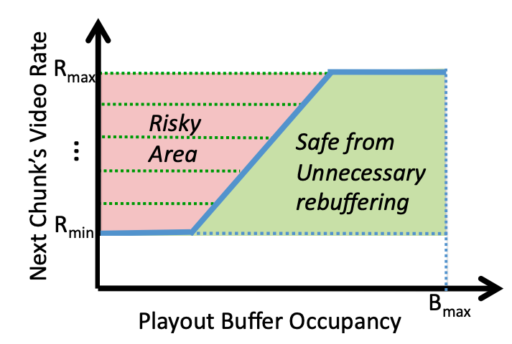
Buffer-based bit-rate adaptation
A highly effective method to provide high video quality despite variable and intermittently poor
network conditions.
Used by Netflix.
http://yuba.stanford.edu/~nickm/papers/sigcomm2014-video.pdf
A Buffer-Based Approach to Rate Adaptation

