Slide 1

CS 352 Medium Access Control
CS 352, Lecture 23.1
http://www.cs.rutgers.edu/~sn624/352
Srinivas Narayana

Slide 2


Link layer
Application
HTTPS
FTP
HTTP
SMTP
DNS
Transport
TCP
UDP
Network
IP
Link
802.3
…
802.11
ATM
Ethernet
The main function of the link layer is link-local delivery:
getting packets from one side of the link to the other.

Slide 3





Two kinds of link layers
point-to-point
Switched Ethernet link between switch and host
PPP for dial-up Internet access
broadcast (shared medium)
Shared Ethernet
802.11 wireless LAN
shared wire (e.g.,
cabled Ethernet)
shared RF
(e.g., 802.11 WiFi)
shared RF
(satellite)
humans at a
cocktail party
(shared air, acoustical)

Slide 4
Multiple access protocols
When there is a single shared broadcast channel, two or more simultaneous transmissions by nodes causes interference
We say there is a collision if a node receives two or more signals at the same time
A multiple access protocol is a distributed algorithm that determines how nodes share channel
i.e., who can transmit?
Communication about channel sharing must use channel
no separate (out-of-band) channel for coordination

Slide 5
Sharing resources: sound familiar?
Medium access control
Q: how to share a link over ~packet transmission time (microseconds)?
Link is attached to the endpoints
Link (usually) cannot support simultaneous transmissions; collision results
Collision can be usually detected within a packet transmission period
Congestion control
Q: how to share a bottleneck link over ~RTT (10-100 milliseconds)?
Link is (usually) remote from the endpoint
Router buffer can hold simultaneous transmissions for a short period
Detecting congestion is indirect (i.e., through loss, delay, etc.) and takes a round-trip time

Slide 6
An ideal multiple access protocol
Given a broadcast channel of rate R, goals:
1. when one node wants to transmit, it can send at rate R.
2. when M nodes want to transmit, each can send at average rate R/M
3. fully decentralized:
no special node to coordinate transmissions
no synchronization of clocks or transmission slots
4. “simple”

Slide 7
MAC protocols: Taxonomy
Three broad classes:
channel partitioning
divide channel into smaller pieces (time slots, frequency, code)
allocate piece to node for exclusive use
turn taking
nodes with more to send can take more or longer turns
random access
channel not divided, allow collisions
use methods to recover from collisions

Slide 8
MAC protocols: Taxonomy
This module
Three broad classes:
channel partitioning
divide channel into smaller pieces (time slots, frequency, code)
allocate piece to node for exclusive use
turn taking
nodes with more to send can take more or longer turns
random access
channel not divided, allow collisions
use methods to recover from collisions
Next module

Slide 9
Channel Partitioning

Slide 10
Dividing time
Time-division multiple access (TDMA)
access the channel in rounds
Simplest scheme: each node gets fixed length slot
length of the slot = packet transmission time
unused slots go idle
example: 6-node link, 1,3,4 have packets to send, slots 2,5,6 idle
6-slot
round
6-slot
round
1
3
4
1
3
4

Slide 11
Dividing time
If channel is partitioned statically, users with higher demand cannot use idle slots. Inefficient
Example: Nodes 1, 3, or 4 may have more data to send, yet cannot use the slots of nodes 2, 5, or 6.
6-slot
round
6-slot
round
1
3
4
1
3
4

Slide 12
Dividing frequency
High frequency
FDMA: frequency division multiple access
Channel divided into frequency bands
Simple scheme: each node assigned a fixed frequency band
Unused transmission time in frequency bands go idle
Example: 6-node link, 1,3,4 have packets to send, frequency bands 2,5,6 idle
Low frequency
frequency bands
FDMA cable
time

Slide 13
Dividing code
Code Division Multiple Access (CDMA)
A unique code is assigned to each pair of nodes
Also called chipping sequence
Users can share frequency bands and can transmit at the same time
Encoded signal = data signal * chipping sequence
Decoded signal = received signal X chipping sequence
Here “X” denotes the inner product of two vectors
Example: [1, 2, 3] X [4, 5, 6] = [1*4, 2*5, 3*6]/3 = [4/3, 10/3, 18/3]

Slide 14
Example of CDMA encode/decode
channel output Z_{i,m}
Z_{i,m}= d_{i}.c_{m}
data
bits
d₀ = 1
1
1
1
1
1
sender
d₁ = -1
1
1
1
-
-
-
-
1
-
-
-
1
-
1
1
1
1
1
1
1
slot 1
channel
output
slot 0
channel
output
1
1
1
1
1
code
1
1
-
-
-
1
-
1
1
1
-
-
-
1
-
1
1
1
slot 1
slot 0
M
D_{i} = S Z_{i,m}.c_{m}
m=1
M
received
input
1
1
1
1
1
1
1
1
d₀ = 1
-
-
-
-
1
-
-
-
1
-
1
1
1
1
1
1
d₁ = -1
1
slot 1
channel
output
slot 0
channel
output
1
1
1
1
1
code
1
1
receiver
-
-
-
1
-
1
1
1
-
-
-
1
-
1
1
1
slot 1
slot 0

Slide 15
CDMA trade-offs
In the place of transmitting 2 (data) bits, we’re sending 2 * 8 = 16 bits on the channel. Seems wasteful?
Real benefit: when multiple users transmit
Suppose resulting signal levels just add up in the channel and the sum is received by each receiver
With CDMA, each receiver can independently decode its corresponding sender’s transmission using the (respective) code!

Slide 16
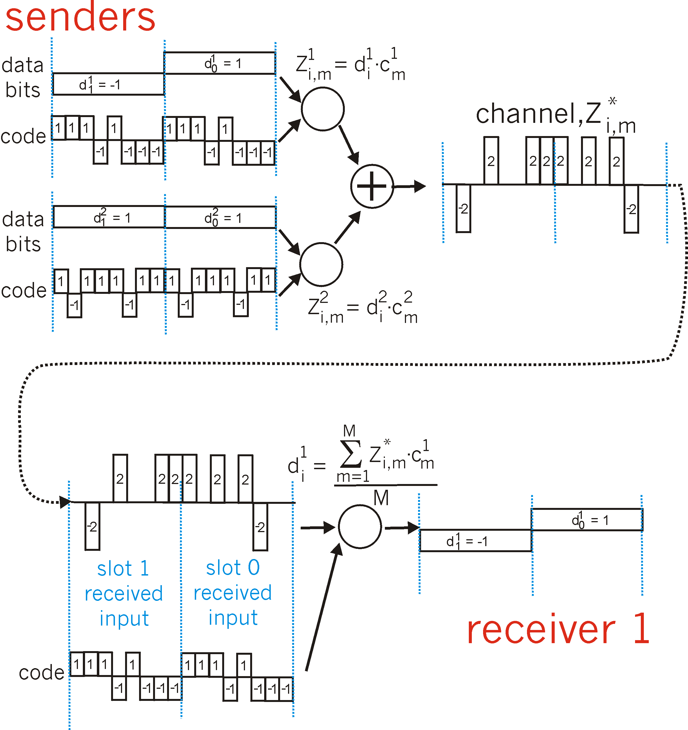
CDMA with two senders
channel sums together transmissions by sender 1 and 2
Sender 1
using same code as sender 1, receiver recovers sender 1’s transmission from summed channel data!
Sender 2
When receiver 2 uses sender 2 code on the same signal, it decodes sender 2’s signal
(try it out!)

Slide 17
Turn-taking protocols

Slide 18

Nodes taking turns
Polling
Orchestrator node “invites” sender nodes to transmit in turn
Concerns:
polling overhead
latency
single point of failure
The orchestrator
data
poll
orchestrator
data
senders

Slide 19
Nodes taking turns
T
Token passing
control token passed from one node to next sequentially
Node with token can transmit
Else, pass it on to the next node in the “ring”
Concerns:
latency
single point of failure (node holding the token)
(nothing
to send)
T
data

Slide 20
Summary
Medium access control: a distributed algorithm to transmit over a shared link
Channel partitioning: TDMA, FDMA, CDMA
Turn-taking: polling, token passing
TDMA, FDMA, & CDMA are widely used in cellular communication
TDMA, FDMA: GSM
CDMA: Qualcomm/Verizon

Slide 22
CS 352 Random Access Protocols
CS 352, Lecture 23.2
http://www.cs.rutgers.edu/~sn624/352
Srinivas Narayana

Slide 23
Review
Medium access control
A distributed algorithm running at nodes to determine
who should transmit over a shared link
Channel Partitioning
Random access
Turn taking

Slide 24
Random access protocols
What if nodes decide to transmit randomly?
When node has packet to send
Transmit at full channel data rate R
No a priori coordination among nodes
Collision possible when two or more transmitting nodes choose to send simultaneously

Slide 25
Random access protocols
A random-access MAC protocol specifies:
(1) How to detect collisions
(2) How to recover from collisions
… Usually by retransmitting after a while
Examples of random-access MAC protocols:
Slotted ALOHA
ALOHA
CSMA
CSMA/CD
CSMA/CA
Rest of this lecture
Next lecture

Slide 26
Slotted ALOHA

Slide 27

Slotted ALOHA
Assumptions:
All frames same size
Time divided into equal size slots (time to transmit 1 frame)
Nodes start to transmit only slot beginning
Node clocks are synchronized
If 2 or more nodes transmit in slot, all nodes detect collision
Operation:
when node obtains fresh frame, transmits in next slot
if no collision: node can send new frame in next slot
if collision: node retransmits frame in each subsequent slot with prob. p until success

Slide 28
Slotted ALOHA: example
All nodes have data to transmit
All nodes choose
not to transmit
C = collision
I = idle
S = successful xmit
Node 2 lucky: it transmitted, others didn’t
node 1
1
1
1
1
node 2
2
2
2
node 3
3
3
3
C
I
C
S
I
C
I
S
S

Slide 29
Slotted ALOHA
Advantages
Single active node can continuously transmit at full rate of channel
Simple, decentralized protocol
Disadvantages
Clock synchronization: nodes must sync on slot start times
Collisions waste slots
Idle slots possible even if demand exists
Must ensure that collision is detected within a frame duration
Even if detection is fast, whole frame time still wasted

Slide 30
Slotted ALOHA: efficiency
Q: What fraction of slots are likely to be successful?
i.e., exactly one node transmits
Assume N nodes, all have frames to send
Steady state: all have detected collision the last time the frame was attempted to be transmitted
Success: one node must choose to transmit (probability p), all other nodes choose not to transmit (probability 1-p)

Slide 31
Slotted ALOHA: efficiency
Prob that given node has success in a slot = p(1-p)^{N-1}
Prob that any node has a success = Np(1-p)^{N-1}
max efficiency: find p* that maximizes Np(1-p)^{N-1}
for many nodes, take limit of Np*(1-p*)^{N-1} as N goes to infinity, gives:
Max efficiency = 1/e = .37
at best: channel used for useful transmissions 37% of the time!

Slide 32
Pure ALOHA

Slide 33
Pure (unslotted) ALOHA
Even simpler algorithm than ALOHA: No synchronization
When a frame first arrives, transmit immediately
No need to wait for the start of a transmission slot
However, the collision probability increases:
Frame sent at t collides with other frames sent in [t-T,t+T]
Here T is the frame transmission time
Notes:
In the analysis of pure ALOHA in Tanenbaum, the number of transmissions within any “frame-time” follows a Poisson distribution. This doesn’t exactly translate to a fixed probability of transmission by each node in a frame time (like we assume in slotted ALOHA), since that would lead to a binomial distribution on the number of transmissions per frame time. However, in the subsequent analysis in the slides, we assume that the probability that any node transmits within a frame time is p.

Slide 34
Collisions in pure ALOHA
Will collide with the beginning of j’s frame
Avoided with probability (1-p)^{N-1}
Node j transmits
Probability p
Will collide with the end of j’s frame
Avoided with probability (1-p)^{N-1}
t - T
t
t + T
Pr(success) = Np(1-p)^{2(N-1)}
Take limit with optimal p as N → ♾
Successful 18% of the time!
Worse than slotted ALOHA.
T
T

Slide 35
Are there better strategies to transmit rather than independently and randomly?

Slide 36
Carrier Sensing Multiple Access (CSMA)

Slide 37
Carrier Sense Multiple Access (CSMA)
Key idea: listen to the channel before transmission
If the channel sensed idle, then transmit entire frame
If the channel sensed busy, then defer transmission
Human analogy: don’t interrupt others!

Slide 38
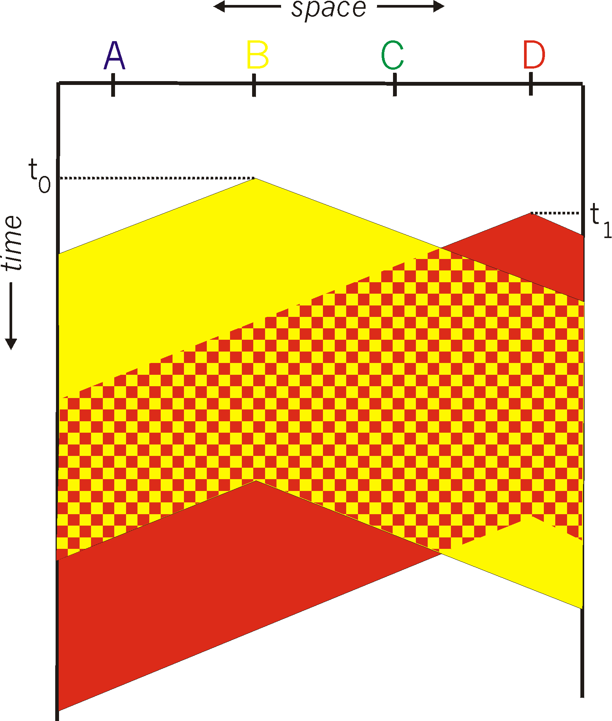
CSMA collisions
spatial layout of nodes
Collisions can still occur. Due to propagation delay, two nodes may not hear each other’s transmissions right away
If there is a collision, the entire packet transmission time is wasted

Slide 39
CSMA collisions
spatial layout of nodes
Collisions can still occur. Due to propagation delay, two nodes may not hear each other’s transmissions right away
If there is a collision, the entire packet transmission time is wasted
Propagation delay between the nodes plays a key role in determining the collision probability

Slide 40
Carrier Sensing with Collision Detection (CSMA/CD)

Slide 41
Carrier sensing + collision detection
On certain types of link technologies (e.g., wired Ethernet), continuous carrier sensing can enable detecting collisions very quickly
Not always possible, e.g., wireless LANs (next lecture)
Suppose it is possible to detect collisions as soon as signal from one node reaches another (transmitting) node
Measure received signal, compare with transmitted signal
CSMA/CD: Stop transmitting when a collision is detected
Reduce wastage of channel capacity
Improve the chances of retransmitting earlier
Analogy: “polite speaker”: stop speaking when interrupted

Slide 42
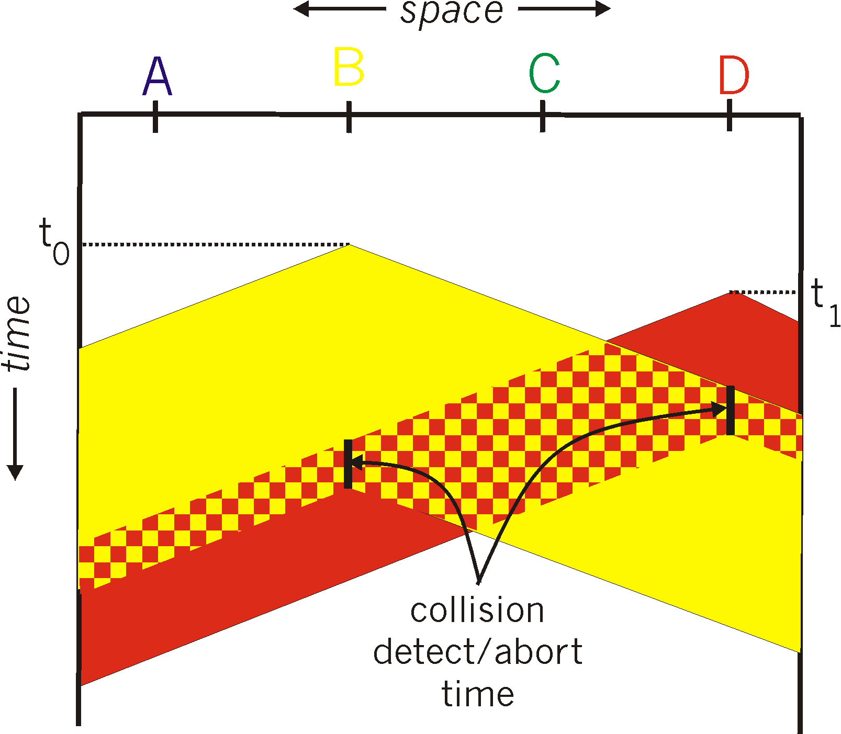
CSMA/CD
Collisions can still occur. Due to propagation delay, two nodes may not hear each other’s transmissions right away
However, upon detecting a collision, node stops transmitting
spatial layout of nodes

Slide 43
CSMA/CD
Collisions can still occur. Due to propagation delay, two nodes may not hear each other’s transmissions right away
However, upon detecting a collision, node stops transmitting
CSMA/CD reduces time spent in collided frames relative to just CSMA
spatial layout of nodes

Slide 44
Impact of random access protocols
The ALOHA protocols were part of ALOHANet, one of the first packet radio networks to be deployed. Connected the islands of Hawaii
Simple protocols, simple node design, no requirement of centralized control or synchronization
Highly influential ideas contributing to the mainstream today
Shared ethernet uses CSMA/CD
Wireless Ethernet (WiFi) MAC protocol on these ideas

Slide 46
CS 352 CSMA/CD in Shared Ethernet
CS 352, Lecture 23.3
http://www.cs.rutgers.edu/~sn624/352
Srinivas Narayana

Slide 47
Review
Medium access control
A distributed algorithm running at nodes to determine
who should transmit over a shared link
Channel Partitioning
Random access
Turn taking
Slotted ALOHA
ALOHA
CSMA
CSMA/CD

Slide 48
Review of CSMA/CD
Sense the medium for existing transmissions
If the medium is idle, transmit
If a collision is detected during transmission, abort the transmission
Retry transmission “later”
Retransmission in the ALOHA protocols:
Transmit with some probability during the next frame time

Slide 49
CSMA/CD in Shared Ethernet

Slide 50

Switched Ethernet vs. Shared Ethernet
Nodes connected over dedicated link to a switch (previous lecture)
Multiple nodes connected to the same Ethernet cable
Classic method: limited geographic coverage, easy to add nodes by adding a tap
Every node can hear every other node
A
C’
B
1
2
6
3
tap
tap
tap
tap
5
4
B’
C
A’

Slide 51
MAC in shared Ethernet
Since the cable is a broadcast medium, it is important to decide which node can transmit at any time.
Shared Ethernet uses CSMA/CD MAC, with a twist

Slide 52
Shared Ethernet: CSMA/CD
1. NIC receives data to send (e.g., from network layer), creates a frame
2. If NIC senses channel idle, starts frame transmission. If NIC senses channel busy, waits until channel idle, then transmits (CSMA)
3. If NIC transmits entire frame without detecting another transmission, NIC is done with frame.
4. If NIC detects another transmission while transmitting, the NIC aborts the transmission and sends a “jam signal” (CD)
5. The NIC waits for some period and attempts to retransmit the frame.
(Note: in ALOHA, retransmission is probabilistic)
Q: how long should the NIC wait?

Slide 53
Ethernet binary exponential backoff
After a frame has experienced a collision, the NIC enters a backoff phase
after m’th collision, NIC chooses K at random from {0,1,2, …, 2^{m}-1}.
NIC waits K·512 “bit times” (time to transmit a single bit)
NIC returns to Step 2 (carrier sensing) after the wait

Slide 54
Ethernet binary exponential backoff
Waiting longer to transmit is a way of responding to higher load
More collisions on the same frame ⬅➔ more transmitting nodes on link
Increasing backoff period exponentially is a way to respond to the number of other transmitting nodes without knowing a priori how many!
Still, each node chooses a random interval to wait (from range)
Only the upper bound of the interval increases exponentially
Randomness avoids synchronization (and repeated collisions) between nodes

Slide 55
CSMA/CD efficiency
T_{prop} = max prop delay between 2 nodes in LAN
t_{trans} = time to transmit max-size frame
efficiency goes to 1
as t_{prop} goes to 0 (closer the nodes, the more efficient)
as t_{trans} goes to infinity (longer the frames, the more likely that carrier sensing prevents collisions)
All from a simple, cheap, decentralized protocol!

Slide 56
Impact of Ethernet CSMA/CD
Basis for the design of wireless medium access control: widely implemented and deployed today in WiFi
We’ll do a deeper dive next lecture
Birth of a powerful idea in Computer Science: exponential backoff
TCP multiplicative decrease was inspired by exponential backoff
A general method to react to load without a priori global information

Slide 57
Comparison of MAC protocols
Channel partitioning
(typically) static allocation of channel
Efficient and fair at high loads (1/N’th)
Inefficient at low loads
Turn-taking
Adapts to node demands by design
May increase delay to transmit (at low load)
Suffers from a single point of failure
Random access
Node with access transmits at full rate
Responsive to load (e.g., exp backoff)
Capacity may be wasted: collision, idle

