Slide 1

Multimedia: Streaming Video & Audio
CS 352, Lecture 22, Spring 2020
http://www.cs.rutgers.edu/~sn624/352
Srinivas Narayana

Slide 2
Course announcements
Quiz 8 (the last one!) will go online later today
Due Tuesday at 10 PM on Sakai
Project 3 due next Friday

Slide 3
Synthesis of protocols

Slide 4
Synthesis: a day in the life of a web request
Our journey down protocol stack complete!
application, transport, network, link
putting-it-all-together: synthesis!
goal: identify, review, understand protocols (at all layers) involved in seemingly simple scenario: requesting www page
scenario: student attaches laptop to campus network, requests/receives www.google.com

Slide 5
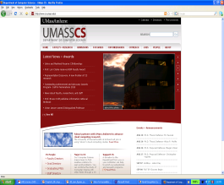



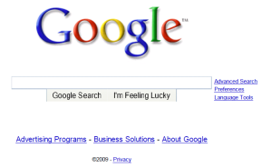
A day in the life: scenario
browser
DNS server
Comcast network
68.80.0.0/13
school network
68.80.2.0/24
web page
web server
Google’s network
64.233.160.0/19
64.233.169.105

Slide 6
A day in the life… connecting to the Internet
DHCP
DHCP
UDP
IP
Eth
Phy
connecting laptop needs to get its own IP address, addr of first-hop router, addr of DNS server: use DHCP
DHCP
DHCP
DHCP
DHCP
DHCP request encapsulated in UDP, encapsulated in IP, encapsulated in 802.3 Ethernet
DHCP
DHCP
UDP
IP
Eth
Phy
DHCP
DHCP
DHCP
DHCP
router
(runs DHCP)
Ethernet frame broadcast (dest: FFFFFFFFFFFF) on LAN, received at router running DHCP server
Ethernet demuxed to IP demuxed, UDP demuxed to DHCP

Slide 7
A day in the life… connecting to the Internet
DHCP
DHCP
UDP
IP
Eth
Phy
DHCP server formulates DHCP ACK containing client’s IP address, IP address of first-hop router for client, name & IP address of DNS server
DHCP
DHCP
DHCP
encapsulation at DHCP server, frame forwarded through LAN, demultiplexing at client
DHCP
DHCP
UDP
IP
Eth
Phy
DHCP
DHCP
DHCP
router
(runs DHCP)
DHCP
DHCP client receives DHCP ACK reply
Client now has IP address, knows name & addr of DNS
server, IP address of its first-hop router

Slide 8
A day in the life… ARP (before DNS, before HTTP)
DNS
UDP
IP
Eth
Phy
before sending HTTP request, need IP address of www.google.com: DNS
DNS
DNS
DNS
ARP
ARP query
DNS query created, encapsulated in UDP, encapsulated in IP, encapsulated in Eth. To send frame to router, need MAC address of router interface: ARP
ARP
ARP reply
Eth
Phy
ARP query broadcast, received by router, which replies with ARP reply giving MAC address of router interface
router
(runs DHCP)
client now knows MAC address of first hop router, so can now send frame containing DNS query

Slide 9
A day in the life… using DNS
DNS
UDP
IP
Eth
Phy
DNS
DNS server
DNS
UDP
IP
Eth
Phy
DNS
DNS
DNS
DNS
DNS
DNS
DNS
DNS
Comcast network
68.80.0.0/13
IP datagram forwarded from campus network into Comcast network, routed (tables created by RIP, OSPF, IS-IS and/or BGP routing protocols) to DNS server
router
(runs DHCP)
IP datagram containing DNS query forwarded via LAN switch from client to 1st hop router
demuxed to DNS server
DNS server replies to client with IP address of www.google.com

Slide 10
A day in the life…TCP connection carrying HTTP
HTTP
HTTP
TCP
IP
Eth
Phy
SYNACK
SYN
SYNACK
SYN
SYNACK
SYN
SYN
to send HTTP request, client first opens TCP socket to web server
router
(runs DHCP)
TCP
IP
Eth
Phy
SYNACK
TCP SYN segment (step 1 in 3-way handshake) inter-domain routed to web server
SYN
SYNACK
SYN
SYNACK
SYNACK
SYN
web server responds with TCP SYNACK (step 2 in 3-way handshake)
web server
64.233.169.105
TCP connection established!

Slide 11
A day in the life… HTTP request/reply
HTTP
HTTP
TCP
IP
Eth
Phy
web page finally (!!!) displayed
HTTP
HTTP
HTTP
HTTP
HTTP
HTTP
HTTP
HTTP
HTTP request sent into TCP socket
router
(runs DHCP)
IP datagram containing HTTP request routed to www.google.com
HTTP
HTTP
TCP
IP
Eth
Phy
HTTP
HTTP
HTTP
web server responds with HTTP reply (containing web page)
HTTP
web server
64.233.169.105
IP datagram containing HTTP reply routed back to client

Slide 12
Multimedia Networking

Slide 13




Multimedia networking
Many applications on the Internet use audio or video
IP video traffic will be 82 percent of all IP traffic […] by 2022, up from 75 percent in 2017
Internet video surveillance traffic will increase sevenfold between 2017 to 2022
Internet video to TV will increase threefold between 2017 to 2022.
Consumer Video-on-Demand (VoD) traffic will nearly double by 2022
Source: Cisco visual networking index 2017--22
13

Slide 14
What’s different about these applications?
Traditional applications (HTTP(S), SMTP)
Delay tolerant but not loss tolerant
Data used after transfer complete
But multimedia applications are often “real time”
Data delivery time during transfer has implications
Video/audio streaming
Delay-sensitive
Real-time audio and video
Delays > 400 ms for audio is a bad user experience
Somewhat loss tolerant
14

Slide 15
Digital representation of audio and video

Slide 16
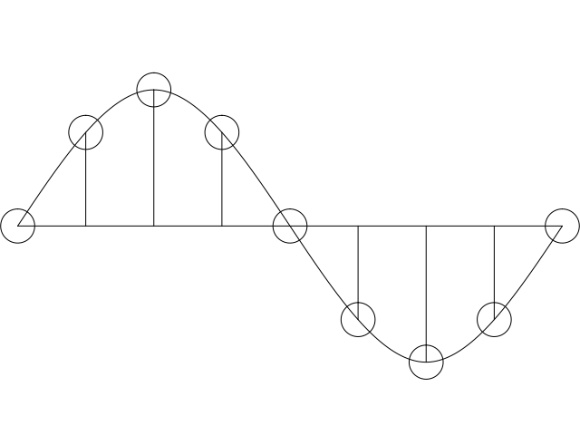
Digital representation of audio
Must convert analog signal to digital representation
Sample
How many times (twice the max frequency in the signal)
Quantize
How many levels or bits to represent each sample
More levels ➔ more accuracy
More levels ➔ more bits to store & more bandwidth to transmit
Compress
Compact representation of quantized values
16

Slide 17
Audio representation
analog audio signal sampled at constant rate
telephone: 8,000 samples/sec
CD music: 44,100 samples/sec
each sample quantized, i.e., rounded
e.g., 2⁸=256 possible quantized values
each quantized value represented by bits, e.g., 8 bits for 256 values
quantization error
quantized value of
analog value
analog
signal
audio signal amplitude
time
sampling rate
(N sample/sec)

Slide 18
Audio representation
example: 8,000 samples/sec, 256 quantized values
Bandwidth needed: 64,000 bps
receiver converts bits back to analog signal:
some quality reduction
Example rates
CD: 1.411 Mbps
MP3: 96, 128, 160 Kbps
Internet telephony: 5.3 Kbps and up
quantization error
quantized value of
analog value
analog
signal
audio signal amplitude
time
sampling rate
(N sample/sec)

Slide 19

Video representation
spatial coding example: instead of sending N values of same color (all purple), send only two values: color value (purple) and number of repeated values (N)
Video: sequence of images displayed at constant rate
e.g., 24 images/sec
Digital image: array of pixels
each pixel represented by bits
Coding: use redundancy within and between images to decrease # bits used to encode image
spatial (within image)
temporal (from one image to next)
Coding/decoding algorithm often called a codec
……………………...…
……………………...…
frame i
temporal coding example: instead of sending complete frame at i+1, send only differences from frame i
frame i+1

Slide 20
Video representation
spatial coding example: instead of sending N values of same color (all purple), send only two values: color value (purple) and number of repeated values (N)
Video bit rate: effective bits per second of the video after encoding
CBR: (constant bit rate): video encoding rate fixed
VBR: (variable bit rate): video encoding rate changes as amount of spatial, temporal coding changes
examples:
MPEG 1 (CD-ROM) 1.5 Mbps
MPEG2 (DVD) 3-6 Mbps
MPEG4 (often used in Internet, < 1 Mbps)
……………………...…
……………………...…
frame i
temporal coding example: instead of sending complete frame at i+1, send only differences from frame i
frame i+1

Slide 21
Multimedia networking: 3 application types
streaming, stored audio, video
streaming: can begin playout before downloading entire file
stored (at server): can transmit faster than audio/video will be rendered (implies storing/buffering at client)
e.g., YouTube, AmazonPrime, Disney, Netflix, Hulu
conversational voice/video over IP
interactive nature of human-to-human conversation limits delay tolerance
e.g., Skype
streaming live audio, video
e.g., live sporting event

Slide 22
Streaming video

Slide 23
Streaming stored content
Media is prerecorded
Client downloads an initial portion and starts viewing
Rest downloaded as time progresses
No need to wait for entire content to be downloaded
Can change content sites mid-stream based on network conditions

Slide 24


Streaming stored video:
Cumulative data
2. video
sent
video
recorded (e.g., 30 frames/sec)
3. video received,
played out at client
(30 frames/sec)
network delay
(fixed in this example)
time
streaming: at this time, client
playing out early part of video,
while server still sending later
part of video

Slide 25
Streaming stored video: challenges
continuous playout constraint: once client playout begins, playback must match original timing
… but network delays are variable (jitter), so will need client-side buffer to match playout requirements
other challenges:
client interactivity: pause, fast-forward, rewind, jump through video
video packets may be lost, retransmitted

Slide 26
Streaming stored video: revisited
constant bit
rate video
transmission
client video
reception
constant bit
rate video
playout at client
Cumulative data
variable
network
delay
buffered
video
client playout
delay
time
client-side buffering and playout delay: compensate for network-added delay, delay jitter

Slide 27

Client-side buffering, playout
buffer fill level, Q(t)
variable fill
rate, x(t)
playout rate,
e.g., CBR r
video server
client application
buffer, size B
client

Slide 28
Client-side buffering, playout
buffer fill level, Q(t)
variable fill
rate, x(t)
playout rate,
e.g., CBR r
video server
client application
buffer, size B
client
1. Initial fill of buffer until playout begins at t_{p}
2. playout begins at t_{p,}
3. buffer fill level varies over time as fill rate x(t) varies and playout rate r is constant

Slide 29
Client-side buffering, playout
buffer fill level, Q(t)
variable fill
rate, x(t)
playout rate,
e.g., CBR r
video server
client application
buffer, size B
playout buffering: average fill rate (x), playout rate (r):
x < r: buffer eventually empties (causing freezing of video playout until buffer again fills)
x > r: buffer will not empty, provided initial playout delay is large enough to absorb variability in x(t)
initial playout delay tradeoff: buffer starvation less likely with larger delay, but larger delay until user begins watching

Slide 30
Streaming multimedia: UDP
server sends at rate appropriate for client
often: send rate = encoding rate = constant rate
transmission rate can be oblivious to congestion levels
short playout delay (2-5 seconds) to remove network jitter
error recovery: application-level, time permitting
RTP [RFC 2326]: multimedia payload types
UDP traffic may not get through firewalls

Slide 31
Streaming multimedia: HTTP/TCP
multimedia file retrieved via HTTP GET
send at maximum possible rate under TCP
fill rate fluctuates due to TCP congestion control, retransmissions (in-order delivery)
larger playout delay: smooth TCP delivery rate
HTTP/TCP passes more easily through firewalls
variable rate, x(t)
video
file
TCP send buffer
TCP receive buffer
application playout buffer
server
client

Slide 32
Streaming multimedia with DASH
Dynamic Adaptive Streaming over HTTP
Used by Netflix and other video streaming services
Client-centric approach to video delivery
Adaptive: Client performs video bit rate adaptation
Dynamic: Can retrieve a single video from multiple sources
Retain benefits of existing Internet and end host systems
Server is standard HTTP server
Provides video/audio content in multiple formats and encodings
DASH allows the use of CDNs for data delivery

Slide 33
Dynamic Adaptive Streaming over HTTP (DASH)

Slide 34
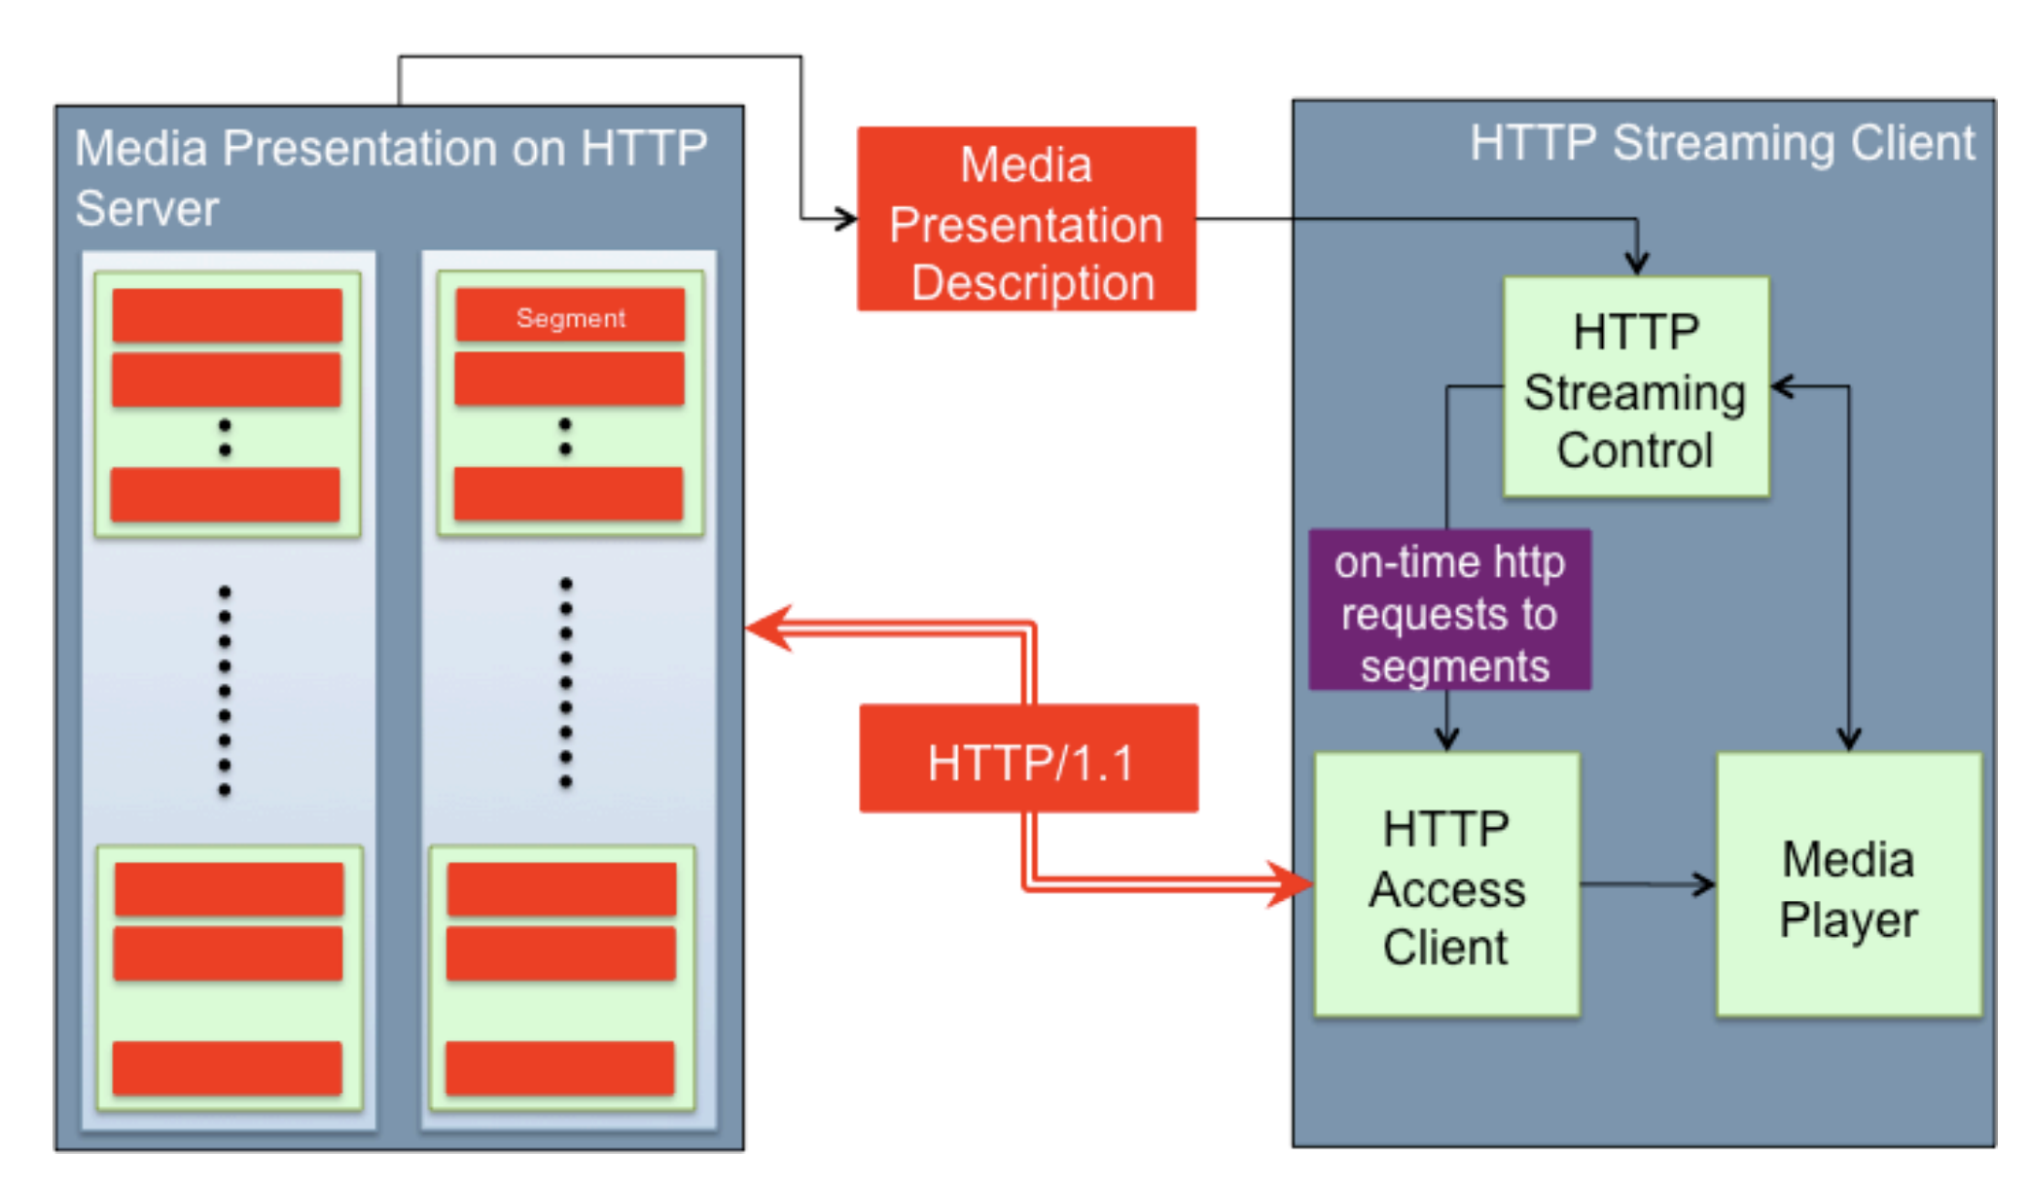
DASH: Key ideas
Content chunks
Each chunk can be independently retrieved
Client-side algorithms to determine and request a varying bit rate for each chunk
Goal: ensure good quality of service
Source: Stockhammer MMSys 2011

Slide 35
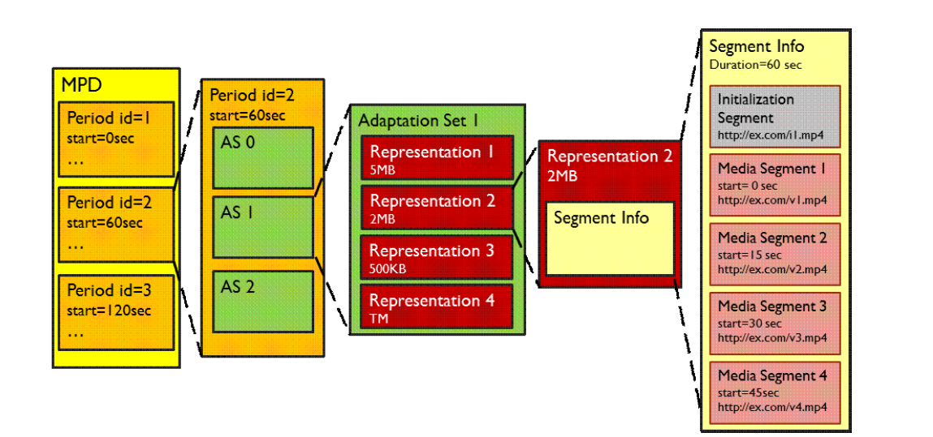
DASH Data model
Media has several periods
Each period has several Adaptation Sets: Audio, video, close caption
Several Representations (ex: codecs, bit rates) per Adaptation set
Several Chunks/Segments per Representation

Slide 36
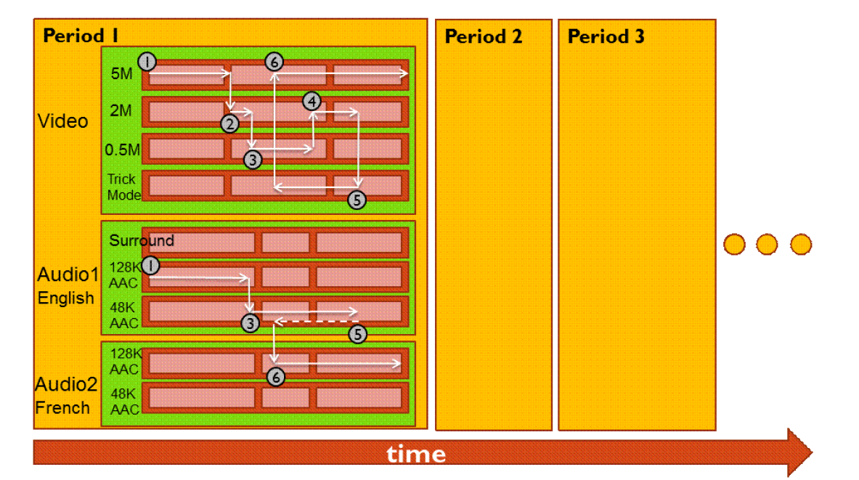
Dynamic bit rate changing of streams

Slide 37
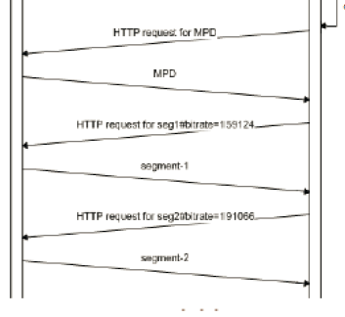
Media Presentation Descriptor (MPD)
MPD requested over http
Also called “manifest”
Describes all segments
Timing information and byte ranges of chunks
Client uses HTTP GET RANGE from a given AS + representation to ask a given bit rate
Client could use a different URL for each AS + representation

Slide 38

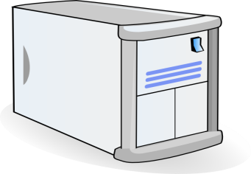


Video Delivery using CDN
2. HTTP reply containing html to construct the web page and a link to stream, say FLV file
4. HTTP reply
FLV stream
Video-servers
(front end)
Front end
web-servers
Internet
1. HTTP GET request for video URL
3. HTTP GET request
for FLV stream
User

Slide 39
Server Selection
File → server mapping done in at least three ways
Dynamic DNS resolution
DNS returns different IP addresses for a given DNS name
HTTP redirect
Use HTTP status code 3xx [with new URL]
Web browser does a GET from the new site
IP anycast
Use BGP to announce the same IP address from different locations
Client reaches “nearest” location according to inter-domain routing

Slide 40
DASH Summary
Widely used in video streaming services
Allows independent requests per segment
Hence, independent segment quality and data sizes
Encoded through separate HTTP objects and corresponding HTTP byte ranges
Combined or separate audio & video streams
Works well with CDNs
Independent representations or chunks can be queried from different locations if needed

