Slide 1

Multimedia: Real-time Conversations
CS 352, Lecture 23, Spring 2020
http://www.cs.rutgers.edu/~sn624/352
Srinivas Narayana

Slide 2
Course announcements
Project 3 due on Friday
Last week of classes
Final exam over a window of 5 days
2 hours, all multiple choice questions

Slide 3
Review of concepts
Digital representation (encoding)
Audio: sampling, quantization, compression
Video: spatial and temporal coding
Video: bit rate. Constant bit rate. Variable bit rate
3 types of multimedia: streaming, conversational, live-stream
Streaming video: client-side buffering and playout delay
If average fill rate < average video bit rate, stalls will happen
If average fill rate > average video bit rate, whether or not stalls happen depends on initial buffering
Can stream over UDP, TCP, HTTP

Slide 4
Streaming multimedia with DASH
Dynamic Adaptive Streaming over HTTP
Used by Netflix and other video streaming services
Client-centric approach to video delivery
Adaptive: Client performs video bit rate adaptation
Dynamic: Can retrieve a single video from multiple sources
Retain benefits of existing Internet and end host systems
Server is standard HTTP server
Provides video/audio content in multiple formats and encodings
DASH allows the use of CDNs for data delivery

Slide 5
Dynamic Adaptive Streaming over HTTP (DASH)

Slide 6
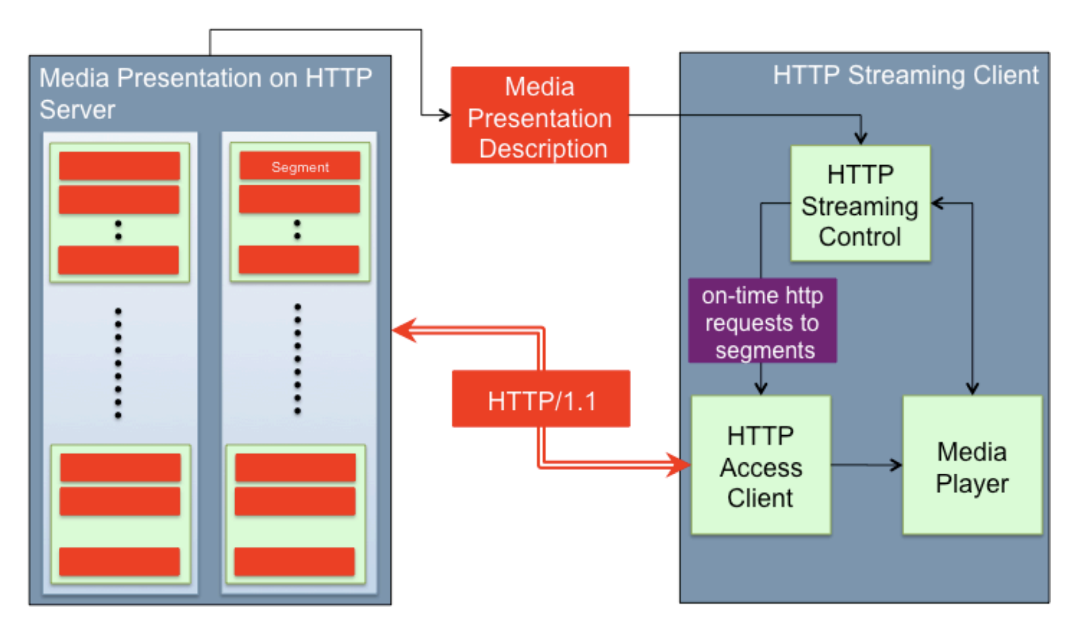
DASH: Key ideas
Content chunks
Each chunk can be independently retrieved
Client-side algorithms to determine and request a varying bit rate for each chunk
Goal: ensure good quality of service
Source: Stockhammer MMSys 2011

Slide 7
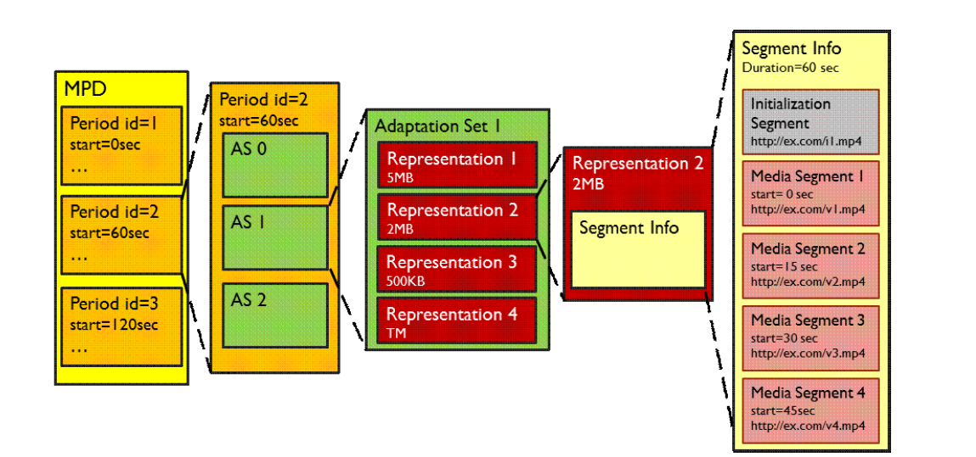
DASH Data model
Media has several periods
Each period has several Adaptation Sets: Audio, video, close caption
Several Representations (ex: codecs, bit rates) per Adaptation set
Several Chunks/Segments per Representation

Slide 8
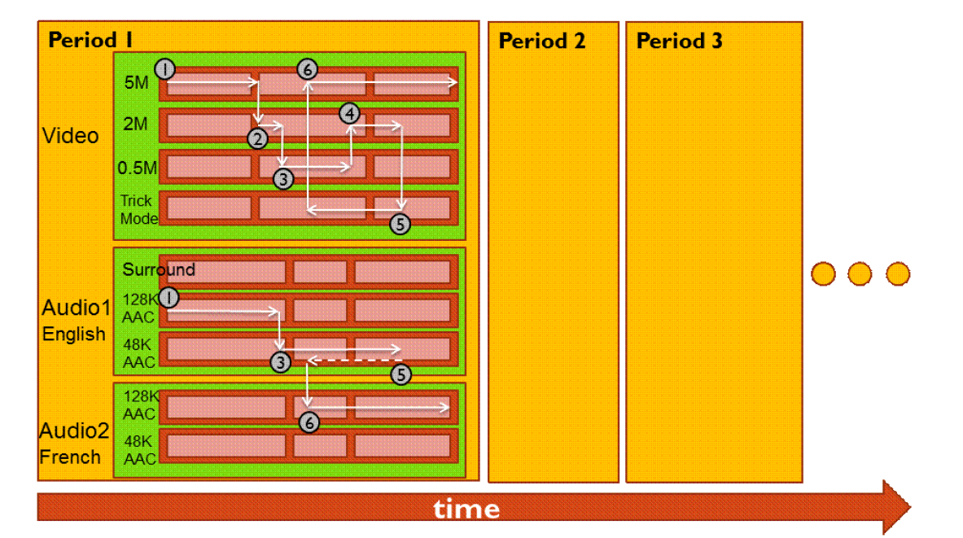
Dynamic bit rate changing of streams

Slide 9
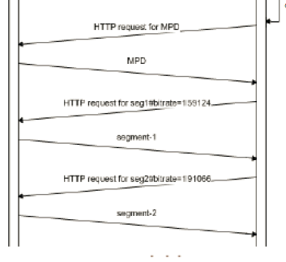
Media Presentation Descriptor (MPD)
MPD requested over http
Also called “manifest”
Describes all segments
Timing information and byte ranges of chunks
Client uses HTTP GET RANGE from a given AS + representation to ask a given bit rate
Client could use a different URL for each AS + representation

Slide 10

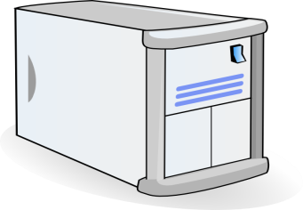


Video Delivery using CDN
2. HTTP reply containing html to construct the web page and a link to stream, say FLV file
4. HTTP reply
FLV stream
Video-servers
(front end)
Front end
web-servers
Internet
1. HTTP GET request for video URL
3. HTTP GET request
for FLV stream
User

Slide 11
Server Selection
File → server mapping done in at least three ways
Dynamic DNS resolution
DNS returns different IP addresses for a given DNS name
HTTP redirect
Use HTTP status code 3xx [with new URL]
Web browser does a GET from the new site
IP anycast
Use BGP to announce the same IP address from different locations
Client reaches “nearest” location according to inter-domain routing

Slide 12
DASH Summary
Widely used in video streaming services
Allows independent requests per segment
Hence, independent segment quality and data sizes
Encoded through separate HTTP objects and corresponding HTTP byte ranges
Combined or separate audio & video streams
Works well with CDNs
Independent representations or chunks can be queried from different locations if needed

Slide 13
Voice over IP (VoIP)

Slide 14
Voice-over-IP (VoIP)
VoIP end-end-delay requirement: needed to maintain “conversational” aspect
higher delays noticeable, impair interactivity
< 150 msec: good
> 400 msec: bad
includes application-level (packetization, playout), network delays
session initialization: how does callee advertise IP address, port number, encoding algorithms?
value-added services: call forwarding, screening, recording
emergency services: 911

Slide 15
VoIP characteristics
speaker’s audio: alternating talk spurts, silent periods
8K 1-Byte samples per second: 8 KBps during talk spurt
Packets generated only during talk spurts
20 msec chunks at 8 KBytes/sec: 160 Bytes of data
application-layer header added to each chunk
Chunk + header encapsulated into UDP or TCP segment
Application sends segment into socket every 20 msec during talk spurt

Slide 16
VoIP: packet loss, delay
network loss: IP datagram lost due to network congestion (router buffer overflow)
“delay loss”: IP datagram arrives too late for playout at receiver
delays: processing, queueing in network; end-system (sender, receiver) delays
typical maximum tolerable delay: 400 ms
loss tolerance: depending on voice encoding and loss concealment, packet loss rates between 1% and 10% can be tolerated

Slide 17
Delay jitter
constant bit
rate
transmission
client
reception
constant bit
rate playout
at client
Cumulative data
variable
network
Delay
(jitter)
buffered
data
client playout
delay
time
end-to-end delays of two consecutive packets: difference can be more or less than 20 msec (transmission time difference)

Slide 18
VoIP: fixed playout delay
receiver attempts to playout each chunk exactly q msecs after chunk was generated.
chunk has time stamp t: play out chunk at t+q
chunk arrives after t+q: data arrives too late for playout: data “lost”
tradeoff in choosing q:
large q: less packet loss but poor interactivity
small q: better interactive experience but more “loss”

Slide 19
VoIP: fixed playout delay
sender generates packets every 20 msec during talk spurt.
first packet received at time r
first playout schedule begins at p, second at p’

Slide 20
Adaptive playout delay (1/3)
goal: low playout delay, low “delay loss” rate
approach: adapt playout delay at the level of a talk spurt
estimate network delay, adjust playout delay @ beginning of talk spurt
silent periods will be compressed and elongated: not that noticeable
Goal: chunks still played out every 20 msec during talk spurt
adaptively estimate packet delay:
d_{i} = (1−α)d_{i-1} + α (r_{i} – t_{i})
delay estimate after ith packet
small constant, e.g. 0.1
time received -
time sent (timestamp)
measured delay of ith packet

Slide 21
Adaptive playout delay (2/3)
also useful to estimate average deviation of delay, v_{i} :
v_{i} = (1-b)v_{i-1} + b * abs(r_{i} – t_{i} – d_{i})
estimates d_{i}, v_{i} calculated for every received packet, but used only at start of talk spurt
for first packet in talk spurt, playout time is:
remaining packets in talk spurt are played out periodically
playout-time_{i} = t_{i} + d_{i} + Kv_{i}

Slide 22
Adaptive playout delay (3/3)
Q: How does receiver determine whether packet is first in a talk spurt?
if no loss, receiver looks at successive timestamps
difference of successive stamps > 20 msec ➔ talk spurt begins.
with possible losses, receiver must look at both time stamps and sequence numbers
difference of successive stamps > 20 msec and sequence numbers without gaps --> talk spurt begins.

Slide 23
VoIP: recovery from packet loss (1/4)
Challenge: recover from packet loss given small tolerable delay between original transmission and playout
Often, retransmission isn’t effective:
If playout time has expired, no point in retransmitting data!
Even if playout time is large and hasn’t expired during the loss, detecting the loss takes an ACK/NAK
By which time one RTT has elapsed! (or an RTO, often worse)
Retransmitted data to get to receiver takes at least another ~½ RTT
It may be too late to avoid a delay loss

Slide 24
VoIP’s approach towards loss
Anticipate loss
Correct for loss proactively
Two approaches:
Forward error correction
Interleaving

Slide 25
VoIP: recovery from packet loss (2/4)
Forward Error Correction (FEC)
Send enough bits to allow recovery without retransmission
Recall parity from the link layer?
Parity FEC
for every group of n chunks, create redundant chunk by exclusive OR-ing n original chunks
send n+1 chunks, increasing bandwidth by factor 1/n
can reconstruct original n chunks if at most one lost chunk from n+1 chunks, with playout delay

Slide 26
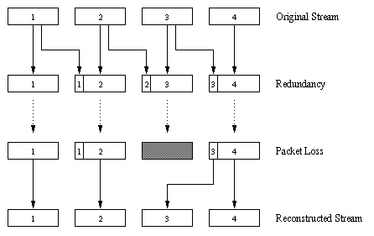
VoIP: recovery from packet loss (3/4)
Piggybacking FEC scheme
send lower resolution audio stream as redundant information along with (the usual) higher quality stream
e.g., nominal stream PCM at 64 kbps and redundant stream GSM at 13 kbps
non-consecutive loss: receiver can conceal loss
generalization: can also append (n-1)st and (n-2)nd low-bit rate chunk

Slide 27
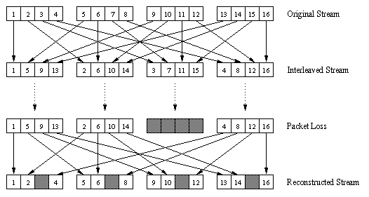
VoIP: recovery from packet loss (4/4)
interleaving to conceal loss:
audio chunks divided into smaller units, e.g. four 5 msec units per 20 msec audio chunk
packet contains small units from different chunks
if packet lost, still have most of every original chunk
no redundancy overhead, but increases playout delay

Slide 28
Case study: Skype

Slide 29




Voice-over-IP: Skype
proprietary application-layer protocol (inferred via reverse engineering)
encrypted msgs
P2P components:
Skype clients (SC)
Skype
login server
supernode (SN)
clients: Skype peers connect directly to each other for VoIP call
supernode
overlay
network
super nodes (SN): Skype peers with special functions
overlay network: among SNs to locate SCs
login server

Slide 30

P2P voice-over-IP: Skype
Skype client operation:
1. joins Skype network by contacting SN (IP address cached) using TCP
Skype
login server
2. logs-in (username, password) to centralized Skype login server
3. obtains IP address for callee from SN, SN overlay
or client buddy list
4. initiate call directly to callee

Slide 31


Skype: peers as relays
problem: both Alice, Bob are behind “NATs”
NAT prevents outside peer from initiating connection to insider peer
inside peer can initiate connection to outside
relay solution: Alice, Bob maintain open connection
to their SNs
Alice signals her SN to connect to Bob
Alice’s SN connects to Bob’s SN
Bob’s SN connects to Bob over open connection Bob initially initiated to his SN

Slide 32
Skype: peers as relays
Pro: A solution to circumvent NATs on both sides of a connection
Con: requires infrastructure outside of NAT (supernode/relay peers)
Con: data must be routed through SNs, which may become bottlenecks
Note: Information up to date as of 2012
We need fresh reverse engineering studies to verify if conclusions are applicable now ☺

Slide 33
Protocols for real-time communication: RTP and SIP

Slide 34
Real-Time Protocol (RTP)
RTP specifies packet structure for packets carrying audio, video data
RFC 3550
RTP packet provides
payload type identification
packet sequence numbering
time stamping
RTP runs in end systems
RTP packets encapsulated in UDP segments
interoperability: if two VoIP applications run RTP, they may be able to work together

Slide 35
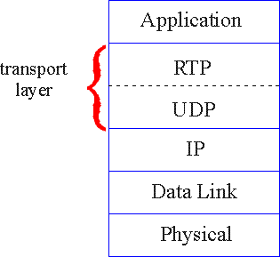
RTP runs on top of UDP
RTP libraries provide transport-layer interface
that extends UDP:
port numbers, IP addresses
payload type identification
packet sequence numbering
time-stamping

Slide 36
RTP example
example: sending 64 kbps PCM-encoded voice over RTP
application collects encoded data in chunks, e.g., every 20 msec = 160 bytes in a chunk
audio chunk + RTP header form RTP packet, which is encapsulated in UDP segment
RTP header indicates type of audio encoding in each packet
sender can change encoding during conference
RTP header also contains sequence numbers, timestamps

Slide 37
RTP header
payload type
sequence number type
time stamp
Synchronization
Source ID
Miscellaneous fields
payload type (7 bits): indicates type of encoding currently being used. If sender changes encoding during call, sender
informs receiver via payload type field
Payload type 0: PCM mu-law, 64 kbps
Payload type 3: GSM, 13 kbps
Payload type 7: LPC, 2.4 kbps
Payload type 26: Motion JPEG
Payload type 31: H.261
Payload type 33: MPEG2 video
sequence # (16 bits): increment by one for each RTP packet sent
detect packet loss, restore packet sequence

Slide 38
RTP header
payload type
sequence number type
time stamp
Synchronization
Source ID
Miscellaneous fields
timestamp field (32 bits long): sampling instant of first byte in this RTP data packet
for audio, timestamp clock increments by one for each sampling period (e.g., each 125 usecs for 8 KHz sampling clock)
if application generates chunks of 160 encoded samples, timestamp increases by 160 for each RTP packet when source is active. Timestamp clock continues to increase at constant rate when source is inactive.
SSRC field (32 bits long): identifies source of RTP stream. Each stream in RTP session has distinct SSRC

Slide 39
SIP: Session Initiation Protocol [RFC 3261]
long-term vision:
all telephone calls, video conference calls take place over Internet
people identified by names or e-mail addresses, rather than by phone numbers
can reach callee (if callee so desires), no matter where callee roams, no matter what IP device callee is currently using

Slide 40
SIP services
SIP provides mechanisms for call setup:
for caller to let callee know she wants to establish a call
caller, callee can agree on media type, encoding
Possible to end call with specific reasons
determine current IP address of callee:
maps mnemonic identifier to current IP address
call management:
add new media streams during call
change encoding during call
invite others
transfer, hold calls

Slide 41
Example: setting up call to known IP address
Alice’s SIP invite message indicates her port number, IP address, encoding she prefers to receive (PCM mu-law)
Bob’s 200 OK message indicates his port number, IP address, preferred encoding (GSM)
SIP messages can be sent over TCP or UDP
default SIP port number is 5060

Slide 42
Setting up a call (more)
codec negotiation:
suppose Bob doesn’t have PCM μlaw encoder
Bob will instead reply with 606 Not Acceptable Reply, listing his encoders. Alice can then send new INVITE message, advertising different encoder
rejecting a call
Bob can reject with replies “busy,” “gone,” “payment required,” “forbidden”
media can be sent over RTP or some other protocol

Slide 43
Example of SIP message
INVITE sip:bob@domain.com SIP/2.0
Via: SIP/2.0/UDP 167.180.112.24
From: sip:alice@hereway.com
To: sip:bob@domain.com
Call-ID: a2e3a@pigeon.hereway.com
Content-Type: application/sdp
Content-Length: 885
c=IN IP4 167.180.112.24
m=audio 38060 RTP/AVP 0
Notes:
HTTP message syntax
sdp = session description protocol
Call-ID is unique for every call
Here we don’t know Bob’s IP address
intermediate SIP servers needed
Alice sends, receives SIP messages using SIP default port 5060
Alice specifies in header that SIP client sends, receives SIP messages over UDP

Slide 44
Name translation, user location
caller wants to call callee, but only has callee’s name or e-mail address.
need to get IP address of callee’s current host:
user moves around
DHCP protocol
user has different IP devices (PC, smartphone, car device)
result can be based on:
time of day (work, home)
caller (don’t want boss to call you at home)
status of callee (calls sent to voicemail when callee is already talking to someone)
An infrastructure of SIP servers to support mobility and callee resolution

Slide 45
SIP registrar
one function of SIP server: registrar
when Bob starts SIP client, client sends SIP REGISTER message to Bob’s registrar server
register message: to support mobility at Bob’s end
REGISTER sip:domain.com SIP/2.0
Via: SIP/2.0/UDP 193.64.210.89
From: sip:bob@domain.com
To: sip:bob@domain.com
Expires: 3600

Slide 46
SIP proxy
another function of SIP server: proxy
Alice sends invite message to her proxy server
contains address sip:bob@domain.com
proxy responsible for routing SIP messages to callee, possibly through multiple proxies
Bob sends response back through the same set of SIP servers
Alice’s proxy returns Bob’s SIP response message to Alice
contains Bob’s IP address
SIP proxy analogous to local DNS server plus indirect routing relay
Alice and Bob’s media traffic sent directly between each other

Slide 47
SIP example: jim@umass.edu calls keith@poly.edu
2. UMass proxy forwards request
to Poly registrar server
Poly SIP
registrar
2
3
3. Poly server returns redirect response, indicating that it should try keith@eurecom.fr
4. Umass proxy forwards request
to Eurecom registrar server
UMass SIP proxy
Eurecom SIP
registrar
4
7
1. Jim sends INVITE message to UMass SIP proxy.
6-8. SIP response returned to Jim
5. eurecom registrar forwards INVITE to 197.87.54.21, which is running keith’s SIP client
8
5
6
1
9
128.119.40.186
9. Data flows between clients
197.87.54.21

Slide 48
Internetworking PSTN and SIP?
A gateway is required to convert SIP messages to circuit switched signaling in the public switched telephone network (PSTN) and vice-versa
SIP proxy server will contact PSTN gateway
A PSTN gateway initiates call to the PSTN callee
Two-way audio conversation occurs through the PSTN gateway

Slide 49
Summary of real-time multimedia
Important to bound playout delays, adapt to loss
Fixed and adaptive playout delays at the granularity of “talk spurts”
Forward error correction mechanisms to avoid retransmissions and conceal packet loss
Relay-based call routing: used by Skype and SIP services
Useful to overcome NATs
Locate users through generic names, amidst mobility
Need extra infrastructure to make all this real

