Slide 1

CS 352 Network Layer: Intro
CS 352, Lecture 14.1
http://www.cs.rutgers.edu/~sn624/352
Srinivas Narayana

Slide 2


Network
Application
HTTPS
FTP
HTTP
SMTP
DNS
Transport
TCP
UDP
Network
IP
Host-to-Net
X.25
…
802.11
ATM

Slide 3




The network layer
Endpoint
Main function: Move data from sending to receiving endpoint
on sending endpoint: encapsulate transport segments into datagrams
on receiving endpoint: deliver datagrams to transport layer
The network layer also runs in every router
The router examines header fields in all network-layer datagrams passing through it
Process
Network Layer
Process
Endpoint

Slide 4
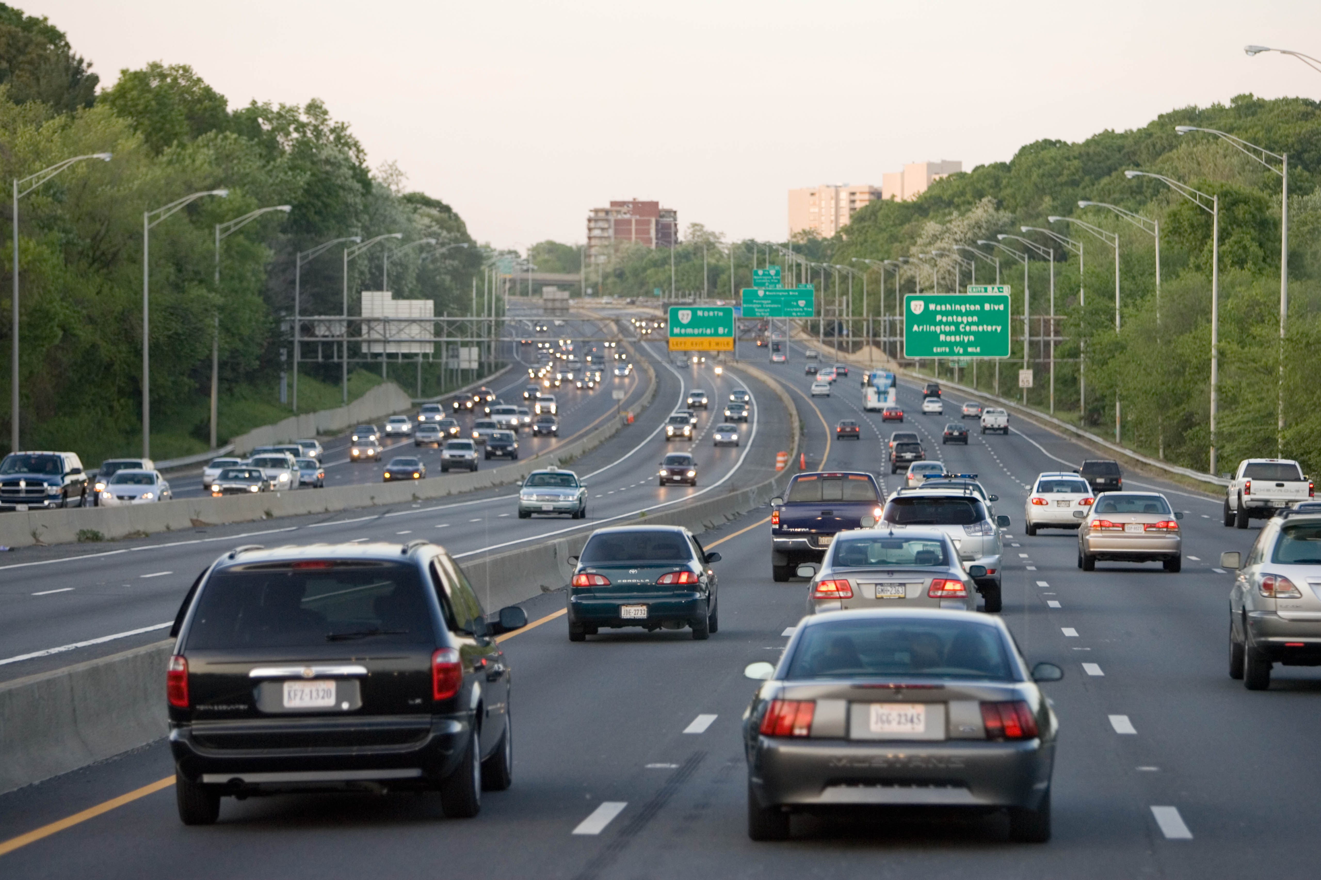
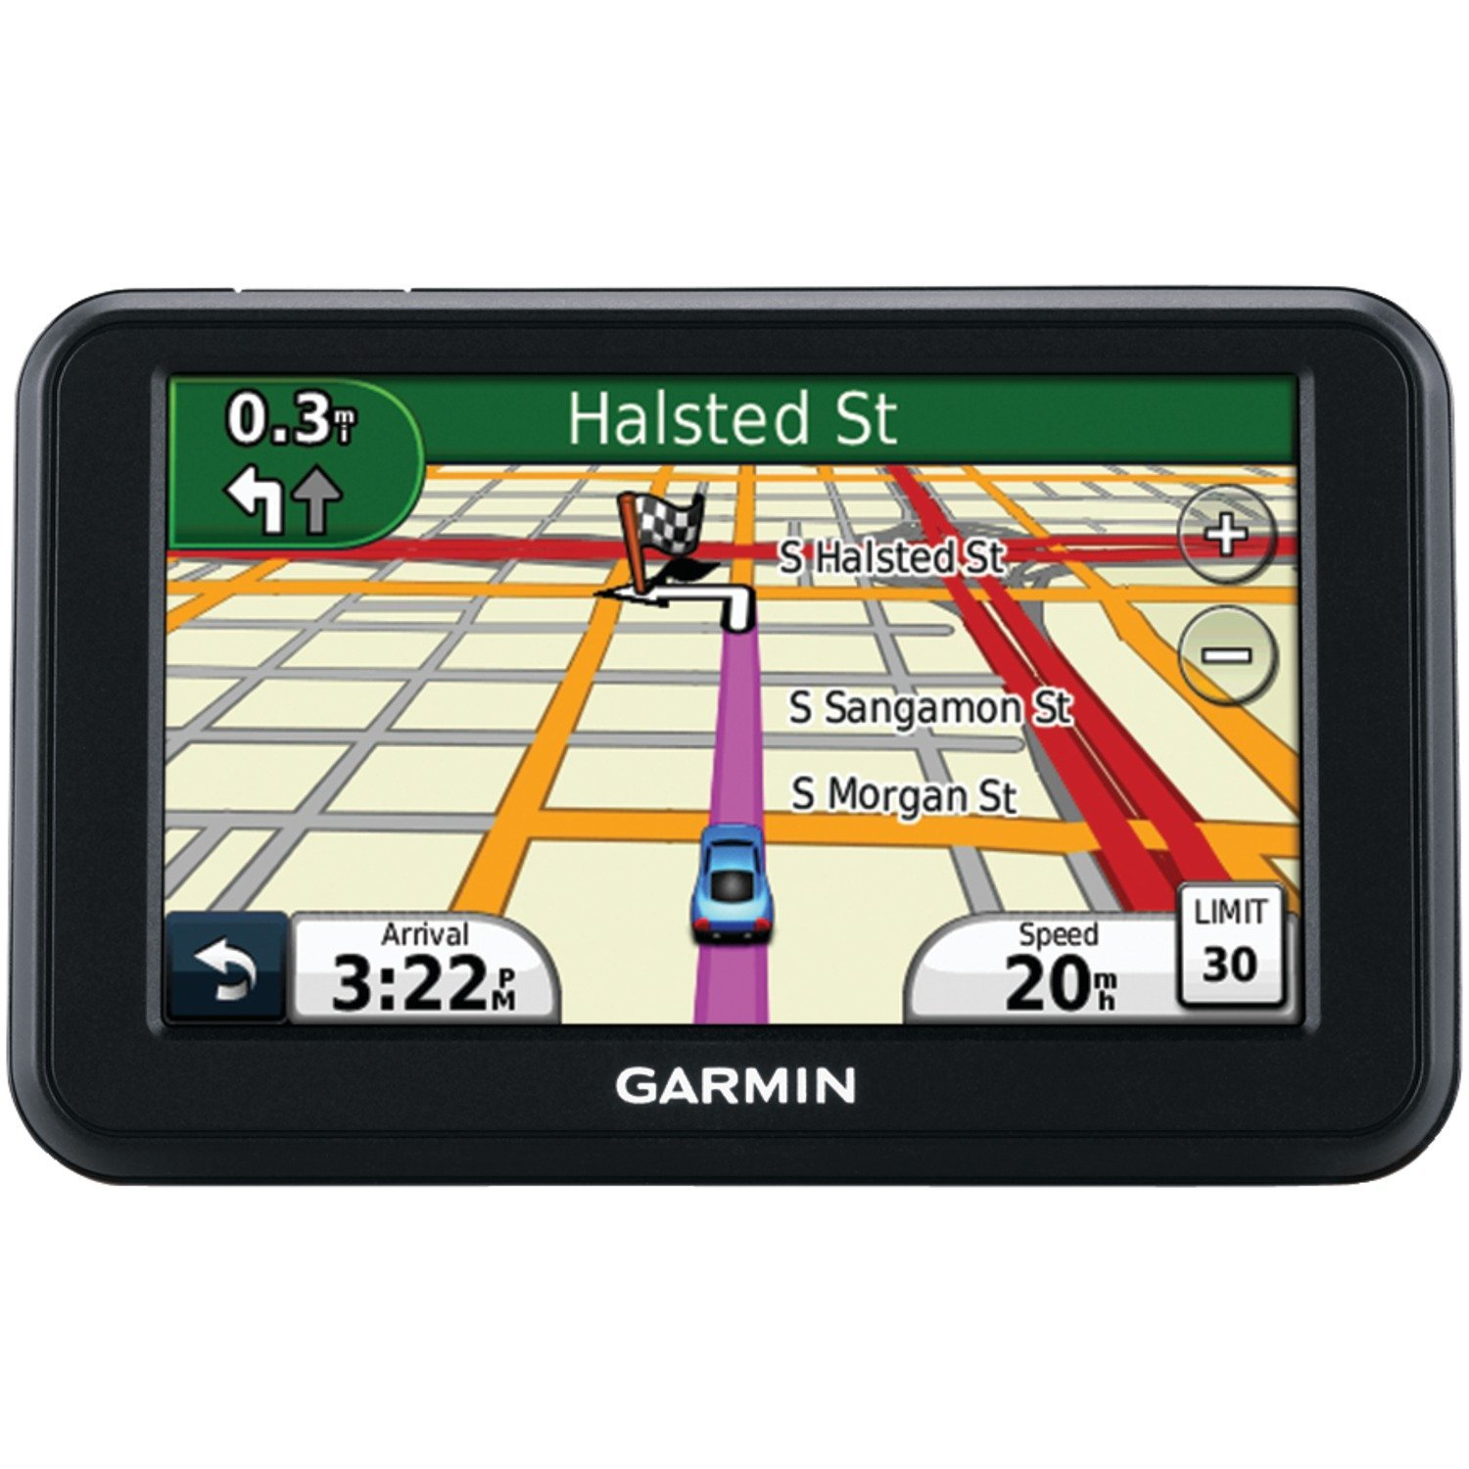
Two key network-layer functions
Forwarding: move packets from router’s input to appropriate router output
Routing: determine route taken by packets from source to destination
routing algorithms
The network layer solves the routing problem.
Analogy: taking a road trip
Forwarding: process of getting through single interchange
Routing: process of planning trip from source to destination

Slide 5
Data plane and Control Plane
Data plane = Forwarding
local, per-router function
determines how datagram arriving on router input port is forwarded to router output port
Control plane = Routing
network-wide logic
determines how datagram is routed along end-to-end path from source to destination endpoint
two control-plane approaches:
Distributed routing algorithm running on each router
Centralized routing algorithm running on a (logically) centralized server
values in arriving
packet header
0111
1
3
2

Slide 7
CS 352 Internet Addressing
CS 352, Lecture 14.2
http://www.cs.rutgers.edu/~sn624/352
Srinivas Narayana

Slide 8
The Internet needs addresses
Addresses allow endpoints to identify, and hence talk to each other
E.g., like people have names
Addresses allow routers to determine how to move a packet
E.g., like the postal system
Network layer addresses are designed to help routers perform the forwarding and routing functions efficiently
Specifically, we’ll look at Internet Protocol (IP) addresses.
Most popular: IP version 4 or IPv4. (Coming up later: IPv6)

Slide 9
IPv4 Addresses
32 bits long
Identifier for a network interface
An IP address corresponds to the point of attachment of an endpoint to the network.
An IP address is NOT an identifier for the endpoint
Dotted quad notation: each byte is written in decimal in MSB order, separated by dots. Example:
10000000 11000011 00000001 01010000
128
.
95
.
1
.
80

Slide 10
Grouping IP addresses by prefixes
IP addresses can be grouped based on a shared prefix of a specified length
Example: consider two IP addresses:
128.95.1.80 and 128.95.1.4
The addresses share a prefix of (bit) length 24: 128.95.1
The addresses have different suffixes of (bit) length 8
IP addresses: prefix corresponds to the network component and the suffix to an endpoint/host component of the address

Slide 11
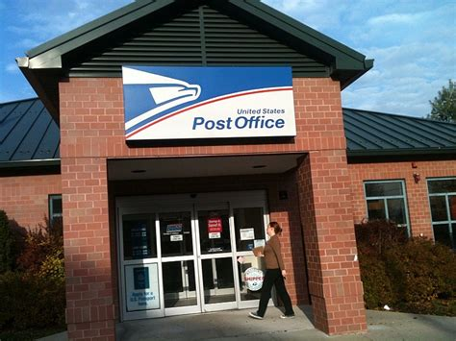
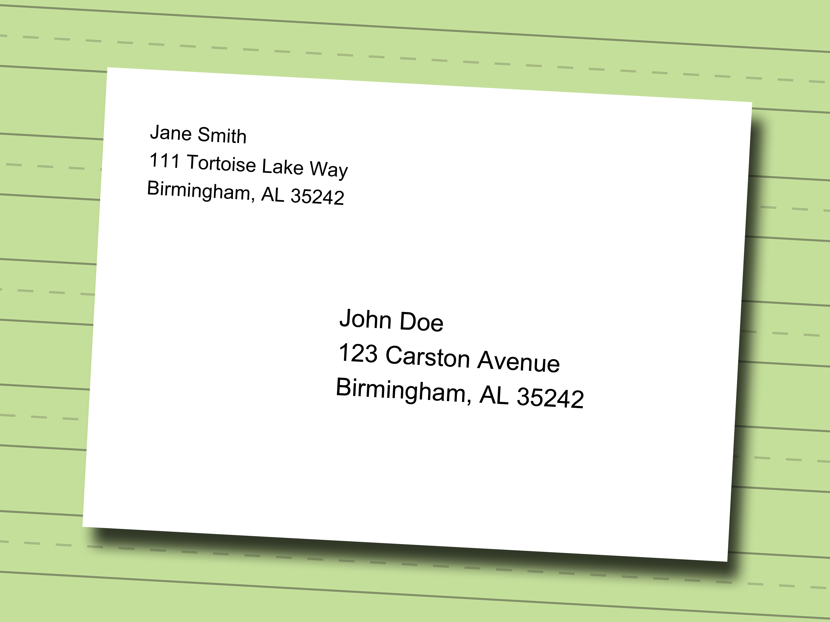
IP addresses use hierarchy to scale routing
IP addresses of endpoint interfaces in a network (e.g., Rutgers Busch campus) share a prefix of some length
Each interface/endpoint has a different suffix, and hence a different 32-bit IP address
Using prefixes reduces the amount of information needed to forward packets over the Internet
IP prefixes are like zip codes: routers don’t need to store info for each endpoint, just each prefix
Prefixes also allow IP addresses to be delegated from one network to another (more on this later)
NJ

Slide 12
IP addresses use hierarchy to scale routing
Postal envelopes should show clearly delineated zip codes.
Q: How to identify the prefix from a 32-bit IP address?
Two methods:
Old: Classful addressing
New: Classless addressing (also called classless inter-domain routing, or CIDR)
NJ

Slide 13
Classful IPv4 addressing

Slide 14
Classful IPv4 addressing
Class
32 bits
A
0
Net
Host
0.x.x.x – 127.x.x.x
Unicast: single endpoint dest
B
10
Net
Host
128.x.x.x – 191.x.x.x
Unicast: single endpoint dest
C
110
Net
Host
192.x.x.x – 223.x.x.x
Unicast: single endpoint dest
D
1110
Multicast address
224.x.x.x – 239.x.x.x
Destination is a group of hosts
E
1111
Reserved
240.x.x.x – 255.x.x.x
8 bit
prefix
16 bit
prefix
24 bit
prefix
First octet of IP address gives you the prefix length.

Slide 15
Classful IPv4 addressing
Class A:
For very large organizations
2²⁴ = 16 million hosts allowed
Class B:
For large organizations
2¹⁶ = 65 thousand hosts allowed
Class C
For small organizations
2⁸ = 255 hosts allowed
Class D
Multicast addresses
No network/host hierarchy

Slide 16
Problems with classful addressing
IP prefixes are allocated to organizations (e.g., Rutgers) by Internet Registry organizations (e.g., ARIN, in North America)
Many organizations required something bigger than class C address, but smaller than a class A (or even B) address
However, the Internet was running out of class B addresses
Too many networks required multiple class C addresses
Not enough nets in class A for large + medium organizations
Key issue: Classful addressing is too coarse-grained: The addressing strategy must allow for greater diversity of network sizes

Slide 17
Classless IPv4 addressing (CIDR)

Slide 18
Classless IPv4 addressing
Also called classless inter-domain routing (CIDR)
Key idea: Network component of the address (ie: prefix) can have any length (usually from 8—32)
Address format: a.b.c.d/x, where x is the prefix length
Customary to use 0s for all suffix bits
network
part
host
part
11001000 00010111 00010000 00000000
200.23.16.0/23

Slide 19
CIDR
An ISP can obtain a block of addresses and partition this further to its customers
Say an ISP has 200.8.0.0/16 address (65K addresses).
The ISP has customer who needs only 64 addresses starting from 200.8.4.128
Then that block can be specified as 200.8.4.128/26
200.8.4.128/26 is “inside” 200.8.0.0/16
200.8.0.0/16
200.8.0.0
200.8.0.1
200.8.4.128/26
…
200.8.1.0
200.8.1.1
…
200.8.255.255

Slide 20
Netmask (or subnet mask)
An alternative to denote the IP prefix length of an organization
32 bits: a 1-bit denotes a prefix bit position. 0 is the host part.
network
part
host
part
11001000 00010111 00010000 00000000
200.23.16.0/23
network part of mask
Host part of mask
11111111 11111111 11111110 00000000
Netmask: 255.255.254.0

Slide 21
Detecting addresses from same network
Given IP addresses A and B, and netmask M.
1. Compute logical AND (A & M).
2. Compute logical AND (B & M).
3. If (A & M) == (B & M) then A and B are
on the same subnet.
Ex: A = 165.230.82.52, B = 165.230.24.93, M = 255.255.128.0
A and B are in the same network according to the netmask
A & M == B & M == 165.230.0.0

Slide 22
Finding your own IP address(es)
A small demo

