Slide 1

Reliable Data Delivery
Lecture 13
http://www.cs.rutgers.edu/~sn624/352-F24
Srinivas Narayana

Slide 2

Review
UDP: best-effort delivery + demultiplexing + error detection
Checksum function: 1s complement of the 1s complement sum
Sender: compute checksum & write.
Receiver: compute checksum, compare to 0
1 1 1 1 0 0 1 1 0 0 1 1 0 0 1 1 0
1 1 1 0 1 0 1 0 1 0 1 0 1 0 1 0 1
1 1 0 1 1 1 0 1 1 1 0 1 1 1 0 1 1
1 1 0 1 1 1 0 1 1 1 0 1 1 1 1 0 0
1 0 1 0 0 0 1 0 0 0 1 0 0 0 0 1 1
wraparound
sum
checksum

Slide 3
Checksum, why you being weird?
https://datatracker.ietf.org/doc/html/rfc1071
Not on the exam
Need a function that is fast to compute, catches likely errors, and easy to verify. Some design considerations:
Basic bit-wise: AND, OR: many inputs map to the same output
XOR: can catch single bit-flips, but not an even number of 1s/0s flipping
Some sort of addition is preferable to this (carries will show errors)
Addition is commutative, associative, has an identity element (0), is efficient to calculate
Checksum can appear anywhere in the packet
Compute checksum by placing a 0 in place originally
Use operations at the natural bit-width of the machine (16 bits was common)
(Regular) two’s complement addition: errors in higher order bit positions can be missed (the final carry-out bit isn’t part of the checksum)
One’s complement: adding the final carry-out to the result helps ☺
Why complement? Why not compare the checksum rather than to 0?
CPUs have ways of detecting if the last result was 0

Slide 4
Some observations on checksums
Checksums don’t detect all bit errors
Consider (x, y) vs. (x – 1, y + 1) as adjacent 16-bit values in packet
Analogy: you can’t assume the package hasn’t been meddled with if its weight matches the one on the stamp. More smarts needed for that. ☺
But it’s a lightweight method that works well in many cases
Checksums are part of the packet; they can get corrupted too
The receiver will just declare an error if it finds an error

Slide 5
Some observations on checksums
Checksums are insufficient for reliable data delivery
If a packet is lost, so is its checksum
UDP and TCP use the same checksum function
TCP also uses the lightweight error detection capability
However, TCP has more mature mechanisms for reliable data delivery (up next!)
Checksum is a mechanism to detect errors, not correct them
Even when they detect errors, checksums don’t tell you where they lie

Slide 6
Playing with checksums
Let’s craft some UDP packets (again)!
sudo tcpdump -i lo udp –XAvvv # observe packets
sudo scapy # tool used to send crafted packets
send(IP(dst="127.0.0.1")/UDP(sport=1024, dport=2048)/"hello world”, iface="lo")
Now can you craft two UDP packets with an identical checksum?

Slide 7
Summary of UDP
A simple transport: Send or receive a single packet from/to the correct application process. That’s it
Just a thin shim around network layer’s best-effort delivery
No connection building, no latency
Suitable for one-off request/response messages
Sometimes suitable for loss-tolerant but delay-sensitive applications
No reliability, performance, or ordering guarantees
Can do basic error detection (bit flips) using checksums
Error detection is necessary to deliver data reliably, but it is insufficient

Slide 8
Reliable data delivery

Slide 9
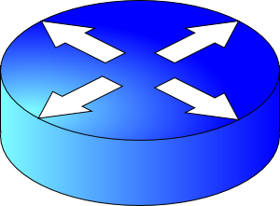

Packet loss
Sender
Receiver
How might a sender and receiver ensure that data is delivered reliably (despite some packets being lost)?
TCP uses three mechanisms

Slide 10
Coping with packet loss: (1) ACK
Key idea: Receiver returns an acknowledgment (ACK) per packet sent
If sender receives an ACK, it knows that the receiver got the packet.
Sender
Receiver
packet
ACK
packet
ACK

Slide 11
Coping with packet corruption: (1) ACK
ACKs also work to detect packet corruption on the way to the receiver
One possibility: A receiver could send a negative acknowledgment, or a NAK, if it receives a corrupted packet
Q: How to detect corrupted packet?
One method: Checksum!
TCP only uses positive ACKs.
Sender
Receiver
packet
NAK
packet
ACK

Slide 12
Coping with packet loss: (2) RTO
What if a packet is dropped?
Key idea: Wait for a duration of time (called retransmission timeout or RTO) before re-sending the packet
In TCP, the onus is on the sender to retransmit lost data when ACKs are not received
Note that retransmission works also if ACKs are lost or delayed
Sender
Receiver
RTO
Retransmission
ACK

Slide 13
How should the RTO be set?
A good RTO must predict the round-trip time (RTT) between the sender and receiver
RTT: the time to send a single packet and receive a (corresponding) single ACK at the sender
Intuition: If an ACK hasn’t returned, and our (best estimate of) RTT has elapsed, the packet was likely dropped.
RTT can be measured directly at the sender. No receiver or router help needed.
Sender
Receiver
RTO
ACK

Slide 14
Coping with packet duplication
If ACKs delayed beyond the RTO, sender may retransmit the same data
Receiver wouldn’t know that it just received duplicate data from this retransmitted packet
Add some identification to each packet to help distinguish between adjacent transmissions
This is known as the sequence number
Sender
Receiver
RTO
Duplicate
packet received!
(Receiver doesn’t know…)
ACK

Slide 15
Coping with packet loss: (3) Sequence #s
A bad scenario: Suppose an ACK was delayed beyond the RTO; sender ended up retransmitting the packet.
At the receiver: sequence number helps disambiguate a fresh transmission from a retransmission
Sequence number same as earlier: retransmission
Fresh sequence number: fresh data
Sender
Receiver
0
RTO
0
ACK

Slide 16
Coping with packet loss: (3) Sequence #s
A good scenario: packet successfully received and ACK returned within RTO
Sequence numbers of successively transmitted packets are different
Sender
Receiver
SEQ 0
Receiver knows these are not duplicate, because sequence numbers are different
RTO
ACK
SEQ 1
RTO

Slide 17
Coping with packet loss: (3) Sequence #s
A good scenario: packet successfully received and ACK returned within RTO
Sequence numbers of successively transmitted packets are different
Sender
Receiver
SEQ 0
Receiver knows these are not duplicate, because sequence numbers are different
RTO
ACK
ACK
SEQ 1
RTO
ACK

Slide 18
Q: What is the seq# of third packet?
Goal: Avoid ambiguity on which packet was received/ACK’ed from both the sender and receiver’s perspective
One option: increment seq#: 2, 3, …
Alternative: since seq # 0 was successfully ACK’ed earlier, it is OK to reuse seq #0 for next transmission.
Seq #s reusable if older packets with those seq #s known to be delivered
Sender
Receiver
SEQ 0
RTO
ACK
SEQ 1
RTO
ACK
???

Slide 19
Stop-and-Wait Reliability
Sender sends a single packet, then waits for an ACK to know the packet was successfully received. Then the sender transmits the next packet.
If ACK is not received until a timeout (RTO), sender retransmits the packet
Disambiguate duplicate vs. fresh packets using sequence numbers that change on “adjacent” packets
Sender
Receiver
SEQ 0
ACK
RTT
SEQ 1
RTO
Retransmit

Slide 20
In principle, these three ideas are sufficient to implement reliable data delivery!

Slide 21
Efficiency problem with stop-and-wait
Sender sends one packet, waits for an ACK (or RTO) before transmitting next one
Unfortunately, too slow ☹
Suppose RTO = RTT = 100 milliseconds
Packet size (bytes in 1 packet) = 12,000 bits
Bandwidth of links from sender to receiver = 12 Mbit/s (1 M = 10⁶)
Rate of data transfer = data size / time
Sender
Receiver
RTT
RTO
120 Kilobit/s == 1% of bw!

Slide 22
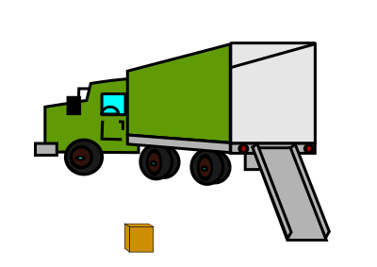
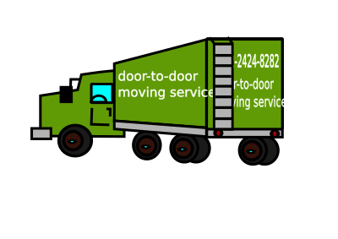


Sending one packet per RTT makes the data transfer rate limited by the time between the endpoints, rather than the bandwidth.
Ensure you got the (one) box safely; make N trips
Ensure you get N boxes safely; make just 1 trip!
Keep many packets in flight

Slide 23
Making reliable data transfer efficient

Slide 24
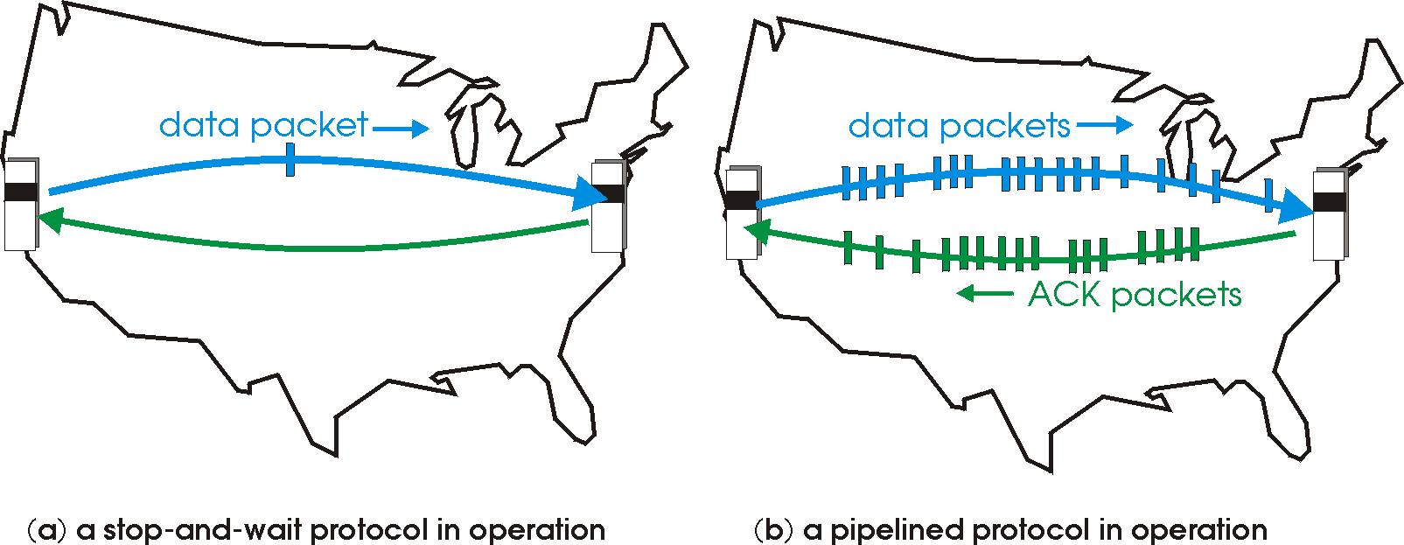
Pipelined reliability
Data in flight: data that has been sent, but sender hasn’t yet received ACKs from the receiver
Note: can refer to packets in flight or bytes in flight
New packets sent at the same time as older ones still in flight
New packets sent at the same time as ACKs are returning
More data moving in same time!
Improves throughput
Rate of data transfer

Slide 25
Pipelined reliability
Stop and wait: send 1 packet per RTT
Pipelined: send N packets per RTT
If there are N packets in flight, throughput improves by N times compared to stop-and-wait!
Sender
Receiver
RTT
RTO

Slide 26
Pipelining makes reliable data transfer efficient.
However, pipelining also makes it more complex.
Which packets are currently in flight?
Which packets were successfully delivered?
Which packets should the sender retransmit?

Slide 28


Review: Demultiplexing
Connection lookup: The operating system does a lookup using these data to determine the right socket and app.
Machine 1
Port 1
Machine 1
IP addr 1
Port 2
…
Denotes an attachment point with the network.
Src port, Dst port
…
…
…
…
Src IP, Dst IP,
Tp Protocol
Port 65535
Machine 1
IP addr 2
socket()
Ports
Each IP address comes with a full copy of its own ports.
Machine

Slide 29
Listing sockets and connections
ss
iperf –s and iperf –s -u

Slide 30
User Datagram Protocol

Slide 31
UDP: User Datagram Protocol [RFC 768]
Best effort service
UDP segments may be lost, corrupted, reordered
UDP is connectionless
Each UDP segment handled independently of others (i.e. no “memory” across packets)
Suitable for one-off req/resp
E.g., DNS uses UDP
Early multimedia apps used UDP
Delay-sensitive but loss tolerant
Why are UDP’s guarantees even okay?
Simple & low overhead compared to TCP:
No delays due to “connection establishment” (which TCP does)
UDP can send a packet immediately
Small segment header (TCP’s is larger)
UDP can blast data without control
TCP is more balanced and measured
Less memory for connection “state” at sender & receiver relative to TCP

Slide 32
UDP segment structure
Length of
segment
(UDP header + data)
Applications
16 bits
16 bits
Error detection
info
(more to come)
Transport
source port #
dest port #
length
checksum
Network
application
data
(message)
Link layer

Slide 33
UDP segment structure
…
Source IP address
Destination IP address
…
Applications
Transport
source port #
dest port #
length
checksum
Network
application
data
(message)
Link layer

Slide 34



Review: UDP demultiplexing
…
Source IP address
Destination IP address
…
Machine 1
Port 1
Machine 1
IP 1
Port 2
…
…
source port #
dest port #
…
length
checksum
Port 44262
…
application
data
(message)
Port 65535
Machine 1
IP 2
socket()
Ports

Slide 35
Seeing UDP packets in action
How to craft and send (UDP) packets?
It’s simpler than you think!
sudo tcpdump -i lo -XAvvv udp # observe packets
sudo scapy # tool used to send crafted packets
Example:
send(IP(dst="127.0.0.1")/UDP(sport=1024, dport=2048)/"hello world”, iface="lo")
See other fields of UDP using UDP().fields_desc
Scapy can send and receive crafted packets!
However, it requires sudo (superuser privileges)

Slide 36
Error Detection in the Transport Layer

Slide 37
Why error detection?
Network provides best effort service
UDP is a simple and low overhead transport
Data may be corrupted along the way (e.g., 1 -> 0)
However, simple error detection is possible!
Was the data I received the same data the remote machine sent?
Error detection is a useful feature for all transport protocols including TCP
Q: Suppose you’re sending a package to a friend. How would you detect tampering with that package?

Slide 38
Error Detection in UDP and TCP
Key idea: have sender compute a function over the data
Store the result in the packet
Receiver can check the function’s value in received packet
An analogy: you’re sending a package of goodies and want your recipient to know if goodies were leaked along the way
Your idea: weigh the package; stamp the weight on the package
Have the recipient weigh the package and cross-check the weight with the stamped value

Slide 39
Requirements on error detection function
Function must be easy to compute
Function value must change if the packet changes
If the packet was modified through “likely” changes, the function value must change
Function must be easy to verify
UDP and TCP use a class of function called a checksum
Very common idea: used in multiple parts of networks and computer systems

Slide 40
UDP & TCP’s Checksum function
Sender:
treat segment contents as sequence of 16-bit integers
checksum: addition (1’s complement sum) of segment contents
sender puts checksum value into UDP/TCP checksum field
Receiver:
compute a checksum of the received segment, including the checksum in packet itself
check if the resulting (computed) checksum is 0
NO – an error is detected
YES – assume no error

Slide 41
Computing 1’s complement sum
Very similar to regular (unsigned) binary addition.
However, when adding numbers, a carryout from the most significant bit needs to be added to the result
Example: add two 16-bit integers
1 1 1 1 0 0 1 1 0 0 1 1 0 0 1 1 0
1 1 1 0 1 0 1 0 1 0 1 0 1 0 1 0 1
1 1 0 1 1 1 0 1 1 1 0 1 1 1 0 1 1
1 1 0 1 1 1 0 1 1 1 0 1 1 1 1 0 0
1 0 1 0 0 0 1 0 0 0 1 0 0 0 0 1 1
wraparound
sum
checksum

Slide 42

From the UDP specification (RFC 768)
Checksum is the 16-bit one's complement of the one's complement sum of a pseudo header of information from the IP header, the UDP header, and the data, padded with zero octets at the end (if necessary) to make a multiple of two octets.
The pseudo header conceptually prefixed to the UDP header contains the source address, the destination address, the protocol, and the UDP length.
Warning: Technical language ahead

