Slide 1

Routing (part 4)
Lecture 26
http://www.cs.rutgers.edu/~sn624/352-F24
Srinivas Narayana

Slide 2

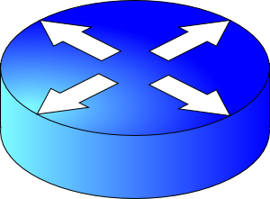


The network layer enables reachability.
We’ll see protocols that solve subproblems.
How does an endpoint get an address?
How does an endpoint talk to another outside its network?
Debugging?
ICMP
Routing protocols
OSPF, RIP, BGP
DHCP
How does an endpoint talk to another within the same network?
ARP
Gateways
NAT

Slide 3
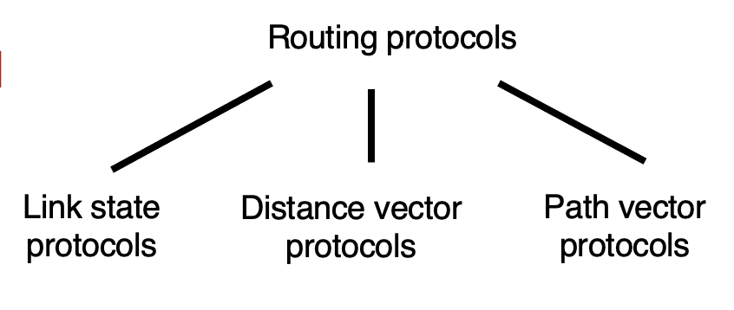


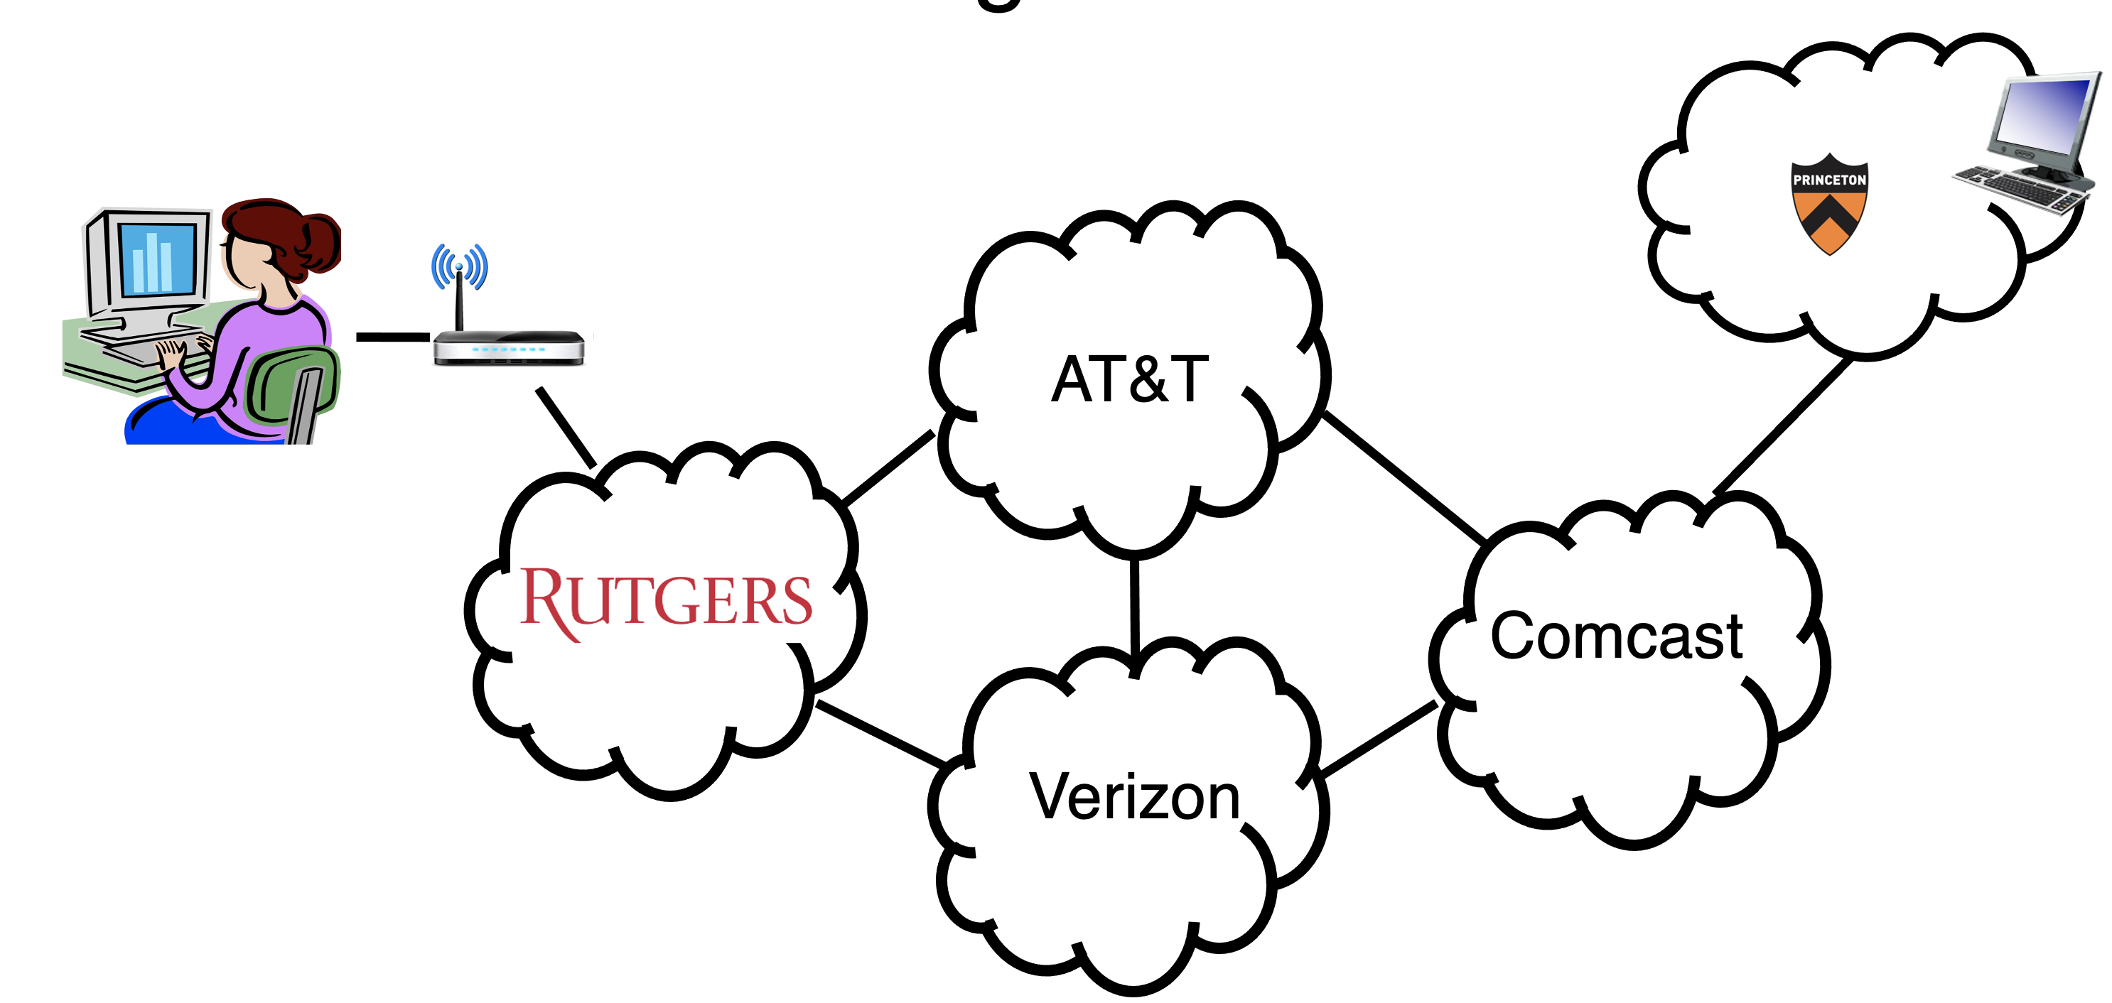
Internet is large and federated
Abstractions of topology for protocol messages
Incremental routing computation
Routing announcement = destination prefix + attributes
AS-level path
Next hop
…
Announcement
Import policy
“I am here.”
Dst: 128.1.2.0/24
AS path: X
1b
“I can reach X”
Dst: 128.1.2.0/24
AS path: AS2, X
AS 2
Route selection
Control plane
1a
1c
2b
1d
2a
2c
X
Data plane
Next hop:
eBGP: 2a to 1c: 2a
iBGP: 1c to 1d: 1c
Export policy
2d

Slide 4
BGP Import Policy
legend:
provider
B
network
X
W
A
customer
C
network:
Y
Suppose an ISP wants to minimize costs by avoiding routing through its providers when possible.
Suppose C announces path Cy to x
Further, y announces a direct path (“y”) to x
Then x may choose not to import the path Cy to y since it has a peer path (“y”) towards y

Slide 5
Q2. BGP Route Selection
When a router imports more than one route to a destination IP prefix, it selects route based on:
local preference value attribute (import policy decision -- set by network admin)
shortest AS-PATH
closest NEXT-HOP router
Several additional criteria: You can read up on the full, complex, list of criteria, e.g., at https://www.cisco.com/c/en/us/support/docs/ip/border-gateway-protocol-bgp/13753-25.html

Slide 6

Example of route selection
NA
EU
Suppose AS A and B are connected to each other both in North America (NA) and in Europe (EU)
A source in NA wants to reach a destination in EU
There are two paths available
Assume same local preference
Same AS path length
Closest next hop-router: choose path via B1 rather than B2
Dst-EU
A1
A2
AS A
B1
B2
Src-NA
AS B

Slide 7

Example of route selection
NA
EU
Choosing closest next-hop results in early exit routing
Try to exit the local AS as early as possible
Also called hot potato routing
Reduce resource use within local AS
potentially at the expense of another AS
Dst-EU
A1
A2
AS A
B1
B2
Src-NA
AS B

Slide 8
Computing the forwarding table
AS3
3b
AS1
1b
3a
3c
1a
1c
AS2
2b
3d
X
1d
2a
2c
2d
Suppose a router in AS1 wants to forward a packet destined to external prefix X.
How is the forwarding table entry for X at 1d computed?
How is the forwarding table entry for X at 1c computed?

Slide 9
eBGP and iBGP announcements
AS3
3b
AS1
1b
3a
3c
1a
1c
AS2
2b
3d
X
1d
AS3,X
AS2,AS3,X
2a
2c
2d
AS2 router 2c receives path announcement AS3,X (via eBGP) from AS3 router 3a
Based on AS2 import policy, AS2 router 2c imports and selects path AS3,X, propagates (via iBGP) to all AS2 routers
Based on AS2 export policy, AS2 router 2a announces (via eBGP) path AS2, AS3, X to AS1 router 1c

Slide 10
eBGP and iBGP announcements
AS3
3b
AS1
1b
AS3,X
3a
3c
1a
1c
AS2
2b
3d
X
1d
AS3,X
AS2,AS3,X
2a
2c
2d
A given router may learn about multiple paths to destination:
AS1 gateway router 1c learns path AS2,AS3,X from 2a (next hop 2a)
AS1 gateway router 1c learns path AS3,X from 3a (next hop 3a)
Through BGP route selection process, AS1 gateway router 1c chooses path AS3,X, and announces path within AS1 via iBGP (next hop 1c)

Slide 11
Setting forwarding table entries
AS3
3b
AS1
1b
AS3,X
3a
3c
1a
1c
2
AS2
2b
1
3d
X
3
1d
AS3,X
AS2,AS3,X
2a
2c
2d
recall: 1a, 1b, 1d learn about dest X via iBGP from next-hop 1c: “path to X goes through 1c”
1d: intra-domain routing: to get to 1c, forward over outgoing local interface 1
dest
Next-Hop
NH
interface
…
…
…
…
…
…
…
…
X
1c
1c
1
IP Dst
Out port
Forwarding table
X
1

Slide 12
Setting forwarding table entries
AS3
3b
AS1
1b
AS3,X
1
2
3a
3c
1a
1c
3
AS2
2b
3d
X
1d
AS3,X
AS2,AS3,X
2a
2c
2d
dest
Next-Hop
NH
interface
recall: 1c learns about dest X via eBGP from next-hop 3a: “path to X goes through 3a”
1c: to get to link-local neighbor 3a, forward out interface 2
…
…
…
…
…
…
…
…
X
3a
3a
2
IP Dst
Out port
Forwarding table
X
2

Slide 13
Summary: Inter-domain routing
Federation and scale introduce new requirements for routing on the Internet
BGP is the protocol that handles Internet routing
Path vector: exchange paths to a destination with attributes
Policy-based import of routes, route selection, and export

Slide 14
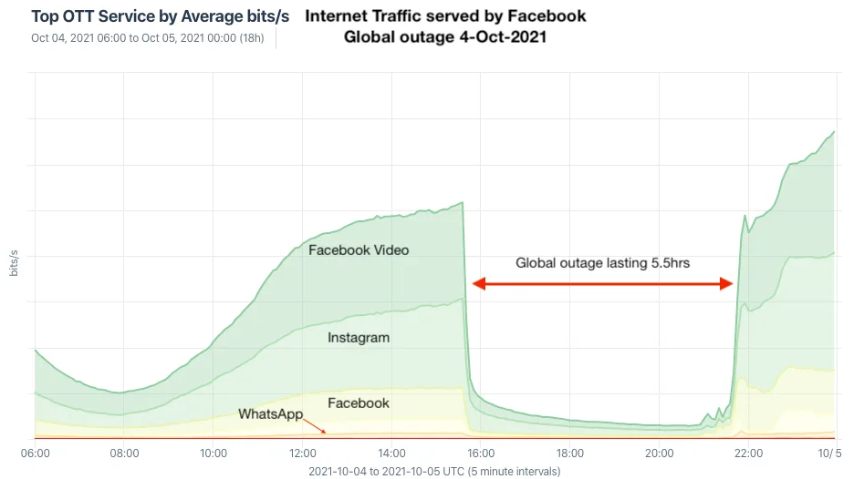
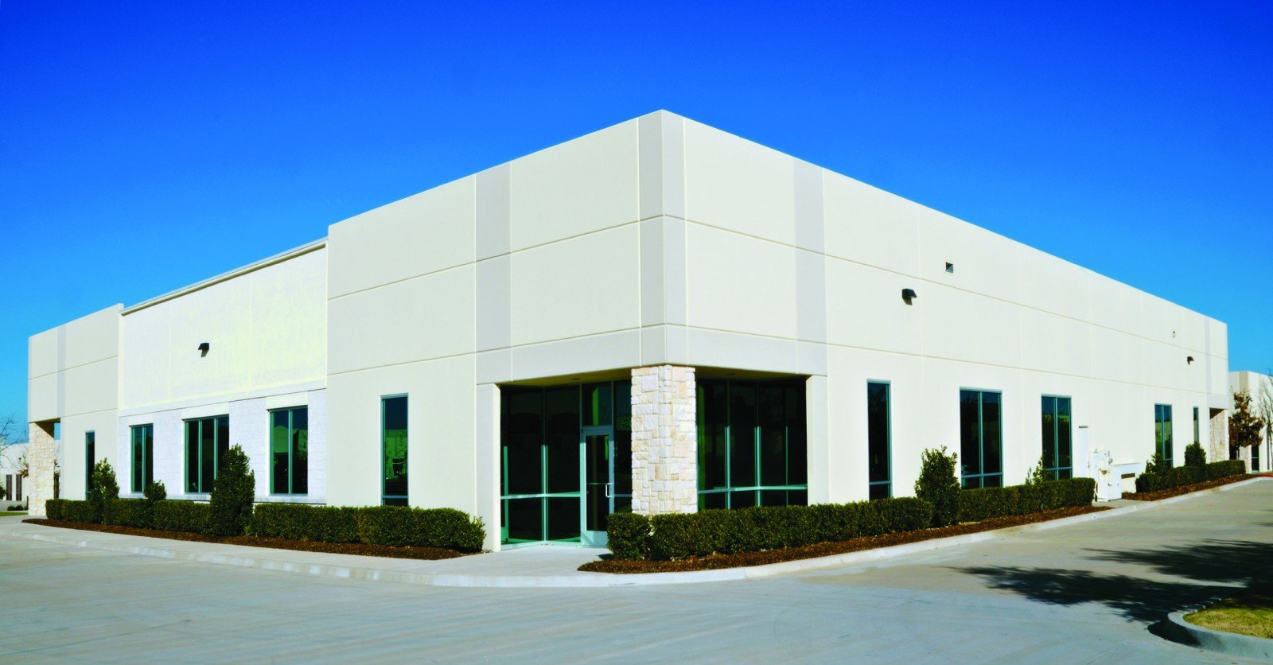
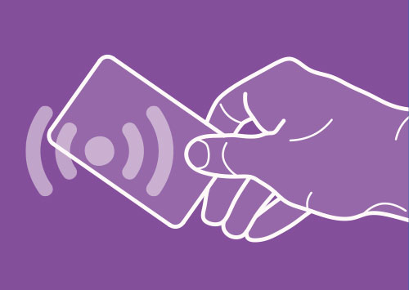
BGP’s impact: October ’21 FB++ outage
BGP route withdrawal:
“I can’t reach FB anymore”
FB network
Rest of the Internet
BGP route withdrawal: don’t use me to get to FB
FB’s DNS servers
No remote access (no more reachability due to BGP withdrawal of DC and DNS servers)
Restricted physical access (prox can’t verify, can’t access prox server)
https://engineering.fb.com/2021/10/05/networking-traffic/outage-details/
By Doug Madory - https://www.kentik.com/blog/facebooks-historic-outage-explained/, CC BY 4.0, https://commons.wikimedia.org/w/index.php?curid=110816752

Slide 15
Network Address Translation (NAT)

Slide 16
Background: The Internet’s growing pains
Networks had incompatible addressing
IPv4 versus other network-layer protocols (X.25)
Entire networks were changing their Internet Service Providers
ISPs don’t want to route directly to internal endpoints
IPv4 address exhaustion
Insufficient large IP blocks even for large networks
Rutgers (AS46) has > 130,000 publicly routable IP addresses
IIT Madras (a well-known public university in India, AS141340) has 512
(Source: ipinfo.io)

Slide 17
Network Address Translation
When a router modifies fields in an IP packet to:
Enable communication across networks with different (network-layer) addressing formats and address ranges
Allow a network to change its connectivity to the Internet en masse by modifying the source IP to a (publicly-visible) gateway IP address
Masquerade as an entire network of endpoints using (say) one publicly visible IP address
Effect: use fewer IP addresses for more endpoints!
We’ll see a standard design: “Network address and port translation” (NAPT, RFC 2663)

Slide 18
Typical NAT setup (NAPT)
rest of
the Internet
local network
10.0.0/24
10.0.0.1
10.0.0.4
10.0.0.2
138.76.29.7
Gateway router
10.0.0.3
The gateway’s IP, 138.76.29.7 is publicly visible
The local endpoint IP addresses in 10.0.0/24 are private
All datagrams leaving local network have the same source IP as the gateway

Slide 19
Typical NAT setup (NAPT)
rest of
the Internet
local network
10.0.0/24
10.0.0.1
10.0.0.4
10.0.0.2
138.76.29.7
Gateway router
10.0.0.3
That is, for the rest of the Internet, the gateway masquerades as a single endpoint representing (hiding) all the private endpoints.
The entire network just needs one (or a few) public IP addresses.

Slide 20
Typical NAT setup (NAPT)
rest of
the Internet
local network
10.0.0/24
10.0.0.1
10.0.0.4
10.0.0.2
138.76.29.7
Gateway router
10.0.0.3
The NAT gateway router accomplishes this by using a different transport port for each distinct (transport-level) conversation between the local network and the Internet.

Slide 21
Typical NAT setup (NAPT)
1: host 10.0.0.1
sends datagram to
an external host,
128.119.40.186, at port 80
2: NAT router
changes datagram
src addr, port from
10.0.0.1, 3345 to
138.76.29.7, 5001,
Updates table
Translation table
Internet-side Local side
138.76.29.7, 5001 10.0.0.1, 3345
…… ……
4: Map back
S: 10.0.0.1, 3345
D: 128.119.40.186, 80
SNAT
1
2
S: 138.76.29.7, 5001
D: 128.119.40.186, 80
10.0.0.1
S: 128.119.40.186, 80
D: 10.0.0.1, 3345
4
S: 128.119.40.186, 80
D: 138.76.29.7, 5001
3
10.0.0.2
4: NAT gateway
changes datagram
dest addr, port from
138.76.29.7, 5001 to
10.0.0.1, 3345
3: Reply arrives to
dst addr, port
138.76.29.7, 5001
138.76.29.7
10.0.0.3
DNAT

Slide 22
Features of IP-masquerading NAT
Use one or a few public IPs: You don’t need a lot of addresses from your ISP
Change addresses of devices inside the local network freely, without notifying the rest of the Internet
Change the public IP address freely independent of network-local endpoints
Devices inside the local network are not publicly visible, routable, or accessible
Most IP masquerading NATs block incoming connections originating from the Internet
Only way to communicate is if the internal host initiates the conversation

Slide 23
If you’re home, you’re likely behind NAT
Most access routers (e.g., your home WiFi router) implement network address translation
You can check this by comparing your local address (visible from ifconfig) and your externally-visible IP address (e.g., type “what’s my IP address?” on your browser search bar)

Slide 24
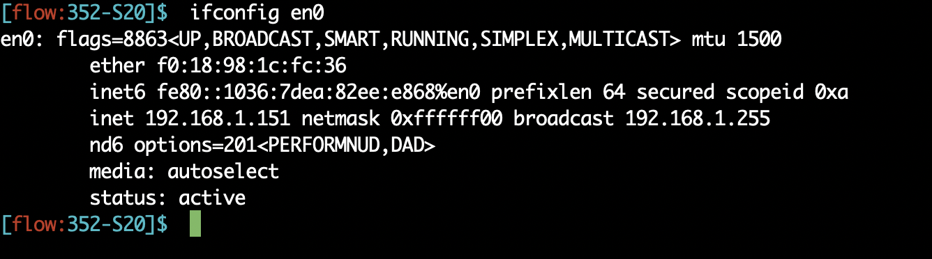
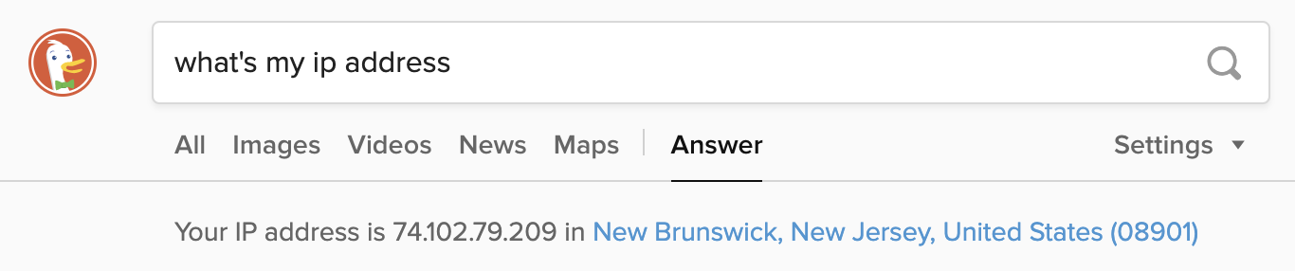
If you’re home, you’re likely behind NAT

Slide 25
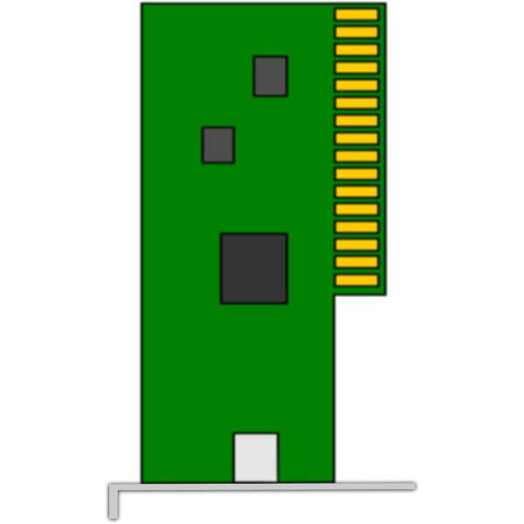
On public cloud, you’re behind NAT
VM
VM
Each VM believes it has its own (vritual) IP subnet.
Each VM believes it has its own (virtual) IP subnet.
Physical
IP subnet used
NAT
NAT
Physical Machine
Physical Machine

Slide 26
Limitations of IP-masquerading NATs
Connection limit due to 16-bit port-number field
~64K total simultaneous connections with a single public IP address
NAT can be controversial
“Routers should only manipulate headers up to the network layer, not modify headers at the transport layer!”
Application developers must take NAT into account
e.g., peer-to-peer applications
Internet “purists”: instead, solve address shortage with IPv6
32-bit IP addresses are just not enough
Esp. with more devices (your watch, your fridge, …) coming online

Slide 27
Synthesis of protocols

Slide 28
Synthesis: a day in the life of a web request
Goal: identify, review, understand protocols (at all layers) involved in seemingly simple scenario: requesting www page
Scenario: student attaches laptop to campus network, requests/receives www.google.com

Slide 29




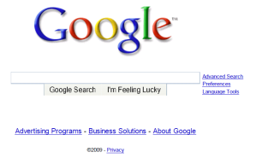
A day in the life: scenario
browser
DNS server
Comcast network
68.80.0.0/13
school network
68.80.2.0/24
web page
web server
Google’s network
64.233.160.0/19
64.233.169.105

Slide 30
A day in the life… connecting to the Internet
DHCP
DHCP
UDP
IP
Eth
Phy
connecting laptop needs to get its own IP address, addr of first-hop router, addr of DNS server: use DHCP
DHCP
DHCP
DHCP
DHCP
DHCP request encapsulated in UDP, encapsulated in IP, encapsulated in link layer Ethernet
DHCP
DHCP
UDP
IP
Eth
Phy
DHCP
DHCP
DHCP
DHCP
router
(runs DHCP)
Packet broadcast (dest: FFFFFFFFFFFF) on the local network, received at a router running DHCP server
Ethernet decapsulated to IP decapsulated to UDP decapsulated to DHCP

Slide 31
A day in the life… connecting to the Internet
DHCP
DHCP
UDP
IP
Eth
Phy
DHCP server formulates DHCP ACK containing client’s IP address, IP address of first-hop router for client, name & IP address of DNS server
DHCP
DHCP
DHCP
DHCP client receives DHCP ACK reply
DHCP
DHCP
UDP
IP
Eth
Phy
DHCP
DHCP
DHCP
router
(runs DHCP)
DHCP
Client now has IP address, knows name & addr of DNS
server, IP address of its first-hop router

Slide 32
A day in the life… ARP (before DNS, before HTTP)
DNS
UDP
IP
Eth
Phy
before sending HTTP request, need IP address of www.google.com: DNS
DNS
DNS
DNS
ARP
ARP query
DNS query created, encapsulated in UDP, encapsulated in IP, encapsulated in Eth. To send frame to router, need MAC address of router interface: ARP
ARP
ARP reply
Eth
Phy
ARP query broadcast, received by router, which replies with ARP reply giving MAC address of router interface
router
(runs DHCP)
client now knows MAC address of gateway router, so can now send packet containing DNS query

Slide 33
A day in the life… using DNS
DNS
UDP
IP
Eth
Phy
DNS
DNS server
DNS
UDP
IP
Eth
Phy
DNS
DNS
DNS
DNS
DNS
DNS
DNS
DNS
Comcast network
68.80.0.0/13
IP datagram forwarded from campus network into Comcast network, routed (tables created by EIGRP, OSPF, and/or BGP routing protocols) to DNS server
router
(runs DHCP)
IP datagram containing DNS query from client to gateway router
decapsulated to DNS server
DNS server replies to client with IP address of www.google.com

Slide 34
A day in the life…TCP connection carrying HTTP
HTTP
HTTP
TCP
IP
Eth
Phy
SYNACK
SYN
SYNACK
SYN
SYNACK
SYN
SYN
to send HTTP request, client first opens TCP socket to web server
router
(runs DHCP)
TCP
IP
Eth
Phy
SYNACK
TCP packet routed using inter-domain routing (BGP) and intra-domain routing (OSPF, EIGRP) to web server
SYN
SYNACK
SYN
SYNACK
SYNACK
SYN
web server
64.233.169.105

Slide 35
A day in the life… HTTP request/reply
HTTP
HTTP
TCP
IP
Eth
Phy
web page finally (!!!) displayed
HTTP
HTTP
HTTP
HTTP
HTTP
HTTP
HTTP
HTTP
HTTP request sent into TCP socket
router
(runs DHCP)
IP datagram containing HTTP request routed to www.google.com
HTTP
HTTP
TCP
IP
Eth
Phy
HTTP
HTTP
HTTP
web server responds with HTTP reply (containing web page)
HTTP
web server
64.233.169.105
IP datagram containing HTTP reply routed back to client

Slide 36
Internet Technology

Slide 37
Outro
Computer networks are a stack of layers
Built for modularity
Each layer does one set of functions very well
Each layer depends on the layers beneath it
Many general and useful principles
Applicable to real life (e.g., feedback control)
Applicable to computer system design (e.g., indirection & hierarchy)

Slide 38
Outro: Now what?
Go about life as usual
One difference: enhanced abilities to work with Internet-based tech
Apply your new skills to solve a problem you care about
Tons of free and open-source software and platforms. Opportunities
Deepen your understanding of the Internet and its tech
CS 553 Internet services (Spring 2025)
Push the boundaries of Internet tech
Talk to me if you’re interested in research

