Slide 1

Transport

Slide 2
Review: slow start, additive inc
AI is slow.
Persistent connections
Large window sizes
Different laws to evolve congestion window
Say MSS = 1 KByte
Default ssthresh = 64KB = 64 MSS
Packet drops/
RTO
Loss occurs at cwnd = 54K
Loss occurs at cwnd = 40K
54 MSS
Additive increase
Set ssthresh to
27 MSS
Additive increase
Congestion Window
Set ssthresh to
20 MSS
Slow start
Slow start
Slow
start
1K
Time

Slide 3

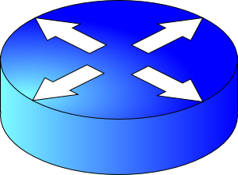
The components of delay
Transmission delay at the first link
Propagation delay of first link
Queueing at the router
Increasing time
Transmission delay at the second link
Propagation delay of second link

Slide 4
Bandwidth-Delay Product

Slide 5
Steady state cwnd for a single flow
Suppose the bottleneck link has rate C
Suppose the propagation round-trip delay (propRTT) between sender and receiver is T
Ignore transmission delays for this example;
Assume steady state: highest sending rate with no bottleneck congestion
Q: how much data is in flight over a single RTT?
C * T data i.e., amount of data unACKed at any point in time
ACKs take time T to arrive (without any queueing). In the meantime, sender is transmitting at rate C

Slide 6
The Bandwidth-Delay Product
C * T = bandwidth-delay product:
The amount of data in flight for a sender transmitting at the ideal rate during the ideal round-trip delay of a packet
Note: this is just the amount of data “on the pipe”
Data
C * T

Slide 7
The Bandwidth-Delay Product
Q: What happens if cwnd > C * T?
i.e., where are the rest of the in-flight packets?
A: Waiting at the bottleneck router queues
Data
C * T

Slide 8
Router buffers and the max cwnd
Router buffer memory is finite: queues can only be so long
If the router buffer size is B, there is at most B data waiting in the queue
If cwnd increases beyond C * T + B, data is dropped!
B
Data
C * T

Slide 9
BDP is a crucial value for a flow
Bandwidth-Delay Product (BDP) governs the window size of a single flow at steady state
The bottleneck router buffer size governs how much the cwnd can exceed the BDP before packet drops occur
BDP is the ideal desired window size to use the full bottleneck link, without any queueing.
Accommodating flow control, also the min socket buffer size to use the bottleneck link fully

Slide 10
Demo of the impact of BDP & B
Utilization
Congestion window

Slide 11
Detecting and Reacting Better to Packet Loss

Slide 12
Can we detect loss earlier than RTO?
Key idea: use the information in the ACKs. How?
Suppose successive (cumulative) ACKs contain the same ACK#
Also called duplicate ACKs
Occur when network is reordering packets, or one (but not most) packets in the window were lost
Fast retransmit: (1) Immediately retransmit packet
Reduce cwnd when you see many duplicate ACKs
Consider many dup ACKs a strong indication that packet was lost
Default threshold: 3 dup ACKs, i.e., triple duplicate ACK
Make cwnd reduction gentler than setting cwnd = 1; recover faster
Fast retransmit: (2) reduce window to half of its current value

Slide 13
Additive Increase/Multiplicative Decrease
Say MSS = 1 KByte
Default ssthresh = 64KB = 64 MSS
Triple duplicate ACK
Perceived loss occurs at cwnd = 80K
Switch to additive increase at cwnd = ssthresh = 64K
New ACK
RTO
(2) Multiplicative decrease
In-flight data
Additive increase
Additive increase
RTO: window drops all the way to 1 MSS
Slow start
(2) Set inflight = ssthresh = 40K
Fast retransmit: (1) retransmit dup-ACKed segment
Fast recovery keeps inflight stable until new ACK
1K
Time

Slide 14
TCP New Reno performs additive increase and multiplicative decrease of congestion window.
In short, we often refer to this as AIMD.
Multiplicative decrease is a part of all TCP algorithms. It is necessary for fairness across TCP flows.

Slide 15
Why does multiplicative decrease help?
Efficiency and Fairness
Chiu and Jain, “Increase and decrease algorithms for congestion avoidance”

Slide 16
Efficient allocation
Don’t want sources to transmit either too slow or too fast
Slow: Underutilize the network
Fast: High delays, lose packets
Every endpoint is reacting
May all under/overshoot
Large oscillations possible!
Optimal efficiency:
Σx_{i} = X_{goal} e.g., link capacity
Efficiency = 1 - distance from efficiency line
2 user example
overload
User 2: x₂
underload
Efficiency
line
User 1: x₁

Slide 17
Fair allocation
Max-min fairness
Flows which share the same bottleneck get the same amount of bandwidth
Fairness = 1 - distance from fairness line
2 user example
2 getting
too much
fairness
line
User 2: x₂
1 getting
too much
User 1: x₁

Slide 18
How should transports react?
Given efficiency and fairness goals above, how should transports behave?
Consider x(t), window or rate of a source, evolving over time t
Assume discrete time steps.
x(t + 1) = function of x(t), feedback from the network

Slide 19
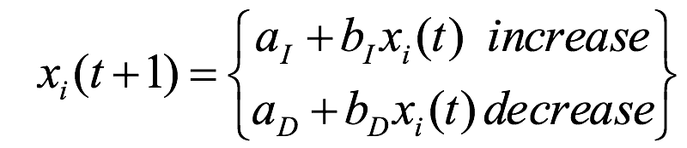
Linear control rules
x_{i}(t): window or rate of the i^{th} user at time t
a_{I}, a_{D}, b_{I}, b_{D}: constant increase/decrease coefficients
Assumption: All users receive same network feedback
Binary feedback: sense congestion or available capacity
Assumption: All users increase or decrease simultaneously

Slide 20
Additive increase, multiplicative decrease
fairness
line
b_{I} = 1, a_{D} = 0
Multiplicative decrease enables converging to fairness
Oscillates around the most efficient point
(x₁,x₂)
(b_{D}x₁+a_{I}, b_{D}x₂+a_{I})
User 2: x₂
(b_{D}x₁,b_{D}x₂)
efficiency
line
User 1: x₁

Slide 21
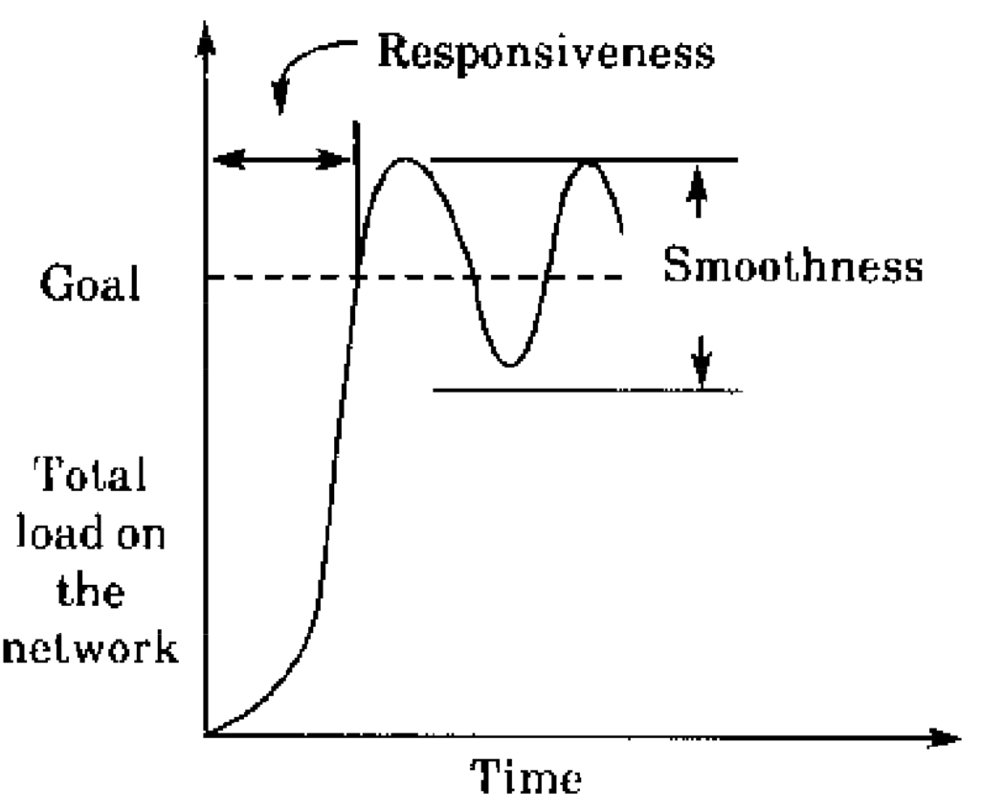
Convergent doesn’t mean static

Slide 22
Simple models are useful
Chiu and Jain’s model isn’t indicative of all TCP/AIMD behavior
But it’s “realistic” enough
Stands the test of time: many more sources, much higher bandwidth, …
Models should be simple
For us to work with
For others to understand
But they don’t have to mimic the “real” thing in every way
A real, complex model is likely useless, but a realistic, simple model might teach us something

Slide 23
Modeling TCP throughput
Given network characteristics, how quickly can TCP (New Reno) send data?
Mathis et al., “Macroscopic behavior of TCP congestion avoidance”

Slide 24
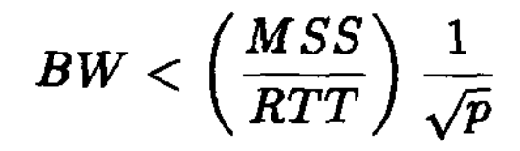
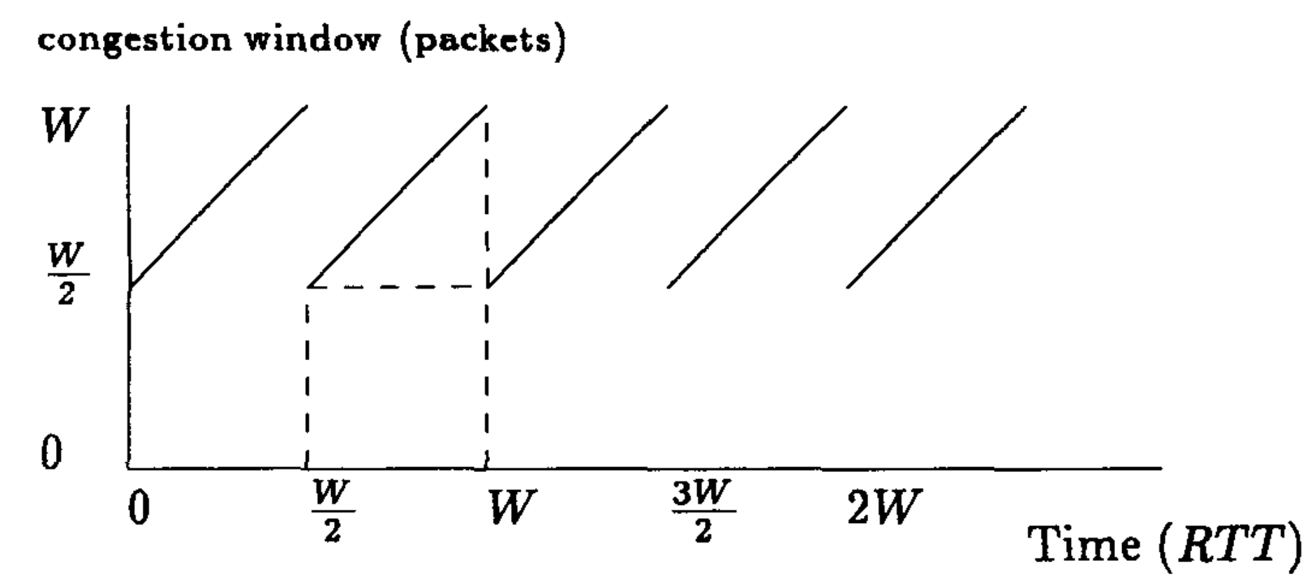
Steady AIMD

Slide 25
Implications
Throughput has a 1/sqrt(p) dependence on packet loss rate
RTT unfairness
Flows with a smaller RTT get better throughput (ramp up faster)
Engineering implications:
Split TCP (CDNs, data center frontends, …)
Special considerations for long-distance connections

Slide 26
Widely Deployed TCPs

Slide 27
Data Center TCP
Alizadeh et al.

Slide 28
Context
Regular TCP: window evolution with all signals measured end to end
Data centers: hardware under single administrative control
Could network switches do better?
What if switches provided better feedback than loss?

Slide 29


Explicit Congestion Notification
Sender 1
Additive Increase:
W → W+1 per round-trip time
Multiplicative Decrease:
W → W/2 per drop or ECN mark
ECN Mark (1 bit)
Receiver
Window Size (Rate)
Time
Queue size > K, mark the packet.
Sender 2
Example of Active Queue Management
ECN = Explicit Congestion Notification
(RED, PI, etc.)
Notes:
DCTCP is based on the existing Explicit Congestion Notification framework in TCP.
----- Meeting Notes (3/7/12 12:24) -----
Remember to mention "SAWTOOTH"

Slide 30
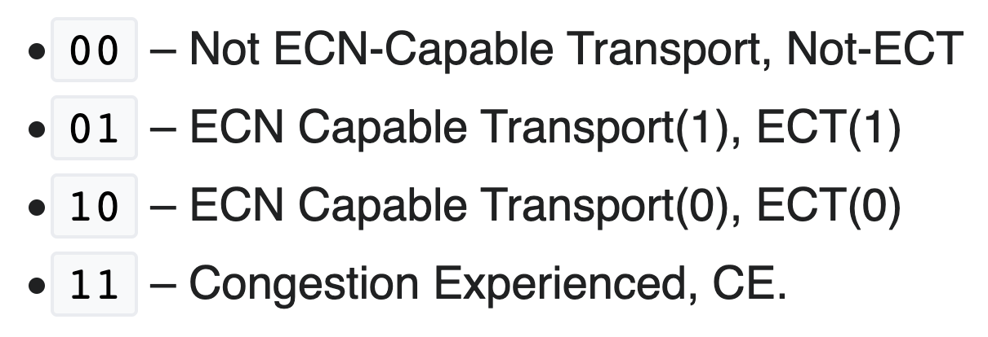
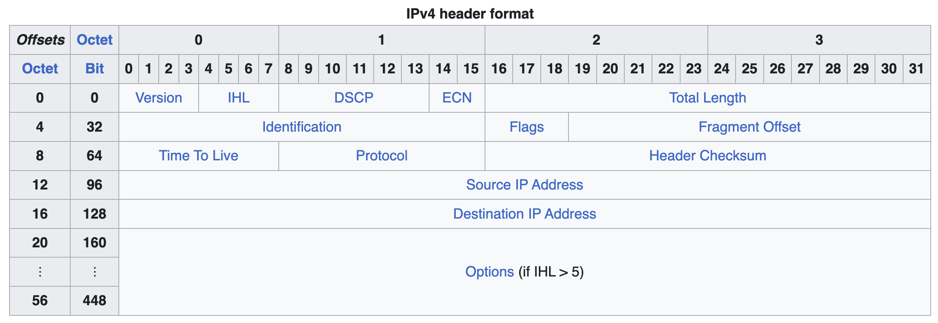
ECN set on the IP header by routers
Dropped if TCP sender is not ECN enabled

Slide 31
Explicit Congestion Notification
Sender 1
Additive Increase:
W → W+1 per round-trip time
Multiplicative Decrease:
W → W/2 per drop or ECN mark
ECN Mark (1 bit)
Receiver
Window Size (Rate)
Time
Receiver’s ACK echoes mark in TCP header
Sender 2
ECN = Explicit Congestion Notification
Notes:
DCTCP is based on the existing Explicit Congestion Notification framework in TCP.
----- Meeting Notes (3/7/12 12:24) -----
Remember to mention "SAWTOOTH"

Slide 32
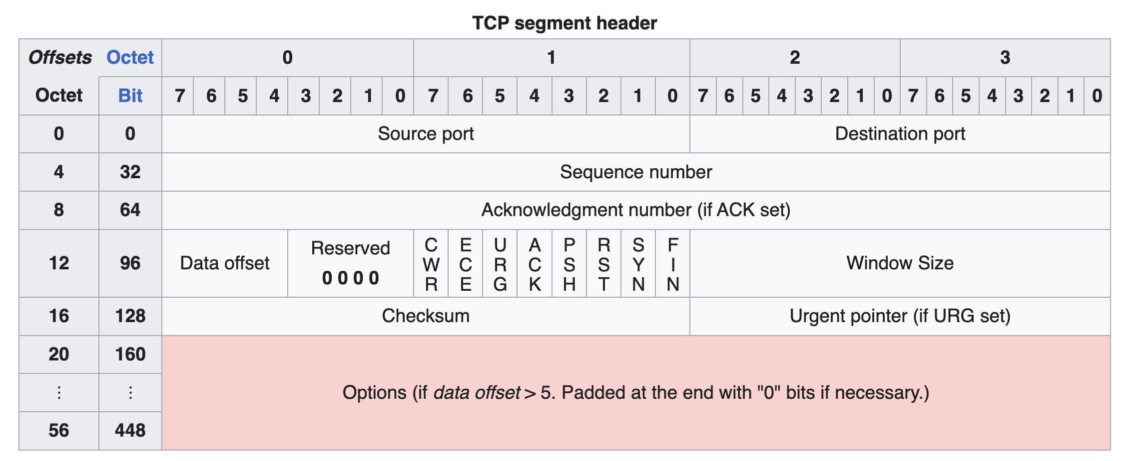
ECN on the TCP header

Slide 33
DCTCP: Main idea
Extract multi-bit feedback from single-bit stream of ECN marks
Reduce window size based on fraction of marked packets

Slide 34
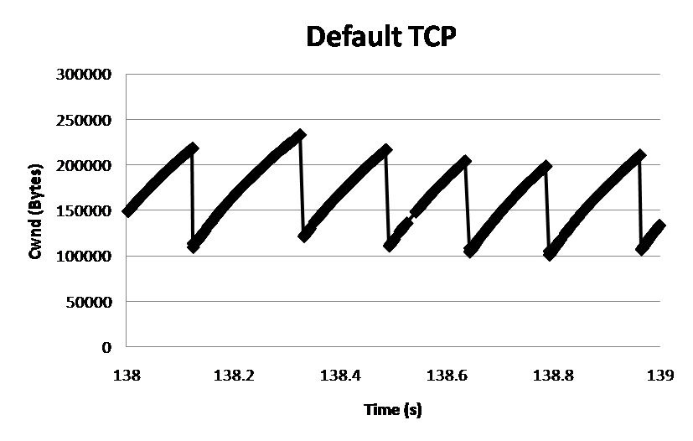
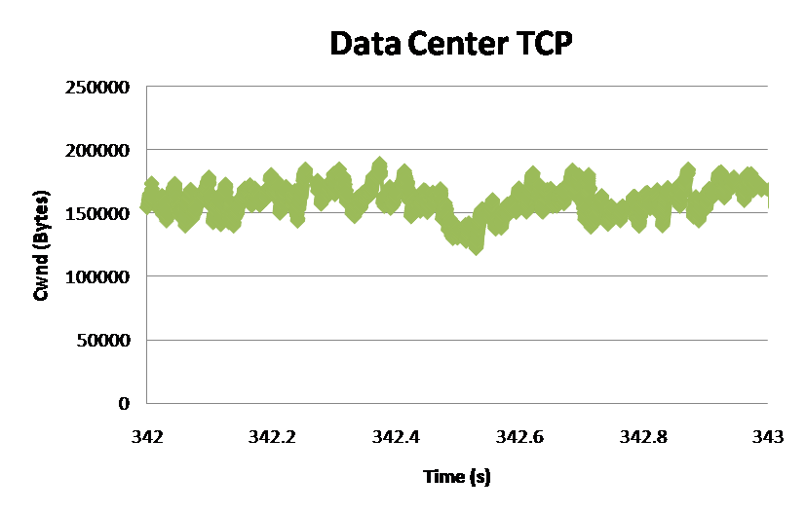
DCTCP: Main idea
ECN Marks | TCP | DCTCP
1 0 1 1 1 1 0 1 1 1 | Cut window by 50% | Cut window by 40%
0 0 0 0 0 0 0 0 0 1 | Cut window by 50% | Cut window by 5%
TCP
DCTCP
Window Size (Bytes)
Window Size (Bytes)
Time (sec)
Time (sec)
Notes:
Start with: “How can we extract multi-bit information from single-bit stream of ECN marks?”
- Standard deviation: TCP (33.6KB), DCTCP (11.5KB)

Slide 35
DCTCP algorithm
B
K
Don’t
Mark
Mark
Switch side:
Mark packets when Queue Length > K.
Sender side:
Maintain running average of fraction of packets marked (α).
Adaptive window decreases:
Note: decrease factor between 1 and 2.
Reacting to and controlling queue size distribution,
specifically, the region above K.
Notes:
very simple marking mechanism
not all the tunings other aqms have
on the source side, the source is tryign to estimate the fraction of packets getting marked
using the obs that there is a stream of ecn marks coming back – more info in the stream than in any single bit
trying to maintain smooth rate variations to operate well even when using shallow buffers, and only a few flows (no stat mux)
F over the last RTT. In TCP there is always a way to get the next RTT from the window size. Comes from the self-clocking of TCP.
Only changing the decrease. Simplest version – makes a lot of sense. So generic could apply it to any algorithm – CTCP, CUBIC – how to cut its window leaving increase part to what it already does. Have to be careful here.

Slide 36
Setting parameters: Marking threshold K
B
K
Tradeoff!
Mark too late: too much queueing & pkt loss
Mark too early: queues too small, lose throughput
How small can queues be without loss of throughput?
for TCP:
K > C x RTT
K > (1/7) C x RTT

Slide 37
Buffering requirements
B
K
How much buffering does DCTCP need for 100% throughput?
Need to quantify queue size oscillations (stability).
Packets sent in this
RTT are marked
Window Size
W*+1
W*
(W*+1)(1-α/2)
Time

