Slide 1

CS 352 Network Security: Introduction
CS 352, Lecture 25.1
http://www.cs.rutgers.edu/~sn624/352
Srinivas Narayana

Slide 2


Security and the Network Stack
Application
HTTPS
FTP
HTTP
SMTP
DNS
Transport
TCP
UDP
Network
IP
Link
802.3
…
802.11
ATM

Slide 3
Why Network Security?
Malicious people share your network
People who want to snoop
People who want to destroy
People who want to corrupt
People who want to pretend
People who want to steal
Problem made more severe as Internet becomes more commercialized
Active and passive attacks

Slide 4
Key aspects of network security
confidentiality: only sender, intended receiver should “understand” message contents
sender encrypts message
receiver decrypts message
integrity: sender, receiver want to ensure message not altered (in transit, or afterwards) without detection
authentication: sender, receiver want to confirm identity of each other
non-repudiation: Once someone sends a message, or conducts a transaction, she can’t later deny the contents of that message
availability: services must be accessible and available to users
4

Slide 5



Friends and enemies: Alice, Bob, Trudy
well-known in network security world
Bob and Alice want to communicate “securely”
Trudy (intruder) may intercept, delete, add messages
Alice
Bob
channel
data, control messages
secure
sender
s
data
secure
receiver
data
Trudy

Slide 6
Who might Bob and Alice be?
Real humans ☺
Web browser/server for electronic transactions (e.g., on-line purchases)
on-line banking client/server
DNS servers
routers exchanging routing table updates
other examples?
6

Slide 7
There are bad actors out there!
Q: What can a “bad actor” do?
A: A lot!
eavesdrop: intercept messages
actively insert messages into connection
impersonation: can fake (spoof) source address in packet (or any field in packet)
hijacking: “take over” ongoing connection by removing sender or receiver, inserting itself in place
denial of service: prevent service from being used by others (e.g., by overloading resources)
7

Slide 8
Cryptography
Preventing adversaries from reading private messages

Slide 9
Terminology of cryptography
Alice’s
encryption
key
Bob’s
decryption
key
K
K
A
B
plaintext
encryption
algorithm
ciphertext
decryption
algorithm
plaintext
En/decryption algorithms are also called ciphers.
m plaintext message
c = K_{A}(m), K_{A}(m) ciphertext, encrypted with key K_{A}
m’ = K_{B}(c), K_{B}(c) decrypted plaintext with key K_{B}
Want: m = K_{B}(K_{A}(m))
Want: K_{A}(m) to be uncorrelated with m
9

Slide 10
Cryptography: Algorithms and Keys
Cryptography requires both an en-/decryption algorithm and “keys”
Key is a string known only to Alice and Bob, which controls how algorithm works
Algorithm
Should be public and known to all
Inspires trust that the algorithm works
Keys:
Should be long enough to prevent easy breaking of the encryption
Should be short enough to keep algorithm efficient
Typical key lengths: 56-bit, 128-bit, 256-bit, 512-bit

Slide 11
Symmetric key cryptography
K
K
S
S
plaintext
message, m
encryption
algorithm
ciphertext
decryption
algorithm
plaintext
K_{S}(m)
m = K_{S}(K_{S}(m))
symmetric key crypto: Bob and Alice share same (symmetric) key: S
Q: how do Bob and Alice agree on key value?
Key techniques of symmetric key crypto:
Substitution and Permutation
11

Slide 12
Substitution-based ciphers
monoalphabetic cipher: substitute one letter for another
Ex: Caesar cipher: Each letter is replaced by a shift: succ(2), pred(3)
More generally, map letters to other letters
plaintext: abcdefghijklmnopqrstuvwxyz
ciphertext: mnbvcxzasdfghjklpoiuytrewq
e.g.:
Plaintext: bob, i love you. alice
ciphertext: nkn, s gktc wky. mgsbc
Key: mapping from set of 26 letters to set of 26 letters
Problem: Easy to break by analyzing statistical properties of written language

Slide 13
Polyalphabetic cipher
n substitution ciphers, M₁,M₂,…,M_{n}
cycling pattern:
e.g., n=4: M₁,M₃,M₄,M₃,M₂; M₁,M₃,M₄,M₃,M₂; ..
for each new plaintext symbol, use subsequent substitution pattern in cyclic pattern
dog: d from M₁, o from M₃, g from M₄
Encryption key: n substitution ciphers, and the cyclic pattern

Slide 14
Permutation-based ciphers
Instead of substituting letters in the plaintext, we change their order
A N D R E W
1 4 2 5 3 6
t h i s i s
a m e s s a
g e i w o u
l d l i k e
t o e n c r
y p t n o w
Key = ANDREW
(used to define a permutation based on alphabet order)
Plaintext = thisisamessageiwould
liketoencryptnow
Ciphertext = tiihssaesmsagioewul
lkdietecdnrytopnw
Also possible to break by analyzing structure of language

Slide 15
Encryption in practice
Most actual encryption algorithms use a complex combination of substitution and permutation
Examples:
Data Encryption Standard (DES)
Multiple iterations of substitution and transposition using a 56-bit key
designed by IBM with input from the NSA
International Data Encryption Algorithm (IDEA)
uses a 128-bit key
Advanced Encryption Standard (AES)

Slide 16
Stream and Block Ciphers

Slide 17
Two types of symmetric ciphers
Stream ciphers
encrypt one bit at time
Block ciphers
Break plaintext message in equal-size blocks
Encrypt each block as a unit

Slide 18
Stream Ciphers
pseudo random
keystream
generator
key
keystream
Combine each bit of keystream with bit of plaintext to get one bit of ciphertext
m(i) = i^{th} bit of message
ks(i) = i^{th} bit of keystream
c(i) = i^{th} bit of ciphertext
c(i) = ks(i) ⊕ m(i) (⊕ = XOR)
m(i) = ks(i) ⊕ c(i)

Slide 19
Block ciphers
Message to be encrypted is processed in blocks of k bits (e.g., 64-bit blocks).
1-to-1 mapping is used to map k-bit block of plaintext to k-bit block of ciphertext
Example with k=3:
input output
000 110
001 111
010 101
011 100
input output
100 011
101 010
110 000
111 001
What is the ciphertext for 010110001111 ?

Slide 20
Block ciphers
How many possible mappings are there for k=3?
How many 3-bit inputs?
How many mappingsor permutations of the 3-bit inputs? 8!
Answer: 40,320 ; not very many!
In general, 2^{k}! mappings; huge for k=64
Problem:
Table approach requires table with 2⁶⁴ entries, each entry with 64 bits
Table too big: instead use function that simulates a randomly permuted table
Many practical ciphers are block-based (DES, AES, …)

Slide 21
Problems with Symmetric Key Cryptography

Slide 22
Encryption using symmetric keys
Same key for encryption and decryption
Efficient to implement: Often the same or very similar algorithm for encryption and decryption
Achieves confidentiality
Vulnerable to tampering
Bad guy can alter the encrypted message
What about authentication?
Vulnerable to replay attacks
Bad guy can steal the encrypted message and later present it on behalf of a legitimate user

Slide 23
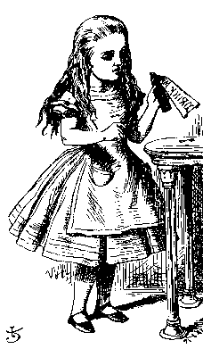
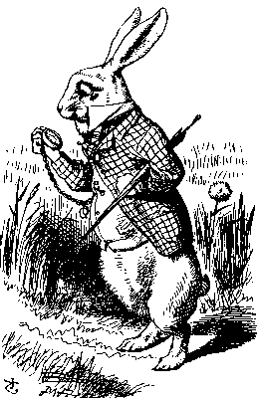
Replay attack
“Login: Alice”
Password please
E_{K}(Alice’s password)
Alice
Bob
Alice’s password is encrypted
From both Bob and attackers
If Bob is trusted, he can decrypt using the same key
But still subject to replay attack

Slide 24
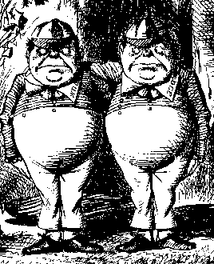
Replay attack
“Login: Alice”
Password please
E_{K}(Alice’s password)
Alice
Bob
Store: E_{K}(Alice’s password)
Trudy

Slide 25
Replay attack
Login: Alice
Password please
E_{K}(Alice’s password)
Trudy
Bob
This is a replay attack
How can we prevent a replay?
By adding a NONCE value; Number used once only
Use a temporary random number!

Slide 26
Challenge-Response
Login: Alice
“Password please” + Nonce
E_{K}(Alice’s password, Nonce)
Alice
Bob
Nonce is the challenge
The encrypted msg is the response
Nonce changed every time
Prevents replay, ensures freshness
Even if Trudy steals the encrypted Nonce value, it won’t work in the next login (nonce changed)

Slide 27
General problems with repeated ciphertext
Block ciphers take chunks of info (ex: 64-bit) to other chunks
Previous example: Passwords can be replayed
But more generally, easy to guess parts of payload with repeated plaintext
Example: HTTP/1.1
Then use those parts of a message to guess other parts of the payload
… and so on

Slide 28
Generalizing nonces for all messages
Nonces can be sent as plain text
Can we use a nonce on every message to prevent replay?
Yes!
Send nonce, E_{k}(message ⊕ nonce) to transfer message
But very inefficient: Double bits for every message
Use a method to generate nonces automatically
Cipher block chaining: use the previous ciphertext as a nonce for the next plain text block
First block randomized using Initialization Vector (IV)

Slide 29
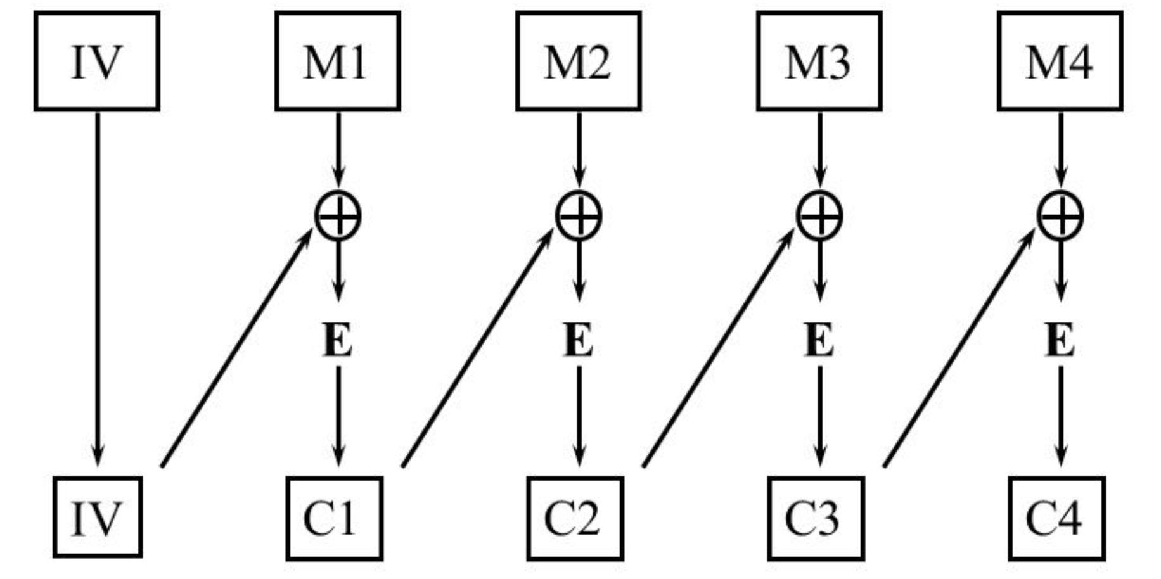
Cipher block chaining: Encryption
Exercise: how would decryption work?

Slide 30
How to agree on a shared secret key?
In reality: two parties may meet in person or communicate “out of band” to exchange shared key
But communicating parties may never meet in person
Example: An online retailer and customer
Much more common for a network ☺
What if the shared secret is stolen?
All secret communications can now be decrypted and are visible
Is there a way to communicate securely without worrying about secure key exchange?
Next lecture: Public key cryptography

