Slide 1

Packet Scheduling in
Data Centers
Lecture 17, Computer Networks (198:552)

Slide 2


Datacenter transport
Goal: Complete flows quickly / meet deadlines
Short flows
(e.g., query, coordination)
Large flows
(e.g., data update, backup)
Low Latency
High Throughput

Slide 3

Low latency cong control (ex: DCTCP)
Keep network queues small (at high throughput)
Want: implicitly prioritize mice
HOL blocking if long queues
Can we do better?

Slide 4



The opportunity
Many DC apps/platforms know flow size or deadlines in advance
Key/value stores
Data processing
Web search
Front end Server
Aggregator
… …
Aggregator
Aggregator
Aggregator
…
…
Worker
Worker
Worker
Worker
Worker
4

Slide 5

H1
H1
H2
H2
H3
H3
H4
H4
H5
H5
H6
H6
H7
H7
H8
H8
TX
H9
H9
RX

Slide 6
DC transport =
Flow scheduling on giant switch
Objective?
Minimize avg FCT
Minimize missed deadlines
H1
H1
H2
H2
H3
H3
H4
H4
H5
H5
H6
H6
H7
H7
H8
H8
TX
H9
H9
RX
ingress & egress
capacity constraints

Slide 7
Example: Minimize average FCT
Size
Flow A
1
A
Flow B
2
B
B
Flow C
3
C
C
C
arrive at the same time share the same bottleneck link

Slide 8
Example: Minimize average FCT
A
Fair sharing: 3, 5, 6 mean: 4.67
Shortest flow first: 1, 3, 6 mean: 3.33
B
B
C
C
C
Throughput
Throughput
1
1
A
B
C
A
B
C
B
C
C
Time
Time
3
5
6
1
3
6

Slide 9
Optimal flow scheduling for avg FCT
NP-hard for multi-link network [Bar-Noy et al.]
Shortest Flow First: 2-approximation
1
1
2
2
3
3

Slide 10
How can we schedule flows based on flow criticality in a distributed way?
Some transmission order

Slide 11
pFabric
Mohammad Alizadeh et al., SIGCOMM’13

Slide 12
pFabric in 1 slide
Packets carry a single priority #
e.g., priority = remaining flow size
pFabric Switches
Send highest priority / drop lowest priority packets
Very small buffers (20-30KB for 10Gbps fabric)
pFabric Hosts
Send/retransmit aggressively
Minimal rate control: just prevent congestion collapse
Main Idea:
Decouple scheduling from rate control

Slide 13
Starvation prevention
Use remaining flow size as priority: What happens?
Transmit earliest packet of flow with the highest priority packet
4
5
6
7
8
9
10
10
9
8
7
6
5
4
5
6
7
8
9
8
8
7
7
6
6
5
5
10
4

Slide 14
pFabric switch
Boils down to a sort
Essentially unlimited priorities
Thought to be difficult in hardware
Existing switching only support 4-16 priorities
pFabric queues very small
51.2ns to find min/max of ~600 numbers
Binary comparator tree: 10 clock cycles
Current ASICs: clock ~ 1ns

Slide 15
pFabric rate control
Minimal version of TCP algorithm
Start at line-rate
Initial window larger than BDP
No retransmission timeout estimation
Fixed RTO at small multiple of round-trip time
Reduce window size upon packet drops
Window increase same as TCP (slow start, congestion avoidance, …)
After multiple consecutive timeouts, enter “probe mode”
Probe mode sends min. size packets until first ACK
What about queue buildup?
Why window control?

Slide 16
Why does pFabric work?
Key invariant:
At any instant, have the highest priority packet (according to ideal algorithm) available at the switch.
Priority scheduling
High priority packets traverse fabric as quickly as possible
What about dropped packets?
Lowest priority → not needed till all other packets depart
Buffer > BDP → enough time (> RTT) to retransmit

Slide 17
Overall mean FCT: Web search workload

Slide 18
Mice FCT (<100KB): Web search workload
Average
99th percentile

Slide 19
Elephant FCT (>10MB): Data mining workload
Average
Why the gap?
Notes:
Pkt drop rate at 80% load: 4.3%

Slide 20
Discussion
Priority-based scheduling: pros and cons
Gaming?
Starvation?
Implementation using a small number of priority queues?
How to set priority thresholds?
When is the “big switch” abstraction appropriate?

Slide 21
PIAS: Information-agnostic scheduling
Wei Bai et al., NSDI’15

Slide 22
State of the art for packet/flow scheduling
pFabric, PDQ, PASE
Assume
Prior knowledge of flow size information
To approximate ideal preemptive shortest job first (SJF)
With customized network elements
Can we minimize FCT without flow size information
with commodity components?

Slide 23
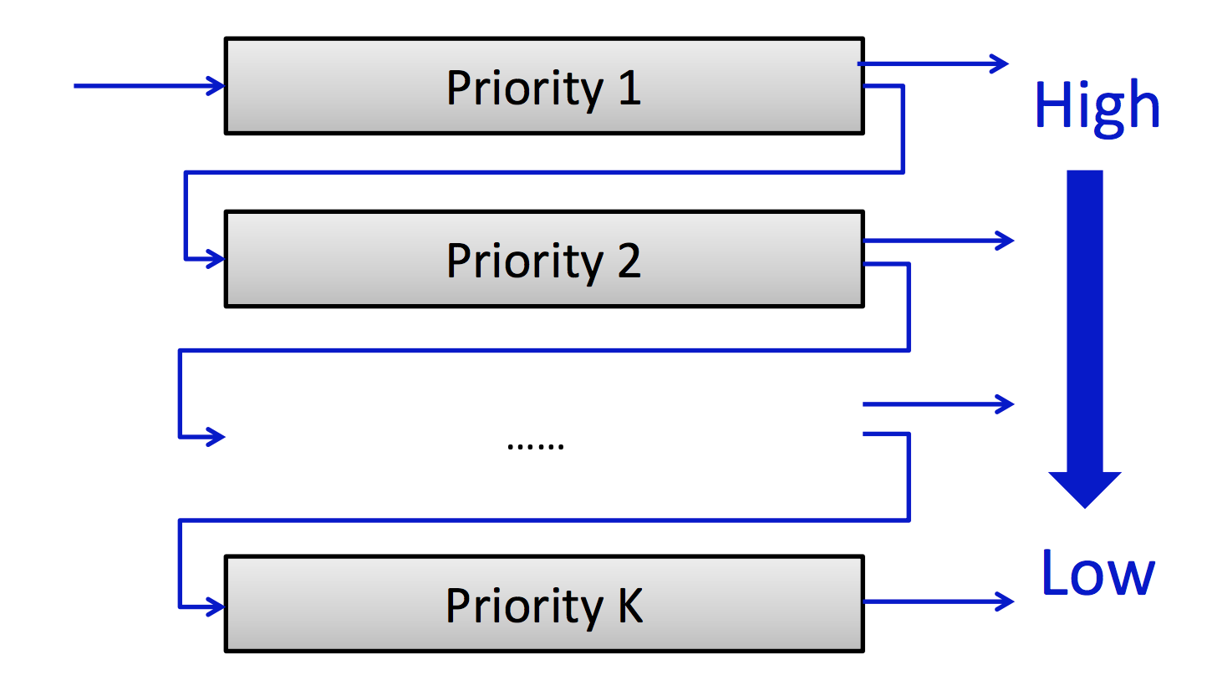
Multi-level feedback queue (MLFQ)
Emulate shortest job first (SJF) without job size information

Slide 24
Realization with commodity components
Don’t keep per-flow sizes and state in switch
Endpoint maintains per-flow state
… sets the priority as a packet tag
Map packets to queues using thresholds on packet priorities
What about bad thresholds? Use ECN to keep queues short
Use DCTCP at endpoints to react smoothly to ECN

Slide 25
Discussion
What happens if a flow transmits with a bursty traffic pattern?
Transmit for x seconds, wait y seconds, transmit again for x
What if a flow transmits just enough to always stay in the highest priority queue?

Slide 26
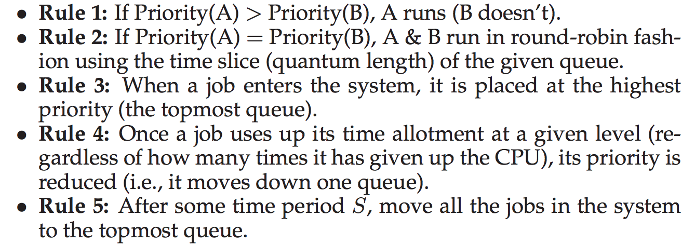
MLFQ rules (Arpaci-Dusseau)

Slide 27
Acknowledgment
Slides heavily adapted from material by Mohammad Alizadeh, Chi-Yao Hong, and Wei Bai

