Slide 1

Centralized Arbitration
for Data Centers
Lecture 18, Computer Networks (198:552)

Slide 2


Datacenter transport
Goals: Complete flows and jobs quickly
Short flows
(e.g., query, coordination)
Large flows
(e.g., data update, backup)
Big-data jobs
(e.g., map-reduce, ML training)
Low Latency
High Throughput
Complete fast

Slide 3

Low latency approaches
Endpoint algorithms
keep queues small
(e.g., DCTCP)
Prioritize mice
over elephants
in the fabric
(e.g., pFabric)

Slide 4

Continuing problems
Flows need not be the most semantically meaningful entities!
Co-flows: Big data jobs, partition/aggregate queries
Result isn’t meaningful until a set of related flows complete
Multiple competing objectives: provider & apps
Fair sharing vs. efficient usage vs. app objectives
Change all switches? Endpoints?
Front end Server
Aggregator
… …
Aggregator
Aggregator
Aggregator
…
…
Worker
Worker
Worker
Worker
Worker
5

Slide 5


Opportunity
Many DC apps/platforms know flow size or deadlines in advance
Key/value stores
Data processing
Web search
Front end Server
Aggregator
… …
Aggregator
Aggregator
Aggregator
…
…
Worker
Worker
Worker
Worker
Worker
5

Slide 6

H1
H1
H2
H2
H3
H3
H4
H4
H5
H5
H6
H6
H7
H7
H8
H8
TX
H9
H9
RX

Slide 7
DC transport =
Flow scheduling on giant switch
Objective?
App: Min. avg FCT, co-flow completion time, delays, retransmits
Net: Share the network fairly
H1
H1
H2
H2
H3
H3
H4
H4
H5
H5
H6
H6
H7
H7
H8
H8
TX
H9
H9
RX
ingress & egress
capacity constraints

Slide 8
Building such a network is hard!
“One big switch” no longer
Failures
Heterogeneous links
Respect internal link rate constraints

Slide 9
DC transport =
Flow scheduling on giant switch
Objective?
App: Min. avg FCT, co-flow completion time, delays, retransmits
Net: Share the network fairly
H1
H1
H2
H2
H3
H3
H4
H4
H5
H5
H6
H6
H7
H7
H8
H8
TX
H9
H9
RX
Ingress, egress, and core
capacity constraints

Slide 10
Building such a network is hard!
“One big switch” no longer
Failures
Heterogeneous links
Respect internal link rate constraints
Switch modifications to prioritize at high speeds
Can we do better?

Slide 11

DC transport =
A controller scheduling
packets at fine granularity
Objective?
App: Min. avg FCT, co-flow completion time, delays, retransmits
Net: Share the network fairly
H1
H1
H2
H2
H3
H3
H4
H4
H5
H5
H6
H6
H7
H7
H8
H8
TX
H9
H9
RX

Slide 12
FastPass
Jonathan Perry et al., SIGCOMM’14

Slide 13
FastPass Goals
Is it possible to design a network that provides
Zero network queues
High utilization
Multiple app and provider objectives

Slide 14



Logically centralized arbiter
Processing times
(1) 10 us A→arbiter
(2) 1—20 us Arbiter
(3) 10 us Arbiter→A
(4) No queuing A→B
(3) At t=95, send A→B through R1
R1
(2) Arbiter allocates time slot & path for pkt
(4) Packet A → B with 0 queues
(1) A has 1 packet for B
B
A

Slide 15
Logically centralized arbiter
Schedule and assign paths to all packets
Will the arbiter scale to schedule packets over a large network?
Will the latency to start flows be a problem?
How will the system deal with faults?
Can endpoints send at the right time?
Clocks must be synchronized!
Concerns with centralization
Concerns with endpoint behavior

Slide 16
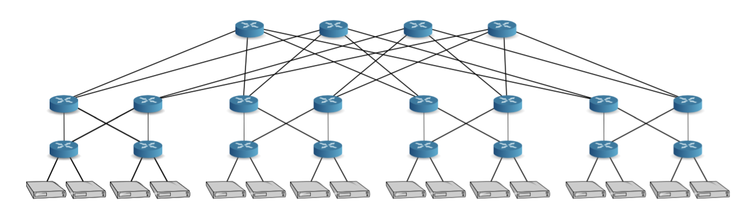
Arbiter problem (1): Time slot allocation
Choose which hosts get to send
Send as much as possible without endpoint port contention
Allocate packet transmissions per time slot
1.2 us: 1500 byte packet at 10 Gbit/s
Notes:
Send as many packets as possible without contending on host input or output ports

Slide 17
Arbiter problem (2): Path selection
Select paths for allocated host transmissions
Ensure no two packets conflict on any network port
At all levels of the topology

Slide 18
Can you solve (1) and (2) separately, or should we solve them together?
Solve separately if the network has full bisection bandwidth
i.e.: one big switch: any port to any other without contention

Slide 19
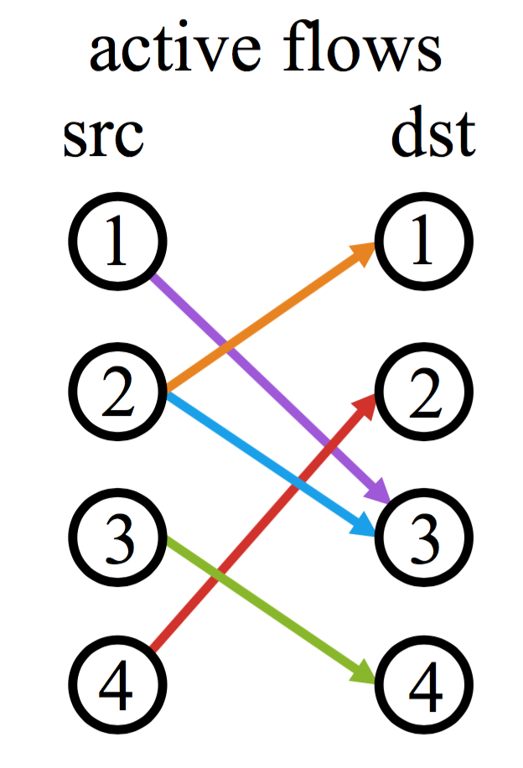
Time slot allocation == Matching problem!
Want: optimal matching
Maximize # packets transmitted in a timeslot
Expensive to implement!
Can do: online maximal matching
Greedy approach: allocate to current time slot if source and destination free; else push to next time slot
Fastpass: allocates in 10 ns per demand

Slide 20
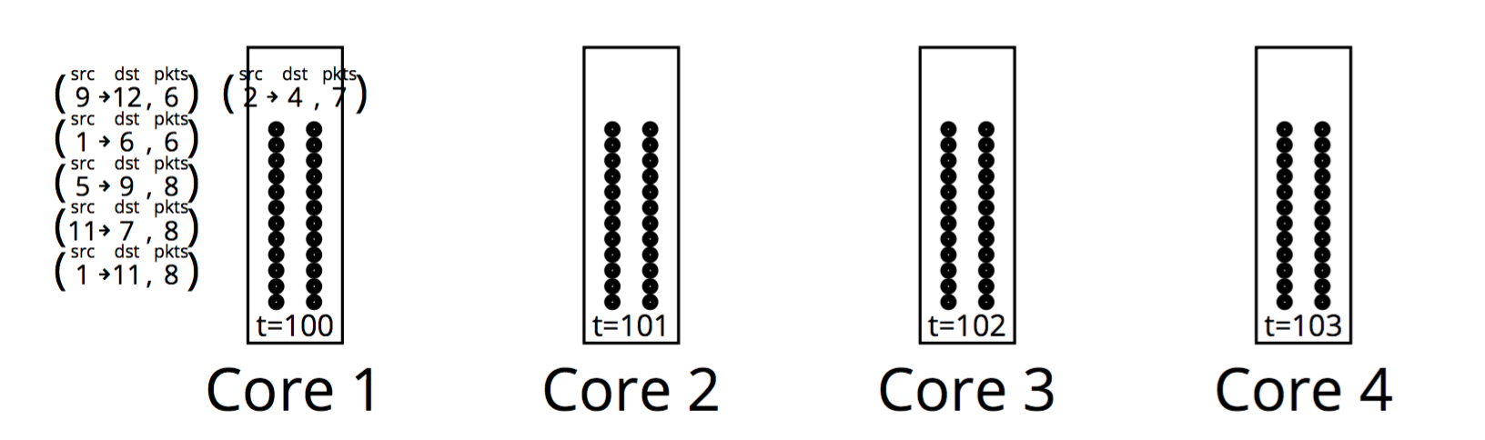


Pipelined time slot allocation
src, dst, pkts:
2 → 4, 6
src, dst, pkts:
2 → 4, 5
src, dst, pkts:
2 → 4, 5
Allocate traffic for 2 Tbits/s on 8 cores!

Slide 21
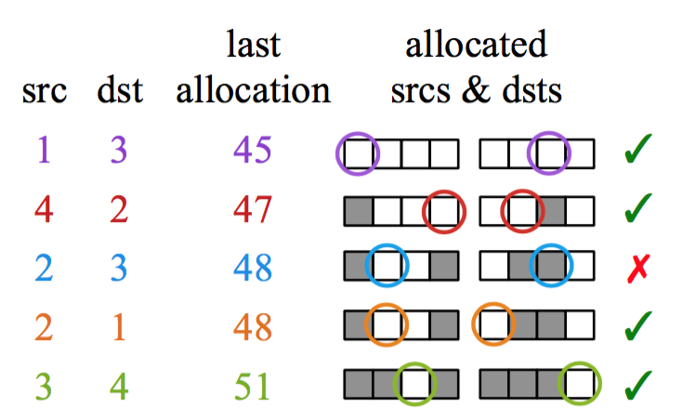
Time slot allocation: Meeting app goals
Ordering the demands changes achieved allocation goal
Max-min fairness: least recently allocated first
FCT minimization: fewest remaining MTUs first
Allocation in batches of 8
timeslots
Optimized using find-first-set
hardware instruction

Slide 22
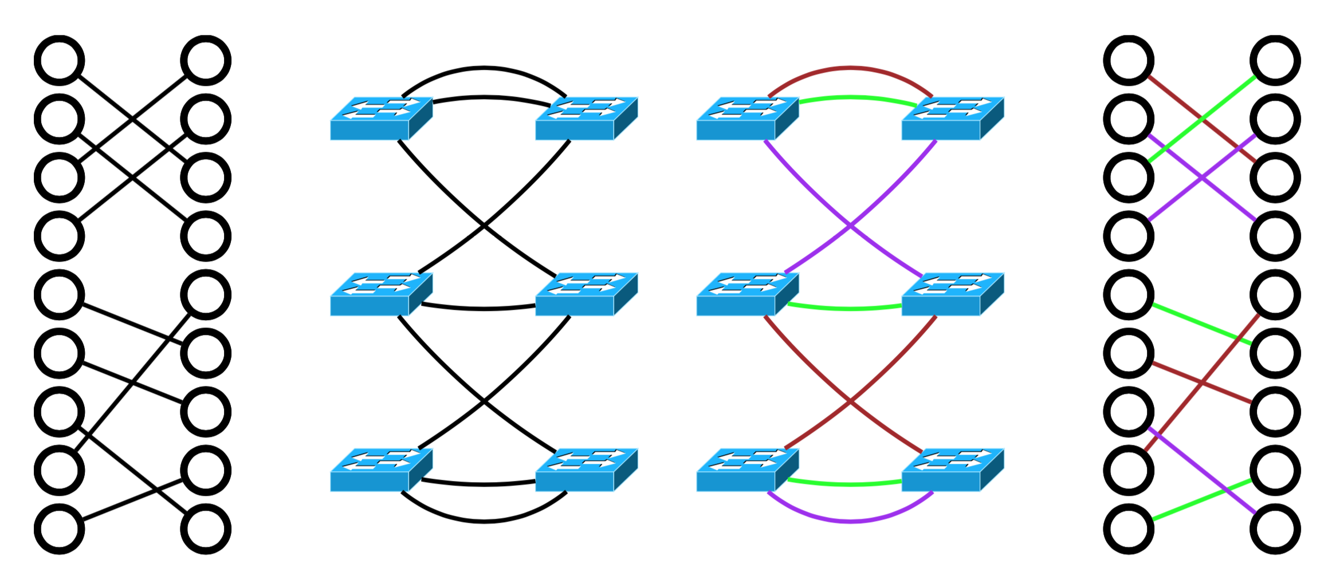
Path selection
Assume a 2-tier topology: ToR → aggregate switch → ToR
Given pair of ToRs, find non-overlapping agg switch
Edge coloring problem!

Slide 23
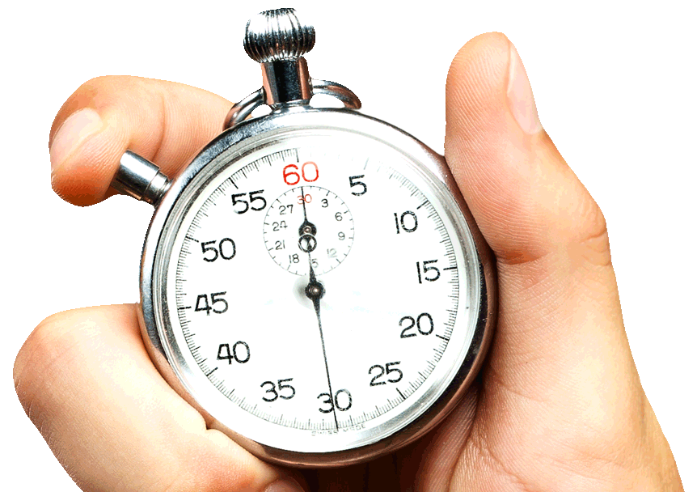
Will the delay to start flows be an issue?
Arbiter must respond before ideal zero-queue transmission occurs
Light load: independent transmissions may win ☺

Slide 24
Can endpoints transmit at the right time?
What happens if not?
(1) Need to ensure that clocks aren’t too out of sync
(2) Endpoints transmit when told
Use PTP to sync within few us
Fastpass qdisc to shape traffic as told
hrtimers for microsecond resolution

Slide 25
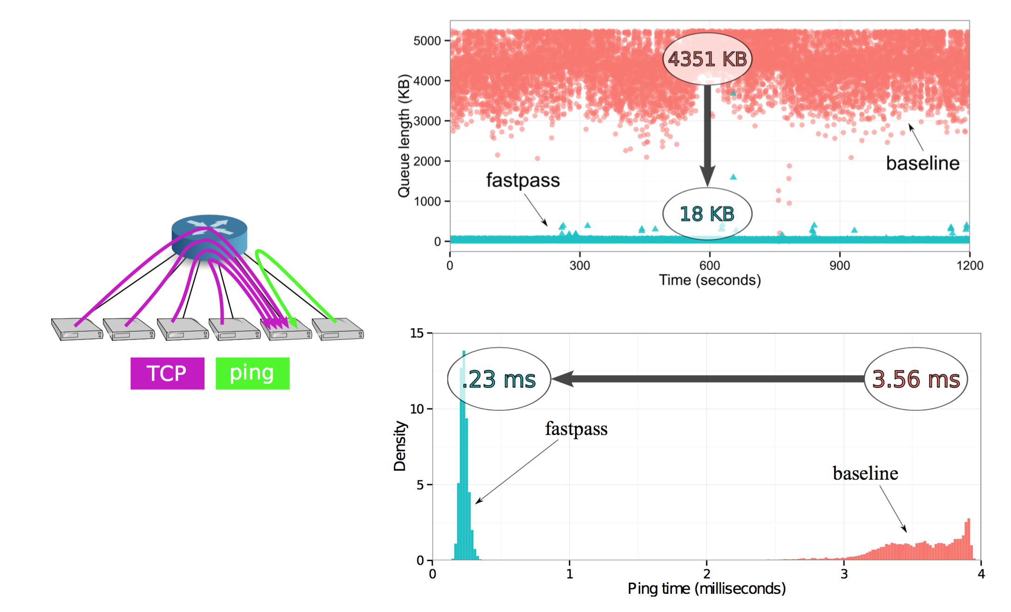
Experimental results on Facebook rack

Slide 26
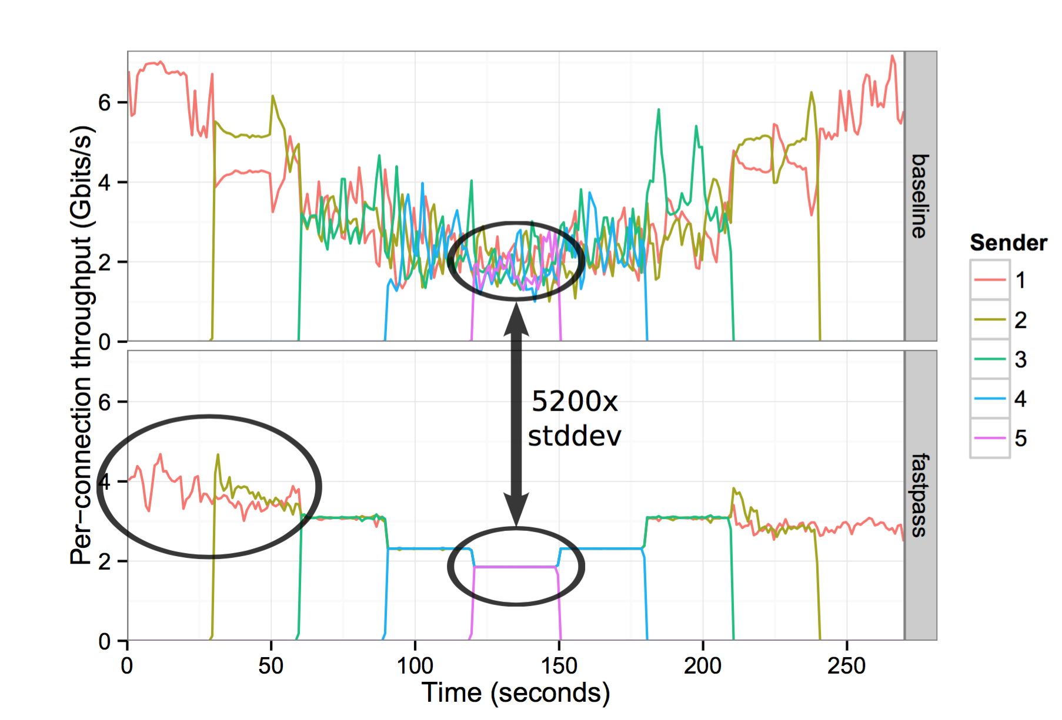
Convergence to network share

Slide 27
Discussion
Ordering demands: an indirect way to set allocation goals?
Online time slot allocation without preemption: what about priorities?
Comparison with delay-based congestion control? Fine-grained network scheduling approaches (ex: pFabric)?
How to scale to much larger networks?
Can you completely eliminate retransmissions and reordering?
What is the impact on the host networking stack?
Do you need to arbitrate the arbitration packets?

Slide 28
Acknowledgment
Slides heavily adapted from material by Mohammad Alizadeh and Jonathan Perry

