Slide 1

Switching, Layering & Measurement
Lecture 2
http://www.cs.rutgers.edu/~sn624/352-F24
Srinivas Narayana

Slide 2


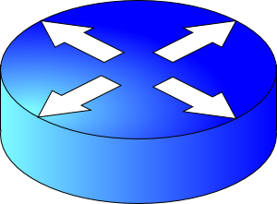

Review of definitions
packet
link
link
link
host/
endpoint
host/
endpoint
router
router
Endpoint or Host: Machine running user application
Packet: a unit of data transmission (ex: 1500 bytes)
Link: a physical communication channel between two or more machines
Router: A machine that processes packets moving them from one link to another towards a destination
Network: Collection of interconnected machines
Address: a unique name given to a machine (more later)

Slide 3
Today’s lecture
Dive a bit deeper into how Internet communication works
Links: how does communication work physically?
Routers: how do they move data between links?
Endpoints: how is networking organized at endpoints?
Understand how to measure the Internet

Slide 4
How do machines talk?

Slide 5
How do machines communicate?
With 1s and 0s
Digital computers deal with 1s and 0s
How do we transmit 1s and 0s in a network?
Encoding and Decoding problem

Slide 6
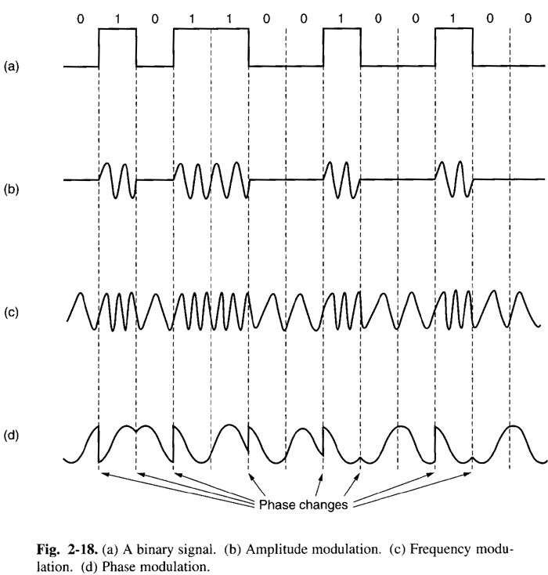
Physical transmission on a single link
Physical signaling (light, AC voltages, etc.) are often analog
Convert bits to signals through modulation of the physical characteristics of signals: encoding
Convert signals back to digital by decoding physical signals

Slide 7
Physical transmission on a single link
Physical signaling (light, AC voltages, etc.) are often analog
Convert bits to signals through modulation of the physical characteristics of signals: encoding
Convert signals back to digital by decoding physical signals

Slide 8
Physical transmission on a single link
Physical signaling (light, AC voltages, etc.) are often analog
Convert bits to signals through modulation of the physical characteristics of signals: encoding
Convert signals back to digital by decoding physical signals

Slide 9
Physical transmission on a single link
Physical signaling (light, AC voltages, etc.) are often analog
Convert bits to signals through modulation of the physical characteristics of signals: encoding
Convert signals back to digital by decoding physical signals

Slide 10

Routers and Multi-link networks
Routers need a way to move data across links
We use the term switching to denote physically moving data from one link to another
There are different possibilities to switch data across links
Router
Router

Slide 11
Switching methods
Host applications transfer data containing many messages.
A message could be a single web page, chat message
(1) Circuit Switching
(2) Message Switching
(3) Packet Switching

Slide 12

Circuit switching
Provides service by setting up the full path of connected links from the origin to the destination
Example: Telephone network
Dedicated path with dedicated resources

Slide 13
Circuit switching
Call request signal
1. Setup: Control message sets up a path from origin to destination
2. Accept signal informs source that data transmission may proceed
3. Data transmission begins
4. Entire path remains allocated to the transmission (whether used or not)
5. When transmission is complete, source releases the circuit
Propagation
Delay
Resource reservation
delay
Time
Call accept signal
Data
Transmission
Time
Data
A
B
C
D

Slide 14


Message switching
Each message is addressed to a destination
Header: metadata that denotes how to process a message
Typically includes a destination address
The message “hops” from node to node through a network while allocating only one link at a time
(Compare to circuit switching, where all links are reserved at the same time, regardless of use.)
Analogy: Postal service

Slide 15
Message switching
When the entire message is received at a router, the next step and link in its journey are selected (routing)
If this selected link is busy, the message waits in a queue until the link becomes free
Store and forward switching
Router waits for all bits of a message to arrive on incoming link before sending the first bit of the message on the outgoing link
Alternative: cut–through switching sends bits as they arrive

Slide 16
Message Switching
Header
Msg
Time
Total transfer time
Msg
Store and forward
delay
Queueing
Delay
Msg
A
B
C
D

Slide 17
Packet switching
Messages are split into smaller pieces called packets
Packets have a maximum length
Packets are numbered and addressed
Packets are sent through the network one at a time
Pipelining: different parts of a message concurrently transmitted over different links
Provides higher utilization of link resources

Slide 18
Packet switching
Header
Pkt 1
Pkt 2
Pkt 1
Store and forward
delay
Total transfer time
Time
Pkt 3
Queueing
Delay
Pkt 2
Pkt 3
Pkt 1
Pkt 2
Pkt 3
A
B
C
D

Slide 19
The Internet uses store-and-forward packet switching.

Slide 20
Comparisons across switching tech
Circuit switching incurs an initial delay in setting up the resources along the path
Packet (and message) switching can start transmitting data right away
Packet switching doesn’t reserve resources for the conversation
While circuit switching does. Needs admission control
Packet switching makes resource reservation decisions per packet
Fewer or no guarantees ➔ easier to build
Telephone networks are more reliable but harder to build

Slide 21
Comparisons across switching tech
(1) Total Delay to transfer a message
Short Bursty Messages:
Packet < Circuit
Long Continuous Messages:
Circuit < Packet
(2) Header overhead (wastage, or what % of bits on the wire is metadata?)
If typical messages are larger than typical packets:
Packet > Message

Slide 22


Switching
host/
endpoint
host/
endpoint
link
link
link
router
router
Many layers…
Encoding and decoding

Slide 23
Layering and Protocols

Slide 24
Solving the problems of communication
Communication over the Internet is a complex problem
Application (e.g., web)
Guarantees (e.g., reliability)
Data movement across the Internet (routing)
Link concerns (encoding/decoding, medium access control)
We solve complex problems by breaking them into simpler ones!
Layering simplifies understanding, testing, and maintaining
It is easy to improve or replace solutions at one layer without affecting others

Slide 25
Software/hardware organization at hosts
Application: useful user-level functions
Communication functions broken up and “stacked”
Transport: provide guarantees to apps
Each layer depends on the one below it.
Each layer supports the one above it.
The interfaces between layers are well-defined and standardized.
Network: best-effort global pkt delivery
Link: best-effort local pkt delivery

Slide 26

Internet software and hardware
are arranged in layers.
Layering provides modularity
Each layer: well-defined function
& interfaces to layers above & below it.
Functionality is implemented in protocols.

Slide 27
Protocols: The “rules” of networking
Protocols consist of two things
Message format
structure of messages exchanged with an endpoint
Actions
operations upon receiving, or not receiving, messages
Example of a Zoom conversation:
Message format: English words and sentences
Actions: when a word is heard, say “yes”; when nothing is heard for more than 3 seconds, say “can you hear me?”

Slide 28
The protocols of the Internet
Standardized by the Internet Engineering Task Force (IETF)
through documents called RFCs (“Request For Comments”)
Layering of protocols
HTTP
FTP
NV
TFTP
HTTPS
FTP
HTTP
SIP
RTSP
TCP
UDP
TCP
UDP
IP
IP
Ether
ATM
…
WiFi
X.25
…
802.11
ATM

Slide 29

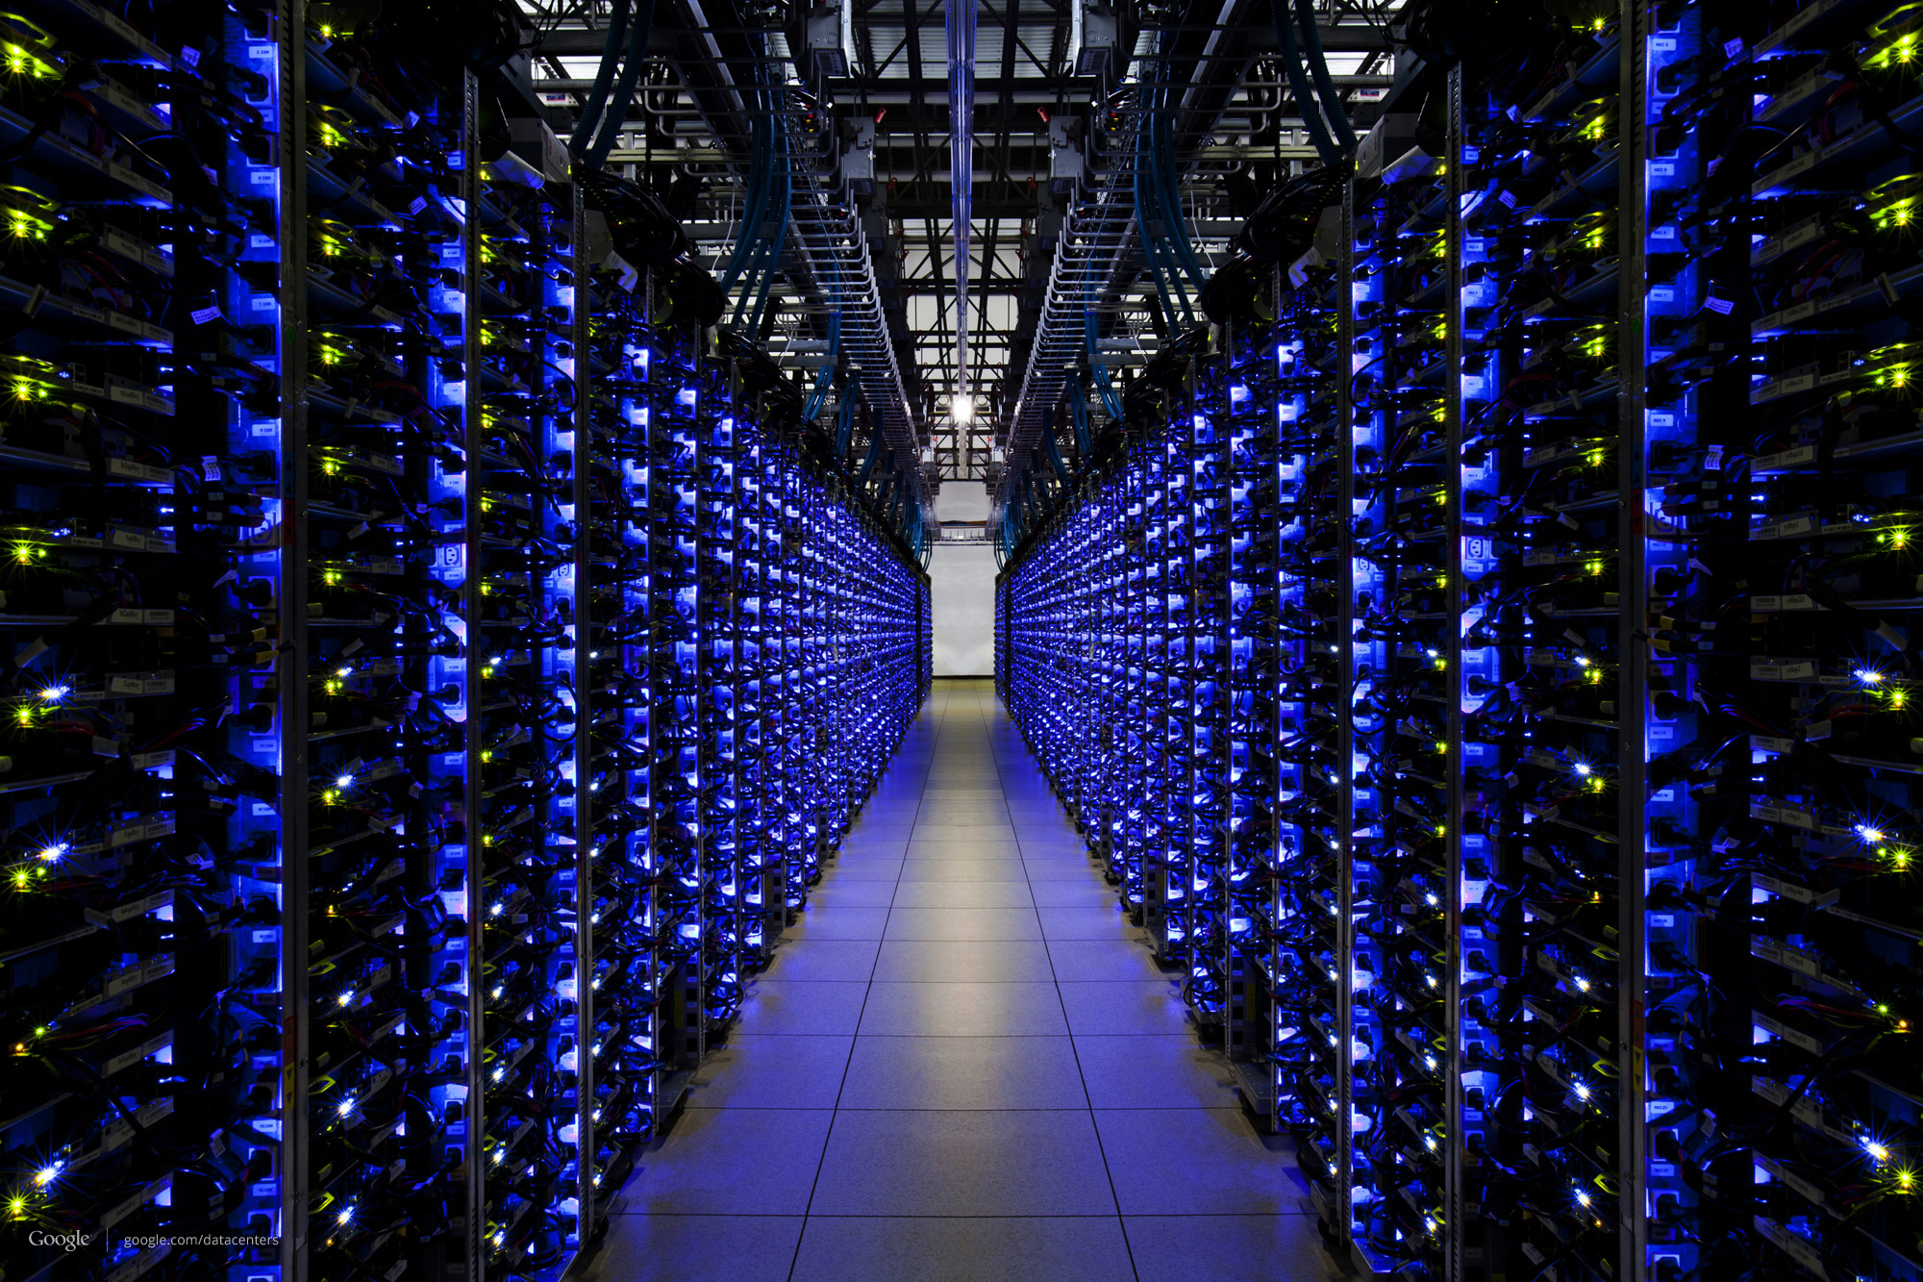


The Internet
Applications
Applications
Packet starts as an
app message
Transport
Packet takes on headers at each layer
Transport
Network
Network
Link layer
Link layer
The Internet

Slide 30

Applications
Applications
Transport
Transport
Network
Network
Network
Network
Link layer
Link layer
Link layer
Link layer

Slide 31
Applications
Applications
Routers have network and link layers too!
Transport
Transport
Network
Network
Network
Network
Link layer
Link layer
Link layer
Link layer

Slide 32
Layering
Communication over the Internet is a complex problem.
Layering simplifies understanding, testing, maintaining
Easy to improve or replace protocol at one layer without affecting others

Slide 33

This course has layers
Application
HTTPS
FTP
HTTP
SIP
RTSP
Transport
TCP
UDP
Network
IP
Host-to-Net
X.25
…
802.11
ATM

Slide 34
Measuring the Internet
Speed, by any other name

Slide 35
What exactly do we mean by speed?
A packet consists of many bits, including header and data
Packet size: length of the packet (bits or bytes) incl. header and data
Bandwidth: For a single link, amount of data it can transmit per unit time (bits/second or Bytes/second or packets/second)
Total packet delay: time from the first bit@sender to the last bit@receiver

Slide 36

Bandwidth and delay are related but distinct
Propagation delay
Bandwidth
Total packet delay = time for a box to travel the length of the belt
Bandwidth = the number of boxes put on the belt per minute (“rate”)

Slide 37
High
Bandwidth
GPU—GPU link in an AI compute cluster
Trans-continental optic fiber
Low delay
High delay
Bluetooth link
Satellite link
(e.g., on a foggy day)
Low
Bandwidth

Slide 38
Total Packet Delay has a few pieces
Propagation delay: Time needed to move one bit across (second)
Imposed by the communication medium; depends on the link “length”
Transmission delay: Time from first bit@sender to last bit@sender
Determined by link bandwidth and packet size
Packet size / link bandwidth
Queueing delay: Time that a packet waits for transmission
Determined by contention for the link
Total packet delay = propagation delay + queueing delay + transmission delay for a single packet

Slide 39
Visualizing the components of delay
Transmission delay at the first link
Propagation delay of first link
Queueing at the router
Increasing time
Transmission delay at the second link
Propagation delay of second link

Slide 40
Bandwidth and delay demo
Throughput (related to bandwidth)
iperf –s # at the destination
iperf –c <destination> # at the source,
e.g., iperf –c localhost
(total) delay
ping <destination>
e.g., ping google.com
(you can try it!)

