Slide 1

Transport: Ordered Delivery
Srinivas Narayana
Fall 2020

Slide 2

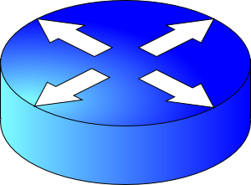
How do apps get perf guarantees?
The network core provides no guarantees on packet delivery
Transport software on the endpoint oversees implementing guarantees on top of an unreliable network
Three important kinds of guarantees
Reliability
Ordered delivery
Resource sharing in the network core
Transmission Control Protocol (TCP)

Slide 3
Ordered data delivery

Slide 4
Reordered pkt reception at receiver
Reordering across packets can happen due to packets taking different paths through a network
Receiver needs a general strategy to ensure that data is presented to the application in the same order that sender pushed those bytes
Receiver stack won’t present a byte received out of order to the application. Why?
Sender
Receiver
1
2
3
4
1
2
4
5
3

Slide 5

Lost & retransmitted pkts
Let’s suppose receiver gets packets 1, 2, and 4, but not 3 (dropped)
3 will be retransmitted, say, after an RTO
Receiver can’t present 4 to the app
… even though 4 has been successfully received
… even though 3 won’t be available for a while (i.e., until the RTO elapses)
Sender
Receiver
1
2
3
4
1
2
4
5

Slide 6
Buffering and Reassembly at the receiver
Network writes here
Application can read up to here
1
2
1
2
4
1
2
3
4
Memory on the receiver machine

Slide 7

Receiver side: App + TCP socket buffer
application
process
An app with a TCP socket reads from the TCP receiver socket buffer
TCP receiver software only releases data to app only if the data is in order relative to all other data already read by the application
Out of order data stays in the TCP receiver socket buffer.
TCP socket
receiver buffers
TCP
code
from sender
receiver protocol stack
Image credit: Kurose and Ross

Slide 8
Implications of buffering & reassembly #1
Packets cannot be delivered to the application if there is an in-order packet missing from the receiver’s buffer
The receiver can only buffer so much out-of-order data
Subsequent out-of-order packets dropped
It doesn’t matter that the packets successfully arrive at the receiver NIC from the sender over the network
TCP application responsiveness & throughput may suffer if there is too much packet reordering in the network

Slide 9
Implications of buffering & reassembly #2
A TCP sender can only send as much as the free receiver buffer space available before packets are dropped at the receiver
This number is called the receiver window size or the advertised window size
TCP is said to implement flow control
Buffer exhaustion can occur even if all data is received in order
The app may not be reading fast enough
The socket buffer may not be large enough

Slide 10
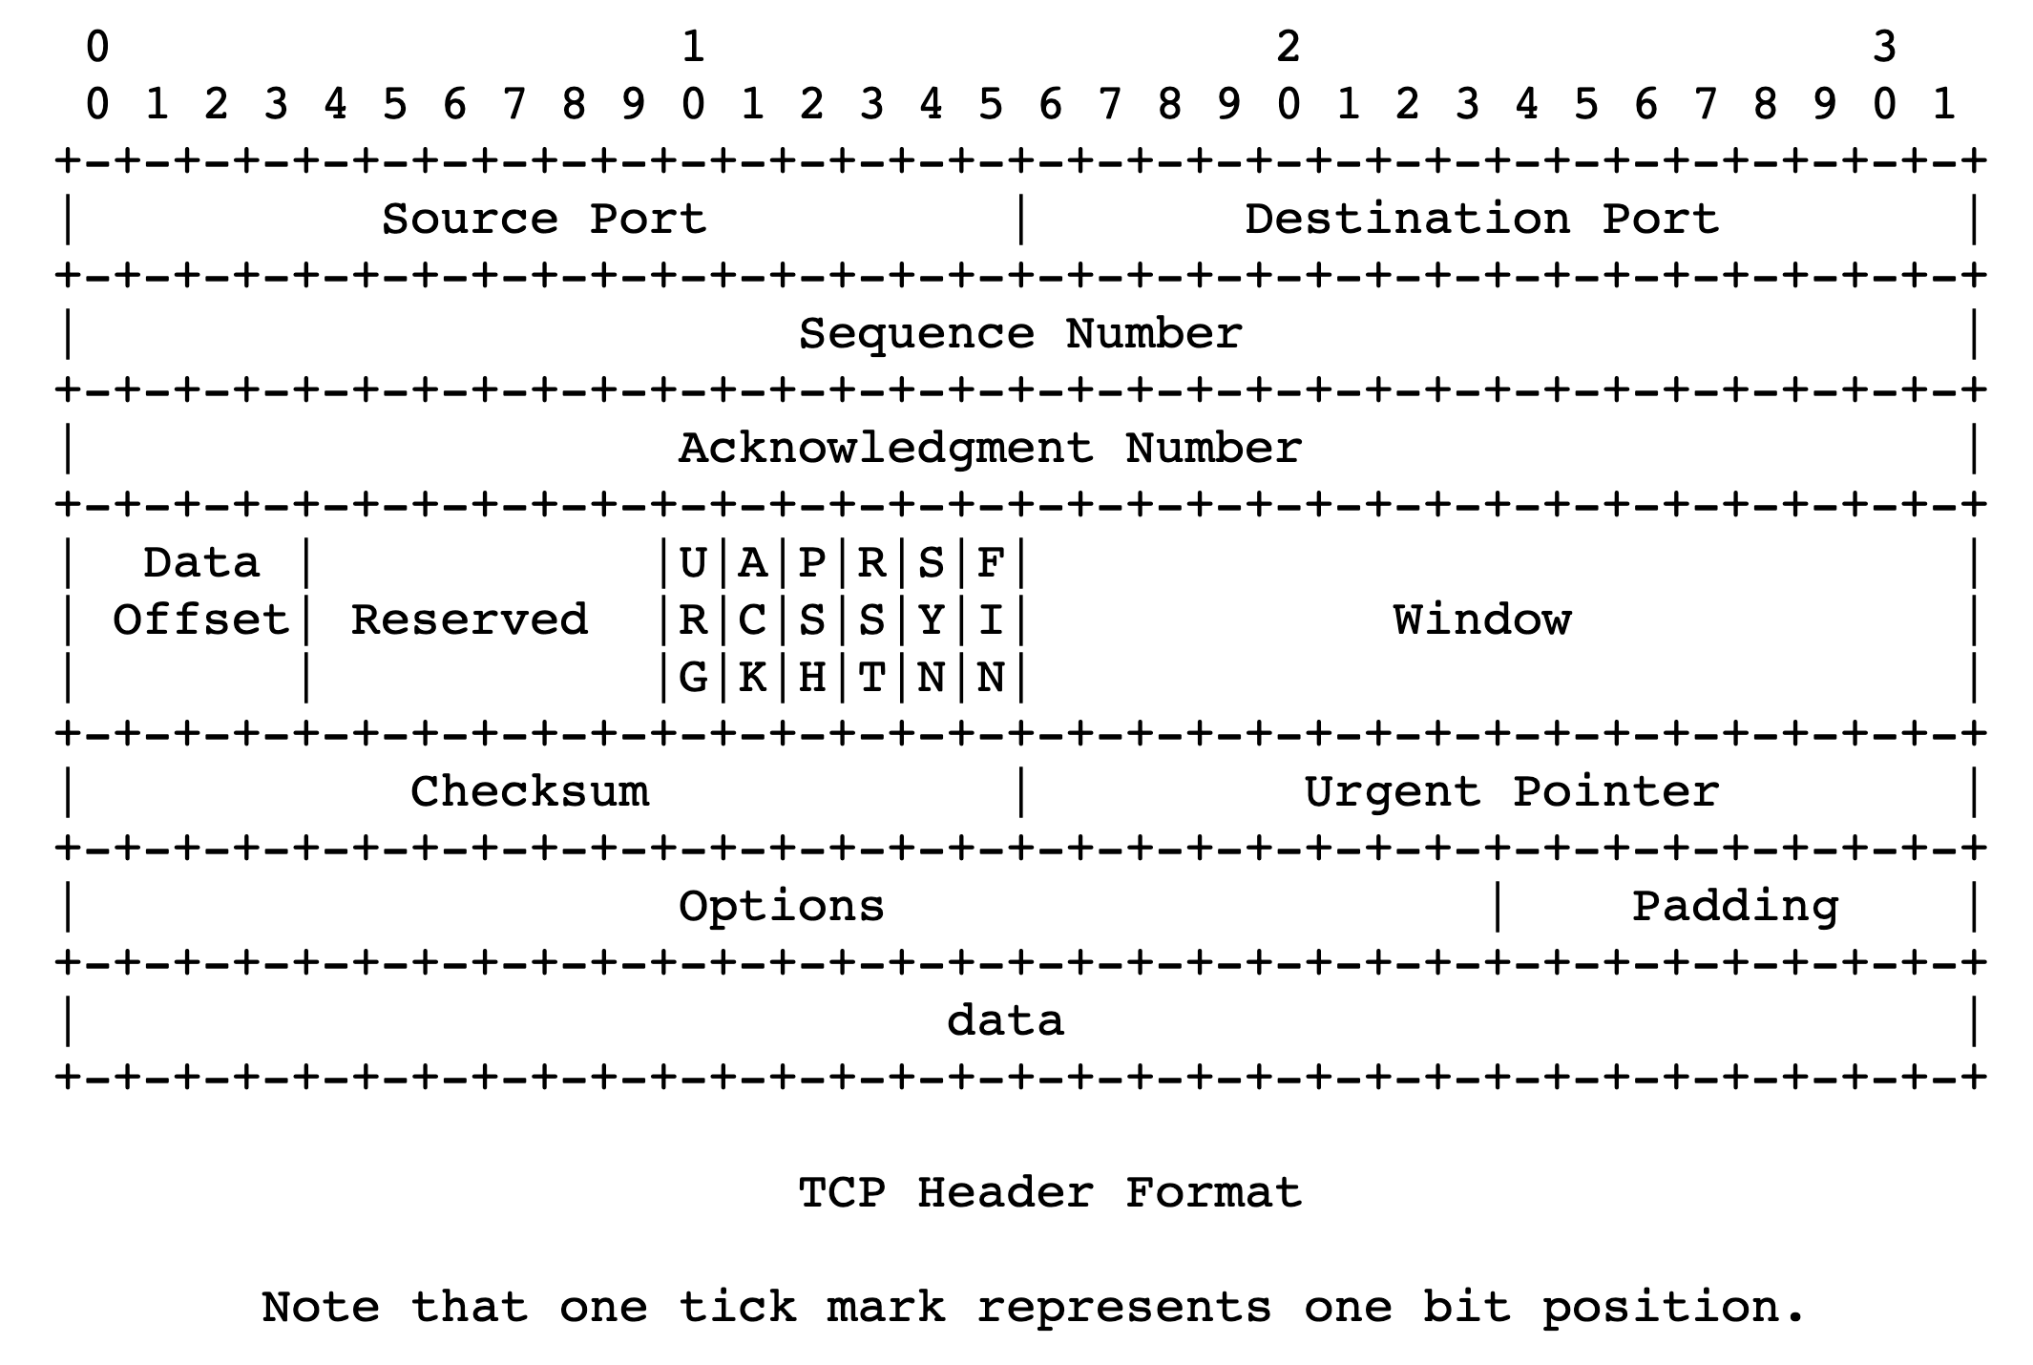
Flow-control-related TCP headers

Slide 11
Implications of buffering & reassembly #3
Even when TCP packets arrive in order, they typically arrive in a burst
Reason: window-based transmission at the sender
Simple sender implementation: if more unACKed data can be held in flight, just send data up to the window size.
However, receiver app won’t read the burst in one shot
Need to size the buffer according to the maximum burst size
Q: what’s the sender’s maximum burst size? i.e., maximum window?

Slide 12
Implications of buffering & reassembly #4
What if packets travel from sender to receiver over multiple paths?
Imagine a situation where one path is much faster than another
First (faster) path sends packets: 1, 3, 5, …
Second (slower) path sends packets: 2, 4, 6, …
Reassembly will require dropping the connection’s throughput to match the slower one

Slide 13
Implications of buffering & reassembly #4
Reordering and reassembly are bad for application throughput
Most network-level load balancing mechanisms avoid per-packet-granularity multi-path forwarding
Balance load at per-flow or per-flowlet (burst) granularity
Multi-path TCP variants exist, but all need to solve the path scheduling problem:
Schedule outgoing packet transmissions and adjust windows
… so that the packets arrive at the receiver (roughly) in order

