Slide 1

Resource Allocation in the
Network Core
Srinivas Narayana
Fall 2020

Slide 2
The approach that the Internet takes to allocate resources in the network core is to use a
distributed algorithm (congestion control)
running at endpoints.
This allows the Internet to scale to a large # of endpoints.
However, it also places trust in endpoints.

Slide 3




Are endpoint algorithms alone enough?
What if an endpoint is buggy, or malicious?
We’d like the network core to do something better than best-effort

Slide 4
Why packet scheduling?

Slide 5
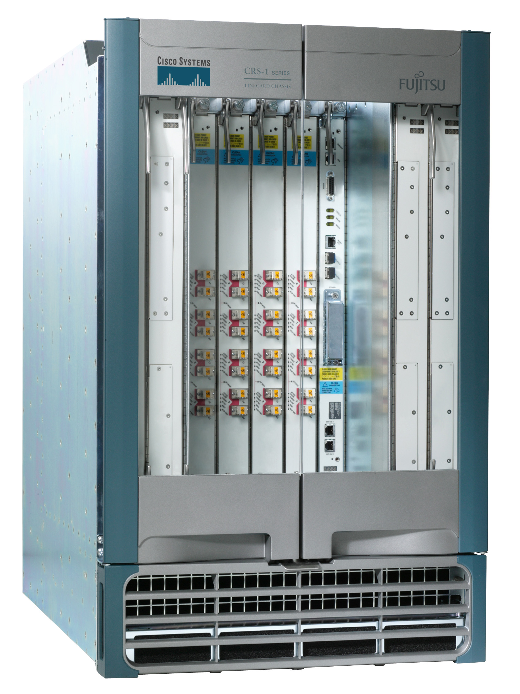
Recall: Packet queueing in routers
packet
buffer
queueing
Output queuing
Outgoing
network interface
switch
fabric
Buffer management / AQM
Scheduling
packet
buffer
queueing
Input queuing
Incoming
network interface
switch
fabric

Slide 6



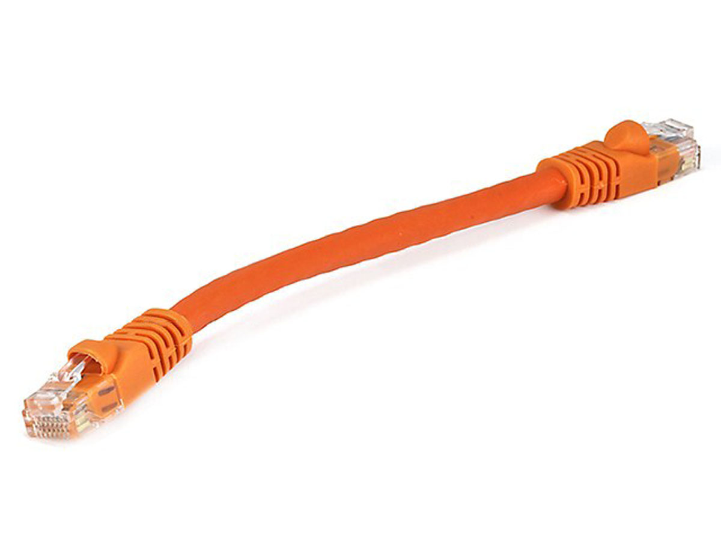
Simplified model of bottleneck link
Queuing delay
Bottleneck queue
(max size B)
Link rate
Flows
Packet-switched core network

Slide 7

FIFO scheduling + Tail-drop buffer mgmt
Buffer size
2
1
b
2
a
1
a
b
Dropped packets

Slide 8
FIFO scheduling + Tail-drop buffer mgmt
6
Head of the line blocking (HOL)
5
4
Buffer size
3
2
1
6
a
4
3
2
5
1
a
b
b
Dropped packets

Slide 9
Next RTT: ACK-clocking makes it worse
13
12
11
10
Buffer size
9
8
7
13
12
11
10
9
8
7
b
b
c
ACK signals sender: prior packet left the network => resource available!
Dropped packets

Slide 10
Network can be monopolized by bad endpoints
ACK clocking synchronizes senders to when resource is available
Conversely, packet losses desynchronize the sender
Contending packet arrivals may not be random enough
e.g., Blue flow can’t capture buffer space for a few round-trips
Can observe this effect when many TCP flows compete
Some TCP flows can never get off the ground
A FIFO tail-drop queue incentivizes sources to misbehave!

Slide 11
Packet scheduling disciplines @ routers
Significantly influences how packets are treated regardless of the endpoint’s transmissions
Implementations of Quality of Service (QoS) within large networks
Implications for net neutrality debates
Intellectually interesting and influential (“top 10”) question
Classic WFQ paper has ~ 1500 citations
Important connections to sched literature (e.g., job scheduling)
Scheduling algorithms influence many daily life decisions!

Slide 12
Fair Resource Allocation
Allocate how? among who?
Following slides adapted heavily from Dr. Jennifer Rexford

Slide 13
Fair and efficient use of a resource
Suppose n users share a single resource
Like the bandwidth on a single link
E.g., 3 users sharing a 30 Gbit/s link
What is a fair allocation of bandwidth?
Suppose user demand is “elastic” (i.e., unlimited)
Allocate each a 1/n share (e.g., 10 Gbit/s each)
But fairness is not enough
Which allocation is best: [5, 5, 5] or [18, 6, 6]?
[5, 5, 5] is fair but [18, 6, 6] is more efficient
What about [5, 5, 5] vs. [22, 4, 4]?

Slide 14
Fair use of a single resource
What if some users have inelastic demand?
E.g., 3 users where 1 user only wants 6 Gbit/s
And the total link capacity is 30 Gbit/s
Should we still do an “equal” allocation?
E.g., [6, 6, 6]
But that leaves 12 Gbps unused
Should we allocate in proportion to demand?
E.g., 1 user wants 6 Gbps, and 2 each want 20 Gbit/s
Allocate [4, 13, 13]?
Or, give the least demanding user all she wants?
E.g., allocate [6, 12, 12]?

Slide 15
Max-min fairness
Protect the less fortunate
Any attempt to increase the allocation of one user necessarily decreases the allocation of another user with equal or lower allocation
Fully utilize a bottleneck resource
If demand exceeds capacity, the link is fully used

Slide 16

Max-min fairness for a single resource
Progressive filling algorithm (also called waterfilling)
Grow all rates until some users stop having demand
Continue increasing all remaining rates until link is fully utilized
If all users have elastic demands, single resource shared evenly
Link rate L/N
N elastic users
Link rate L/N
…
Link rate L
Link rate L/N

Slide 17
Allocation over multiple resources
A
B
Three users A, B, and C
Two 30 Gbit/s links
C
TCP Reno implements proportional fairness.
Kelly, Maulloo, Tan’98
Maximum throughput: [30, 30, 0]
Unfair: total throughput of 60, but user C starves
Max-min fairness: [15, 15, 15]
Inefficient: everyone gets equal share, but throughput is just 45
Proportional fairness: [20, 20, 10]
Allocate inversely proportional to resource use per bit
C is penalized for using 2 busy links rather than 1

Slide 18
Allocate fairly among who?
Abstract entity:
flow
Traffic sources?
Web servers, video servers, etc. need more than their fair share
Traffic destinations?
Vulnerable to malicious sources denying service to receivers
Application-level flows? (i.e., src + dst + transport ports)
Malicious app can start up many such flows
Administrative entities? (e.g., Rutgers NetID, ISP, …)
How should a router identify packets belonging to an entity?

