Slide 1

Router Design: Requirements
Srinivas Narayana
Fall 2020

Slide 2

Control & Data Planes inside a router
Traditionally:
Individual routing algorithm components in each and every router interact in the control plane
Control plane
per route-change processing
(~ a few seconds)
Routing
Algorithm
control
plane
data
plane
Data plane
per-packet processing
(~ tens of nanoseconds)
0111
1
3
2
values in arriving
packet header

Slide 3
Routers: Some requirements

Slide 4
Requirements: Speed!
Inherently
parallel workload
➔ Leverage hardware parallelism!

Slide 5

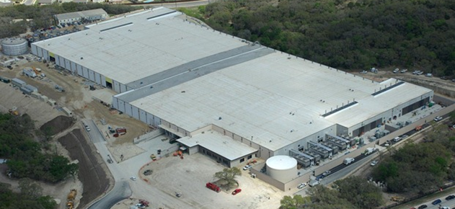


Requirements: port density, power, area
INTERNET
Fabric
Servers

Slide 6

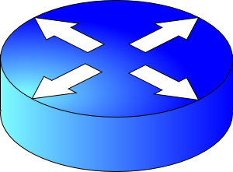


Requirements: resource allocation
Do better than best-effort on fairness and efficiency while allocating resources in the network core

Slide 7
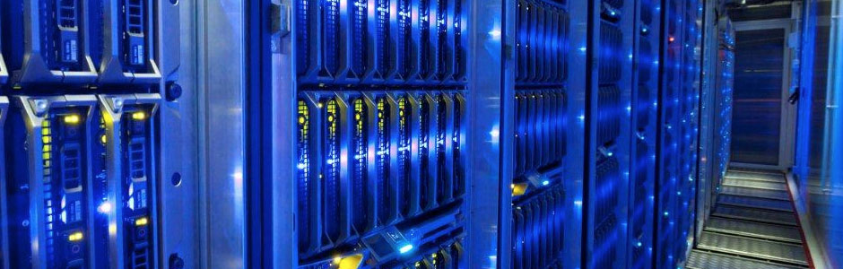
Requirements: “Maintainability”
Tons of devices: want “zero-touch”
  Small networks: configure routers manually
The era of cloud and virtualization brought special needs
  Scale
  Multiple levels of addressing, tunnel-based routing protocols
  Telemetry
Boils down to observability and programmability

Slide 8
Overview of router functionality
Historically evolving, multiple concurrent router designs
  MGR: router from the late 1990s (50Gbit/s router, Partridge et al)
  RMT: router from the late 2010s
Many things in common. Some functions implemented:
  Packet receive/transmit from/to physical interfaces
  Packet and header parsing
  Packet lookup and modification: ingress & egress processing
  High-speed switching fabric to connect different interfaces
  Traffic management: fair sharing, rate limiting, prioritization
  Buffer management: admission into switch memory

Slide 9
Life of a Packet: Part 1
Srinivas Narayana
Fall 2020

Slide 10
Router functionality
Historically evolving, multiple concurrent router designs
  MGR: router from the late 1990s (50Gbit/s router, Partridge et al)
  RMT: router from the late 2010s
Many things in common. Some functions implemented:
  Packet receive/transmit from/to physical interfaces
  Packet and header parsing
  Packet lookup and modification: ingress & egress processing
  High-speed switching fabric to connect different interfaces
  Traffic management: fair sharing, rate limiting, prioritization
  Buffer management: admission into switch memory

Slide 11
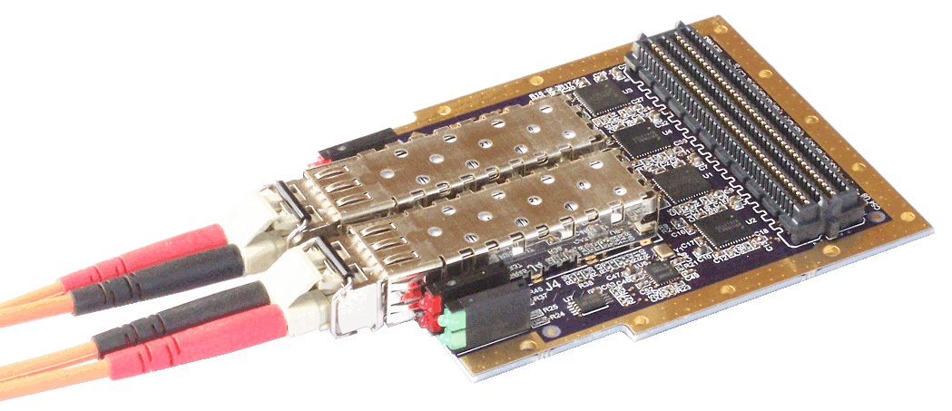
(1) Receive data at line cards
Circuitry to interface with physical medium: CoAx, optical
  SerDes/IO modules: serialize/deserialize data from the wire
  Network interfaces keep getting faster: more parallelism
  but stay the same size (Moore’s law is alive here, for now)
  Communication technologies still getting faster: optical, wireless
Multiple network interfaces on a single “line card”
  Component detachable from the rest of the switch
  Ex: upgrade multiple 10 Gbit/s interfaces to 40 Gbit/s in one shot
Preliminary header processing possible
  MGR: convert link-layer headers to standard format

Slide 12
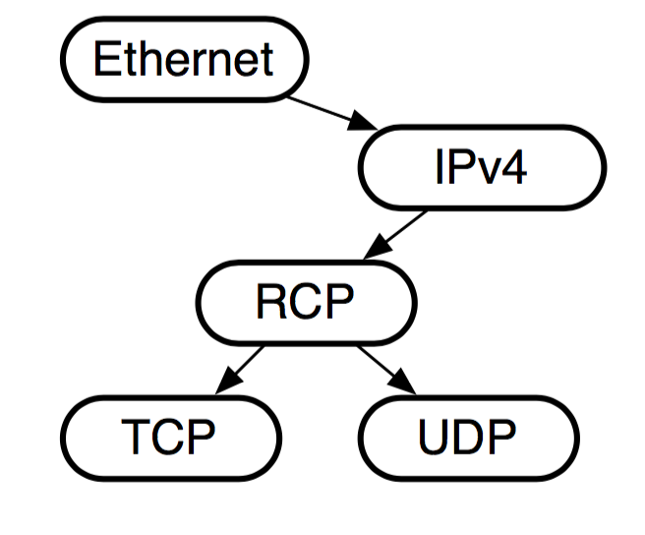
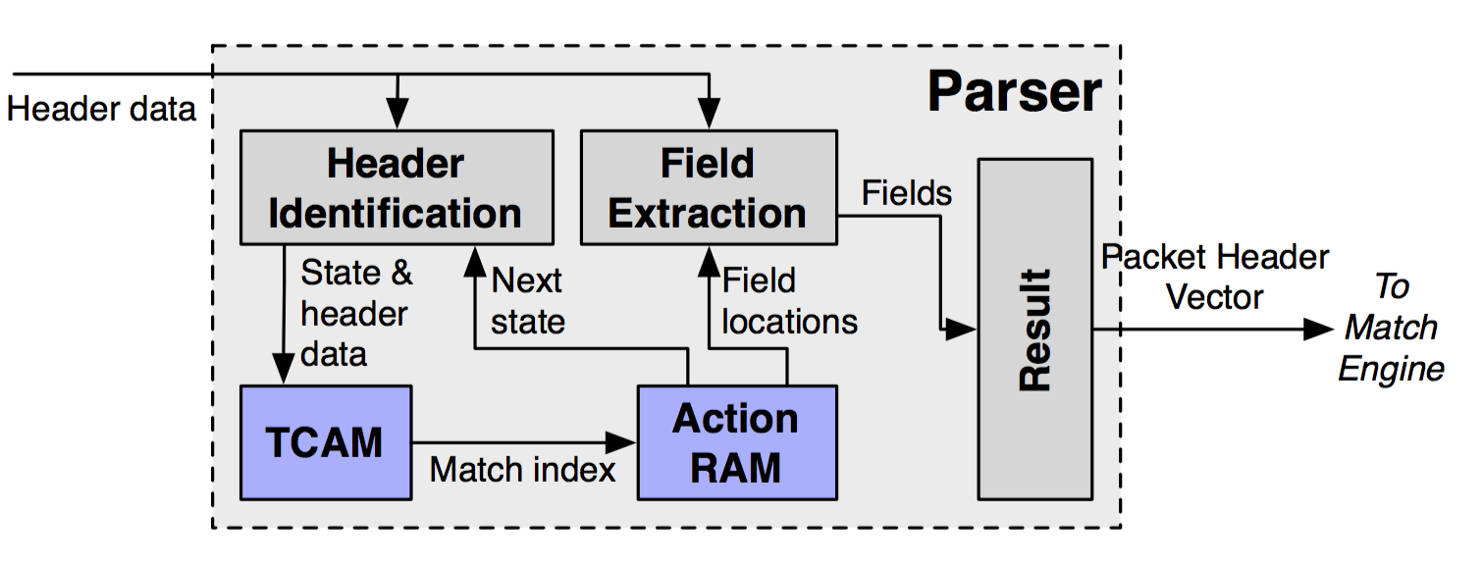
(2) Packet parsing
Extract header fields: branching, looped processing
  Ex: Determine transport-level protocol based on IP protocol type
  Ex: Multiple encapsulations of VLAN or MPLS headers
Outcome: parse graph and bits extracted from the parsed regions
MGR: done in software by loading, branching on headers
RMT: programmable packet parsing in hardware

Slide 13
(2) Packet parsing
Key principle: Separate data paths for header and payload
  Conserve bandwidth for data read/written inside switch!
Header continues on to route lookup/modification
Payload sits on a buffer until router knows what to do with the packet
  Buffer could be on the ingress line card (MGR)
  But more commonly a buffer shared between line cards (RMT)

Slide 14
Things that routers are expected to do…
RFC 1812: Forward pkts using route lookup, but also …
Update TTL (time-to-live IP header field): ttl -= 1
Update IP checksum (TTL updated)
IP to link-layer translation across networks (e.g., ARP for dst)
Rewrite link layer source address
Special processing (IP options): source route, record route, …
Handle IPv4 packet fragmentation
Handle multicast packets
Maintain QoS assurances

Slide 15
(3) Packet lookup
Typical structure: Sequence of tables (Ex: L2, L3, ACL tables)
  Exact match lookup
  Longest prefix match
  Wildcard lookups
Outcome: a (set of) output ports + (possibly modified) headers
Look-up tables with a range of sizes (# entries), widths (headers)
Several header modifications may happen
  Examples: TTL decrements, IP checksum re-computation
  Encapsulate/decapsulate tunnel headers (MPLS, NVGRE, VXLAN)
  MAC source address rewrite
Interesting algorithmic problems!

Slide 16
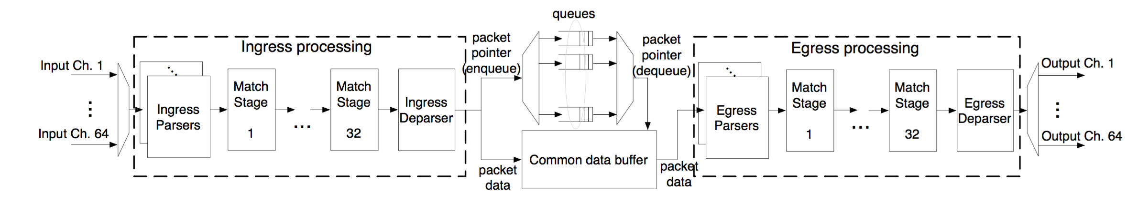
(3) Packet lookup in RMT: Pipelined parallelism
Different functionalities (ex: L2, L3) in different table stages
Highly parallel over packets: admit 1 packet/cycle
Pipeline circuitry clocked at a high rate: ex: RMT@1 GHz
Deterministic throughput

Slide 17
(3) Packet lookup in MGR
A forwarding engine card separate from line cards
  Scale forwarding and interface capacity separately
Use Alpha 21164 (a 415MHz generic processor)
Programmed in assembly to do route lookup and other processing.
Heavily use caching across different memories in a hierarchy
Traffic locality: a small fast memory can service a large fraction of traffic
However, can’t guarantee deterministic throughput for packets
  Packet might access slower memories in the memory hierarchy

Slide 18
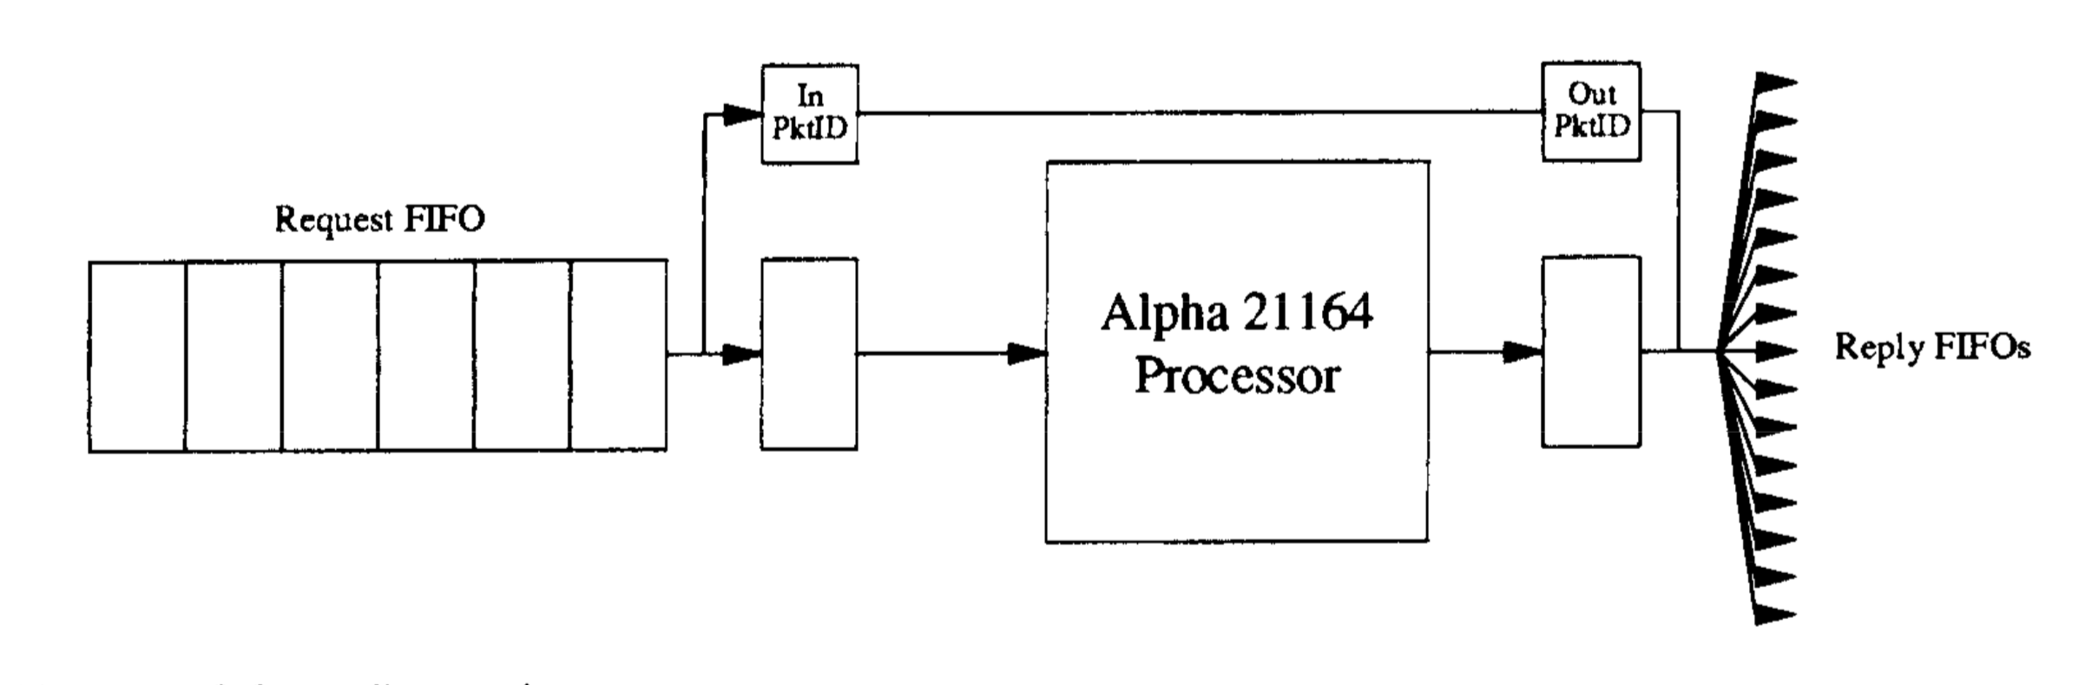
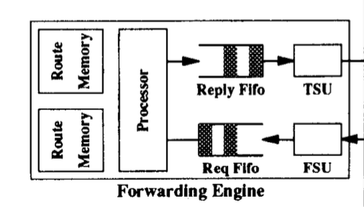
(3) MGR: Memory layout matters
Try to fit all code into local instruction cache
Local cache of routes for fast route lookup
Far-away external memory stores full forwarding table
  Accessed through a dedicated bus

Slide 19
(3) Packet lookup in MGR
Many micro-optimizations to improve performance
Separate fast path from slow path (optimize the common case)
  ARP lookup
  Fragmentation
  Error handling
Separate packet classification from QoS
Two copies of table in ext memory to support downtime-less updates to the routing table itself

Slide 20
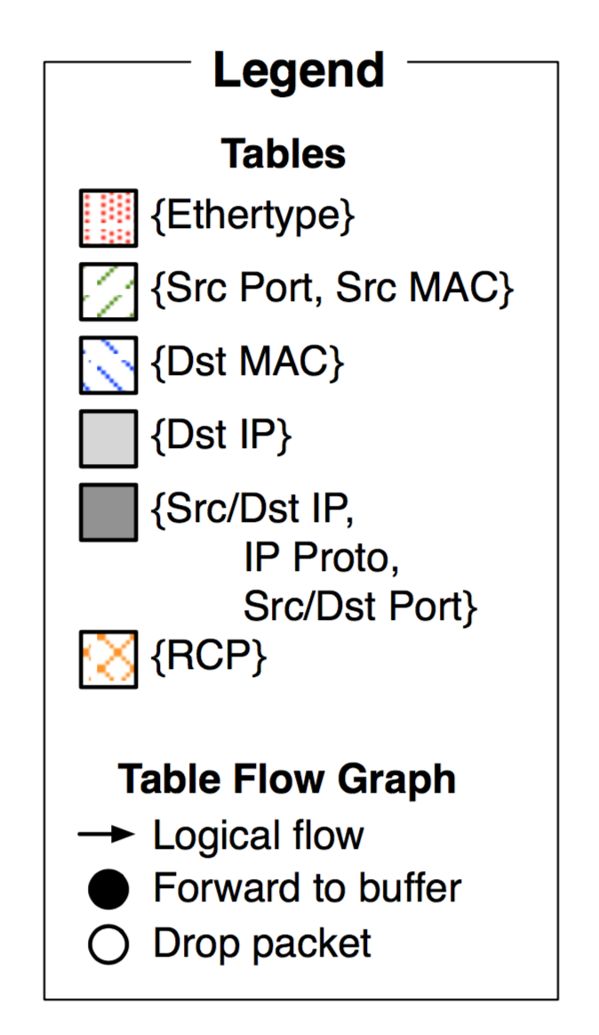
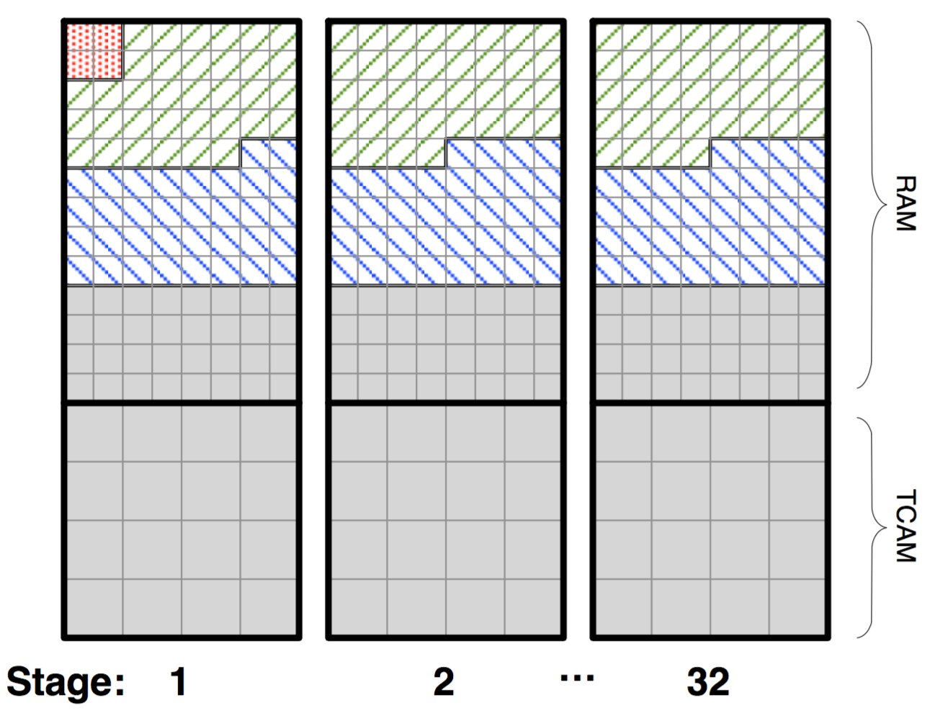
(3) RMT: Memory layout matters
RMT: flexible partitioning of memory across SRAM and TCAM
Numerous fixed size memory blocks
Circuitry for independent block-level access
Deterministic access times
  All of it is SRAM or TCAM
Interesting compiler issues
  “Packing” tables

Slide 21
Summary
Routers are specialized computers
  Data plane implements specific functions, but at high speed
  Earlier generations of routers: software, then SW-HW hybrids
  Modern routers: ASICs
  Careful attention to detail required for good performance
    data layout in memory
    timing of operations
Control plane: still software
  Routing protocols and management tasks are still too expressive for ASICs ☺

Slide 22
Life of a Packet: Part 2
Srinivas Narayana
Fall 2020

Slide 23
Router functionality
Historically evolving, multiple concurrent router designs
  MGR: router from the late 1990s (50Gbit/s router, Partridge et al)
  RMT: router from the late 2010s
Many things in common. Some functions implemented:
  Packet receive/transmit from/to physical interfaces
  Packet and header parsing
  Packet lookup and modification: ingress & egress processing
  High-speed switching fabric to connect different interfaces
  Traffic management: fair sharing, rate limiting, prioritization
  Buffer management: admission into switch memory

Slide 24
A packet after route lookup
What we have:
One or more output ports, or a decision to drop
packet headers, possibly modified from ingress

Slide 25
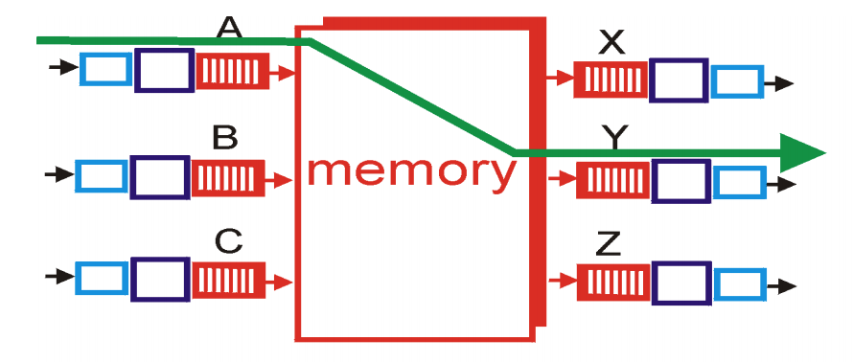
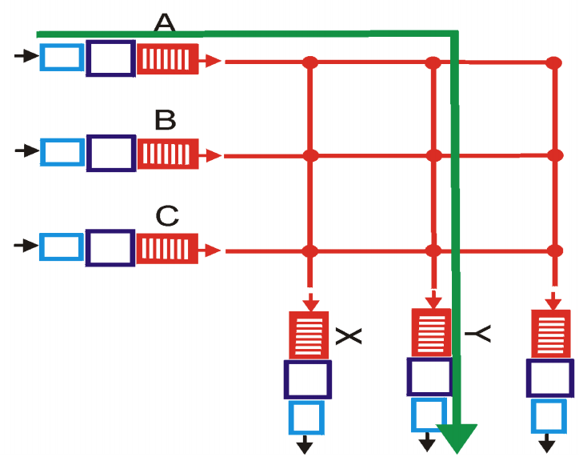
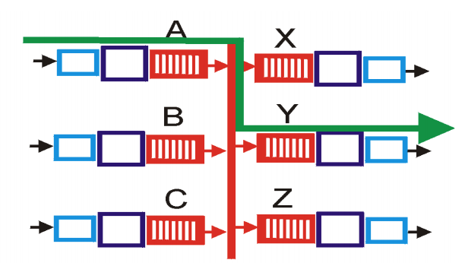
(4) Interconnect/Switching Fabric
Move headers and packet from one interface to another
Kinds of fabrics: memory, bus, crossbar

Slide 26
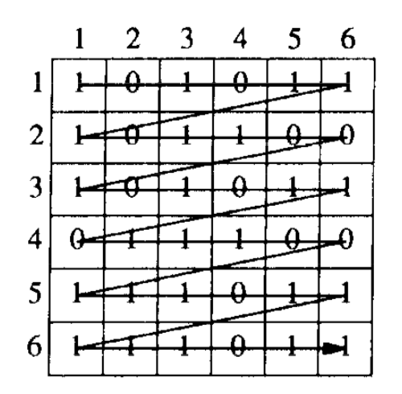
(4) Crossbars: The scheduling problem
Want to utilize fabric capacity regardless of demand pattern
  Crossbar is non-blocking
MGR considers strategies to pair incoming demands & output ports
  Greedy, wavefront, block wavefront
  Need to address fairness across ports

Slide 27
(4) RMT switching fabric
RMT uses memory as the fabric to hold packet headers and payloads between any two interfaces
In the late 90s and early 2000s, there was considerable research on building high-speed packet buffers
Today: shared memory switches & routers (shared ➔ across ports)
  Fast memory can be clocked at 1 GHz
Fundamental tradeoff: faster memories are not very dense
  Can’t make the memory too large
  Can’t hold too many packets!
Workaround: use memory access patterns: e.g., each queue is FIFO
Traffic manager implements scheduling & buffer management

Slide 28
(5) Traffic Manager
Where should the packets not currently serviced wait?
Two designs: Input-queued vs. output-queued
Output queueing avoids HOL blocking exhibited by input queueing.
  Suppose port 1 wants to send to both 2 and 3 but port 2 busy
  Packets from p1 towards p3 need not be delayed

Slide 29
(5) Traffic Manager
RMT: Queueing represents output port contention
A single output port can be represented by multiple queues
  e.g., to implement weighted fair queueing
Each queue is just a linked list in the shared memory
  Maximum flexibility in queue sizes, but pointer overhead
  Separate memory to maintain per-queue heads and tails

Slide 30
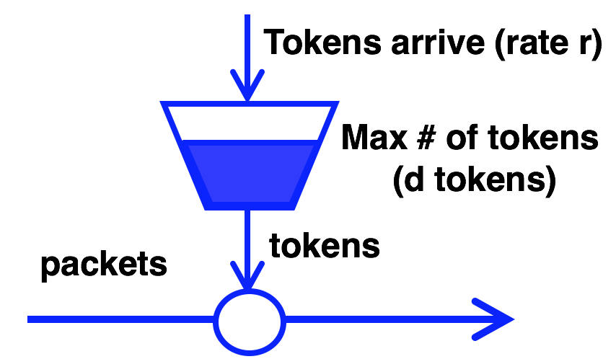
(5) Traffic Manager: Scheduling policies
Q: how to dequeue packets from the buffer?
Fair queueing across ports or flows
Strict prioritization of some ports over others
Rate limiting per port

Slide 31

(5) Traffic Manager: Buffer Management
Q: how to enqueue packets into buffer?
  If buffer is full, which packet should be dropped?
Typical buffer management: Tail-drop
Want fairness: if queue 1 has too many buffered pkts, don’t tail-drop q2
  Share memory by partitioning (carving memory out) across queues
And efficiency
  if q1 has no pkts, q2 should be able to use (nearly) all buffer memory
  Interesting space for dynamic buffer management algorithms
  e.g., Dynamic queue length thresholds for shared-memory packet switches (Choudhury and Hahne)

Slide 32
(6) Egress line card processing
Combine headers with payload for transmission
  Must incorporate effect of header modifications
  Also called deparsing or serialization
Multicast: egress-specific packet processing
  Ex: different source MAC address for each output port
Multicast makes almost everything inside the switch (interconnect, lookups, queueing) more complex

Slide 33
Summary
Packet buffer memory is a precious resource
  Modern routers have a few tens of MegaBytes buffer
  … for all packets across all ports
Traffic Manager: scheduling and buffer-management algorithms
Buffer memory costs substantial amount: capital, area, power
  Data centers: cheap routers with shallow buffers

