Slide 1

The Application Layer: SMTP, FTP
CS 352, Lecture 5
http://www.cs.rutgers.edu/~sn624/352-S19
Srinivas Narayana

Slide 2
Recap: Application-layer protocols
DNS: lookup a (machine-readable) address using a (human-readable) name?
Used by many applications as a building block
Recursive lookups for scale and administrative convenience
HTTP: Transfer content over the Internet with portability
Very familiar to users of the Internet
Many, many, applications use HTTP
Today: SMTP (email) and FTP (file transfer)

Slide 3
SMTP
Simple Mail Transfer Protocol

Slide 4
Electronic Mail
outgoing
message queue
user mailbox
Three major components:
User agents
a.k.a. “mail reader”
e.g., Applemail, Outlook
Web-based user agents (ex: gmail)
user
agent
mail
server
user
agent
SMTP
mail
server
user
agent
SMTP
SMTP
mail
server
user
agent
user
agent
user
agent

Slide 5
Electronic Mail: Mail servers
Mail Servers
Mailbox contains incoming messages for user
Message queue of outgoing (to be sent) mail messages
Sender mail server makes connection to Receiver mail server
IP address, port 25
SMTP protocol
Used to send messages
Client: sending user agent or sending mail server
server: receiving mail server
user
agent
mail
server
user
agent
SMTP
mail
server
user
agent
SMTP
SMTP
mail
server
user
agent
user
agent
user
agent

Slide 6


Scenario: Alice sends message to Bob
1) Alice uses UA to compose message and “to” bob@someschool.edu
2) Alice’s UA sends message to her mail server; message placed in message queue
3) Client side of SMTP opens TCP connection with Bob’s mail server
4) SMTP client sends Alice’s message over the TCP connection
5) Bob’s mail server places the message in Bob’s mailbox
6) Bob invokes his user agent to read message
1
mail
server
mail
server
user
agent
user
agent
2
3
6
4
5

Slide 7
Sample SMTP interaction
220 hill.com SMTP service ready
HELO town.com
250 hill.com Hello town.com, pleased to meet you
MAIL FROM: <jack@town.com>
250 <jack@town.com>… Sender ok
RCPT TO: <jill@hill.com>
250 <jill@hill.com>… Recipient ok
DATA
354 Enter mail, end with “.” on a line by itself
Jill, I’m not feeling up to hiking today. Will you please fetch me a pail of water?
.
250 message accepted
QUIT
221 hill.com closing connection

Slide 8
MAIL command response codes

Slide 9
Mail message (stored on server) format
SMTP: protocol for exchanging email msgs
RFC 822: standard for text message format:
header lines, e.g.,
To:
From:
Subject:
different from SMTP commands!
(these would still be under “DATA”)
body
the “message”, ASCII characters only
header
blank
line
body

Slide 10
Message format: multimedia extensions
MIME: multimedia mail extension, RFC 2045, 2056
additional lines in msg header declare MIME content type
From: alice@crepes.fr
To: bob@hamburger.edu
Subject: Picture of yummy crepe.
MIME-Version: 1.0
Content-Transfer-Encoding: base64
Content-Type: image/jpeg
base64 encoded data .....
.........................
......base64 encoded data
MIME version
method used
to encode data
multimedia data
type, subtype,
parameter declaration
encoded data

Slide 11
Mail access protocols
POP3 or IMAP4
SMTP
SMTP
access
protocol
user
agent
user
agent
sender’s mail
server
receiver’s mail
server
Why not use SMTP here?
SMTP: delivery/storage to receiver’s server
Mail access protocol: retrieval from server
POP: Post Office Protocol [RFC 1939]
Client connects to POP3 server on TCP port 110
IMAP: Internet Mail Access Protocol [RFC 1730]
Client connects to TCP port 143
HTTP: gmail, Yahoo! Mail, etc.
Why do we need a sender side mail server?

Slide 12
POP vs IMAP
POP3
Stateless server
UA-heavy processing
UA retrieves email from server, then typically deleted from server
Latest changes are at the UA
Simple protocol (list, retr, del within a POP session)
IMAP4
Stateful server
UA and server processing
Server sees folders, etc. which are visible to UAs
Changes visible at the server
Complex protocol

Slide 13
What about web-based email?
Connect to mail servers via web browser
Ex: gmail, outlook, etc.
Browsers speak HTTP
Email servers speak SMTP
Need a bridge to retrieve email using HTTP!

Slide 14
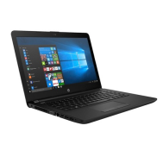


Web based email
HTTP server
HTTP
server
SMTP
Client
SMTP server
Internet

Slide 15
Comparing SMTP with HTTP
HTTP: pull
SMTP: push
both have ASCII command/response interaction, status codes
HTTP: each object encapsulated in its own response msg
SMTP: multiple objects sent in multipart msg
HTTP: can put non-ASCII data directly in response
SMTP: need ASCII-based encoding!

Slide 16
Try an SMTP interaction!

Slide 17
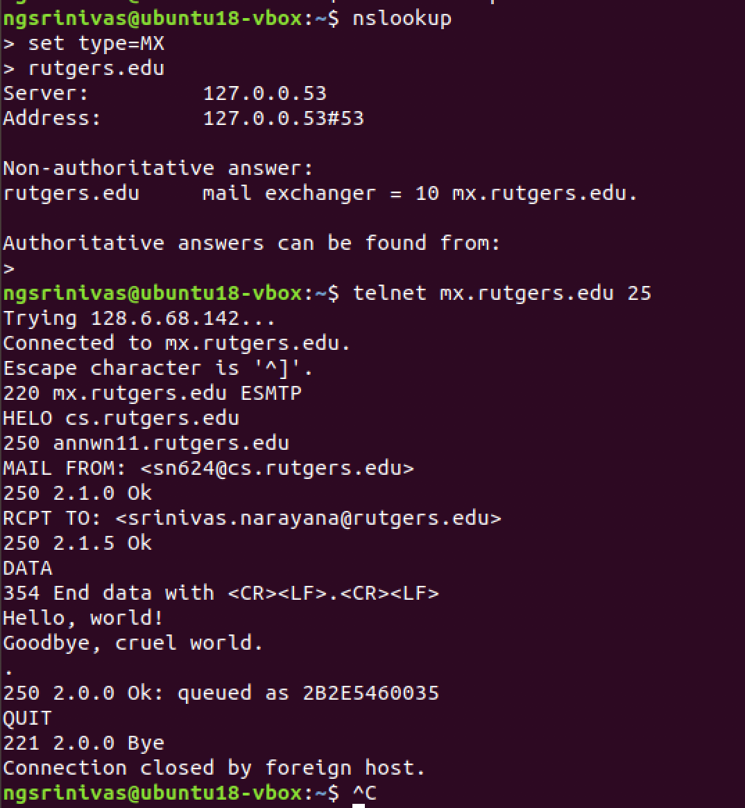

Slide 18
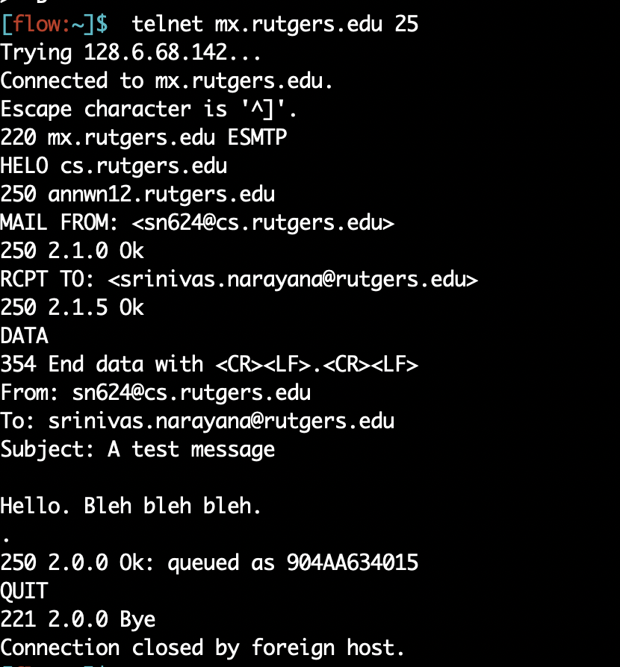

Slide 19
FTP
File Transfer Protocol

Slide 20
Client server connection
DNS
Host name
IP Address
IP Address, port 21
ftp commands
Data transfer, port 20

Slide 21
FTP: the file transfer protocol
FTP
user
interface
file transfer
FTP
client
FTP
server
user
at host
local file
system
remote file
system
transfer file to/from remote host
client/server model
client: side that initiates transfer (either to/from remote)
server: remote host
ftp: RFC 959
ftp server: port 21, port 20 (data connection)

Slide 22
FTP: separate control & data connections
“out of band” control
Control connection:
Authorization
Directory browse
Commands
Data connection
Transfer files
FTP server maintains “state”: current directory, earlier authentication
TCP control connection
port 21
FTP
client
TCP data connection
port 20
FTP
server

Slide 23
FTP commands, responses
Sample commands
sent as ASCII text over control channel
USER username
PASS password
LIST return list of file in current directory
RETR filename retrieves (gets) file
STOR filename stores (puts) file onto remote host
Sample return codes
status code and phrase (as in HTTP)
331 Username OK, password required
125 data connection already open; transfer starting
425 Can’t open data connection
452 Error writing file

Slide 24
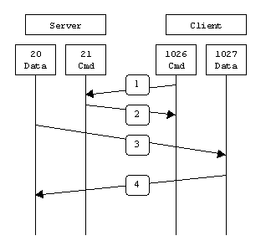
FTP Active connection
Data connection initiated from the server
Client opens a connection from port x for sending commands to server port 21
Server opens a connection from port 20 to send data at port x+1

Slide 25
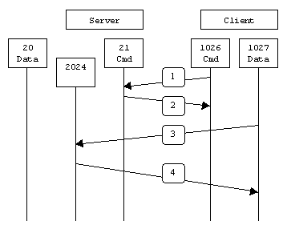
FTP passive connection (always client initiated)
Connections always initiated from the client
Client opens a connection from port x for sending commands to server port 21
Client sends a request for PASSIVE connection with PASV command
Server replies with a new port number S_{p} on which it is listening
Client opens a connection from port x+1 to server port S_{p}

Slide 26
Problems with FTP
Sends passwords in plain ASCII text
Eavesdropper can recover passwords
Fatal flaw, turned off at a lot of sites
Replaced with scp, sftp instead

Slide 27
Recall the Internet protocol stack…
Application
HTTPS
FTP
HTTP
SMTP
DNS
Transport
TCP
UDP
Network
IP
Host-to-Net
X.25
…
802.11
ATM

Slide 28
Themes from application-layer protocols
Request/response nature of protocols
Headers determine the actions of all the parties of the protocol
Separation of concerns: Examples:
Content rendering for users (browser, UA) separated from protocol ops (mail server)
Reliable mail reception: Retrieve email at an “always on” receiver mail server
Reliable mail sending: Send mail using a different machine rather than UA
In-band vs. out-of-band control: SMTP+HTTP vs. FTP
Q: How are commands recognized as distinct from data?
Keep it simple until you really need complexity
Examples: ASCII-based design; stateless servers
IMAP for email organization
Secure extensions for FTP and HTTP

Slide 29
Next: Transport
Application
HTTPS
FTP
HTTP
SMTP
DNS
Transport
TCP
UDP
Network
IP
Host-to-Net
X.25
…
802.11
ATM

