Slide 1

Network

Slide 2
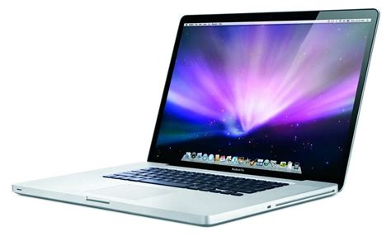


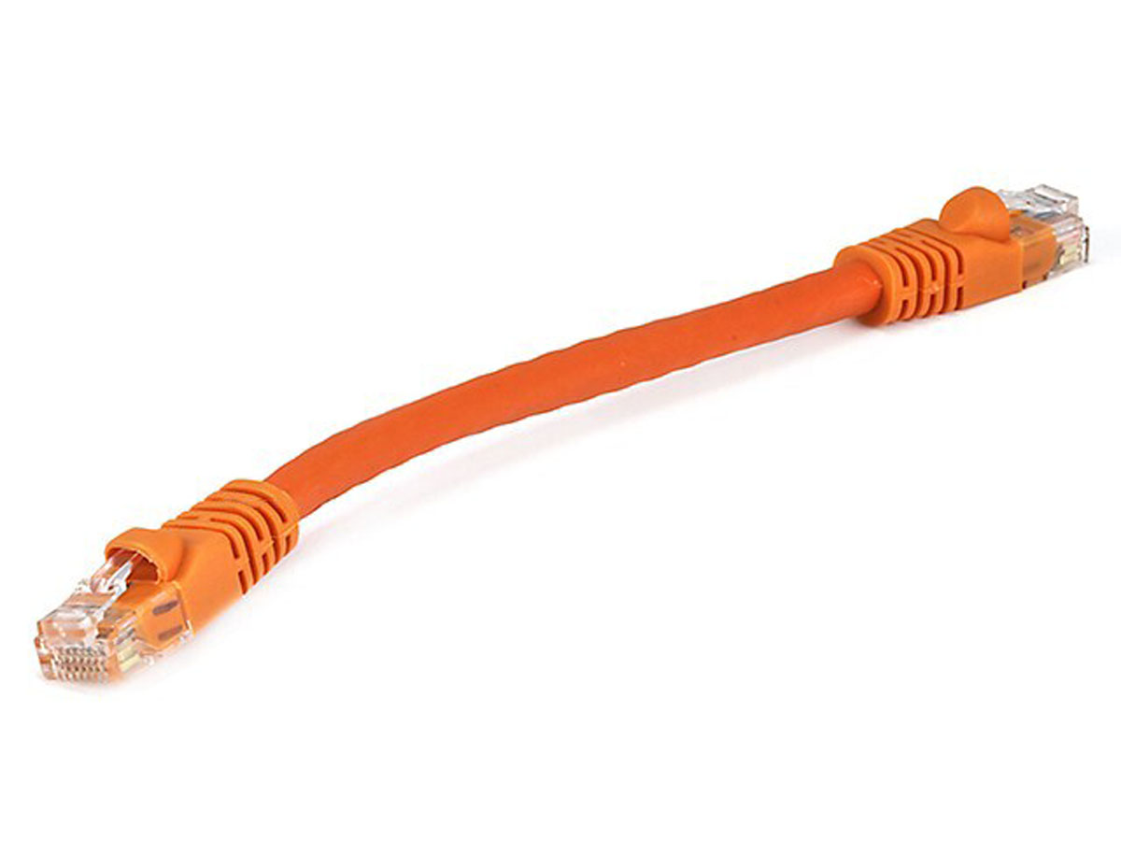
What’s in a router?
Queuing delay
Bottleneck queue
(max size B)
Link rate
Flows
Packet-switched core network

Slide 3

Control & Data Planes inside a router
Control plane
per route-change processing
(~ a few seconds)
Routing
Algorithm
control
plane
data
plane
Data plane
per-packet processing
(~ tens of nanoseconds)
0111
1
3
2
values in arriving
packet header

Slide 4
Hardware Router overview
Input port
Output port
Input port
Switching fabric
Output port
…
…
Input port
Output port
Line Termination
Parsing
Lookup & Modification
Buffering & Scheduling
Line Termination
(Match-Action)
(Traffic Management)

Slide 5
Study 2 designs
Historically evolving, multiple concurrent router designs
2 exemplars:
MGR: router from the late 1990s (50Gbit/s router, Partridge et al)
RMT: router from the late 2010s

Slide 6
Life of a Packet

Slide 7
(2) Packet parsing
Dividing a sentence into its grammatical parts:
“I ate an apple”
Sentence := Subject (I) Verb (ate) Object (an apple)
Object:= Article (an) Noun (apple)
Packet parsing: dividing sequence of bits into header fields
1100100101011
➔ ethernet destination (1100) | source (1001) | ethertype (01) | …
Unlike parsing English, parsing packets is quite mechanical
Series of extractions and branches to assign fields to packet bits
Parsing could be implemented in software (MGR) or hardware (RMT)

Slide 8
(2) Packet parsing
A key principle: Separate header and payload data paths
Router functionality is “header-heavy” but “payload-light”
Don’t move the payload around too much
Conserve bandwidth & resources for data moved inside the router
Header goes on as input to route lookup/packet modification
Payload sits on a buffer until router knows what to do with pkt
Buffer could be on the ingress line card (MGR) or a buffer shared between line cards (RMT)

Slide 9
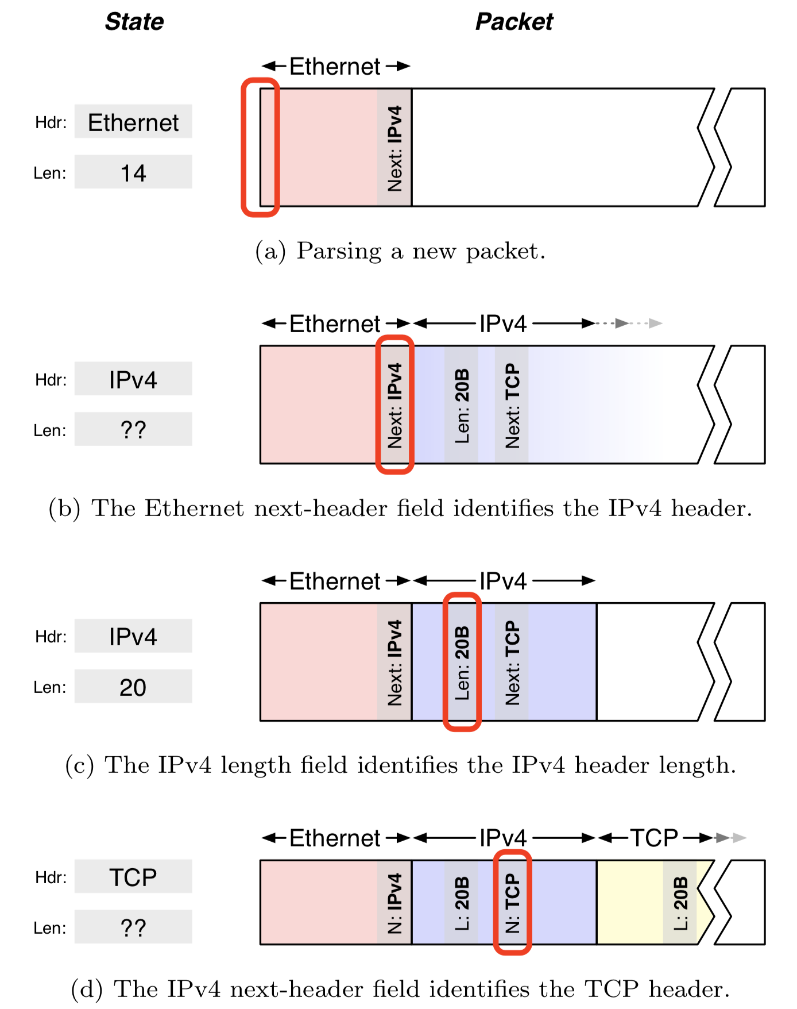
Parsing state machine
Parsing is an inherently sequential process
Previous header determines the next header type
Current header length determines the start of the next header
Parser state: tracks the current header and its length
Help jump to the next state
Source: Design principles for packet parsers, Gibb et al.

Slide 10
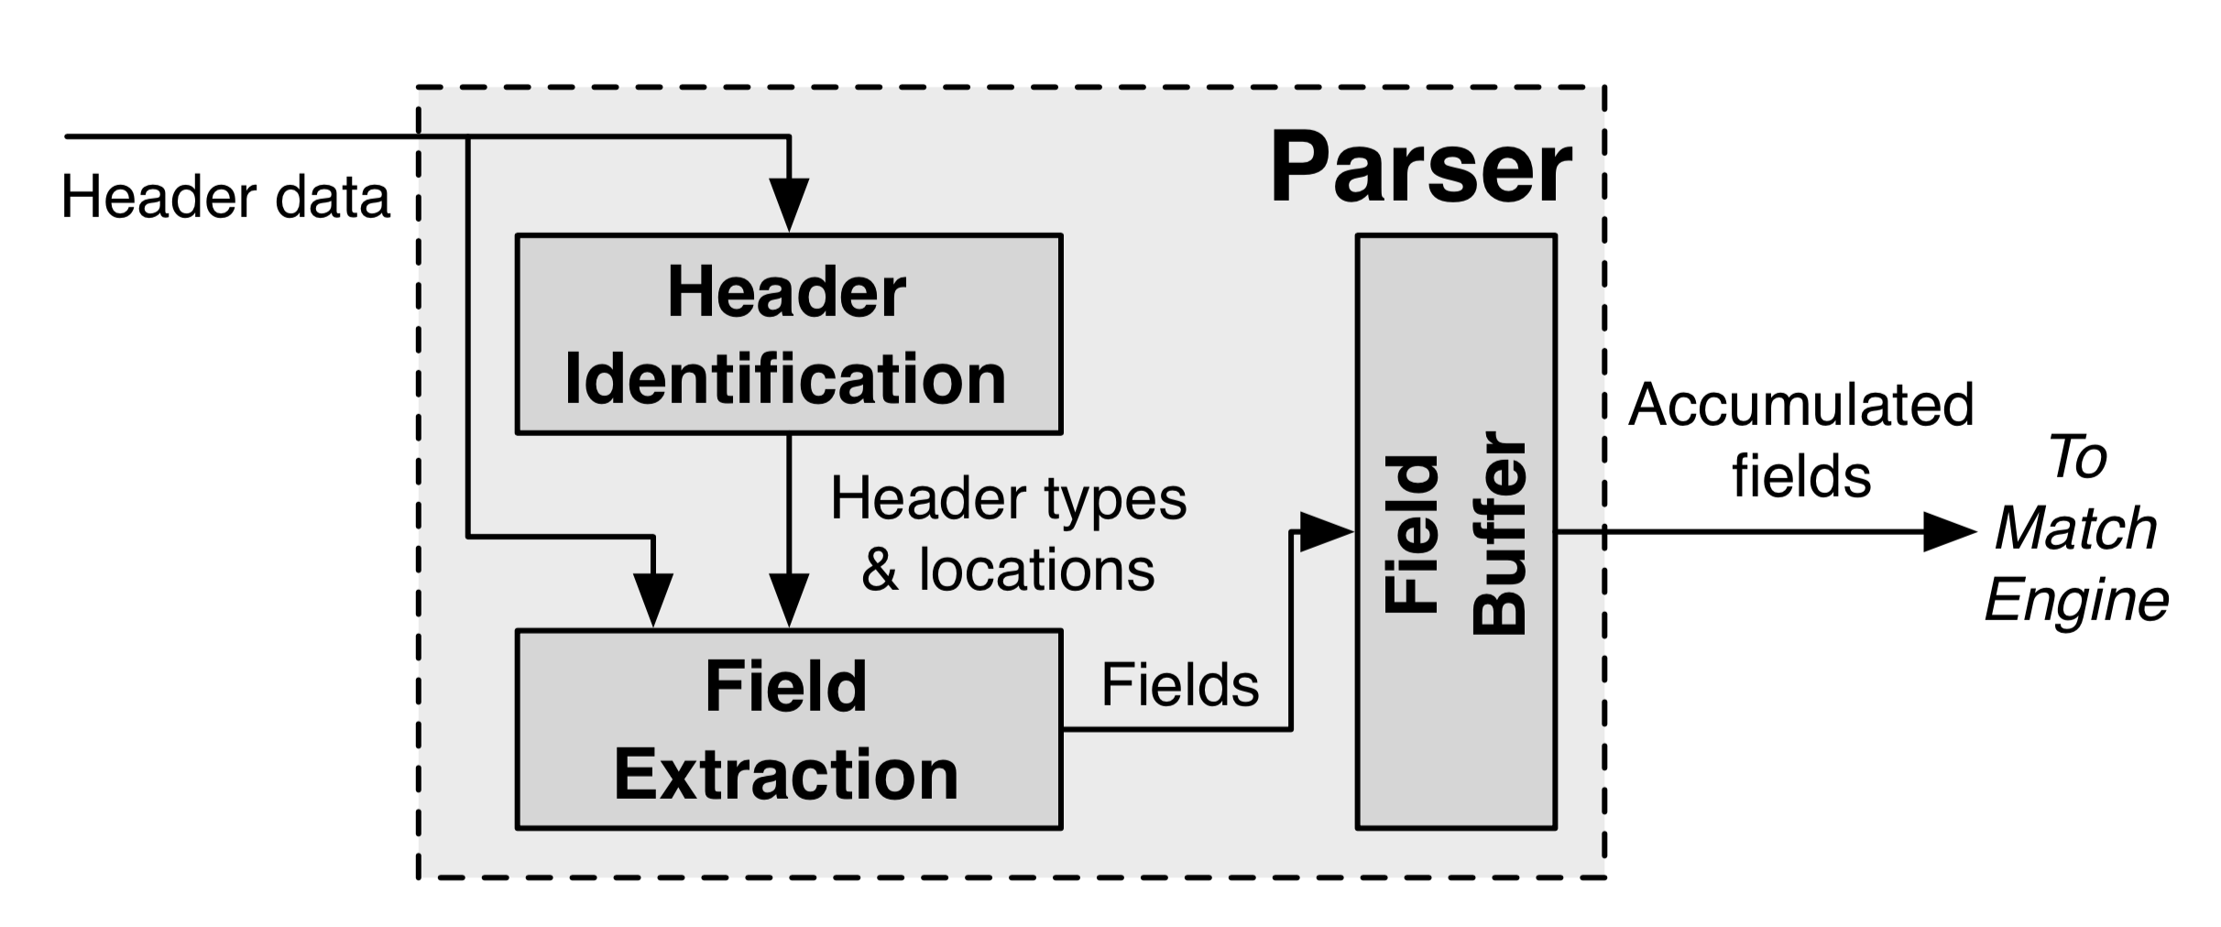
A hardware (fixed function) parser
Two steps:
Header identification: Identify sequence of headers
Extract fields from identified headers to send to matching components of tables
Design digital circuits with a high clock rate?

Slide 11
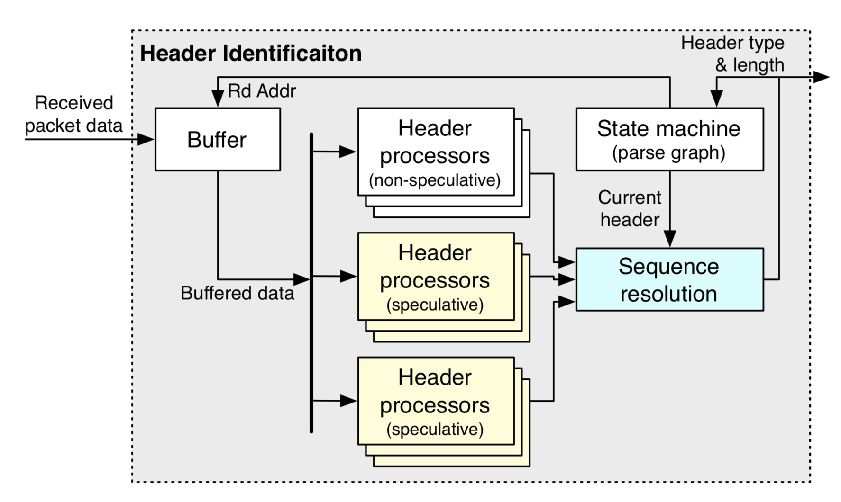
(Fixed function) header identification
Identify headers through fixed-function header processors
Simple design: extract one header per clock cycle
Speculate to extract multiple headers/cycle
Sequence resolution picks one

Slide 12
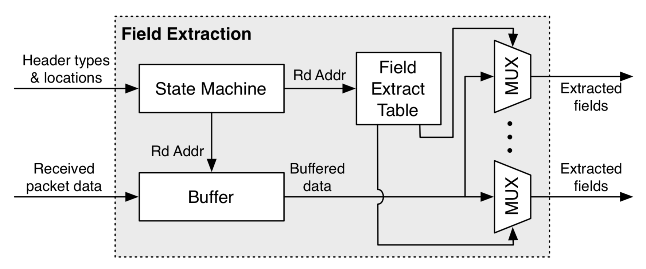
(Fixed function) field extraction
Extract fields using fixed offsets into the packet, depending on parser state
Field-extraction table is hard-coded for specific fields and protocols
E.g., IPv4 length: always at bytes 3 & 4

Slide 13
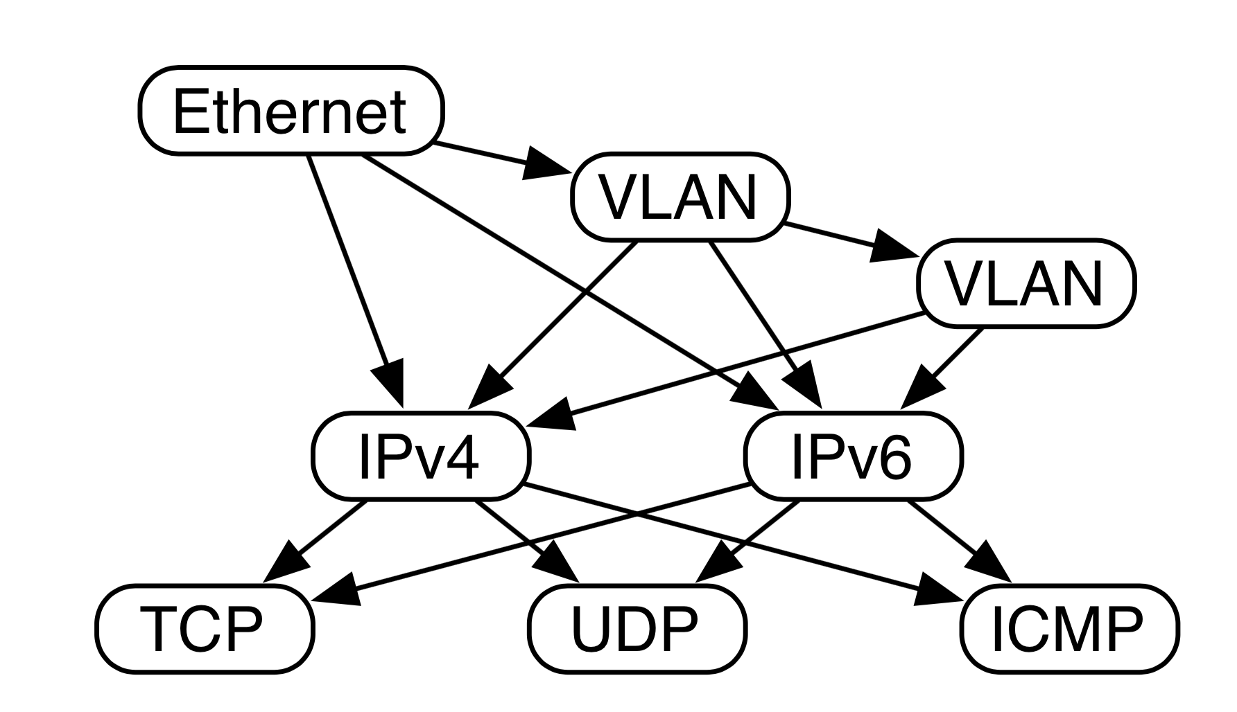
RMT makes parsing programmable
Parse graph: Representation of all valid header sequences you expect

Slide 14
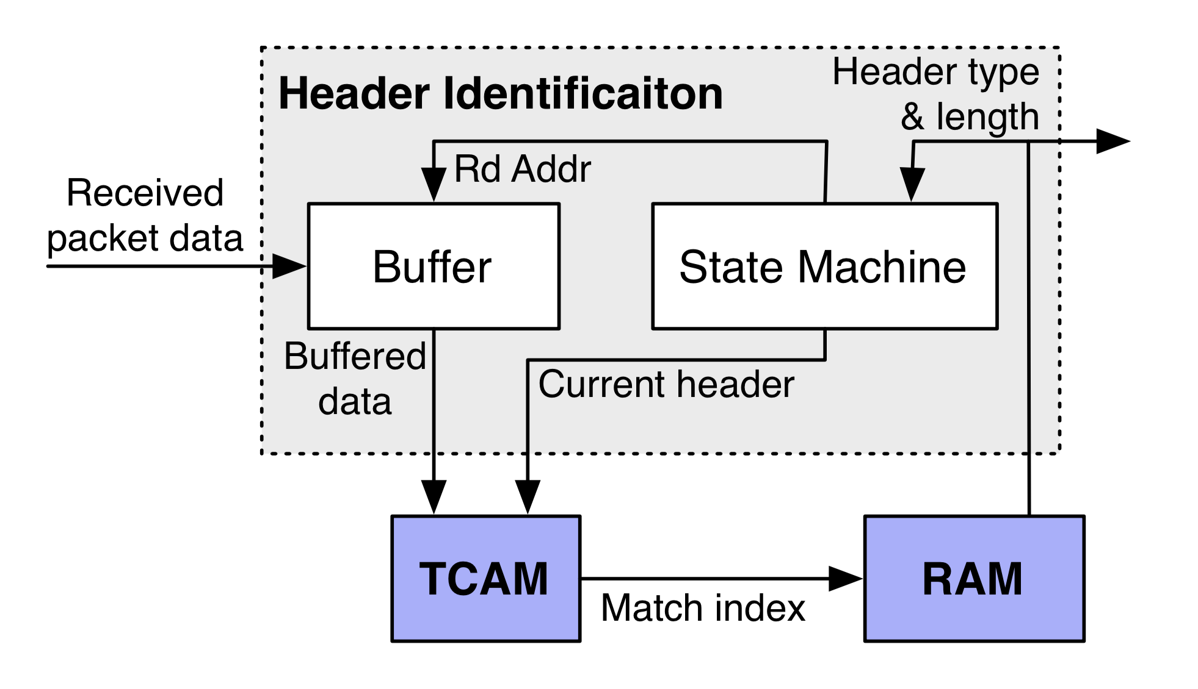
Programmable parser
Reprogrammable TCAM allows us to identify headers based on the protocol parse graph
Reprogrammable SRAM contains the protocol-dependent field extractions:
e.g., IPv4, byte 8 → TTL, 12—15 → IPv4 source address, etc.
Extracting the next header & length is a special case of generic field extractions for each protocol

Slide 15
Output of programmable parser
Vector of extracted packet fields and labels. Example:
Ethernet -> src: 1010..; dst: 0101…; ethertype: IPv4
IPv4 -> version: …; …
… <other headers>
Termed the packet header vector (PHV)
Fed into the packet lookup and modification engines

Slide 16
(3) Packet Lookup & Modification
The main job of a router is to forward packets to the correct output port(s)
Typically done by looking up a table of entries that were pre-computed by the control plane
Look-up tables with a range of sizes (# entries), widths (headers)
Packets may also need to be modified
RFC 1812 TTL decrement, recompute IP checksum, MAC rewrite, …
Virtualized public cloud: encap/decap headers
Outcome: a (set of) output ports + (possibly modified) headers

Slide 17
Typical table structures
Sequence of tables: L2, L3, ACL
Ethernet (L2) headers to forward packets within one IP network
IP (L3) headers to forward packets across IP networks
Access control lists (ACL) to implement firewalls & other policies
Different kinds of lookups possible:
Exact match
Longest prefix match
Wildcard match

Slide 18
Packet lookup in MGR
A forwarding engine card separate from line cards
Scale forwarding and interface capacity separately
Software: Use Alpha 21164 (a 415MHz generic processor)
Programmed in assembly to do route lookup and other processing.
Many optimizations to improve performance
Need for such optimizations continues today for software

Slide 19
MGR Software lookup performance
Separate fast path from slow path (optimize the common case)
ARP lookup, fragmentation, error handling
Try to fit all code into the processor instruction cache
Heavily use caching for table entries across different memories in a hierarchy
Traffic locality: a small fast memory can service “most” traffic
Two copies of table in external memory to support downtime-less updates to the forwarding table
However, can’t guarantee deterministic throughput for packets
Packet might access slower memories in the memory hierarchy

Slide 20
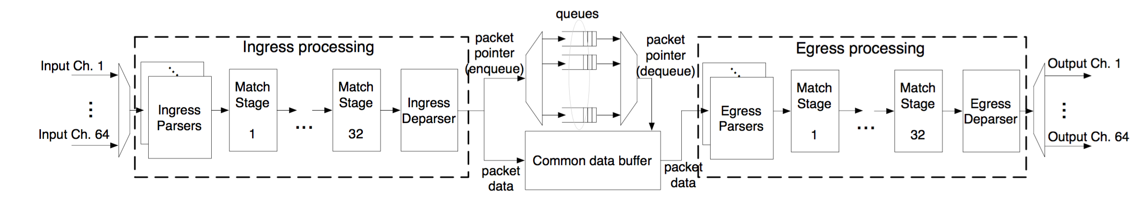
Packet lookup in RMT: Pipelined parallelism
Different functionalities (ex: L2, L3) in different table stages
Highly parallel over packets: admit 1 packet/cycle
Pipeline circuitry clocked at a high rate: ex: RMT@1 GHz
Deterministic throughput

Slide 21
Traditional pipelined hardware: fixed-function (Multiple Match-Action Tables)
L2 Table
IPv4 Table
IPv6 Table
ACL Table
L2 Hdr Actions
v4 Hdr Actions
v6 Hdr Actions
ACL Actions
Fixed Parser
Fixed Header Processing Pipeline

Slide 22
MMT isn’t enough!
Operators want new protocols and services
Virtualization and the cloud
VMs have their own address space (e.g., 10.0.x.x)
Physical networks route traffic using a different set of addresses (e.g., 128.6.x.x)
Keep them separate so you can place VMs wherever you can
Need: dedicated new packet headers to use for forwarding within the “core” fabric of the network
E.g., VXLAN, NVGRE
Research experimentation and domain-specific headers
E.g., finance; university campuses; network feedback signals

Slide 23
MMT isn’t enough!
Want to use table memory flexibly
Different environments need tables of different shapes and sizes
Enterprises: ACL-heavy (“students can see information sent to other students from professors, but cannot see info from professors to printers”)
Tier-1 ISP like ATT: L3-heavy (~1 million Internet IPv4 prefixes)
Static table sizes don’t work well
Can’t use another table’s memory, even if it is empty
Heterogenous devices to support different scenarios: complexity
Even device for a specific market may have insufficient resources

Slide 24
MMT isn’t enough!
All of this might be supported if switch hardware can be upgraded as often as software in general (e.g., on smartphone)
Unfortunately, the reality is very far from it:
Each device generation hardware upgrade: 3--5 years
New ASIC design, verification, fabrication, testing
Even software upgrades take time:
Features requested by other customers stand in the way of releasing new feature that one customer wants

Slide 25
RMT: Protocol Independent Switch Arch
Stages of Match-Action Tables
To egress pipeline
Memory
ALU
Programmable Parser
(Gibb et al, ANCS’13)
Programmable Match-Action Pipeline
(RMT, SIGCOMM’13)
Programmable scheduler
(PIFO, SIGCOMM’16)

Slide 26
A primer on high-speed memories
Computers have different kinds of memory
Fastest caches (L1, L2, …) made of SRAM
Fast main memory made of DRAM
Storage (HDD) made of magnetic disks, tape, SSDs, and so on
Translation Lookaside Buffer (TLB) with CAM/TCAM
Today’s high-speed routers use SRAM and TCAM
Static Random Access Memory for exact match
Ternary Content Addressable Memory for wildcard ACL match (also longest prefix match)

Slide 27
SRAM principles of operation
SRAM bank
Memory is organized into banks
Each bank can be independently accessed through an address
Data in the memory row at the address can be read/written each clock cycle
Banks of larger sizes are denser (fewer wires to run), but you can only read/write one data row per bank per clock cycle (reduced parallelism)
Looking up (ex: IPv4 dst) involves computing address(es) & reading mem
address
data row
address
address

Slide 28
TCAM principles of operation
TCAM bank
Banks are accessed using content, not addresses (CAM)
Contents of the memory are ternary: values can be 0, 1, or x (don’t care)
Incoming keys are matched against TCAM, with any bit accepted at the location of the wildcard bits
Ternary logic is power- and area-hungry relative to SRAM
0101
data row
0xx1
content
content

Slide 29
Match-Action Table memory design
Match and Action units supplied with the Packet Header Vector
Each stage accesses its own memory containing tables
RMT uses a crossbar to pick PHV fields for matching against contents of SRAM/TCAM banks
Flexible key generation for lookup
Distinction from fixed-function:
User-programmed fields stored in mem
Note: PHVs contain fields which are
programmatically chosen
PHV
+
xbar
Mem banks

Slide 30
Match-Action Table memory design
Entry looked up in the memory (SRAM/TCAM) contains a pointer to the instruction (action) for that entry
Instructions implemented through programmable ALUs
More general ALUs than fixed-function hardware devices
Feasible since compute components are extremely cheap
VLIW: operate on multiple headers simultaneously
Entry also contains pointers to:
Action data (e.g., port),
statistics (counters), if needed
ALUs
PHV

Slide 31
Achieving reconfigurable match-action
Separately configurable and addressable memory banks is the key to using tables flexibly
L2
PHV
L2
L2
L2
L2
L2
VS.
T1
T1
T2
T3
Fixed-function matching
Flexible match function
Achieved by running extra wires (for read/write) to each memory bank + extra crossbars for multiple parallel tables

Slide 32
Achieving reconfigurable match-action
Separately configurable and addressable memory banks is the key to using tables flexibly
L2
PHV
L2
L2
L2
L2
L2
VS.
T1
T1
T2
T3
Fixed-function matching
Flexible match function
Different memory banks can contain entries for different tables (e.g., IPv4 matching, ACL, …)

Slide 33
Achieving reconfigurable match-action
Separately configurable and addressable memory banks is the key to using tables flexibly
L2
PHV
L2
L2
L2
L2
L2
VS.
T1
T1
T2
T3
Fixed-function matching
Flexible match function
Each table in a match-action stage may use a different crossbar configuration to extract a different set of fields from the PHV

Slide 34
Achieving reconfigurable match-action
Separately configurable and addressable memory banks is the key to using tables flexibly
L2
PHV
L2
L2
L2
L2
L2
VS.
T1
T1
T2
T3
Fixed-function matching
Flexible match function
The cost: 14% extra area (& power) for the fatter wires

Slide 35
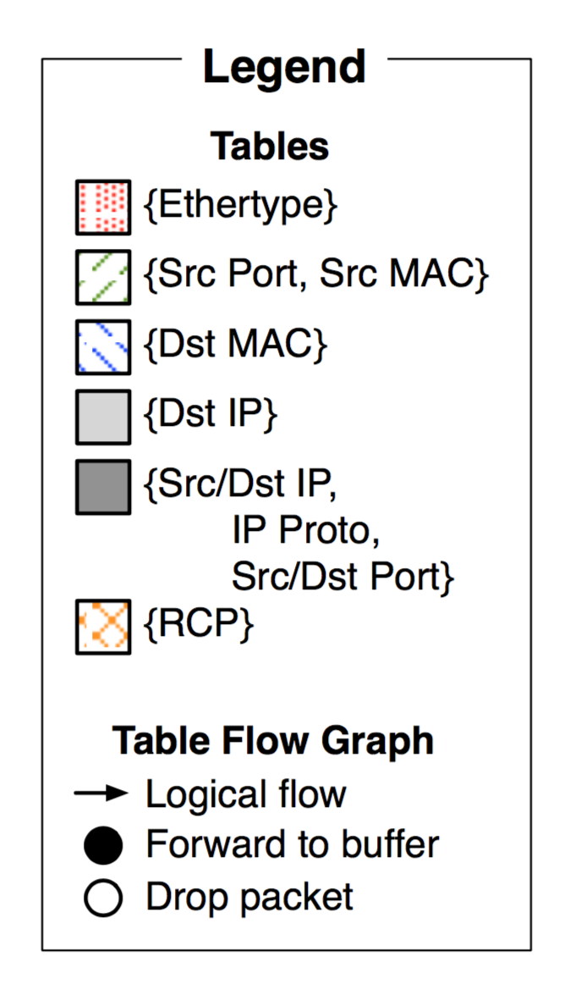
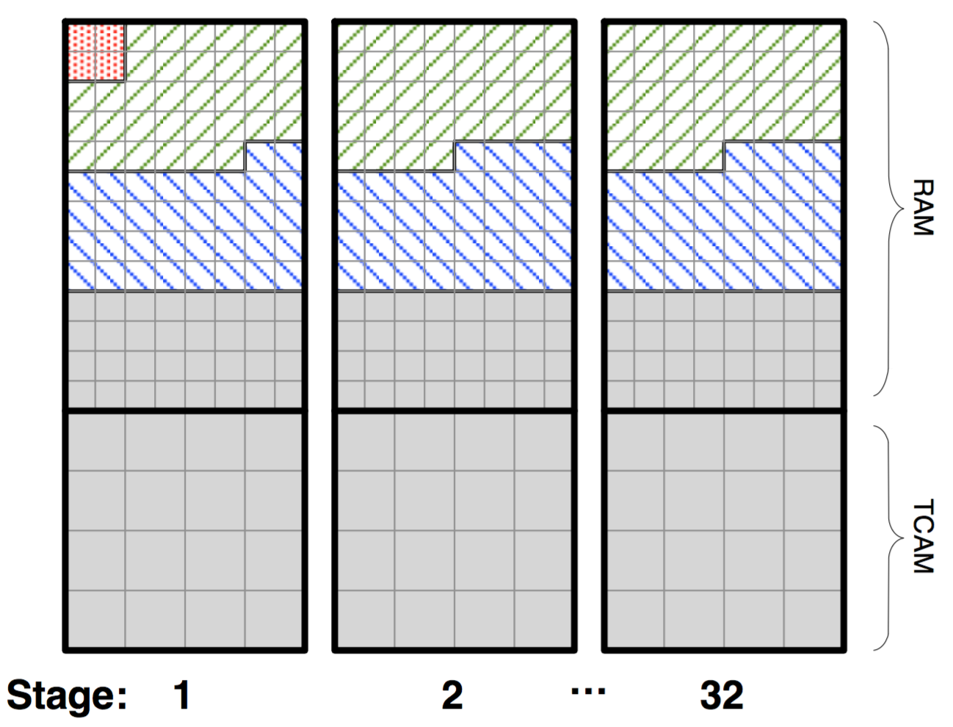
Memory layout and use matters
RMT: flexible partitioning of memory across SRAM and TCAM
Numerous fixed size memory blocks
Memory fragmentation possible
Circuitry for independent block-level access
Deterministic access times
All of it is SRAM or TCAM
Interesting compiler issues
“Packing” tables

Slide 36
Packet after route lookup
What we have after lookup and modifications:
One or more output ports, or a decision to drop
packet headers, possibly modified from ingress

Slide 39
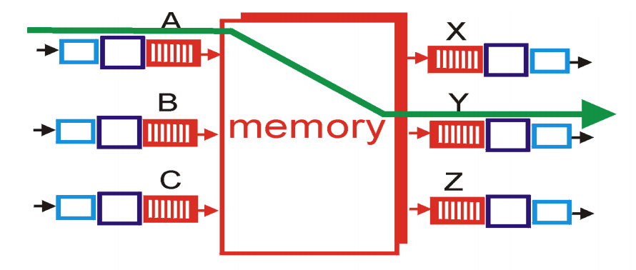
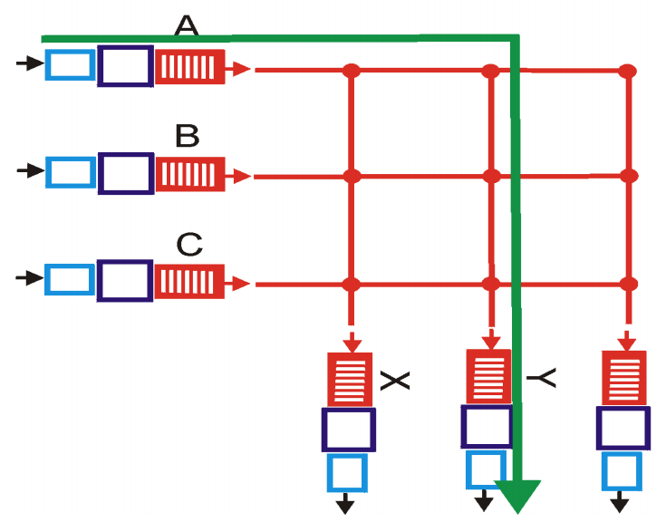
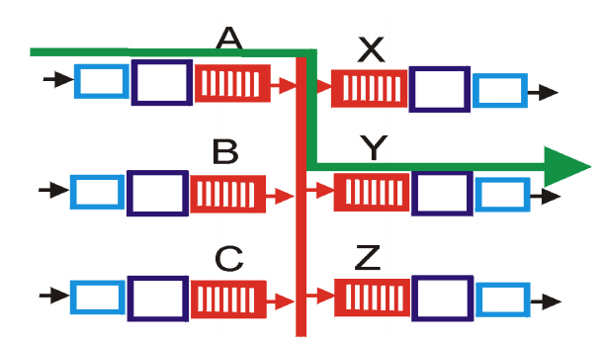
(4) Interconnect/Switching Fabric
Move headers and packet from one interface to another
Kinds of fabrics: memory, bus, crossbar

Slide 40
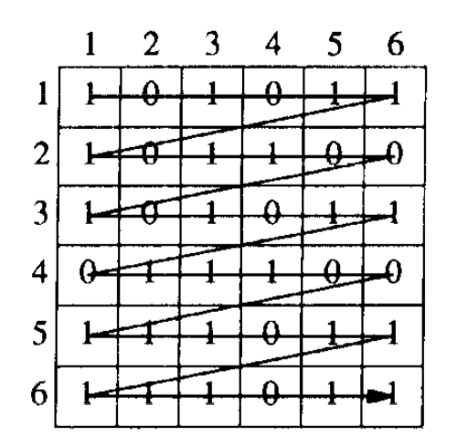
(4) Crossbars: The scheduling problem
Want to utilize fabric capacity regardless of demand pattern
Crossbar is non-blocking
MGR considers strategies to pair incoming demands & output ports
Greedy, wavefront, block wavefront
Need to address fairness across ports

Slide 41
(4) RMT switching fabric
RMT uses memory as the fabric to hold packet headers and payloads between any two interfaces
In the late 90s and early 2000s, there was considerable research on building high-speed packet buffers
Today: shared memory switches & routers (shared ➔ across ports)
Fast memory can be clocked at 1 GHz
Fundamental tradeoff: faster memories are not very dense
Can’t make the memory too large
Can’t hold too many packets!
Workaround: use memory access patterns: e.g., each queue is FIFO
Traffic manager implements scheduling & buffer management

Slide 42
(5) Traffic Manager
Where should the packets not currently serviced wait?
Two designs: Input-queued vs. output-queued
Output queueing avoids HOL blocking exhibited by input queueing.
Suppose port 1 wants to send to both 2 and 3 but port 2 busy
Packets from p1 towards p3 need not be delayed

Slide 43
(5) Traffic Manager
RMT: Queueing represents output port contention
A single output port can be represented by multiple queues
e.g., to implement weighted fair queueing
Each queue is just a linked list in the shared memory
Maximum flexibility in queue sizes, but pointer overhead
Separate memory to maintain per-queue heads and tails

Slide 44
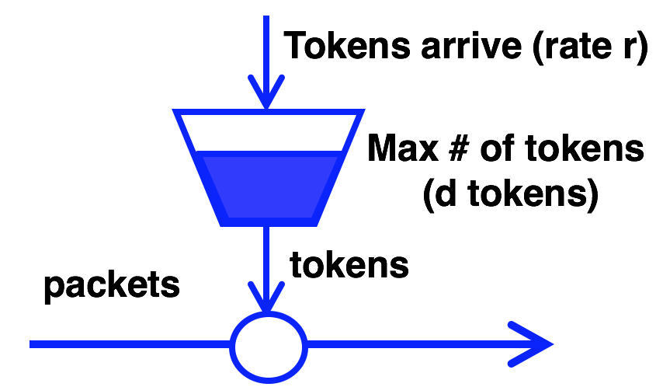
(5) Traffic Manager: Scheduling policies
Q: how to dequeue packets from the buffer?
Fair queueing across ports or flows
Strict prioritization of some ports over others
Rate limiting per port

Slide 45

(5) Traffic Manager: Buffer Management
Q: how to enqueue packets into buffer?
If buffer is full, which packet should be dropped?
Typical buffer management: Tail-drop
Want fairness: if queue 1 has too many buffered pkts, don’t tail-drop q2
Share memory by partitioning (carving memory out) across queues
And efficiency
if q1 has no pkts, q2 should be able to use (nearly) all buffer memory
Interesting space for dynamic buffer management algorithms
e.g., Dynamic queue length thresholds for shared-memory packet switches (Choudhury and Hahne)

Slide 46
(6) Egress line termination
Combine headers with payload for transmission
Must incorporate effect of header modifications
Also called deparsing or serialization
Multicast: egress-specific packet processing
Ex: different source MAC address for each output port
Multicast makes almost everything inside the switch (interconnect, lookups, queueing) more complex

Slide 47
Summary
Packet buffer memory is a precious resource
Modern routers have a few tens of MegaBytes buffer
… for all packets across all ports
Traffic Manager: scheduling and buffer-management algorithms
Buffer memory costs substantial amount: capital, area, power
Data centers: cheap routers with shallow buffers

Slide 48
Three kinds of data plane programmability
Packet header formats, i.e., the packet parser
Example: Go from IPv4 -> IPv6
Custom packet format to carry financial info at high speed on a point-to-point link
Table formats, actions, sizes, i.e., the match-action tables
Change which fields in the packet can be processed by a table
Control the table sizes, i.e., # entries, and hence the memory resource footprint according to use case.

Slide 49
Three kinds of data plane programmability
Packet scheduling, i.e., the traffic manager
Flexible classification of packets
Flexible assignment of ordering and timing of when packets are transmitted from an outgoing link

Slide 50
… distinct from control plane programmability
The control plane must compute the packet-processing rules put into the memory on the router ASIC
Example: packet with IPv4 destination 10.0.0.1 must go out of port 4
Data plane programmability refers to the flexibility in the allowed set of packet headers, tables, and actions themselves, not the actual rules.
Example: There is a table that matches on IPv4 destination addr whose action is to determine the output port

