Slide 1

Congestion Control II
Lecture 18
http://www.cs.rutgers.edu/~sn624/352-F24
Srinivas Narayana

Slide 2



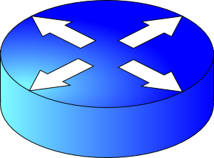


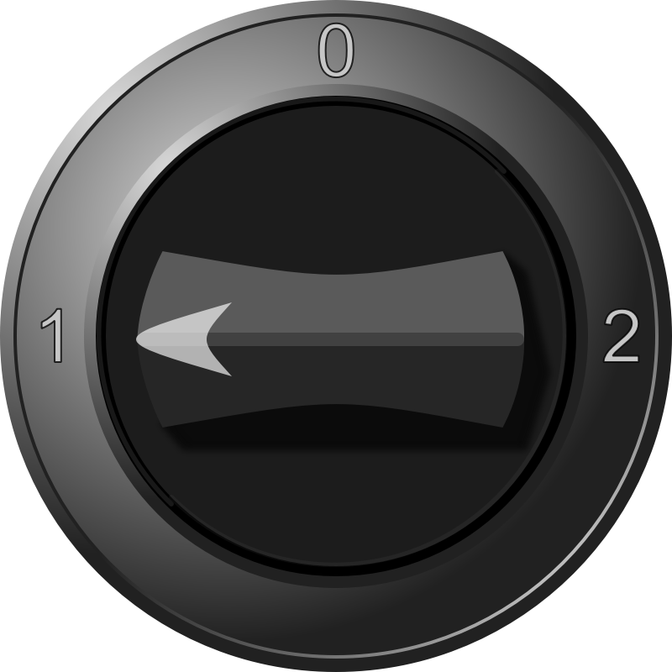
sender
Multiple locations for bottlenecks
application
process
recv()
TCP socket
receiver buffers
Congestion Control
Flow Control
What’s the bottleneck? How to adapt how much data to keep in flight?
TCP
code
from sender
Distributed algorithm converging to an efficient and fair outcome
Sense and React
receiver
TCP congestion control algorithm
Steady state?
How to get to steady state?
Loss, ACKs, etc.
Congestion window, sending rate
H
C
Bottleneck link
Signals
Knobs

Slide 3
Congestion window
The sender maintains an estimate of the amount of in-flight data needed to keep the link fully busy without congesting it
This estimate is called the congestion window (cwnd)
Recall: There is a relationship between the sending rate (throughput) and the sender’s window: sender transmits a window’s worth of data over an RTT duration
Rate = window / RTT

Slide 4
Interaction b/w flow & congestion control
Use window = min(congestion window, receiver advertised window)
Overwhelm neither the receiver nor network links & routers
Window <= Congestion window (congestion control)
Window <= Advertised window (flow control)
Sender’s view:
0
1
2
3
4
5
6
7
0
1
Last cumulative
ACK’ed seq #
Last transmitted
seq #

Slide 5

Review: Steady state operation
(2) Keep transmissions over the bottleneck link back to back
Send packet burst (as allowed by window)
Data
Receive data packet
(1) Keep transmissions ACK-clocked: Send new data on ACK
Sender
Receiver
Receive ACK
Send ACK
ACKs

Slide 6
Review: Slow start
Problems:
Congestion window grows too fast!
Congestion window drops too fast!
Need gentler adaptation of cwnd closer to steady state
Q: How to get to steady state?
Packet drops/
RTO
Congestion Window
Slow start
Slow start
Slow start
1 MSS
Time

Slide 7
TCP Congestion Avoidance

Slide 8
Two congestion control algorithms
TCP New Reno
The most studied, classic “textbook” TCP algorithm
The primary knob is congestion window
The primary signal is packet loss (RTO)
Adjustment using additive increase
TCP BBR
Recent algorithm developed & deployed by Google
The primary knob is sending rate
The primary signal is rate of incoming ACKs
Adjustment using gain cycling and filters

Slide 9
TCP New Reno: Additive Increase
Remember the recent past to find a good estimate of link rate
The last good cwnd without packet drop is a good indicator
TCP New Reno calls this the slow start threshold (ssthresh)
Increase cwnd by 1 MSS every RTT after cwnd hits ssthresh
Effect: increase window additively per RTT
Host A
Host B
say ssthresh=4
four segments
RTT
five segments
RTT
six segments
RTT
seven segments
…
time

Slide 10
TCP New Reno: Additive increase
Start with ssthresh = 64K bytes (TCP default)
Do slow start until ssthresh
Once the threshold is passed, do additive increase
Add one MSS to cwnd for each cwnd worth data ACK’ed
For each MSS ACK’ed, cwnd = cwnd + (MSS/cwnd) * MSS
Upon a TCP timeout (RTO),
Set cwnd = 1 MSS
Set ssthresh = max(2 * MSS, 0.5 * cwnd)
i.e., the next linear increase will start at half the current cwnd

Slide 11
Behavior of Additive Increase
Say MSS = 1 KByte
Default ssthresh = 64KB = 64 MSS
Packet drops/
RTO
Loss occurs at cwnd = 54K
Loss occurs at cwnd = 40K
54 MSS
Additive increase
Set ssthresh to
27 MSS
Additive increase
Congestion Window
Set ssthresh to
20 MSS
Slow start
Slow start
Slow
start
1K
Time

Slide 12
TCP BBR: finding the bottleneck link rate
1. Send data at a specific rate
Data gets across the bottleneck at the bottleneck link rate.
2. Receive data packet
Use ACK receive rate to determine sending rate
Data
Sender
Receiver
4. Measure rate of incoming ACKs
3. Send ACK
ACKs

Slide 13
TCP BBR: finding the bottleneck link rate
Assuming that the link rate of the bottleneck
== the rate of data getting across the bottleneck link
== the rate of data getting to the receiver
== the rate at which ACKs are generated by the receiver
== the rate at which ACKs reach the sender
Measuring ACK rate provides an estimate of bottleneck link rate
BBR: Send at the maximum ACK rate measured in the recent past
Update max with new bottleneck rate estimates, i.e., larger ACK rate
Forget estimates last measured a long time ago
Incorporated into a rate filter

Slide 14
TCP BBR: Adjustments by gain cycling
BBR periodically increases its sending rate by a gain factor to see if the link rate has increased (e.g., due to a path change)
Steady state operation: constant sending rate
Last max ACK rate was measured a while ago. Forget it & use a more recent max ACK rate
…
Gain cycle
Sending rate
…
Filter
No change
in ACK rate
Detect higher ACK rate:
Update sending rate
Bottleneck link rate increase
Time
Bottleneck link rate decrease

Slide 15
Bandwidth-Delay Product

Slide 16
Steady state cwnd for a single flow
Suppose the bottleneck link has rate C
Suppose the propagation round-trip delay (propRTT) between sender and receiver is T
Ignore transmission delays for this example;
Assume steady state: highest sending rate with no bottleneck congestion; back-to-back packets over bottleneck link
Q: how much data is in flight over a single RTT?
C * T data i.e., amount of data unACKed at any point in time
ACKs take time T to arrive (without any queueing). In the meantime, sender is transmitting at rate C

Slide 17
The Bandwidth-Delay Product
C * T = bandwidth-delay product:
The amount of data in flight for a sender transmitting at the ideal rate during the ideal round-trip delay of a packet
Note: this is just the amount of data “on the pipes”
Data
C * T

Slide 18
The Bandwidth-Delay Product
Q: What happens if cwnd > C * T?
i.e., where are the rest of the in-flight packets?
A: Waiting at the bottleneck router queues
Data
C * T

Slide 19
Router buffers and the max cwnd
Router buffer memory is finite: queues can only be so long
If the router buffer size is B, there is at most B data waiting in the queue
If cwnd increases beyond C * T + B, data is dropped!
B
Data
C * T

Slide 20
Summary
Bandwidth-Delay Product (BDP) governs the window size of a single flow at steady state
The bottleneck router buffer size governs how much the cwnd can exceed the BDP before packet drops occur
BDP is the ideal desired window size to use the full bottleneck link, without any queueing.
Accommodating flow control, also the min socket buffer size to use the bottleneck link fully:
Important to set socket buffer sizes well for high BDP paths

Slide 21
Detecting and Reacting to Packet Loss

Slide 22
Detecting packet loss
Congestion Window
Grow too fast
Drop too fast
1 MSS
Time
So far, all the algorithms we’ve studied have a coarse loss detection mechanism: RTO timer expiration
Let the RTO expire, drop cwnd all the way to 1 MSS
Analogy: you’re driving a car
You accelerate until the next car in front is super close to you (RTO) and then hit the brakes hard (cwnd := 1)
Q: Can you see obstacles from afar and slow down proportionately?
That is, can the sender see packet loss coming in advance?
And reduce cwnd more gently?

Slide 23
Can we detect loss earlier than RTO?
Key idea: use the information in the ACKs. How?
Suppose successive (cumulative) ACKs contain the same ACK#
Also called duplicate ACKs
Occur when network is reordering packets, or one (but not most) packets in the window were lost
Reduce cwnd when you see many duplicate ACKs
Consider many dup ACKs a strong indication that packet was lost
Default threshold: 3 dup ACKs, i.e., triple duplicate ACK
Make cwnd reduction gentler than setting cwnd = 1; recover faster

Slide 24
Fast Retransmit & Fast Recovery

Slide 25
Distinction: In-flight versus window
So far, window and in-flight referred to the same data
Fast retransmit/recovery differentiate the two notions
cwnd = 6
inflight = 3
Sender’s view:
0
1
2
3
4
5
6
7
0
1
0
1
2
3
4
5
6
7
0
1
Triple duplicate ACKs
(assume subsequent 3 pieces of data were successfully received)
Last cumulative
ACK’ed seq #
Last transmitted
seq #
cwnd is the interval between the last cumulatively ACK’ed seq# and the last transmitted seq#
inflight is the data currently believed to be in flight.

Slide 26
TCP fast retransmit (RFC 2581)
The fact that ACKs are coming means that data is getting delivered to the receiver, although with some loss.
Before the dup ACKs arrive, we assume inflight = cwnd
TCP sender does two actions with fast retransmit

Slide 27
TCP fast retransmit (RFC 2581)
(1) Reduce the cwnd and in-flight gently
Don’t drop cwnd all the way down to 1 MSS
Reduce the amount of in-flight data multiplicatively
Set inflight → inflight / 2
That is, set cwnd = (inflight / 2) + 3MSS
This step is called multiplicative decrease
Algorithm also sets ssthresh to inflight / 2

Slide 28
TCP fast retransmit (RFC 2581)
Example: Suppose cwnd and inflight (before triple dup ACK) were both 8 MSS.
After triple dup ACK, reduce inflight to 4 MSS
Assume 3 of those 8 MSS no longer in flight; set cwnd = 7 MSS
Updated to
inflight = 4
cwnd = 7
cwnd = inflight = 8
0
1
2
3
4
5
6
7
0
1
2
3
4
5
6
7
0
1
5
Last cumulative
ACK’ed seq #
Assumed not in flight (dup ACK)

Slide 29
TCP fast retransmit (RFC 2581)
(2) The seq# from dup ACKs is immediately retransmitted
That is, don’t wait for an RTO if there is sufficiently strong evidence that a packet was lost

Slide 30
TCP fast recovery (RFC 2581)
Sender keeps the reduced inflight until a new ACK arrives
New ACK: an ACK for the seq# that was just retransmitted
Cumulative ACK may also indicate the (three or more) pieces of data that were previously delivered to generate the duplicate ACKs
Conserve packets in flight: transmit some data over lossy periods (rather than no data, which would happen if cwnd := 1)

Slide 31
TCP fast recovery (RFC 2581)
Keep incrementing cwnd by 1 MSS for each dup ACK
cwnd = 6
inflight = 3
0
1
2
3
4
5
6
7
0
1
2
3
4
5
6
7
0
1
5
Last cumulative
ACK’ed seq #
Assumed not in flight (dup ACK)

Slide 32
TCP fast recovery (RFC 2581)
Keep incrementing cwnd by 1 MSS for each dup ACK
cwnd = 7
inflight = 3
0
1
2
3
4
5
6
7
0
1
2
3
4
5
6
7
0
1
Last cumulative
ACK’ed seq #
Assumed not in flight (dup ACK)

Slide 33
TCP fast recovery (RFC 2581)
Keep incrementing cwnd by 1 MSS for each dup ACK
cwnd = 8
inflight = 3
0
1
2
3
4
5
6
7
0
1
2
3
4
5
6
7
0
1
Last cumulative
ACK’ed seq #
Assumed not in flight (dup ACK)

Slide 34
TCP fast recovery (RFC 2581)
Eventually a new ACK arrives, acknowledging the retransmitted data and all data in between
Deflate cwnd to half of cwnd before fast retransmit.
cwnd and inflight are aligned and equal once again
Perform additive increase from this point!
cwnd = 3
inflight = 3
0
1
2
3
4
5
6
7
0
1
2
3
4
5
6
7
0
1
Last cumulative
ACK’ed seq #
New ACK acknowledged this data

Slide 35
Additive Increase/Multiplicative Decrease
Say MSS = 1 KByte
Default ssthresh = 64KB = 64 MSS
Triple duplicate ACK
Fast retransmit: (1) retransmit dup-ACKed segment
Perceived loss occurs at cwnd = 80K
Switch to additive increase at cwnd = ssthresh = 64K
New ACK
RTO
(2) Multiplicative decrease
In-flight data
Additive increase
Additive increase
RTO: window drops all the way to 1 MSS
Slow start
(2) Set inflight = ssthresh = 40K
Fast recovery keeps inflight stable until new ACK
1K
Time

Slide 36
TCP New Reno performs additive increase and multiplicative decrease of congestion window.
In short, we often refer to this as AIMD.
Multiplicative decrease is a part of all TCP algorithms, including BBR.
[It is necessary for fairness across TCP flows.]

Slide 37
Summary: TCP loss detection & reaction
Don’t wait for an RTO and then set the cwnd to 1 MSS
Instead, react proportionately by sensing pkt loss in advance
Fast Retransmit
Triple dup ACK: sufficiently strong signal that network has dropped data, before RTO
Immediately retransmit data
Multiplicatively decrease in-flight data to half of its value
Fast Recovery
Maintain this reduced amount of in-flight data as long as dup ACKs arrive
Data is successfully getting delivered
When new ACK arrives, do additive increase from there on

Slide 38
Connection Management
How does a TCP connection start?

Slide 39




Starting a TCP connection
TCP requires sender/receiver to set up some context
Sequence numbers, window size, buffers, OS table entries
Let’s talk. Here’s my request.
RTO
Provision enough socket buffers.
Sender
e.g., browser
Connection finished. Server forgot.
Attack by resource exhaustion at server
(SYN flood)
Receiver
e.g., web server
OK. Here’s my response.
Entries in operating system tables (connection lookup), choose sequence #, etc.
Server thinks new connection, may accept data!

Slide 40
Starting a TCP connection
TCP requires sender/receiver to set up some context
Sequence numbers, window size, buffers, OS table entries
Let’s talk. Here’s my request.
Provision enough socket buffers.
Sender
e.g., browser
Attack by resource exhaustion at server
(SYN flood)
Receiver
e.g., web server
OK. Here’s my response.
Entries in operating system tables (connection lookup), choose sequence #, etc.

Slide 41
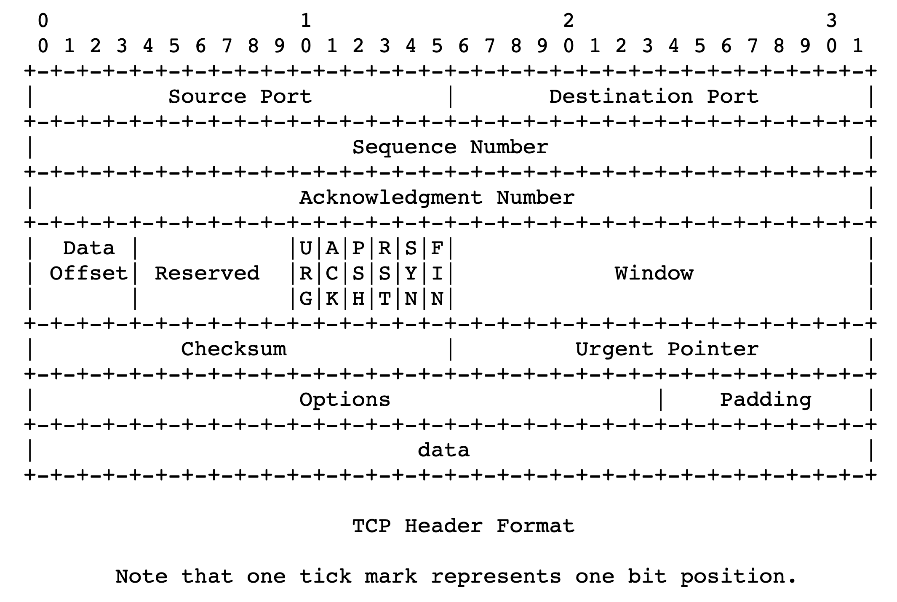
TCP 3-way handshake
Server state
ss = socket(AF_INET,SOCK_STREAM)
ss.bind((‘’,server_port))
ss.listen(1)
csockid, addr = ss.accept()
Client state
cs = socket(AF_INET, SOCK_STREAM)
LISTEN
cs.connect((host,server_port))
LISTEN
choose init seq num, x
send TCP SYN msg
No app data
SYNbit=1, Seq=x
SYNSENT
choose init seq num, y
send TCP SYNACK
msg, acking SYN
SYN RCVD
SYNbit=1, Seq=y
ACKbit=1; ACKnum=x+1
received SYNACK(x)
indicates server is live;
send ACK for SYNACK;
this segment may contain
client-to-server data
received ACK(y)
indicates client is live
ESTAB
ACKbit=1, ACKnum=y+1
Provision resources
ESTAB
Notes:
TCP’s three way handshake, that operates as follows
Let’s say the client and server both create a TCP socket as we learned about in Chapter 2 and enter the LISTEN state
The client then connects to the server sending a SYN message with a sequence number x (SYN Message is an TCP Segment with SYN but set in the header – you might want to go back and review the TCP segment format!)
The server is waiting for a connection, and receives the SYN message enters the SYN received state (NOT the established state and sends a SYN ACK message back.
Finally the client sends an ACK message to the server, and when the server receiver this enters the ESTABLished state. This is when the application process would see the return from the wait on the socket accept() call

Slide 42
Implications of 3-way handshake
Any application data can only be sent an RTT after
Fresh connection: at least 2 RTTs to get a response
Often fruitful to use persistent connections
Measures to address this startup delay:
TCP fast open
QUIC

