Slide 1

Programmable Software Switches
Lecture 11, Computer Networks (198:552)

Slide 2
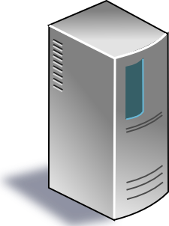



Software-Defined Network (SDN)
Centralized control plane
Data plane
Data plane
Data plane
Data plane

Slide 3
Why software switching?
Early roots in networking: first switches were fully in software
… until high link speeds forced everyone to make ASICs
A tool for experimentation
Virtualization: need flexible switching policies inside endpoint!
Why switching?
Where is all the policy coming from?

Slide 4
What do software switches need to do?
Forward packets based on specified rules
Allow changing the forwarding rules frequently
Provide high performance
High throughput and low latency
Be robust
Different traffic patterns (e.g., port scans)
Can we make performance deterministic?

Slide 5
A conventional packet data path
L2 matching
(exact match on 48-bit MAC address)
L3 matching
(Longest-prefix-match on 32-bit IP address)
Access Control List (ACL)
(flexible fields + priorities)
pkt

Slide 6
A packet data path in a virtualized cluster
Multiple logical data paths with frequent rule changes
…
…
…
Tenant policies
Provider policies
Topology traversal

Slide 7
High performance is challenging
Lots of lookups
Compute hashes and maintain other data structures
Large tables: numerous highly-specific keys
User-kernel crossings
Programmable toolchain much easier to build in user space
Rules and policies change a lot
New tenants, new endpoints, VM migrations, …
Need to understand computer systems deeply
Costs of memory accesses and hash computations
Core/thread-level parallelism, NIC-queue-to-core mapping, etc.

Slide 8
A few other quirks to accommodate
Metadata carried between table stages
Ex: Late-bind forwarding decisions
Ex: Accumulate partial field modifications before one-shot write
Statistics per flow
Counters
Timeouts
Stateful processing
Connection tracking for firewalls: e.g., TCP establishment state
NAT, DNS tunnel detection, load balancing, …
<insert your idea here!>

Slide 9
Papers for today: Click and OpenVSwitch
Each highly influential in its own right
Click spurred a lot of work in flexible router design
OVS spurred work on programmable networks
Useful software tools: Course project and beyond!
Useful tools layered on top
Mininet, network functions, ...
Active research area: packet processing performance + flexibility
Kernel bypass
Hardware offloads
Kernel network stack optimizations

Slide 10
The Design and Implementation of OpenVSwitch
Usenix NSDI ‘15
Ben Pfaff et al.

Slide 11
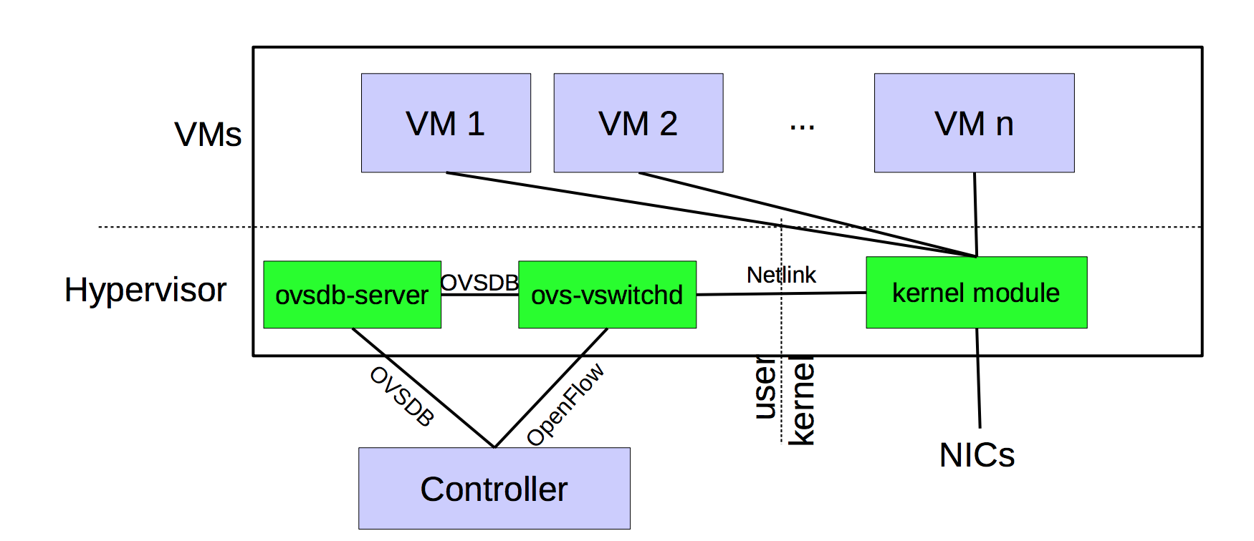
Deployment setting: Virtualized clusters

Slide 12
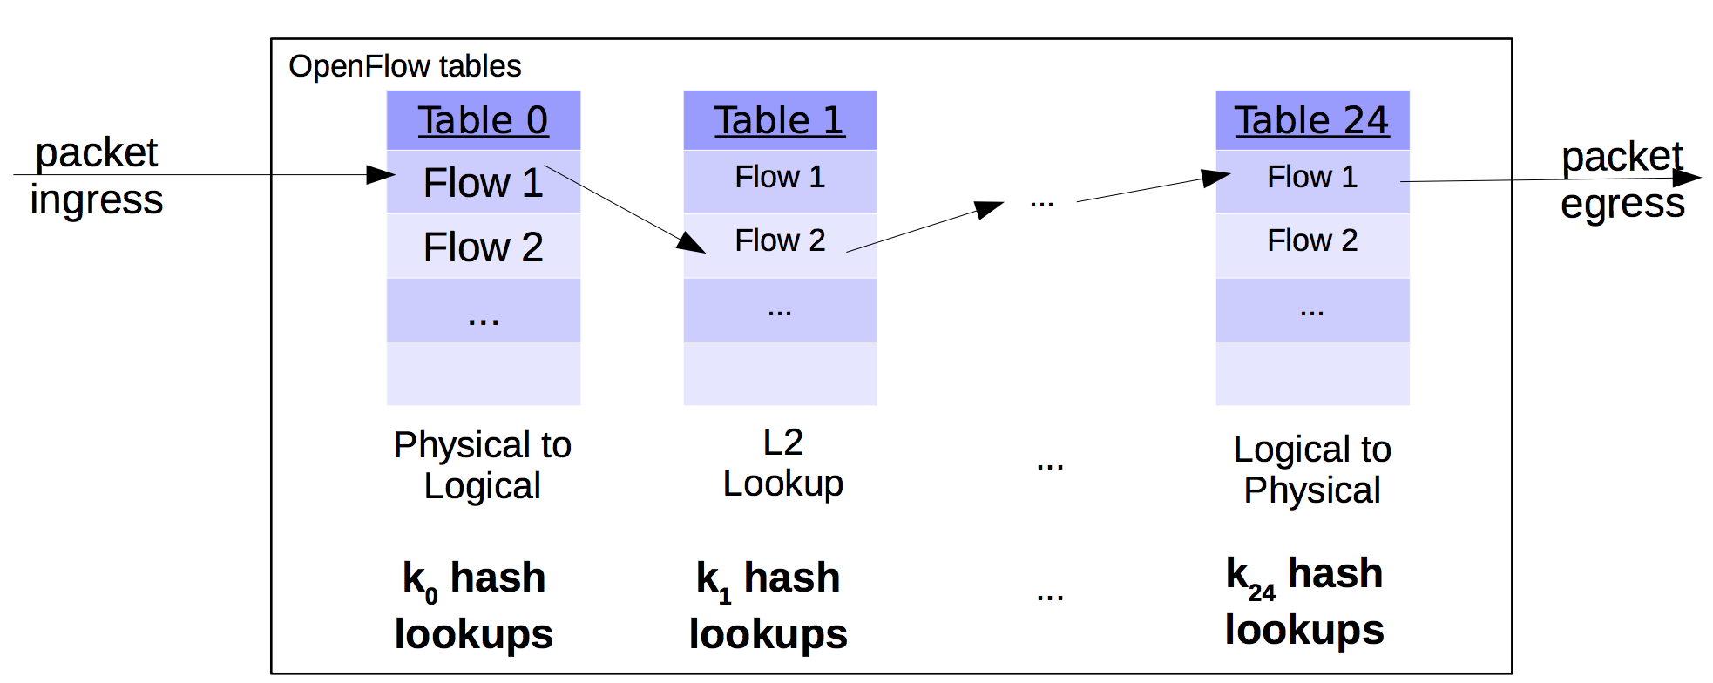
Implications for forwarding performance
Complex policies: Can’t do 100+ lookups per packet!

Slide 13
Idea 1: Microflow cache
Microflow: complete set of packet headers and metadata
Example: srcIP, dstIP, IP TTL, srcMAC, dstMAC
Just one lookup per packet!
Hit
Microflow cache in the kernel
Use a large hash table
Miss
Openflow table in user space

Slide 14
Problems with micro-flows
Too many micro-flows: e.g., each TCP port
Many micro-flows may be short lived!
Poor cache-hit rate
Can we cache the outcome of rule lookup directly?
Naive approach: Cross-product explosion!
Example: Table 1 on source IP, table 2 on destination IP

Slide 15
Idea 2: Mega-flow cache
Build the cache of rules lazily using fields accessed in OF table
Ex: contain just src/dst IP combinations that appeared in packets
Hit
Megaflow cache in the kernel
Use tuple space search
Miss
Openflow table in user space

Slide 16
Improvements to mega-flow caching
You have an OF table. What happens if you populate the mega-flow blindly by concatenating the fields accessed on lookup?
Hint 1: consider flow tables that match on highly variable fields
Hint 2: consider priorities of rules with overlapping matches
Hint 3: consider the number of lookups vs. microflow cache
OVS introduced a series of algorithmic improvements
Priority sorting of mega-flow tables
Staged lookups starting with more static sets of fields
Prefix trie to detect non-overlapping longest-prefix matches
Combine with micro-flow cache!

Slide 17
Click Modular Router
Symposium on Operating Systems Principles (SOSP) ‘99
Robert Morris, Eddie Kohler, John Jannotti, and Frans Kaashoek

Slide 18
Motivation for Click
Flexibility: Add new features and enable experimentation
Openness: Allow users/researchers to build and extend
… In contrast to most commercial routers
Modularity
Simplify the composition of existing features
Simplify the addition of new features
Speed/efficiency
Operation (optionally) in the operating system
... without the user needing to grapple with OS internals

Slide 19
Router as a graph of elements
Large number of small elements
Each performing a simple packet function
E.g., IP look-up, TTL decrement, buffering
Connected together in a graph
Elements inputs/outputs snapped together
Beyond elements in series to a graph
E.g., packet duplication or classification
Packet flow as main organizational primitive
Consistent with data-plane operations on a router
(Larger elements needed for, say, control planes)

Slide 20
Click elements: Push vs. pull
Packet hand-off between elements
Directly inspired by properties of routers
Annotations on packets to carry temporary state
Push processing
Initiated by the source end
E.g., when an unsolicited packet arrives (e.g., from a device)
Pull processing
Initiated by the destination end
E.g., to control timing of packet processing (e.g., based on a timer or packet scheduler)

Slide 21
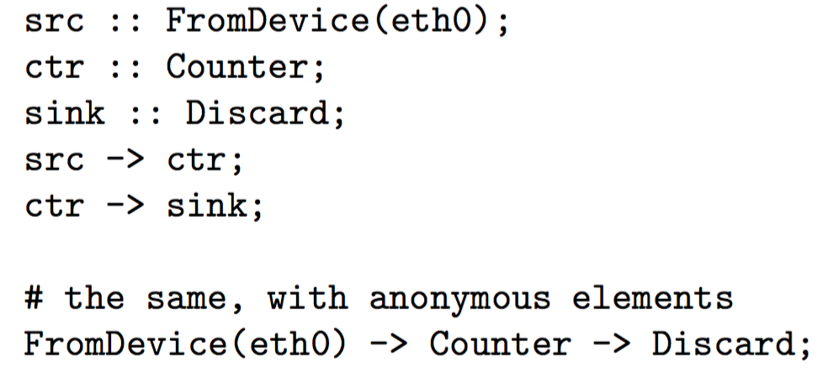
Click language
Declarations
Create elements
Connections
Connect elements
Compound elements
Combine multiple smaller elements, and treat as single, new element to use as a primitive class
Language extensions through element classes
Use configuration strings, rather than syntactic extensions

Slide 22
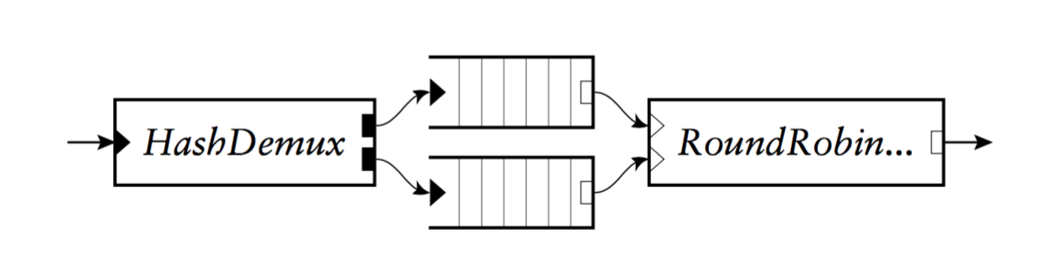
Example: Stochastic Fair Queueing

Slide 24
Backup Slides

Slide 25
Handlers and Control Socket
Access points for user interaction
Appear like files in a file system
Can have both read and write handlers
Examples
Installing/removing forwarding-table entries
Reporting measurement statistics
Changing a maximum queue length
Control socket
Allows other programs to call read/write handlers
Command sent as single line of text to the server

Slide 26
Example: EtherSwitch Element
Ethernet switch
Expects and produces Ethernet frames
Each input/output pair of ports is a LAN
Learning and forwarding switch among these LANs
Element properties
Ports: any # of inputs, and same # of outputs
Processing: push
Element handlers
Table (read-only): returns port association table
Timeout (read/write): returns/sets TIMEOUT

