Slide 1
Project proposal: Questions to answer
What are you trying to do? Articulate your goals using no jargon.
How is it done today, and what are the limits of current practice?
What is new in your approach? Why would it succeed?
What are the risks?
What are the mid-term and final “exams” to check for success?

Slide 2

High-Speed Hardware Switches
Lecture 12, Computer Networks (198:552)

Slide 3

The router data plane
Management plane
(part of)
control
plane
Data plane implements per-packet decisions
On behalf of control & management planes
Forward packets at high speed
Manage contention for switch/link resources
Processor
data plane
Switching
fabric
Net intf
Net intf
Net intf
Net intf

Slide 4
Requirements on router data planes
Speed!
Inherently
parallel workload
➔ Leverage hardware parallelism!

Slide 5
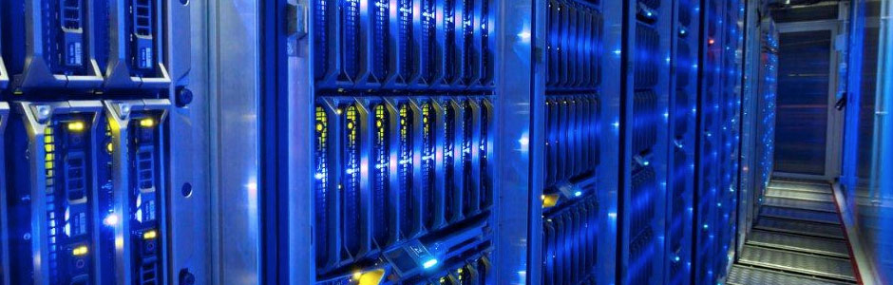
Requirements on router data planes
Speed!
Area & footprint
Power
Port density
Programmability

Slide 6
Overview of router functionality
Different routers are very different
Historically evolving, multiple concurrent designs
… but there are many commonalities (Ex: MGR, RMT)
Packet receive/transmit from/to physical interfaces
Packet and header parsing
Packet lookup and modification: ingress & egress processing
High-speed switching fabric to connect different interfaces
Traffic management: fair sharing, rate limiting, prioritization
Buffer management: admission into switch memory

Slide 7
Life of a packet

Slide 8
(1) Receive data at line cards
Circuitry to interface with physical medium: CoAx, optical
SerDes/IO modules: serialize/deserialize data from the wire
Interfaces just keep getting faster: more parallelism
… but stay the same size
Multiple network interfaces on a single line card
Component detachable from the rest of the switch
Ex: upgrade multiple 10 Gbit/s interfaces to 40 Gbit/s in one shot
Preliminary header processing possible
MGR: convert link-layer headers to standard format

Slide 9
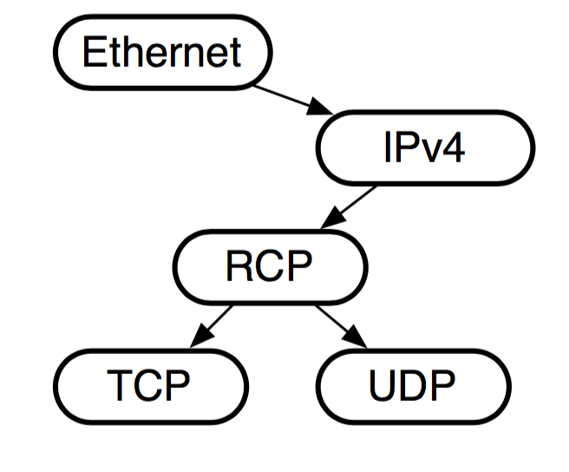
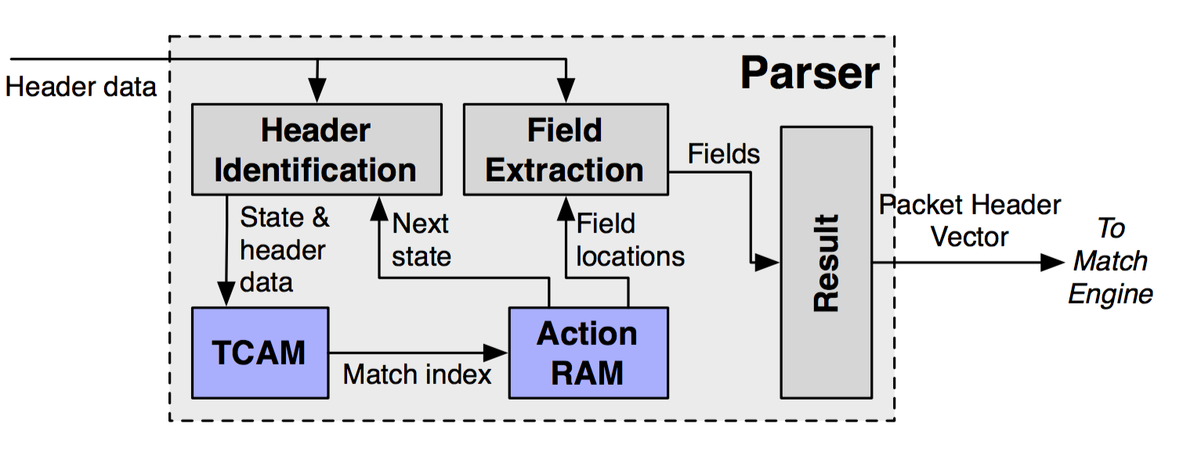
(2) Packet parsing
Extract header fields: branching, looped processing
Ex: Determine transport-level protocol based on IP protocol type
Ex: Multiple encapsulations of VLAN or MPLS headers
Outcome: parse graph and data in the parsed regions
MGR: done in software using bit slicing of header memory
RMT: programmable packet parsing in hardware

Slide 10
(2) Packet parsing
Key principle: Separate the packet header and payload
Conserve bandwidth for data read/written inside switch!
Header continues on to packet lookup/modification
Payload sits on a buffer until router knows what to do with the packet
Buffer could be on the ingress line card (MGR)
But more commonly a buffer shared between line cards (RMT)

Slide 11
(3) Packet lookup
Typical structure: Sequence of tables (Ex: L2, L3, ACL tables)
Exact match lookup
Longest prefix match
Wildcard lookups
Outcome: a (set of) output ports, possible header rewrites
Wide range of table sizes (# entries) and widths (headers)
Header modifications possible
TTL decrements, IP checksum re-computation
Encapsulate/decapsulate tunneling headers (MPLS, NV-GRE, …)
MAC source address rewrite
Interesting algorithmic problems!

Slide 12
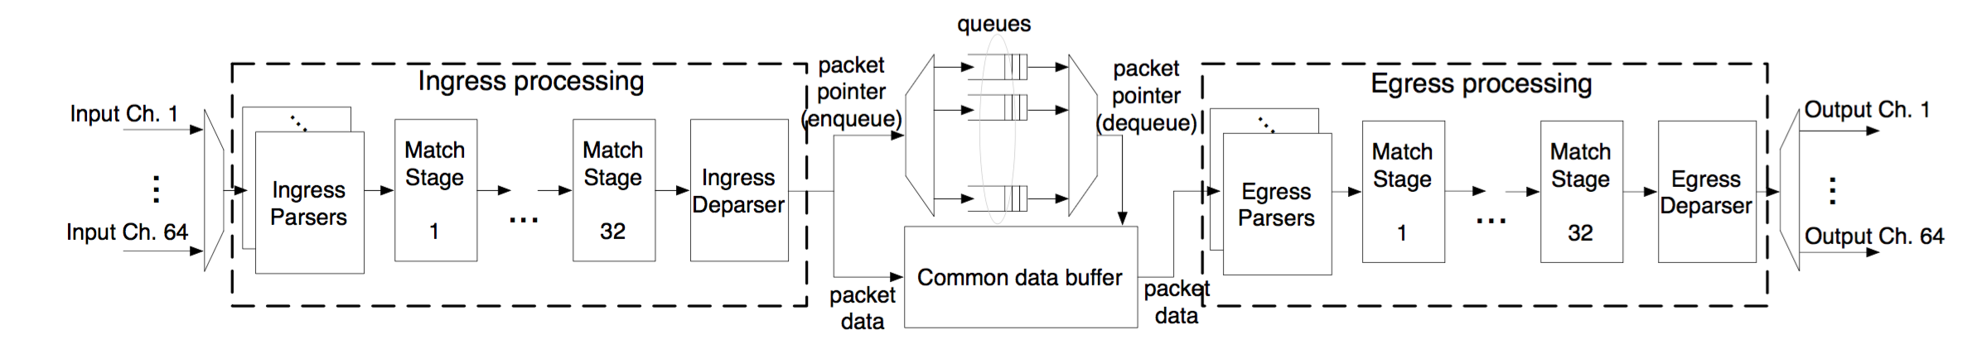
(3) Packet lookup: Pipelined parallelism
Different functionalities (ex: L2, L3) in different table stages
Highly parallel over packets (1 packet/stage): high throughput
Pipeline circuitry clocked at a high rate: ex: RMT@1 GHz
MGR: software with memory access non-determinism
RMT: deterministic hardware pipeline stages

Slide 13
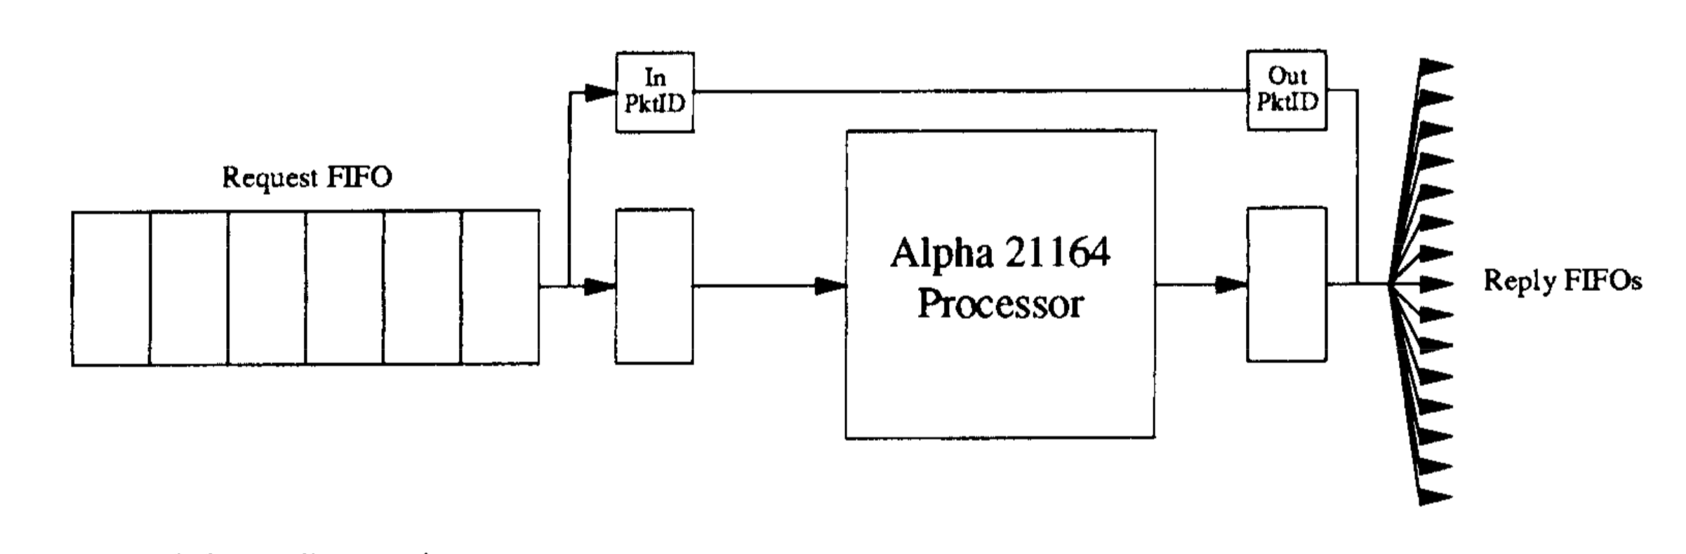
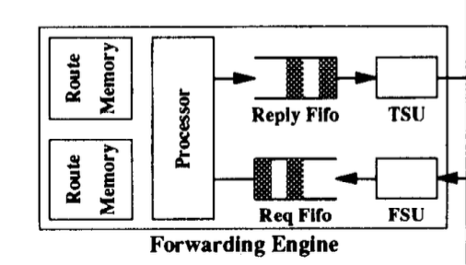
(3) Packet lookup: Memory layout matters!
MGR: Cache hierarchy
Large tertiary/main memory containing full route table
… but far too slow for random access lookup with small delays
Employ a fast L1 route cache
Fast and slow path processing

Slide 14
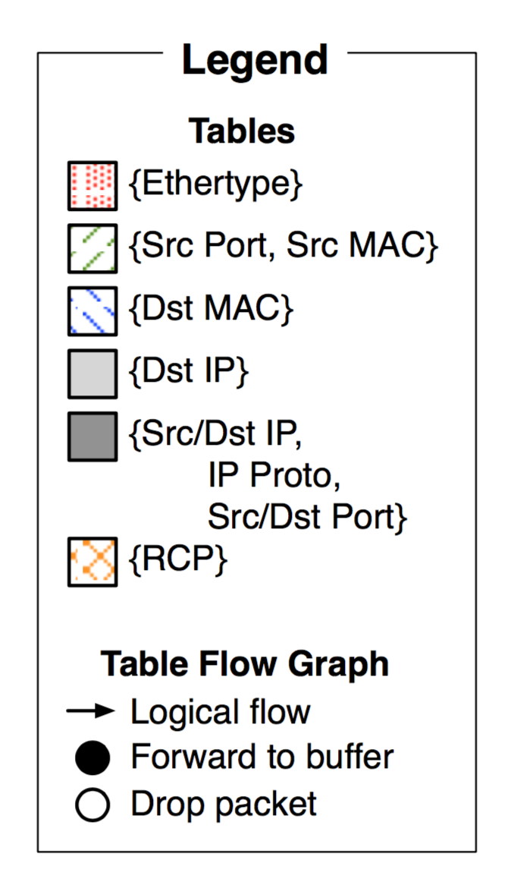
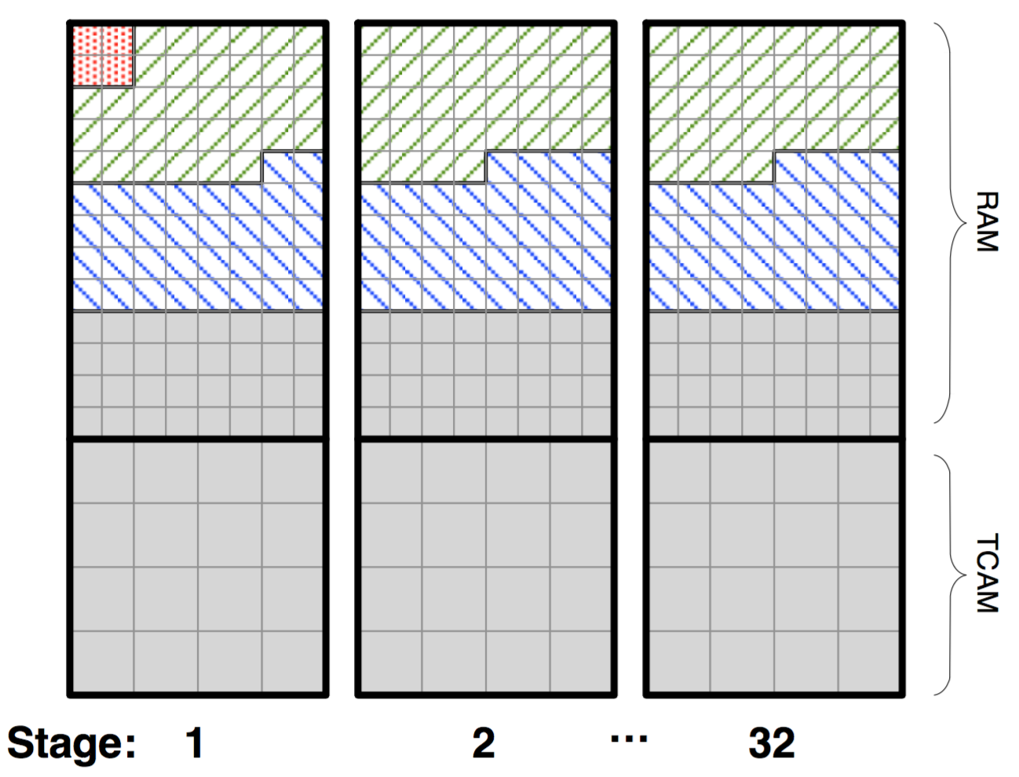
(3) Packet lookup: Memory layout matters!
RMT: flexible partitioning of memory across SRAM and TCAM
Numerous fixed size memory blocks
Circuitry for independent block-level access
Deterministic access times
All of it is SRAM or TCAM
Contrast to MGR (DRAM)

Slide 15
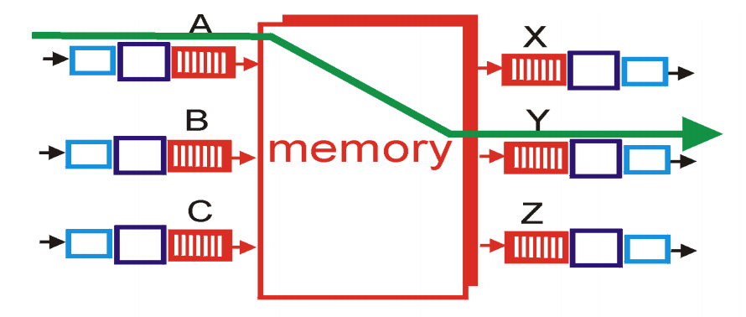
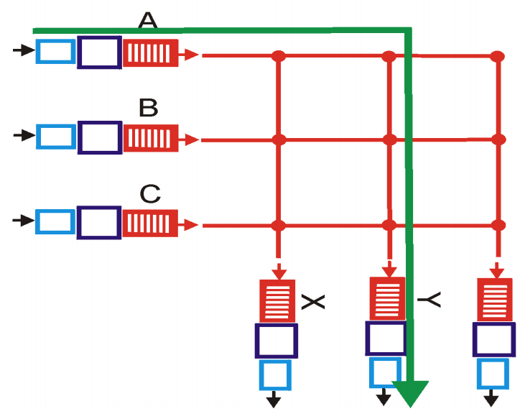
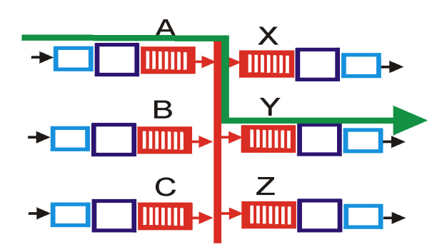
(4) Interconnect/Switching Fabric
Move headers and packet from one interface to another
Kinds of fabrics: memory, bus, crossbar

Slide 16
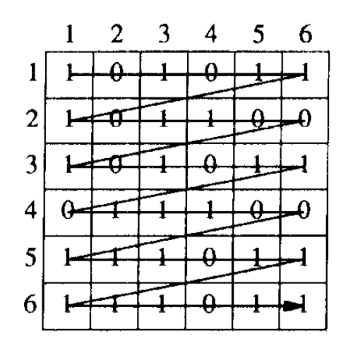
(4) Crossbars: The scheduling problem
Demands from port i to port j
Can one utilize fabric capacity regardless of demand pattern?
Blocking vs. nonblocking
Different topology designs

Slide 17
(5) Queueing: Traffic management
Where should the packets not currently serviced wait?
Input-queued vs. output-queued
HOL blocking? Suppose port 1 wants to send to both 2 and 3
But port 2 is clogged
Port 1’s packets towards port 3 should not be delayed!

Slide 18
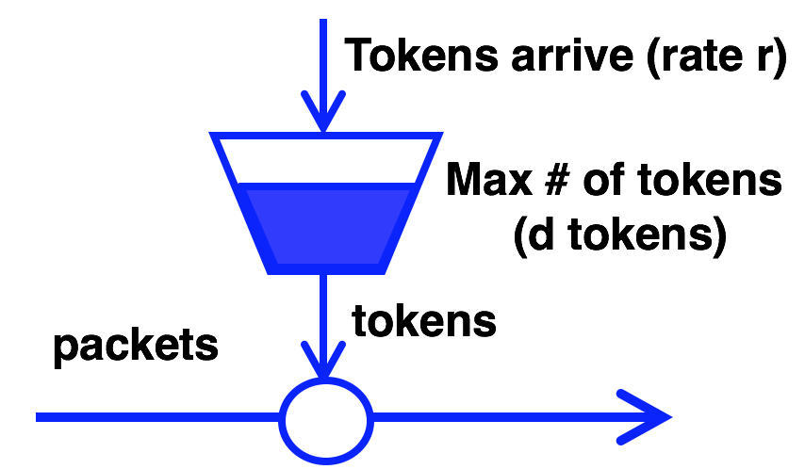
(5) Queueing: Traffic Management
Better to have queues represent output port contention
Scheduling policies:
Fair queueing across ports
Strict prioritization of some ports over others
Rate limiting per port!

Slide 19

(5) Queueing: Buffer Management
Typical buffer management: Tail-drop
How should buffer memory be partitioned across ports?
Static partitioning: if port 1 has no packets, don’t drop port 2
Shared memory with dynamic partitioning
However, need to share fairly:
If output port 1 is congested, why should port 2 traffic suffer?
Algorithmic problems in dynamic memory sizing across ports!

Slide 20
(6) Egress processing
Combine headers with payload for transmission
Need to incorporate header modifications
… also called “deparsing”
Multicast: egress-specific packet processing
Ex: source MAC address
Multicast makes almost everything inside the switch (interconnect, queueing, lookups) more complex

