Slide 1

Application Architecture
Lecture 7
Srinivas Narayana
http://www.cs.rutgers.edu/~sn624/553-S25

Slide 2



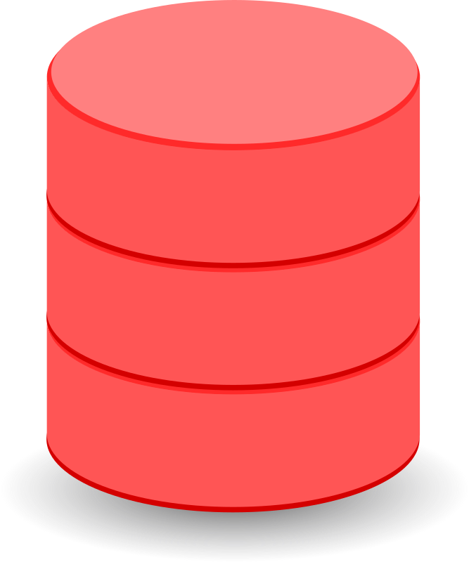

Review: Offline and Online components
Services, databases, ML inference
update
User request
update
update
Online, real-time request processing
Offline processing:
Batch processing; stream events; ML training
Data, events,
etc

Slide 3
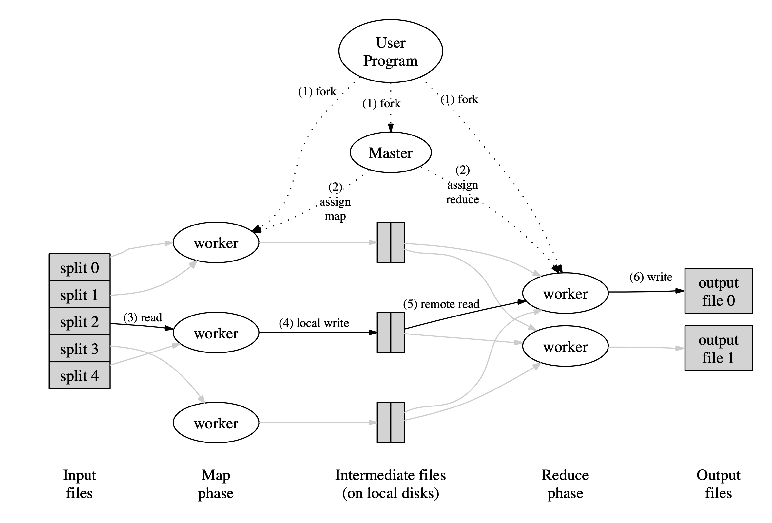
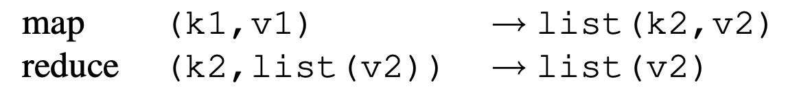
Review: Map-Reduce
Different (intermediate) key space
Same key space

Slide 4
Processing steps in MapReduce
Input data consumed from a distributed filesystem
Master ships code to the worker node closest to data, if possible (CPU, memory constraints permitting)
Each mapper partitions its input data by the reducer key
Typically, through a hash function, e.g., hash (key) mod R == r
Sort output data (per partition) by the key; run map function
Reducers are informed of partial result at each mapper
Reducer pulls files from mappers through RPC
Output persisted to distributed filesystem (typically involves replication)
Result: R output files in the DFS (one per reducer partition)

Slide 5
Implementation Key Principles
Data locality
Reduce network bandwidth: ship code to data
Locally persist (not DFS) intermediate results
Handle failures by re-doing compute
No fancy hardware fault tolerance (e.g., RAID)
Mapper failure: restart map job
Assume deterministic operations
Reducer failure (after completion): no problem (DFS)
Identify and skip shards with deterministic faults
Mitigate stragglers through eager replication of compute close to job completion
Combiners at mapper: preliminary reduce for associative and commutative functions

Slide 6
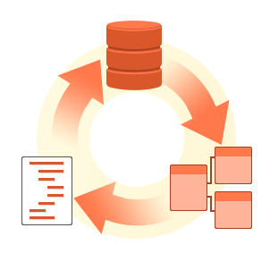
More examples of using map-reduce
Database Joins
Example: user activity (e.g. URLs) with user information (e.g. age)
Grouping (GROUPBY) aggregations:
Count, sum, etc
Creating the sequence of events in a user session, determining whether e.g. a new version of a web page resulted in better sales
Large distributed sorting
Output sorting after mapper: important!

Slide 7
Building on Map-Reduce: (1) Workflows
One Map-Reduce job isn’t usually enough
Google web search index: pipeline of 10 jobs; recommendation systems: 50—100
Workflows: Chains of map-reduce jobs
E.g., one MR for counting requests by URL; another to sort count
Explicit output files from each?
Like writing to file at the end of each tool in Unix pipeline
Materialization of the intermediate results needed?
Stragglers make workflows slower
Separate systems needed just to orchestrate the workflows correctly

Slide 8

Building on Map-Reduce: (2) Dataflow
Dataflow engines: handle the entire workflow
“Operators”: chain map-reduce functions
Only persist intermediate outputs to DFS when necessary
Chain reducers (no explicit mappers) when the key is the same
Don’t wait for stragglers of the previous job
Stream Processing
Incremental execution of batch jobs when new data arrives
Selectively materialize or recompute intermediate results
Lineages (RDD/Spark) or checkpoint

Slide 9
Serverless

Slide 10
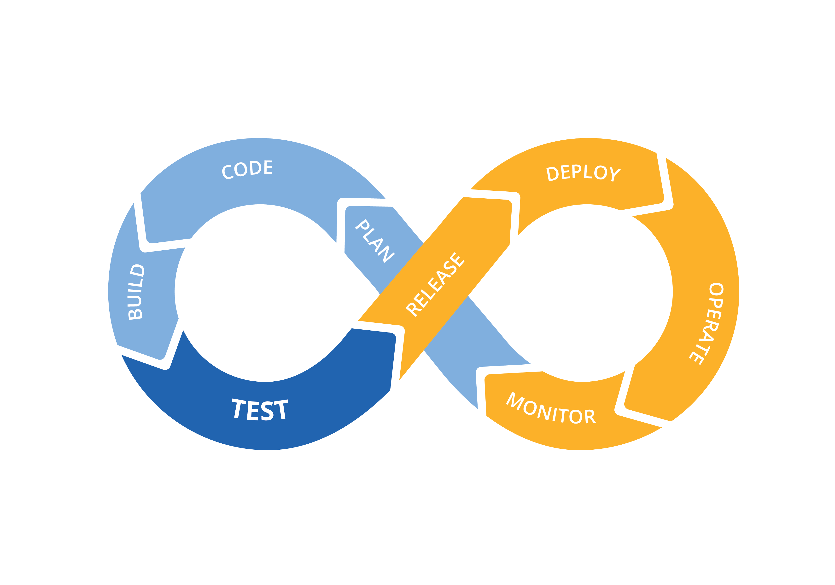
Managing app deployments
Consider a simple model to build and run your Internet application:
Develop application in the language of choice
Build & test
Deploy over on-premise equipment (bare-metal servers) or cloud (virtual machines, containers, etc)
Manage these resources

Slide 11
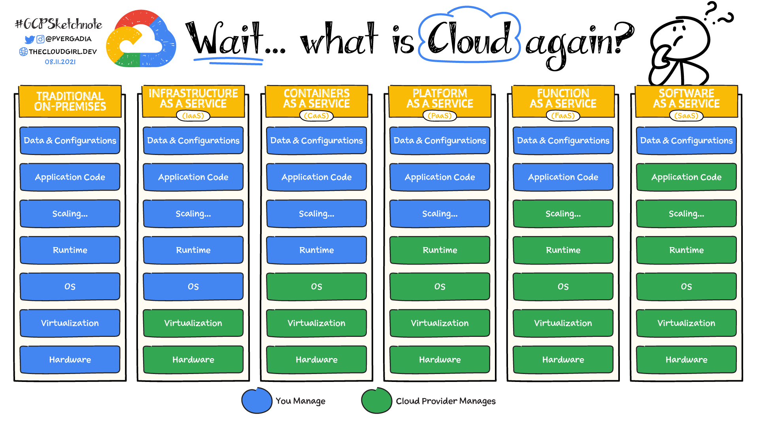
“_____ as a service”
https://cloud.google.com/learn/paas-vs-iaas-vs-saas

Slide 12

Serverless computing
What if you could write code that deploys directly into a managed (cloud-like) environment?
Programming model/abstraction reminiscent of functional programming
Even those unfamiliar with such resource management can deliver (scalable, high performance, high availability, etc.) services
Often only provide source code for the framework/runtime (e.g. python)
Many commercial offerings available today (AWS, Azure, Google)
Bindings in Javascript, Python, C#, etc

Slide 13
Serverless Abstractions
Servers required
But someone else manages them
Stateless functions
No persistent memory across invocations
Event-triggered:
E.g. HTTP request
E.g. notification from a message router
Computation decoupled from where/how it is run
Placement, scaling, and fault tolerance are managed by someone else
Charged for execution time, not allocated resources
“pay as you go”
Scale down to zero cost when service is idle

Slide 14
Example (1/3)
import json
def hello(event, context):
body = {
"message": "Go Serverless v4.0! Your function executed successfully!",
}
response = {"statusCode": 200, "body": json.dumps(body)}
return response
https://github.com/serverless/examples/blob/v4/aws-python-http-api/handler.py

Slide 15
Example (2/3)
def lucky_number(event, context):
upperLimit = 100
number = random.randint(0, upperLimit)
response = {
'version': '1.0',
'response': {
'outputSpeech': {
'type': 'PlainText',
'text': 'Your lucky number is ' + str(number),
}
}
}
return response
https://github.com/serverless/examples/blob/v4/aws-python-alexa-skill/handler.py
https://github.com/serverless/examples

Slide 16
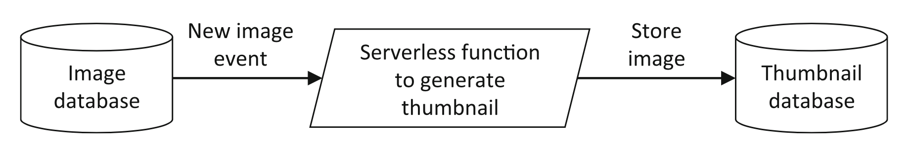
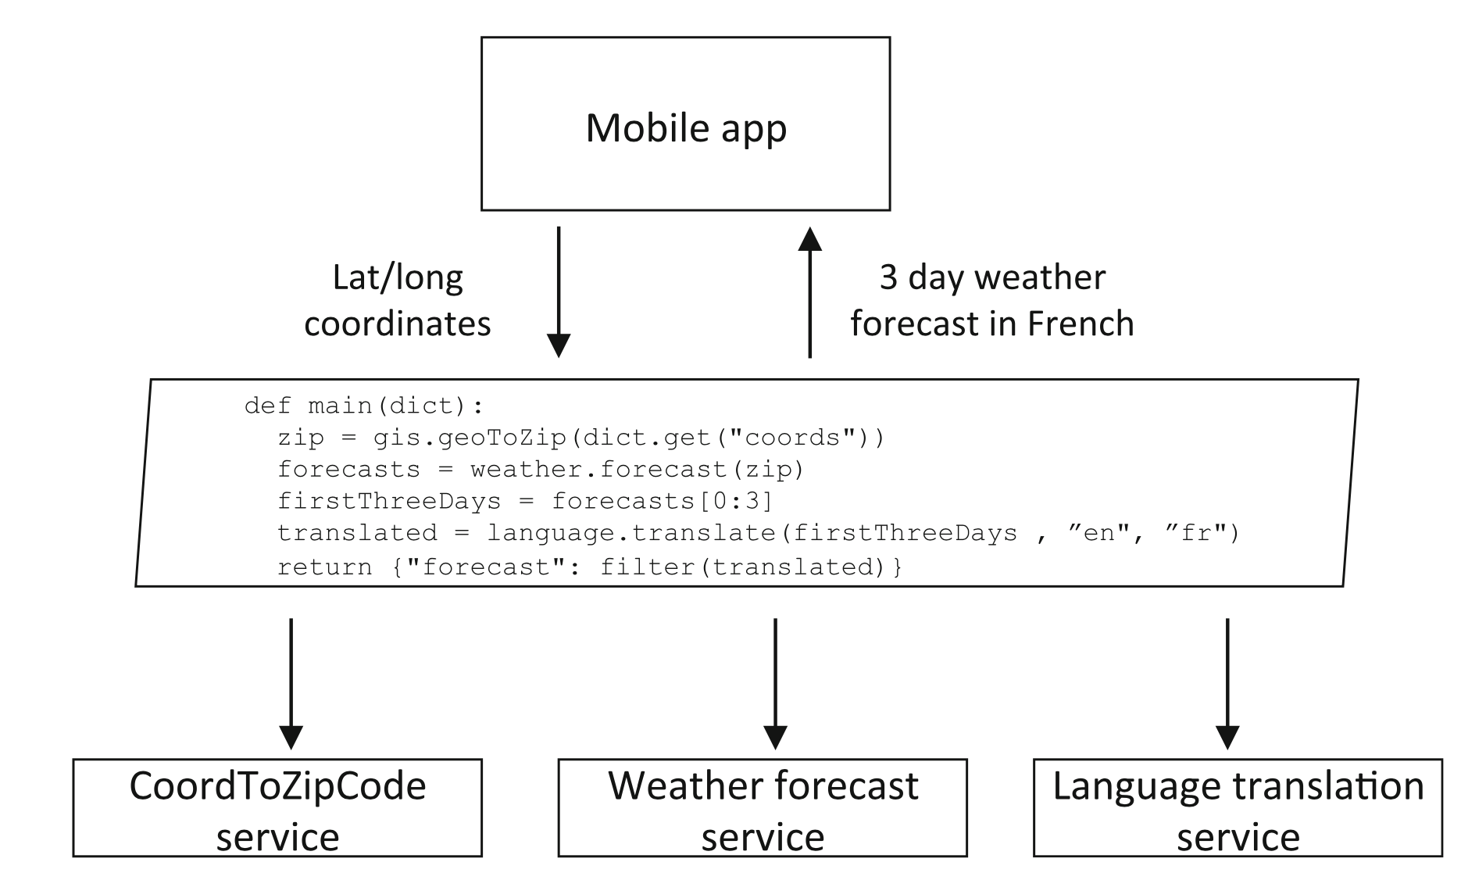
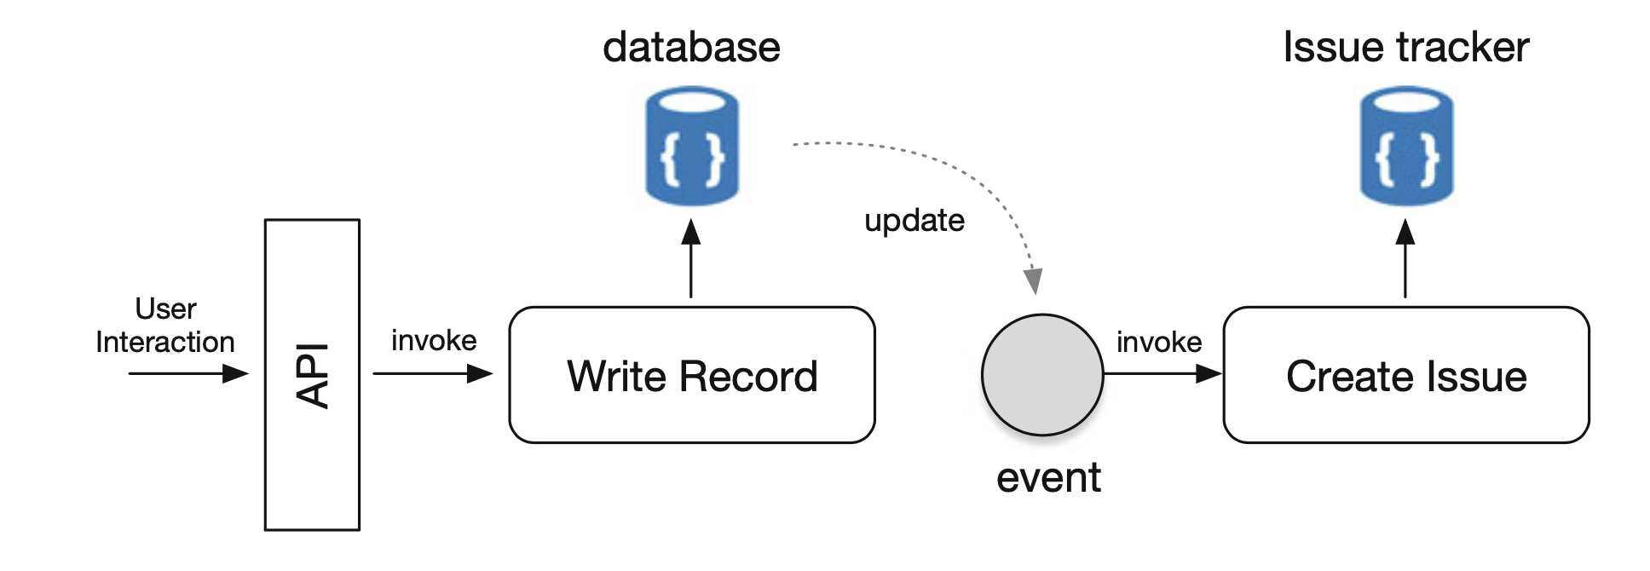
More examples (3/3)
Event processing
Offloading computation from mobile apps
Coordination service
Edge computation (CDNs, IoTs)
Chatbots
Bursty, compute-intensive,
short lived

Slide 17
Consequences of serverless abstraction
Stateless: Database/storage integration becomes necessary
Storage options: ephemeral? Long-term? High IOPS? Low latency?
Ecosystem of other tools:
Manage state, record logs, send alerts, perform authentication and authorization, messaging queues, cloud-based storage
Prone to vendor lock-in!
Relinquish control of resource provisioning, monitoring, maintenance, scalability, fault tolerance, placement, logging, …
Cost-driven decision making
Your billing tier depends on memory provisioned
Packages and software libraries that inflate memory size
Consequences of long polling, websockets?

Slide 18
Consequences of serverless abstraction
Supporting stateful interactions (HTTP cookies, sessions)
Retrieve session state from storage across several connections/requests
Dedicated proxy to supply the session state
How to compose multiple stateless functions?
Coordination server (always on, itself not serverless)
Use a messaging queue (message router/broker)
May need frameworks and tools to turn existing high-level language code (e.g. legacy applications) into serverless functions
e.g. python decorator app.route(…) web-hook
Unpredictable performance
Functions may run on different kinds of machines

Slide 19
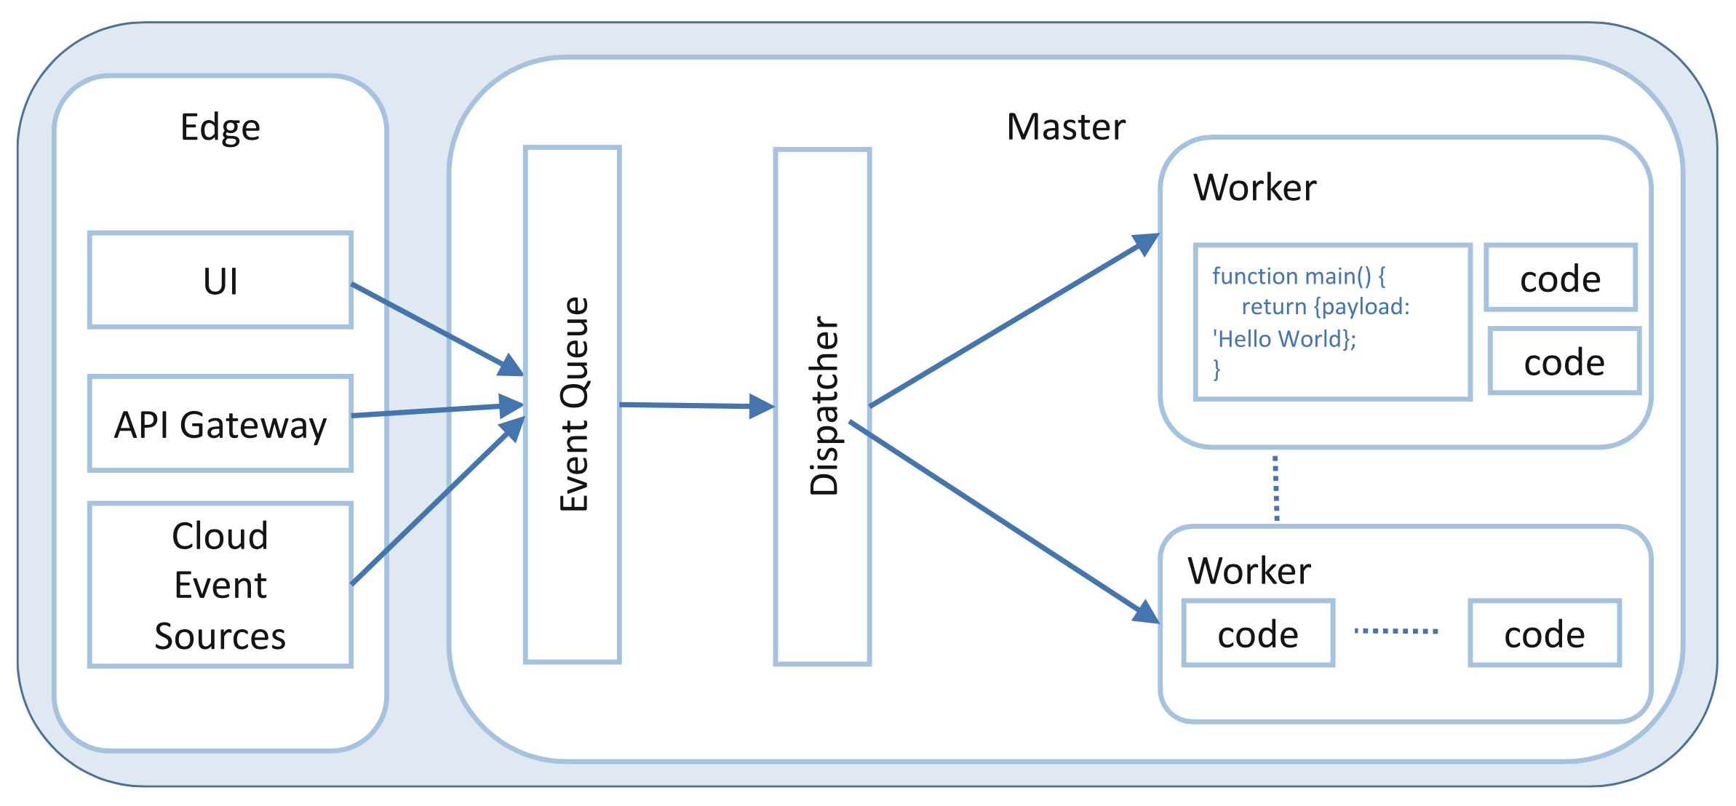
What should the hosting platform do?
Take an event sent over HTTP or from an event source
Determine which function(s) to which to dispatch the event
Send event to a function instance
Wait for a response, make it available to the user
Gather execution logs
Stop function when idle
Isolate functions
Orchestrate, scale
Fault tolerance
Locality: code, data, package

