Slide 1

Reliability (wrap-up); Ordering
Lecture 13 http://www.cs.rutgers.edu/~sn624/352-S22
Srinivas Narayana

Slide 2


Quick recap of concepts
Pipelined Reliability
TCP: Connection-oriented
SEQ 0
Tp layer
Q1. Which packets are currently in flight?
SEQ 1
SEQ 2
Sliding windows
SEQ 3
0
1
2
3
4
5
6
7
0
RTT
ACK 1
Stop and Wait
ACK 2
ACK 3
SEQ 0
ACK 4
Latest
ACK’ed
Latest transmitted (or) acceptable
RTT
ACK pkts after a drop?
ACK
No
Q2. Which packets were successfully delivered?
Yes
SEQ 1
Go-back-N
Selective repeat
Q3. Which packets should the sender retransmit?
RTO
Cumulative ACK
Retransmit
Selective ACK

Slide 3
Review: Cumulative ACK
RTO
Sender
0
1
2
3
4
2
5
6
Maximum
window size = 8
ACK 2
ACK 2
ACK 1
ACK 2
ACK 5
ACK 6
ACK 7
Receiver
0
1
E
3
4
2
5
6
Maximum
window size = 8
Buffered by
receiver in
its memory
Time
Packet with error (or)
dropped packet
Subtle: Even if there were multiple drops, retransmission after an RTO only includes the first dropped sequence number. Recovering each drop will require one RTO after corresponding packet was transmitted.

Slide 4
Selective repeat with selective ACK
RTO
Sender
0
1
2
3
4
5
6
2
Maximum
window size = 8
ACK 2
SACK 0--1, 3—4, 6--6
ACK 2
SACK 0--1, 3--4
ACK 2
SACK 0--1, 3--3
ACK 5
SACK 0—4, 6—6
ACK 1
ACK 2
Receiver
0
1
E
3
4
E
6
2
Maximum
window size = 8
Buffered by
receiver in
its memory
Time
Packet with
error (or) drop
This slide assumes retransmissions are only triggered by an RTO.
If other signals were to be used to retransmit earlier (e.g., triple dup ACK -- more on this soon),
SACK significantly reduces the number of duplicate transmissions compared to cumulative-only ACKs.

Slide 5
TCP: Cumulative & Selective ACKs
Sender retransmits the seq #s it thinks aren’t received successfully yet
Pros & cons: selective vs. cumulative ACKs
Precision of info available to sender
Redundancy of retransmissions
Packet header space
Complexity (and bugs) in transport software
On modern Linux, TCP uses selective ACKs by default
Sender
Receiver
1
2
3
4
2
3
4
5
5

Slide 6
TCP reliability metadata

Slide 7
Metadata on TCP packets for Reliability
TCP uses metadata in the form of sequence #s and ACK #s
Where are these stored? Naturally, in the packet header!

Slide 8
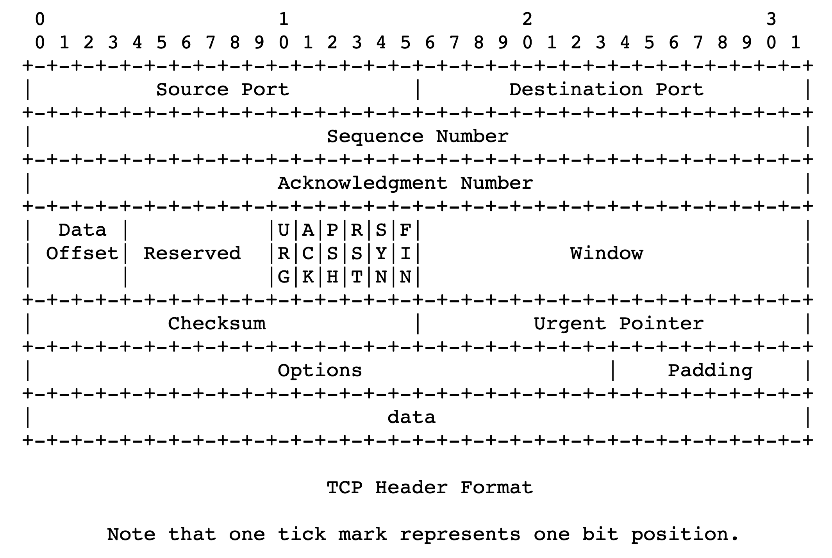
TCP header structure
Source port, destination port (connection demultiplexing)
Size of the TCP header (in 32-bit words)
Basic error detection through checksums (similar to UDP)

Slide 9
TCP header structure
Identifies data in the packet from sender’s perspective
TCP uses byte seq #s
Identifies the data being ACKed from the receiver’s perspective.
TCP uses next seq # that the receiver is expecting.

Slide 10
Observing a TCP exchange
sudo tcpdump -i eno1 tcp portrange 56000-56010
curl --local-port 56000-56010 https://www.google.com > output.html
Bonus: Try crafting TCP packets with scapy!

Slide 11
Buffering and Ordering in TCP

Slide 12
Memory Buffers at the Transport Layer

Slide 13
Sockets need receive-side memory buffers
Since TCP uses selective repeat, the receiver must buffer data that is received after loss:
e.g., hold packets so that only the “holes” (due to loss) need to be filled in later, without having to retransmit packets that were received successfully
Apps read from the receive-side socket buffer when you do a recv() call.
Even if data is always reliably received, applications may not always read the data immediately
What if you invoked recv() in your program infrequently (or never)?
For the same reason, UDP sockets also have receive-side buffers

Slide 14

Receiver app’s interaction with TCP
Upon reception of data, the receiver’s TCP stack deposits the data in the receive-side socket buffer
An app with a TCP socket reads from the TCP receive socket buffer
e.g., when you do data = sock.recv()
application
process
recv()
TCP socket
receiver buffers
TCP
code
from sender
receiver TCP interaction

Slide 15
Sockets need send-side memory buffers
The possibility of packet retransmission in the future means that data can’t be immediately discarded from the sender once transmitted.
App has issued send() and moved on; TCP stack must buffer this data
Transport layer must wait for ACK of a piece of data before reclaiming (freeing) the memory for that data.
application
process
send()
TCP socket
sender buffers
TCP
code
to receiver
sender TCP interaction

Slide 16
Ordered Delivery

Slide 17

Reordering packets at the receiver side
Let’s suppose receiver gets packets 1, 2, and 4, but not 3 (dropped)
Suppose you’re trying to download a document containing a report
What would happen if transport at the receiver directly presents packets 1, 2, and 4 to the application (i.e., receiving 1,2,4 through the recv() call)?
Sender
Receiver
1
2
3
4
1
2
4
5

Slide 18
Reordering packets at the receiver side
Reordering can happen for a few reasons:
Drops
Packets taking different paths through a network
Receiver needs a general strategy to ensure that data is presented to the application in the same order that the sender pushed it
To implement ordered delivery, the receiver uses
Sequence numbers
Receiver socket buffer
We’ve already seen the use of these for reliability; but they can be used to order too!
Sender
Receiver
1
2
3
4
1
2
3
5
5

Slide 19
Receive-side app and TCP
TCP receiver software only releases the data from the receive-side socket buffer to the application if:
the data is in order relative to all other data already read by the application
This process is called TCP reassembly
application
process
recv()
TCP socket
receiver buffers
TCP
code
from sender
receiver protocol stack

Slide 20
TCP Reassembly
Sender/Net writes here
Application can recv() up to here
1
2
1
2
4
1
2
3
4
Socket buffer memory on the receiver

Slide 21
Implications of ordered delivery
Packets cannot be delivered to the application if there is an in-order packet missing from the receiver’s buffer
The receiver can only buffer so much out-of-order data
Subsequent out-of-order packets dropped
It won’t matter that those packets successfully arrive at the receiver from the sender over the network
TCP application-level throughput will suffer if there is too much packet reordering in the network
Data may have reached the receiver, but won’t be delivered to apps upon a recv() (...or may not even be buffered!)

Slide 22
Stream-Oriented Data Transfer

Slide 23
Sequence numbers in the app’s stream
Data written by application over time
e.g., send() call
…
100
150
180
240
273
310
…
packet
packet
packet
packet
packet
Increasing sequence #s
TCP uses byte sequence numbers

Slide 24
Sequence numbers in the app’s stream
Data written by application over time
e.g., send() call
…
100
150
180
240
273
310
…
packet
packet
packet
packet
packet
Increasing sequence #s
Packet boundaries aren’t important for TCP software
TCP is a stream-oriented protocol
(We use SOCK_STREAM when creating sockets)

Slide 25
Sequence numbers in the app’s stream
Data written by application over time
e.g., send() call
…
…
1st recv()
2nd recv()
3rd recv()
4th recv()
A recv() call may return a part of a packet, a full packet, or multiple packets together.
App does a recv()

Slide 29
How much data to keep in flight?

Slide 30
How much data to keep in flight?
Challenging question! We want to increase throughput. But:
The receiving app must keep up: otherwise, receiver socket buffer will fill up. Once full, subsequent packets are dropped.
Even if receiving app is fast, there must be sufficient buffering for selective repeat, if some data is dropped/corrupted
The network path must be able to keep up.
We don’t want window to be so large that pkts dropped anyway
Challenge: The sender must figure out where the bottleneck is: receiving app? Socket buffer? A link along the network path?
Flow control and congestion control

Slide 31
Inspecting TCP stack parameters
A small demo

Slide 32
Info on (tuning) TCP stack parameters
https://www.ibm.com/support/knowledgecenter/linuxonibm/liaag/wkvm/wkvm_c_tune_tcpip.htm
https://cloud.google.com/solutions/tcp-optimization-for-network-performance-in-gcp-and-hybrid

