Slide 1

Flexible Transport
Lecture 11, Computer Networks (198:552)
Fall 2019
Notes:
Slide material heavily adapted courtesy of Albert Greenberg, Changhoon Kim, Mohammad Alizadeh.

Slide 2
Modularity through layering
Protocols “stacked” in endpoint and router software/hardware
Apps: useful user-level functions
HTTP
FTP
NV
TFTP
Transport: provide guarantees to apps
TCP
UDP
IP
Network: best-effort global pkt delivery
Ether
ATM
…
WiFi
Link: best-effort local pkt delivery

Slide 3
Two Main Transport Layers
User Datagram Protocol (UDP)
Abstraction of independent messages between endpoints
Just provides demultiplexing and error detection
Header fields: port numbers, checksum, and length
Low overhead, good for query/response and multimedia
Transmission Control Protocol (TCP)
Provides support for a stream of bytes abstraction

Slide 4
Transmission Control Protocol (TCP)
Multiplexing/demultiplexing
Determine which conversation a given packet belongs to
All transports need to do this
Reliability and flow control
Ensure that data sent is delivered to the receiver application
Ensure that receiver buffer doesn’t overflow
Ordered delivery
Ensure bits pushed by sender arrive at receiver app in order
Congestion control
Ensure that data sent doesn’t overwhelm network resources

Slide 5
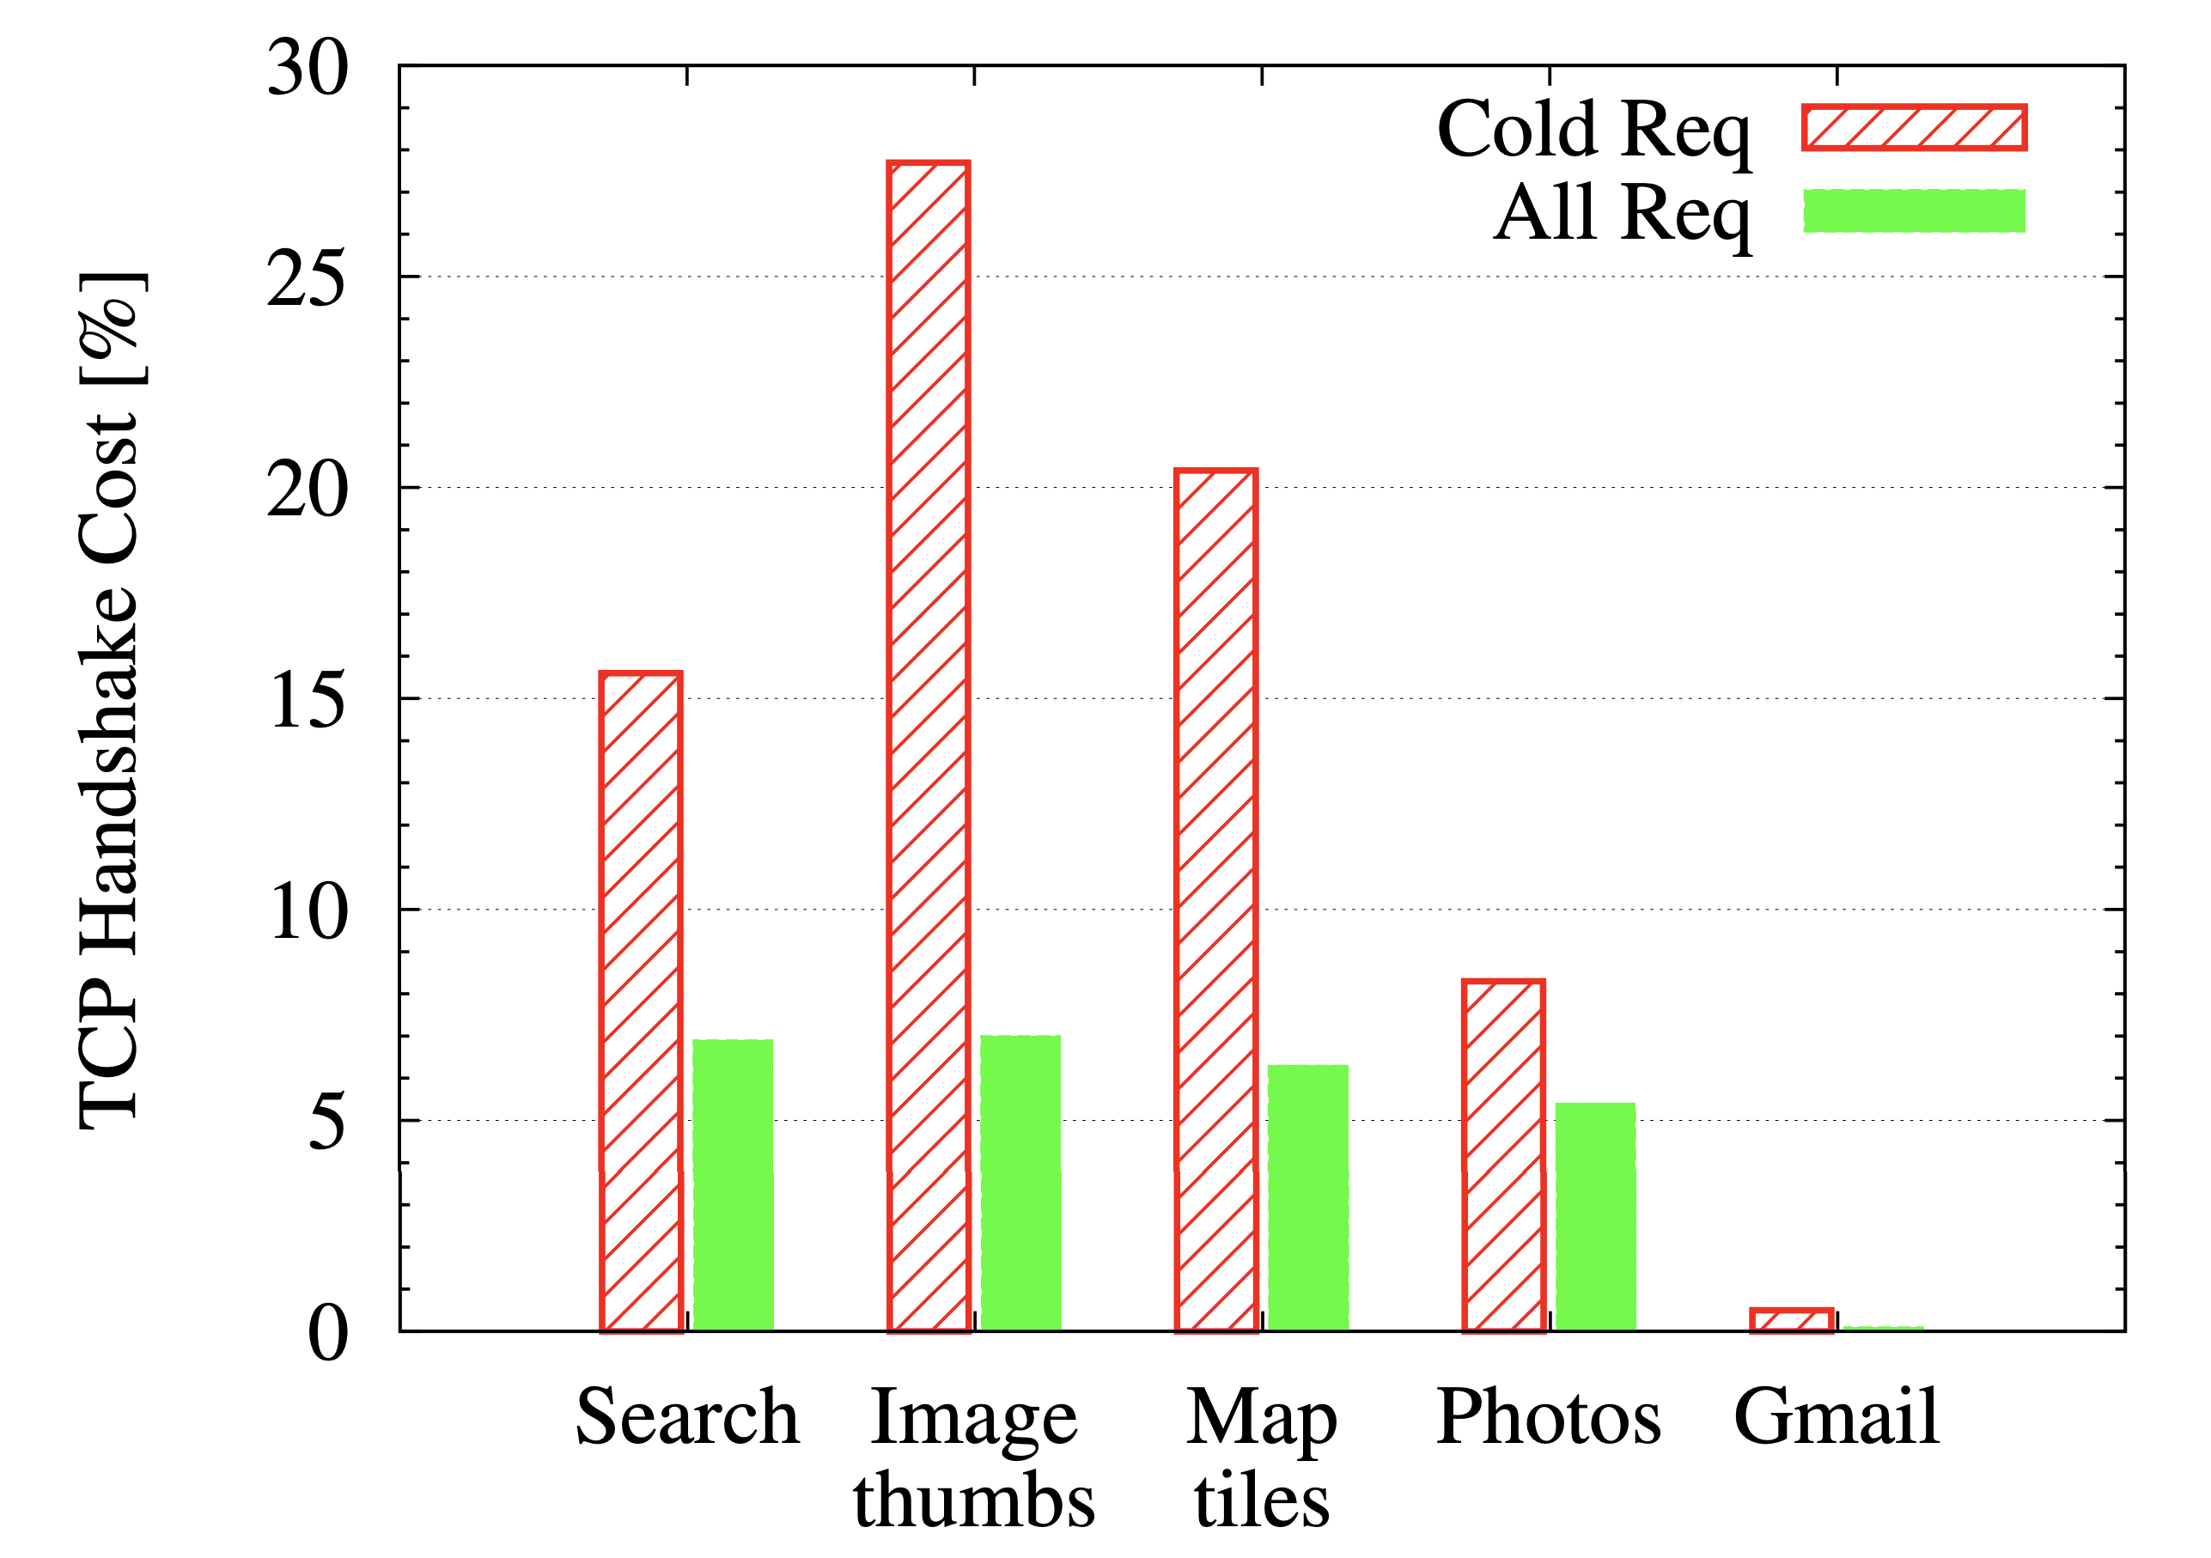
Things we’d like to change about TCP (1/N)
3-way handshake: too much latency (esp. small web requests)
Request latencies to Google services
Source: “TCP Fast Open,” CoNext 2011
Problem made worse by adding security (HTTPS / TLS) over TCP.
TLS handshake adds more round trips.

Slide 6
Things we’d like to change about TCP (2/N)
Ability to handle streams of data within a connection
Q: examples of apps that might need it?
Typical web page contain tens, if not hundreds of objects
A browser could render partial pages with objects that finished downloading to provide a better user experience
One solution is to open a TCP connection for each object
High overhead -- at client and server
Connections cannot learn about network conditions together
Streams within single TCP connection:
head-of-line blocking

Slide 7
Head-of-line blocking at client side
Network writes here
Application can read up to here
1
2
Suppose pkt 3 contains object 2 and pkts 1,2,4 contain object 1.
Browser can’t render object 1.
1
2
4
1
2
3
4
Memory on the receiver machine

Slide 8
Things we’d like to change about TCP (3/N)
TCP measures a connection round-trip time RTT as the time between transmitting each packet and receiving its ACK
Recall: What’s the RTT useful for?
Good RTT estimate critical to know when to retransmit lost pkts
Also for algorithms using RTT to determine sending rate
What happens to the RTT estimate when a packet is retransmitted?
Today: ignore RTT for any packet transmitted more than once (Karn’s algorithm)
Issue: TCP conflates two uses of sequence numbers:
Ordered data delivery (know which data to deliver first to app)
Reliable delivery (track which data was received)

Slide 9
Things we’d like to change about TCP (3/N)
TCP measures a connection round-trip time RTT as the time between transmitting each packet and receiving its ACK
Recall: What’s the RTT useful for?
Good RTT estimate critical to know when to retransmit lost pkts
Also for algorithms using RTT to determine sending rate
What happens to the RTT estimate when a packet is retransmitted?
Today: ignore RTT for any packet transmitted more than once (Karn’s algorithm)
Issue: TCP conflates two uses of sequence numbers:
Ordered data delivery (know which data to deliver first to app)
Reliable delivery (track which data was received)
There are many other things we’d like to change, but we’ll only talk about the 3 above in the context of QUIC.

Slide 10
What’s so hard about changing TCP?
You may need to change the operating system kernel
You may need to change the operating system kernel on all servers and clients (ex: all your laptops and phones!)
You may need to change the entire network!
Middleboxes sitting in the network may change, drop, or add info on packets
Middleboxes may drop packets if they don’t understand something on the packet

Slide 11
QUIC
Designed over UDP with fresh packet formats at app layer
Issue #1: Better handshake procedure
Designed with security & encryption in mind from the beginning
Almost everything is encrypted
If middlebox can’t read a piece of info, it can’t make any decisions based on that info
In particular, can’t change packet without endpoints noticing
Issue #2: Support lightweight streams natively
Issue #3: Better RTT estimation for retransmissions

Slide 12
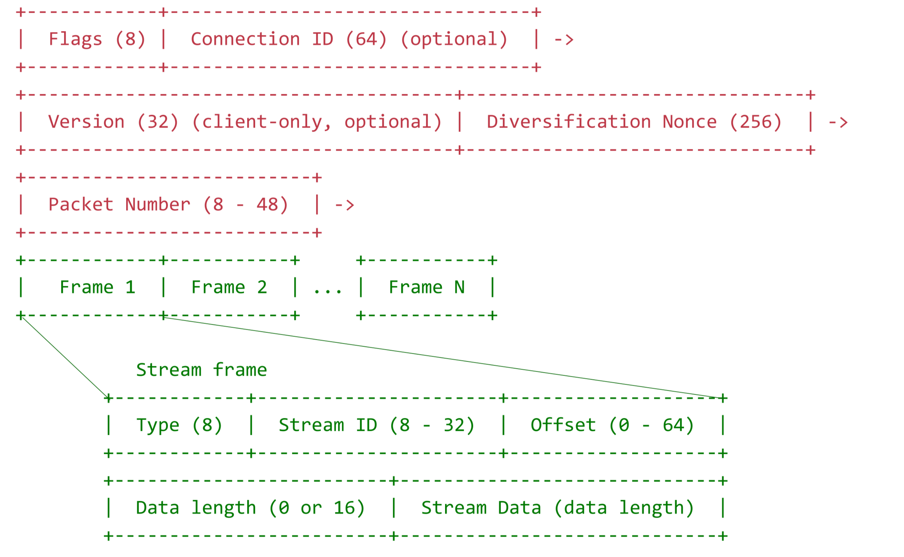
#2: Streams without HOLB
QUIC supports packet format with frame-level data

Slide 13
#2: Streams without HOLB
Stream-level flow control
Separate advertised window per stream and for connection
Window update frames per stream
Stream-level sending rate mechanisms (“priorities”)
QUIC receiver can deliver packets to app as long as stream packets received in order (even if connection’s packets are not)
Ideas are known from prior work on “Structured Streaming”

Slide 14
No HOLB across streams
Network writes here
Application can read up to here
1
2
1
2
4
Suppose pkt 3 contains object 2 and pkts 1,2,4 contain object 1.
App can read pkt 4 since stream 1 is in order.
1
2
4
3
Memory on the receiver machine

Slide 15
#3: Better RTT estimation
Use separate sequence numbers for data and packet delivery

Slide 16
#3: Better RTT estimation
Decouple reliability completely from ordered delivery

Slide 17
#3: Better RTT estimation
Decouple reliability completely from ordered delivery
Packet numbers are monotonically increasing (and hence unique)
Distinct from frame offsets within stream
Use time between the transmission of a packet and its ACK (identifiable using unique packet number) for RTT estimate
Regardless of original transmission or retransmission
Better RTTs when you need them the most: loss recovery
Also have more ACK blocks (256) than TCP SACK

Slide 18
#1 Lower-latency handshake
“Common case” 0-RTT handshake
Otherwise, 1-RTT or (more rarely) 2-RTT handshake
Merge cryptographic information within the first packet
Use cached credentials to make subsequent handshakes faster
Optimistically assume handshake succeeds
Server can reject or drop request without doing too much work
(More details to come…)

Slide 19
Results

Slide 20
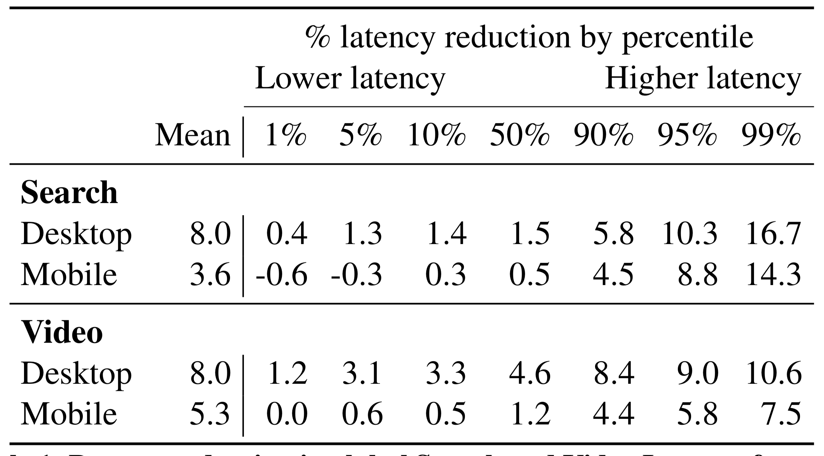
Latency improvements

Slide 21
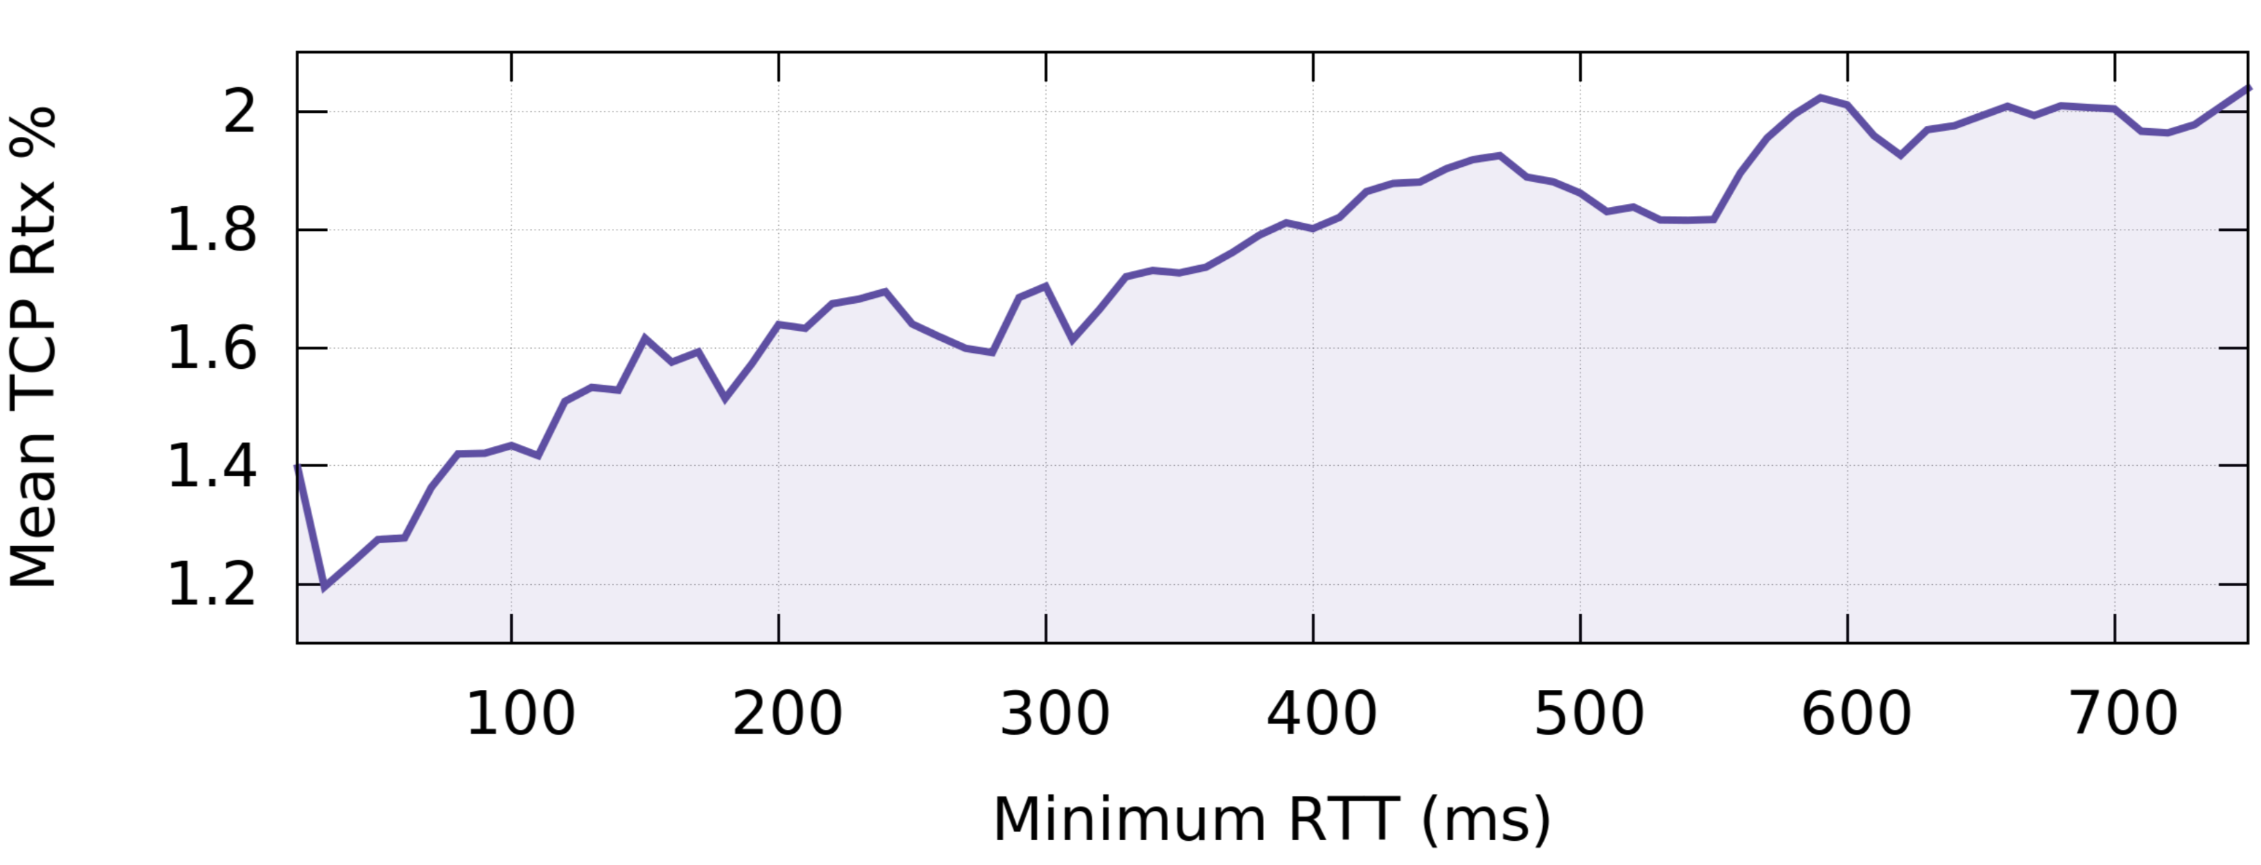
Retransmission prevalence to Google clients

Slide 22
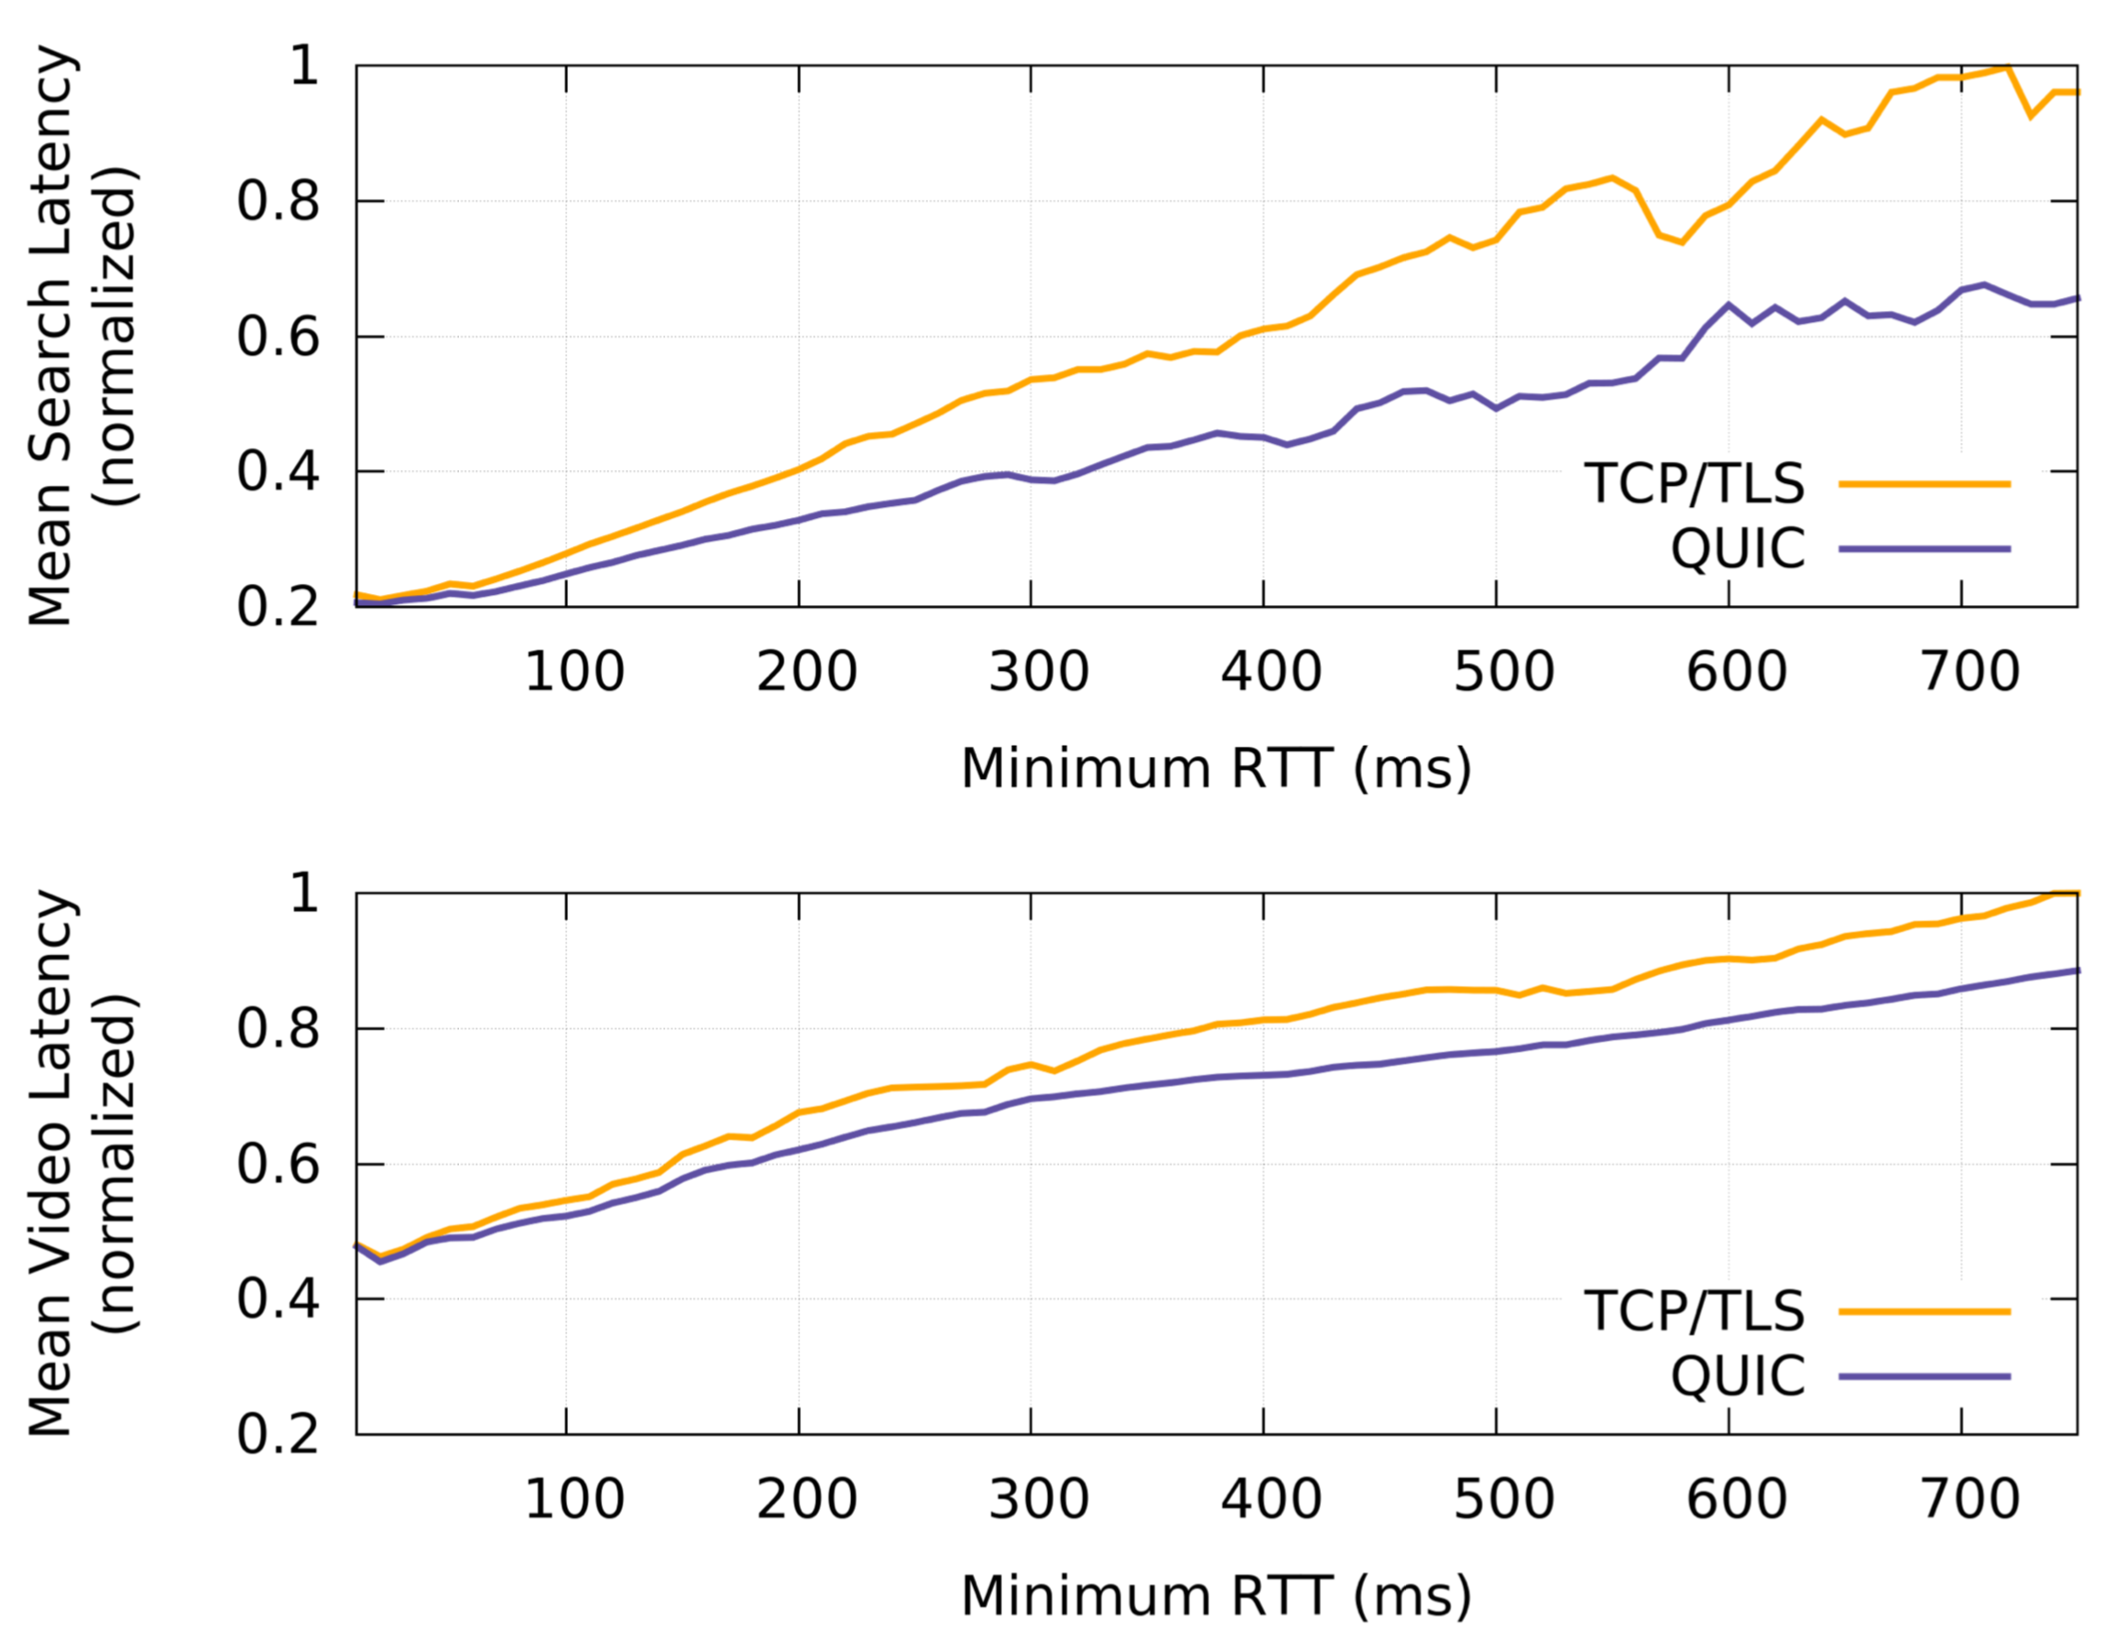
Improvements by minimum RTT
Hypothesis: better loss recovery behavior of QUIC results in higher improvements as minRTT increases
Not proven conclusively through targeted experiments in the paper. But possible to do (someone should do it!)
In general, good idea to combine macrobenchmarks with microbenchmarks

Slide 23
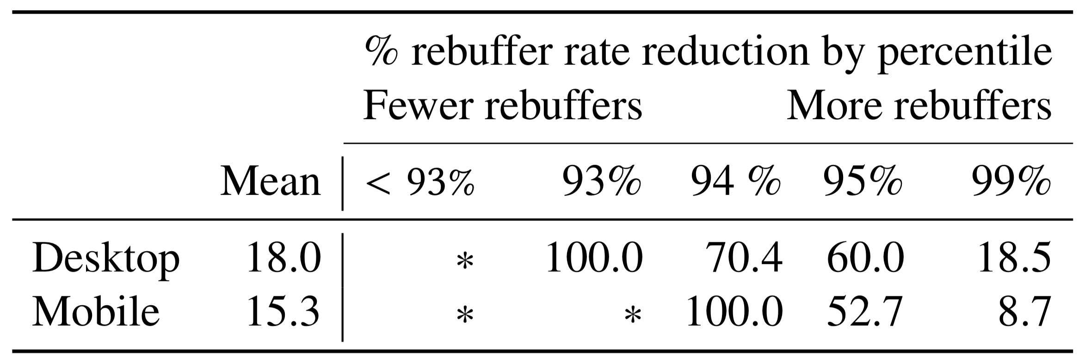
Video rebuffer rate

Slide 24
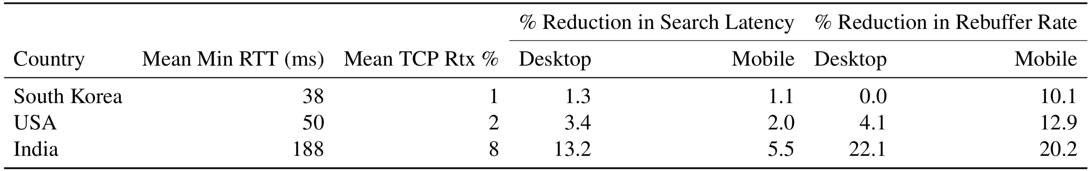
Improvements by region

Slide 25
Lessons from QUIC
Layering enables modularity but can hurt performance (TCP+TLS)
Benchmark application metrics (macrobenchmarks) and protocol metrics (microbenchmarks) to ensure
That features are working correctly
That features are useful to applications
User space networking has performance caveats
High CPU usage
Harder to write applications (PACKET_RX_RING + mmap)
Extra data transfer while bandwidth-limited (ex: video start) is bad
Google tried FEC, but performance didn’t improve as imagined

Slide 26
Discussion of QUIC

Slide 28
What you need to know to understand the QUIC handshake
Security and cryptography basics:
Confidentiality. Encryption techniques. Example of a technique (ex: Diffie-hellman key exchange) for secret communication. Difference between public and private key crypto. Forward secrecy. Specific reasons to prefer private or public.
Authentication. How certificates allow you to do this.
Integrity: how one-way functions allow you to do this.
TLS: goals: provide server authentication, confidentiality, integrity. The TLS handshake. What it achieves.
QUIC handshake: how the different components come together to achieve TLS goals. How the results of the handshake can be used later.

Slide 29
Some lessons from QUIC handshake
Encrypt as much as possible:
Security properties, but also avoid protocol entrenchment: need endpoints to be able to change without the core interfering
If you exchange metadata in plaintext (e.g., handshake packets), use all the plaintext while generating shared secrets. Otherwise, someone can tamper with integrity.
More a security principle than a networking principle
TLS does the same thing (prevent “downgrade” attacks)

