Slide 1

Reliable Data Delivery
Lecture 13
http://www.cs.rutgers.edu/~sn624/352-F24
Srinivas Narayana

Slide 2

Review
UDP: best-effort delivery + demultiplexing + error detection
Checksum function: 1s complement of the 1s complement sum
Sender: compute checksum & write.
Receiver: compute checksum, compare to 0
1 1 1 1 0 0 1 1 0 0 1 1 0 0 1 1 0
1 1 1 0 1 0 1 0 1 0 1 0 1 0 1 0 1
1 1 0 1 1 1 0 1 1 1 0 1 1 1 0 1 1
1 1 0 1 1 1 0 1 1 1 0 1 1 1 1 0 0
1 0 1 0 0 0 1 0 0 0 1 0 0 0 0 1 1
wraparound
sum
checksum

Slide 3
Checksum, why you being weird?
https://datatracker.ietf.org/doc/html/rfc1071
Not on the exam
Need a function that is fast to compute, catches likely errors, and easy to verify. Some design considerations:
Basic bit-wise: AND, OR: many inputs map to the same output
XOR: can catch single bit-flips, but not an even number of 1s/0s flipping
Some sort of addition is preferable to this (carries will show errors)
Addition is commutative, associative, has an identity element (0), is efficient to calculate
Checksum can appear anywhere in the packet
Compute checksum by placing a 0 in place originally
Use operations at the natural bit-width of the machine (16 bits was common)
(Regular) two’s complement addition: errors in higher order bit positions can be missed (the final carry-out bit isn’t part of the checksum)
One’s complement: adding the final carry-out to the result helps ☺
Why complement? Why not compare the checksum rather than to 0?
CPUs have ways of detecting if the last result was 0

Slide 4
Some observations on checksums
Checksums don’t detect all bit errors
Consider (x, y) vs. (x – 1, y + 1) as adjacent 16-bit values in packet
Analogy: you can’t assume the package hasn’t been meddled with if its weight matches the one on the stamp. More smarts needed for that. ☺
But it’s a lightweight method that works well in many cases
Checksums are part of the packet; they can get corrupted too
The receiver will just declare an error if it finds an error

Slide 5
Some observations on checksums
Checksums are insufficient for reliable data delivery
If a packet is lost, so is its checksum
UDP and TCP use the same checksum function
TCP also uses the lightweight error detection capability
However, TCP has more mature mechanisms for reliable data delivery (up next!)
Checksum is a mechanism to detect errors, not correct them
Even when they detect errors, checksums don’t tell you where they lie

Slide 6
Playing with checksums
Let’s craft some UDP packets (again)!
sudo tcpdump -i lo udp –XAvvv # observe packets
sudo scapy # tool used to send crafted packets
send(IP(dst="127.0.0.1")/UDP(sport=1024, dport=2048)/"hello world”, iface="lo")
Now can you craft two UDP packets with an identical checksum?

Slide 7
Summary of UDP
A simple transport: Send or receive a single packet from/to the correct application process. That’s it
Just a thin shim around network layer’s best-effort delivery
No connection building, no latency
Suitable for one-off request/response messages
Sometimes suitable for loss-tolerant but delay-sensitive applications
No reliability, performance, or ordering guarantees
Can do basic error detection (bit flips) using checksums
Error detection is necessary to deliver data reliably, but it is insufficient

Slide 8
Reliable data delivery

Slide 9
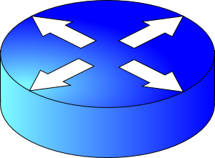

Packet loss
Sender
Receiver
How might a sender and receiver ensure that data is delivered reliably (despite some packets being lost)?
TCP uses three mechanisms

Slide 10
Coping with packet loss: (1) ACK
Key idea: Receiver returns an acknowledgment (ACK) per packet sent
If sender receives an ACK, it knows that the receiver got the packet.
Sender
Receiver
packet
ACK
packet
ACK

Slide 11
Coping with packet corruption: (1) ACK
ACKs also work to detect packet corruption on the way to the receiver
One possibility: A receiver could send a negative acknowledgment, or a NAK, if it receives a corrupted packet
Q: How to detect corrupted packet?
One method: Checksum!
TCP only uses positive ACKs.
Sender
Receiver
packet
NAK
packet
ACK

Slide 12
Coping with packet loss: (2) RTO
What if a packet is dropped?
Key idea: Wait for a duration of time (called retransmission timeout or RTO) before re-sending the packet
In TCP, the onus is on the sender to retransmit lost data when ACKs are not received
Note that retransmission works also if ACKs are lost or delayed
Sender
Receiver
RTO
Retransmission
ACK

Slide 13
How should the RTO be set?
A good RTO must predict the round-trip time (RTT) between the sender and receiver
RTT: the time to send a single packet and receive a (corresponding) single ACK at the sender
Intuition: If an ACK hasn’t returned, and our (best estimate of) RTT has elapsed, the packet was likely dropped.
RTT can be measured directly at the sender. No receiver or router help needed.
Sender
Receiver
RTO
ACK

Slide 14
Coping with packet duplication
If ACKs delayed beyond the RTO, sender may retransmit the same data
Receiver wouldn’t know that it just received duplicate data from this retransmitted packet
Add some identification to each packet to help distinguish between adjacent transmissions
This is known as the sequence number
Sender
Receiver
RTO
Duplicate
packet received!
(Receiver doesn’t know…)
ACK

Slide 15
Coping with packet loss: (3) Sequence #s
A bad scenario: Suppose an ACK was delayed beyond the RTO; sender ended up retransmitting the packet.
At the receiver: sequence number helps disambiguate a fresh transmission from a retransmission
Sequence number same as earlier: retransmission
Fresh sequence number: fresh data
Sender
Receiver
0
RTO
0
ACK

Slide 16
Coping with packet loss: (3) Sequence #s
A good scenario: packet successfully received and ACK returned within RTO
Sequence numbers of successively transmitted packets are different
Sender
Receiver
SEQ 0
Receiver knows these are not duplicate, because sequence numbers are different
RTO
ACK
SEQ 1
RTO

Slide 17
Coping with packet loss: (3) Sequence #s
A good scenario: packet successfully received and ACK returned within RTO
Sequence numbers of successively transmitted packets are different
Sender
Receiver
SEQ 0
Receiver knows these are not duplicate, because sequence numbers are different
RTO
ACK
ACK
SEQ 1
RTO
ACK

Slide 18
Q: What is the seq# of third packet?
Goal: Avoid ambiguity on which packet was received/ACK’ed from both the sender and receiver’s perspective
One option: increment seq#: 2, 3, …
Alternative: since seq # 0 was successfully ACK’ed earlier, it is OK to reuse seq #0 for next transmission.
Seq #s reusable if older packets with those seq #s known to be delivered
Sender
Receiver
SEQ 0
RTO
ACK
SEQ 1
RTO
ACK
???

Slide 19
Stop-and-Wait Reliability
Sender sends a single packet, then waits for an ACK to know the packet was successfully received. Then the sender transmits the next packet.
If ACK is not received until a timeout (RTO), sender retransmits the packet
Disambiguate duplicate vs. fresh packets using sequence numbers that change on “adjacent” packets
Sender
Receiver
SEQ 0
ACK
RTT
SEQ 1
RTO
Retransmit

Slide 20
In principle, these three ideas are sufficient to implement reliable data delivery!

Slide 21
Efficiency problem with stop-and-wait
Sender sends one packet, waits for an ACK (or RTO) before transmitting next one
Unfortunately, too slow ☹
Suppose RTO = RTT = 100 milliseconds
Packet size (bytes in 1 packet) = 12,000 bits
Bandwidth of links from sender to receiver = 12 Mbit/s (1 M = 10⁶)
Rate of data transfer = data size / time
Sender
Receiver
RTT
RTO
120 Kilobit/s == 1% of bw!

Slide 22
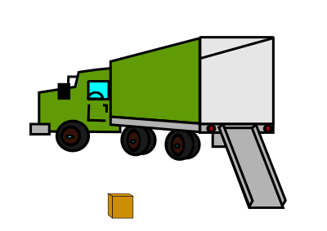
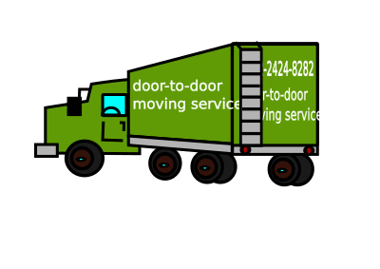


Sending one packet per RTT makes the data transfer rate limited by the time between the endpoints, rather than the bandwidth.
Ensure you got the (one) box safely; make N trips
Ensure you get N boxes safely; make just 1 trip!
Keep many packets in flight

