Slide 1

CS 352 Internet Technology
Srinivas Narayana
http://www.cs.rutgers.edu/~sn624/352-S19
Dept. of Computer Science
Rutgers University

Slide 2
About us: Management
Professor: Srinivas Narayana
http://www.cs.rutgers.edu/~sn624
srinivas.narayana@rutgers.edu
Office hours: CoRE 312, Thursdays 10 am -- noon or by appointment
Class: Wed 10.20 – 11.40 AM and Fri 3.20 – 4.40 PM TIL 232
Recitation section 5: Bala Murali Komanduri bk455@scarletmail.rutgers.edu
Thursday 12.15 —1.10 PM LSH-B267
Recitation section 6: Jayant Kannadkar jdk176@scarletmail.rutgers.edu
Thursday 8.55 – 9.50 AM LSH-B115
Course info
http://www.cs.rutgers.edu/~sn624/352-S19/
Piazza: accessible from class Sakai site

Slide 3
Class etiquette
Cell phones in off position
No FB status updates, texting, selfies in class
If you need to surf while in class (I prefer you do not), do not disturb your neighbors
Stop me anytime to ask questions
Try to learn as much as you can in class

Slide 4
What is a Network?
Carrier of information between 2 or more entities
Interconnection may be any medium capable of communicating information:
copper wire
Lasers (optic fibre)
Microwave
Cable (coax)
satellite link
Wireless link (cellular, 802.11, bluetooth)
Examples: Ethernet, 802.11(WIFI), cable modem, cellular

Slide 5

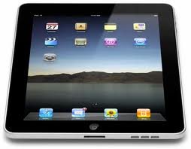
A single link network
Send bits of data in packets or frames
Need to worry about errors, how to convert bits into signals and vice versa

Slide 6
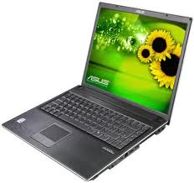

A single link multiple access network
Send bits of data in packets or frames
Need to worry about errors, how to convert bits into signals and vice versa
In addition, how to differentiate among many receivers?
Every host as a link layer address: MAC address
Packets or frames will have destination address
However, can’t have every computer in the world on the same link!

Slide 7

A multi-link network
Router
Router
Router
Connect multiple links via routers
Need to figure out how to route packets from one host to another host

Slide 8
Components of a network
Link
Communication links for transmission
Host
Computer running applications of end user
Router
Computer for routing packets from input line to another output line
Gateway
A device directly connected to two or more possibly different networks (serves as an access point), provides access
Network
A group of hosts, links, routers capable of sending packets among its members

Slide 9
Why are networks useful?
Availability of resources
Resources become available regardless of user location
Performance and load sharing
Ex: Move work to the least loaded machine
High reliability
Alternative sources for the same data (multiple copies)
Human-to-human communication!
Ex: telephone (voice over IP), text messaging

Slide 10
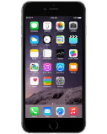

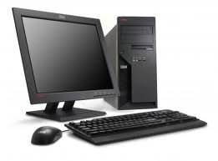
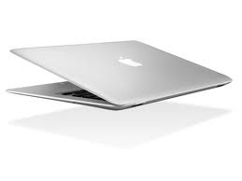
What is Internet Technology?
What is an internet?
Network of networks
What is the Internet?
A global internet based on the IP protocol
Network to network – adopt a common language
What does “Internet technology” refer to?
Architecture, protocols, and services

Slide 11
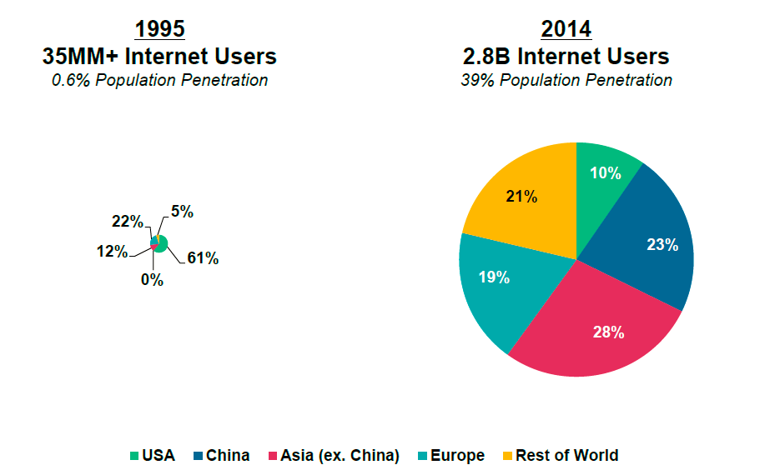
Internet growth
2018:
3.6B users
Mobile Phones: in 1995 80 M, now 5 B

Slide 12

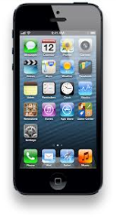










Evolution of Internet Applications
2010-now
1992
1996
2000
2004
2008
ftp
web
chat
Games
IM
Yahoo!
news
Blog
Search
Music
itunes
Games
search
Wikipedia
Craiglist
Youtube

Slide 13
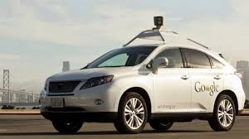
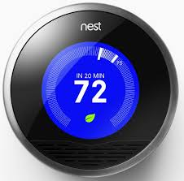
Web evolution
Web 1.0
Read-only web
Content ➔ Users
Yahoo, google, daily targum
Web 2.0
Read-write web
Content ➔Users and Users ➔ Content
Blog, wikipedia, facebook, twitter, youtube
Web 3.0
Contextual web
Personalized, location dependent
Apps on your phone get organized (ex: weather, maps); Google NOW
Web 4.0
Devices will be connected as first class objects: refrigerator, car, fitbit, thermostat, …
Prediction-Machine learning

Slide 14
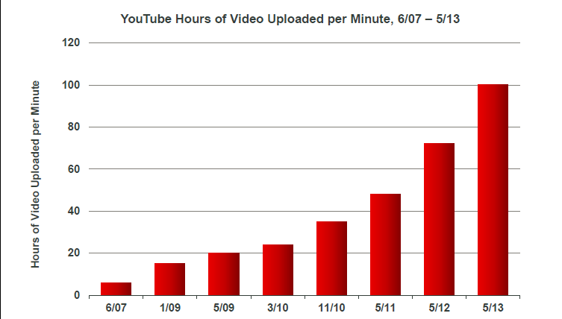
Content is exploding
400 hrs (not to scale)
2018
HD quality video: 2G to 4G / hour
Source: Mary Meeker Internet trends Presentation

Slide 15
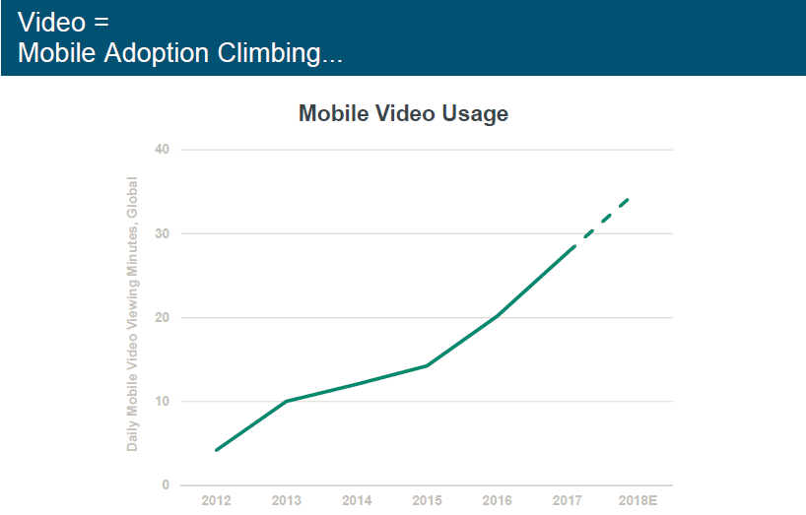
1.8 B youtube users

Slide 16
Transforming the economy
Mobile payment
Venmo, square, paytm
Shared resource platforms
Uber, Airbnb, WeWork

Slide 17
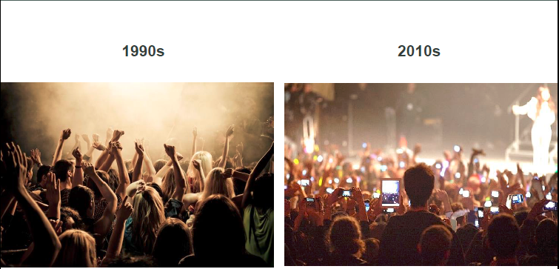
Just dancing and listening, to video, tweets, selfies, and share
Source: Mary Meeker Internet trends Presentation

Slide 18



Scale of Web apps
2.23 B
active users
> 1 B iphones
300 M ipads
3.5 B searches/day

Slide 19
Impact of the Internet on People
Access to remote information
HW assignments from my server
Stock quotes from financial web site
News, wikipedia, google
Person to person and group communication
email, whatsapp, blogs, fb, twitter, instagram, snapchat
Interactive entertainment
video clips (youtube), movies (netflix), music (itunes, spotify), games
Online commerce
Amazon, Ebay, hotels

Slide 20
Impact of the Internet on Society
The good
Access to information, services, e-commerce, productivity
The bad
Gossip, distraction, Internet addiction, chat room
The ugly
Phishing, fraud, trolling, cyberbullying
The Internet is a mirror of society

Slide 21
Internet Players
Users of applications
Everyone (mom and pop, kids) to get something done
Network Designers
Protocol design and implementation
Performance, cost, scale
Internet Service Providers
Administrators and ISPs (AT&T)
Management, revenue, deployment
Market/businesses on the Internet
Consumer to consumer (ebay), Business to consumer (amazon, netflix), Business to business (alibaba, importers.com,21food.com), Consumer to business (hotjobs, monster), Govt to C, Govt to B, etc.

Slide 22
Internet service providers (ISPs)
Local ISPs: Tier 3 (cablevision)
Regional ISPs: Tier2 (internap)
Global ISPs: Tier 1 (Verizon, Sprint, AT&T, level 3, century link, Deutsche Telekom, NTT) provide access to the entire internet; connect ISP to other ISPs
Peering ISPs
Have a mutual relationship about forwarding traffic of each others customers (no $ involved)
Transit ISPs
Provides access to all reachable customers ($$ involved)

Slide 23
Core Networks: ISP Tiers
local
ISP
Tier 3
ISP
local
ISP
local
ISP
local
ISP
Local and tier- 3 ISPs are customers of
higher tier ISPs
connecting them to rest of Internet
Tier-2 ISP
Tier-2 ISP
Tier 1 ISP
NAP
Tier 1 ISP
Tier 1 ISP
Tier-2 ISP
Tier-2 ISP
Tier-2 ISP
local
ISP
local
ISP
local
ISP
local
ISP

Slide 24
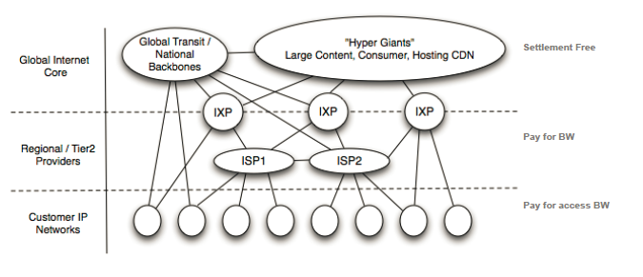
ISPs connected via Exchanges
Flatter Internet
Business models among, content provider, transit providers, and customers
Net Neutrality
Internet Inter-domain traffic By Labovitz et.al, SIGCOMM 2010

Slide 25
Types of Networks in an Internet
Local area networks (LAN)
Privately owned, within building
High speed, broadcast, Ethernet
2 to 100 Mbps
Wide area networks (WAN)
Spans a large area
Point-to-point, high speed fiber lines
Long delays but very high speed links
Several Gbps

Slide 26
Types of Networks (cont’d)
Wireless networks
Hosts connected by radio or infrared links
Local area and wide area
Satellite networks

Slide 27
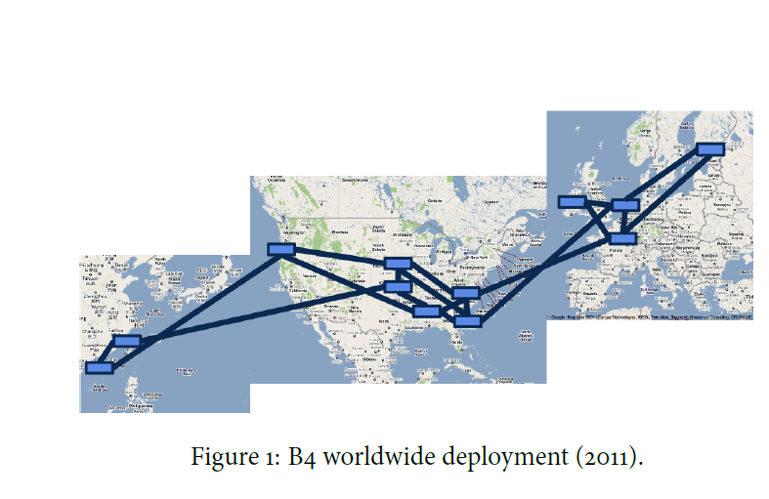
Google WAN

Slide 28
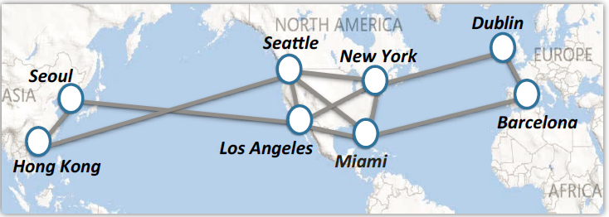
Microsoft WAN

Slide 29
Historical perspective
Late 1960’s: ARPAnet (4 nodes)
Early 1970’s: Aloha net, ethernet, multiple access problem
Mid-to-late 1970’s: TCP/IP, 4.2BSD
1980’s to early 1990’s: early internet growth, e-mail & file transfer dominant, NSFNET
Mid 1990s: NSFnet handed over to commercial service providers, WWW explodes
Late 90s, business models using the internet; dot-com boom and bust
Early to mid 2000s, Web 2.0, Facebook, google, Wikipedia
Future: “Embedded networks”, 5 to 10 billion devices waiting to be networked, media convergence, ubiquitous RFID tags

Slide 30
Course Goals
Understand the basic design principles of computer networks
Understand how the Internet works
Services, protocols, and architectures
Text: “Computer networking, a top-down approach,” by James Kurose and Keith Ross

Slide 31
Course Assessments
Sakai quizzes (15%)
6 of them, can drop lowest grade
2 Mid-terms (15% each)
No electronic devices, notes, or cheat sheets allowed
Final (25%)
You must notify me at least 2 weeks before the final if you need to take the makeup!
Project (30%)
Part 1 (10%)
Part 2 (10%)
Part 3 (10%)
You may not dispute a grade before 24 hours or after 7 days of receiving it

Slide 32
Programming assignments
Single long project
Broken into three parts
Can work in a group of 2
Both program and write-up required
Background needed to get started:
C or Python (211, 214 level)
Comfortable using data structures (dictionaries, vectors, trees)
Unix (login, permissions, gcc)

Slide 33
Programming assignments
Each phase of the code feeds into the next phase
Make improvements for next phase of the assignment
Hand-in via sakai
Failure to meet the deadline will result in a zero for all team members. No exceptions.
You must turn in all projects to pass this course

Slide 34
Academic integrity
No cheating on projects and exams
Run code similarity detectors on the projects & code review
Scrutinize exams for copying
Department academic integrity policy
https://www.cs.rutgers.edu/academic-integrity/introduction
Please read and acknowledge your awareness of this policy

