Slide 1

The Application Layer: HTTP
CS 352, Lecture 4
http://www.cs.rutgers.edu/~sn624/352-S19
Srinivas Narayana

Slide 2
A recap: Domain Name Service (DNS)
Hostname to IP address translation
Hierarchical structure to scale lookups
Recursive and Iterative queries
Caching for performance optimization
Multiple layers of indirection to delegate the lookup work

Slide 3
Some themes from DNS
Request/response nature of protocols
ASCII-based message structures
DNS, HTTP, SMTP, FTP - simple (ASCII) protocols
Higher performance using caching
Scale using indirection

Slide 4
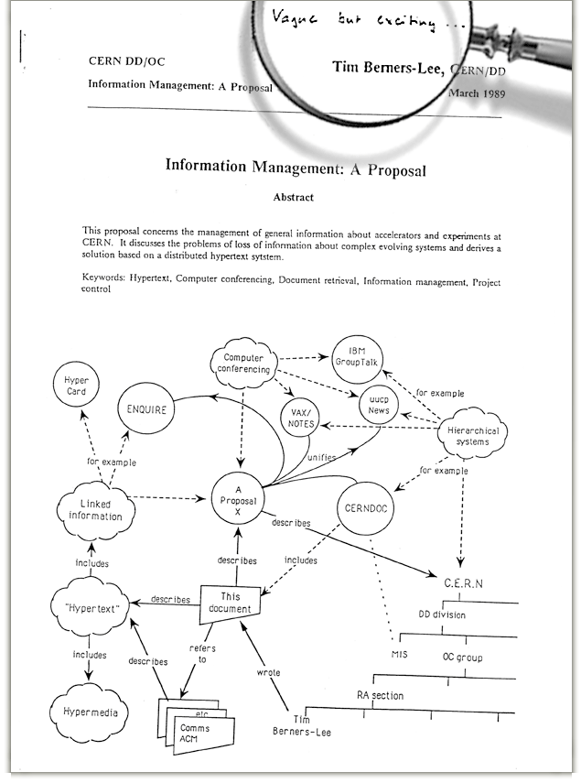
The Web
“Vague, but exciting”

Slide 5
Web and HTTP: Some terms
Web page consists of objects
Object can be HTML file, JPEG image, video stream chunk, audio file,…
Web page consists of base HTML-file which includes several referenced objects
Each object is addressable by a URL
Example URL:
www.cs.rutgers.edu/~netid/picture.jpeg
host name
path name

Slide 6
HTTP overview
HTTP: hypertext transfer protocol
client/server model
Client: browser that requests, receives, “displays” Web objects
Server: Web server sends objects in response to requests
HTTP 1.0: RFC 1945
HTTP 1.1: RFC 2068
HTTP request
PC running
Explorer
HTTP response
HTTP request
Server
running
Apache Web
server
HTTP response
Mac running
Navigator

Slide 7
HTTP messages: request message
HTTP request message:
ASCII (human-readable format)
request line
(GET, POST,
HEAD commands)
GET /somedir/page.html HTTP/1.1
Host: www.someschool.edu
User-agent: Mozilla/4.0
Connection: close
Accept-language:fr
(extra carriage return, line feed)
header
lines
Carriage return,
line feed
indicates end
of message

Slide 8
Client server connection
DNS
Hostname | IP address
Host name
IP Address
IP Address, 80
http messages

Slide 9
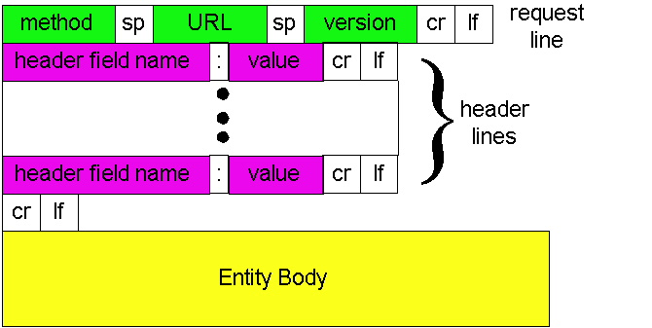
HTTP request message: general format
http://www.w3.org/Protocols/rfc2616/rfc2616-sec14.html#sec14

Slide 10
Method types
GET
Get the file specified in the path URL field in entity body
POST
accept the entity enclosed in the entity body as a new subordinate of the resource identified by the URL field
HEAD
asks server to leave requested object out of response
PUT
uploads file in entity body to path specified in URL field
DELETE
deletes file specified in the URL field

Slide 11
Uploading form input: GET and POST
POST method:
Web page often includes form input
Input is uploaded to server in entity body
Posted content not visible in the URL
Free form content (ex: images) can be posted since entity body interpreted as data bytes
GET method:
Entity body is empty
Input is uploaded in URL field of request line
Example:
http://site.com/form?first=jane&last=doe

Slide 12
Example: Client POST request
POST /cgi-bin/rats.cgi HTTP/1.0
Referer: http://nes:8192/cgi-bin/rats.cgi
Connection: Keep-Alive
User-Agent: Mozilla/4.73 [en] (X11; U; Linux 2.2.12-20 i686)
Host: nes:8192
Accept: image/gif, image/x-xbitmap, image/jpeg, image/pjpeg, image/png, */*
Accept-Encoding: gzip
Accept-Language: en
Accept-Charset: iso-8859-1,*,utf-8
Content-type: application/x-www-form-urlencoded
Content-length: 93
Account=cs111fall&First=Alice&Last=White&SSN=123456789&Bday=01011980&State=CreateAccount
http://www.w3.org/Protocols/rfc2616/rfc2616-sec14.html#sec14

Slide 13
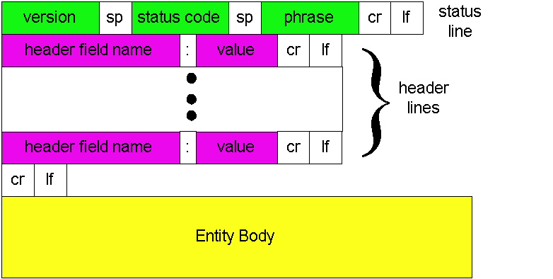
HTTP response message: general format
Unlike HTTP request, No method name

Slide 14
HTTP message: response message
status line
(protocol
status code
status phrase)
HTTP/1.1 200 OK
Connection: close
Date: Thu, 06 Aug 1998 12:00:15 GMT
Server: Apache/1.3.0 (Unix)
Last-Modified: Mon, 22 Jun 1998 …...
Content-Length: 6821
Content-Type: text/html
data data data data data ...
header
lines
data, e.g.,
requested
HTML file

Slide 15
HTTP response status codes
In first line in server->client response message.
A few sample codes:
200 OK
request succeeded, requested object later in this message
301 Moved Permanently
requested object moved, new location specified later in this message (Location:)
400 Bad Request
request message not understood by server
404 Not Found
requested document not found on this server
505 HTTP Version Not Supported

Slide 16
Try out HTTP (client side) for yourself!
1. Telnet to your favorite Web server:
Opens TCP connection to port 80
(default HTTP server port).
Anything typed in sent
to port 80 at www.eden.rutgers.edu
telnet web.mit.edu 80
2. Type in a GET HTTP request:
By typing this in (hit carriage
return twice), you send
this minimal (but complete)
GET request to HTTP server
GET / HTTP/1.1
Host: web.mit.edu
3. Look at response message sent by HTTP server!

Slide 17
Additional details about HTTP
Persistent vs. Nonpersistent HTTP connections
Cookies (User-server state)
Web caches

Slide 18
Recall the Internet protocol stack…
Application
HTTPS
FTP
HTTP
SIP
RTSP
Transport
TCP
UDP
Network
IP
Host-to-Net
X.25
…
802.11
ATM

Slide 19
HTTP connections
Non-persistent HTTP
At most one object is sent over a TCP connection.
HTTP/1.0 uses nonpersistent HTTP
Persistent HTTP
Multiple objects can be sent over single TCP connection between client and server.
HTTP/1.1 uses persistent connections in default mode
TCP is a kind of reliable communication service provided by the transport layer. It requires the connection to be set up before data communication.

Slide 20


Non-persistent HTTP
1a. HTTP client initiates TCP connection to HTTP server
1b. HTTP server at host “accepts” connection, notifying client
Suppose user visits a page with text and 10 images.
2. HTTP client sends HTTP request message
3. HTTP server receives request message, replies with response message containing requested object
time

Slide 21
Non-persistent HTTP (contd.)
4. HTTP server closes TCP connection.
5. HTTP client receives response message containing html file, displays html. Parsing html file, finds 10 referenced jpeg objects
time
6. Steps 1-5 repeated for each of 10 jpeg objects

Slide 22
HTTP Response time
Definition of RTT: time to send a small packet to travel from client to server and back.
Sum of propagation and queueing delays.
Response time:
one RTT to initiate TCP connection
one RTT for HTTP request and first few bytes of HTTP response to return
file transmission time
total = 2RTT + transmit time
initiate TCP
connection
RTT
request
file
RTT
time to
transmit
file
file
received
time
time

Slide 23
Persistent vs. Non-persistent
Non-persistent HTTP issues:
requires 2 RTTs per object
Browsers can open parallel TCP connections to fetch referenced objects
Persistent HTTP
server leaves connection open after sending response
subsequent HTTP messages between same client/server sent over open connection

Slide 24
HTTP: User data on servers?
So far, HTTP is “stateless”
The server maintains no information about past client requests
What can state about the user @ the server bring?
authorization
shopping carts
recommendations
user session state

Slide 25

Cookies: Keeping user memory
client
server
Cookie file
usual http request msg
server
creates ID
1678 for user
ebay: 8734
usual http response +
Set-cookie: 1678
entry in backend
database
Cookie file
usual http request msg
cookie: 1678
amazon: 1678
ebay: 8734
cookie-
specific
action
access
usual http response msg
one week later:
access
Cookie file
usual http request msg
cookie: 1678
cookie-
spectific
action
amazon: 1678
ebay: 8734
usual http response msg

Slide 26
Summary of cookies
Four components:
cookie header line of HTTP response message
cookie header line in HTTP request message
cookie file kept on user’s host, managed by user’s browser
back-end database at Web site
Client and server collaboratively track and remember the user’s state.

Slide 27

Cookies and Privacy
Aside
Cookies and privacy
cookies permit sites to learn a lot about you
you may supply name and e-mail to sites

Slide 28
Web caches (proxy server)
Web caches: Machines that remember web responses for a network
Why cache web responses?
Reduce response time for client requests
Reduce traffic on an institution’s access link

Slide 29

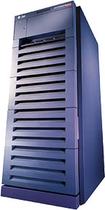
Web caches (proxy server)
You can configure a HTTP proxy on your laptop’s network settings.
If you do, your browser sends all HTTP requests to the proxy (cache).
Hit: cache returns object
Miss:
cache requests object from origin server
caches it locally
and returns it to client
Clients
Web Server
(also called origin server in this context)
GET foo.html
GET foo.html
The Internet
Proxy Server
Store foo.html
on receiving response

Slide 30
Web Caches: how does it look on HTTP?
cache
server
Conditional GET guarantees cache content is up-to-date while still saves traffic and response time whenever possible
Date in the cache’s request is the last time the server provided in its response header “last modified”
HTTP request msg
If-modified-since: <date>
object
not
modified
HTTP response
HTTP/1.0
304 Not Modified
HTTP request msg
If-modified-since: <date>
object
modified
HTTP response
HTTP/1.0 200 OK
<data>

Slide 31
Content Distribution Networks (CDN)
A global network of web caches
Provisioned by ISPs
Or content providers! (Netflix, google, …)
Uses
Reduce bandwidth requirements of content provider
Reduce $$ of maintaining servers
Reduce traffic on the link to the content provider
Improve response time to user for that service

Slide 32
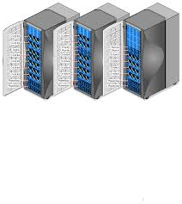
Without CDN
DOMAIN NAME | IP ADDRESS
www.yahoo.com | 98.138.253.109
cs.rutgers.edu | 128.6.4.2
www.google.com | 74.125.225.243
www.princeton.edu | 128.112.132.86
Cluster with Yahoo’s origin servers
Huge bandwidth requirements
Large propagation delays to reach users
So, distribute content to geographically distributed cache servers.
Often, use DNS to redirect request to users to copies of content!
98.138.253.109

Slide 33
CDN terms
Origin server
Server that holds the authoritative copy of the content
CDN server
A replica server owned by the CDN provider
CDN name server
A DNS like name server used for redirection
Client

Slide 34
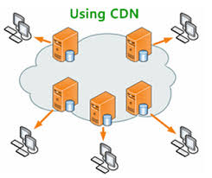
With CDN
DOMAIN NAME | IP ADDRESS
www.yahoo.com | 124.8.9.8 (NS of CDN)
cs.rutgers.edu | 128.6.4.2
www.google.com | 74.125.225.243
www.princeton.edu | 128.112.132.86
Scale through indirection to CDN name server.
CDN Name Server (124.8.9.8)
Custom logic to map ONE domain name to one of many IP addresses!
DOMAIN NAME | IP ADDRESS
www.yahoo.com | 12.1.2.3
www.yahoo.com | 12.1.2.4
www.yahoo.com | 12.1.2.5
www.yahoo.com | 12.1.2.6
12.1.2.3
12.1.2.4
CDN servers
12.1.2.6
12.1.2.5
98.138.253.109
Origin server
Client

Slide 35
Themes from HTTP
Request/response nature of protocols
Headers determine the actions of all the parties of the protocol
ASCII-based message structures
Higher performance using caching
Scaling using indirection
These principles form of the basis of the web that we enjoy today!

