Slide 1

Transport Layer: Congestion Control
CS 352, Lecture 9
http://www.cs.rutgers.edu/~sn624/352-S19
Srinivas Narayana
(slides heavily adapted from text authors’ material)

Slide 2
Principles of congestion control
congestion:
informally: “too many sources sending too much data too fast for network to handle”
different from flow control!
manifestations:
lost packets (buffer overflow at routers)
long delays (queueing in router buffers)
a top-10 problem!

Slide 3

Costs of congestion: scenario 1
original data: λ_{in}
throughput: λ_{out}
two senders, two receivers
one router, infinite buffers
output link capacity: R
no retransmission
Host A
unlimited shared output link buffers
Host B
R/2
λ_{out}
delay
λ_{in}
R/2
λ_{in}
R/2
maximum per-connection throughput: R/2
large delays as arrival rate, λ_{in}, approaches capacity

Slide 4
Costs of congestion: scenario 2
one router, finite buffers
sender retransmission of timed-out packet
application-layer input = application-layer output: λ_{in} = λ_{out}
transport-layer input includes retransmissions : λ_{in} λ_{in}
‘
λ_{in} : original data
λ'_{in}: original data, plus retransmitted data
λ_{out}
Host A
finite shared output link buffers
Host B

Slide 5
Costs of congestion: scenario 2
R/2
idealization: perfect knowledge
sender sends only when router buffers available
λ_{out}
λ_{in}
R/2
λ_{in} : original data
copy
λ'_{in}: original data, plus retransmitted data
λ_{out}
A
free buffer space!
finite shared output link buffers
Host B

Slide 6

Causes/costs of congestion: scenario 2
Idealization: known loss packets can be lost, dropped at router due to full buffers
sender only resends if packet known to be lost
λ_{in} : original data
copy
λ'_{in}: original data, plus retransmitted data
λ_{out}
A
no buffer space!
Host B

Slide 7
Causes/costs of congestion: scenario 2
Idealization: known loss packets can be lost, dropped at router due to full buffers
sender only resends if packet known to be lost
R/2
when sending at R/2, some packets are retransmissions but asymptotic goodput is still R/2 (why?)
λ_{out}
λ_{in}
R/2
λ_{in} : original data
λ'_{in}: original data, plus retransmitted data
λ_{out}
A
free buffer space!
Host B

Slide 8


Costs of congestion: scenario 2
Realistic: duplicates
packets can be lost, dropped at router due to full buffers
sender times out prematurely, sending two copies, both of which are delivered
R/2
when sending at R/2, some packets are retransmissions including duplicated that are delivered!
λ_{out}
λ_{in}
R/2
λ_{in}
copy
λ'_{in}
λ_{out}
timeout
A
free buffer space!
Host B

Slide 9
Costs of congestion: scenario 2
Realistic: duplicates
packets can be lost, dropped at router due to full buffers
sender times out prematurely, sending two copies, both of which are delivered
R/2
when sending at R/2, some packets are retransmissions including duplicated that are delivered!
λ_{out}
λ_{in}
R/2
“costs” of congestion:
more work (retrans) for given “goodput”
unneeded retransmissions: link carries multiple copies of pkt
decreasing goodput

Slide 10
Costs of congestion: scenario 3
Q: what happens as λ_{in} and λ_{in}’ increase ?
four senders
multihop paths
timeout/retransmit
A: as red λ_{in}’ increases, all arriving blue pkts at upper queue are dropped, blue throughput goes to 0
Host A
λ_{in} : original data
λ_{out}
Host B
λ'_{in}: original data, plus retransmitted data
finite shared output link buffers
Host D
Host C

Slide 11
Costs of congestion: scenario 3
C/2
λ_{out}
λ_{in}’
C/2
another “cost” of congestion:
when packet dropped, any “upstream transmission capacity used for that packet was wasted!

Slide 12
TCP’s Congestion Control

Slide 13
TCP Congestion Control
Goal: fully (fairly) utilize the resource (bandwidth)
Don’t over use - congestion
Don’t under use – waste
Remember: available link rates may change over time
TCP introduces a second window, called the “congestion window”
This window maintains TCP’s best estimate of amount of outstanding data to allow in the network to achieve self-clocking
Sending size = min(congestion control window, flow control window)

Slide 14
TCP Congestion Control
Guiding principles:
Successful new ACK: can send more data per unit time
Lost segment: must reduce data being sent
Probe for max sending rate at which packets still get delivered
Typically two phases of window adjustments:
Increase the usage (window size) to keep probing the network
Decrease the usage when congestion is detected

Slide 15
TCP congestion control: additive increase multiplicative decrease
approach: sender increases transmission rate (window size), probing for usable bandwidth, until loss occurs
additive increase: increase cwnd by 1 MSS every RTT until loss detected
multiplicative decrease: cut cwnd in half after loss
additively increase window size …
…. until loss occurs (then cut window in half)
AIMD saw tooth
behavior: probing
for bandwidth
cwnd: TCP sender
congestion window size
time

Slide 16
TCP Congestion Control: details
sender sequence number space
TCP sending rate:
roughly: send cwnd bytes, wait RTT for ACKS, then send more bytes
cwnd
last byte
ACKed
last byte sent
sent, not-yet ACKed
(“in-flight”)
rate
cwnd
sender limits transmission:
cwnd is dynamic, function of perceived network congestion
~
bytes/sec
~
RTT
LastByteSent-
LastByteAcked
cwnd
<

Slide 17
TCP Slow Start
Host A
Host B
when connection begins, increase rate exponentially until first loss event:
initially cwnd = 1 MSS
double cwnd every RTT
done by incrementing cwnd for every ACK received
summary: initial rate is slow but ramps up exponentially fast
one segment
RTT
two segments
four segments
time

Slide 18
TCP: detecting, reacting to loss
loss indicated by timeout:
cwnd set to 1 MSS;
window then grows exponentially (as in slow start) to threshold, then grows linearly
loss indicated by 3 duplicate ACKs: TCP RENO
dup ACKs indicate network capable of delivering some segments
cwnd is cut in half window then grows linearly
TCP Tahoe always sets cwnd to 1 (timeout or 3 duplicate acks)

Slide 19
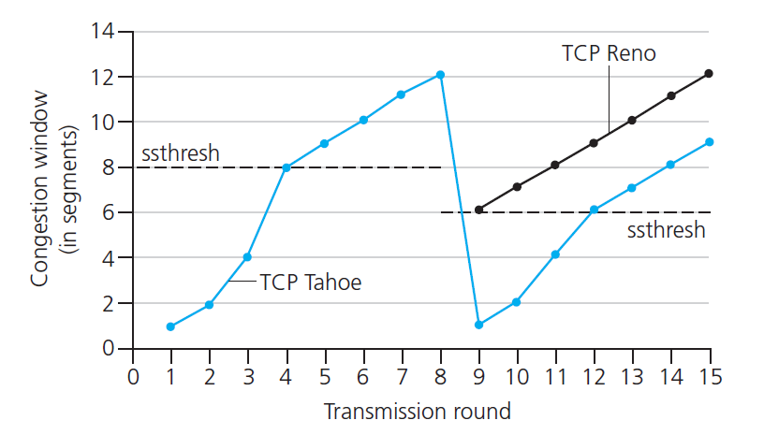
TCP: switching from slow start to CA
Q: when should the exponential increase switch to linear?
A: when cwnd gets to 1/2 of its value before timeout.
Implementation:
variable ssthresh
on loss event, ssthresh is set to 1/2 of cwnd just before loss event
* Check out the online interactive exercises for more examples: http://gaia.cs.umass.edu/kurose_ross/interactive/

Slide 20
TCP Congestion Control: Big picture
New
ACK!
New
ACK!
.
duplicate ACK
new ACK
dupACKcount++
new ACK
cwnd = cwnd + MSS (MSS/cwnd)
dupACKcount = 0
transmit new segment(s), as allowed
cwnd = cwnd+MSS
dupACKcount = 0
transmit new segment(s), as allowed
Λ
cwnd = 1 MSS
ssthresh = 64 KB
dupACKcount = 0
cwnd > ssthresh
slow
start
Λ
congestion
avoidance
timeout
ssthresh = cwnd/2
cwnd = 1 MSS
dupACKcount = 0
retransmit missing segment
duplicate ACK
timeout
dupACKcount++
ssthresh = cwnd/2
cwnd = 1 MSS
dupACKcount = 0
retransmit missing segment
timeout
New
ACK!
ssthresh = cwnd/2
cwnd = 1
dupACKcount = 0
retransmit missing segment
New ACK
dupACKcount == 3
cwnd = ssthresh
dupACKcount = 0
dupACKcount == 3
ssthresh= cwnd/2
cwnd = ssthresh + 3
retransmit missing segment
ssthresh= cwnd/2
cwnd = ssthresh + 3
retransmit missing segment
fast
recovery
duplicate ACK
cwnd = cwnd + MSS
transmit new segment(s), as allowed

Slide 21
TCP throughput
avg. TCP thruput as function of window size, RTT?
ignore slow start, assume always data to send
W: window size (measured in bytes) where loss occurs
avg. window size (# in-flight bytes) is ¾ W
avg. thruput is 3/4W per RTT
avg TCP thruput =
3
W
4
RTT
bytes/sec
W
W/2

Slide 22
TCP Fairness
fairness goal: if K TCP sessions share same bottleneck link of bandwidth R, each should have average rate of R/K
TCP connection 1
bottleneck
router
capacity R
TCP connection 2

Slide 23
Why is TCP fair?
two competing sessions:
additive increase gives slope of 1, as throughout increases
multiplicative decrease decreases throughput proportionally
R
equal bandwidth share
loss: decrease window by factor of 2
congestion avoidance: additive increase
Connection 2 throughput
loss: decrease window by factor of 2
congestion avoidance: additive increase
Connection 1 throughput
R

Slide 24
Explicit Congestion Notification (ECN)
network-assisted congestion control:
two bits in IP header (ToS field) marked by network router to indicate congestion
congestion indication carried to receiving host
receiver (seeing congestion indication in IP datagram) ) sets ECE bit on receiver-to-sender ACK segment to notify sender of congestion
source
TCP ACK segment
destination
application
transport
network
link
physical
ECE=1
application
transport
network
link
physical
ECN=11
ECN=00
ECN=11
IP datagram

