Slide 1

Network Support for Quality of Service (QoS)
CS 352, Lecture 24
http://www.cs.rutgers.edu/~sn624/352-S19
Srinivas Narayana
(heavily adapted from slides by Prof. Badri Nath and the textbook authors)

Slide 2
Review: Streaming multimedia
Watching media prerecorded at servers at multiple quality levels, ex: Netflix
Client downloads an initial portion and starts viewing/listening
Need continuous playout:
Manage network delays through a client buffer
Playout rate must be not larger than average download rate
Predominant model: Dynamic Adaptive Streaming over HTTP
DASH video is divided into chunks
Each chunk can be retrieved with an independent bitrate and from an independent (CDN) location

Slide 3
Review: Conversational multimedia
Two parties making a real-time conversation, ex: Skype
Important to bound playout delays & adapt to loss
More than ~400 ms audio delay provides for a very poor experience
Fixed and adaptive playout delays at the granularity of “talk spurts”
Retransmissions not really effective to conceal loss
Forward error correction mechanisms
Relay-based call routing: used by Skype
Useful to overcome NATs
But need extra infrastructure to make it work

Slide 4
Network support
How can the network benefit multimedia network transfers?

Slide 5
Network support for Multimedia
A best effort Internet architecture does not offer any guarantees on delay, bandwidth, and loss
Network may drop, reorder, corrupt packets
Network may treat transfers randomly regardless of their “importance”
However, multimedia apps require delay and loss bounds
How to provide quality of service (QoS) for multimedia applications through network mechanisms?
Provision enough resources: make the best of best effort service
Mechanisms to handle traffic differently based on importance
Result: specific protocols and architectures for QoS

Slide 6
Dimensioning best effort networks
approach: deploy enough link capacity so that congestion doesn’t occur, multimedia traffic flows without delay or loss
low complexity of network mechanisms (use current “best effort” network)
high bandwidth costs
challenges:
network dimensioning: how much bandwidth is “enough?”
estimating network traffic demand: needed to determine how much bandwidth is “enough” (for that much traffic)

Slide 7

Providing multiple classes of service
thus far: making the best of best effort service
one-size fits all service model
alternative: multiple classes of service
partition traffic into classes
network treats different classes of traffic differently (analogy: VIP service versus regular service)
granularity: differential service among multiple classes, not among individual connections
history: ToS bits
0111

Slide 8

Multiple classes of service: scenario
H1
H3
R1
R2
H4
H2
R1 output
interface
queue
1.5 Mbps link

Slide 9
Scenario 1: mixed HTTP and VoIP
example: 1Mbps VoIP, HTTP share 1.5 Mbps link.
HTTP bursts can congest router, cause audio loss
want to give priority to audio over HTTP
R1
R2
Principle 1
packet marking needed for router to distinguish between different classes; and new router policy to treat packets accordingly

Slide 10
Principles for QOS guarantees (more)
what if applications misbehave (VoIP sends higher than declared rate)
policing: force source adherence to bandwidth allocations
marking, policing at network edge
1 Mbps
phone
R1
R2
1.5 Mbps link
packet marking and policing
Principle 2
provide protection (isolation) for one class from others

Slide 11
Principles for QOS guarantees (more)
allocating fixed (non-sharable) bandwidth to flow: inefficient use of bandwidth if flows doesn’t use its allocation
1 Mbps
phone
1 Mbps logical link
R1
R2
1.5 Mbps link
0.5 Mbps logical link
Principle 3
while providing isolation, it is desirable to use
resources as efficiently as possible

Slide 12
Review: Queues on routers
Where does contention between the two connections happen in the network earlier?
Contention == increased queueing (and queuing delays), possibility of loss
Where are the queues located on the routers?
Principle: It is useful to provide quality of service by managing how packets traverse router queues, ie: packet scheduling

Slide 13
Packet scheduling for QoS
Shaping and policing

Slide 14
Review: Packet scheduling for QoS
packet scheduling: choose next queued packet to send on outgoing link
previously covered under the networking layer
FCFS: first come first served
simply multi-class priority
round robin
weighted fair queueing (WFQ)
packet
arrivals
packet
departures
queue
(waiting area)
link
(server)

Slide 15
Packet scheduling mechanisms
Goal: provide isolation between different kinds of traffic by limiting traffic not to exceed declared parameters
Three commonly used criteria:
(long term) average rate: how many pkts can be sent per unit time (in the long run)
crucial question: what is the interval length: 100 packets per sec or 6000 packets per min have same average!
peak rate: e.g., 6000 pkts per min (ppm) avg.; 1500 ppm peak rate
(max.) burst size: max number of pkts sent consecutively (with no intervening idle)

Slide 16
QoS mechanism (1): Leaky Bucket
Used in conjunction with resource reservation to police the host’s reservation
At the host-network interface, allow packets into the network at a constant rate
Packets may be generated in a bursty manner, but after they pass through the leaky bucket, they enter the network evenly spaced

Slide 17
Leaky Bucket: Analogy
Packets from host
Leaky
Bucket
Network

Slide 18
Shaping traffic with leaky buckets
The leaky bucket is a traffic shaper: It changes the characteristics of packet stream
Traffic shaping makes traffic more manageable and more predictable
Usually, a system/network administrator would set the rate at which packets may be sent through the leaky bucket
Administrator also sets up policies to map any connection that started up to a leaky bucket (and rate) of its own

Slide 19
Issues with a leaky bucket
In some cases, we may want to allow short bursts of packets to enter the network without smoothing them out
For a leaky bucket, average rate == peak rate
But sometimes, we can allow the peak rate to be higher
Ex: a short transfer that only has a few packets
For this purpose we use a token bucket, which is an enhanced leaky bucket

Slide 20
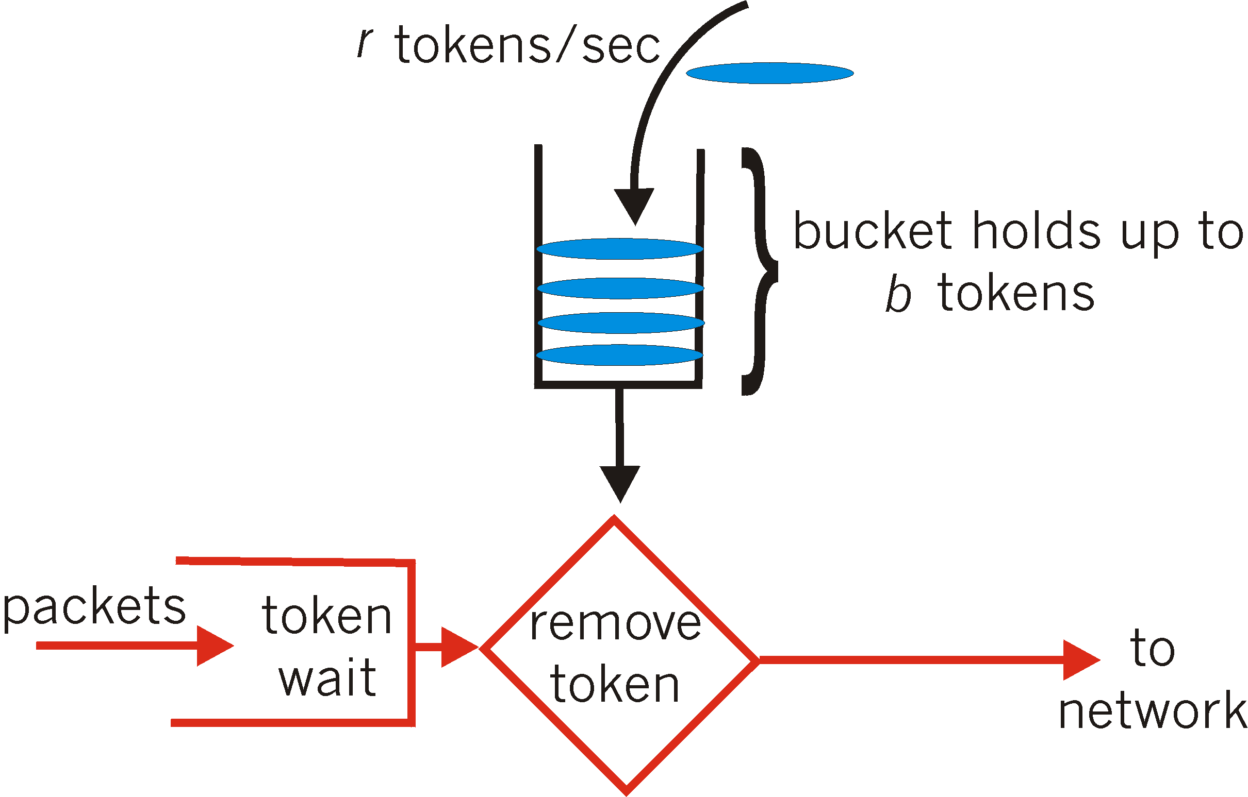
QoS mechanism (2): Token Bucket
token bucket: limit input to specified burst size and average rate
bucket can hold b tokens
tokens generated at rate r tokens/sec unless bucket full
over interval of length t: number of packets admitted less than or equal to (r * t + b)

Slide 21
Token Bucket: Notes
The bucket holds tokens instead of packets
Tokens are generated and placed into the token bucket at a constant rate
When a packet arrives at the token bucket, it is transmitted if there is a token available.
Otherwise it may be buffered until a token becomes available
Or even dropped: in which case we call it a policer
The Internet is full of traffic policers
The token bucket has a fixed size, so when it becomes full, subsequently generated tokens are discarded

Slide 22
Token Bucket vs. Leaky Bucket
Case 1: Short burst arrivals
Arrival time at bucket
0
1
2
3
4
5
6
Departure time from a leaky bucket
Leaky bucket rate = 1 packet / 2 time units
Leaky bucket size = 4 packets
0
1
2
3
4
5
6
Departure time from a token bucket
Token bucket rate = 1 tokens / 2 time units
Token bucket size = 2 tokens
0
1
2
3
4
5
6

Slide 23
Token Bucket vs. Leaky Bucket
Case 2: Large burst arrivals
Arrival time at bucket
0
1
2
3
4
5
6
Departure time from a leaky bucket
Leaky bucket rate = 1 packet / 2 time units
Leaky bucket size = 2 packets
0
1
2
3
4
5
6
Departure time from a token bucket
Token bucket rate = 1 token / 2 time units
Token bucket size = 2 tokens
0
1
2
3
4
5
6
??
Departure time from a token bucket policer
Token bucket rate = 1 token / 2 time units
Token bucket size = 2 tokens

Slide 24
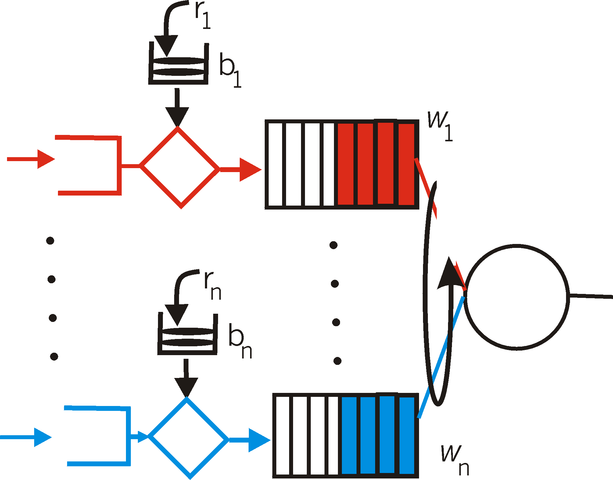
QoS guarantees for delays too!
token bucket, WFQ combine to provide guaranteed upper bound on delay, i.e., QoS guarantee!
arriving
traffic
token rate, r
bucket size, b
per-flow
rate, R
WFQ
D = b/R
arriving
traffic
max

Slide 25
Differentiated Services
Using marking and packet scheduling to provide QoS

Slide 26
Differentiated services
want “qualitative” service classes
“behaves like a wire”
relative service distinction: Platinum, Gold, Silver
scalability: simple functions in network core, relatively complex functions at edge routers (or hosts)
signaling, maintaining per-flow router state difficult with large number of flows
don’t define define service classes, provide functional components to build service classes

Slide 27
Edge-router packet marking
profile: pre-negotiated rate r, bucket size b
packet marking at edge based on per-flow profile
rate r
b
user packets
possible use of marking:
class-based marking: packets of different classes marked differently
intra-class marking: conforming portion of flow marked differently than non-conforming one

Slide 28
Diffserv architecture
marking
r
b
scheduling
edge router:
per-flow traffic management
marks packets as in-profile and out-profile
.
.
.
core router:
per class traffic management
buffering and scheduling based on marking at edge
preference given to in-profile packets over out-of-profile packets

Slide 29
Per-connection QoS guarantees
basic fact of life: can not support traffic demands beyond link capacity
1 Mbps
phone
R1
R2
1 Mbps
phone
1.5 Mbps link
Principle 4
call admission: flow declares its needs, network may
block call (e.g., busy signal) if it cannot meet needs

Slide 30


QoS guarantee scenario
resource reservation
call setup, signaling (RSVP)
traffic, QoS declaration
per-element admission control
request/
reply
QoS-sensitive scheduling (e.g., WFQ)

Slide 31
Summary of network support for QoS
Need ways to distinguish traffic (marking) and handle traffic contention (scheduling)
Packet scheduling: a great place to provide QoS by isolating traffic from each other
Abstractions:
Leaky bucket: shape traffic
Token bucket: shape and police traffic
The Internet DiffServ architecture builds on these mechanisms
Resource reservation and call admission required to ensure QoS when demand exceeds capacity
However, not very widely deployed on the Internet today

