Slide 1

Congestion Control (Part 2)
Lecture 15 http://www.cs.rutgers.edu/~sn624/352-S22
Srinivas Narayana

Slide 2



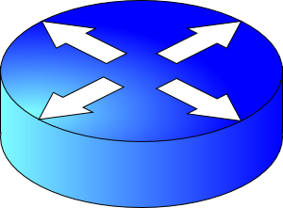
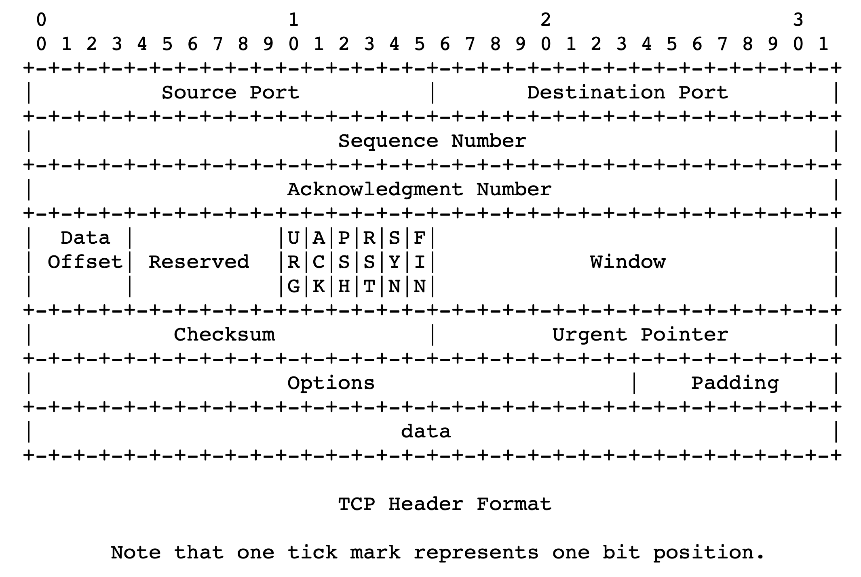
sender
Multiple locations for bottlenecks
application
process
recv()
Congestion Control
TCP socket
receiver buffers
Flow Control
What’s the bottleneck? How to adapt how much data to keep in flight?
TCP
code
from sender
Flow Control: Receiver informs sender free buffer over time
Last transmitted
seq #
receiver
Last cumulative
ACK’ed seq #
Sender’s view:
0
1
2
3
4
5
6
7
0
1
Window <= Advertised window

Slide 3
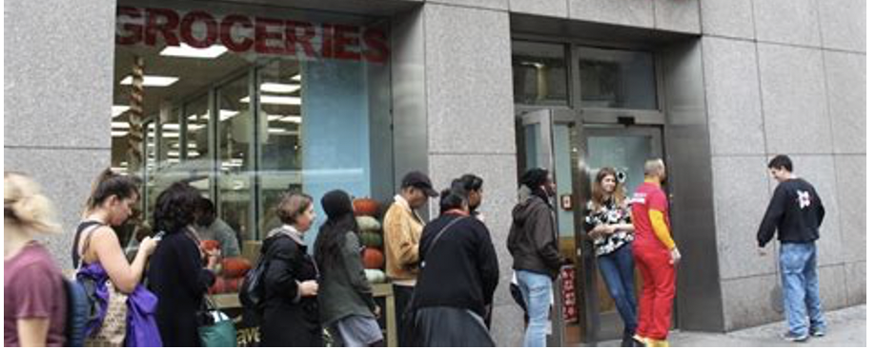
The approach that the Internet takes is to use a distributed algorithm to converge to an efficient and fair outcome.
T
Fast link
Bottleneck link
1. Send packet burst (as allowed by window)
Inter-packet delay T
2. Receive data packet
5. Send data
ACK clocking
Data
Sender
T
T
Receiver
T
4. Receive ACK
3. Send ACK
ACKs

Slide 4
Getting to a fast ACK clock
The Feedback Loop

Slide 5

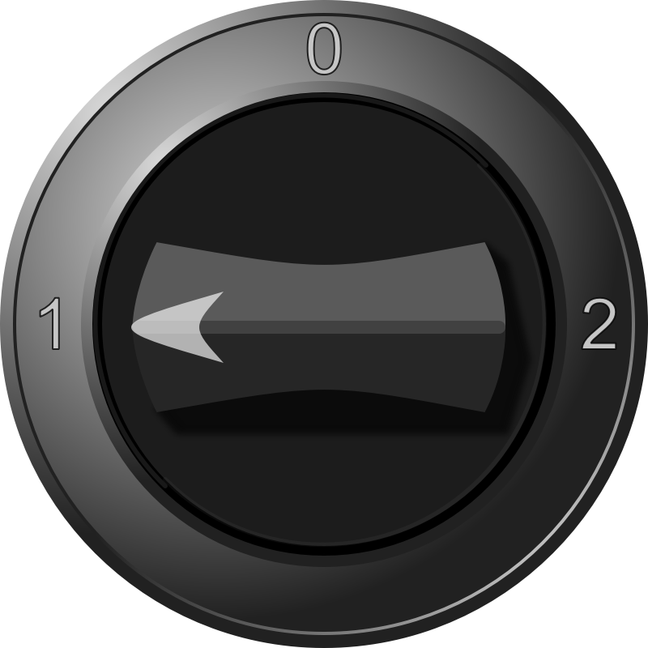
An example of a feedback loop
You
H
C
Signals:
Water temperature
Water pressure
Knobs:
Turn temperature up/down
Open the tap wider
Your bathroom shower

Slide 6
The congestion control feedback loop
TCP congestion control algorithm
Signals:
ACKs
Loss (RTOs), etc.
Knobs:
Sending rate
Congestion window
Bottleneck link

Slide 7
Congestion window
The sender maintains an estimate of the amount of in-flight data needed to keep the pipe full without congesting it.
This estimate is called the congestion window (cwnd)
Recall: There is a relationship between the sending rate (throughput) and the sender’s window: sender transmits a window’s worth of data over an RTT duration
Throughput = sending rate = window / RTT

Slide 8
Interaction Flow & Congestion control
Use window = min(congestion window, receiver advertised window)
Overwhelm neither the receiver nor network links & routers
Window <= Congestion window (congestion control)
Window <= Advertised window (flow control)
Sender’s view:
0
1
2
3
4
5
6
7
0
1
Last cumulative
ACK’ed seq #
Last transmitted
seq #

Slide 9
Finding the Right Congestion Window

Slide 10
Let’s play a game
Suppose I’m thinking of a positive integer. You need to guess the number I have in mind.
Each time you guess, I will tell you whether your number is smaller or larger than (or the same as) the one I’m thinking of
Note that my number can be very large
How would you go about guessing the number?

Slide 11
Finding the right congestion window
TCP congestion control algorithms solve a similar problem!
There is an unknown bottleneck link rate that the sender must match
If sender sends more than the bottleneck link rate:
packet loss, delays, etc.
If sender sends less than the bottleneck link rate:
all packets get through; successful ACKs

Slide 12
Quickly finding a rate: TCP slow start
Initially cwnd = 1 MSS
MSS is “maximum segment size”
Upon receiving an ACK of each MSS, increase the cwnd by 1 MSS
Effectively, double cwnd every RTT
Initial rate is slow but ramps up exponentially fast
On loss (RTO), restart from cwnd := 1 MSS
Host A
Host B
one segment
RTT
two segments
four segments
time

Slide 13
Behavior of slow start
Packet drops/
RTO
Congestion Window
Slow start
Slow start
Slow start
1 MSS
Time

Slide 14
Slow start has problems
Congestion window increases too rapidly
Example: suppose the “right” window size cwnd is 17
cwnd would go from 16 to 32 and then dropping down to 1
Result: massive packet drops
Congestion window decreases too rapidly
Suppose the right cwnd is 31, and there is a loss when cwnd is 32
Slow start will resume all the way back from cwnd 1
Result: unnecessarily low throughput
Instead, perform finer adjustments of cwnd based on signals

Slide 15
Use slow start mainly at the beginning
You might accelerate your car a lot when you start, but you want to make only small adjustments after.
Want a smooth ride, not a jerky one!
Slow start is a good algorithm to get close to the bottleneck link rate when there is little info available about the bottleneck, e.g., starting of a connection
Once close enough to the bottleneck link rate, use a different set of strategies to perform smaller adjustments to cwnd
Called TCP congestion avoidance

Slide 16
TCP Congestion Avoidance

Slide 17
Two congestion control algorithms
TCP New Reno
The most studied, classic “textbook” TCP algorithm
The primary knob is congestion window
The primary signal is packet loss (RTO)
Adjustment using additive increase
TCP BBR
Recent algorithm developed & deployed by Google
The primary knob is sending rate
The primary signal is rate of incoming ACKs
Adjustment using gain cycling and filters

Slide 18
TCP New Reno: Additive Increase
Remember the recent past to find a good estimate of link rate
The last good cwnd without packet drop is a good indicator
TCP New Reno calls this the slow start threshold (ssthresh)
Increase cwnd by 1 MSS every RTT after cwnd hits ssthresh
Effect: increase window additively per RTT
Host A
Host B
say ssthresh=4
four segments
RTT
five segments
RTT
six segments
RTT
seven segments
…
time

Slide 19
TCP New Reno: Additive increase
Start with ssthresh = 64K bytes (TCP default)
Do slow start until ssthresh
Once the threshold is passed, do additive increase
Add one MSS to cwnd for each cwnd worth data ACK’ed
For each MSS ACK’ed, cwnd = cwnd + (MSS * MSS) / cwnd
Upon a TCP timeout (RTO),
Set cwnd = 1 MSS
Set ssthresh = max(2 * MSS, 0.5 * cwnd)
i.e., the next linear increase will start at half the current cwnd

Slide 20
Behavior of Additive Increase
Say MSS = 1 KByte
Default ssthresh = 64KB = 64 MSS
Packet drops/
RTO
Loss occurs at cwnd = 54K
Loss occurs at cwnd = 40K
54 MSS
Additive increase
Set ssthresh to
27 MSS
Additive increase
Congestion Window
Set ssthresh to
20 MSS
Slow start
Slow start
Slow
start
1K
Time

Slide 21
TCP BBR: finding the bottleneck link rate
1. Send data at a specific rate
Data gets across the bottleneck at the bottleneck link rate.
2. Receive data packet
Use ACK receive rate to determine sending rate
Data
Sender
Receiver
4. Measure rate of incoming ACKs
3. Send ACK
ACKs

Slide 22
TCP BBR: finding the bottleneck link rate
Assuming that the link rate of the bottleneck
== the rate of data getting across the bottleneck link
== the rate of data getting to the receiver
== the rate at which ACKs are generated by the receiver
== the rate at which ACKs reach the sender
Measuring ACK rate provides an estimate of bottleneck link rate
BBR: Send at the maximum ACK rate measured in the recent past
Update max with new bottleneck rate estimates, i.e., larger ACK rate
Forget estimates last measured a long time ago
Incorporated into a rate filter

Slide 23
TCP BBR: Adjustments by gain cycling
BBR periodically increases its sending rate by a gain factor to see if the link rate has increased (e.g., due to a path change)
Steady state operation: constant sending rate
Last max ACK rate was measured a while ago. Forget it & use a more recent max ACK rate
…
Gain cycle
Sending rate
…
No change
in ACK rate
Detect higher ACK rate:
Update sending rate
Bottleneck link rate increase
Time
Bottleneck link rate decrease

Slide 24
Summary: Getting to Steady State
Want to get to highest sending rate that doesn’t congest the bottleneck link
Slow start: Exponential increase towards a reasonable estimate of link rate
Congestion avoidance: milder adjustments to get close to correct link rate estimate.
TCP New Reno: additive increase
TCP BBR: gain cycling and filters

Slide 25
Bandwidth-Delay Product

Slide 26
Goal of steady state operation
(2) Keep transmissions over the bottleneck link back to back
Send packet burst (as allowed by window)
Receive data packet
(1) Keep transmissions ACK-clocked: Send new data on ACK
Data
Sender
Receiver
Receive ACK
Send ACK
ACKs

Slide 27
Steady state cwnd for a single flow
Suppose the bottleneck link has rate C
Suppose the propagation round-trip delay (propRTT) between sender and receiver is T
Ignore transmission delays for this example;
Assume steady state: highest sending rate with no bottleneck congestion
Q: how much data is in flight over a single RTT?
C * T data i.e., amount of data unACKed at any point in time
ACKs take time T to arrive (without any queueing). In the meantime, sender is transmitting at rate C

Slide 28
The Bandwidth-Delay Product
C * T = bandwidth-delay product:
The amount of data in flight for a sender transmitting at the ideal rate during the ideal round-trip delay of a packet
Note: this is just the amount of data “on the pipe”
Data
C * T

Slide 29
The Bandwidth-Delay Product
Q: What happens if cwnd > C * T?
i.e., where are the rest of the in-flight packets?
A: Waiting at the bottleneck router queues
Data
C * T

Slide 30
Router buffers and the max cwnd
Router buffer memory is finite: queues can only be so long
If the router buffer size is B, there is at most B data waiting in the queue
If cwnd increases beyond C * T + B, data is dropped!
B
Data
C * T

Slide 31
Summary
Bandwidth-Delay Product (BDP) governs the window size of a single flow at steady state
The bottleneck router buffer size governs how much the cwnd can exceed the BDP before packet drops occur

Slide 32
Detecting and Reacting to Packet Loss

Slide 33
Detecting packet loss
So far, all the algorithms we’ve studied have a coarse loss detection mechanism: RTO timer expiration
Let the RTO expire, drop cwnd all the way to 1 MSS
Analogy: you’re driving a car
You’re waiting until the next car in front is super close to you (RTO) and then hitting the brakes really hard (set cwnd := 1)
Q: Can you see obstacles from afar and slow down proportionately?
That is, can the sender see packet loss coming in advance?
And reduce cwnd more gently?

Slide 34
Can we detect loss earlier than RTO?
Key idea: use the information in the ACKs. How?
Suppose successive (cumulative) ACKs contain the same ACK#
Also called duplicate ACKs
Occur when network is reordering packets, or one (but not most) packets in the window were lost
Reduce cwnd when you see many duplicate ACKs
Consider many dup ACKs a strong indication that packet was lost
Default threshold: 3 dup ACKs, i.e., triple duplicate ACK
Make cwnd reduction gentler than setting cwnd = 1; recover faster

Slide 35
Fast Retransmit & Fast Recovery

Slide 36
Distinction: In-flight versus window
So far, window and in-flight referred to the same data
Fast retransmit & fast recovery differentiate the two notions
cwnd = 6
inflight = 3
Sender’s view:
0
1
2
3
4
5
6
7
0
1
0
1
2
3
4
5
6
7
0
1
Triple duplicate ACKs
(assume subsequent 3 pieces of data were successfully received)
Last cumulative
ACK’ed seq #
Last transmitted
seq #
cwnd is the interval between the last cumulatively ACK’ed seq# and the last transmitted seq#
inflight is the data currently believed to be in flight.

Slide 37
TCP fast retransmit (RFC 2581)
The fact that ACKs are coming means that data is getting delivered to the receiver, albeit with some loss.
Note: Before the dup ACKs arrive, we assume inflight = cwnd
TCP sender does two actions with fast retransmit

Slide 38
TCP fast retransmit (RFC 2581)
(1) Reduce the cwnd and in-flight gently
Don’t drop cwnd all the way down to 1 MSS
Reduce the amount of in-flight data multiplicatively
Set inflight → inflight / 2
That is, set cwnd = (inflight / 2) + 3MSS
This step is called multiplicative decrease
Algorithm also sets ssthresh to inflight / 2

Slide 39
TCP fast retransmit (RFC 2581)
Example: Suppose cwnd and inflight (before triple dup ACK) were both 8 MSS.
After triple dup ACK, reduce inflight to 4 MSS
Assume 3 of those 8 MSS no longer in flight; set cwnd = 7 MSS
inflight = 4
cwnd = 7
cwnd = inflight = 8
0
1
2
3
4
5
6
7
0
1
2
3
4
5
6
7
0
1
5
Last cumulative
ACK’ed seq #
Assumed not in flight (dup ACK)

Slide 40
TCP fast retransmit (RFC 2581)
(2) The seq# from dup ACKs is immediately retransmitted
That is, don’t wait for an RTO if there is sufficiently strong evidence that a packet was lost

Slide 41
TCP fast recovery (RFC 2581)
Sender keeps the reduced inflight until a new ACK arrives
New ACK: an ACK for the seq# that was just retransmitted
May also include the (three or more) pieces of data that were subsequently delivered to generate the duplicate ACKs
Conserve packets in flight: transmit some data over lossy periods (rather than no data, which would happen if cwnd := 1)

Slide 42
TCP fast recovery (RFC 2581)
Keep incrementing cwnd by 1 MSS for each dup ACK
cwnd = 6
inflight = 3
0
1
2
3
4
5
6
7
0
1
2
3
4
5
6
7
0
1
5
Last cumulative
ACK’ed seq #
Assumed not in flight (dup ACK)

Slide 43
TCP fast recovery (RFC 2581)
Keep incrementing cwnd by 1 MSS for each dup ACK
cwnd = 7
inflight = 3
0
1
2
3
4
5
6
7
0
1
2
3
4
5
6
7
0
1
Last cumulative
ACK’ed seq #
Assumed not in flight (dup ACK)

Slide 44
TCP fast recovery (RFC 2581)
Keep incrementing cwnd by 1 MSS for each dup ACK
cwnd = 8
inflight = 3
0
1
2
3
4
5
6
7
0
1
2
3
4
5
6
7
0
1
Last cumulative
ACK’ed seq #
Assumed not in flight (dup ACK)

Slide 45
TCP fast recovery (RFC 2581)
Eventually a new ACK arrives, acknowledging the retransmitted data and all data in between
Deflate cwnd to half of cwnd before fast retransmit.
cwnd and inflight are aligned and equal once again
Perform additive increase from this point!
cwnd = 3
inflight = 3
0
1
2
3
4
5
6
7
0
1
2
3
4
5
6
7
0
1
Last cumulative
ACK’ed seq #
New ACK acknowledged this data

Slide 46
Additive Increase/Multiplicative Decrease
Say MSS = 1 KByte
Default ssthresh = 64KB = 64 MSS
Triple duplicate ACK
Perceived loss occurs at cwnd = 80K
Switch to additive increase at cwnd = ssthresh = 64K
New ACK
RTO
Multiplicative decrease
In-flight data
Additive increase
Additive increase
RTO: window drops all the way to 1 MSS
Slow start
(2) Set inflight = ssthresh = 40K
Fast retransmit: (1) retransmit dup-ACKed segment
Fast recovery keeps inflight stable until new ACK
1K
Time

Slide 47
TCP New Reno performs additive increase and multiplicative decrease of its congestion window.
In short, we often refer to this as AIMD.
Multiplicative decrease is a part of all TCP algorithms, including BBR.
[It is necessary for fairness across TCP flows.]

Slide 48
Summary: TCP loss detection & reaction
Don’t wait for an RTO and then set the cwnd to 1 MSS
Tantamount to waiting to get super close to the car in front and then jamming the brakes really hard
Instead, react proportionately by sensing pkt loss in advance
Fast Retransmit
Triple dup ACK: sufficiently strong signal that network has dropped data, before RTO
Immediately retransmit data
Multiplicatively decrease in-flight data to half of its value
Fast Recovery
Maintain this reduced amount of in-flight data as long as dup ACKs arrive
Data is successfully getting delivered
When new ACK arrives, do additive increase from there on

