Slide 1

Domain Name System
Lecture 5
http://www.cs.rutgers.edu/~sn624/352-F24
Srinivas Narayana

Slide 2

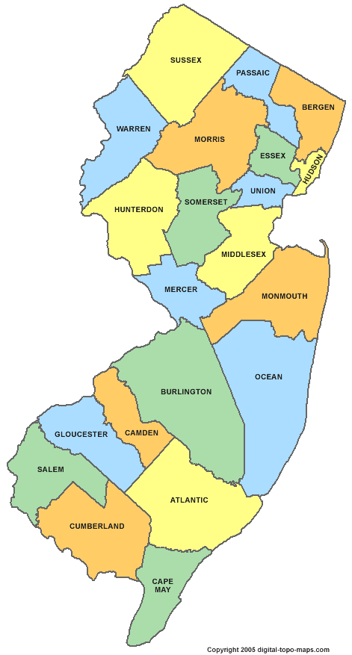
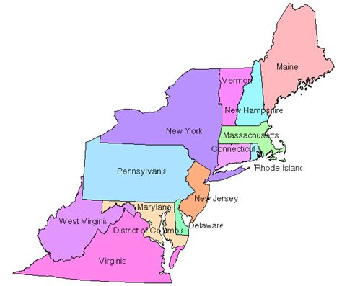
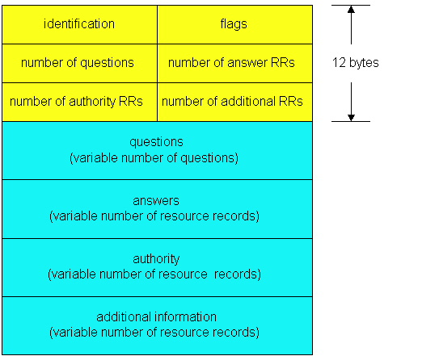

Review
Domain Name System
Human readable → IP addresses
Hierarchical, distributed database
Root server, TLD server, Authoritative name server
Client-server
QR
OPCODE
Peer to peer
Iterative queries

Slide 3
Query type
root DNS server
Recursive query:
Puts burden of name resolution on the contacted (e.g., root) name server
Query 2 (to root DNS server) is recursive from the local server
In general, recursive is not preferred for higher levels of the DNS hierarchy
2
3
7
6
.edu DNS server
local DNS server
dns.rutgers.edu
5
4
1
8
umass.edu DNS server
dns.umass.edu
requesting host
cs.rutgers.edu
gaia.cs.umass.edu

Slide 4
Problem: Load on Higher Levels of DNS
Think about the query load on the root DNS server (regardless of recursive/iterative)
Must root server answer every DNS query?

Slide 5
DNS caching
Once (any) name server learns a name to IP address mapping, it caches the mapping
Cache entries timeout (disappear) after some time
TLD servers typically cached in local name servers
In practice, root name servers aren’t visited often!
Caching is pervasive in DNS

Slide 6
Bootstrapping DNS
How does a host contact the name server if all it has is the domain name and no (name server) IP address?
IP address of at least 1 nameserver (usually, a local name server) must be known a priori
The local name server may be bootstrapped “statically”, e.g.,
File /etc/resolv.conf in unix
Start -> settings-> control panel-> network ->TCP/IP -> properties in windows
The local DNS server or with another protocol!
DHCP: Dynamic Host Configuration Protocol
The local DNS server must know the root servers

Slide 7
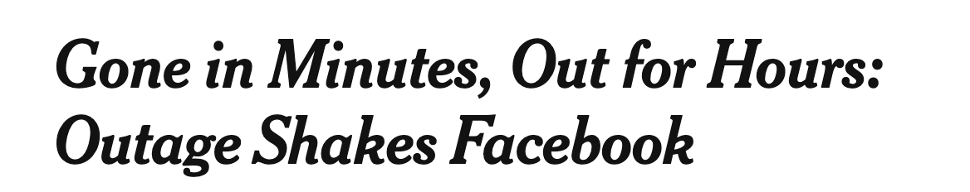



DNS may seem “basic”, low level, but …

Slide 8
DNS Resource Records

Slide 9
DNS is a distributed database
DNS stores resource records (RRs)
(Incomplete) message format for each resource record (RR):
Class, type, name, value, TTL
You can read all the gory details of the message format at https://www.iana.org/assignments/dns-parameters/dns-parameters.xhtml

Slide 10
DNS records
Type=A
name is hostname
value is IPv4 address
Type=CNAME
name is alias name for some “canonical” (the real) name
e.g., www.ibm.com is really
servereast.backup2.ibm.com
value is canonical name
Type=AAAA
name is hostname
value is IPv6 address
Type=NS
name is domain (e.g. foo.com)
value is hostname of authoritative name server for this domain
Type=MX
value is name of mailserver associated with name
More complete info at https://www.iana.org/assignments/dns-parameters/dns-parameters.xhtml

Slide 11
DNS record example
NAME | Design.cs.rutgers.edu
TYPE | A
CLASS | IN
TTL | 1 day(86400)
ADDRESS | 192.26.92.30
RRs in response
to query
records for
authoritative servers
Information about nameserver
NAME | Cs.rutgers.edu
TYPE | NS
CLASS | IN
TTL | 1 day(86400)
NSDNAME | Ns-lcsr.rutgers.edu
DNS serves as a general repository of information for the Internet!

Slide 12
DNS record types
dig –t <type> <domain-name>

Slide 13
Summary of DNS
Hostname to IP address translation via a global network of servers
Embodies several scaling principles
Partition through a hierarchy to silo query load
Replication to scale out at each level of hierarchy
Caching to reduce query load
Once you have a reliable DB, can implement many useful things on top!
Example 1: Scaling large web services, e.g., google search, by redirecting different clients to different servers (IP addresses)
Reliability, load balancing, performance optimization
Example 2: Associating certificates, keys (security info) with domain names
https://www.rfc-editor.org/rfc/rfc8162.html
https://datatracker.ietf.org/doc/draft-ietf-dnsop-svcb-https/00/

Slide 14
The Web (HTTP)

Slide 15
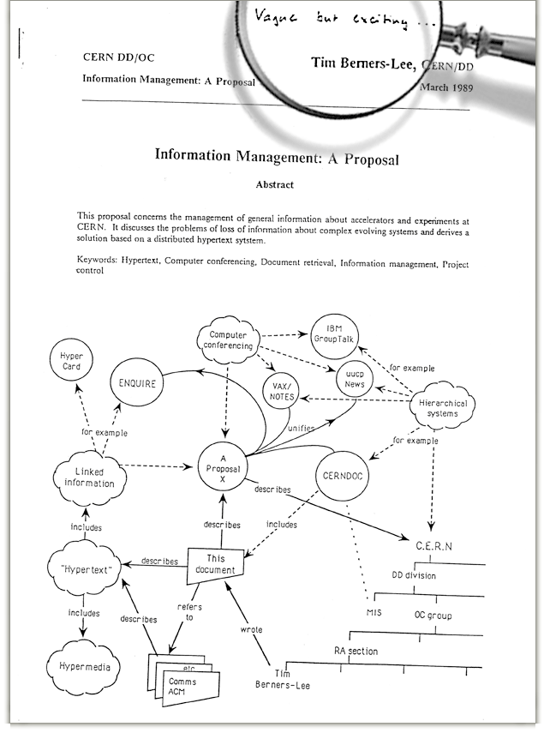
The Web: Humble origins
Tim Berners-Lee: a way to manage and access documents at CERN research lab
Info containing links to other info, accessible remotely through a standardized mechanism independent of the heterogeneity of the underlying machines
“Hypertext”

Slide 16
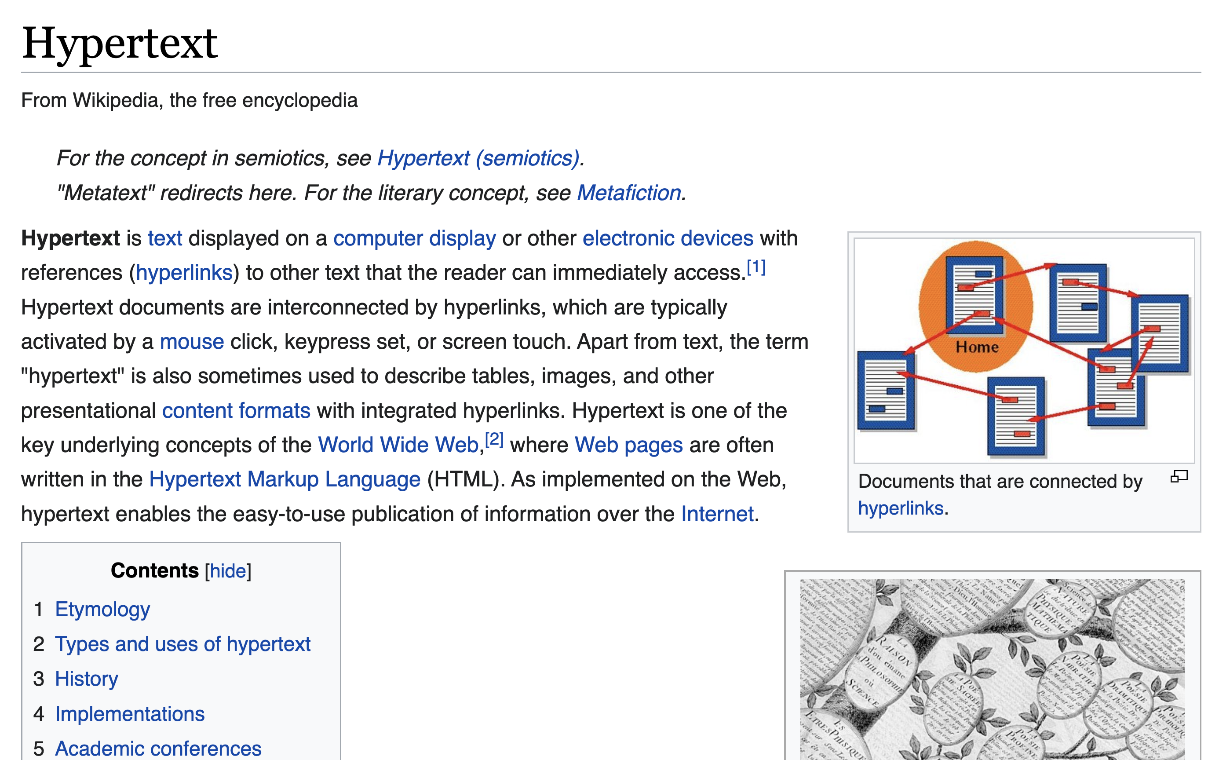
Web and HTTP: Terms
HTTP stands for “HyperText Transfer Protocol”
A web page consists of many objects
Object can be HTML file, JPEG image, video stream chunk, audio file,…
Web page consists of base HTML-file which embeds several objects
Each object is addressable by a uniform resource locator (URL)
sometimes also referred to as uniform resource identifier (URI)
Example URL:
www.cs.rutgers.edu/~sn624/index.html
Domain/host name
path

Slide 17
HTTP Protocol

Slide 18

Client server protocol
Hostname | IP address
Cs.Rutgers.edu | 10.0.1.2
DNS
I want to browse cs.rutgers.edu
Host name
Server IP Address
HTTP application typically associated with port 80
clientIP, clientPort, server IP Address, 80
HTTP request
HTTP response
HTTP messages

Slide 19
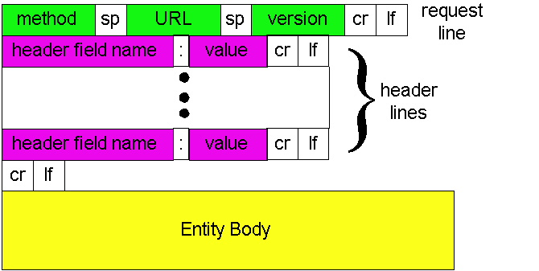
HTTP Request: Message Format
Type of request
Object/process
requested
Protocol version
Parameters influencing
the request
Data needed to fulfill request
http://www.w3.org/Protocols/rfc2616/rfc2616-sec14.html#sec14

Slide 20
HTTP messages: request message
ASCII (human-readable format)
request line
(GET, POST,
HEAD commands)
GET /352/syllabus.html HTTP/1.1
Host: www.cs.rutgers.edu
User-agent: Mozilla/4.0
Connection: close
Accept-language:en
(extra carriage return, line feed)
Header lines
Carriage return,
line feed
indicates end
of header

Slide 21
The URL
Universal Resource Locator: a way to name objects on server
But can also name an application process on the server!
Examples:
Data storage from data entered in web forms
Login pages
Web carts
Providing almost any service requires data handling by running code at the server
Not just rendering “static” resources

Slide 22
HTTP method types
GET
Get the resource specified in the requested URL (could be a process)
POST
Send entities (specified in the entity body) to a data-handling process at the requested URL
HEAD
Asks server to leave requested object out of response, but send the rest of the response
Useful for debugging
PUT
Update a resource at the requested URL with the new entity specified in the entity body
DELETE
Deletes file specified in the URL
and other methods

Slide 23
Uploading form input: GET and POST
POST method:
Web page often includes form input
Input is uploaded to server in entity body
Posted content not visible in the URL
Free form content (ex: images) can be posted since entity body interpreted as data bytes
GET method:
Entity body is empty
Input is uploaded in URL field of request line
URL must contain a restricted set of characters
Example:
http://site.com/form?first=jane&last=austen

Slide 24
Difference between POST and PUT
POST: the URL of the request identifies the resource that processes the entity body
PUT: the URL of the request identifies the resource that is contained in the entity body
https://tools.ietf.org/html/rfc2616

Slide 25
Difference between HEAD and GET
GET: return the requested resource in the entity body of the response along with response headers (we’ll see these shortly)
HEAD: return all the response headers in the GET response, but without the resource in the entity body
https://tools.ietf.org/html/rfc2616

Slide 26
Observing HTTP GET and POST

Slide 27
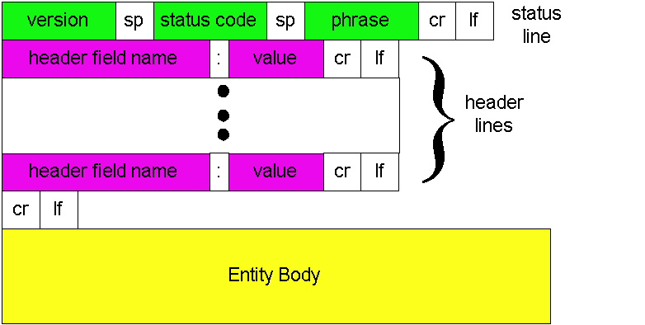
HTTP Response: General format
Unlike HTTP request, No method name
HTTP protocol version
used by server
Was request successful?
(or error condition)
Returned object data

Slide 28
HTTP message: response message
status line
(protocol
status code
status phrase)
HTTP/1.1 200 OK
Connection: close
Date: Thu, 06 Aug 1998 12:00:15 GMT
Server: Apache/1.3.0 (Unix)
Last-Modified: Mon, 22 Jun 1998 …...
Content-Length: 6821
Content-Type: text/html
data data data data data ...
response
header
lines
data, e.g., requested
HTML file in entity body

Slide 29
HTTP response status codes
In first line in server->client response message.
A few sample codes:
200 OK
request succeeded, requested object later in this message
301 Moved Permanently
requested object moved, new location specified later in this message (Location:)
403 Forbidden
Insufficient permissions to access the resource
404 Not Found
requested document not found on this server
505 HTTP Version Not Supported

Slide 30
Observing HTTP behaviors
wget google.com (or) curl google.com
telnet example.com 80
GET / HTTP/1.1
Host: example.com
(followed by two enter’s)
Exercise: try
telnet google.com 80
telnet web.mit.edu 80

Slide 32
Example
root DNS server
2
Host at cs.rutgers.edu wants IP address for gaia.cs.umass.edu
Local DNS server
Root DNS server
TLD DNS server
Authoritative DNS server
3
.edu DNS server
4
5
local DNS server
dns.rutgers.edu
7
6
1
8
umass.edu DNS server
dns.umass.edu
requesting host
cs.rutgers.edu
gaia.cs.umass.edu

Slide 33
Query type
root DNS server
2
Iterative query
Contacted server replies with name of server to contact
“I don’t know this name, but ask this other server”
Queries 2,4,6 are iterative from point of view of the local DNS server
3
.edu DNS server
4
5
local DNS server
dns.rutgers.edu
7
6
1
8
umass.edu DNS server
dns.umass.edu
requesting host
cs.rutgers.edu
gaia.cs.umass.edu

