Slide 1

Transport Security
Part II
Lecture 13, Computer Networks (198:552)
Fall 2019
Notes:
Slide material heavily adapted courtesy of Albert Greenberg, Changhoon Kim, Mohammad Alizadeh.

Slide 2
Review: Some key security properties
confidentiality: only sender, intended receiver should “understand” message contents
sender encrypts message
receiver decrypts message
integrity: sender, receiver want to ensure message not altered (in transit, or afterwards) without detection
authentication: sender, receiver want to confirm identity of each other
non-repudiation: Once someone sends a message, or conducts a transaction, she can’t later deny the contents of that message

Slide 3
Review: Mechanisms to get properties
Cryptography: provide confidentiality
Symmetric key crypto: m = dec_{Ks}(enc_{Ks}(m))
public key crypto: m = dec_{K}⁻(enc_{K}⁺(m))
Key exchange problem vs. efficient computations
Diffie-Hellman-Merkle key exchange
Integrity: Message digest with shared secret
Non-repudiation: digital signature
Use public key cryptography over message digest
Authentication:
Use public key cryptography and nonce
Certifying authority binds public key with an entity by acting as a trusted third party

Slide 4
How should applications use the security mechanisms described
thus far?
Modularity. Implement once, implement well.
Reuse across many applications.

Slide 5
How should apps use security?
Application
Application
Security
Transport
Transport
Network
Network
normal application
secure application
Would be nice to provide an API to applications
Useful to have security layer above transport
5

Slide 6
Transport Layer Security (TLS)
Providing security properties in a practical protocol

Slide 7
Goals of TLS
Confidentiality
Message integrity
Server authentication (optionally, client authentication)
Work in the context of the existing network protocol stack

Slide 8

Could do something like this… (PGP)
-
K_{A}
.
.
-
-
K_{A}(H(m))
K_{S}
m
H( )
K_{A}( )
.
+
K_{S}( )
m
+
Internet
.
+
K_{S}
K_{B}( )
+
K_{B}(K_{S} )
+
K_{B}
but want to send byte streams & interactive data
want set of secret keys for entire connection
want certificate exchange as part of protocol: handshake phase

Slide 9
TLS/SSL and the rest of the protocol stack
Application
Application
TLS/SSL
TCP
TCP
IP
IP
normal application
application with TLS/SSL
TLS/SSL provides application programming interface (API) to applications
C and Java libraries/classes readily available
Ex: OpenSSL
9

Slide 10

Step (1): a simple handshake
Client hello
Server public key certificate
K_{B}⁺(MS) = EMS
MS: master secret
EMS: encrypted master secret
Q: What all might the “master secret” be used for?

Slide 11
Step (2): key derivation
considered bad to use same key for more than one cryptographic operation
use different keys for message integrity and encryption
four keys:
K_{c} = encryption key for data sent from client to server
M_{c} = integrity digest key for data sent from client to server
K_{s} = encryption key for data sent from server to client
M_{s} = integrity digest key for data sent from server to client
keys derived from key derivation function (KDF)
Takes master secret and (possibly) some additional random data and creates the keys

Slide 12
Step (3): Data records
why not encrypt data in constant stream as we write it to TCP?
where would we put the message digest? If at end, no message integrity until all data processed.
e.g., with instant messaging, how can we do integrity check over all bytes sent before displaying?
instead, break stream in series of records
each record carries a message digest
receiver can act on each record as it arrives
How does receiver distinguish the digest from data within a record?
want to use variable-length records
length
data
Message digest

Slide 13
Goals of TLS
Confidentiality
Message integrity
Server authentication (optionally, client authentication)
Work in the context of the existing network protocol stack
Evolve as new security standards are put in place
TLS implements cipher negotiation

Slide 14
TLS/SSL “Cipher Suite”
Cipher suite
public-key algorithm
symmetric encryption algorithm
Integrity hashing algorithm
TLS/SSL supports several cipher suites
Negotiation: client, server agree on cipher suite
client offers choices
server picks one
Common symmetric ciphers
AES – Advanced Encryption Standard
DES – Data Encryption Standard: block
3DES – Triple strength: block
ChaCha: stream
RC4 – Rivest Cipher 4: stream
SSL Public key encryption
RSA with DH
Integrity hashing algorithms
HMAC-MD5 and others

Slide 15
Handshake with Negotiation
server authentication
negotiation: agree on cipher suite
establish necessary keys
client authentication (optional)
TLS 1.2: All this takes a few round trip times to accomplish!
15

Slide 16
Client hello
Client nonce, ciphers, TLS ver
A typical handshake with RSA
Server hello
Server nonce, certificate, cipher choice
Client nonce encrypted with pvt key
Server authenticated
Client created session keys
Client premaster secret
Encrypted with server pub key
Server created session keys
Server finished
Msg encrypted with sess key
Client finished
Msg encrypted with sess key

Slide 17
Client hello
Client nonce, ciphers, TLS ver
A typical handshake with DHM
Server hello
Server nonce, certificate, cipher choice
Client nonce, DHM public value
Server authenticated
Client created session keys
Client DHM public value
Encrypted with server pub key
Server created session keys
Server finished
Msg encrypted with sess key
Client finished
Msg encrypted with sess key

Slide 18
QUIC handshake
Adding security in 1 (or 0) RTT to your transport connection
Optimize the common case

Slide 19
Goals of QUIC handshake
Reduce round-trip times to get set up with secure connection
Initial handshake takes 1 RTT, starting from the first byte received from the client, before server can send data
Later, server can send data immediately upon receiving the first byte from the client (“0-RTT” handshake)

Slide 20
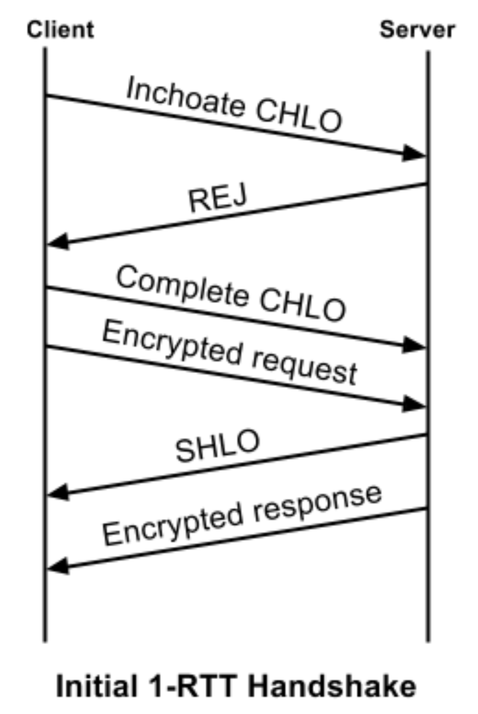
Initial 1-RTT handshake
Client first sends an “inchoate” (incomplete) client hello message
Server REJ message contains:
server’s long-term DHM public value
Certificate chain authenticating the server
Signature of DHM public value using the certified (private) key
Client source address token signed by server
What properties does each of these (help) establish?

Slide 21
Initial 1-RTT handshake
Client first sends an “inchoate” (incomplete) client hello message
Server REJ message contains:
server’s long-term DHM public value
Certificate chain authenticating the server
Signature of DHM public value using the certified (private) key
Client source address token signed by server: session ticket
Useful later on to authenticate the client
Prevent DoS (of server and other clients)

Slide 22
Initial 1–RTT handshake
Finish the handshake
Client sends its ephemeral DHM public value to server in a complete CHLO.
Server then responds with its ephemeral DHM public value.
Ephemeral DH values provide forward secrecy for the communication

Slide 23
Other handshake details
In later handshakes, client optimistically sends its source address token to the server
Optimistic version negotiation: client proposes a cipher suite and encrypts first request with that cipher suite
If server can’t speak that cipher suite, it forces version renegotiation, similar to TLS
Both techniques optimize the common case when clients speak to a known server with an agreed-upon cipher suite

Slide 24
Important principle
Use a hash of all the plaintext data that was exchanged in the handshake when generating the symmetric key for the connection
True in both TLS and QUIC
Why?
Example: cipher downgrade attacks
Provide “backward integrity” over all prior messages
Notes:
Thanks to Jakob Degen for suggesting the term backward integrity in class. I’m not sure if there is a term of art for this property and what that is.

Slide 25
Client hello
Client nonce, ciphers, TLS ver
Server hello
Server nonce, certificate, cipher choice
Client nonce encrypted with pvt key
Server authenticated
Client created session keys
Client premaster secret
Encrypted with server pub key
Server created session keys
Server finished
Digest of all handshake msgs
Client finished
Digest of all handshake msgs

