Slide 1

Crash Consistency

Slide 2
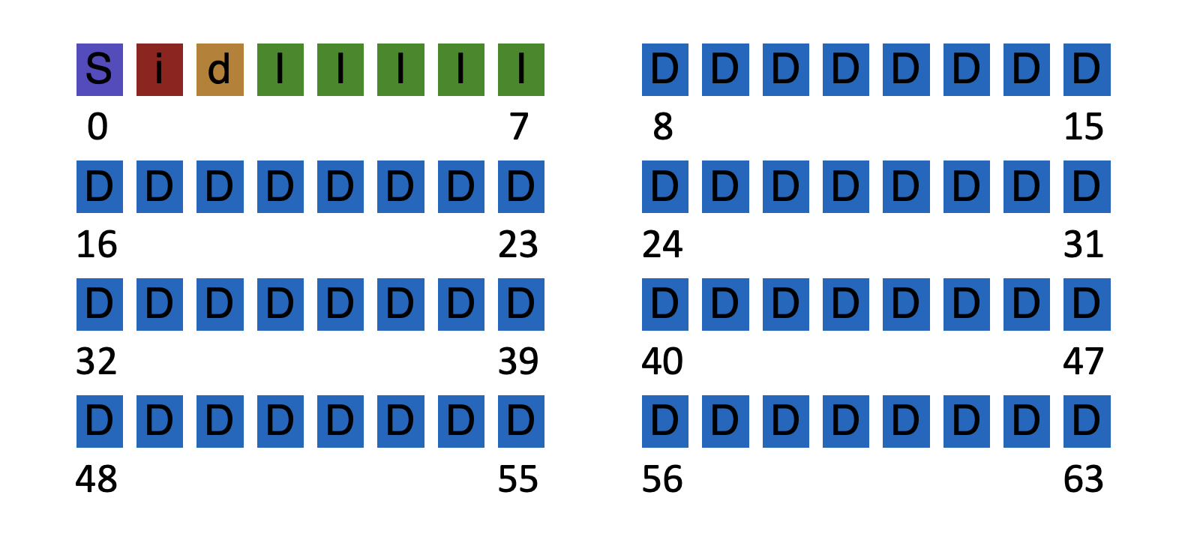
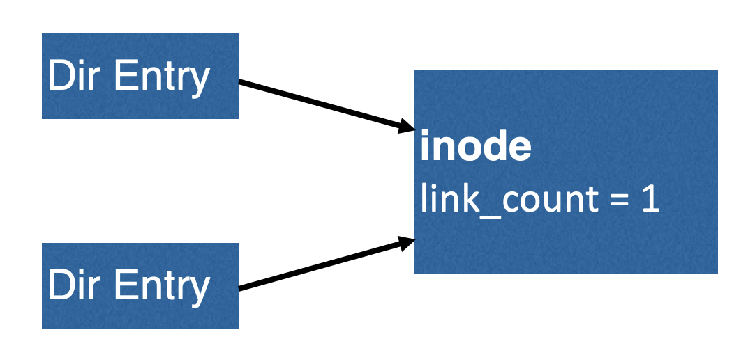
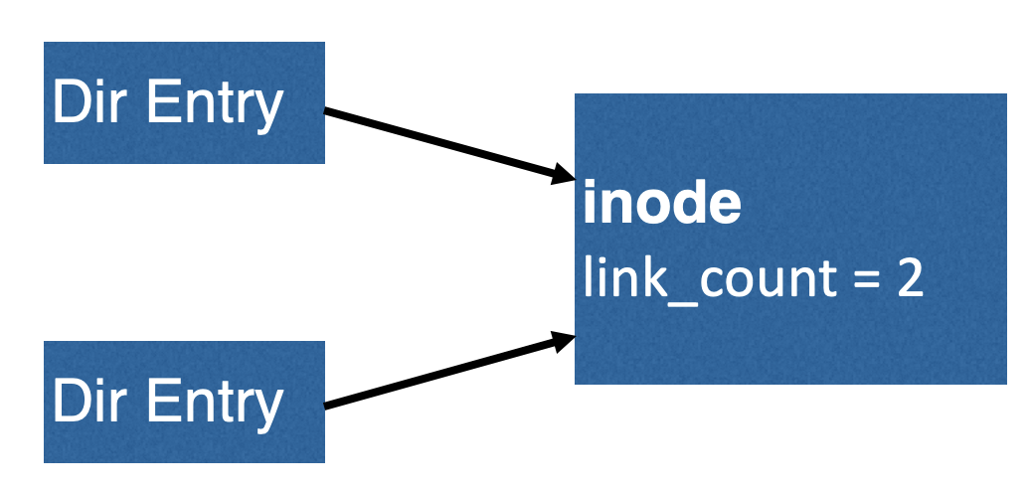
Inconsistency: a result of redundancy (non-independence)
Knowing A limits the possible values of B.
Inode pointer
Data block bitmap
Inode link count
Directory entry
Superblock total block count
Inode pointer
Filesystem checker: after a crash, look at data structures on disk, and make them consistent.
100s of checks & fixes

Slide 3

Duplicate Pointers
inode
link_count = 1
block
(number 123)
inode
link_count = 1
How to fix????

Slide 4
Duplicate Pointers
copy
inode
link_count = 1
block
(number 123)
inode
link_count = 1
block
(number 789)

Slide 5
Duplicate Pointers
inode
link_count = 1
block
(number 123)
inode
link_count = 1
block
(number 789)
Simple fix!
But is this correct?

Slide 6
Bad Pointer
inode
link_count = 1
9999
super block
tot-blocks=8000
How to fix???

Slide 7
Bad Pointer
inode
link_count = 1
Simple fix! (But is this correct?)
super block
tot-blocks=8000

Slide 8
Problems with fsck
Problem 1:
Not always obvious how to fix file system image
Don’t know “correct” state, just a consistent one
Easy way to get consistency: reformat disk!

Slide 9
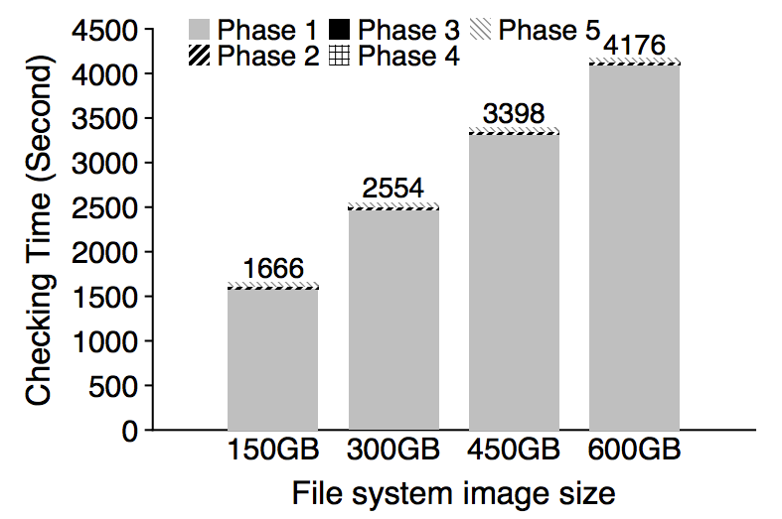
Problem 2: fsck is very slow
Checking a 600GB disk takes ~70 minutes
ffsck: The Fast File System Checker
Ao Ma, EMC Corporation and University of Wisconsin—Madison; Chris Dragga, Andrea C. Arpaci-Dusseau, and Remzi H. Arpaci-Dusseau, University of Wisconsin—Madison

Slide 10
Consistency Solution #2: Journaling
Goals
Ok to do some recovery work after crash, but not to read entire disk
Don’t move file system to just any consistent state, get correct state (in most cases)
Strategy
Atomicity
Definition of atomicity for concurrency
operations in critical sections are not interrupted by operations on related critical sections
Definition of atomicity for persistence
collections of writes are not interrupted by crashes; either (all new) or (all old) data is visible

Slide 11
Consistency vs Correctness
Say a set of writes moves the disk from state A to B
empty
all states
consistent states
A
B
fsck gives consistency
Atomicity gives A or B.

Slide 12
Journaling: General Strategy
Never delete ANY old data, until, ALL new data is safely on disk
Ironically, adding redundancy to fix the problem caused by redundancy.
Do a little extra work during regular operation, to avoid A LOT OF extra work during recovery

Slide 13
Fight Redundancy with Redundancy
Want to replace X with Y. Original:
DISK
X
redundant
f(X)

Slide 14
Fight Redundancy with Redundancy
Want to replace X with Y. Original:
DISK
Good time to crash?
X
f(X)
Yes, good time to crash

Slide 15
Fight Redundancy with Redundancy
Want to replace X with Y. Original:
DISK
Good time to crash?
Y
f(X)
bad time to crash

Slide 16
Fight Redundancy with Redundancy
Want to replace X with Y. Original:
DISK
DISK
Good time to crash?
Y
f(Y)
good time to crash

Slide 17
Fight Redundancy with Redundancy
Want to replace X with Y. With journal:
DISK
DISK
Good time to crash?
X
f(X)
good time to crash

Slide 18
Fight Redundancy with Redundancy
Want to replace X with Y. With journal:
DISK
DISK
X
f(X)
good time to crash
Y

Slide 19
Fight Redundancy with Redundancy
Want to replace X with Y. With journal:
DISK
DISK
X
f(X)
good time to crash
Y
f(Y)

Slide 20
Fight Redundancy with Redundancy
Want to replace X with Y. With journal:
DISK
DISK
Y
f(X)
good time to crash
Y
f(Y)

Slide 21
Fight Redundancy with Redundancy
Want to replace X with Y. With journal:
DISK
Y
f(Y)
good time to crash
Y
f(Y)

Slide 22
Fight Redundancy with Redundancy
Want to replace X with Y. With journal:
DISK
DISK
Y
f(Y)
good time to crash
f(Y)

Slide 23
Fight Redundancy with Redundancy
Want to replace X with Y. With journal:
DISK
DISK
Y
f(Y)
good time to crash

Slide 24
Fight Redundancy with Redundancy
Want to replace X with Y. With journal:
DISK
DISK
Y
f(Y)
With journaling, it’s always a good time to crash!

Slide 25
Inconsistency: how do we fix it?
Develop algorithm to atomically update two blocks: Write 10 to block 0; write 5 to block 1
Assume these are only blocks in file system.
Assume: only 1 block, not multiple, can be written in one shot
Usage Scenario: Block 0 stores Alice’s bank account;
Block 1 stores Bob’s bank account; transfer $2 from Alice to Bob
Time | Block 0 | Block 1
1 | 12 | 3
2 | 12 | 5
3 | 10 | 5
don’t crash here!
A wrong update algorithm can leads to inconsistent states (non-atomic updates)

Slide 26
Initial Solution: Journal New Data
Suppose we make a copy of each block first
Time | Block 0 | Block 1 | J:2 | J:3 | J:valid:4
1 | 12 | 3 | 0 | 0 | 0
2 | 12 | 3 | 10 | 0 | 0
3 | 12 | 3 | 10 | 5 | 0
4 | 12 | 3 | 10 | 5 | 1
5 | 10 | 3 | 10 | 5 | 1
6 | 10 | 5 | 10 | 5 | 1
7 | 10 | 5 | 10 | 5 | 0
Crash here? → Old data
Crash here? →New data
Let’s understand behavior if crash occurs after each write
Usage Scenario: Block 0 stores Alice’s bank account;
Block 1 stores Bob’s bank account; transfer $2 from Alice to Bob

Slide 27
void update_accounts(int cash1, int cash2) {
write(cash1 to block 2) // Alice backup
write(cash2 to block 3) // Bob backup
write(1 to block 4) // backup is safe
write(cash1 to block 0) // Alice
write(cash2 to block 1) // Bob
write(0 to block 4) // discard backup
}
void recovery() {
if(read(block 4) == 1) {
write(read(block 2) to block 0) // restore Alice
write(read(block 3) to block 1) // restore Bob
write(0 to block 4) // discard backup
}
}

Slide 28
Terminology
Extra blocks are called a journal
The writes to the journal are a journal transaction
The last valid bit written is a journal commit block
The actual writes of data is called checkpoint

Slide 29
Problem with Initial approach: Journal Size
…
0
N-1
N
2N-1
2N
Disadvantages?
- slightly < half of disk space is usable
- transactions copy all the data (1/2 bandwidth!)

Slide 30
Fix #1: Small Journals
Still need to first write all new data elsewhere before overwriting new data
Goal:
Reuse small area as backup for any block
How?
Store block numbers in a transaction header

Slide 31
New Layout
journal
5,2
A
B
0
0
1
2
3
4
5
6
7
8
9
10
11
12
transaction: write A to block 5; write B to block 2

Slide 32
New Layout
journal
B
A
5,2
A
B
1
0
1
2
3
4
5
6
7
8
9
10
11
12
transaction: write A to block 5; write B to block 2
Checkpoint: Writing new data to in-place locations

Slide 33
New Layout
journal
B
A
5,2
A
B
0
0
1
2
3
4
5
6
7
8
9
10
11
12

Slide 34
New Layout
journal
journal
B
B
A
A
5,2
5,2
A
A
B
B
0
0
0
0
1
1
2
2
3
3
4
4
5
5
6
6
7
7
8
8
9
9
10
10
11
11
12
12
transaction: write C to block 4; write T to block 6

Slide 35
New Layout
journal
B
A
4,6
A
B
0
0
1
2
3
4
5
6
7
8
9
10
11
12
transaction: write C to block 4; write T to block 6

Slide 36
New Layout
journal
journal
B
A
4,6
C
B
0
0
1
2
3
4
5
6
7
8
9
10
11
12
transaction: write C to block 4; write T to block 6

Slide 37
New Layout
journal
journal
B
A
4,6
C
T
0
0
1
2
3
4
5
6
7
8
9
10
11
12
transaction: write C to block 4; write T to block 6

Slide 38
New Layout
journal
journal
B
C
A
T
4,6
C
T
1
0
0
1
1
2
2
3
3
4
4
5
5
6
6
7
7
8
8
9
9
10
10
11
11
12
12
transaction: write C to block 4; write T to block 6
Checkpoint: Writing new data to in-place locations

Slide 39
New Layout
journal
journal
B
C
A
T
4,6
C
T
0
0
0
0
1
1
1
2
2
2
3
3
3
4
4
4
5
5
5
6
6
6
7
7
7
8
8
8
9
9
9
10
10
10
11
11
11
12
12
12
transaction: write C to block 4; write T to block 6

Slide 40
Optimizations
1. Reuse small area for journal
2. Barriers - (fsync)
3. Checksums
4. Circular journal
5. Logical journal

Slide 41
Correctness depends on Ordering
journal
journal
journal
B
B
C
C
A
A
T
T
4,6
4,6
C
C
T
T
0
0
0
0
0
0
1
1
1
1
2
2
2
2
3
3
3
3
4
4
4
4
5
5
5
5
6
6
6
6
7
7
7
7
8
8
8
8
9
9
9
9
10
10
10
10
11
11
11
11
12
12
12
12
transaction: write C to block 4; write T to block 6
write order: 9, 10, 11, 12, 4, 6, 12
Enforcing total ordering among these writes is inefficient. Why?
Random writes
Instead: Use barriers w/ disk cache flush at key points (when??)

Slide 42
Ordering
journal
journal
journal
journal
B
B
B
C
C
C
A
A
A
T
T
T
4,6
4,6
4,6
C
C
C
T
T
T
0
0
0
0
0
0
0
0
1
1
1
1
1
2
2
2
2
2
3
3
3
3
3
4
4
4
4
4
5
5
5
5
6
6
6
6
6
7
7
7
7
7
8
8
8
8
8
9
9
9
9
9
10
10
10
10
10
11
11
11
11
11
12
12
12
12
12
transaction: write C to block 4; write T to block 6
write order: 9,10,11 | 12 | 4,6 | 12
Use barriers at key points in time: 1) Before journal commit, ensure journal transaction entries complete
2) Before checkpoint, ensure journal commit complete
3) Before free journal, ensure in-place updates complete
Force disk controller to commit data through fsync/sync

Slide 43
Optimizations
1. Reuse small area for journal
2. Barriers
3. Checksums
4. Circular journal
5. Logical journal

Slide 44
Checksums to avoid txn commit barrier
journal
journal
journal
journal
journal
B
B
B
B
C
C
C
C
A
A
A
A
T
T
T
T
4,6
4,6
4,6
4,6
C
C
C
C
T
T
T
T
0
0
0
0
0
0
0
0
0
0
1
1
1
1
1
1
2
2
2
2
2
2
3
3
3
3
3
3
4
4
4
4
4
4
5
5
5
5
5
5
6
6
6
6
6
6
7
7
7
7
7
7
8
8
8
8
8
8
9
9
9
9
9
9
10
10
10
10
10
10
11
11
11
11
11
11
12
12
12
12
12
12
write order: 9,10,11 | 12 | 4,6 | 12
write order: 9,10,11 | 12 | 4,6 | 12
Can we get rid of barrier between (9, 10, 11) and 12 ???

Slide 45
Checksums to avoid txn commit barrier
journal
B
C
A
T
4,6
C
T
(ck)
0
1
2
3
4
5
6
7
8
9
10
11
12
write order: 9,10,11,12 | 4,6 | 12
In last transaction block, store checksum of rest of transaction
data in 12 = checksum(9, 10, 11)
During recovery: If checksum does not match transaction, treat txn as not valid

Slide 46
Optimizations
1. Reuse small area for journal
2. Barriers
3. Checksums
4. Circular journal
5. Logical journal

Slide 47
Write Buffering Optimization
Note: after journal write, there is no rush to checkpoint
If system crashes, still have persistent copy of written data!
Journaling is sequential, checkpointing is random
Solution? Delay checkpointing for some time
Difficulty: need to reuse journal space
Solution: keep many transactions for un-checkpointed data

Slide 48
Circular Buffer
T1
T2
T3
T4
Journal:
0
128 MB
Keep data also in memory until checkpointed on disk

Slide 49
Circular Buffer
T2
T3
T4
Journal:
0
128 MB
checkpoint and cleanup

Slide 50
Circular Buffer
T5
T2
T3
T4
Journal:
0
128 MB
New transaction reuses cleaned-up space

Slide 51
Circular Buffer
T5
T3
T4
Journal:
0
128 MB
checkpoint and cleanup

Slide 52
Optimizations
1. Reuse small area for journal
2. Barriers
3. Checksums
4. Circular journal
5. Logical journal

Slide 53
Physical Journal
TxB
length=3
blks=4,6,1
0000000000
0000000000
0000000000
0000100000
inode
…
addr[?]=521
data block
TxE
(checksum)

Slide 54
Physical Journal
TxB
length=3
blks=4,6,1
0000000000
0000000000
0000000000
0000100000
inode
…
addr[?]=521
data block
TxE
(checksum)
Actual changed data is much smaller!

Slide 55
Logical Journal
TxB
length=1
list of
changes
TxE
(checksum)
Logical journals record changes to bytes, not contents of new blocks
Tradeoff: More work upon recovery! Need to read existing contents of in-place data and (re-)apply changes
Metadata journaling

Slide 56
Optimizations
1. Reuse small area for journal
2. Barriers
3. Checksums
4. Circular journal
5. Logical journal

Slide 57
File System Integration
FS
Journal
Scheduler
Disk

Slide 58
How to avoid writing all disk blocks twice?
Observation: some blocks (e.g., user data) could be considered less important
Strategy: journal all metadata, including:
superblock, bitmaps, inodes, indirects, directories
For regular data, write it back whenever convenient.
Problem? Of course, files may contain garbage if fail before writing the data.
Unordered metadata journaling

Slide 59
Writeback Journal
journal
journal
journal
B
I
?
0
0
1
2
3
4
5
6
7
8
9
10
11
12
transaction: append to inode I

Slide 60
Writeback Journal
journal
journal
journal
B
I
?
TxB
B’
I’
0
0
0
0
1
1
1
2
2
2
3
3
3
4
4
4
5
5
5
6
6
6
7
7
7
8
8
8
9
9
9
10
10
10
11
11
11
12
12
12
transaction: append to inode I

Slide 61
Writeback Journal
journal
B
I
?
TxB
B’
I’
TxE
0
0
0
0
1
1
1
1
2
2
2
2
3
3
3
3
4
4
4
4
5
5
5
5
6
6
6
6
7
7
7
7
8
8
8
8
9
9
9
9
10
10
10
10
11
11
11
11
12
12
12
12
transaction: append to inode I

Slide 62
Writeback Journal
journal
journal
journal
B
I’
?
TxB
B’
I’
TxE
0
0
0
1
1
1
2
2
2
3
3
3
4
4
4
5
5
5
6
6
6
7
7
7
8
8
8
9
9
9
10
10
10
11
11
11
12
12
12
transaction: append to inode I

Slide 63
Writeback Journal
journal
journal
journal
B’
I’
?
TxB
B’
I’
TxE
0
0
0
0
1
1
1
1
2
2
2
2
3
3
3
3
4
4
4
4
5
5
5
5
6
6
6
6
7
7
7
7
8
8
8
8
9
9
9
9
10
10
10
10
11
11
11
11
12
12
12
12
transaction: append to inode I
what if we crash now?
Point to garbage data?
Possibly leak sensitive data?
Solutions?

Slide 64
Ordered Metadata Journaling
Still only journal metadata
But write data before the transaction
No leaks of sensitive data or data loss if metadata consistent
Tip: write the “pointed-to” thing first before writing the pointer
(A generally applicable tip in many contexts!)

Slide 65
Ordered Journal
journal
journal
B
I
?
0
0
0
1
1
2
2
3
3
4
4
5
5
6
6
7
7
8
8
9
9
10
10
11
11
12
12
transaction: append to inode I

Slide 66
Ordered Journal
journal
journal
B
I
D
0
0
0
1
1
2
2
3
3
4
4
5
5
6
6
7
7
8
8
9
9
10
10
11
11
12
12
transaction: append to inode I
What happens if crash now?
B indicates D currently free, I does not point to D;
Lose D, but that might be acceptable

Slide 67
Ordered Journal
journal
journal
B
I
D
TxB
I’
B’
0
0
1
2
3
4
5
6
7
8
9
10
11
12
transaction: append to inode I

Slide 68
Ordered Journal
journal
journal
B
I
D
TxB
I’
B’
TxE
0
1
2
3
4
5
6
7
8
9
10
11
12
transaction: append to inode I

Slide 69
Ordered Journal
journal
B
I’
D
TxB
I’
B’
TxE
0
1
2
3
4
5
6
7
8
9
10
11
12
transaction: append to inode I

Slide 70
Ordered Journal
journal
B’
I’
D
TxB
I’
B’
TxE
0
1
2
3
4
5
6
7
8
9
10
11
12
transaction: append to inode I

Slide 71
Summary
Most modern file systems use journals
Ordered metadata journaling mode is popular
FSCK is still useful for weird cases: bit flips, filesystem bugs, …
Some file systems don’t use journals, but still usually write new data before deleting old (copy-on-write file systems)
Crash consistency makes persistent memory different from physical (main) memory

Slide 72
Operating Systems

Slide 73
Outro

Slide 74
Summary
An OS is a set of abstractions, mechanisms, policies to access your machine hardware
OS work with, rely on, and support hardware capabilities
When hardware changes, OS support must change
Virtualization: getting an app to use machine as if it’s own
Concurrency: doing things simultaneously on a machine
Persistence: accessing and storing data that remains after failure
OK, now what?

Slide 75
Go about life as usual (1/3)
But live with a deeper appreciation of how your machines work
Example: When you buy more memory, what do you expect to run faster, and what won’t?
What does your machine hardware guarantee? What isn’t?

Slide 76
Put your OS knowhow to use (tech work: 2/3)
You’ve programmed significantly in this course. In future:
Become a power-user of the machine
Debug functionality and optimize performance for your software
Why is ML inference slow? Why does my system run out of memory?
How do you design a complex system? What are the foundational problems?
What principles should you use to organize functionality? What functionality goes where?

Slide 77
Go one level deeper (3/3)
Use your knowledge to solve a problem you care about
Learn more about computer systems
Rutgers CS curriculum: CS 552, 519, 545, …
Push the boundaries of systems
Talk to me about research
Thanks & all the best!

