Slide 1

Video
Lecture 9
http://www.cs.rutgers.edu/~sn624/352-F24
Srinivas Narayana

Slide 2
Digital representation of audio and video

Slide 3
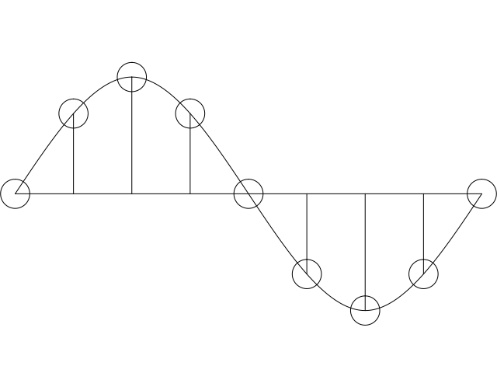
Digital representation of audio
Must convert analog signal to digital representation
Sample
How many times (twice the max frequency in the signal)
Quantize
How many levels or bits to represent each sample
More levels ➔ more accurate representation of signal
More levels ➔ more bits to store & need more bandwidth to transmit
Compress
Compact representation of quantized values
3

Slide 4
Audio representation
analog audio signal sampled at constant rate
telephone: 8,000 samples/sec
CD music: 44,100 samples/sec
each sample quantized, i.e., rounded
e.g., 2⁸=256 possible quantized values
each quantized value represented by bits, e.g., 8 bits for 256 values
quantization error
quantized value of
analog value
analog
signal
audio signal amplitude
time
sampling rate
(N sample/sec)

Slide 5
Audio representation
example: 8,000 samples/sec, 256 quantized values
Bandwidth needed: 64,000 bps
receiver converts bits back to analog signal:
some quality reduction
Example rates
CD: 1.411 Mbps
MP3: 96, 128, 160 Kbps
Internet telephony: 5.3 Kbps and up
quantization error
quantized value of
analog value
analog
signal
audio signal amplitude
time
sampling rate
(N sample/sec)

Slide 6

Video representation
Video: sequence of images displayed at constant rate
e.g., 30 images/sec
Appear continuous due to the stroboscopic effect
frame i
frame i+1

Slide 7
Video representation
spatial coding example: instead of sending N values of same color (all purple), send only two values: color value (purple) and number of repeated values (N)
Digital image: array of pixels
each pixel represented by bits
Encode luminance and color
Number of pixels: resolution
Coding: use redundancy within and between images to decrease # bits used to encode image
spatial (within image)
temporal (from one image to next)
Encoding/decoding algorithm
often called a codec
……………………...…
……………………...…
frame i
temporal coding example: instead of sending complete frame at i+1, send only differences from frame i (motion vectors)
frame i+1

Slide 8
Video codecs: terminology
Video bit rate: effective number of bits per second of the video after encoding
It depends on many factors
Resolution of each image: more pixels = more bits
Detail per pixel: more luminance & color detail = more bits
Amount of movement in the video. More movement = more bits
Quality of overall compression in the codec
Video bit rate is typically correlated with quality of perception
Higher bit rate == better to perceive

Slide 9
Bit-rates: terminology
Bit-rate of a video changes over the duration of the video
CBR: (constant bit rate): fixed bit-rate video
VBR: (variable bit rate): different parts of the video have different bit rates, e.g., changes in color, motion, etc.
For VBR, we talk about average bit-rate over video’s duration
Examples of average video bit-rates
MPEG 1 (CD-ROM) 1.5 Mbps. MPEG2 (DVD) 3-6 Mbps
MPEG4 (often used in Internet, < 1 Mbps)
In general, one Internet video stream takes up a few Mbit/s (more for HD)
https://blog.video.ibm.com/streaming-video-tips/what-is-video-encoding-codecs-compression-techniques/

Slide 10
Networking multimedia: 3 types
On-demand streamed video/audio
Can begin playout before downloading the entire file
Ful video/audio stored at the server: able to transmit faster than audio/video will be rendered (with storing/buffering at client)
e.g., Spotify, YouTube, Netflix
Conversational voice or video over IP
interactive human-to-human communication limits delay tolerance
e.g., Zoom
Live streamed audio, video
e.g, sporting event on sky sports
Can delay a little, but must be close to the “live edge” of content

Slide 11
On-demand Video Streaming

Slide 12
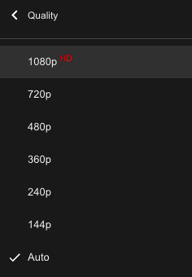
Streaming (stored) video
Media is prerecorded at different qualities
Available in storage at the server
Client downloads an initial portion and starts viewing
The rest is downloaded as time progresses
No need for user to wait for entire content to be downloaded (streaming)
Can change the quality of the content and where it’s fetched mid-stream

Slide 13


Streaming stored video
Constant bit rate video
Cumulative data (e.g. bytes)
Client
e.g., your phone
2. video
sent
video
recorded (e.g., 30 frames/sec)
3. video received,
played out at client
(30 frames/sec)
network delay
(fixed in this example)
time
streaming: at this time, client
playing out early part of video,
while server still sending later
part of video
Server
e.g. Netflix

Slide 14
Streaming stored video: challenges
Continuous playout constraint: once video playout begins at client, time gap between frames must match the original time gap in the video (why?)
But network delays are variable!
Clients have a client-side buffer of downloaded video to absorb variation in network delay, available bandwidth
The video buffer also helps with user interactions: pause, fast-forward, rewind, jump through video

Slide 15
Introduce a delay for smooth playout
constant bit
rate video
transmission
client video
reception
constant bit
rate video
playout at client
Cumulative data
variable
network
delay
buffered
video
client playout
delay
time
Client-side buffering with playout delay:
compensate for variations in the network delay

Slide 16
But not too small a delay
constant bit
rate video
transmission
client video
reception
constant bit
rate video
playout at client
Cumulative data
variable
network
delay
buffered
video
client playout
delay
time
Playout delay that’s too small can cause stalls
There’s nothing in the buffer to show to the user

Slide 17

Client-side buffering, playout
buffer fill level, B(t)
variable fill
rate, x(t)
playout rate,
e.g., CBR r
video server
Client’s
buffer, size B_{max}
client
Most video is broken up in time into multiple segments
Client downloads video segment by segment
For example: a segment might be 4 seconds worth of video.

Slide 18
Client-side buffering, playout
buffer fill level, B(t)
variable fill
rate, x(t)
playout rate,
e.g., CBR r
video server
Client’s
buffer, size B_{max}
client
1. Initial fill of buffer until playout begins at t_{p}
2. playout begins at t_{p}
3. buffer fill level varies over time as fill rate x(t) varies (assume playout rate r is constant for now)

Slide 19
Client-side buffering, playout
buffer fill level, B(t)
variable fill
rate, x(t)
playout rate,
e.g., CBR r
video server
Client’s
buffer, size B_{max}
playout buffering: average fill rate (x), playout rate (r):
x < r: buffer eventually empties for a sufficiently long video. Stall and rebuffering
x > r: buffer will not empty, provided the initial playout delay is large enough to absorb variability in x(t)
initial playout delay tradeoff: buffer starvation less likely with larger delay, but also incur a larger delay until the user begins watching

Slide 20
Client-side buffering, playout
buffer fill level, B(t)
variable fill
rate, x(t)
playout rate,
e.g., CBR r
video server
Client’s
buffer, size B_{max}
playout buffering: average fill rate (x), playout rate (r):
is x < r or x > r for a given network connection?
It can be hard to control x or even predict it in general
Best-effort network inflicts long queues, low bandwidth, loss, etc.
How to set the playout rate r?
Too low a bit-rate r: video has poorer quality than needed
Too high a bit-rate r: buffer might empty out. Stall/rebuffering!

Slide 21
Adaptive bit–rate video
Motivation: Want to provide high quality video experience, without stalls
Observations:
Videos come in different qualities (average bit rates)
Versions of the video for different quality levels readily available
Different segments of video can be downloaded separately
Adapt bit rate per segment through collaboration between the video client (e.g., your browser) and the server (e.g., @ Netflix)
Adaptive bit-rate (ABR) video: change the bit-rate (quality) of next video segment based on network and client conditions
A typical strategy: Buffer-based rate adaptation

Slide 22
Buffer-based bit-rate adaptation
Key idea: If there is a large stored buffer of video, optimize for video quality, i.e., high bit rates
Else (i.e., buffer has low occupancy), avoid stalls by being conservative and ask for a lower quality (bit-rate)
Hope: lower bandwidth requirement of a lower quality stream is satisfiable more easily
Buffer is measured in seconds of playout left before stalling

Slide 23
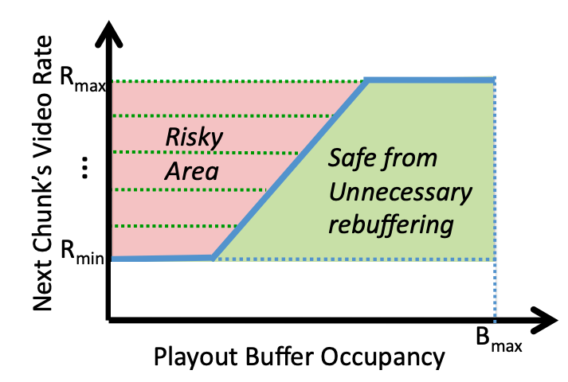
Buffer-based bit-rate adaptation
A highly effective method to provide high video quality despite variable and intermittently poor
network conditions.
Used by Netflix.
http://yuba.stanford.edu/~nickm/papers/sigcomm2014-video.pdf
A Buffer-Based Approach to Rate Adaptation

Slide 24
Dynamic Adaptive Streaming over HTTP (DASH)

Slide 25
Streaming multimedia with DASH
Dynamic Adaptive Streaming over HTTP
Used by Netflix and most popular video streaming services
Adaptive: Perform video bit rate adaptation
It can be done on the client or the server (with client feedback)
Dynamic: Retrieve a single video from multiple sources
The DASH video server is just a standard HTTP server
Provides video/audio content in multiple formats and encodings
Leverage existing web infrastructure
CDN
DNS

Slide 26
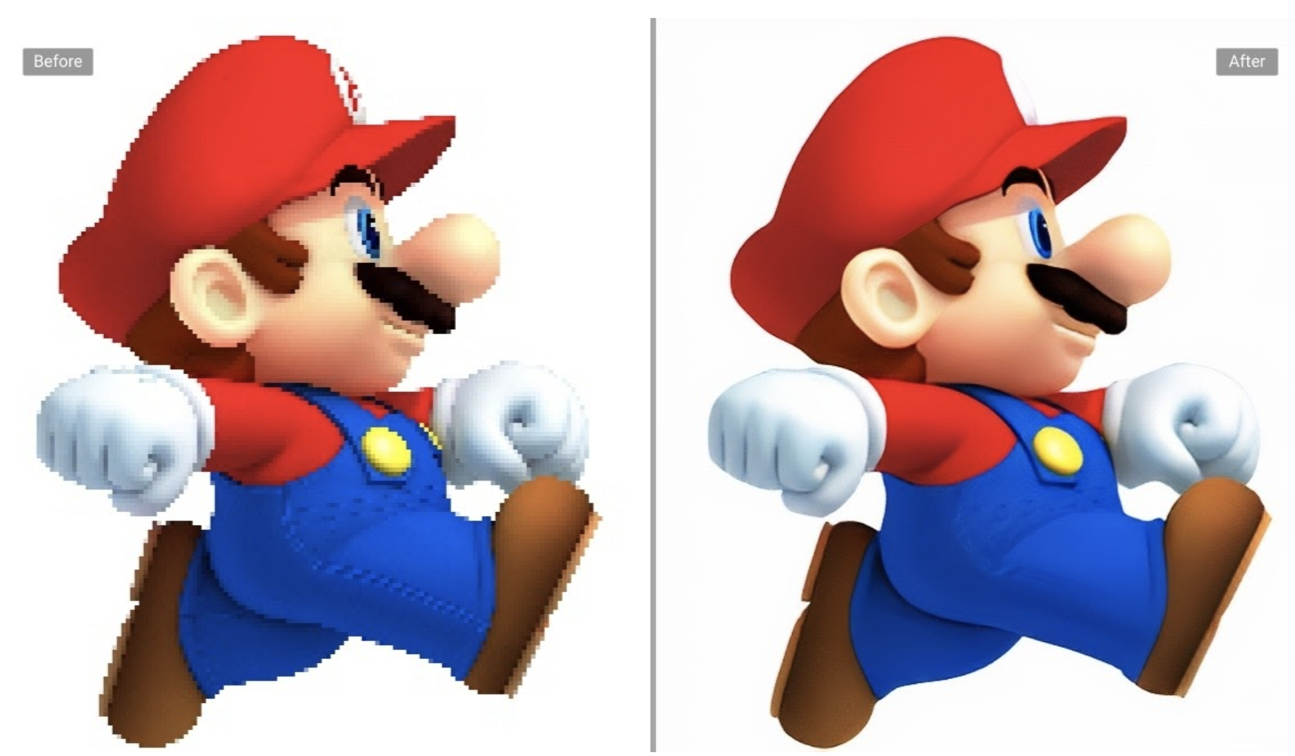
DASH: Key ideas
Web Browser
Or Video Client
Content (video, audio, transcript, etc.) divided into segments (time)
Algorithms to determine and request varying attributes (e.g., bitrate, language) for each segment
Goal: ensure good quality of service, match user prefs, etc.
HTTP
client
Media
player
Issue requests on time. Pick attributes for each segment of content
Media Presentation
Description (manifest)
Video
Server
Audio
Transcripts

Slide 27
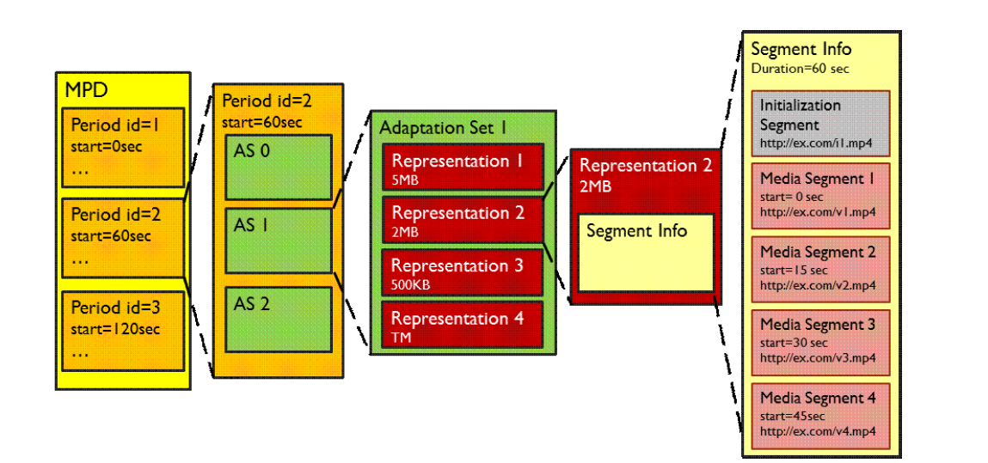
What does the manifest contain?
Functionally equivalent: RSes of given AS
Functionally different: different ASes
Adaptation set: functionally equivalent content
Representations: codecs, bit rates, etc.
Periods:
Durations of content
Multiple segments per representation
URL available for each segment
Byte ranges per segment (HTTP header for a range request)
Source: Stockhammer, MMSys.
https://www.w3.org/2010/11/web-and-tv/papers/webtv2_submission_64.pdf

Slide 28
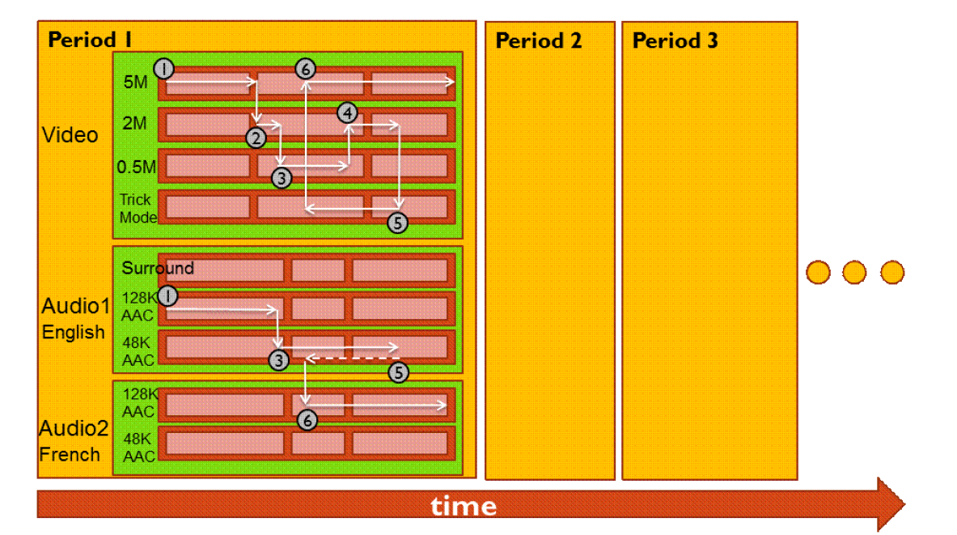
Dynamic changes in stream quality

Slide 29


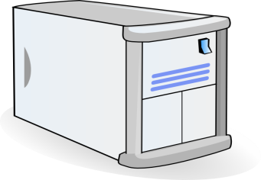

Dynamic changes in stream location
Just an HTTP request for an HTTP object
CDN DNS points user to best CDN server
3. HTTP GET request
for URLs
1. HTTP GET request for video URL
CDN servers caching the video
Internet
YouTube origin servers
2. HTTP reply containing html to construct the web page, manifest, with URLs for video content
4. HTTP reply
with cached resources at those URLs
User

Slide 30
DASH reference player
https://reference.dashif.org/dash.js/latest/samples/dash-if-reference-player/index.html

Slide 31
DASH Summary
Piggyback video on HTTP: widely used
Enables independent HTTP requests per segment
Choose dynamic quality & preferences over time
Independent HTTP byte ranges
Works well with CDNs
Fetch segments from locations other than the origin server
Fetch different segments from possibly different locations
More resources on DASH
https://www.w3.org/2010/11/web-and-tv/papers/webtv2_submission_64.pdf
https://www.youtube.com/watch?v=xgowGnH5kUE

Slide 32


Application Layer: Wrap-up
Name resolution, the web, video
Protocols built over the socket() abstraction
Simple designs go a long way
Plain text protocols, header-based evolution
Infrastructure for functionality, performance, …
CDNs, web proxies
Fit your apps to run on browsers: run almost anywhere (e.g. video)
Apps are ultimately what users and most engineers care about
BUT: if you don’t understand what’s under the hood, you risk bad design and poor performance in Internet applications
App layer
App layer

