Slide 1

Quality of Service
Lecture 25 http://www.cs.rutgers.edu/~sn624/352-S22
Srinivas Narayana

Slide 2






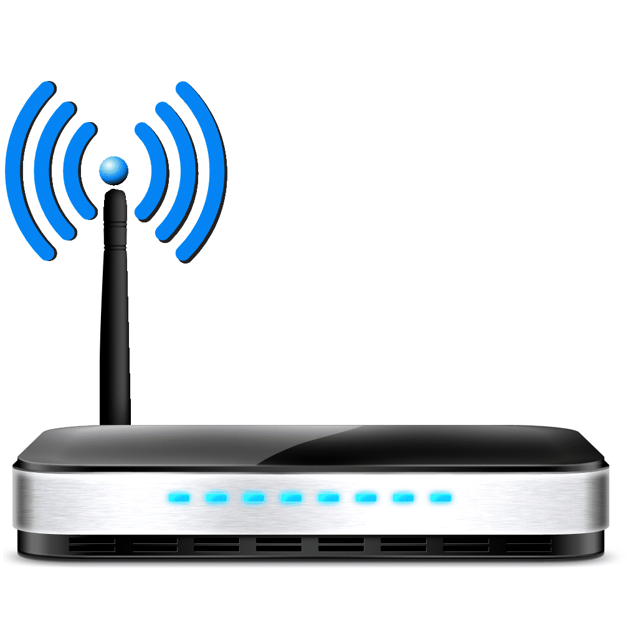
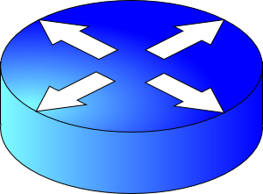






The network layer is all about reachability.
Net layer
Internet is federated! Incomplete visibility
Border Gateway Protocol (BGP)
Rutgers: “use AT&T to get to Princeton”
“I can reach p’ton”
Dst: 91.1/16
AS path: comcast, p’ton
“I am p’ton”
Dst: 91.1/16
AS path: p’ton
AT&T
Messages
BGP announcements
Comcast
Routing protocols
Algorithms
Verizon
Dst: 91.1/16
AS path:
comcast, p’ton
Import policy
Verizon: “OK to use route from Comcast”
Best route selection
Verizon: Don’t announce Princeton route to AT&T
Link
state
Distance
Vector
Path
Vector
Export policy

Slide 3
Computing the forwarding table
AS3
3b
AS1
1b
3a
3c
1a
1c
AS2
2b
3d
X
1d
2a
2c
2d
Suppose a router in AS1 wants to forward a packet destined to external prefix X.
How is the forwarding table entry for X at 1d computed?
How is the forwarding table entry for X at 1c computed?

Slide 4
eBGP and iBGP announcements
AS3
3b
AS1
1b
3a
3c
1a
1c
AS2
2b
3d
X
1d
AS3,X
AS2,AS3,X
2a
2c
2d
AS2 router 2c receives path announcement AS3,X (via eBGP) from AS3 router 3a
Based on AS2 import policy, AS2 router 2c imports and selects path AS3,X, propagates (via iBGP) to all AS2 routers
Based on AS2 export policy, AS2 router 2a announces (via eBGP) path AS2, AS3, X to AS1 router 1c

Slide 5
eBGP and iBGP announcements
AS3
3b
AS1
1b
AS3,X
3a
3c
1a
1c
AS2
2b
3d
X
1d
AS3,X
AS2,AS3,X
2a
2c
2d
A given router may learn about multiple paths to destination:
AS1 gateway router 1c learns path AS2,AS3,X from 2a (next hop 2a)
AS1 gateway router 1c learns path AS3,X from 3a (next hop 3a)
Through BGP route selection process, AS1 gateway router 1c chooses path AS3,X, and announces path within AS1 via iBGP (next hop 1c)

Slide 6
Setting forwarding table entries
AS3
3b
AS1
1b
AS3,X
3a
3c
1a
1c
2
AS2
2b
1
3d
X
3
1d
AS3,X
AS2,AS3,X
2a
2c
2d
recall: 1a, 1b, 1d learn about dest X via iBGP from next-hop 1c: “path to X goes through 1c”
1d: intra-domain routing: to get to 1c, forward over outgoing local interface 1
dest
Next-Hop
NH
interface
…
…
…
…
…
…
…
…
X
1c
1c
1
IP Dst
Out port
Forwarding table
X
1

Slide 7
Setting forwarding table entries
AS3
3b
AS1
1b
AS3,X
1
2
3a
3c
1a
1c
3
AS2
2b
3d
X
1d
AS3,X
AS2,AS3,X
2a
2c
2d
dest
Next-Hop
NH
interface
recall: 1c learns about dest X via eBGP from next-hop 3a: “path to X goes through 3a”
1c: to get to link-local neighbor 3a, forward out interface 2
…
…
…
…
…
…
…
…
X
3a
3a
2
IP Dst
Out port
Forwarding table
X
2

Slide 8
Summary: Inter-domain routing
Federation and scale introduce new requirements for routing on the Internet
BGP is the protocol that handles Internet routing
Path vector: exchange paths to a destination with attributes
Policy-based import of routes, route selection, and export

Slide 9
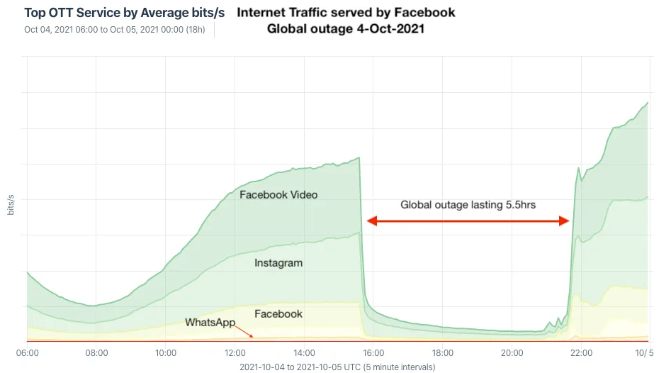
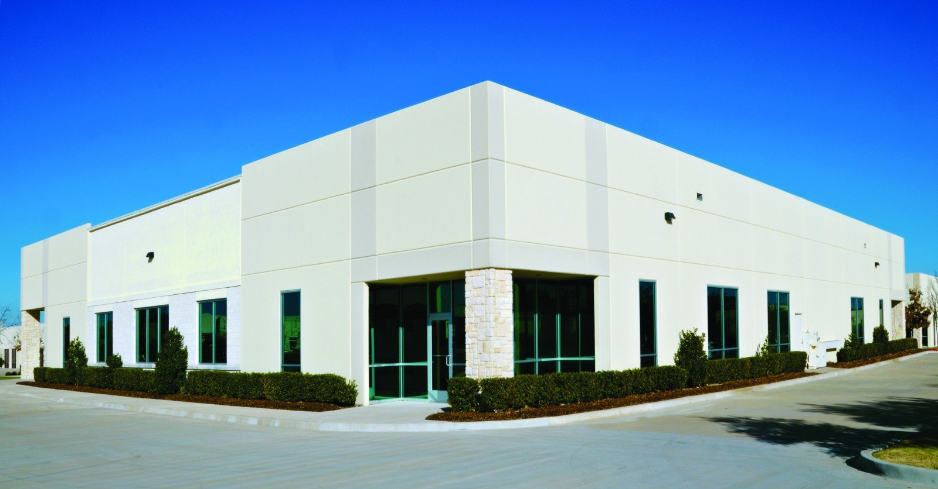
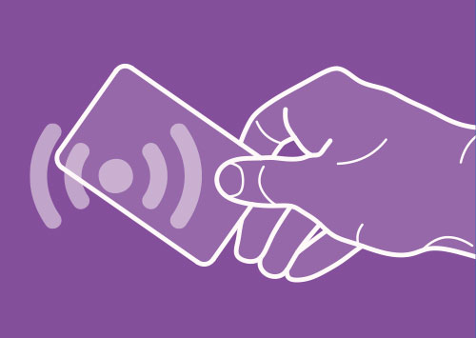
BGP’s impact: October ’21 FB++ outage
BGP route withdrawal:
“I can’t reach FB anymore”
FB network
Rest of the Internet
BGP route withdrawal: don’t use me to get to FB
FB’s DNS servers
No remote access (no more reachability due to BGP withdrawal of DC and DNS servers)
Restricted physical access (prox can’t verify, can’t access prox server)
https://engineering.fb.com/2021/10/05/networking-traffic/outage-details/
By Doug Madory - https://www.kentik.com/blog/facebooks-historic-outage-explained/, CC BY 4.0, https://commons.wikimedia.org/w/index.php?curid=110816752

Slide 10
Beyond best effort networking

Slide 11
Network support for applications
A best effort Internet architecture does not offer any guarantees on delay, bandwidth, and loss
Network may drop, reorder, corrupt packets
Network may treat traffic randomly regardless of their “importance”
However, many apps require special treatment & guarantees
E.g., voice over IP (phone calls) require strict delay guarantees
E.g., HD video requires a reasonable minimum bandwidth
E.g., remote surgery with 3D-vision requires strict sync & latency
Q: How to provide quality of service (QoS) for apps?

Slide 12


Why best effort isn’t enough: Contention
Conf call: Requires low latency
High delay
Packet drops
Resource contention occurs in the core of the network
Congestion control will react, but may be too little & too late:
Congestion control can’t prevent packet drops “now”
Congestion control won’t prevent high-sending-rate flows from inflicting large delays or recurring drops
BitTorrent: Requires high throughput
FIFO queue

Slide 13
Can networks help improve the quality of service for applications?
Yes, but networks must become
better than best-effort.

Slide 14
Approach 1: Provision more capacity
If you’re an ISP (e.g., AT&T), you might deploy enough capacity so that contention doesn’t occur any more
Low complexity: can use current “best effort” network
However, this approach incurs high costs (e.g., bandwidth)
A key challenge: estimating how much bandwidth is enough
Need to estimate demand over time
Network operators can do this quite well usually
But there are exceptional circumstances: pandemics, Superbowl, etc.

Slide 15
Approach 2: Classes of service
Have the network treat different traffic differently
Also called traffic differentiation
Analogy: lines at an airport (e.g., first class vs. economy)
Partition traffic into classes and offer service guarantees per class and across classes
Classes may be indicated using the IP type of service header bits
Classes may be inferred from IP & transport headers (e.g., src/dst/ports)
Packet classification: assigning packets to classes
(Not in scope: we won’t discuss packet classification)

Slide 16
Kinds of Service Guarantees

Slide 17
(1) Strict prioritization
Transmitted immediately regardless of HTTP packets
Conf call
H3
H1
R1
R2
H4
HTTP
H2
1.5 Mbps link
Suppose a 1Mbps interactive flow and an HTTP connection share a 1.5 Mbps link.
A network operator (e.g., Rutgers admin) might choose to prioritize the interactive app strictly over the HTTP flow.

Slide 18
(2) Rate limiting
Rate limited to 1 Mbit/s
What if a flow doesn’t respect its allocation?
Example: Say, conf call flow goes beyond 1 Mbit/s
Don’t want to starve HTTP flow!
An operator might want to limit a flow to a certain max rate
Isolation: HTTP should not be impacted by the conf call
Conf call
H3
H1
R1
R2
H4
HTTP
H2
1.5 Mbps link

Slide 19
(3) Weighted fair sharing
Allocated 2/3rd of the link
An operator might want to partition the link’s rate C into separate allocations for each class
Partitions may have weights w (example: 2, 1)
Usually, class i gets the illusion of traversing a logical link of rate
w_{i} * C / ∑_{j} w_{j}
w=2
Conf call
H3
H1
R1
R2
H4
w=1
HTTP
H2
Allocated 1/3rd of the link

Slide 20
(3) Weighted fair sharing
Class 1
Customary to think of different classes as belonging to different queues
For this reason, weighted fair sharing is also called weighted fair queueing (WFQ)
Each queue is first-in-first-out (FIFO)
The link multiplexes among these queues
Intuitively, packets of one queue should not influence the behavior of other queues
Hence, fair queueing is also a form of isolation across traffic classes
Class 2
Link
Class 3

Slide 21
(3) Weighted fair sharing
Class 1
But what if one class doesn’t use its share?
Can other classes use the spare capacity?
Yes! WFQ is work-conserving: a router implementing WFQ will allow other classes to use the unused capacity
Work conservation makes WFQ different from rate limits applied separately to each class
Class i’s usage can exceed w_{i} * C / ∑_{j} w_{j}
(only if spare capacity is available, of course.)
Class 2
Link
Class 3

Slide 22
Q: Where are guarantees enforced?
We’ve seen three kinds of service guarantees: prioritization, rate limiting, and fair sharing
Common goal: allocate the bottleneck link capacity across packets from traffic classes
This allocation occurs in the packet scheduler in the bottleneck router
Recall: scheduling is the task of choosing the packet (among buffered packets) which is transmitted over the output link
A router is said to implement packet scheduling policies

Slide 23
Why care about service guarantees?
Influences how packets are treated at contentious resources in the core of the network
Regardless of the endpoint transport
Service guarantees: prioritization, rate limiting, fair sharing
Implementations of scheduling (QoS) within large networks have implications for debates on network neutrality
Scheduling is a fundamental problem in computer networks
Next lecture: a deeper look at mechanisms for one kind of service guarantee

Slide 24
Rate Limiting

Slide 25
Measures of transmission rate
Long-term/average rate: data rate transmitted per unit time, over a long period
Crucial question: what is the time interval over which rate is measured?
Average and instantaneous behaviors can be very different
Same average rate
Rate
Measurement duration
Rate
Measurement duration
Time
Time

Slide 26
Measures of transmission rate
Peak rate: largest instantaneous rate that is transmitted
Measurement duration is typically very small
Burst size: maximum amount of data sent consecutively without any intervening idle periods
Measurement duration
peak rate
Rate
Time

Slide 27
Rate enforcement
There are two kinds of rate enforcement policies:
shaping and policing
Two specific mechanisms to implement those:
leaky buckets and token buckets

Slide 28
Shaping
vs. Policing
Enforces rate by queueing excess packets in a buffer
Drop only if buffer is full
Requires memory to buffer packets
Can inflate round-trip time (queueing in shaping buffer)
Enforces rate by dropping excess packets immediately
Can result in high loss rates
Does not require a memory buffer
No additional inflation in round-trip times

Slide 29
Leaky bucket shaper

Slide 30


Intuition: release packets at steady rate
Packets from source
Bucket
leaking water
at a steady
rate
Leaky
Bucket
Shaper
Shaping buffer
Timed release mechanism for packets
Packets leaving at steady rate

Slide 31
Leaky Bucket Shaper
Packets may enter in a bursty manner
However, once they pass through the leaky bucket, they are evenly spaced
The shaping buffer holds packets up to a certain point
If the buffer is full, packets are dropped
Setting the rate is a policy concern
Assume an admin provides us the rate
Shapers may be used in the core of a network to limit bandwidth use, or at the edge to pace packets entering the network in the first place

Slide 32
Leaky Bucket Shaper
For a leaky bucket shaper, assume average rate == peak rate
However, many Internet transfers just have a few packets
For example, web requests and responses
Enforcing rate limit for those can significantly delay completion
We often wish to have peak rate higher than avg rate
Especially at the beginning of a connection
If so, use a token bucket: burst-tolerant version of a leaky bucket

Slide 33
Token bucket shaper

Slide 34
Token bucket shaper
Fill at rate r
Limits traffic class to a specified average rate r and burst size B
Tokens are filled in at rate r
The token bucket can hold a maximum of B tokens. Further tokens dropped
Note: distinct from shaping buffer size
Suppose a packet is at the head of the shaping buffer
If a token exists in the bucket, remove token, and transmit the packet
If not, wait.
Bucket size B
Packets
Remove token
Transmit
Shaping buffer

Slide 35
Token bucket shaper
Fill at rate r
In time t, the maximum number of packets that depart the shaper is (r * t) + B
A full bucket of tokens would allow small flows to go through unaffected
A maximum burst of B packets
Longer flows have average rate r
Bucket emptied initially, the rest of the flow must respect the token fill rate
As t → ∞, the average rate approaches r
That is, (1/t) * (r*t + B) → r
Bucket size B
Packets
Remove token
Transmit
Shaping buffer

Slide 36
Token bucket policers

Slide 37
Token bucket policer
Fill at rate r
A token bucket policer is just a token bucket shaper without the shaping buffer
No place for packets to wait if there are no tokens
If token exists, packet transmitted.
If not, packet dropped
Simple and efficient to implement.
The internet has tons of token bucket policers
Bucket size B
Packets
Remove token
Transmit
Shaping buffer

Slide 38
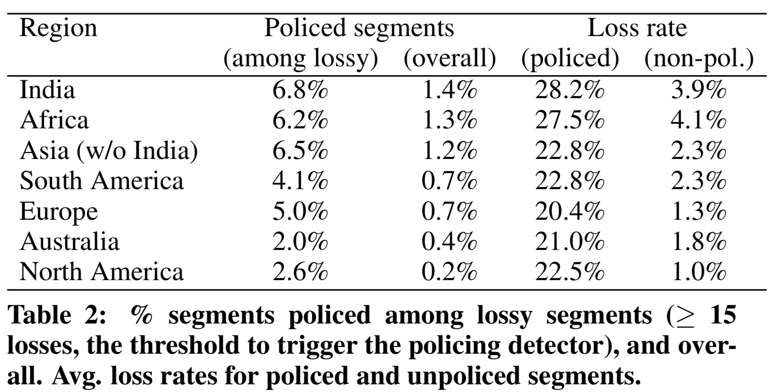
Google study from 2016
Small but non-trivial fraction of policed links
Significant impact on packet loss rate
Flach et al., An Internet-Wide Analysis of Traffic Policing, SIGCOMM 2016

Slide 39
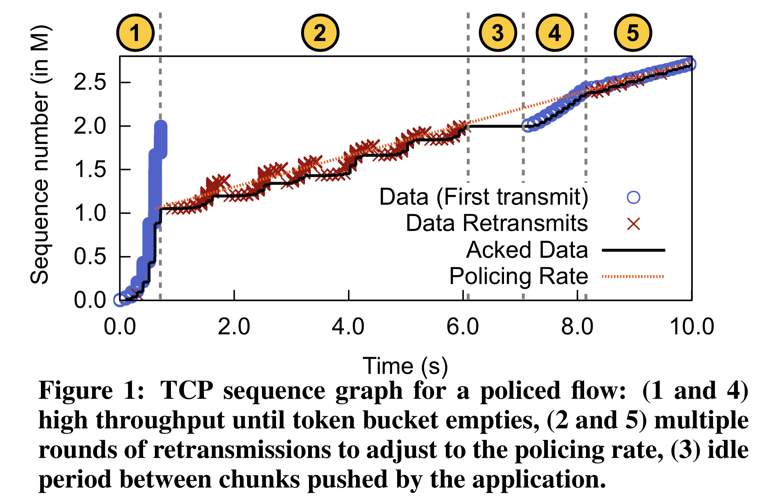
Impact on TCP
Policers drop multiple packets in a burst: causing RTOs and retransmissions after emptying of token bucket
Slow start period: burst allowed with a full bucket of tokens

Slide 40
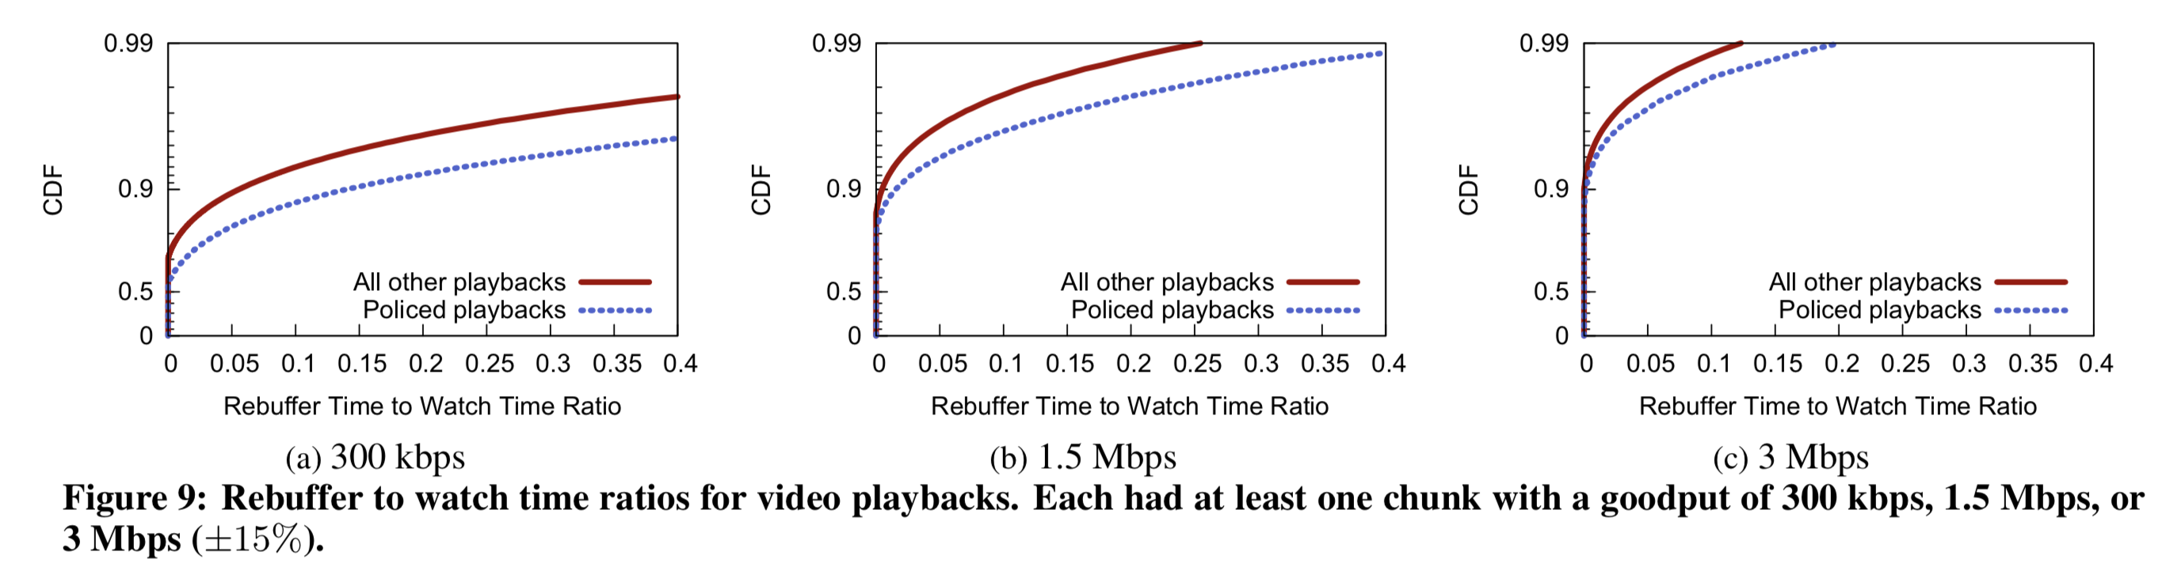
Effect on actual apps: YouTube
Video rebuffer rate: rebuffer time / overall watch time

Slide 41
Summary of rate limiting
Rate limiting is a useful mechanism to isolate traffic classes from each other
Two strategies: policing and shaping
Leaky bucket and token bucket
The Internet has a lot of token bucket policers, causing real impact on TCP connections and app performance
Understand how ISPs treat consumer Internet traffic

Slide 42
Synthesis of protocols

Slide 43
Synthesis: a day in the life of a web request
Our journey down protocol stack complete!
application, transport, network, link
putting-it-all-together: synthesis!
Goal: identify, review, understand protocols (at all layers) involved in seemingly simple scenario: requesting www page
Scenario: student attaches laptop to campus network, requests/receives www.google.com

Slide 44




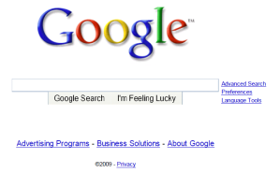
A day in the life: scenario
browser
DNS server
Comcast network
68.80.0.0/13
school network
68.80.2.0/24
web page
web server
Google’s network
64.233.160.0/19
64.233.169.105

Slide 45
A day in the life… connecting to the Internet
DHCP
DHCP
UDP
IP
Eth
Phy
connecting laptop needs to get its own IP address, addr of first-hop router, addr of DNS server: use DHCP
DHCP
DHCP
DHCP
DHCP
DHCP request encapsulated in UDP, encapsulated in IP, encapsulated in link layer Ethernet
DHCP
DHCP
UDP
IP
Eth
Phy
DHCP
DHCP
DHCP
DHCP
router
(runs DHCP)
Packet broadcast (dest: FFFFFFFFFFFF) on the local network, received at a router running DHCP server
Ethernet decapsulated to IP decapsulated to UDP decapsulated to DHCP

Slide 46
A day in the life… connecting to the Internet
DHCP
DHCP
UDP
IP
Eth
Phy
DHCP server formulates DHCP ACK containing client’s IP address, IP address of first-hop router for client, name & IP address of DNS server
DHCP
DHCP
DHCP
DHCP client receives DHCP ACK reply
DHCP
DHCP
UDP
IP
Eth
Phy
DHCP
DHCP
DHCP
router
(runs DHCP)
DHCP
Client now has IP address, knows name & addr of DNS
server, IP address of its first-hop router

Slide 47
A day in the life… ARP (before DNS, before HTTP)
DNS
UDP
IP
Eth
Phy
before sending HTTP request, need IP address of www.google.com: DNS
DNS
DNS
DNS
ARP
ARP query
DNS query created, encapsulated in UDP, encapsulated in IP, encapsulated in Eth. To send frame to router, need MAC address of router interface: ARP
ARP
ARP reply
Eth
Phy
ARP query broadcast, received by router, which replies with ARP reply giving MAC address of router interface
router
(runs DHCP)
client now knows MAC address of gateway router, so can now send packet containing DNS query

Slide 48
A day in the life… using DNS
DNS
UDP
IP
Eth
Phy
DNS
DNS server
DNS
UDP
IP
Eth
Phy
DNS
DNS
DNS
DNS
DNS
DNS
DNS
DNS
Comcast network
68.80.0.0/13
IP datagram forwarded from campus network into Comcast network, routed (tables created by EIGRP, OSPF, and/or BGP routing protocols) to DNS server
router
(runs DHCP)
IP datagram containing DNS query from client to gateway router
decapsulated to DNS server
DNS server replies to client with IP address of www.google.com

Slide 49
A day in the life…TCP connection carrying HTTP
HTTP
HTTP
TCP
IP
Eth
Phy
SYNACK
SYN
SYNACK
SYN
SYNACK
SYN
SYN
to send HTTP request, client first opens TCP socket to web server
router
(runs DHCP)
TCP
IP
Eth
Phy
SYNACK
TCP packet routed using inter-domain routing (BGP) and intra-domain routing (OSPF, EIGRP) to web server
SYN
SYNACK
SYN
SYNACK
SYNACK
SYN
web server
64.233.169.105

Slide 50
A day in the life… HTTP request/reply
HTTP
HTTP
TCP
IP
Eth
Phy
web page finally (!!!) displayed
HTTP
HTTP
HTTP
HTTP
HTTP
HTTP
HTTP
HTTP
HTTP request sent into TCP socket
router
(runs DHCP)
IP datagram containing HTTP request routed to www.google.com
HTTP
HTTP
TCP
IP
Eth
Phy
HTTP
HTTP
HTTP
web server responds with HTTP reply (containing web page)
HTTP
web server
64.233.169.105
IP datagram containing HTTP reply routed back to client

