Slide 1

Application Architecture
Lecture 6
Srinivas Narayana
http://www.cs.rutgers.edu/~sn624/553-S25

Slide 2


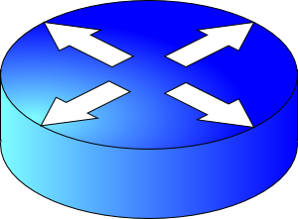
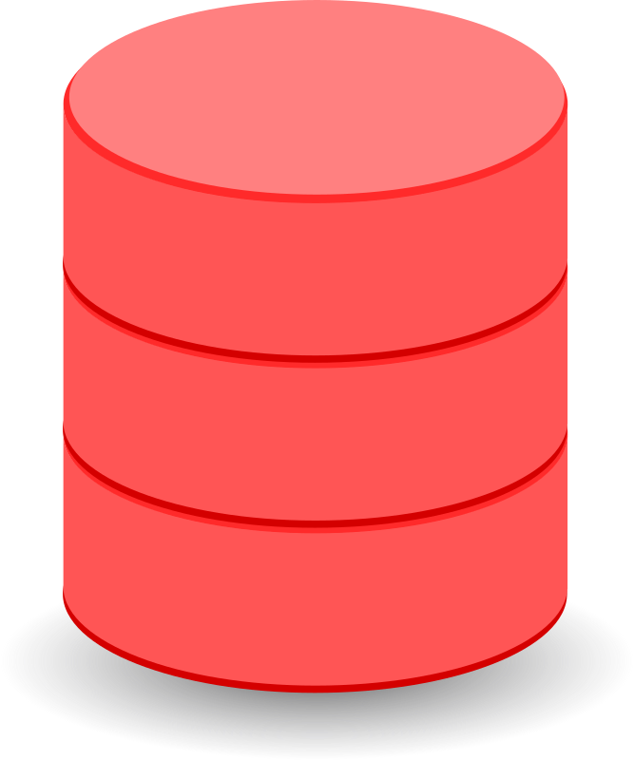

Review: Offline and Online components
Services, databases, ML inference
update
User request
update
update
Online, real-time request processing
Offline processing:
Batch processing; stream events; ML training
Data, events,
etc

Slide 3
Partition-Aggregate
Processing interactive search queries

Slide 4
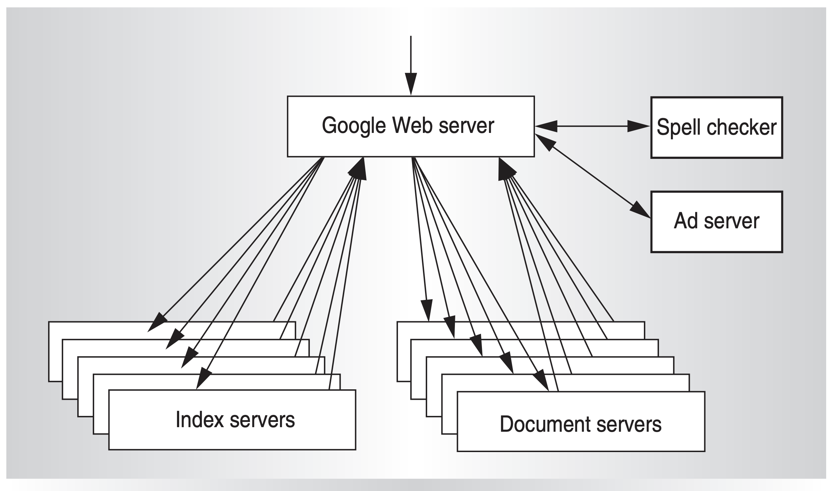
Review: Google search architecture
Web search for a planet, MICRO’03

Slide 5
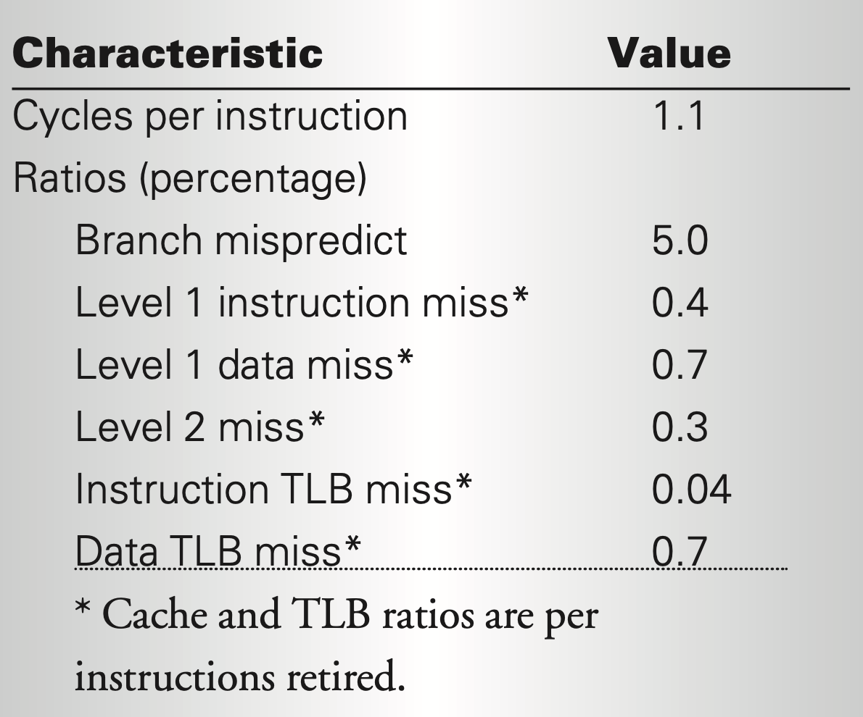
Review of the Web Search workload
Depending on the user’s query, decompress a part of an index, then search for document IDs there
Depending on the user’s query, collect snippets from within Web documents
Data-dependent accesses
High branch misprediction
Blocks randomly accessed (OK within block)
Fewer opportunities for instruction-level parallelism; faster/better servers not better

Slide 6

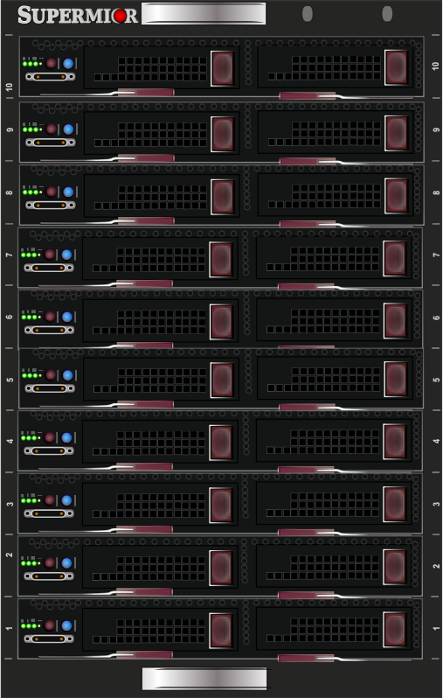

How to use parallelism?
Assume: one thread == one core
Fast core
Fast core
Few fast cores with high-speed interconnect, or more slow cores?
Cost per query processed is dominated by capital server costs
Power draw and cooling: faster == denser
Fast core
Fast core
Slow core
Slow core
Slow core
Slow core
Slow core
Slow core
Slow core
Slow core
Slow core
Discussion applies to both hyperthreaded or multicore
Server rack

Slide 7


Two kinds of parallelism
Data parallelism: independent compute over shards of data
Fast interconnects not as critical
Stateless: little coordination within a request
Request parallelism: independent compute across requests
More machines for more requests
Shard itself can be replicated for throughput
Need lower latency?
Compensate slow cores with smaller shard (add more shards)
Each shard becomes more available
Turn throughput into latency advantage
1
2
3
a
b
4
5
6
a
4
4
b
4

Slide 8

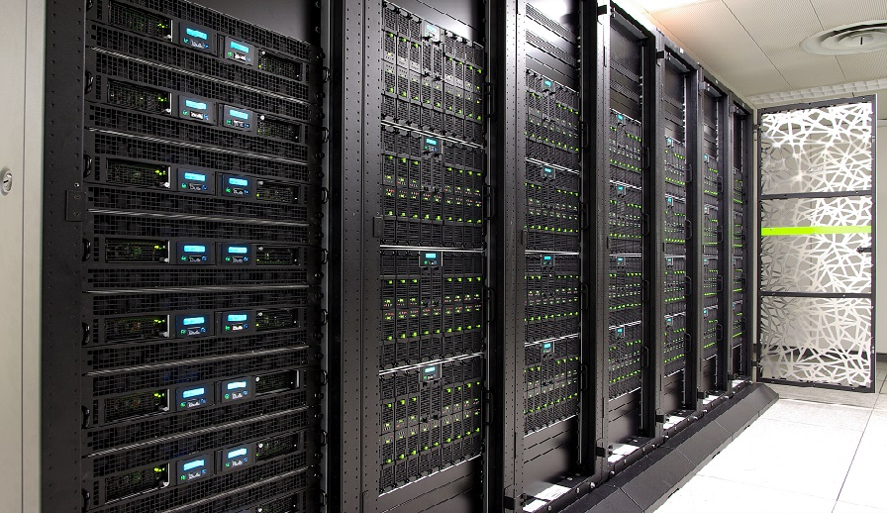
Google search
Index servers
Doc servers
GWS
LB
1
1
user
DNS
2
2
GFE
Partition
Pick one
Word → Doc
Aggregate
All-up SLO (300 ms)
Relevant document IDs
(Doc, word) → Snippet
Partition
Snippet results
Aggregate

Slide 9
Many apps can use partition-aggregate
Need low latency, but single-threaded low latency is hard
Data parallelism
Little coordination across shards
Inexpensive merges across partial results from shards
Query parallelism
More replicas/machines for more requests
Use commodity (not fancy) hardware
Turn high throughput into a latency advantage
Focus on price per unit performance
Significant problems: cooling for many compute servers

Slide 10
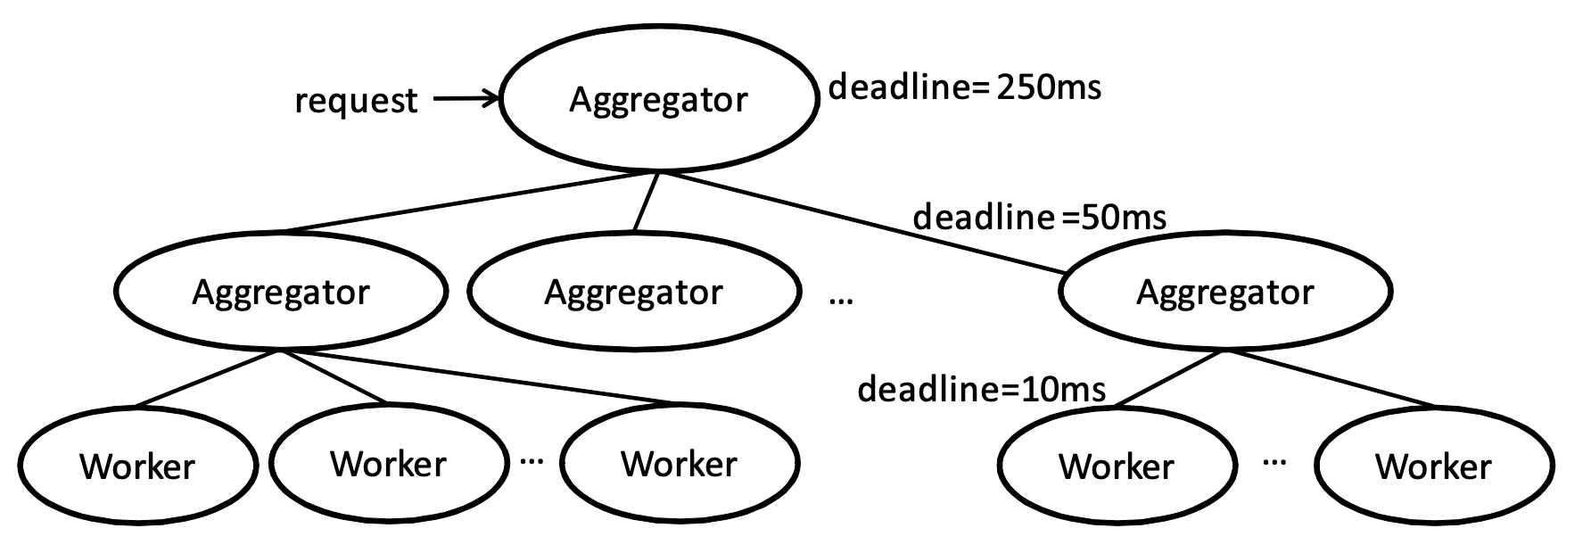
Tail performance becomes important
With partition-aggregate, each machine may serve many requests within a single user-level request
A single user sends multiple requests over a session
Many shards are queried for a single user-level query
Delays in any one of them can delay the entire response
Leaving the shard out degrades the result
Example: 1000 shards* 10 user requests per session
1 delay in 10,000 machine-level responses can be visible to a user
99.99th percentile delay matters
Lots of delay on cutting the tail: hedging, duplication, …

Slide 11
Map Reduce
Batch processing with simple abstractions

Slide 12
Example: Batch data processing
Server access log: want to get top-5 URLs visited
192.0.2.1 - - [07/Dec/2021:11:45:26 -0700] "GET /index.html HTTP/1.1" 200 4310
Analytics (not real time user query). How would you go about it?
One way: shell script
cat /var/log/nginx/access.log
| awk ‘{print $7}’
| sort
| uniq –c
| sort –r –n
| head –n 5

Slide 13
Example: Batch data processing
Another way: Python script
counts = {}
for line in open(“/var/log/access.log”):
url = line.split()[6]
counts[url] += 1
sorted_counts = counts.items().sort()[::-1]
print (sorted_counts[0:5])
Which method would you use, and why?

Slide 14

What do we want from implementation?
Process large log files, even when doesn’t fit into memory
Ability to experiment with different processing steps
Without corrupting the original data
Unix principles help!
Programs/tools that do one thing well (e.g., sort)
Separate logic from wiring
Any tool can produce for, or consume from, any other tool (pipe |)
Inputs come from standard input or a file. Immutable inputs
A choice to inspect data or write to disk anywhere (e.g., tee)
Inspect output at any point (e.g., less)

Slide 15
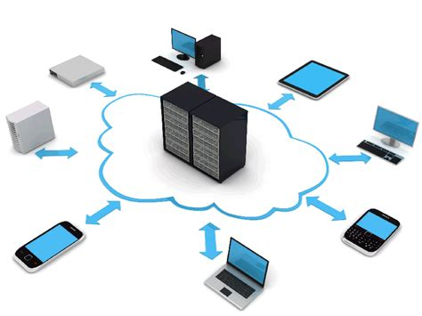
Map-Reduce
One way to think about it: a distributed implementation of Unix processing pipelines for large batch processing
Large data sets: data comes from a distributed filesystem (GFS, HDFS)
Large computations: want to use multiple servers since data-intensive
Examples:
Distributed grep, term frequencies, distributed sort
Output?
A data structure, e.g., a search index
A set of pre-computed values for faster reads, e.g., key-value cache
Input to load into a traditional relational database (SQL) or view

Slide 16



Distributed system considerations
Data resides on multiple machines
How to bring data together? How to compute with parallel machines?
Network bandwidth between servers is a significant consideration
How to handle failures?
Machine failures?
What happens to partial computations?
Should we replicate compute?
What happens to intermediate results?
Should you persist it? Replicate it?
MapReduce
Algorithm developers == Distributed system experts?

Slide 17
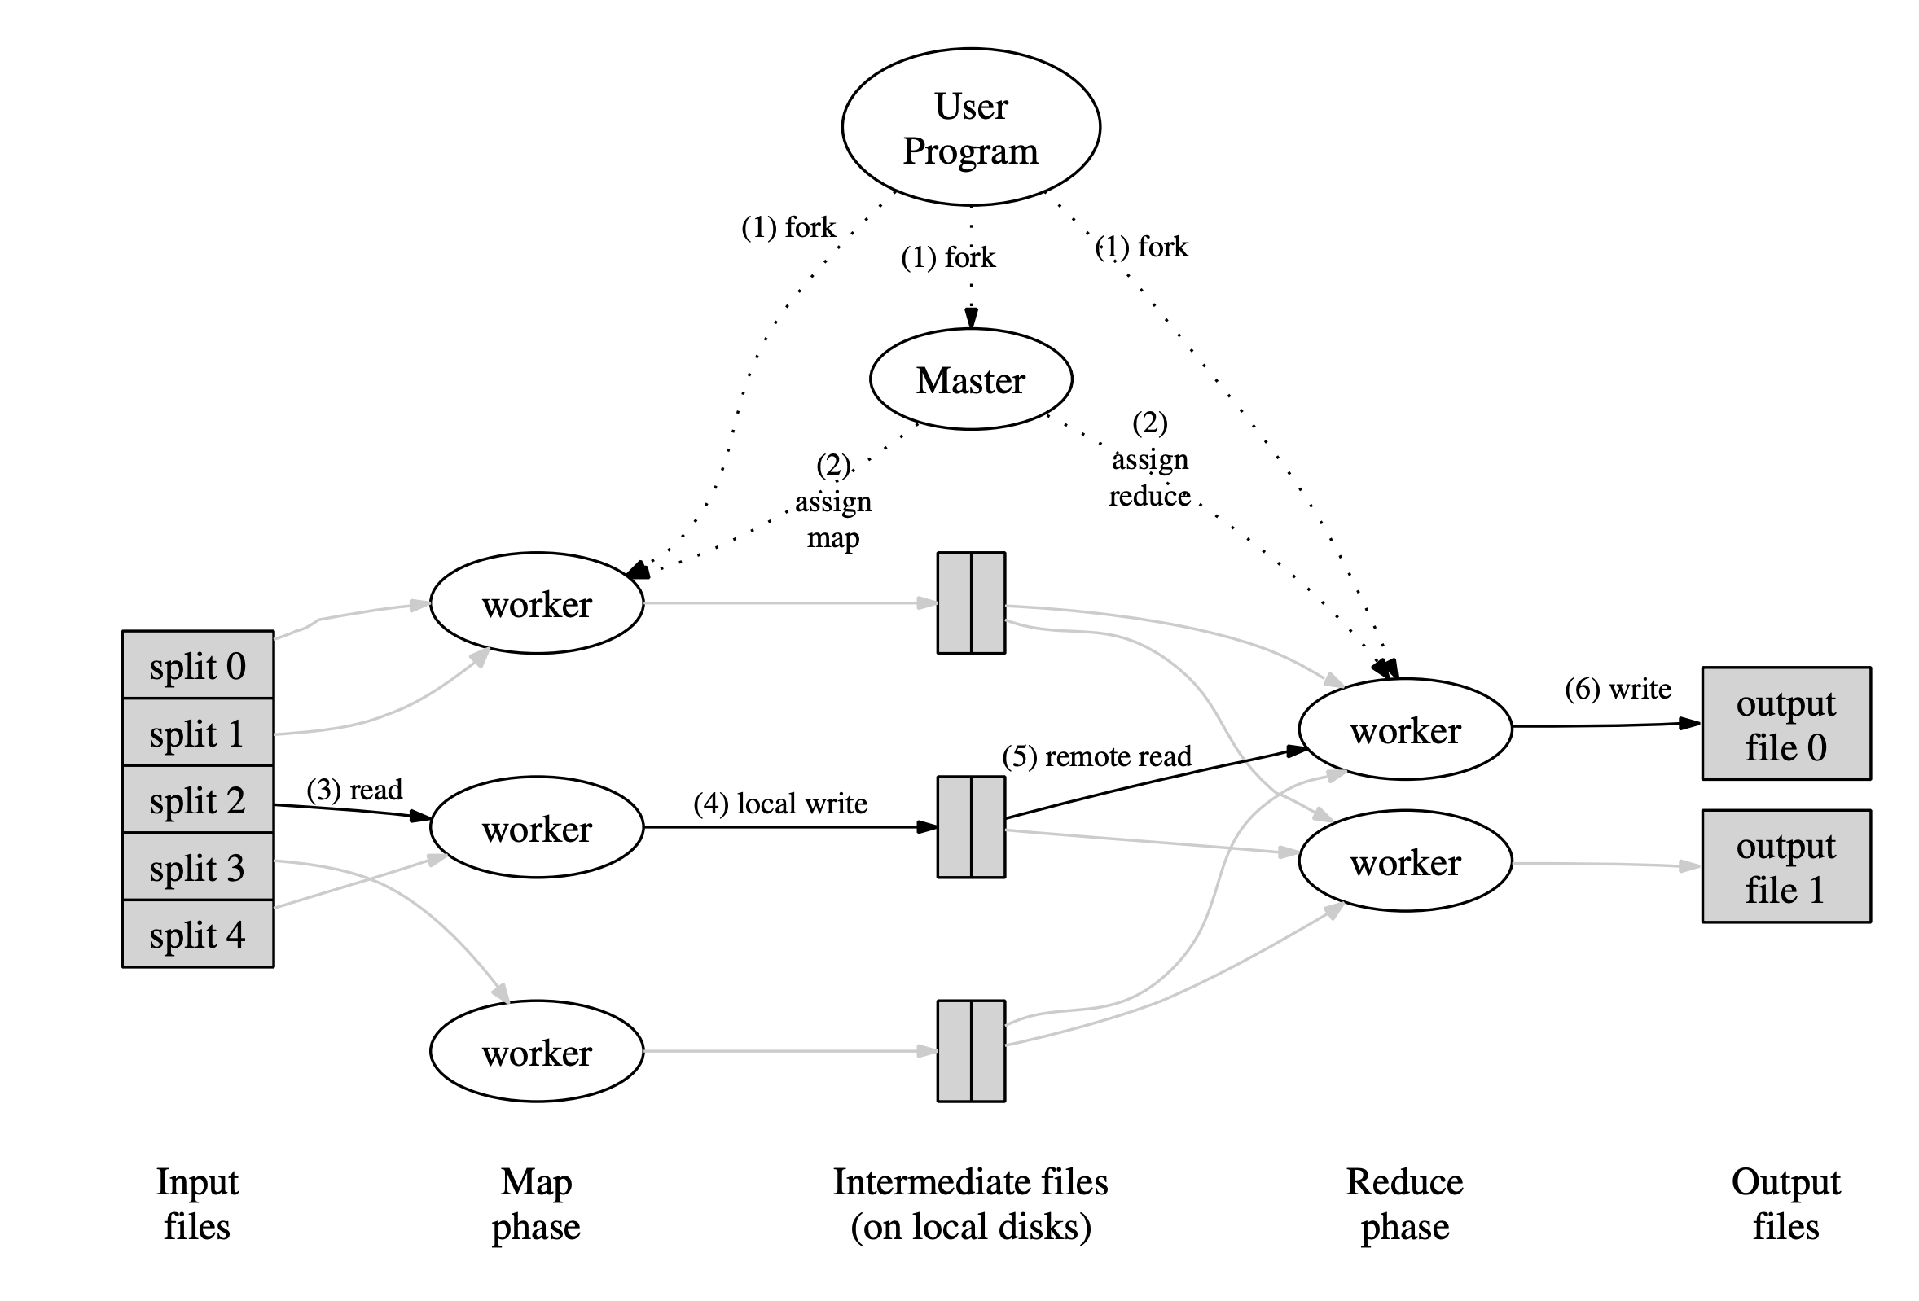
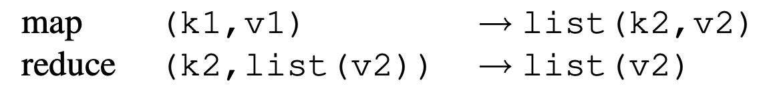
Abstraction borrowed from functional programming
Many different implementations exist
Key advantage of MapReduce: handle dist system issues!
Different (intermediate) key space
Same key space

Slide 18
Processing steps in MapReduce
Input data consumed from a distributed filesystem
Master ships code to the worker node closest to data, if possible (CPU, memory constraints permitting)
Each mapper partitions its input data by the reducer key
Typically through a hash function, e.g., hash (key) mod R == r
Sort output data (per partition) by the key; run map function
Reducers are informed of partial result at each mapper
Reducer pulls files from mappers through RPC
Output persisted to distributed filesystem (typically involves replication)
Result: R output files in the DFS (one per reducer partition)

Slide 19
Implementation Key Principles
Data locality
Reduce network bandwidth: ship code to data
Locally persist (not DFS) intermediate results
Handle failures by re-doing compute
No fancy hardware fault tolerance (e.g., RAID)
Mapper failure: restart map job
Assume deterministic operations
Reducer failure (after completion): no problem (DFS)
Identify and skip shards with deterministic faults
Mitigate stragglers through eager replication of compute close to job completion
Combiners at mapper: preliminary reduce for associative and commutative functions

Slide 20
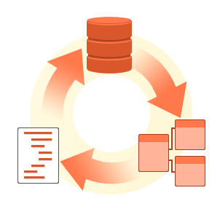
More examples of using map-reduce
Database Joins
Example: user activity (e.g. URLs) with user information (e.g. age)
Grouping (GROUPBY) aggregations:
Count, sum, etc
Creating the sequence of events in a user session, determining whether e.g. a new version of a web page resulted in better sales
Large distributed sorting
Output sorting after mapper: important!

Slide 21
Building on Map-Reduce: (1) Workflows
One Map-Reduce job isn’t usually enough
Google web search index: pipeline of 10 jobs; recommendation systems: 50—100
Workflows: Chains of map-reduce jobs
E.g., one MR for counting requests by URL; another to sort count
Explicit output files from each?
Like writing to file at the end of each tool in Unix pipeline
Materialization of the intermediate results needed?
Stragglers make workflows slower
Separate systems needed just to orchestrate the workflows correctly

Slide 22
Building on Map-Reduce: (2) Dataflow
Dataflow engines: handle the entire workflow
“Operators”: chain map-reduce functions
Only persist intermediate outputs to DFS when necessary
Chain reducers (no explicit mappers) when the key is the same
Don’t wait for stragglers of the previous job
Stream Processing
Incremental execution of batch jobs when new data arrives
Selectively materialize or recompute intermediate results
Lineages (RDD/Spark) or checkpoint

