Slide 1

Persistence

Slide 2
Abstractions
Resource management
(isolation; efficiency)
Virtualization (CPU, memory)
Concurrency
Interaction with Devices
Store data users care about: persist beyond reboots
Disks and Persistence
Backing store for paging
Space multiplexing
(coexist)
Shared view of storage!
Permissions
Intelligence in software, mostly

Slide 3
Motivation
What good is a computer without any I/O devices?
- keyboard, display, disks
We want:
- H/W that will let us plug in different devices
- OS that can interact with different combinations

Slide 4
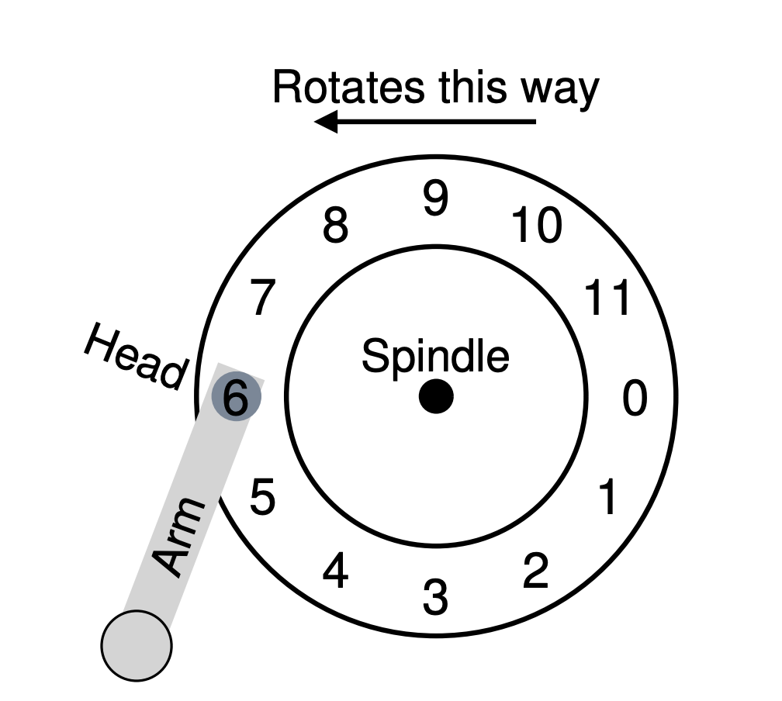
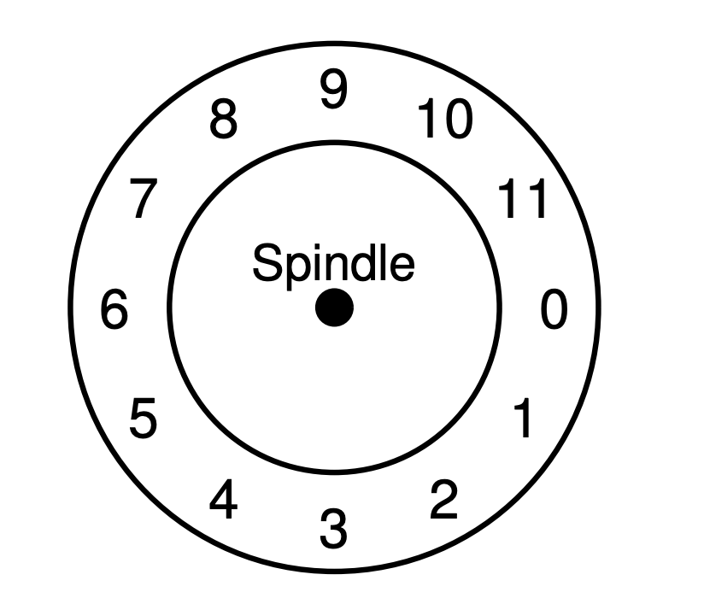
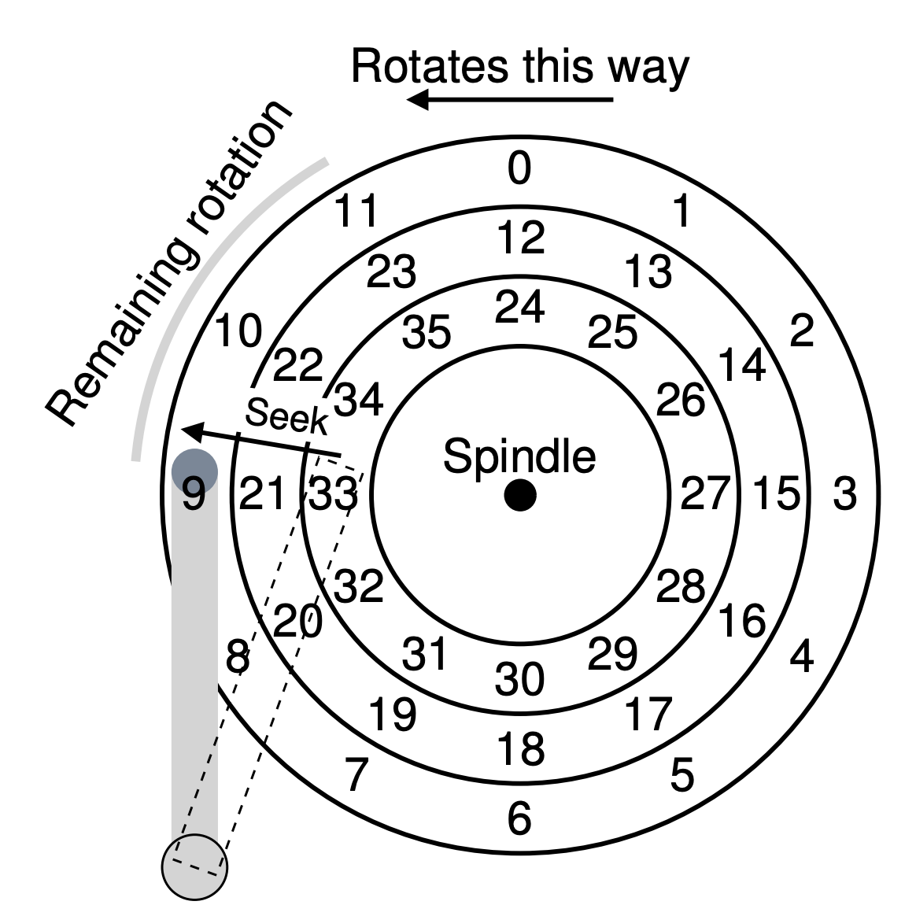
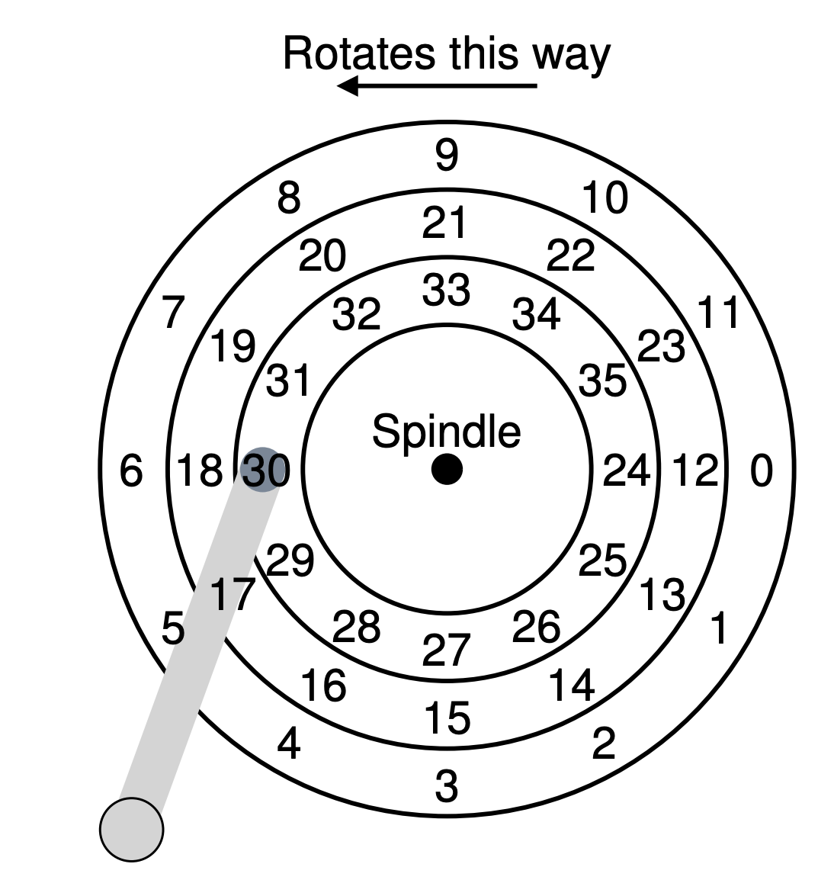
Disk
sector

Slide 5
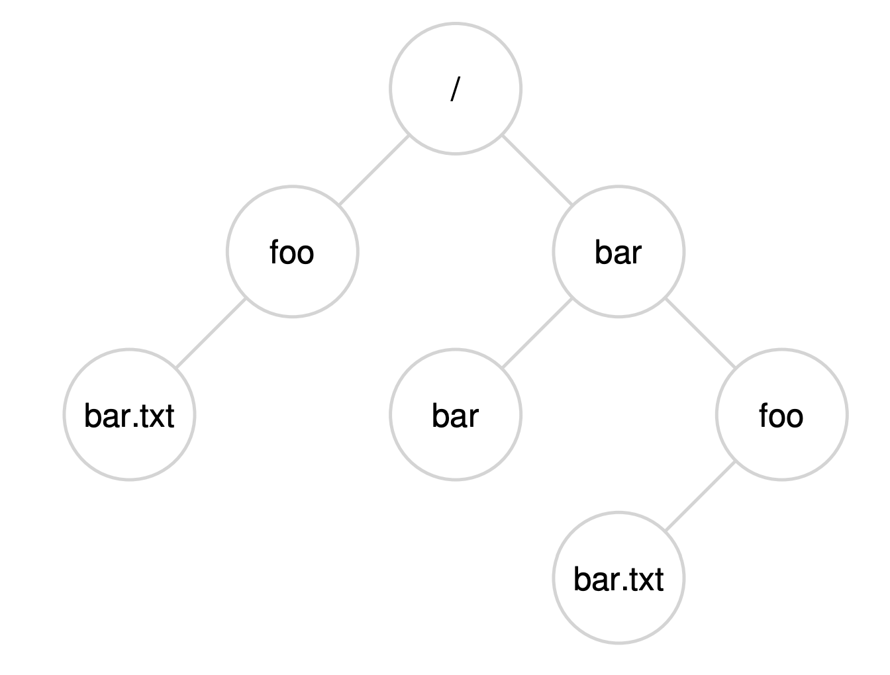
Filesystems
Abstractions over blocks of data
Flat mapping of name to blocks? E.g. hash table
Something a bit more flexible:
A hierarchy
creat(), open(),
read(), write(),
mkdir(), readdir(), …
link(), unlink()

Slide 6
Filesystems
Why are file systems useful?
- Durability across restarts
- Naming and organization
- Sharing among programs and users
Why interesting?
- Crash recovery
- Performance
- API design for sharing
- Security for sharing
Abstraction is useful: pipes, devices,
/proc, /afs, etc.

Slide 7
Filesystems
API example -- UNIX/Posix/Linux/xv6/&c:
- fd = open("x/y", -);
- write(fd, "abc", 3);
- link("x/y", "x/z");
- unlink("x/y");
- Plan 9 OS (Bell labs) - Attempts to structure entire OS as a filesystem
- http://plan9.bell-labs.com/plan9/

Slide 8
Questions for filesystems
What on-disk structures to represent files and directories?
Contiguous, Extents, Linked, FAT, Indexed, Multi-level indexed
Which are good for different metrics?
What disk operations are needed for:
make directory
open file
write/read file
close file

Slide 9
FS Implementation
1. On-disk structures
- how does file system represent files, directories?
2. Access methods
- what steps must reads/writes take?

Slide 10
Part 1: Disk Structures

Slide 11
Persistent Store
Given: large array of blocks on disk
Want: some structure to map files to disk blocks
D
D
D
D
D
D
D
D
D
D
D
D
D
D
D
D
0
7
8
15
D
D
D
D
D
D
D
D
D
D
D
D
D
D
D
D
16
23
24
31
D
D
D
D
D
D
D
D
D
D
D
D
D
D
D
D
32
39
40
47
D
D
D
D
D
D
D
D
D
D
D
D
D
D
D
D
48
55
56
63

Slide 12
Similarity to Memory?
Same principle: map logical abstraction to physical resource
Physical View
Process 1
Process 3
Process 2
Logical View: Address Spaces

Slide 13
On-Disk Structures
- data block
- inode table
- indirect block
- directories
- data bitmap
- inode bitmap
- superblock

Slide 14
FS Structs: Empty Disk
D
D
D
D
D
D
D
D
D
D
D
D
D
D
D
D
0
7
8
15
D
D
D
D
D
D
D
D
D
D
D
D
D
D
D
D
16
23
24
31
D
D
D
D
D
D
D
D
D
D
D
D
D
D
D
D
32
39
40
47
D
D
D
D
D
D
D
D
D
D
D
D
D
D
D
D
48
55
56
63
Assume each block is 4KB

Slide 15
Data Blocks
D
D
D
D
D
D
D
D
D
D
D
D
D
D
D
D
0
7
8
15
D
D
D
D
D
D
D
D
D
D
D
D
D
D
D
D
16
23
24
31
D
D
D
D
D
D
D
D
D
D
D
D
D
D
D
D
32
39
40
47
D
D
D
D
D
D
D
D
D
D
D
D
D
D
D
D
48
55
56
63

Slide 16
Inodes
D
D
D
I
I
I
I
I
D
D
D
D
D
D
D
D
0
7
8
15
D
D
D
D
D
D
D
D
D
D
D
D
D
D
D
D
16
23
24
31
D
D
D
D
D
D
D
D
D
D
D
D
D
D
D
D
32
39
40
47
D
D
D
D
D
D
D
D
D
D
D
D
D
D
D
D
48
55
56
63

Slide 17
One Inode Block
Each inode is typically 256 bytes (depends on the FS, maybe 128 bytes)
4KB disk block
16 inodes per inode block.
inode
16
inode
17
inode
18
inode
19
inode
20
inode
21
inode
22
inode
23
inode
24
inode
25
inode
26
inode
27
inode
28
inode
29
inode
30
inode
31

Slide 18
Inode
type (file or dir?)
uid (owner)
rwx (permissions)
size (in bytes)
Blocks
time (access)
ctime (create)
links_count (# paths)
addrs[N] (N data blocks)

Slide 19
Inodes
D
D
D
I
I
I
I
I
D
D
D
D
D
D
D
D
0
7
8
15
D
D
D
D
D
D
D
D
D
D
D
D
D
D
D
D
16
23
24
31
D
D
D
D
D
D
D
D
D
D
D
D
D
D
D
D
32
39
40
47
D
D
D
D
D
D
D
D
D
D
D
D
D
D
D
D
48
55
56
63

Slide 20
Inode
type
uid
rwx
size
blocks
time
ctime
links_count
addrs[N]
Assume single level (just pointers to data blocks)
What is max file size?
Assume 256-byte inodes (all can be used for pointers)
Assume 4-byte addrs
How to get larger files?
256 / 4 = 64
64 * 4K = 256 KB!

Slide 21
inode
data
data
data
data

Slide 22
inode
indirect
indirect
indirect
indirect
Indirect blocks are stored in
regular data blocks.
what if we want to
optimize for small files?

Slide 23
inode
data
data
data
indirect
Better for small files

Slide 24
Inode
type
uid
rwx
size
Blocks (optional)
time
ctime
links_count
direct_ptr[N]
indirect_ptr[N+X]
//Some stat structure

Slide 25
Assume 256 byte inodes (16 inodes/block).
What is offset for inode with number 0?
D
D
D
I
I
I
I
I
D
D
D
D
D
D
D
D
0
7
8
15
D
D
D
D
D
D
D
D
D
D
D
D
D
D
D
D
16
23
24
31
D
D
D
D
D
D
D
D
D
D
D
D
D
D
D
D
32
39
40
47
D
D
D
D
D
D
D
D
D
D
D
D
D
D
D
D
48
55
56
63

Slide 26
Assume 256 byte inodes (16 inodes/block). What is offset for inode with number 4?
D
D
D
I
I
I
I
I
D
D
D
D
D
D
D
D
0
7
8
15
D
D
D
D
D
D
D
D
D
D
D
D
D
D
D
D
16
23
24
31
D
D
D
D
D
D
D
D
D
D
D
D
D
D
D
D
32
39
40
47
D
D
D
D
D
D
D
D
D
D
D
D
D
D
D
D
48
55
56
63

Slide 27
Assume 256 byte inodes (16 inodes/block).
What is offset for inode with number 40?
D
D
D
I
I
I
I
I
D
D
D
D
D
D
D
D
0
7
8
15
D
D
D
D
D
D
D
D
D
D
D
D
D
D
D
D
16
23
24
31
D
D
D
D
D
D
D
D
D
D
D
D
D
D
D
D
32
39
40
47
D
D
D
D
D
D
D
D
D
D
D
D
D
D
D
D
48
55
56
63

Slide 28
File Organization: The inode
Each inode is referred to by inode number.
by inode number, File system calculate where the inode is on the disk.
Ex: inode number: 32
Calculate the offset into the inode region (32 x sizeof(inode) (256 bytes) = 8192
Add start address of the inode table(12 KB) + offset into inode region = 20 KB
The Inode table
iblock 0
iblock 1
iblock 2
iblock 3
iblock 4
Super | i-bmap | d-bmap | 0 | 1 | 2 | 3 | 16 | 17 | 18 | 19 | 32 | 33 | 34 | 35 | 48 | 49 | 50 | 51 | 64 | 65 | 66 | 67
 |  |  | 4 | 5 | 6 | 7 | 20 | 21 | 22 | 23 | 36 | 37 | 38 | 39 | 52 | 53 | 54 | 55 | 68 | 69 | 70 | 71
 |  |  | 8 | 9 | 10 | 11 | 24 | 25 | 26 | 27 | 40 | 41 | 42 | 43 | 56 | 57 | 58 | 59 | 72 | 73 | 74 | 75
 |  |  | 12 | 13 | 14 | 15 | 28 | 29 | 30 | 31 | 44 | 45 | 46 | 47 | 60 | 61 | 62 | 63 | 76 | 77 | 78 | 79
0KB
4KB
8KB
12KB
16KB
20KB
24KB
28KB
32KB

Slide 29
Directories
File systems vary
Common design: Store directory entries in data blocks
Large directories just use multiple data blocks
Use bit in inode to distinguish directories from files
Various formats could be used
- lists
- b-trees

Slide 30
Simple Directory List Example
valid
name
inode
1
.
134
1
..
35
1
foo
80
1
bar
23
unlink(“foo”)

Slide 31
Hard links and Soft (symbolic) links
Hard Link :
A hard link acts as a copy (mirrored) of the selected file. It accesses the data available in the original file.
If earlier selected file is deleted, the hard link to the file will still contain the data of that file.
ln /path/to/source /path/to/link
Soft Link :
A soft link (also known as symbolic link) acts as a pointer or a reference to the file name. It does not access the data available
in the original file. If the earlier file is deleted, the soft link will be pointing to a file that does not exist anymore
ln -s /path/to/source /path/to/link

Slide 32
Allocation
How do we find free data blocks or free inodes?
Free list
Bitmaps
Tradeoffs!

Slide 33
Bitmaps?
D
D
D
I
I
I
I
I
D
D
D
D
D
D
D
D
0
7
8
15
D
D
D
D
D
D
D
D
D
D
D
D
D
D
D
D
16
23
24
31
D
D
D
D
D
D
D
D
D
D
D
D
D
D
D
D
32
39
40
47
D
D
D
D
D
D
D
D
D
D
D
D
D
D
D
D
48
55
56
63

Slide 34
Opportunity for Inconsistency
D
i
d
I
I
I
I
I
D
D
D
D
D
D
D
D
0
7
8
15
D
D
D
D
D
D
D
D
D
D
D
D
D
D
D
D
16
23
24
31
D
D
D
D
D
D
D
D
D
D
D
D
D
D
D
D
32
39
40
47
D
D
D
D
D
D
D
D
D
D
D
D
D
D
D
D
48
55
56
63
(Need file system checking)

Slide 35
Superblock
Need to know basic FS configuration metadata, like:
- block size
- # of inodes
Store this in superblock

Slide 36
Superblock – Real FS (also FUSE)
Struct superblock{
start address of inode bitmap
start address of data block bitmap
start address of inode region
start address of data block region
//Anything else that is required
}

Slide 37
Superblock
S
i
d
I
I
I
I
I
D
D
D
D
D
D
D
D
0
7
8
15
D
D
D
D
D
D
D
D
D
D
D
D
D
D
D
D
16
23
24
31
D
D
D
D
D
D
D
D
D
D
D
D
D
D
D
D
32
39
40
47
D
D
D
D
D
D
D
D
D
D
D
D
D
D
D
D
48
55
56
63

Slide 38
On-Disk Structures
Super Block
Data Bitmap
Data Block
directories
indirects
Inode Bitmap
Inode Table

Slide 39
Part 2 : Operations
- create file
- write
- open
- read
- close
How do they affect the data structures in the filesystem?

Slide 40
create /foo/bar
data
inode
root
foo
bar
root
foo
bitmap
bitmap
inode
inode
inode
data
data
read
read
read
read
read
write
write
read
write
write
What needs to be read and written?

Slide 41
open /foo/bar
data
inode
root
foo
bar
root
foo
bar
bitmap
bitmap
inode
inode
inode
data
data
data
read
read
read
read
read

Slide 42
write to /foo/bar (assume file exists and has been opened)
data
inode
root
foo
bar
root
foo
bar
bitmap
bitmap
inode
inode
inode
data
data
data
read
read
write
write
write

Slide 43
read /foo/bar – assume opened
data
inode
root
foo
bar
root
foo
bar
bitmap
bitmap
inode
inode
inode
data
data
data
read
read
write

Slide 44
close /foo/bar
data
inode
root
foo
bar
root
foo
bar
bitmap
bitmap
inode
inode
inode
data
data
data
nothing to do on disk!

Slide 45
Efficiency
How can we avoid this excessive I/O for basic ops?
Cache for:
- reads
- write buffering

Slide 46
Write Buffering
Why does procrastination help?
Overwrites, deletes, scheduling
Shared structs (e.g., bitmaps+dirs) often overwritten.
We decide: how much to buffer, how long to buffer…
- tradeoff durability vs. performance

Slide 47
How to allocate file data to disk blocks?

Slide 48
Allocation Strategies
Many different approaches
Contiguous
Extent-based
Linked
File-allocation Tables
Indexed
Multi-level Indexed
Questions
Amount of fragmentation (internal and external) – freespace that can’t be used
Ability to grow file over time?
Performance of sequential accesses (contiguous layout)?
Speed to find data blocks for random accesses?
Wasted space for meta-data overhead (everything that isn’t data)?
Meta-data must be stored persistently too!

Slide 49
Contiguous Allocation
Allocate each file to contiguous sectors on disk
Meta-data:
OS allocates by finding sufficient free space
Must predict future size of file; Should space be reserved?
Example: IBM OS/360
Starting block and size of file
A
A
A
B
B
B
B
C
C
C
Fragmentation (internal and external)?
Ability to grow file over time?
Seek cost for sequential accesses?
Speed to calculate random accesses?
Wasted space for meta-data?
- Horrible external frag (needs periodic compaction)
- May not be able to without moving
+ Excellent performance
+ Simple calculation
+ Little overhead for meta-data

Slide 50
Small # of Extents
Allocate multiple contiguous regions (extents) per file
Meta-data:
Small array (2-6) designating each extent
Each entry: starting block and size
A
A
A
B
B
B
B
C
C
C
D
D
A
A
A
D
B
B
B
B
C
C
C
B
B
Fragmentation (internal and external)?
Ability to grow file over time?
Seek cost for sequential accesses?
Speed to calculate random accesses?
Wasted space for meta-data?
- Helps external fragmentation
- Can grow (until run out of extents)
+ Still good performance
+ Still simple calculation
+ Still small overhead for meta-data

Slide 51
Linked Allocation
Allocate linked-list of fixed-sized blocks (multiple sectors)
Meta-data:
Examples: TOPS-10, Alto
Location of first block of file
Each block also contains pointer to next block
D
D
A
A
A
D
B
B
B
B
C
C
C
B
B
D
B
D
Fragmentation (internal and external)?
Ability to grow file over time?
Seek cost for sequential accesses?
Speed to calculate random accesses?
Wasted space for meta-data?
+ No external frag (use any block); internal?
+ Can grow easily
+/- Depends on data layout
- Ridiculously poor
- Waste pointer per block
Trade-off: Block size (does not need to equal sector size)
Notes:
Larger --> ??
Smaller --> ??

Slide 52
File-Allocation Table (FAT)
Variation of Linked allocation
Keep linked-list information for all files in on-disk FAT table
Meta-data: Location of first block of file
And, FAT table itself
D
D
A
A
A
D
B
B
B
B
C
C
C
B
B
D
B
D
Draw corresponding FAT Table?
Comparison to Linked Allocation
Same basic advantages and disadvantages
Disadvantage: Read from two disk locations for every data read
Optimization: Cache FAT in main memory
Advantage: Greatly improves random accesses
What portions should be cached? Scale with larger file systems?

Slide 53
Indexed Allocation
Allocate fixed-sized blocks for each file
Meta-data:
Allocate space for ptrs at file creation time
Fixed-sized array of block pointers
D
D
A
A
A
D
B
B
B
B
C
C
C
B
B
D
B
D
Advantages
No external fragmentation
Files can be easily grown up to max file size
Supports random access
Disadvantages
Large overhead for meta-data:
Wastes space for unneeded pointers (most files are small!)

Slide 54
Multi-Level Indexing
Variation of Indexed Allocation
Dynamically allocate hierarchy of pointers to blocks as needed
Meta-data: Small number of pointers allocated statically
Additional pointers to blocks of pointers
Examples: UNIX FFS-based file systems, ext2, ext3
double indirect
indirect
indirect
triple indirect
Comparison to Indexed Allocation
Advantage: Does not waste space for unneeded pointers
Still fast access for small files
Can grow to what size??
Disadvantage: Need to read indirect blocks of pointers to calculate addresses (extra disk read)
Keep indirect blocks cached in main memory

Slide 55
Flexible # of Extents
Modern file systems: Dynamic multiple contiguous regions (extents) per file
Organize extents into multi-level tree structure
Each leaf node: starting block and contiguous size
Minimizes meta-data overhead when have few extents
Allows growth beyond fixed number of extents
Fragmentation (internal and external)?
Ability to grow file over time?
Seek cost for sequential accesses?
Speed to calculate random accesses?
Wasted space for meta-data?
+ Both reasonable
+ Can grow
+ Still good performance
+/- Some calculations depending on size
+ Relatively small overhead

Slide 56
Assume Multi-Level Indexing
Simple approach
More complex file systems build from these basic data structures

Slide 57
Summary/Future
We’ve described a very simple FS.
- basic on-disk structures
- the basic ops
Future questions:
- how to handle crashes?

Slide 58
Summary
Using multiple types of name provides
- convenience
- efficiency
Mount and link features provide flexibility.
Special calls (fsync, rename) let developers communicate special requirements to file system

