Slide 1

The Application Layer: Sockets, DNS
Lecture 3
http://www.cs.rutgers.edu/~sn624/352-S22
Srinivas Narayana

Slide 2


Application-layer Protocol
Message format:
Syntax: what fields in messages & how fields are delineated
Semantics: meaning of information in fields
Actions: when and how processes send & respond to messages
Public-domain protocols:
defined in RFCs
allows for interoperability
e.g., HTTP, SMTP
Proprietary protocols:
e.g., Skype

Slide 3



Application Addresses
We usually think of an application executing on a single endpoint
However, applications can reside on, say, 2 different endpoints connected by a network
In order to communicate, need to identify the communicating parties
Telephone network: phone number (10 digits)
Computer network: IP address
IPv4 (32 bits) 128.6.24.78
IPv6 (128 bits) 2001:4000:A000:C000:6000:B001:412A:8000
Suppose there is more than one networked program executing on a host
In addition to host address, we need one more address
“Which Program to talk to?”
Identity for an application: port number + IP addr
Host / house (IP address)
App / person (port #)

Slide 4

IP address & port number
Host
Host
process
socket
P4
process
process
Processes
P1
socket
socket
P2
Host
Operating system
Internet
process
A socket is the door between
OS/network and the application process
The application’s programming interface to the network
socket
P3

Slide 5
An app-layer connection is a 4-tuple
Host: IP address B
Host:: IP address A
process
socket
process
process
socket
socket
Host: IP address C
Internet
process
socket
Connection := (IP_{S}, Port_{S}, IP_{D}, Port_{D})
_{(S = source, D = destination)}

Slide 6




Socket system calls
Process A (client)
connect()
send()
Process B
(server)
bind(IPaddr, port)
listen()
accept()
recv()
process
process
IP addr + port
socket
socket
IP addr + port

Slide 7
Seeing app-layer connections
netstat

Slide 8
Recall: Apps rely on services by lower layers
Host A
Host B
Application
Layer
Application Protocol
Application
Layer
Transport
Layer
Transport Protocol
Transport
Layer
Within the operating system of respective endpoint or router
Network
Layer
Network
Layer
Network
Layer
Network
Layer
H-to-N
Layer
H-to-N
Layer
H-to-N
Layer
H-to-N
Layer
Router
Router

Slide 9
Common Architectures of Applications

Slide 10
Client-server architecture
client
Server:
Always-on endpoint
Provides a “service” to the world
Typically permanent IP address
Compute clusters to scale to many users
Clients:
A “customer” of the server
May be intermittently connected
May have dynamic IP addresses
Typically do not communicate directly with other clients
The web (HTTP) works this way!
Many mobile apps too (e.g., Instagram)
server
client

Slide 11
Peer-to-peer (P2P) architecture
peer
Peers:
Intermittently connected hosts
Directly talking to each other
Little to no reliance on always-up servers
Examples: BitTorrent, Skype
Today, many applications use a hybrid model
Example: Skype “supernodes”
peer

Slide 12
Going forward: A few applications
Domain Name System
The web: HTTP
Mail
Streaming video

Slide 14
Domain Name System

Slide 15
“You have my name. Can you lookup my address?”

Slide 16
Domain Name System (DNS)
Problem statement:
Average brain can easily remember 7 digits for a few names
On average, IP addresses have 12 digits
We need an easier way to remember IP addresses
Solution:
Use alphanumeric names to refer to hosts. Called host names or domain names
Example: cs.rutgers.edu
We need a directory (address book): add a service to map between alphanumeric host names and binary IP addresses
We call this process Address Resolution

Slide 17

Types of Directories
Directories map a name to an address
Simplistic designs
Central directory
Ask everyone (e.g., flooding)
Tell everyone (e.g., push to a file like /etc/hosts)
Scalable distributed designs
Hierarchical namespace (e.g., Domain Name System (DNS))
Flat name space (e.g., Distributed Hash Table)

Slide 18
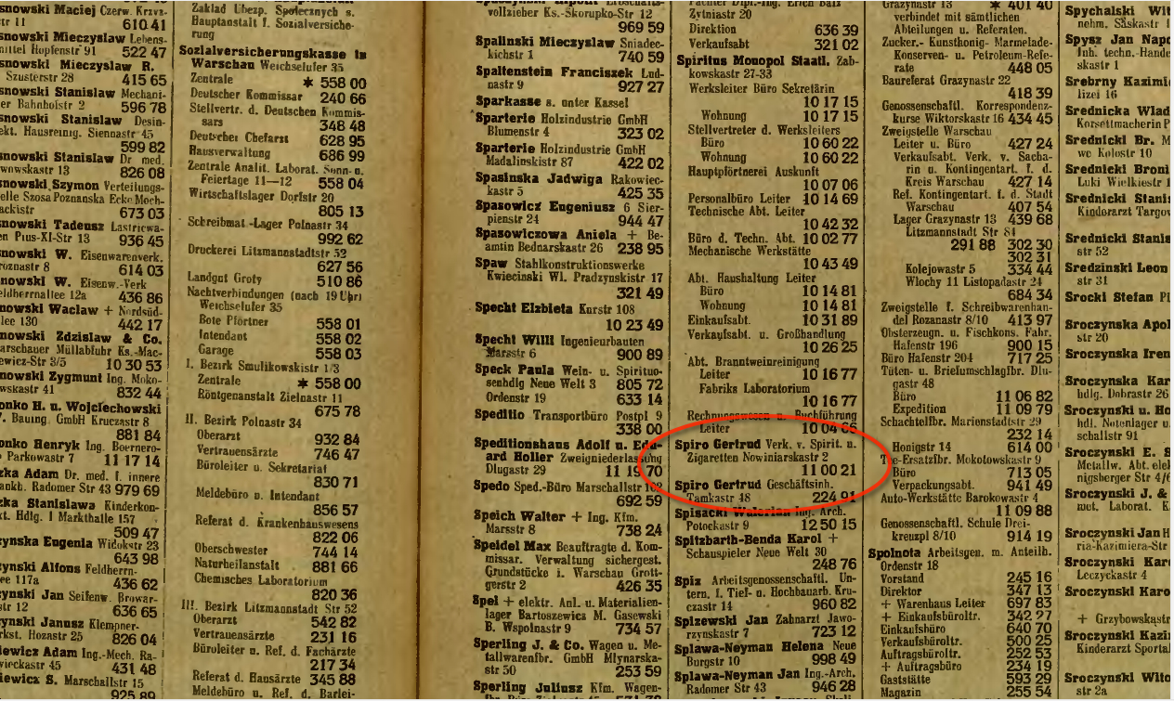
Simple DNS
What if every endpoint has a local directory?
/etc/hosts.txt
How things worked in the early days of the Internet!
What if endpoints changed addresses? How do you keep this up to date?

Slide 19
Simple DNS
DOMAIN NAME | IP ADDRESS
spotify.com | 98.138.253.109
cs.rutgers.edu | 128.6.4.2
www.google.com | 74.125.225.243
www.princeton.edu | 128.112.132.86
<Client IP, CPort, DNS server IP, 53>
QUERY cs.rutgers.edu
<DNS server, 53, Client IP, Cport>
RESPONSE 128.6.4.2
Key idea: Implement a server that looks up a table.
Will this scale?
Every new host needs to be entered in this table
Performance: can the server serve billions of Internet users
Failure: what if the server or the database crashes?
How to secure this server?

Slide 20
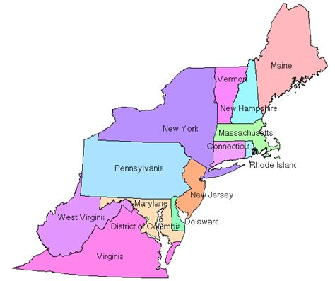

Distributed and hierarchical database
Root DNS Servers
Top-level domain (TLD) servers
com DNS servers
org DNS servers
edu DNS servers
google.com
DNS servers
wnyc.org
DNS servers
rutgers.edu
DNS servers
umass.edu
DNS servers
amazon.com
DNS servers
cs.rutgers.edu DNS server
Authoritative name server
RFC 1034: Distribution through hierarchy enables scaling

Slide 21
DNS Protocol
Client and Server
Client connects to Port 53 on server
Assume DNS server IP known
Two types of messages
Queries
Responses
Type of Query (OPCODE)
Standard query (0x0)
e.g., Request IP address for a given domain name
Updates (0x5)
Provide a binding of IP address to domain name
Each type has a common message format that follows the header

Slide 22
DNS Protocol
When client wants to know an IP address for a host name
Client sends a DNS query to the “local” name server in its network
If name server contains the mapping, it returns the IP address to the client
Otherwise, the name server forwards the request to the root name server
The request works its way down the tree toward the host until it reaches a name server with the correct mapping

Slide 23
Example
root DNS server
2
Host at cs.rutgers.edu wants IP address for gaia.cs.umass.edu
Local DNS server
Root DNS server
TLD DNS server
Authoritative DNS server
3
.edu DNS server
4
5
local DNS server
dns.rutgers.edu
7
6
1
8
umass.edu DNS server
dns.umass.edu
requesting host
cs.rutgers.edu
gaia.cs.umass.edu

Slide 24
Query type
root DNS server
2
Iterative query:
Contacted server replies with name of server to contact
“I don’t know this name, but ask this server”
Queries are iterative for the local DNS server
3
.edu DNS server
4
5
local DNS server
dns.rutgers.edu
7
6
1
8
umass.edu DNS server
dns.umass.edu
requesting host
cs.rutgers.edu
gaia.cs.umass.edu

Slide 25
Query type
root DNS server
Recursive query:
Puts burden of name resolution on the contacted name server
Problem: think about the root DNS server.
Must it answer every DNS query?
2
3
7
6
.edu DNS server
local DNS server
dns.rutgers.edu
5
4
1
8
umass.edu DNS server
dns.umass.edu
requesting host
cs.rutgers.edu
gaia.cs.umass.edu

Slide 26
DNS in action
dig <domain-name>
dig +trace <domain-name>
dig @<dns-server> <domain-name>

Slide 27




DNS may seem simple, but …

Slide 29
DNS Resource Records

Slide 30
DNS is a distributed database
DNS stores resource records (RRs)
(Incomplete) message format (headers):
Class, type, name, value, TTL
You can read all the gory details of the message format at https://www.iana.org/assignments/dns-parameters/dns-parameters.xhtml

Slide 31
DNS records
Type=A
name is hostname
value is IP address
Type=CNAME
name is alias name for some “canonical” (the real) name
e.g., www.ibm.com is really
servereast.backup2.ibm.com
value is canonical name
Type=AAAA
name is hostname
value is IPv6 address
Type=NS
name is domain (e.g. foo.com)
value is hostname of authoritative name server for this domain
Type=MX
value is name of mailserver associated with name
More complete info at https://www.iana.org/assignments/dns-parameters/dns-parameters.xhtml

Slide 32
DNS record example
NAME | Design.cs.rutgers.edu
TYPE | A
CLASS | IN
TTL | 1 day(86400)
ADDRESS | 192.26.92.30
RRs in response
to query
records for
authoritative servers
Information about nameserver
NAME | Cs.rutgers.edu
TYPE | NS
CLASS | IN
TTL | 1 day(86400)
NSDNAME | Ns-lcsr.rutgers.edu
DNS serves as a general repository of information for the Internet!

Slide 33
DNS record types
dig –t <type> <domain-name>

Slide 34
DNS caching and updating records
Once (any) name server learns a name to IP address mapping, it caches the mapping
Cache entries timeout (disappear) after some time
TLD servers typically cached in local name servers
In practice, root name servers aren’t visited often

Slide 35
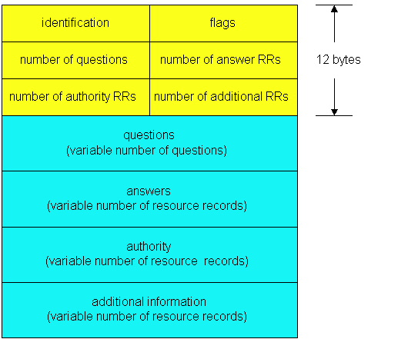
DNS protocol messages
DNS protocol : query and reply messages, both with same message format
QR
Opcode
Message header
QR = 0 for Query, 1 for response
Opcode= 0 standard
identification: 16 bit # for query, reply to query uses same #
flags:
Authoritative answer
recursion desired
recursion available
reply is authoritative

Slide 36
DNS protocol, messages
QR
OPCODE
Name, type fields
for a query
RRs in response
to query
records for
authoritative servers
Information about nameserver
additional “helpful”
info that may be used

Slide 37
Bootstrapping DNS
How does a host contact the name server if all it has is the domain name and no (name server) IP address?
IP address of at least 1 nameserver (usually, a local resolver) must be known a priori
The name server may be bootstrapped “statically”, e.g.,
File /etc/resolv.conf in unix
Start -> settings-> control panel-> network ->TCP/IP -> properties in windows
… or with another protocol!
DHCP: Dynamic Host Configuration Protocol (more on this later)

Slide 38
Summary of DNS
Hostname to IP address translation via a global network of servers
Use Multiple layers of indirection
Hierarchically scale
Good performance (load distribution)
Resilient to local transient failure
Additional load distribution can happen at each level (e.g., TLD server)
Uses caching all over for better performance
DNS can be used to implement useful primitives atop domain names:
Example: Scaling large web services, e.g., google search
Domain-authoritative server will return an address from a pool of IP addresses, for example from Google’s server “farm”

Slide 39
Some themes and observations on DNS
Request/response nature of the protocol
How messages are structured: simple, text-based protocol
Similar in HTTP, SMTP, FTP
Load distribution through hierarchy and replication
Caching is an effective method to improve performance

