Slide 1

The Application Layer: SMTP, Multimedia
Lecture 7 http://www.cs.rutgers.edu/~sn624/352-S22
Srinivas Narayana

Slide 2



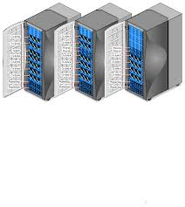

Quick recap of concepts
HyperText Transfer Protocol (HTTP)
Caching
e.g., proxy server
Origin’s DNS
CDN name servers
App layer
Ask the CDN
Here’s your nearest CDN cache server
Content Distribution Networks
Origin servers
Simple Mail Transfer Protocol (SMTP)
CDN servers
Clients
Sender’s mail server
Recipient’s mail server
SMTP
Sender’s user agent
SMTP
Recipient’s user agent
??

Slide 3
Mail Access Protocols

Slide 4
Mail access protocols
POP3 or IMAP4
SMTP
SMTP
access
protocol
user
agent
user
agent
Bob
Alice
sender’s mail
server
receiver’s mail
server
SMTP: delivery/storage to receiver’s server. Focused on push
Mail access protocol: pull from server
POP: Post Office Protocol [RFC 1939]
Client connects to POP3 server on TCP port 110
IMAP: Internet Mail Access Protocol [RFC 1730]
Client connects to TCP port 143
HTTP: gmail, outlook, etc.

Slide 5
POP vs IMAP
POP3
Stateless server
UA-heavy processing
UA retrieves email from server, then typically deleted from server
Latest changes are at the UA
Simple protocol (list, retr, del within a POP session)
IMAP4
Stateful server
UA and server processing
Server sees folders, etc. which are visible to UAs
Latest changes are at the server
Complex protocol
Heavily used: email sync across devices, reliable, …

Slide 6
What about web-based email?
Connect to mail servers via web browser
Ex: gmail, scarletmail, etc.
Browsers speak HTTP
Email servers speak SMTP
Need to bridge these two

Slide 7


Web based email
Application process on the web server machine uses SMTP to push mail
HTTP
HTTP
Alice
alice@scarletmail.rutgers.edu
Bob
HTTP server
scarletmail.rutgers.edu
HTTP server
outlook.com
App process on the web server uses access protocol to pull email
May run on the same or different machines
(owned by your
webmail provider)
SMTP
Client/Server
aspmx4.googlemail.com
SMTP server
outlook-com.olc.protection.outlook.com
IMAP
Bob
bob@outlook.com
Internet
Alice’s mail provider’s server(s)
Bob’s mail provider’s server(s)

Slide 8
Comparing SMTP with HTTP
HTTP: pull
SMTP: push
both have ASCII command/response interaction, status codes
HTTP: each object encapsulated in its own response msg
SMTP: multiple objects sent in multipart msg
HTTP: can put non-ASCII data directly in response (dedicated entity body for binary data)
SMTP: need ASCII-based encoding (base64)

Slide 9
More themes from app-layer protocols
Keep it simple until you really need complexity
Start with ASCII-based design; stateless servers. Then introduce:
Cookies for HTTP state
Stateful mail (IMAP, folders, etc.) for email organization
Security extensions (e.g., HTTPS, IMAPS, SMTPS, …)
Performance optimizations: persistence, caching, indirection, …
Use headers as much as possible to non-intrusively evolve functionality
Partition functions based on what’s done best at the user (app), protocol, and infrastructure. Examples:
Content rendering for users (browser, UA) separate from protocol operations (mail server)
Mail UAs don’t need to be always on to send or receive email reliably. That’s the mail server’s job (an “infrastructure” concern)

Slide 10
Multimedia: Data Representations

Slide 11




Multimedia networking
Many applications on the Internet use audio or video
IP video traffic will be 82 percent of all IP traffic […] by 2022, up from 75 percent in 2017
CCTV traffic over the Internet will increase sevenfold between 2017 to 2022
Internet video to TV will increase threefold between 2017 to 2022.
Consumer Video-on-Demand (VoD) traffic will nearly double by 2022
Source: Cisco visual networking index 2017--22
11

Slide 12
What’s different about these applications?
Traditional applications (HTTP(S), SMTP)
Delay tolerant but not loss tolerant
Data used after transfer complete
Multimedia applications are often real time
Data delivery time during transfer matters for user experience
Video/audio streaming
Delay-sensitive
Real-time audio and video
Delays > 400 ms for audio is a bad user experience
Somewhat loss tolerant
12

Slide 13
Digital representation of audio and video

Slide 14
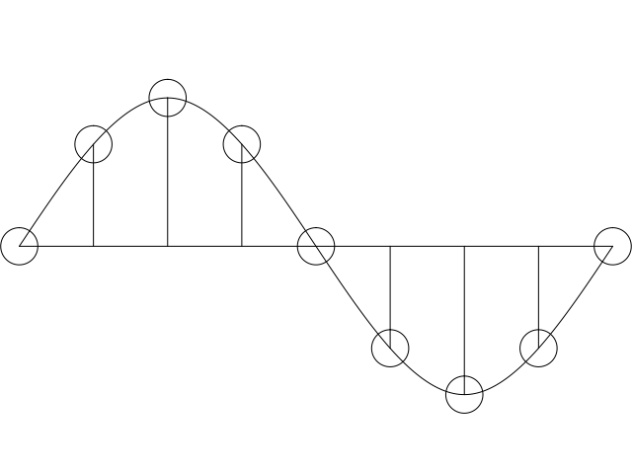
Digital representation of audio
Must convert analog signal to digital representation
Sample
How many times (twice the max frequency in the signal)
Quantize
How many levels or bits to represent each sample
More levels ➔ more accuracy
More levels ➔ more bits to store & need more bandwidth to transmit
Compress
Compact representation of quantized values
14

Slide 15
Audio representation
analog audio signal sampled at constant rate
telephone: 8,000 samples/sec
CD music: 44,100 samples/sec
each sample quantized, i.e., rounded
e.g., 2⁸=256 possible quantized values
each quantized value represented by bits, e.g., 8 bits for 256 values
quantization error
quantized value of
analog value
analog
signal
audio signal amplitude
time
sampling rate
(N sample/sec)

Slide 16
Audio representation
example: 8,000 samples/sec, 256 quantized values
Bandwidth needed: 64,000 bps
receiver converts bits back to analog signal:
some quality reduction
Example rates
CD: 1.411 Mbps
MP3: 96, 128, 160 Kbps
Internet telephony: 5.3 Kbps and up
quantization error
quantized value of
analog value
analog
signal
audio signal amplitude
time
sampling rate
(N sample/sec)

Slide 17

Video representation
Video: sequence of images displayed at constant rate
e.g., 30 images/sec
Appear continuous due to the stroboscopic effect
frame i
frame i+1

Slide 18
Video representation
spatial coding example: instead of sending N values of same color (all purple), send only two values: color value (purple) and number of repeated values (N)
Digital image: array of pixels
each pixel represented by bits
Encode luminance and color
Number of pixels: resolution
Coding: use redundancy within and between images to decrease # bits used to encode image
spatial (within image)
temporal (from one image to next)
Coding/decoding algorithm
often called a codec
……………………...…
……………………...…
frame i
temporal coding example: instead of sending complete frame at i+1, send only differences from frame i (motion vectors)
frame i+1

Slide 19
Video codecs: terminology
Video bit rate: effective number of bits per second of the video after encoding
It depends on many factors
Resolution of each image: more pixels = more bits
Detail per pixel: better luminance & color detail = more bits
Amount of movement in the video. More movement = more bits
Quality of overall compression in the codec
Video bit rate is typically correlated with quality of perception.
Higher bit rate == better to perceive

Slide 20
Bit-rates: terminology
Bit-rate of a video changes over the duration of the video
CBR: (constant bit rate): fixed bit-rate video
VBR: (variable bit rate): different parts of the video have different bit rates, e.g., changes in color, motion, etc.
For VBR, we talk about average bit-rate over video’s duration
Examples of average video bit-rates
MPEG 1 (CD-ROM) 1.5 Mbps. MPEG2 (DVD) 3-6 Mbps
MPEG4 (often used in Internet, < 1 Mbps)
In general, one Internet video stream takes up a few Mbit/s (unless HD)
https://blog.video.ibm.com/streaming-video-tips/what-is-video-encoding-codecs-compression-techniques/

Slide 21
Networking multimedia: 3 types
On-demand streamed video/audio
Can begin playout before downloading the entire file
Ful video/audio stored at the server: able to transmit faster than audio/video will be rendered (with storing/buffering at client)
e.g., Spotify, YouTube, Netflix
Conversational voice or video over IP
interactive human-to-human communication limits delay tolerance
e.g., Zoom, Google Stadia
Live streamed audio, video
e.g, sporting event on sky sports
Can buffer a little, but must be close to the “live edge” of content

Slide 22
On-demand Video Streaming

Slide 23
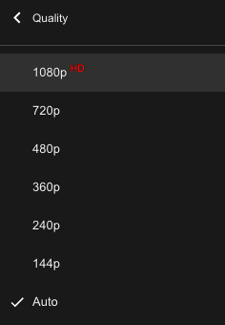
Streaming (stored) video
Media is prerecorded at different qualities
Available in storage at the server
Client downloads an initial portion and starts viewing
The rest is downloaded as time progresses
No need for user to wait for entire content to be downloaded!
Can change the quality of the content and where it’s fetched mid-stream
More on this soon

Slide 24


Streaming stored video
Constant bit rate video
Cumulative data (e.g. bytes)
Client
e.g., your phone
2. video
sent
video
recorded (e.g., 30 frames/sec)
3. video received,
played out at client
(30 frames/sec)
network delay
(fixed in this example)
time
streaming: at this time, client
playing out early part of video,
while server still sending later
part of video
Server
e.g. Netflix

Slide 25
Streaming stored video: challenges
Continuous playout constraint: once client playout begins, playback must match the original timing of the video (why?)
But network delays are variable!
Clients have a client-side buffer of downloaded video to absorb variation in network conditions
Client interactivity: pause, fast-forward, rewind, jump through video

Slide 26
Scenario 1: Constant bit-rate video
constant bit
rate video
transmission
client video
reception
constant bit
rate video
playout at client
Cumulative data
variable
network
delay
buffered
video
client playout
delay
time
Client-side buffering with playout delay:
compensate for network-added delays and variations in the delay

Slide 27
Scenario 2: Small playout delay
constant bit
rate video
transmission
client video
reception
constant bit
rate video
playout at client
Cumulative data
variable
network
delay
buffered
video
client playout
delay
time
Playout delay that’s too small can cause stalls
There’s nothing in the buffer to show to the user

Slide 28

Client-side buffering, playout
buffer fill level, B(t)
variable fill
rate, x(t)
playout rate,
e.g., CBR r
video server
Client’s
buffer, size B_{max}
client
Most video is broken up in time into multiple segments
Client downloads video segment by segment
For example: a segment might be 4 seconds worth of video.

Slide 29
Client-side buffering, playout
buffer fill level, B(t)
variable fill
rate, x(t)
playout rate,
e.g., CBR r
video server
Client’s
buffer, size B_{max}
client
1. Initial fill of buffer until playout begins at t_{p}
2. playout begins at t_{p}
3. buffer fill level varies over time as fill rate x(t) varies (assume playout rate r is constant for now)

Slide 30
Client-side buffering, playout
buffer fill level, B(t)
variable fill
rate, x(t)
playout rate,
e.g., CBR r
video server
Client’s
buffer, size B_{max}
playout buffering: average fill rate (x), playout rate (r):
x < r: buffer eventually empties for a sufficiently long video. Stall and rebuffering
x > r: buffer will not empty, provided the initial playout delay is large enough to absorb variability in x(t)
initial playout delay tradeoff: buffer starvation less likely with larger delay, but also incur a larger delay until the user begins watching

Slide 31
Client-side buffering, playout
buffer fill level, B(t)
variable fill
rate, x(t)
playout rate,
e.g., CBR r
video server
Client’s
buffer, size B_{max}
playout buffering: average fill rate (x), playout rate (r):
is x < r or x > r for a given network connection?
It is hard to predict this in general!
Best effort network suffers long queues, paths with low bandwidth, …
How to set playout rate r?
Too low a bit-rate r: video has poorer quality than needed
Too high a bit-rate r: buffer might empty out. Stall/rebuffering!

Slide 32
Adaptive bit–rate video
Motivation: Want to provide high quality video experience, without stalls
Observations:
Videos come in different qualities (average bit rates)
Versions of the video for different quality levels readily available
Different segments of video can be downloaded separately
Adapt bit rate per segment through collaboration between the video client (e.g., your browser) and the server (e.g., @ Netflix)
Adaptive bit-rate (ABR) video: change the bit-rate (quality) of next video segment based on network and client conditions
A typical strategy: Buffer-based rate adaptation

Slide 33
Buffer-based bit-rate adaptation
Key idea: If there is a large stored buffer of video, optimize aggressively for video quality, i.e., high bit rates
Else (i.e., buffer has low occupancy), avoid stalls by being conservative and ask for a lower quality (bit-rate)
Hope: lower bandwidth requirement of a lower quality stream is satisfiable more easily

Slide 34
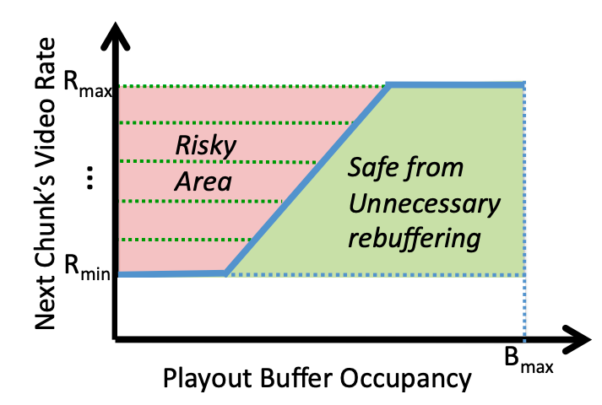
Buffer-based bit-rate adaptation
A highly effective method to provide high video quality despite variable and intermittently poor
network conditions.
Used by Netflix.
http://yuba.stanford.edu/~nickm/papers/sigcomm2014-video.pdf
A Buffer-Based Approach to Rate Adaptation

