Slide 1

Congestion Control
Lecture 15 http://www.cs.rutgers.edu/~sn624/352-S22
Srinivas Narayana

Slide 2


Quick recap of concepts
TCP:
Reliability
Ordering
Reordering degrades connection throughput. Apps can’t recv().
Packets may even be dropped due to insufficient buffering.
Tp layer
recv()
SEQ 0
Packet boundaries
SEQ 1
SEQ 2
SEQ 3
RTT
ACK 1
ACK 2
ACK 3
ACK 4
How much data to keep in flight?
Sequence numbers
Stream-Oriented Transport

Slide 3



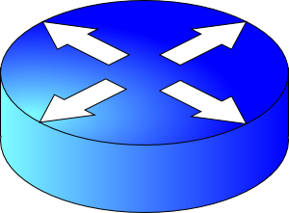
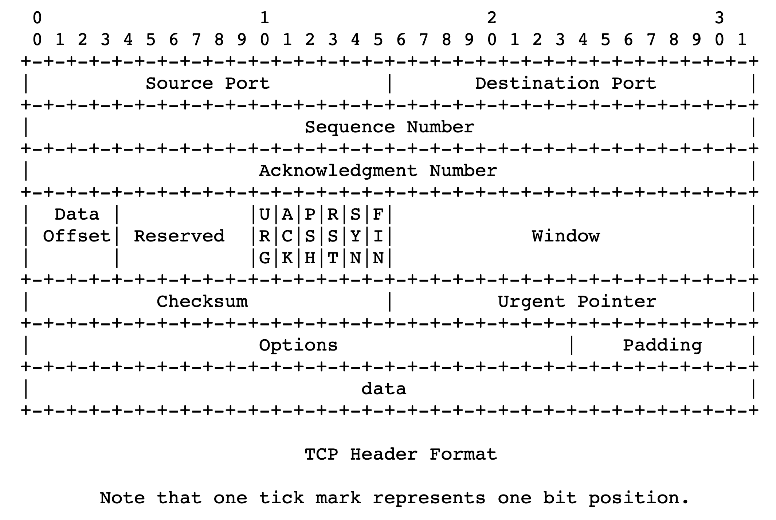
sender
Multiple locations for bottlenecks
application
process
recv()
Congestion Control
TCP socket
receiver buffers
Flow Control
What’s the bottleneck? How to adapt how much data to keep in flight?
TCP
code
from sender
Flow Control: Receiver informs sender free buffer over time
Last transmitted
seq #
receiver
Last cumulative
ACK’ed seq #
Buffer >= desired W
Sender’s view:
0
1
2
3
4
5
6
7
0
1
Low socket buffering
==
Poor TCP throughput
Window <= Advertised window

Slide 4

Congestion
Routers have buffers which accommodate queued packets.
∞
Max amount of useful data that link can support, ~ link rate
Packets get dropped beyond max buffer
Too many retransmissions due to packet drops!
Amount of useful (fresh) data plummets.
Congestion collapse
Amount of useful data that gets across to the receiver
Queueing delay
~100%
~100%
Link load
Fraction of link used (link load)
https://en.wikipedia.org/wiki/Network_congestion#Congestive_collapse

Slide 5
How should multiple endpoints share net?
It is difficult to know where the bottleneck link is
It is difficult to know how many other endpoints are using that link
Endpoints may join and leave at any time
Network paths may change over time, leading to different bottleneck links (with different link rates) over time

Slide 6
The approach that the Internet takes is to use a distributed algorithm to converge to an efficient and fair outcome.

Slide 7
The approach that the Internet takes is to use a distributed algorithm to converge to an efficient and fair outcome.
No one can centrally view or control all the endpoints and bottlenecks in the Internet.
Every endpoint must try to reach a globally good outcome by itself: i.e., in a distributed fashion.
This also puts a lot of trust in endpoints.

Slide 8
The approach that the Internet takes is to use a distributed algorithm to converge to an efficient and fair outcome.
If there is spare capacity in the bottleneck link, the endpoints should use it.

Slide 9
The approach that the Internet takes is to use a distributed algorithm to converge to an efficient and fair outcome.
If there are N endpoints sharing a bottleneck link, they should be able to get equitable shares of the link’s capacity.
For example: 1/N’th of the link capacity.

Slide 10
Flow Control vs. Congestion Control
Avoid overwhelming the receiving application
Sender is managing the receiver’s socket buffer
Avoid overwhelming the bottleneck network link
Sender is managing the bottleneck link capacity and bottleneck router buffers

Slide 11
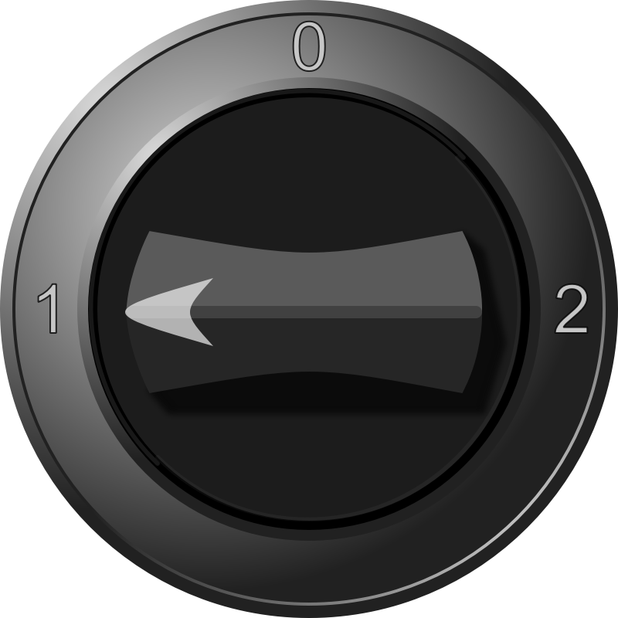


The approach that the Internet takes is to use a distributed algorithm to converge to an efficient and fair outcome.
H
C
How to achieve this?
Approach: sense and react
Example: taking a shower
Use a feedback loop with signals and knobs

Slide 12
Signals and Knobs in Congestion Control
Signals
Packets being ACK’ed
Packets being dropped (e.g. RTO fires)
Packets being delayed (RTT)
Rate of incoming ACKs
Knobs
What can you change to “probe” the available bottleneck capacity?
Suppose receiver buffer is unbounded:
Increase window/sending rate: e.g., add x or multiply by a factor of x
Decrease window/sending rate: e.g., subtract x or reduce by a factor of x
Implicit feedback signals measured directly at sender.
(There are also explicit signals that the network might provide.)

Slide 13
Sense and react, sure…but how?
H
Where do you want to be?
The steady state
How do you get there?
Congestion control algorithms
Sense accurately
React proportionately
C

Slide 14
Subsequent modules/lectures
Feedback loops used by 2 important TCPs
TCP New Reno and TCP BBR
Strategies to react “proportionately” to network signals like loss
Fast retransmit and fast recovery
Strategies to measure loss accurately
How to predict the RTT of a packet successfully received (in the future)?

Slide 15
The Steady State
Efficiency of a single TCP conversation

Slide 16
What does efficiency look like?
Suppose we want to achieve an efficient outcome for one TCP conversation by observing network signals from the endpoint
Q: How should the endpoint behave at steady state?
Challenge: bottleneck link is remotely located

Slide 17
Steady state: Ideal goal
High sending rate: Use the full capacity of the bottleneck link
Low delay: Minimize the overall delay of packets to get to the receiver
Overall delay = propagation + queueing + transmission
Assume propagation and transmission components fixed
“Low delay” reduces to low queueing delay
i.e., don’t push so much data into the network that packets have to wait in queues
Key question: When to send the next packet?

Slide 18
When to send the next packet?
T
Fast link
Bottleneck link
1. Send packet burst (as allowed by window)
Inter-packet delay T
2. Receive data packet
5. Send data packet on ACK
Data
Sender
T
T
Receiver
T
4. Receive ACK
3. Send ACK
ACKs

Slide 19
Rationale
When the sender receives an ACK, that’s a signal that the previous packet has left the bottleneck link (and the rest of the network)
Hence, it must be safe to send another packet without congesting the bottleneck link
Such transmissions are said to follow packet conservation
ACK clocking: “Clock” of ACKs governs packet transmissions

Slide 20
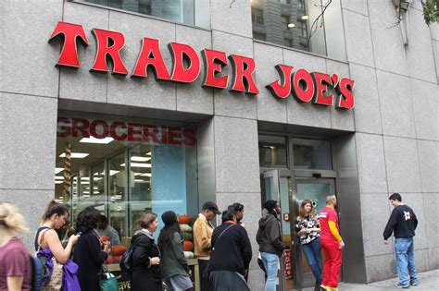
ACK clocking: analogy
How to avoid crowding a grocery store?
Strategy: Send the next waiting customer exactly when a customer exits the store
However, this strategy alone can lead to inefficient use of resources…

Slide 21
ACK clocking alone can be inefficient
Sender pushing data slowly
T
Large delay T
Send data packet on ACK
Data
Sender
T
T
Receiver
T
ACKs

Slide 22
ACK clocking alone can be inefficient
Sender pushing data slowly
T
Large delay T
Send data packet on ACK
Data
Sender
Receiver
The sending rate should be high enough to keep the “pipe” full
Analogy: a grocery store with only 1 customer in entire store
If the store isn’t “full”, you’re using store space inefficiently

Slide 23
Steady State of Congestion Control
Send at the highest rate possible (to keep the pipe full)
while being ACK-clocked (to avoid congesting the pipe)
So, how to get to steady state?

Slide 24
Getting to Steady State
The Feedback Loop

Slide 25
An example of a feedback loop
You
H
C
Signals:
Water temperature
Water pressure
Knobs:
Turn temperature up/down
Open the tap wider
Your bathroom shower

Slide 26
The congestion control feedback loop
TCP congestion control algorithm
Signals:
ACKs
Loss (RTOs), etc.
Knobs:
Sending rate
Congestion window
Bottleneck link

Slide 27
Congestion window
The sender maintains an estimate of the amount of in-flight data needed to keep the pipe full without congesting it.
This estimate is called the congestion window (cwnd)
Recall: There is a relationship between the sending rate (throughput) and the sender’s window: sender transmits a window’s worth of data over an RTT duration
Rate = window / RTT

Slide 28
Interaction b/w flow & congestion control
Use window = min(congestion window, receiver advertised window)
Overwhelm neither the receiver nor network links & routers
Window <= Congestion window (congestion control)
Window <= Advertised window (flow control)
Sender’s view:
0
1
2
3
4
5
6
7
0
1
Last cumulative
ACK’ed seq #
Last transmitted
seq #

