Slide 1

Network Layer: Router Design
Lecture 19 http://www.cs.rutgers.edu/~sn624/352-S22
Srinivas Narayana

Slide 2




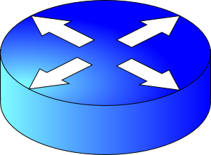
Quick recap of concepts
Network layer’s main function: moving data from one endpoint to another
Analogy: postal system
Net layer
Addressing (IPv4)
Locate, not identify
endpoint
Network
layer
endpoint
Forwarding
Routing
10000000 11000011 00000001 01010000
Data plane
Control plane
.
.
128
195
1
.
80
Classful
Classless (CIDR)
IP prefixes
==
zip code
128.195.0.0/20

Slide 3
Netmask (or subnet mask)
An alternative to denote the IP prefix length of an organization
32 bits: a 1-bit denotes a prefix bit position. 0 denotes host bit.
network
part
host
part
11001000 00010111 00010000 00000000
200.23.16.0/23
network part of mask
host part of mask
11111111 11111111 11111110 00000000
Netmask: 255.255.254.0

Slide 4
Detecting addresses from same network
Given IP addresses A and B, and netmask M.
1. Compute logical AND (A & M).
2. Compute logical AND (B & M).
3. If (A & M) == (B & M) then A and B are
on the same network.
Ex: A = 165.230.82.52, B = 165.230.24.93, M = 255.255.128.0
A and B are in the same network according to the netmask
A & M == B & M == 165.230.0.0
165.230.0.0 is the IP prefix of the network containing A and B

Slide 5
Finding your own IP address(es)
The old way (still works today on Mac and Linux):
ifconfig –a
The new way using “iproute2” tools on Linux:
ip link
ip addr
What else do you see in these outputs?

Slide 6
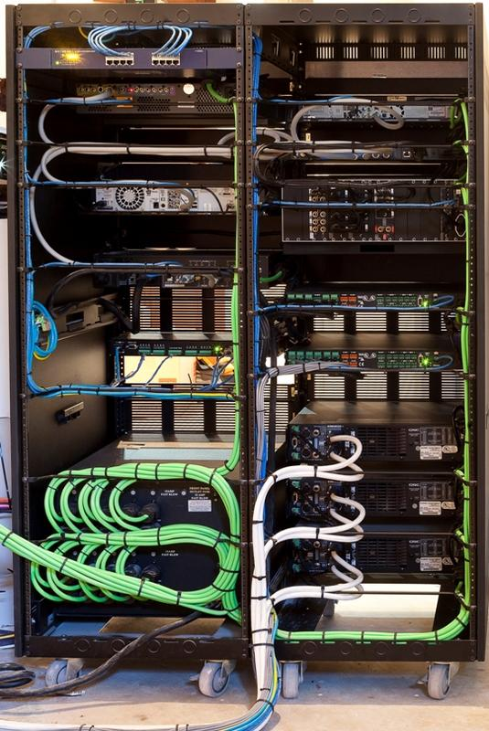
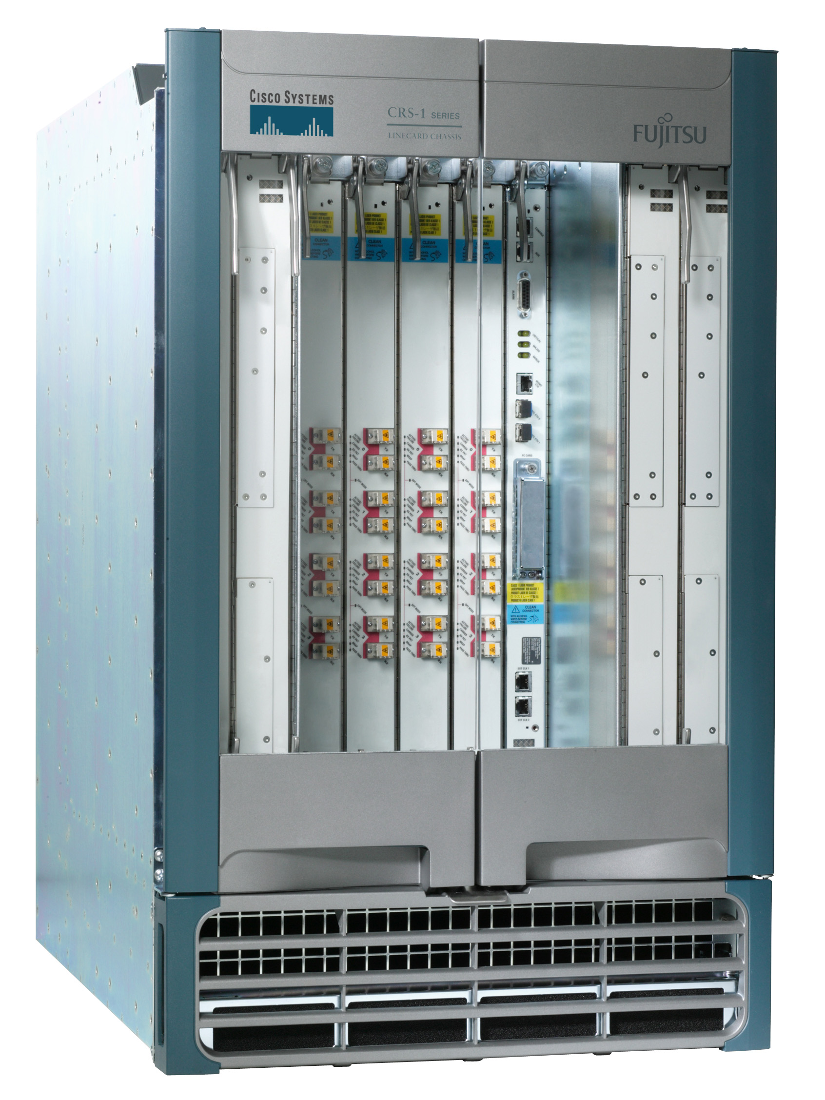
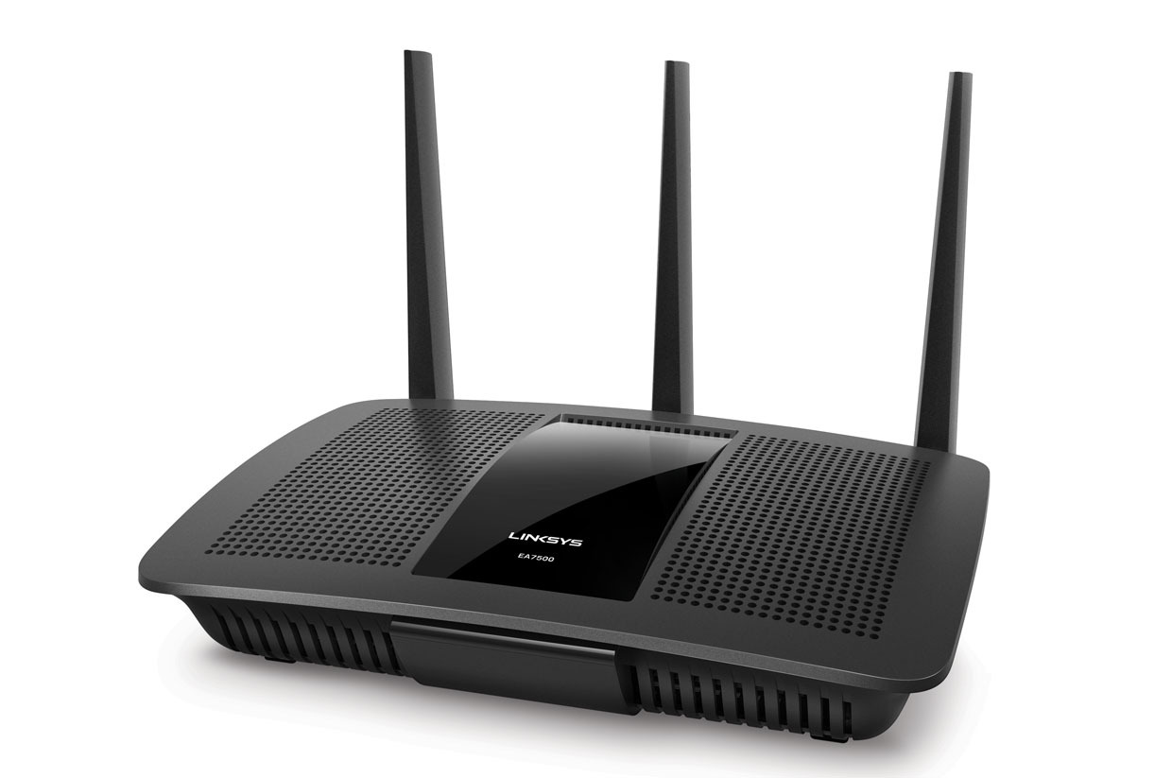
Next we’ll talk about routers
Access routers
Core router
Data center top-of-rack switch

Slide 7
What’s inside a router?

Slide 8
Router architecture overview
Review: assuming distributed routing, routing function: decide which ports packets need to exit
route
processor
Control plane
Data plane
Review: Forwarding function: move packets from one input port to another.
high-speed
switching
fabric
router input ports
router output ports

Slide 9
Different and evolving designs
There are different kinds of routers, with their own designs
Access routers (e.g., home WiFi), chassis/core routers, top-of-rack switches
Router designs have also evolved significantly over time
For simplicity and concreteness, we will learn about one high-speed router design from the early 2000s.
Called the MGR (multi-gigabit router). It could support an aggregate rate of 50 Gbit/s (1 G = 10⁹)
Today’s single-chip routers can support aggregate rates of ~10 Tbit/s (1 T = 10¹²)

Slide 10
Input port functions
Input port
Output port
Input port
Switching fabric
Output port
Line termination: receives physical (analog) signals and turns them into digital signals
Rate of link connecting to a single port termed line speed or line rate (modern routers: 100+ Gbit/s)
Link layer: performs medium access control functions (e.g., Ethernet)
…
…
Input port
Output port
Per-output
Queues
Line
Term
Link
Layer
/ MAC
(receive)
Route
lookup
switching
fabric

Slide 11
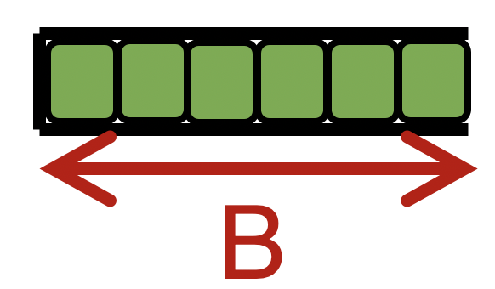

Input port functions
Input port
Output port
Input port
Switching fabric
Output port
Route lookup: high-speed lookup of which output port the packet is destined to
Goal: must complete this processing at the line rate
Queueing: packets may wait in per-output-port queues if packets are arriving too fast for the switching fabric to send them to the output port
…
…
Input port
Output port
Per-output
Queues
Line
Term
Link
Layer
/ MAC
(receive)
Route
lookup
switching
fabric

Slide 12

Route lookups
Route
lookup
Per-output
Queues
Line
Term
Link
Layer
Packet forwarding in the Internet is based on the destination IP address on the packet.
Example: if dst IP on packet is 65.45.145.34, it matches the forwarding table prefix 65.0.0.0/8.
The packet is forwarded out port 3.
Example 2: what about dst IP 128.9.5.6?
Parse
Transport
Extract destination IP address
Network
Link layer
Route Lookup Data Structure
Outgoing Port
Forwarding Table
Dst-network
Port
65.0.0.0/8
3
128.9.0.0/16
1
149.12.0.0/19
7

Slide 13
Route lookups
Route
lookup
Per-output
Queues
Line
Term
Link
Layer
Number of entries in the forwarding table matters.
Fitting into router memory
Designing hardware and software for fast lookups
Parse
Transport
Extract destination IP address
Network
Link layer
Route Lookup Data Structure
Outgoing Port
Forwarding Table
Dst-network
Port
65.0.0.0/8
3
128.9.0.0/16
1
149.12.0.0/19
7

Slide 14
Route lookups
Route
lookup
Per-output
Queues
Line
Term
Link
Layer
Recall: IP addresses can be aggregated based on shared prefixes.
The number of table entries in a router is proportional to the number of prefixes, NOT the number of endpoints.
Today: ~ 1 million prefixes.
Parse
Transport
Extract destination IP address
Network
Link layer
Route Lookup Data Structure
Outgoing Port
Forwarding Table
Dst-network
Port
65.0.0.0/8
3
128.9.0.0/16
1
149.12.0.0/19
7

Slide 15
Route lookups
Route
lookup
Per-output
Queues
Line
Term
Link
Layer
Destination-IP-based forwarding has consequences.
Forwarding behavior is independent of the source: legitimate source vs. malicious attack traffic
Forwarding behavior is independent of the application: web traffic vs. file download vs. video
IP-based packet processing is “baked into” router hardware: evolving the IP protocol faces tall deployment hurdles
Parse
Transport
Extract destination IP address
Network
Link layer
Route Lookup Data Structure
Outgoing Port
Forwarding Table
Dst-network
Port
65.0.0.0/8
3
128.9.0.0/16
1
149.12.0.0/19
7

Slide 16
Output port functions
Input port
Output port
Input port
Switching fabric
Output port
Components in reverse order of those in the input port
This is where most routers have the bulk of their packet buffers
Recall discussions regarding router buffers from transport
MGR uses per-port output buffers, but modern routers have shared memory buffers
More efficient use of memory under varying demands
…
…
Input port
Output port
Queues
Link
Layer
/ MAC
(transmit)
Line
Termination
Switching
fabric
To output link

Slide 17
Output port functions
Input port
Output port
Input port
Switching fabric
Output port
Two important policy decisions
Scheduling: which among the waiting packets gets to be transmitted out the link?
Ex: First-In-First-Out (FIFO)
Buffer management: which among the packets arriving from the fabric get space in the packet buffer?
Ex: Tail drop: later packets dropped first
…
…
Input port
Output port
Queues
Link
Layer
/ MAC
(transmit)
Line
Termination
Switching
fabric
To output link

Slide 18
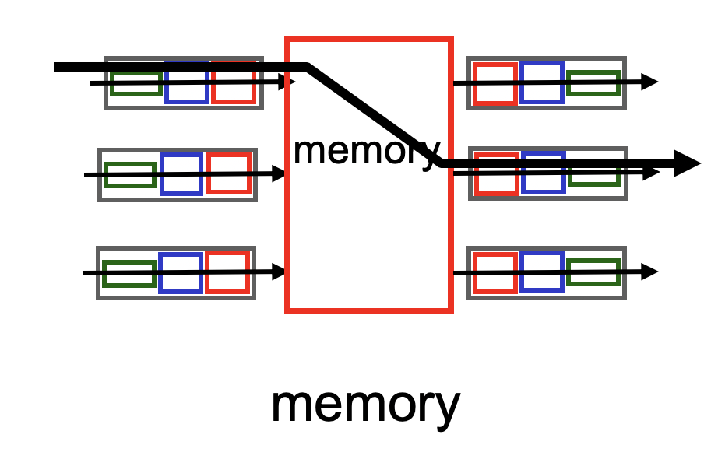
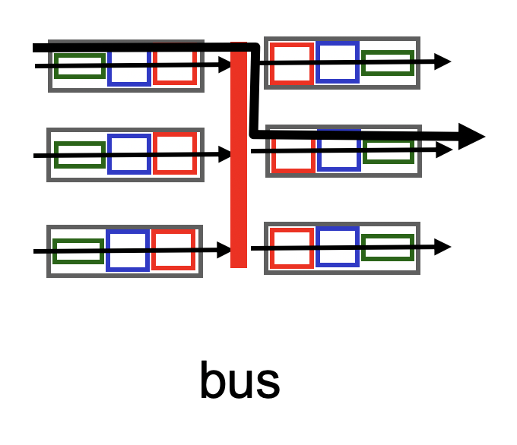
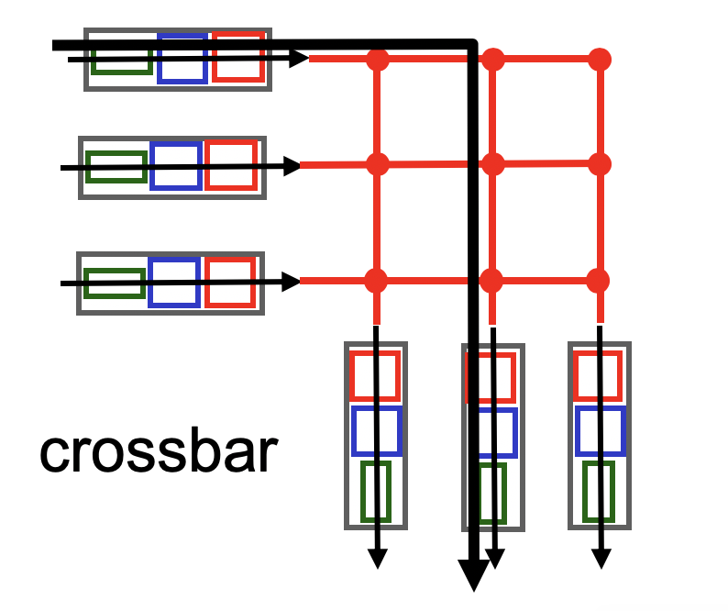
Fabrics: Types
Input port
Output port
Input port
Switching fabric
Output port
…
…
Fabric goal: Ferry as many packets as possible from input to output ports as quickly as possible.
Input port
Output port
Input port writes packets into shared memory.
Output port reads the packet when output link ready to transmit.
Single shared channel to move data from input to output port.
Easy to build buses; technology is quite mature.
Each input port has a physical data path to every output port.
Switch at the cross-over points turns on to connect pairs of ports.

Slide 19
Fabrics: Types
Input port
Output port
Input port
Switching fabric
Output port
…
…
Input port
Output port
Crossbars can get expensive as the number of ports grows (N² connections for N ports)
MGR uses a crossbar and schedules (in,out) port pairs.
Modern high-speed routers use highly optimized shared-memory-based interconnects.

Slide 20

Nonblocking fabrics
Input port
Output port
Input port
Switching fabric
Output port
…
…
Input port
Output port
High-speed switching fabrics designed to be nonblocking:
If an output port is “available”, an input port can always transmit to it without being blocked by the switching fabric itself
Crossbars are nonblocking by design
Shared memory can be designed to be nonblocking if memory is optimized to be fast enough

Slide 21
Nonblocking fabrics
Input port
Output port
Input port
Switching fabric
Output port
…
…
Input port
Output port
With a nonblocking fabric, queues aren’t formed due to the switching fabric.
With a nonblocking fabric, there are no queues due to inefficiencies at the input port or the switching fabric
Queues only form due to contention for the output port
Fundamental, unavoidable, given the route

Slide 22
Nonblocking fabrics
Input port
Output port
Input port
Switching fabric
Output port
…
…
Input port
Output port
With a nonblocking fabric, queues aren’t formed due to the switching fabric.
With a nonblocking fabric, there are no queues due to inefficiencies at the input port or the switching fabric
Queues only form due to contention for the output port
Fundamental, unavoidable, given the route
Typically, these queues form on the output side
But can also “backpressure” to the input side if there is high contention for the output port
i.e.: can’t move pkts to output Qs since buffers full, so buffer @ input

Slide 23
Control (plane) processor
A general-purpose processor that “programs” the data plane:
Forwarding table
Scheduling and buffer management policy
Implements the routing algorithm by processing routing protocol messages
Mechanism by which routers collectively solve the Internet routing problem
More on this soon.
Control Processor
Input port
Output port
Input port
Switching fabric
Output port
…
…
Input port
Output port

Slide 24

Router design: the bigger picture
Control plane
Traditional distributed routing: per route-change processing
(~ a few tens of seconds)
Routing
Algorithm
control
plane
data
plane
Data plane
per-packet processing
(~ tens of nanoseconds)
0111
1
3
2
values in arriving
packet header, i.e, destination IP address

Slide 25
Longest Prefix Matching

Slide 26
Review: Route lookup
Table lookup matches a packet against an IP prefix
Ex: 65.12.45.2 matches 65.0.0.0/8
Prefixes are allocated to organizations by Internet registries
But organizations can reallocate a subset of their IP address allocation to other orgs
Parse
Transport
Extract destination IP address
Network
Link layer
Route Lookup Data Structure
Outgoing Port
Forwarding Table
Dst-network
Port
65.0.0.0/8
3
128.9.0.0/16
1
149.12.0.0/19
7

Slide 27
Example of IP block reallocation
Dst IP Prefix | Output port
65.0.0.0/8 | 3
128.9.0.0/16 | 1
… | …
200.23.16.0/20 | 7 (towards A)
Suppose ISP A reallocates a part of its IP block to orgs 1… 8
ISP A owns the IP block 200.23.16.0/20.
Organization 1
200.23.16.0/23
Organization 2
200.23.18.0/23
[BGP] Send me pkts destined to
200.23.16.0/20
Organization 3
200.23.20.0/23
.
ISP A
.
.
.
.
Internet
.
Organization 8
200.23.30.0/23
There is an announcement mechanism (BGP) by which ISP A can inform the rest of the Internet about the prefixes it owns.
It is enough to announce a coarse-grained prefix 200.23.16.0/20 rather than 8 separate sub-prefixes.
Route Aggregation
Save forwarding table memory
Fewer routing protocol msgs

Slide 28
Example of IP block reallocation
Dst IP Prefix | Output port
65.0.0.0/8 | 3
128.9.0.0/16 | 1
… | …
200.23.16.0/20 | 7 (towards A)
Suppose ISP A reallocates a part of its IP block to orgs 1… 8
ISP A owns the IP block 200.23.16.0/20.
Organization 1
200.23.16.0/23
Organization 2
200.23.18.0/23
[BGP] Send me pkts destined to
200.23.16.0/20
Organization 3
200.23.20.0/23
.
ISP A
.
.
.
.
Internet
.
Organization 8
200.23.30.0/23
Now suppose one of these organizations adds another ISP for its Internet service and prefers using the new ISP.
Note: it’s possible for the organization to retain its assigned IP block.

Slide 29
Example of IP block reallocation
Dst IP Prefix | Output port
65.0.0.0/8 | 3
128.9.0.0/16 | 1
… | …
200.23.16.0/20 | 7 (towards A)
Suppose ISP A reallocates a part of its IP block to orgs 1… 8
ISP A owns the IP block 200.23.16.0/20.
Organization 1
200.23.16.0/23
Organization 2
200.23.18.0/23
[BGP] Send me pkts destined to
200.23.16.0/20
Organization 3
200.23.20.0/23
.
ISP A
.
.
.
.
Internet
.
Organization 8
200.23.30.0/23
[BGP] Announce 200.23.18.0/23
(besides other IP prefixes)
ISP B
Organization 2
200.23.18.0/23

Slide 30
Example of IP block reallocation
Dst IP Prefix | Output port
65.0.0.0/8 | 3
128.9.0.0/16 | 1
200.23.18.0/23 | 4 (towards B)
200.23.16.0/20 | 7 (towards A)
Suppose ISP A reallocates a part of its IP block to orgs 1… 8
ISP A owns the IP block 200.23.16.0/20.
Organization 1
200.23.16.0/23
Organization 2
200.23.18.0/23
[BGP] Send me pkts destined to
200.23.16.0/20
Organization 3
200.23.20.0/23
.
ISP A
.
.
.
.
Internet
.
Organization 8
200.23.30.0/23
[BGP] Announce 200.23.18.0/23
(besides other IP prefixes)
ISP B
Organization 2
200.23.18.0/23

Slide 31
A closer look at the forwarding table
200.23.18.0/23 is inside 200.23.16.0/20
A packet with destination IP address 200.23.18.xx is in both prefixes
i.e., both entries match
Q: How should the router choose to forward the packet?
The org prefers B, so should choose B
Dst IP Prefix | Output port
65.0.0.0/8 | 3
128.9.0.0/16 | 1
200.23.18.0/23 | 4 (towards B)
200.23.16.0/20 | 7 (towards A)
200.23.16.0/20

Slide 32
Longest Prefix Matching (LPM)
Use the longest matching prefix, i.e., the most specific route, among all prefixes that match the packet.
Policy borne out of the Internet’s IP allocation model: prefixes and sub-prefixes are handed out
Internet routers use longest prefix matching.
Very interesting algorithmic problems
Challenges in designing efficient software and hardware data structures
Dst IP Prefix | Output port
65.0.0.0/8 | 3
128.9.0.0/16 | 1
200.23.18.0/23 | 4 (towards B)
200.23.16.0/20 | 7 (towards A)
200.23.16.0/20

Slide 33
Internet routers perform longest-prefix matching on destination IP addresses of packets.

Slide 34
Why is LPM prevalent?
Verizon
Rutgers
Agg. route
AT&T
Specific route
An ISP (e.g., Verizon) has allocated a sub-prefix (or “subnet”) of a larger prefix that the ISP owns to an organization (e.g., Rutgers)
Further, the ISP announces the aggregated prefix to the Internet to save on number of forwarding table memory and number of announcements
The organization (e.g., Rutgers) is reachable over multiple paths (e.g., through another ISP like AT&T)
The organization has a preference to use one path over another, and expresses this by announcing the longer (more specific) prefix
Routers in the Internet must route based on the longer prefix

