Slide 1

Network Layer: Router Design, Protocols
Lecture 20 http://www.cs.rutgers.edu/~sn624/352-S22
Srinivas Narayana

Slide 2


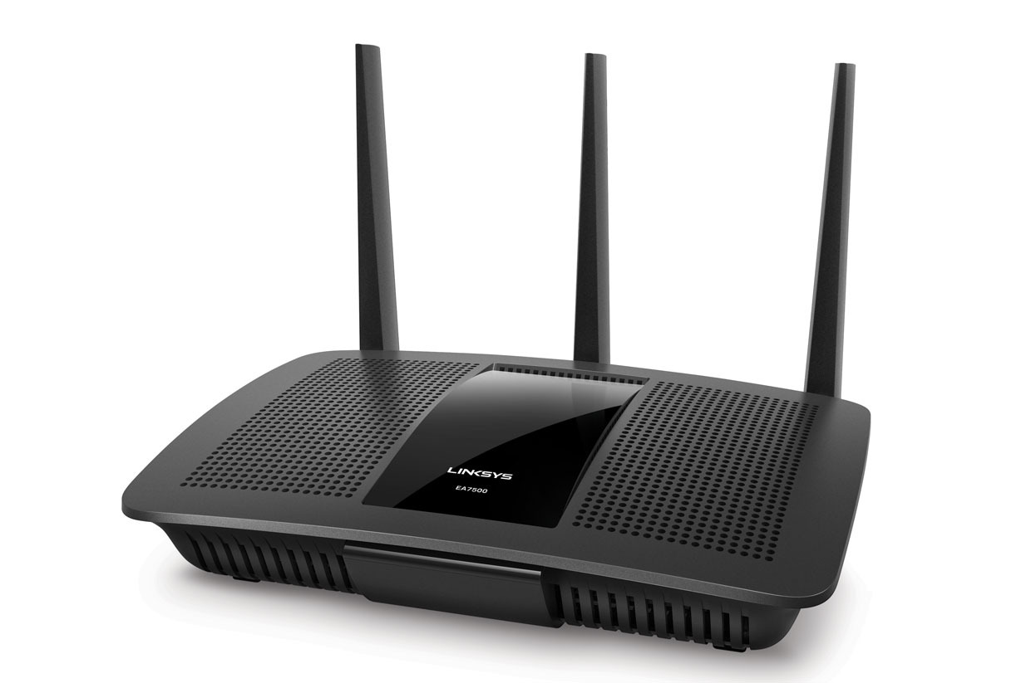

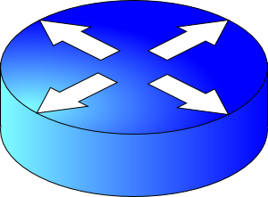
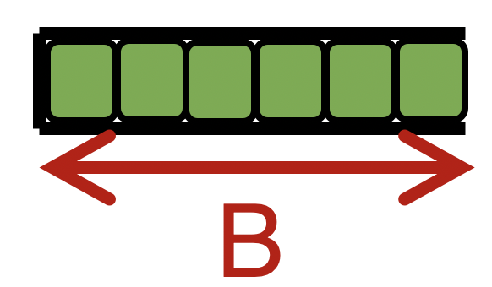

Quick recap of concepts
route
processor
Net layer
high-speed
switching
fabric
router input ports
router output ports
Forwarding Table
Dst-network
Port
network
part
host
part
65.0.0.0/8
3
The Internet uses destination IP based forwarding.
128.9.0.0/16
1
11001000 00010111 00010000 00000000
200.23.16.0/23
149.12.0.0/19
7

Slide 3
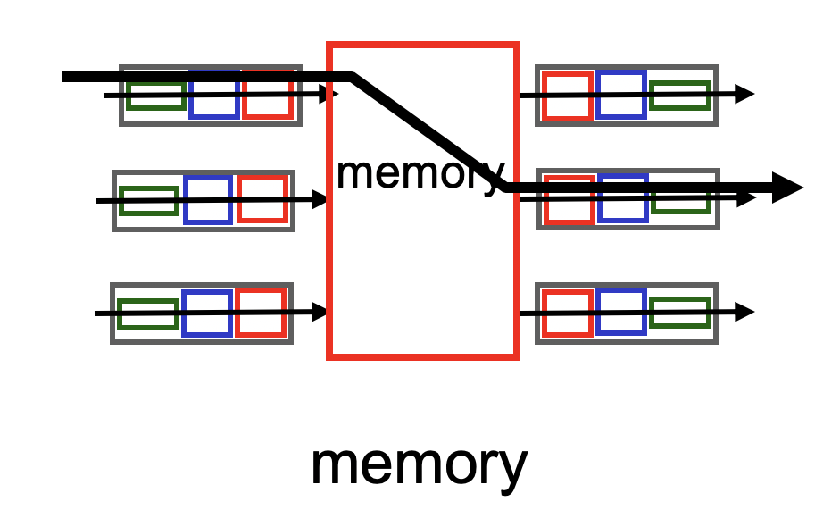
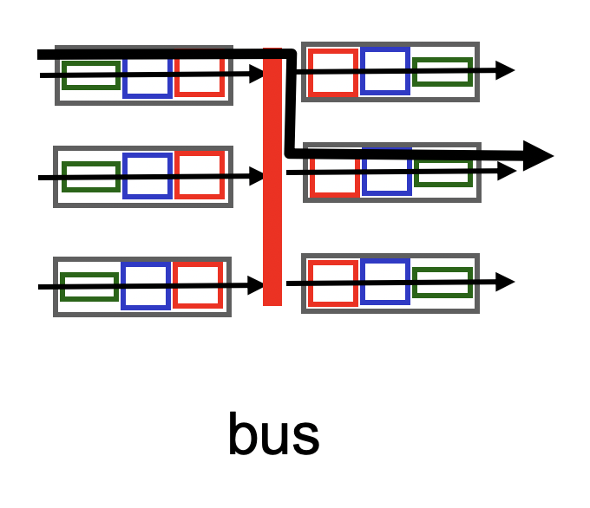
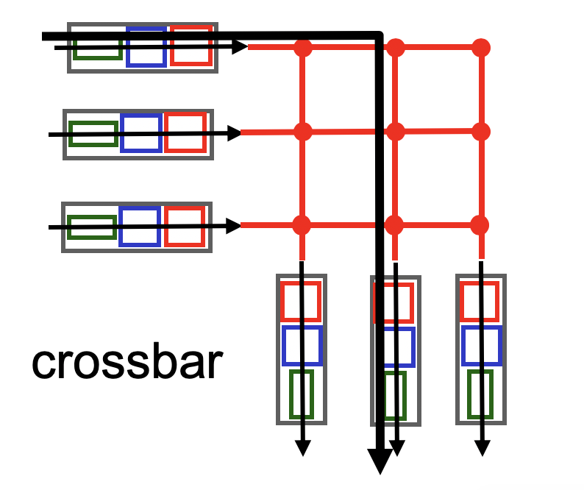
Review: Fabrics
Input port
Output port
Input port
Switching fabric
Output port
…
…
Fabric goal: Ferry as many packets as possible from input to output ports as quickly as possible.
Input port
Output port

Slide 4
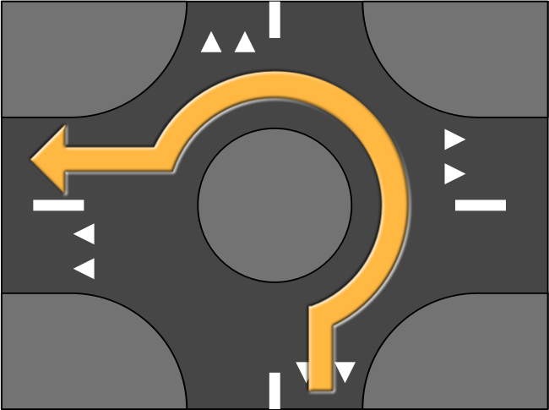
Nonblocking fabrics
Input port
Output port
Input port
Switching fabric
Output port
…
…
Input port
Output port
High-speed switching fabrics designed to be nonblocking:
If an output port is “available”, an input port can always transmit to it without being blocked by the switching fabric itself
Crossbars are nonblocking by design
Shared memory can be designed to be nonblocking if memory is optimized to be fast enough

Slide 5
Nonblocking fabrics
Input port
Output port
Input port
Switching fabric
Output port
…
…
Input port
Output port
With a nonblocking fabric, queues aren’t formed due to the switching fabric.
With a nonblocking fabric, there are no queues due to inefficiencies at the input port or the switching fabric
Queues only form due to contention for the output port
Fundamental, unavoidable, given the route

Slide 6
Nonblocking fabrics
Input port
Output port
Input port
Switching fabric
Output port
…
…
Input port
Output port
With a nonblocking fabric, queues aren’t formed due to the switching fabric.
With a nonblocking fabric, there are no queues due to inefficiencies at the input port or the switching fabric
Queues only form due to contention for the output port
Fundamental, unavoidable, given the route
Typically, these queues form on the output side
But can also “backpressure” to the input side if there is high contention for the output port
i.e.: can’t move pkts to output Qs since buffers full, so buffer @ input

Slide 7
Control (plane) processor
A general-purpose processor that “programs” the data plane:
Forwarding table
Scheduling and buffer management policy
Implements the routing algorithm by processing routing protocol messages
Mechanism by which routers collectively solve the Internet routing problem
More on this soon.
Control Processor
Input port
Output port
Input port
Switching fabric
Output port
…
…
Input port
Output port

Slide 8

Router design: the bigger picture
Control plane
Traditional distributed routing: per route-change processing
(~ a few tens of seconds)
Routing
Algorithm
control
plane
data
plane
Data plane
per-packet processing
(~ tens of nanoseconds)
0111
1
3
2
values in arriving
packet header, i.e, destination IP address

Slide 9
Longest Prefix Matching

Slide 10

Review: Route lookup
Table lookup matches a packet against an IP prefix
Ex: 65.12.45.2 matches 65.0.0.0/8
Prefixes are allocated to organizations by Internet registries
But organizations can reallocate a subset of their IP address allocation to other orgs
Parse
Transport
Extract destination IP address
Network
Link layer
Route Lookup Data Structure
Outgoing Port
Forwarding Table
Dst-network
Port
65.0.0.0/8
3
128.9.0.0/16
1
149.12.0.0/19
7

Slide 11
Example of IP block reallocation
Dst IP Prefix | Output port
65.0.0.0/8 | 3
128.9.0.0/16 | 1
… | …
200.23.16.0/20 | 7 (towards A)
Suppose ISP A reallocates a part of its IP block to orgs 1… 8
ISP A owns the IP block 200.23.16.0/20.
Organization 1
200.23.16.0/23
Organization 2
200.23.18.0/23
[BGP] Send me pkts destined to
200.23.16.0/20
Organization 3
200.23.20.0/23
.
ISP A
.
.
.
.
Internet
.
Organization 8
200.23.30.0/23
There is an announcement mechanism (BGP) by which ISP A can inform the rest of the Internet about the prefixes it owns.
It is enough to announce a coarse-grained prefix 200.23.16.0/20 rather than 8 separate sub-prefixes.
Route Aggregation
Save forwarding table memory
Fewer routing protocol msgs

Slide 12
Example of IP block reallocation
Dst IP Prefix | Output port
65.0.0.0/8 | 3
128.9.0.0/16 | 1
… | …
200.23.16.0/20 | 7 (towards A)
Suppose ISP A reallocates a part of its IP block to orgs 1… 8
ISP A owns the IP block 200.23.16.0/20.
Organization 1
200.23.16.0/23
Organization 2
200.23.18.0/23
[BGP] Send me pkts destined to
200.23.16.0/20
Organization 3
200.23.20.0/23
.
ISP A
.
.
.
.
Internet
.
Organization 8
200.23.30.0/23
Now suppose one of these organizations adds another ISP for its Internet service and prefers using the new ISP.
Note: it’s possible for the organization to retain its assigned IP block.

Slide 13
Example of IP block reallocation
Dst IP Prefix | Output port
65.0.0.0/8 | 3
128.9.0.0/16 | 1
… | …
200.23.16.0/20 | 7 (towards A)
Suppose ISP A reallocates a part of its IP block to orgs 1… 8
ISP A owns the IP block 200.23.16.0/20.
Organization 1
200.23.16.0/23
Organization 2
200.23.18.0/23
[BGP] Send me pkts destined to
200.23.16.0/20
Organization 3
200.23.20.0/23
.
ISP A
.
.
.
.
Internet
.
Organization 8
200.23.30.0/23
[BGP] Announce 200.23.18.0/23
(besides other IP prefixes)
ISP B
Organization 2
200.23.18.0/23

Slide 14
Example of IP block reallocation
Dst IP Prefix | Output port
65.0.0.0/8 | 3
128.9.0.0/16 | 1
200.23.18.0/23 | 4 (towards B)
200.23.16.0/20 | 7 (towards A)
Suppose ISP A reallocates a part of its IP block to orgs 1… 8
ISP A owns the IP block 200.23.16.0/20.
Organization 1
200.23.16.0/23
Organization 2
200.23.18.0/23
[BGP] Send me pkts destined to
200.23.16.0/20
Organization 3
200.23.20.0/23
.
ISP A
.
.
.
.
Internet
.
Organization 8
200.23.30.0/23
[BGP] Announce 200.23.18.0/23
(besides other IP prefixes)
ISP B
Organization 2
200.23.18.0/23

Slide 15
A closer look at the forwarding table
200.23.18.0/23 is inside 200.23.16.0/20
A packet with destination IP address 200.23.18.xx is in both prefixes
i.e., both entries match
Q: How should the router choose to forward the packet?
The org prefers B, so should choose B
Dst IP Prefix | Output port
65.0.0.0/8 | 3
128.9.0.0/16 | 1
200.23.18.0/23 | 4 (towards B)
200.23.16.0/20 | 7 (towards A)
200.23.16.0/20

Slide 16
Longest Prefix Matching (LPM)
Use the longest matching prefix, i.e., the most specific route, among all prefixes that match the packet.
Policy borne out of the Internet’s IP allocation model: prefixes and sub-prefixes are handed out
Internet routers use longest prefix matching.
Very interesting algorithmic problems
Challenges in designing efficient software and hardware data structures
Dst IP Prefix | Output port
65.0.0.0/8 | 3
128.9.0.0/16 | 1
200.23.18.0/23 | 4 (towards B)
200.23.16.0/20 | 7 (towards A)
200.23.16.0/20

Slide 17
Internet routers perform longest-prefix matching on destination IP addresses of packets.

Slide 18
Why is LPM prevalent?
Verizon
Rutgers
Agg. route
AT&T
Specific route
An ISP (e.g., Verizon) has allocated a sub-prefix (or “subnet”) of a larger prefix that the ISP owns to an organization (e.g., Rutgers)
Further, the ISP announces the aggregated prefix to the Internet to save on number of forwarding table memory and number of announcements
The organization (e.g., Rutgers) is reachable over multiple paths (e.g., through another ISP like AT&T)
The organization has a preference to use one path over another, and expresses this by announcing the longer (more specific) prefix
Internet routers forward based on the longer prefix

Slide 19
IPv4 Datagram Format

Slide 20
Transport
Network
total datagram
length (bytes)
Link layer
IP protocol version
number
32 bits
header length
(bytes)
ver
hdr
len
type of
service
Bits for
traffic differentiation
e.g., audio, web, bulk
(more on this later)
length
for
fragmentation/
reassembly
flags
fragment
offset
16-bit identifier
max number
remaining hops
(decremented at
each router)
time to
live
upper
protocol
header
checksum
32-bit source IP address
upper layer protocol to deliver payload to, e.g., TCP, UDP
32-bit destination IP address
Options (if any)
E.g. timestamp,
record the route
taken, specify
list of routers
to visit (“source routing”)
How much header overhead?
Suppose 20 bytes of TCP
20 bytes of IP
= 40 bytes
data
(variable length,
typically a TCP
or UDP segment)

Slide 21
The rest of this lecture and the next
We’ll talk about some support protocols and mechanisms for the network layer
Protocols: DHCP, ICMP, ARP
Mechanisms: NAT
We’ll also talk about IP version 6 (IPv6)
Some of these protocols use an IP header underneath their own header (ICMP) or replace the IP header with their own (ARP)
But these shouldn’t be construed as transport/network protocols
They are fundamental to supporting IP/network layer functionality
More appropriately discussed as support protocols for the network layer

Slide 22


The network layer is all about reachability.
Every protocol we’ll see solves a sub-problem.
How does an endpoint get an address?
How does an endpoint talk to another outside its network?
Debugging?
ICMP
Routing protocols
OSPF, RIP, BGP
DHCP
How does an endpoint talk to another within the same network?
ARP
Gateways
NAT & IPv6

Slide 23
Dynamic Host Configuration Protocol (DHCP)

Slide 24
How does an endpoint get its IP addr?
One possibility: hard-code the IP address on the endpoint
e.g., a system admin writing addresses in a file
Linux: /etc/network/interfaces
Mac OS X (10.14.6): system preferences > Network > name of interface > advanced > TCP/IP > “Manually”
Another possibility: dynamically receive an address “from the network”
DHCP: Dynamic Host Configuration Protocol
Provide plug-and-play functionality for endpoints (e.g., phones, laptops)

Slide 25
Many similar bootstrapping problems
How does a host get its IP address?
How does a host know its local DNS server?
How does a host know its netmask?
i.e., so that it can know which other hosts are in the same network
Note: the details how A and B talk to each other changes significantly when A and B are in the same network vs. different network
How does a host know how to reach other networks?
i.e., which router is at the “border” of the current network?
This router is also called the gateway router: crucial for an endpoint to communicate with another endpoint external to the network

Slide 26
How DHCP works
An endpoint that just joined a network knows nothing about it
Endpoint doesn’t even have an IP address for its point of attachment
We solved a similar bootstrapping problem before:
Domain Name Service (DNS) to retrieve addresses
Often, it makes little sense to have the endpoint contact a “known” server to receive an IP address
E.g., connecting to a brand-new network you’ve never been in
The only idea that really works is to ask everyone
Broadcast a query

Slide 27


How DHCP works
DHCP
server
223.1.1.0/24
DHCP allows a host to dynamically obtain its IP address from a server on a network when it joins the network
DHCP can allow a host to be mobile across different networks, obtaining IP addresses as needed
DHCP uses leases on addresses
Host must renew lease periodically
Allows network to reuse an IP with an expired lease, reclaiming addresses from inactive hosts
223.1.1.1
223.1.2.1
223.1.1.2
223.1.1.4
223.1.2.9
223.1.3.27
223.1.2.2
223.1.1.3
223.1.2.0/24
223.1.3.1
223.1.3.2
DHCP
Client program on the endpoint broadcasts message requesting an IP address.
223.1.3.0/24

Slide 28
DHCP client-server scenario
DHCP discover
223.1.2.4
src : 0.0.0.0, 68
dest.: 255.255.255.255,67
yiaddr: 0.0.0.0
transaction ID: 654
DHCP server:
223.1.2.5
Broadcast: is there a DHCP server out there?
Arriving
client
DHCP offer
src: 223.1.2.5, 67
dest: 255.255.255.255, 68
yiaddrr: 223.1.2.4
transaction ID: 654
lifetime: 3600 secs
DHCP runs on UDP ports 67 (server) and 68 (client)
Client’s initial IP address is set to 0.0.0.0
Yiaddr stands for “your IP address” – an address value the server sends to the client for consideration
Note that the IP allocation has an associated lifetime (lease period)
Broadcast: I’m a DHCP server! Here’s an IP address you can use
DHCP request
src: 0.0.0.0, 68
dest:: 255.255.255.255, 67
yiaddrr: 223.1.2.4
transaction ID: 655
lifetime: 3600 secs
Broadcast: OK. I’ll take that IP address!
DHCP ACK
src: 223.1.2.5, 67
dest: 255.255.255.255, 68
yiaddrr: 223.1.2.4
transaction ID: 655
lifetime: 3600 secs
Broadcast: OK. You’ve got that IP address!

Slide 29
Multiple DHCP servers can coexist
Server 1
Client
Server 2
DHCPDISCOVER
DHCPDISCOVER
DHCPOFFER
DHCPOFFER
Collects replies
Selects server 2
DHCPREQUEST
DHCPREQUEST
DHCPACK

Slide 30
DHCP returns more than an IP address
Name and IP address of the local DNS server
Netmask of the IP network the host is on
Useful to know whether another endpoint is inside or outside the current IP network
Address of the gateway router to enable the endpoint to reach other IP networks

Slide 31
Your home router runs DHCP
Likely, your home devices (laptops, tablets, phones) are all using DHCP-assigned IP addresses
The DHCP server is running on the control processor of your home’s access router (e.g., WiFi router)
You can access the DHCP client program on Linux using the command dhclient and on Linux using sudo ipconfig <interface> DHCP

Slide 32
Summary of DHCP
Want endpoints to have plug and play functionality
Avoid tedious manual configuration of IP addresses and other information
DHCP: a general bootstrapping mechanism for critical information required for network layer functionality
Hosts can be simple: receive information from DHCP servers by broadcasting over the network

Slide 33
IP fragmentation and reassembly
Fragmentation
one large datagram goes in
3 smaller datagrams come out
Links and transmission media have MTUs (maximum transmission unit):
Largest possible link-level frame
On a network path, a packet might traverse links with different MTUs
This may result in a large IP datagram to be divided (fragmented) by a router
Fragments reassembled only at the destination endpoint, at the IP layer
IP header bits used to identify and reassemble related fragments
Link with smaller MTU
Network with large MTU
Reassembly
= IP header
= IP payload

Slide 34
IP fragmentation and reassembly
Suppose a large 4000-byte datagram reaches a router. The next link has MTU 1500 bytes.
Note: MTU includes IP headers, so does the length field of the IP header. IP payload = 3980 bytes.
Result: 3 datagrams of length 1500, 1500, 1040 bytes resp.
IP payload = 1480, 1480, 1020 bytes resp. (adds to 3980)
Offset field = index of payload byte / 8
length
=4000
ID
=x
fragflag
=0
offset
=0
length
=1500
ID
=x
fragflag
=1
offset
=0
1480/8
length
=1500
ID
=x
fragflag
=1
offset
=185
2960/8
length
=1040
ID
=x
fragflag
=0
offset
=370

Slide 35
IP fragmentation and reassembly
At the destination endpoints, the fragments are reassembled using the IP identifier field
Fragments of the same original datagram share the same IP ID
The fragmentation flag is set to 0 for the terminal fragment, and 1, if other fragments follow
The offset field allows the IP stack to reassemble the fragments in order into a single IP datagram
length
=4000
ID
=x
fragflag
=0
offset
=0
length
=1500
ID
=x
fragflag
=1
offset
=0
1480/8
length
=1500
ID
=x
fragflag
=1
offset
=185
2960/8
length
=1040
ID
=x
fragflag
=0
offset
=370

