Slide 1

Network Layer: Protocols (Part 2)
Lecture 21 http://www.cs.rutgers.edu/~sn624/352-S22
Srinivas Narayana

Slide 2


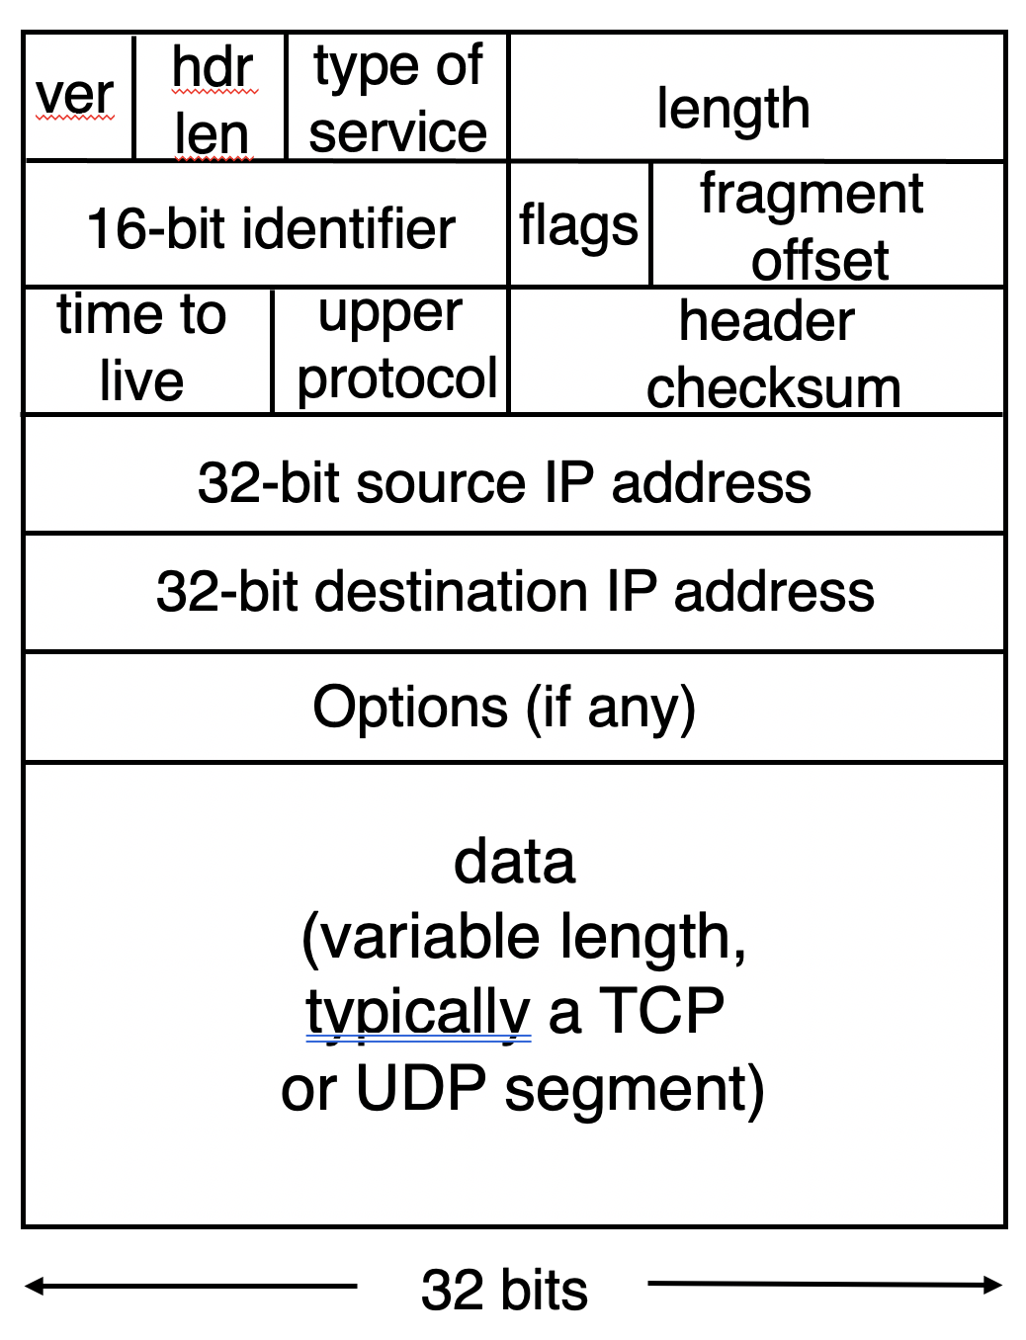


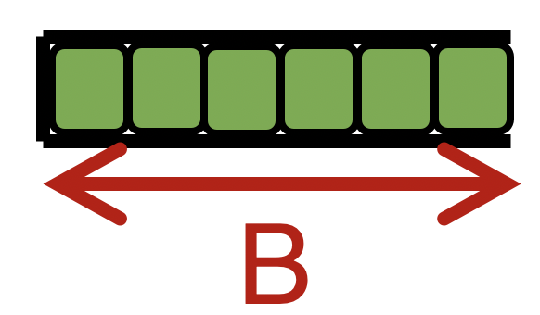

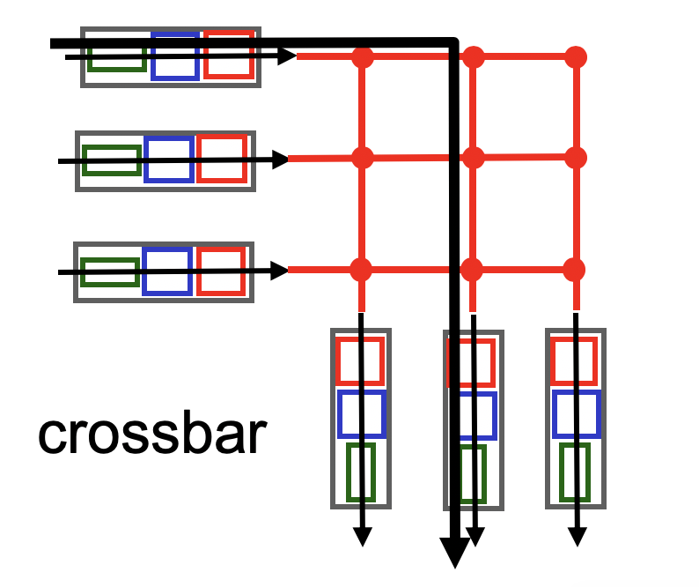

Quick recap of concepts
route
processor
IPv4 datagram
Net layer
high-speed
switching
fabric
router input ports
router output ports
In nonblocking fabrics, queues form only due to contention for output port.
Nonblocking
Blocking
Forwarding Table
Output port contention is fundamental; unavoidable.
Longest prefix matching on dst IP address
Scheduling and buffer management crucial.

Slide 3
Mapping routes
ip route (Linux)
Try ip route get ____
route (Mac OS X)

Slide 4


The network layer is all about reachability.
Every protocol we’ll see solves a sub-problem.
How does an endpoint get an address?
How does an endpoint talk to another outside its network?
Debugging?
ICMP
Routing protocols
OSPF, RIP, BGP
DHCP
How does an endpoint talk to another within the same network?
ARP
Gateways
NAT & IPv6

Slide 5
Dynamic Host Configuration Protocol (DHCP)

Slide 6
How does an endpoint get its IP addr?
One possibility: hard-code the IP address on the endpoint
e.g., a system admin writing addresses in a file
Linux: /etc/network/interfaces
Mac OS X (10.14.6): system preferences > Network > name of interface > advanced > TCP/IP > “Manually”
Another possibility: dynamically receive an address “from the network”
DHCP: Dynamic Host Configuration Protocol
Provide plug-and-play functionality for endpoints (e.g., phones, laptops)

Slide 7
Many similar bootstrapping problems
How does a host get its IP address?
How does a host know its local DNS server?
How does a host know its netmask?
i.e., so that it can know which other hosts are in the same network
Note: the details how A and B talk to each other changes significantly when A and B are in the same network vs. different network
How does a host know how to reach other networks?
i.e., which router is at the “border” of the current network?
This router is also called the gateway router: crucial for an endpoint to communicate with another endpoint external to the network

Slide 8
How DHCP works
An endpoint that just joined a network knows nothing about it
Endpoint doesn’t even have an IP address for its point of attachment
We solved a similar bootstrapping problem before:
Domain Name Service (DNS) to retrieve addresses
Often, it makes little sense to have the endpoint contact a “known” server to receive an IP address
E.g., connecting to a brand-new network you’ve never been in
The only idea that really works is to ask everyone
Broadcast a “query”

Slide 9


How DHCP works
DHCP
server
223.1.1.0/24
DHCP allows a host to dynamically obtain its IP address from a server on a network when it joins the network
DHCP can allow a host to be mobile across different networks, obtaining IP addresses as needed
DHCP uses leases on addresses
Host must renew lease periodically
Allows network to reuse an IP with an expired lease, reclaiming addresses from inactive hosts
223.1.1.1
223.1.2.1
223.1.1.2
223.1.1.4
223.1.2.9
223.1.3.27
223.1.2.2
223.1.1.3
223.1.2.0/24
223.1.3.1
223.1.3.2
DHCP
Client program on the endpoint broadcasts message requesting an IP address.
223.1.3.0/24

Slide 10
DHCP client-server scenario
DHCP discover
223.1.2.4
src : 0.0.0.0, 68
dest.: 255.255.255.255,67
yiaddr: 0.0.0.0
transaction ID: 654
DHCP server:
223.1.2.5
Broadcast: is there a DHCP server out there?
Arriving
client
DHCP offer
src: 223.1.2.5, 67
dest: 255.255.255.255, 68
yiaddrr: 223.1.2.4
transaction ID: 654
lifetime: 3600 secs
DHCP runs on UDP ports 67 (server) and 68 (client)
Client’s initial IP address is set to 0.0.0.0
Yiaddr stands for “your IP address” – an address value the server sends to the client for consideration
Note that the IP allocation has an associated lifetime (lease period)
Broadcast: I’m a DHCP server! Here’s an IP address you can use
DHCP request
src: 0.0.0.0, 68
dest:: 255.255.255.255, 67
yiaddrr: 223.1.2.4
transaction ID: 655
lifetime: 3600 secs
Broadcast: OK. I’ll take that IP address!
DHCP ACK
src: 223.1.2.5, 67
dest: 255.255.255.255, 68
yiaddrr: 223.1.2.4
transaction ID: 655
lifetime: 3600 secs
Broadcast: OK. You’ve got that IP address!

Slide 11
Multiple DHCP servers can coexist
Server 1
Client
Server 2
DHCPDISCOVER
DHCPDISCOVER
DHCPOFFER
DHCPOFFER
Collects replies
Selects server 2
DHCPREQUEST
DHCPREQUEST
DHCPACK

Slide 12
DHCP returns more than an IP address
Name and IP address of the local DNS server
Netmask of the IP network the host is on
Useful to know whether another endpoint is inside or outside the current IP network
Address of the gateway router to enable the endpoint to reach other IP networks

Slide 13
Your home router runs DHCP
Likely, your home devices (laptops, tablets, phones) are all using DHCP-assigned IP addresses
The DHCP server is running on the control processor of your home’s access router (e.g., WiFi router)
You can access the DHCP client program on Linux using the command dhclient

Slide 14
Summary of DHCP
Want endpoints to have plug and play functionality
Avoid tedious manual configuration of IP addresses and other information
DHCP: a general bootstrapping mechanism for critical information required for network layer functionality
Hosts can be simple: receive information from DHCP servers by broadcasting over the network

Slide 15
Internet Control Message Protocol (ICMP)

Slide 16
Internet Control Message Protocol
A protocol for troubleshooting and diagnostics
Works over IP: unreliable delivery of packets
Some functions of ICMP:
Determine reachability and network errors
Specify that packets have been in the network for too long

Slide 17
ICMP message
ICMP header
Message type, Code, Checksum,
ICMP data
IP header
https://en.wikipedia.org/wiki/Internet_Control_Message_Protocol#Control_messages

Slide 18
Specific uses of ICMP
Echo request reply
Check remotely if an endpoint is alive and connected
Without running an app remotely or controlling that endpoint
An unreachable destination
Invalid address and/or port
Knowing if packet’s IP time-to-live expired
Example, due to routing loops
Look at two tools built using ICMP: ping and traceroute

Slide 19
Ping
Uses ICMP echo request (type=8, code=0) and reply (type=0, code=0)
Source sends ICMP echo request message to dst address
Destination network stack replies with an ICMP echo reply message
Source can calculate round trip time (RTT) of packets
If no echo reply comes back, then the destination is unreachable
Don’t need to have a server program running on the other side
In general, the remote endpoint can be completely outside your control

Slide 20
Ping
A
R1
R2
R3
B
Echo
request
Time
Ping time
Echo reply
A small demo…

Slide 21
Traceroute
A tool that can record the router-level path taken by packets
A clever use of the IP time-to-live (TTL) field
In general, when a router receives an IP packet, it decrements the TTL field on the packet
A failsafe mechanism to ensure packets don’t keep taking up network resources for too long
If a router receives a packet with TTL=0, it sends an ICMP time exceeded message (type=11, code=0) to the source endpoint

Slide 22
Traceroute
Traceroute sends multiple packets to a destination endpoint
But it progressively increases the TTL on those packets: 1, 2, ...
Every time a time exceeded message is received, record the router’s IP address
Process repeated until the destination endpoint is reached
If the packet reaches the destination endpoint (i.e.: TTL is high enough), then the endpoint sends a port unreachable message

Slide 23
Traceroute
A
R1
R2
R3
B
TTL=1, dest = B, dstport = invalid
Time
Time exceeded
Source: R1
TTL = 2
Similarly, capture IP addresses of routers at distance 3, 4, …
TE(R2)
Port un- reachable
Source: B
Have full router-level path until destination
A small demo…

Slide 24
Summary of ICMP
A protocol for network diagnostics and troubleshooting
Two useful tools: ping and traceroute
Ping: test connectivity to a machine totally outside your control
Use ICMP echo request and reply
Traceroute: determine router-level path to a remote endpoint
A smart use of the TTL field in the IP header

Slide 25
Address Resolution Protocol

Slide 26
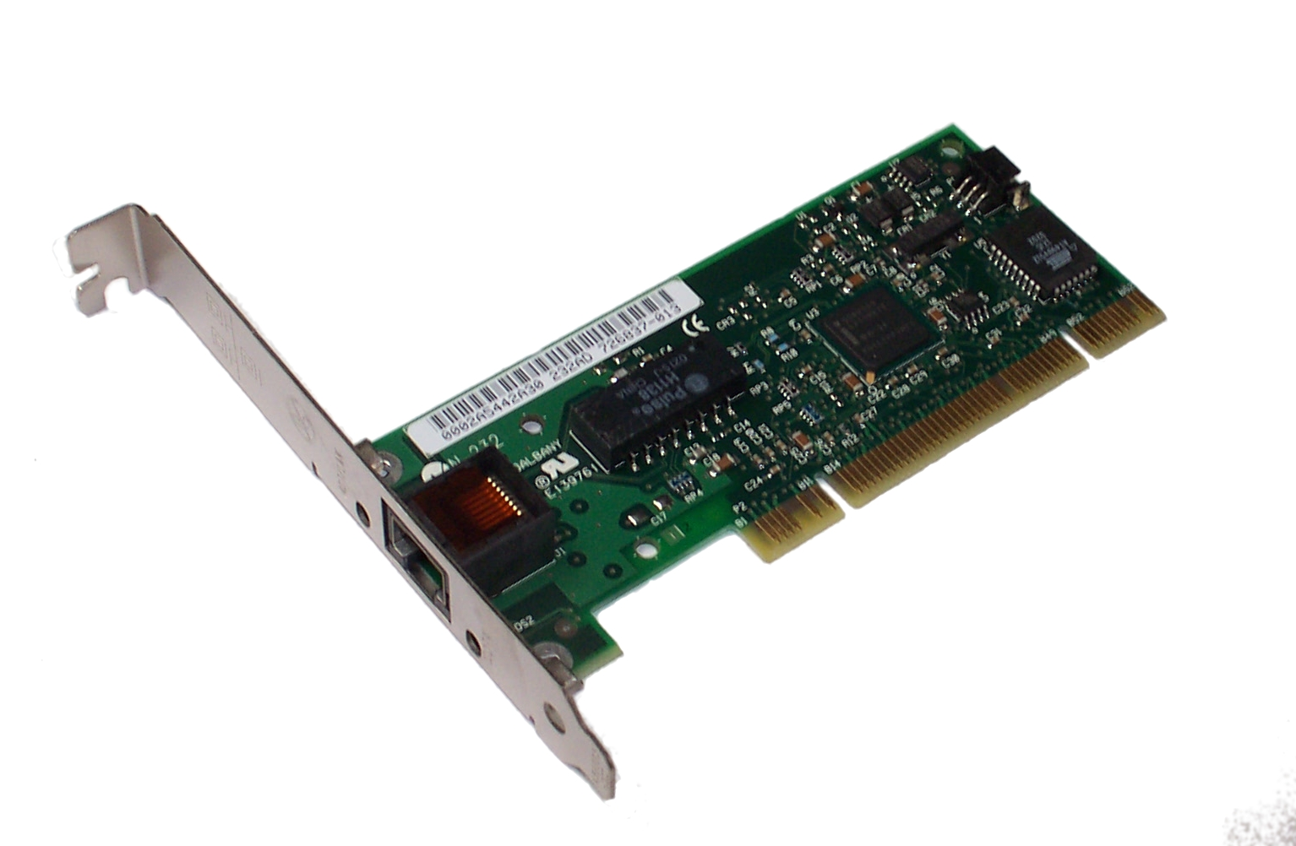
Background: Let’s peek into the link layer
Each network adapter has a hardware address or a MAC address
E.g., the Wi-Fi adapter on your laptop has one
Assigned by the manufacturer, not expected to vary over time
Think about it as an identifier for the device
To communicate over a single link, a sender needs the destination hardware address
Directory mechanisms like DNS and bootstrapping mechanisms like DHCP provide IP addresses
Given an IP address, how does an endpoint find the hardware address?

Slide 27
Address Resolution Protocol (ARP)
ARP solves the following problem. Given an IP, find the machine’s hardware address
IP → MAC resolution
All endpoints that are looked up are expected to be within the same network
Hence, address resolution can use broadcast:
We don’t need to develop directory mechanisms like DNS
Send (ARP) queries to everyone, asking for a MAC given an IP

Slide 28
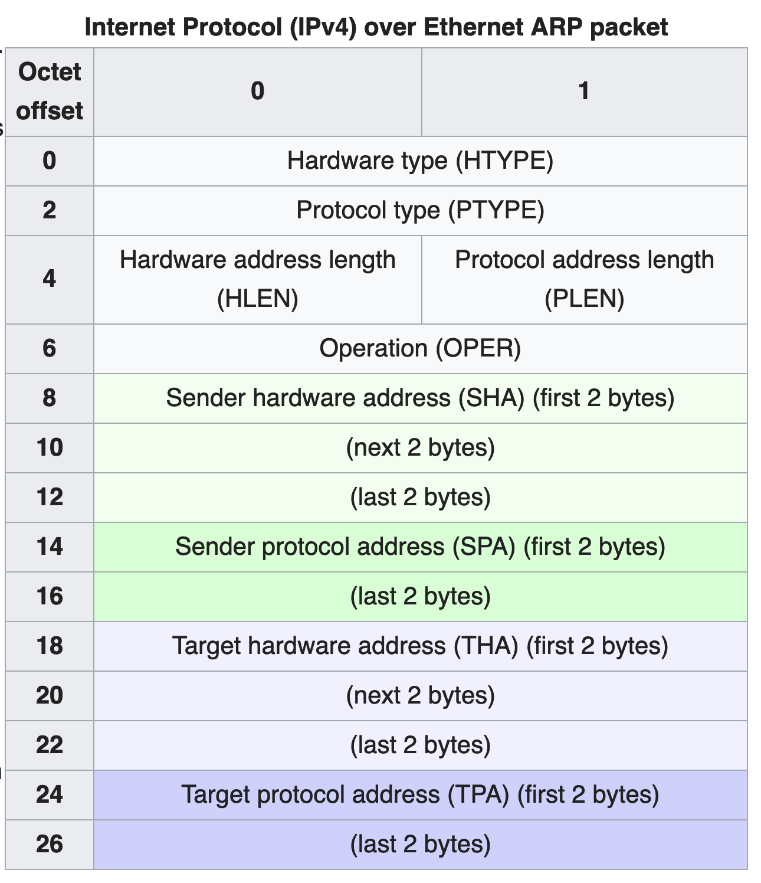
ARP packet format
Hardware type: link-layer protocol
Example: Ethernet (1)
Hardware address length:
Example: Ethernet = 6 bytes
Protocol Type: network-layer protocol
Example: IPv4 (0x0800)
Protocol address length
Example: IPv4 = 4 bytes
Operation:
ARP request: 1, reply: 2
Sender’s addresses
Address to be resolved (or response)

Slide 29
ARP operation
Hardware type: Ethernet
Protocol type: IPv4
Hardware addr length: 6
Protocol addr length: 4
Operation: 2 (reply)
Sender hardware addr: 05:23:f4:3d:e1:04
Sender protocol addr:
128.195.1.20
Target HW addr:
98:22:ee:f1:90:1a
Target protocol addr:
128.195.1.38
Who has 128.195.1.38?
Tell 128.195.1.20
ARP request
ARP request broadcast
A
B
C
Ethernet Address:
05:23:f4:3d:e1:04
IP Address:
128.195.1.20
Ethernet Address:
12:04:2c:6e:11:9c
IP Address:
128.195.1.122
Ethernet Address:
98:22:ee:f1:90:1a
IP Address:
128.195.1.38
Wants to transmit
to 128.195.1.38
Different target IP address: ignore ARP
Matching target IP: send reply

Slide 30
Communicating outside the local net?
Suppose endpoint A wants to communicate with endpoint B that is in a different network
ARP broadcast outside the local network is too expensive
How does one limit the scope of the broadcast? Internet-wide?
Besides, the hardware address format used by B’s network might be different from that of A’s network!
ARPs are not meaningful across network boundaries
Communicating to a network-external endpoint just means sending the packet to the gateway router
Host can know that a destination is external using IP addr and netmask
Host can talk to the gateway using DHCP (to get IP) and ARP (to get MAC)

Slide 31
Summary of ARP
A useful mechanism to allow hosts inside a network to communicate:
ARP protocol helps resolve IP addresses into MAC addresses using a broadcast mechanism
Communication outside the local network requires ARP-ing for and sending packets to the gateway

