Slide 1

Network Layer: Protocols (Part 3)
Lecture 22 http://www.cs.rutgers.edu/~sn624/352-S22
Srinivas Narayana

Slide 2


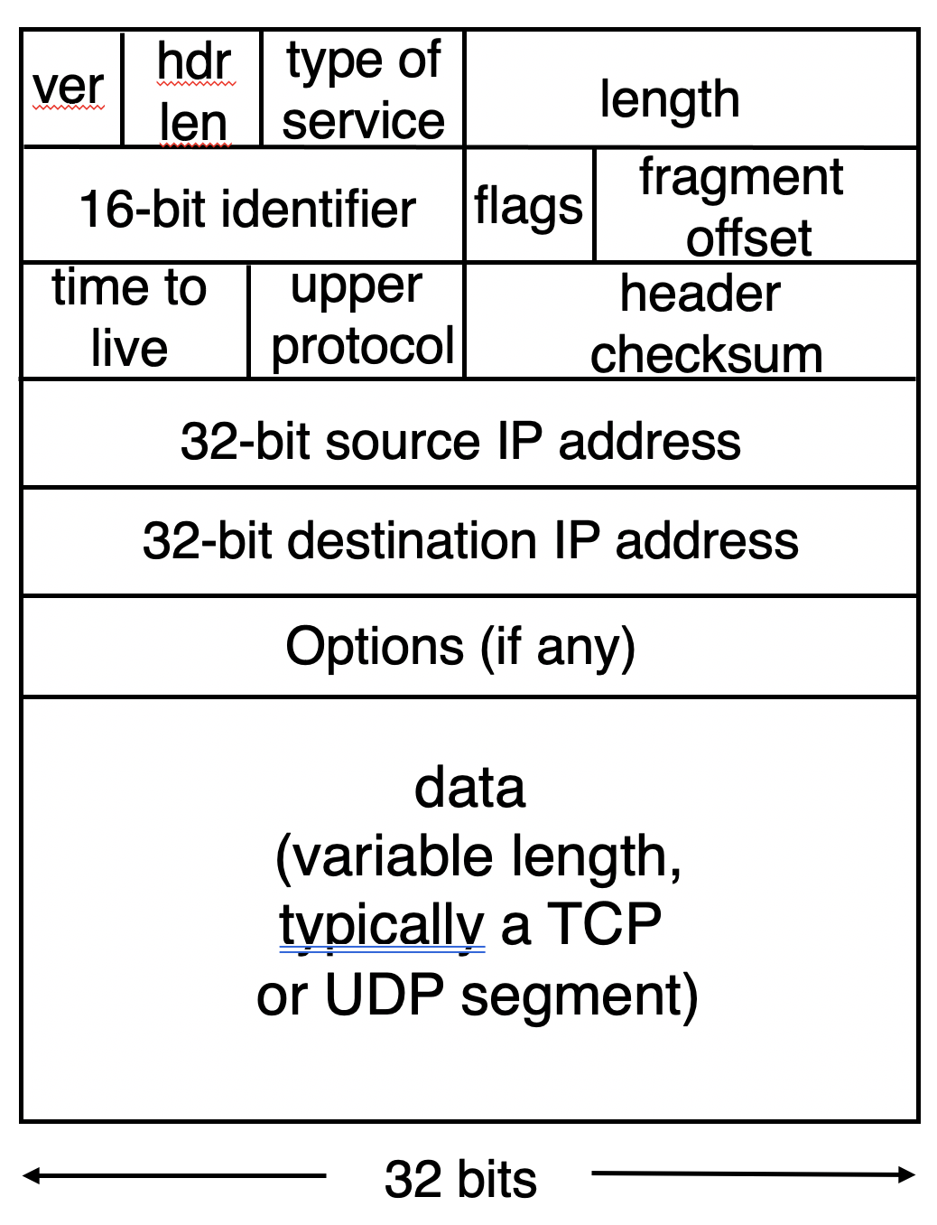


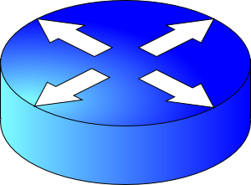


The network layer is all about reachability.
Every protocol below solves a sub-problem.
Net layer
How does an endpoint get an address?
Debugging
How does an endpoint talk to another outside its network?
ICMP
DHCP
ping
IP addr, netmask
Gateway router
DNS server
traceroute
How does an endpoint talk to another within the same network?
Broadcast
Routing protocols
OSPF, RIP, BGP
ARP
DHCP
server
Gateways
NAT

Slide 3
Address Resolution Protocol

Slide 4
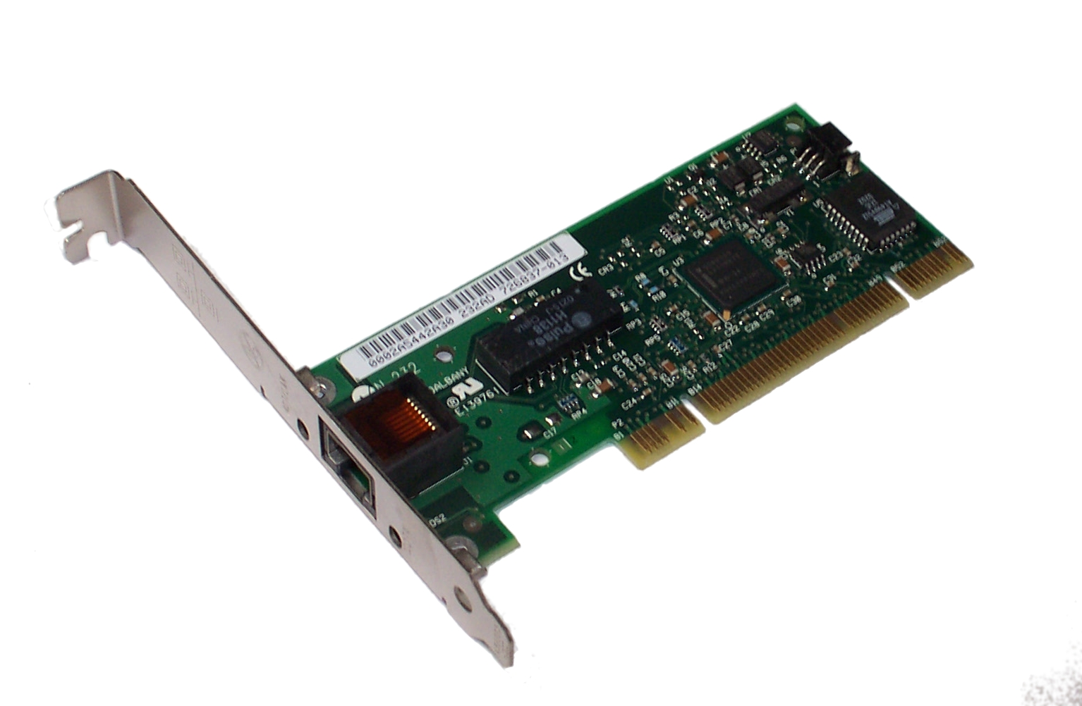
Background: Let’s peek into the link layer
Each network adapter has a hardware address or a MAC address
E.g., the Wi-Fi adapter on your laptop has one
Assigned by the manufacturer, not expected to vary over time
Think about it as an identifier for the device
To communicate over a single link, a sender needs the destination hardware address
Directory mechanisms like DNS and bootstrapping mechanisms like DHCP provide IP addresses
Given an IP address, how does an endpoint find the hardware address?

Slide 5
Address Resolution Protocol (ARP)
ARP solves the following problem. Given an IP, find the machine’s hardware address
IP → MAC resolution
All endpoints that are looked up are expected to be within the same network
Hence, address resolution can use broadcast:
We don’t need to develop directory mechanisms like DNS
Send (ARP) queries to everyone, asking for a MAC given an IP

Slide 6
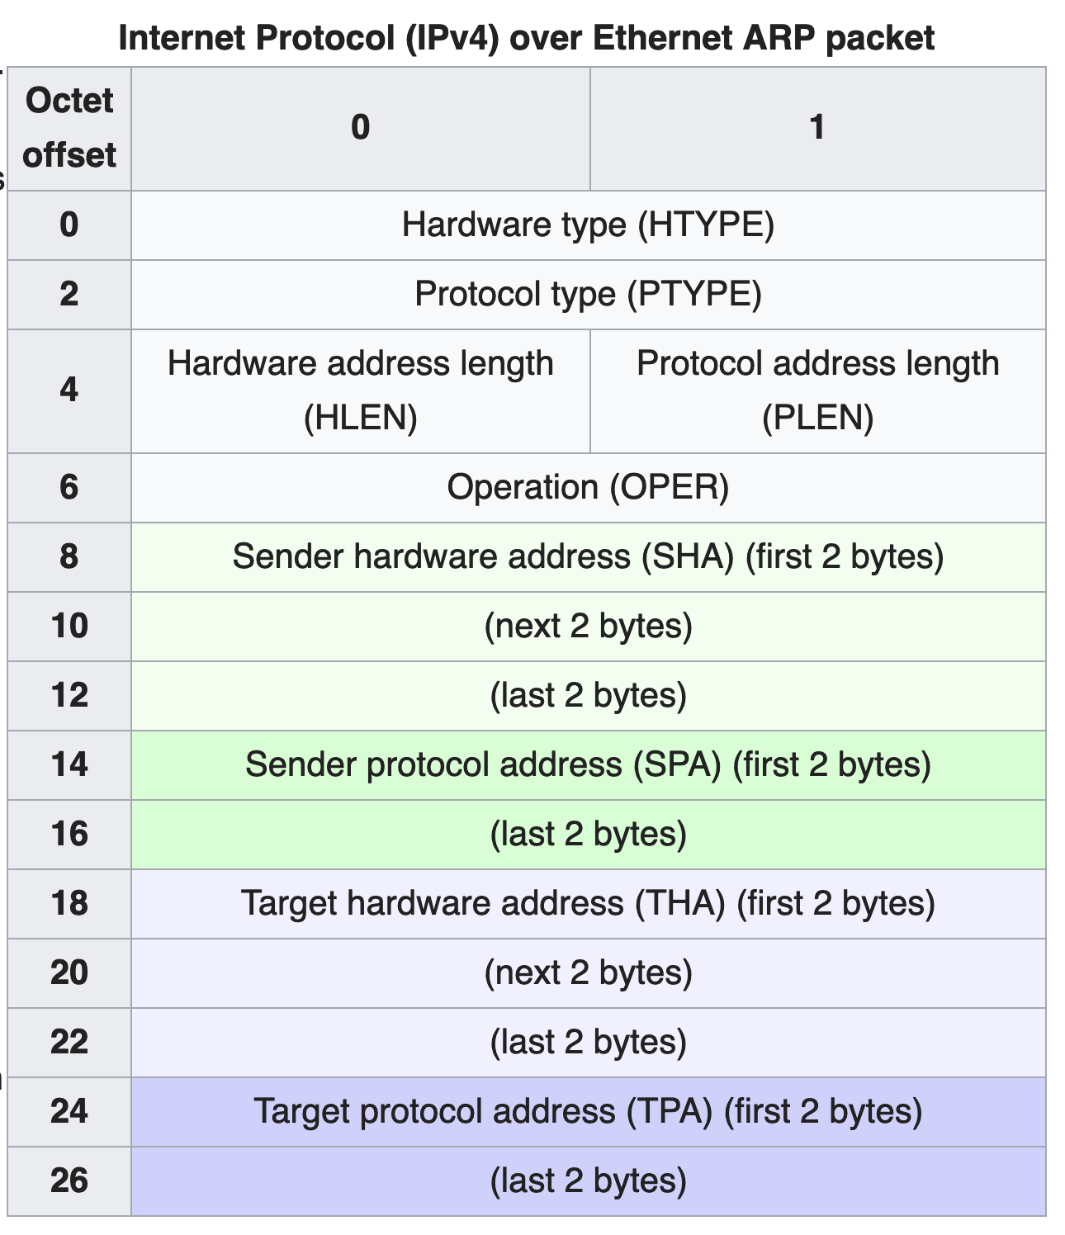
ARP packet format
Hardware type: link-layer protocol
Example: Ethernet (1)
Hardware address length:
Example: Ethernet = 6 bytes
Protocol Type: network-layer protocol
Example: IPv4 (0x0800)
Protocol address length
Example: IPv4 = 4 bytes
Operation:
ARP request: 1, reply: 2
Sender’s addresses
Address to be resolved (or response)

Slide 7
ARP operation
Hardware type: Ethernet
Protocol type: IPv4
Hardware addr length: 6
Protocol addr length: 4
Operation: 2 (reply)
Sender hardware addr: 05:23:f4:3d:e1:04
Sender protocol addr:
128.195.1.20
Target HW addr:
98:22:ee:f1:90:1a
Target protocol addr:
128.195.1.38
Who has 128.195.1.38?
Tell 128.195.1.20
ARP request
ARP request broadcast
A
B
C
Ethernet Address:
05:23:f4:3d:e1:04
IP Address:
128.195.1.20
Ethernet Address:
12:04:2c:6e:11:9c
IP Address:
128.195.1.122
Ethernet Address:
98:22:ee:f1:90:1a
IP Address:
128.195.1.38
Wants to transmit
to 128.195.1.38
Different target IP address: ignore ARP
Matching target IP: send reply

Slide 8
Communicating outside the local net?
Suppose endpoint A wants to communicate with endpoint B that is in a different network
ARP broadcast outside the local network is too expensive
How does one limit the scope of the broadcast? Internet-wide?
Besides, the hardware address format used by B’s network might be different from that of A’s network!
ARPs are not meaningful across network boundaries
Communicating to a network-external endpoint just means sending the packet to the gateway router
Host can know that a destination is external using IP addr and netmask
Host can talk to the gateway using DHCP (to get IP) and ARP (to get MAC)

Slide 9
Summary of ARP
A useful mechanism to allow hosts inside a network to communicate:
ARP protocol helps resolve IP addresses into MAC addresses using a broadcast mechanism
Communication outside the local network requires ARP-ing for and sending packets to the gateway

Slide 10
Network Address Translation (NAT)

Slide 11
Background: The Internet’s growing pains
Networks had incompatible addressing
IPv4 versus other network-layer protocols (X.25)
Routable address ranges different across networks
Entire networks were changing their Internet Service Providers
ISPs don’t want to route directly to internal endpoints, just to the gateway
IPv4 address exhaustion
Insufficient large IP blocks even for large networks
Rutgers (AS46) has > 130,000 publicly routable IP addresses
IIT Madras (a well-known public university in India, AS141340) has 512
(Source: ipinfo.io)

Slide 12
Network Address Translation
When a router modifies fields in an IP packet to:
Enable communication across networks with different (network-layer) addressing formats and address ranges
Allow a network to change its connectivity to the Internet en masse by modifying the source IP to a (publicly-visible) gateway IP address
Masquerade as an entire network of endpoints using (say) one publicly visible IP address
Effect: use fewer IP addresses for more endpoints!

Slide 13
Typical NAT setup
rest of
the Internet
local network
10.0.0/24
10.0.0.1
10.0.0.4
10.0.0.2
138.76.29.7
Gateway router
10.0.0.3
The gateway’s IP, 138.76.29.7 is publicly visible
The local endpoint IP addresses in 10.0.0/24 are private
All datagrams leaving local network have the same source IP as the gateway

Slide 14
Typical NAT setup
rest of
the Internet
local network
10.0.0/24
10.0.0.1
10.0.0.4
10.0.0.2
138.76.29.7
Gateway router
10.0.0.3
That is, for the rest of the Internet, the gateway masquerades as a single endpoint representing (hiding) all the private endpoints.
The entire network just needs one (or a few) public IP addresses.

Slide 15
Typical NAT setup
rest of
the Internet
local network
10.0.0/24
10.0.0.1
10.0.0.4
10.0.0.2
138.76.29.7
Gateway router
10.0.0.3
The NAT gateway router accomplishes this by using a different transport port for each distinct (transport-level) conversation between the local network and the Internet.

Slide 16
Typical NAT setup
1: host 10.0.0.1
sends datagram to
an external host,
128.119.40.186, at port 80
2: NAT router
changes datagram
src addr, port from
10.0.0.1, 3345 to
138.76.29.7, 5001,
Updates table
Translation table
Internet-side Local side
138.76.29.7, 5001 10.0.0.1, 3345
…… ……
4: Map back
S: 10.0.0.1, 3345
D: 128.119.40.186, 80
1
2
S: 138.76.29.7, 5001
D: 128.119.40.186, 80
10.0.0.1
S: 128.119.40.186, 80
D: 10.0.0.1, 3345
4
S: 128.119.40.186, 80
D: 138.76.29.7, 5001
3
10.0.0.2
4: NAT gateway
changes datagram
dest addr, port from
138.76.29.7, 5001 to
10.0.0.1, 3345
3: Reply arrives to
dst addr, port
138.76.29.7, 5001
138.76.29.7
10.0.0.3

Slide 17
Features of IP-masquerading NAT
Use one or a few public IPs: You don’t need a lot of addresses from your ISP
Change addresses of devices inside the local network freely, without notifying the rest of the Internet
Change the public IP address freely independent of network-local endpoints
Devices inside the local network are not publicly visible, routable, or accessible
Most IP masquerading NATs block incoming connections originating from the Internet
Only way to communicate is if the internal host initiates the conversation

Slide 18
If you’re home, you’re likely behind NAT
Most access routers (e.g., your home WiFi router) implement network address translation
You can check this by comparing your local address (visible from ifconfig) and your externally-visible IP address (e.g., type “what’s my IP address?” on your browser search bar)

Slide 19
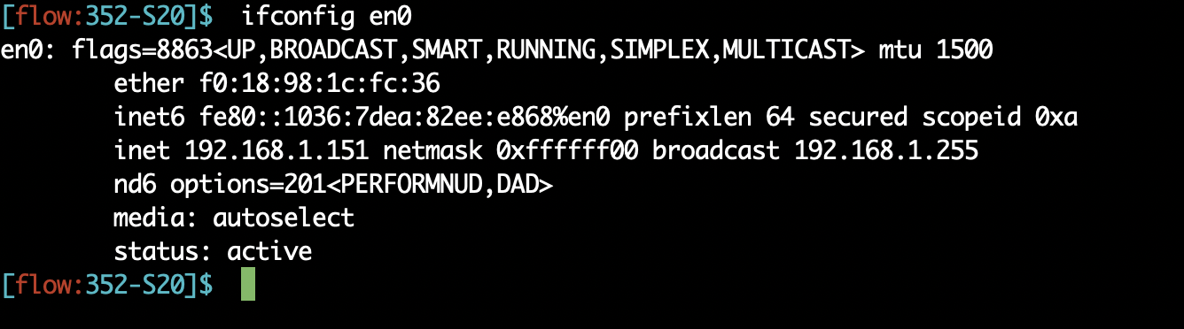
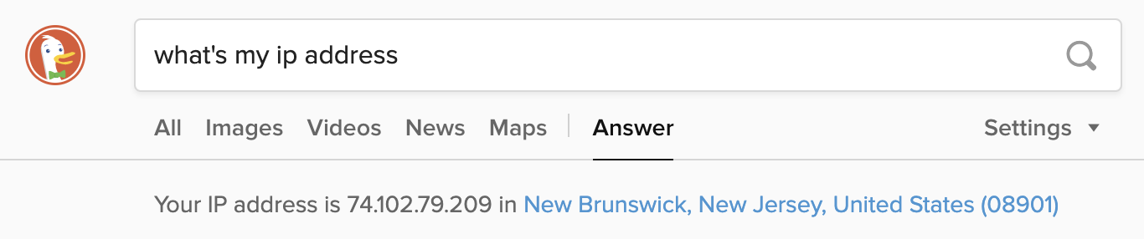
If you’re home, you’re likely behind NAT

Slide 20
Limitations of IP-masquerading NATs
Connection limit due to 16-bit port-number field
~64K total simultaneous connections with a single public IP address
NAT can be controversial
“Routers should only manipulate headers up to the network layer, not modify headers at the transport layer!”
Application developers must take NAT into account
e.g., peer-to-peer applications like Skype
Internet “purists”: instead, solve address shortage with IPv6
32-bit IP addresses are just not enough
Esp. with more devices (your watch, your fridge, …) coming online

Slide 21
Internet Protocol version 6 (IPv6)

Slide 22
IPv6: Main changes from IPv4
Large address space: 128-bit addresses (16 bytes)
Allows up to 3.4 x 10³⁸ unique addresses
Fixed length headers (40 bytes)
Improves the speed of packet processing in routers
IPv6 options processing happens through a separate mechanism: using the field corresponding to the upper-layer protocol
New control message protocol: ICMPv6

Slide 23
IPv6: Main changes from IPv4
New quality of service bits: flow label and traffic class
Flow label: denotes packets belonging to the same conversation
How the field is populated (ie: what exactly belongs to a “flow”) isn’t specified
Routers may choose to provide performance guarantees to flows of specific traffic classes (more on this later)
No IP checksum: remove redundant error detection mechanisms
Checksums exist already on common transport (TCP/UDP) and link layer (Ethernet) headers

Slide 24
IPv6 datagram format
Version: 6
Class and flow label: for traffic differentiation at routers
Next header: same as the upper-layer protocol in IPv4. Also used to include IPv6 options
Hop limit: same as TTL in IPv4
ver
class
flow label
payload len
next hdr
hop limit
source address
(128 bits)
destination address
(128 bits)
32 bits

Slide 25
IPv6 datagram format
Version: 6
Class and flow label: for traffic differentiation at routers
Next header: same as the upper-layer protocol in IPv4. Also used to include IPv6 options
Hop limit: same as TTL in IPv4
ver
class
flow label
payload len
next hdr
hop limit
source address
(128 bits)
destination address
(128 bits)
data
32 bits

Slide 26
Can you spot the differences?
ver
hdr
len
type of
service
length
ver
class
flow label
flags
fragment
offset
16-bit identifier
payload len
next hdr
hop limit
time to
live
upper
protocol
header
checksum
source address
(128 bits)
32-bit source IP address
destination address
(128 bits)
32-bit destination IP address
Options (if any)
data
data
(variable length,
typically a TCP
or UDP segment)
32 bits
32 bits

Slide 27
IPv6 addresses
IPv6 uses IPv4-CIDR-like (classless) addressing
Notation: xx:xx:xx:xx:xx:xx:xx:xx
x = 4-bit hex number
Contiguous 0s are compressed: 47CD::A456:0124
An IPv4-compatible IPv6 address has a prefix of 96 0-bits
Example: ::128.64.18.87
Globally routable unicast addresses must start with bits 001
CIDR prefixes written the usual way:
Example: 2000::/48 can contain 2⁸⁰ endpoints

Slide 28
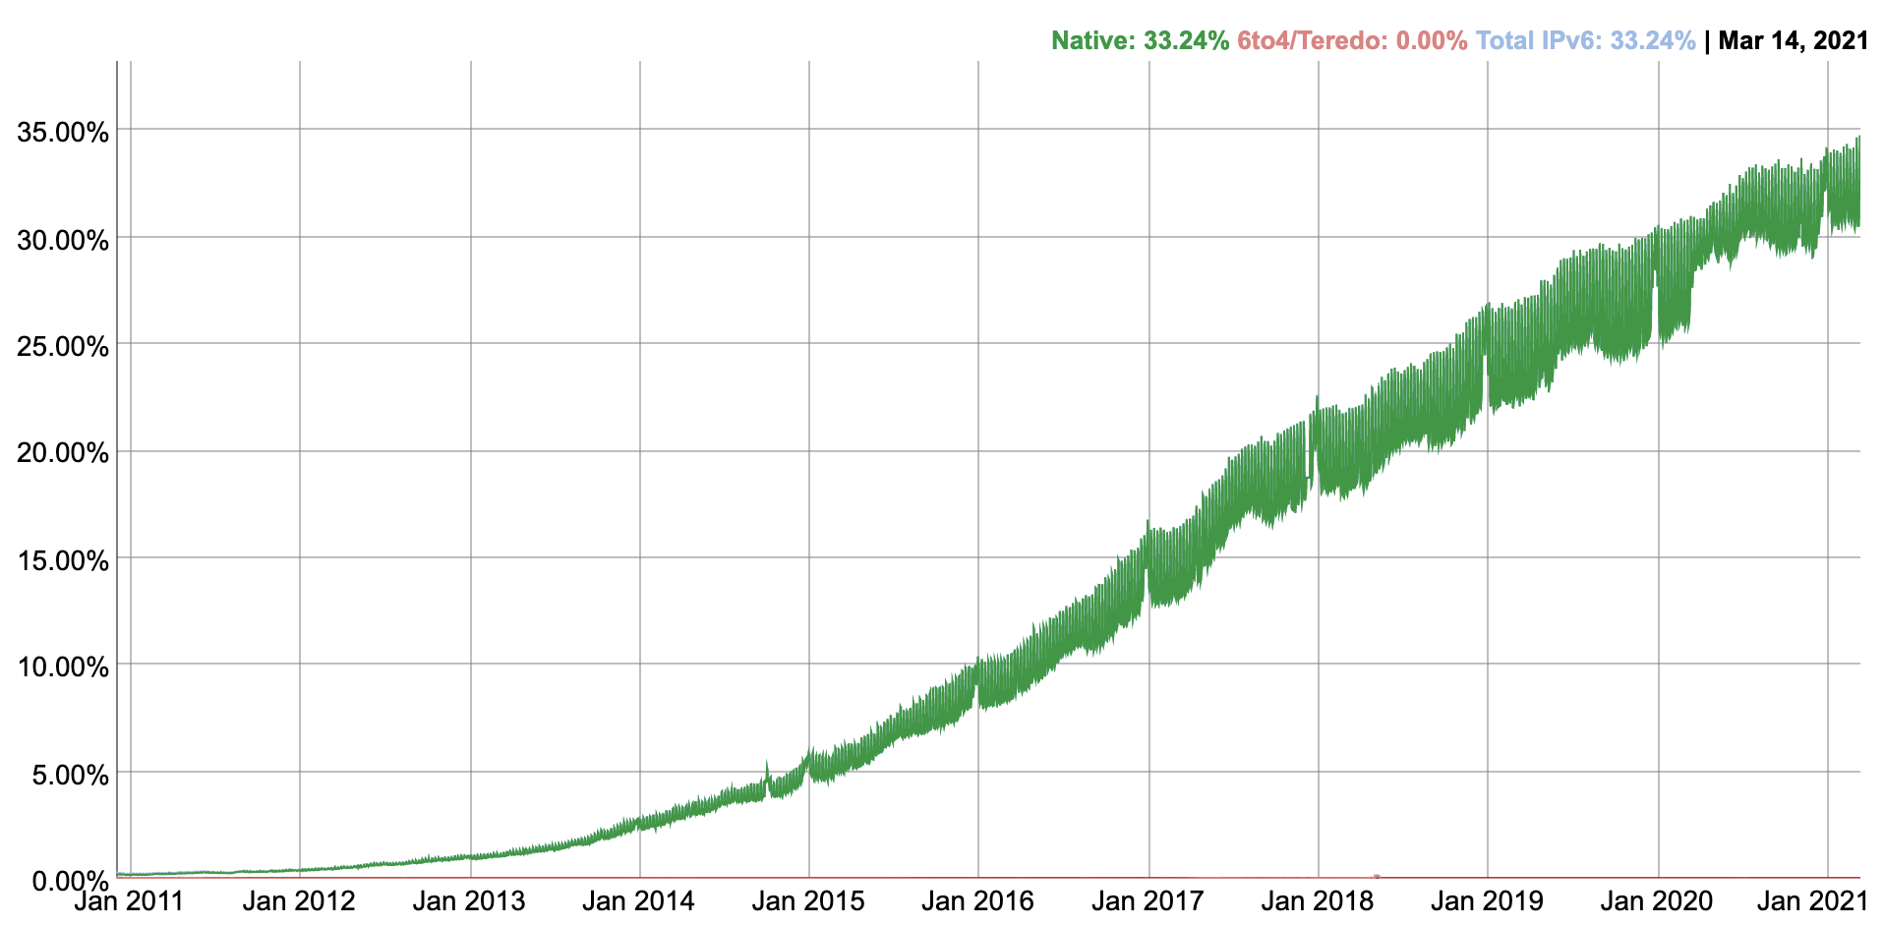
IPv6 adoption
Source: https://www.google.com/intl/en/ipv6/statistics.html#tab=ipv6-adoption
When IP became a mainstream network-layer protocol, IPv4 was baked into router hardware.
Now, about 1/3rd of Internet hosts (contacting Google) support IPv6.
IPv6 adoption has been
trending up.
~0% of Internet hosts used IPv6 for a long time (about 30 years)
In 2012, Google and a bunch of large orgs decided to support IPv6 irrevocably.

