Slide 1

Routing Protocols: Part 1
Lecture 23 http://www.cs.rutgers.edu/~sn624/352-S22
Srinivas Narayana

Slide 2




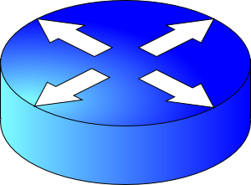


The network layer is all about reachability.
Every protocol below solves a sub-problem.
Net layer
How does an endpoint get an address?
Debugging
ICMP
How does an endpoint talk to another outside its network?
DHCP
ping
traceroute
Routing protocols
OSPF, RIP, BGP
How does an endpoint talk to another within the same network?
Broadcast
ARP
Gateways
NAT
IPv6

Slide 3
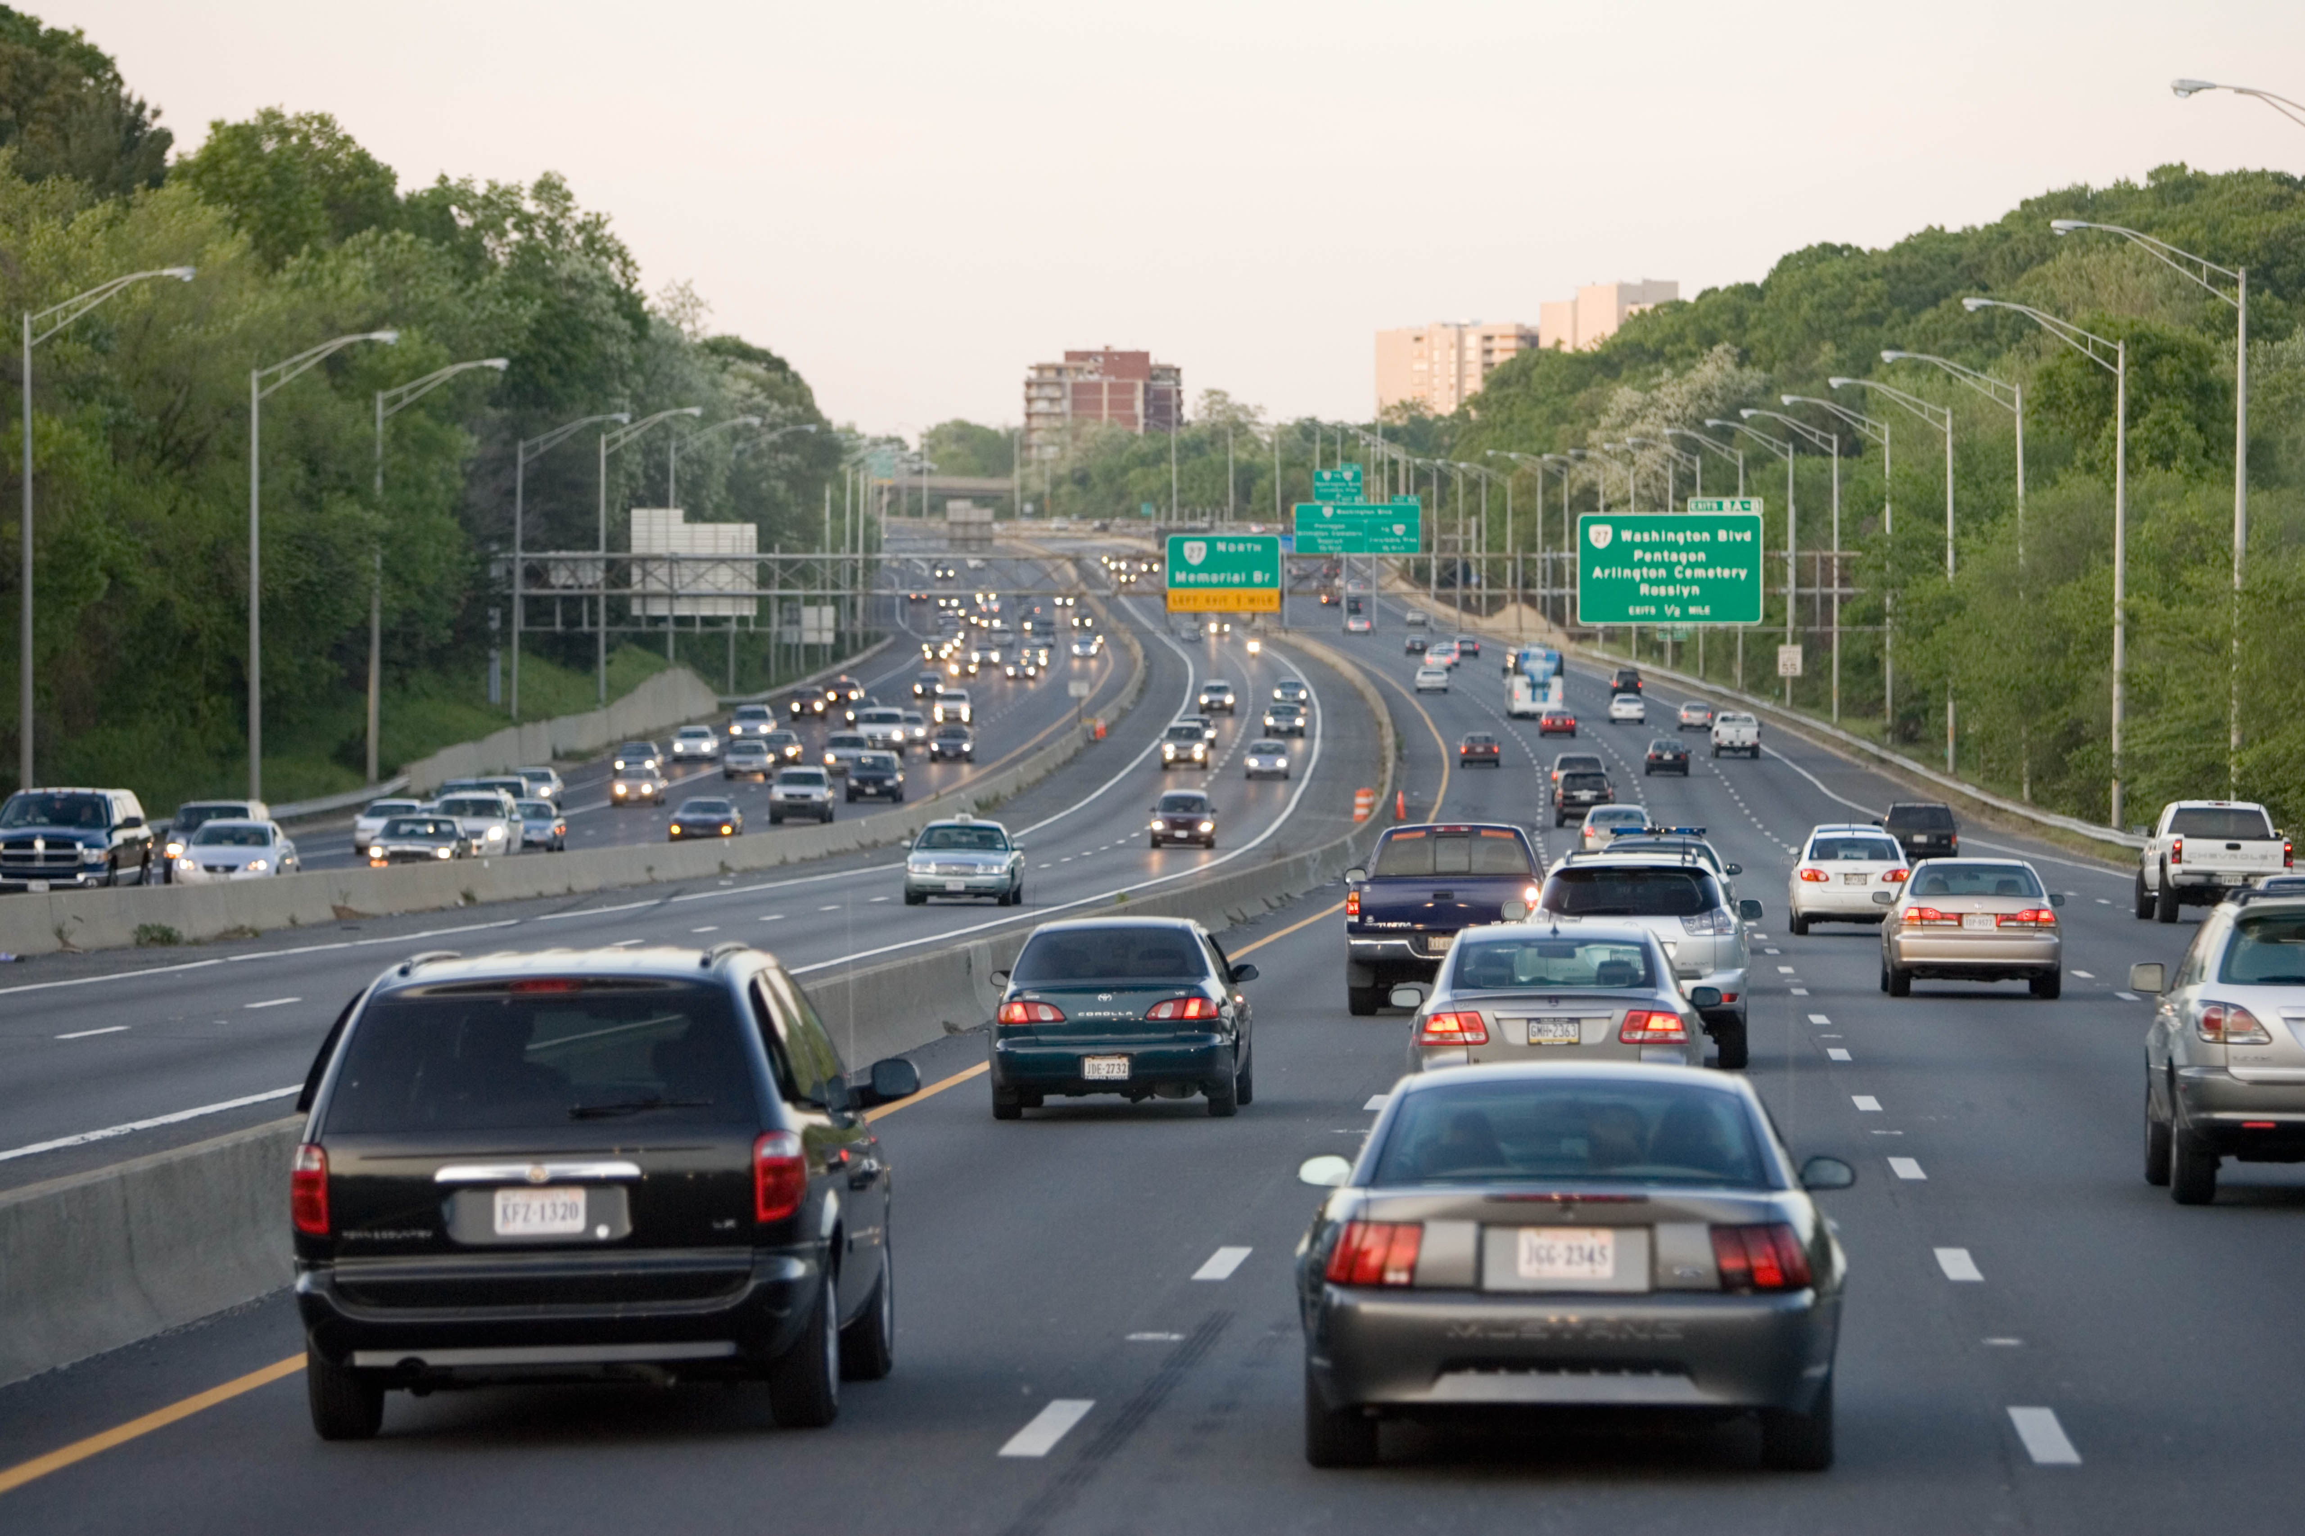
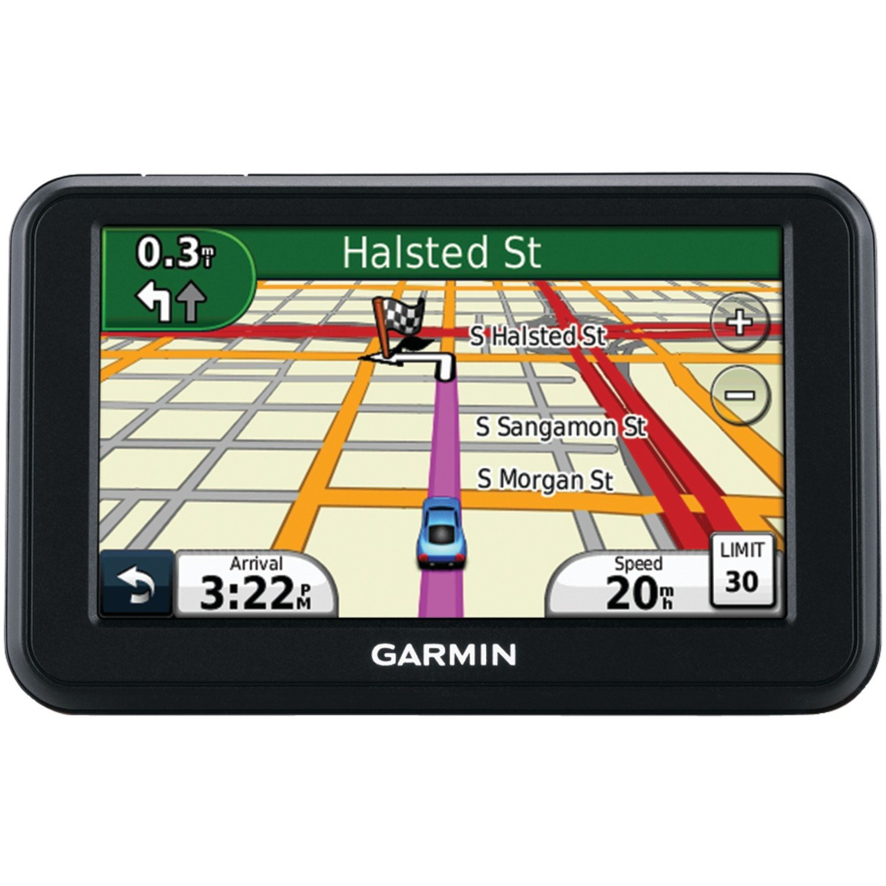
Review: Key network-layer functions
Forwarding (data plane): move packets from router’s input to appropriate router output
Routing (control plane): determine route taken by packets from source to destination
Analogy: taking a road trip
Forwarding: process of getting through single interchange
Routing: process of planning trip from source to destination
network
layer
runs
everywhere

Slide 4
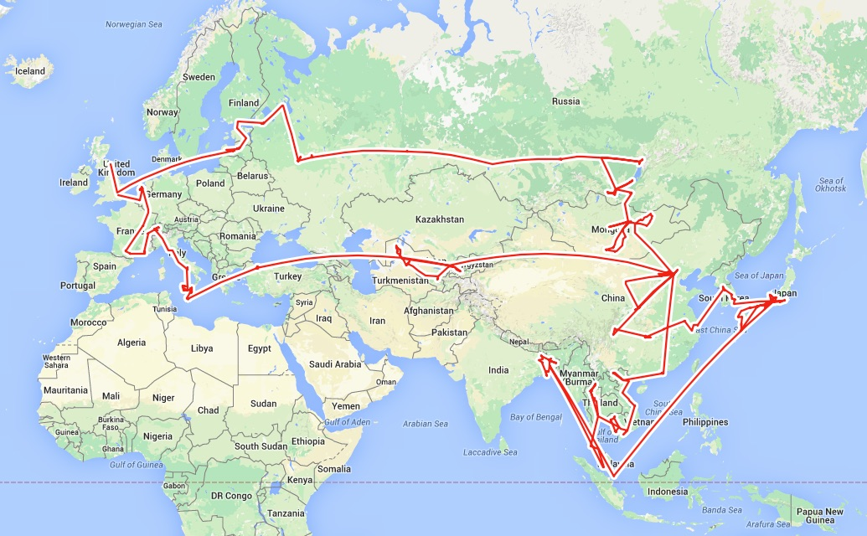
Routing is a fundamental problem in networking.
How would one design a “Google Maps”
to navigate the Internet?

Slide 5
Goals of Routing Protocols #1
Determine good paths from source to destination
“Good” = least cost
Least propagation delay
Least cost per unit bandwidth (e.g., $ per Gbit/s)
Least congested (workload-driven)
“Path” = a sequence of router ports (links)

Slide 6


Goals of Routing Protocols #2
Make networks resilient to failures
Routers & links can fail without taking down the entire network
Entire subsets can be unreachable; rest still reachable
Hence, the protocol must be distributed

Slide 7

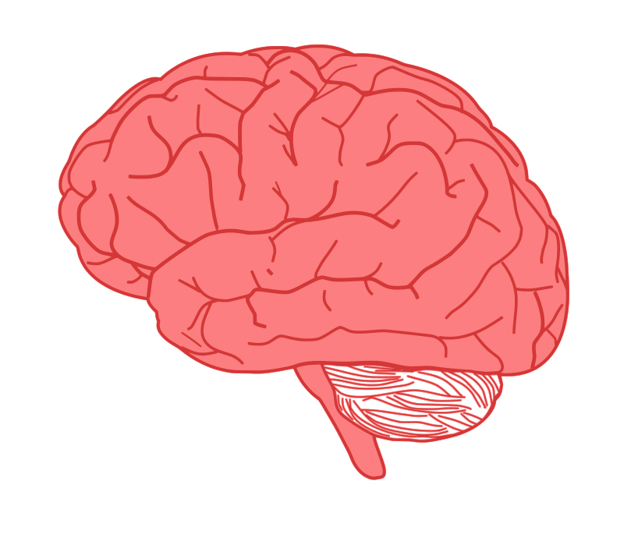


Per-router control plane
Distributed control plane: Components in every router interact with other components to produce a routing outcome.
Routing
Algorithm
control
plane
data
plane
Routing protocol
Data plane
per-packet processing, moving packet from input port to output port
Q1. What info exchanged?
0111
1
3
2
values in arriving
packet header,
i.e, destination IP address
Q2. What computation?

Slide 8
The graph abstraction
Routing algorithms work over an abstract representation of a network: the graph abstraction
Each router is a node in a graph
Each link is an edge in the graph
Edges have weights (also called link metrics). Set by netadmin
Ex: Rutgers campus
u: Computer Science
v: School of Engineering
…
5
v
3
w
2
5
u
2
1
z
3
1
2
x
y
1

Slide 9
The graph abstraction
Routing algorithms work over an abstract representation of a network: the graph abstraction
G = (N, E)
N = {u, v, w, x, y, z}
E = { (u,v), (u,x), (v,x), (v,w), (x,w), (x,y), (w,y), (w,z), (y,z) }
Ex: Rutgers campus
u: Computer Science
v: School of Engineering
…
5
v
3
w
2
5
u
2
1
z
3
1
2
x
y
1

Slide 10
The graph abstraction
5
Cost of an edge: c(x, y)
Examples: c(u, v) = 2, c(u, w) = 5
Cost of a path = sum of edge costs
c(path x → w → y → z) = 3 + 1 + 2 = 6
Outcome of routing: each node should determine the least cost path to every other node
Q1: What information should nodes exchange with each other to enable this computation?
Q2: What algorithm should each node run to compute the least cost path to every node?
v
3
w
2
5
u
2
1
z
3
1
2
x
y
1

Slide 11
The rest of this lecture
Routing protocols
Link state
protocols
Distance vector protocols
Each router has complete information of the graph
Messages exchanged by flooding all over the network
Communication expensive, but complete
Each router only maintains distances & next hop to others
Messages are exchanged over each link and stay within the link
Communication cheap, but incomplete

Slide 12
Link State Protocols

Slide 13
Link state protocol
Each router knows the state of all the links and routers in the network
Every router performs an independent computation on globally shared knowledge of network’s complete graph representation
Routing protocols
Link state
protocols
Distance vector protocols

Slide 14
Q1: Information exchange
Link state flooding: the process by which neighborhood information of each network router is transmitted to all other routers
Each router sends a link state advertisement (LSA) to each of its neighbors
LSA contains the router ID, the IP prefix owned by the router, the router’s neighbors, and link cost to those neighbors
Upon receiving an LSA, a router forwards it to each of its neighbors: flooding
5
v
3
w
2
5
u
2
1
z
3
1
2
x
y
1

Slide 15
Q1: Information exchange
Eventually, the entire network receives LSAs originated by each router
LSAs put into a link state database
LSAs occur periodically and whenever the graph changes
Example: if a link fails
Example: if a new link or router is added
The routing algorithm running at each router can use the entire network’s graph to compute least cost paths
5
v
3
w
2
5
u
2
1
z
3
1
2
x
y
1

Slide 16
Q2: The algorithm
Dijkstra’s algorithm
Given a network graph, the algorithm computes the least cost paths from one node (source) to all other nodes
This can then be used to compute the forwarding table at that node
Iterative algorithm: maintain estimates of least costs to reach every other node. After k iterations, each node definitively knows the least cost path to k destinations
Notation:
c(x,y): link cost from node x to y; = ∞ if not direct neighbors
D(v): current estimate of cost of path from source to destination v
p(v): (predecessor node) the last node before v on the path from source to v
N': set of nodes whose least cost path is definitively known

Slide 17
Dijsktra’s Algorithm
1 Initialization:
2 N' = {u}
3 for all nodes v
4 if v adjacent to u
5 then D(v) = c(u,v)
6 else D(v) = ∞
7
8 Loop
9 find w not in N' such that D(w) is a minimum
10 add w to N'
11 update D(v) for all v adjacent to w and not in N' :
12 D(v) = min( D(v), D(w) + c(w,v) )
13 /* new cost to v is either old cost to v or known
14 shortest path cost to w plus cost from w to v */
15 until all nodes in N'
Initial estimates of distances are just the link costs of neighbors.
Least cost node among all estimates. This cost cannot decrease further.
Relaxation

Slide 18
Visualization
min cost in N \ N’
N \ N’
Nodes with estimated least path costs, not definitively known to be smallest possible
N’
nodes whose least cost paths from u are definitively known
W should move to N’.
w
c(w, v)
D(w)
v
Relaxation: for each v in N \ N’, is the cost of the path via w smaller than known least cost path to v?
If so, update D(v)
Predecessor of v is w.
D(v)
v’
u
v’’
Cost of path via w: D(w) + c(w,v)
Cost of known best path: D(v)

Slide 19
Dijkstra’s algorithm: example
Step
0
1
2
3
4
5
N'
u
ux
uxy
uxyv
uxyvw
uxyvwz
D(v),p(v)
2,u
2,u
2,u
D(w),p(w)
5,u
4,x
3,y
3,y
D(x),p(x)
1,u
D(y),p(y)
∞
2,x
D(z),p(z)
∞
∞
4,y
4,y
4,y
5
v
3
w
2
5
u
2
1
z
3
1
2
x
y
1

Slide 20
Constructing the forwarding table
To find the router port to use for a given destination (router), find the predecessor of the node iteratively until reaching an immediate neighbor of the source u
The port connecting u to this neighbor is the output port for this destination

Slide 21
Constructing the forwarding table
5
Suppose we want forwarding entry for z.
v
3
w
2
5
u
2
1
z
3
1
2
x
y
1
D(v),p(v)
2,u
D(w),p(w)
3,y
D(x),p(x)
1,u
D(y),p(y)
2,x
D(z),p(z)
4,y
z: p(z) = y
y: p(y) = x
x: p(x) = u
x is an immediate
neighbor of u
Forwarding table at u:
destination
link
z
(u,x)

Slide 22
Summary of link state protocols
Each router announces link state to the entire network using flooding
Each node independently computes least cost paths to every other node using the full network graph
Dijkstra’s algorithm can efficiently compute these best paths
Easy to populate the forwarding table from predecessor information computed during the algorithm

Slide 23
Distance Vector Protocols

Slide 24
Distance Vector Protocol
Each router only exchanges a distance vector with its neighbors
Distance: how far the destination is
Vector: a value for each destination
DVs are only exchanged between neighbors; not flooded
Use incomplete view of graph derived from neighbors’ distance vectors to compute the shortest paths
Routing protocols
Link state
protocols
Distance vector protocols

Slide 25
Q1: Distance Vectors
D_{x}(y) = estimate of least cost from x to y
Distance vector: D_{x} = [D_{x}(y): y є N ]
Node x knows cost of edge to each neighbor v: c(x,v)
Node x maintains D_{x}
Node x also maintains its neighbors’ distance vectors
For each neighbor v, x maintains D_{v} = [D_{v}(y): y є N ]
Nodes exchange distance vector periodically and whenever the local distance vector changes (e.g., link failure, cost changes)
Notes:
At each node we need
- an array (known as DV) that lists the current least costs to reach all known destinations
- also need to maintain the next-hop along the least cost path
- the DV’s from all neighbors

Slide 26
Q2: Algorithm
Bellman-Ford algorithm
Each node initializes its own distance vector (DV) to edge costs
Each node sends its DVs to its neighbors
When a node x receives new DV from a neighbor v, it updates its own DV using the Bellman-Ford equation:
Given d_{x}(y) := estimated cost of the least-cost path from x to y
Update d_{x}(y) = min_{v} {c(x,v) + d_{v}(y) }
cost of path from neighbor v to destination y
minimum taken over
all neighbors v of x
cost to reach neighbor v directly from x

Slide 27
Visualization
Neighbor v sends its distance vector to x.
Which neighbor v offers the current best path from x to y?
Path through neighbor v has cost c(x,v) + d_{v}(y)
Choose min-cost neighbor
Remember min-cost neighbor as the one used to reach node y
This neighbor determines the output port!
v
c(x,v)
v’
x
d_{v}(y)
v’’
y
v’’’
Use v’’ and link (x,v’’) to reach y.

Slide 28
D_{x}(y) = min{c(x,y) + D_{y}(y), c(x,z) + D_{z}(y)} = min{2+0 , 7+1} = 2
D_{x}(z) = min{c(x,y) + D_{y}(z),
c(x,z) + D_{z}(z)}
= min{2+1 , 7+0} = 3
node x table
cost to
cost to
cost to
x y z
x y z
x y z
x
0 2 7
x
0 2 3
x
0 2 3
from
y
∞
∞
∞
from
y
2 0 1
from
y
2 0 1
z
∞
∞
∞
z
7 1 0
z
3 1 0
node y table
cost to
cost to
cost to
x y z
x y z
x y z
y
x
∞
∞
∞
x
0 2 7
2
1
2 0 1
x
0 2 3
x
z
from
y
from
y
2 0 1
from
y
2 0 1
7
z
∞
∞
∞
z
7 1 0
z
3 1 0
node z table
cost to
cost to
cost to
x y z
x y z
x y z
x
∞ ∞ ∞
x
0 2 7
x
0 2 3
from
y
from
y
2 0 1
from
y
2 0 1
∞
∞
∞
z
z
3 1 0
z
3 1 0
7
1
0
time
Notes:
This example assumes that nodes are computing routes in a lock-step fashion.

Slide 29
Good news travels fast
Suppose the link cost reduces or a new better path becomes available in a network.
The immediate neighbors of the change detect the better path immediately
Since their DV changed, these nodes notify their neighbors immediately.
And those neighbors notify still more neighbors
… until the entire network knows to use the better path
Good news travels fast through the network
This is despite messages only being exchanged among neighbors
1
y
4
1
x
z
2

Slide 30
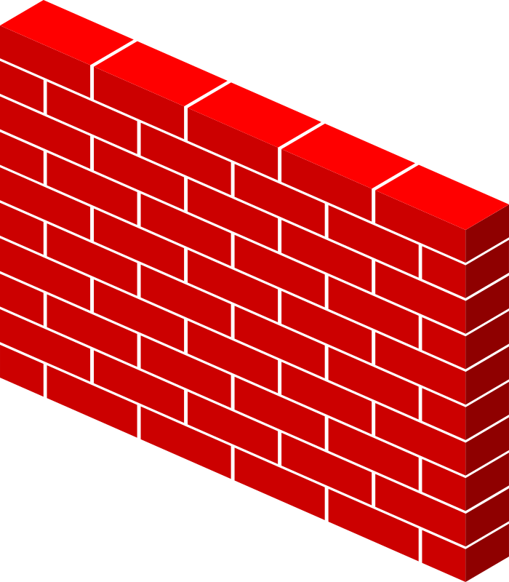
Bad news travels slowly
If router goes down, could be a while before network realizes it.
B still thinks it can reach A through C… bad!
A
B
C
D
E
1
2
3
4
Initially
C thinks it can reach A through B… worse!
3
2
3
4
After 1 exchange
3
4
3
4
After 2 exchanges
B, D think they can reach A through C… ugly!
5
4
5
4
After 3 exchanges
5
6
5
6
After 4 exchanges
Count to infinity problem
7
6
7
6
After 5 exchanges
etc… to infinity

Slide 31
Bad news travels slowly
Reacting appropriately to bad news requires information that only other routers have. DV does not exchange sufficient info.
B needs to know that C has no other path to A other than via B.
DV does not exchange paths; just distances!
Poisoned reverse: if X gets its route to Y via Z, then X will announce d_{X}(Y) = ∞ in its message to Z
Effect: Z won’t use X to route to Y
However, this won’t solve the problem in general (think why.)
A
B
C
D
E

Slide 32
Summary: Comparison of LS and DV
Link State Algorithms
Distance Vector Algorithms
Nodes have full visibility into the network’s graph
Copious message exchange: each LSA is flooded over the whole network
Robust to network changes and failures
Only distances and neighbors are visible
Sparse message exchange: DVs are exchanged among neighbors only
Brittle to router failures. Incorrect info may propagate all over net
OSPF
Open Shortest Path First
(v2 RFC 2328)
EIGRP
Enhanced Interior Gateway Routing Protocol
(RFC 7868)

