Slide 1

Quality of Service (continued)
Lecture 26 http://www.cs.rutgers.edu/~sn624/352-S22
Srinivas Narayana

Slide 2


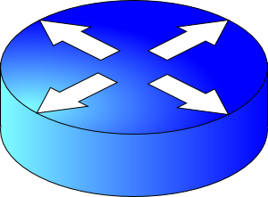
Best effort networking isn’t enough
Conf call: Requires low latency
High delay
Packet drops
Resource contention occurs in the core of the network
Congestion control will react, but may be too little & too late
Instead, network should differentiate classes of traffic
Network should provide service guarantees for each class
Prioritization, rate limiting, fair queueing
Implemented in the router’s packet scheduler
BitTorrent: Requires high throughput
FIFO queue

Slide 3
Why care about service guarantees?
Influences how packets are treated at contentious resources in the core of the network
Regardless of the endpoint transport
Implementations of scheduling (QoS) within large networks have implications for debates on network neutrality
Scheduling is a fundamental problem in computer networks
Next: Rate limiting

Slide 4
Rate Limiting

Slide 5
Measures of transmission rate
Long-term/average rate: data rate transmitted per unit time, over a long period
Crucial question: what is the time interval over which rate is measured?
Average and instantaneous behaviors can be very different
Same average rate
Rate
Measurement duration
Rate
Measurement duration
Time
Time

Slide 6
Measures of transmission rate
Peak rate: largest instantaneous rate that is transmitted
Measurement duration is typically very small
Burst size: maximum amount of data sent consecutively without any intervening idle periods
Measurement duration
peak rate
Rate
Time

Slide 7
Rate enforcement
There are two kinds of rate enforcement policies:
shaping and policing
Two specific mechanisms to implement those:
leaky buckets and token buckets
Basic mechanism: wait for the passage of appropriate time before releasing packets for transmission

Slide 8
Shaping
vs. Policing
Enforces rate by queueing excess packets in a buffer
Drop only if buffer is full
Requires memory to buffer packets
Can inflate round-trip time (queueing in shaping buffer)
Enforces rate by dropping excess packets immediately
Can result in high loss rates
Does not require a memory buffer
No additional inflation in round-trip times

Slide 9
Leaky bucket shaper

Slide 10


Intuition: release packets at steady rate
Packets from source
Bucket
leaking water
at a steady
rate
Leaky
Bucket
Shaper
Shaping buffer
Timed release mechanism for packets
Packets leaving at steady rate

Slide 11
Leaky Bucket Shaper
Packets may enter in a bursty manner
However, once they pass through the leaky bucket, they are evenly spaced
The shaping buffer holds packets up to a certain point
If the buffer is full, packets are dropped
Setting the rate is a policy concern
Assume an admin provides us the rate
Shapers may be used in the core of a network to limit bandwidth use, or at the edge to pace packets entering the network in the first place

Slide 12
Leaky Bucket Shaper
For a leaky bucket shaper, assume average rate == peak rate
However, many Internet transfers just have a few packets
For example, web requests and responses
Enforcing rate limit for those can significantly delay completion
We often wish to have peak rate higher than avg rate
Especially at the beginning of a connection
If so, use a token bucket: burst-tolerant version of a leaky bucket

Slide 13
Token bucket shaper

Slide 14
Token bucket shaper
Fill at rate r
Limits traffic class to a specified average rate r and burst size B
Tokens are filled in at rate r
The token bucket can hold a maximum of B tokens. Further tokens dropped
Note: distinct from shaping buffer size
Suppose a packet is at the head of the shaping buffer
If a token exists in the bucket, remove token, and transmit the packet
If not, wait.
Bucket size B
Packets
Remove token
Transmit
Shaping buffer

Slide 15
Token bucket shaper
Fill at rate r
In time t, the maximum number of packets that depart the shaper is (r * t) + B
A full bucket of tokens would allow small flows to go through unaffected
A maximum burst of B packets
Longer flows have average rate r
Bucket emptied initially, the rest of the flow must respect the token fill rate
As t → ∞, the average rate approaches r
That is, (1/t) * (r*t + B) → r
Bucket size B
Packets
Remove token
Transmit
Shaping buffer

Slide 16
Token bucket policers

Slide 17
Token bucket policer
Fill at rate r
A token bucket policer is just a token bucket shaper without the shaping buffer
No place for packets to wait if there are no tokens
If token exists, packet transmitted.
If not, packet dropped
Simple and efficient to implement.
The internet has tons of token bucket policers
Bucket size B
Packets
Remove token
Transmit
Shaping buffer

Slide 18
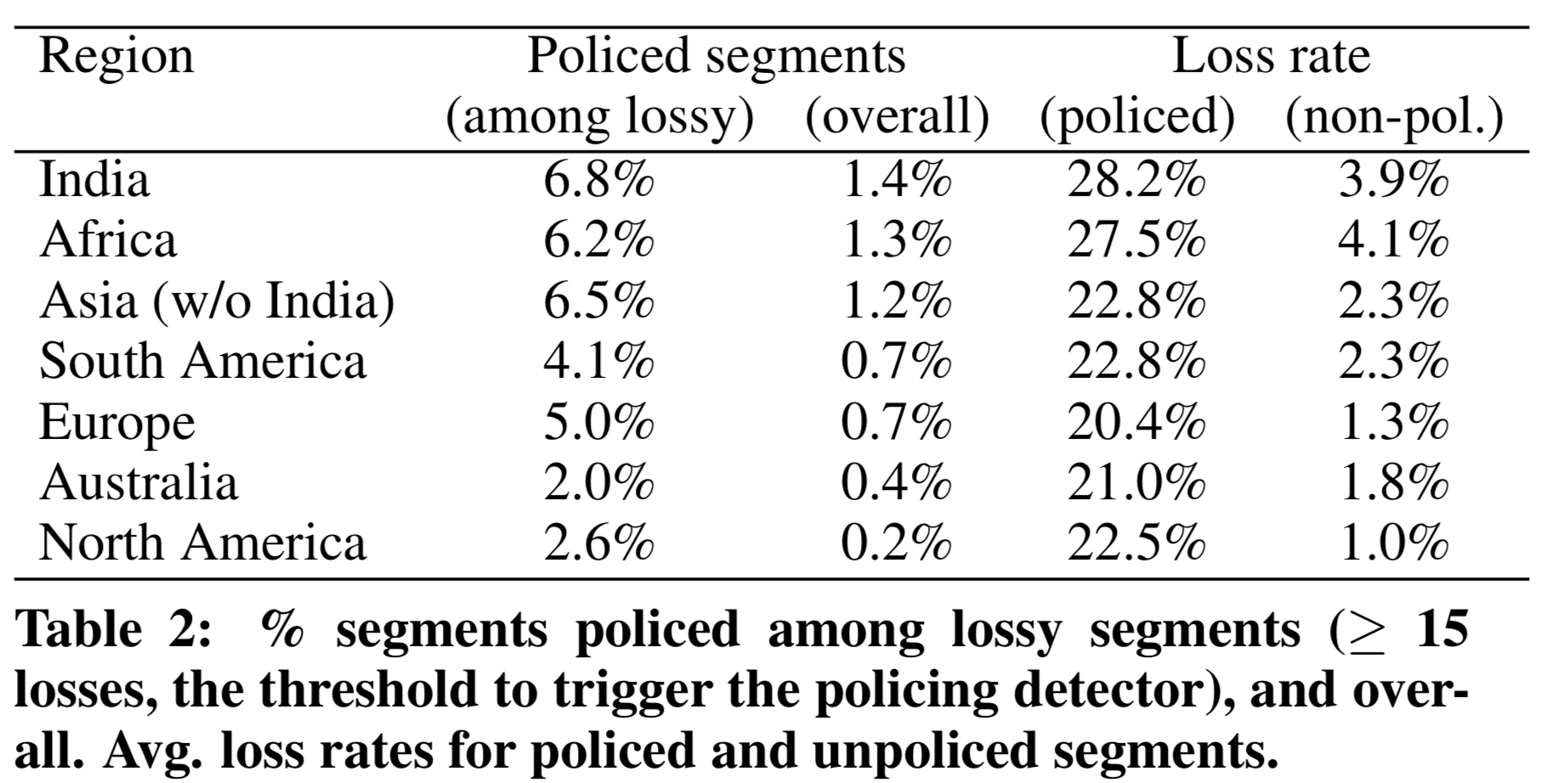
Google study from 2016
Small but non-trivial fraction of policed links
Significant impact on packet loss rate
Flach et al., An Internet-Wide Analysis of Traffic Policing, SIGCOMM 2016

Slide 19
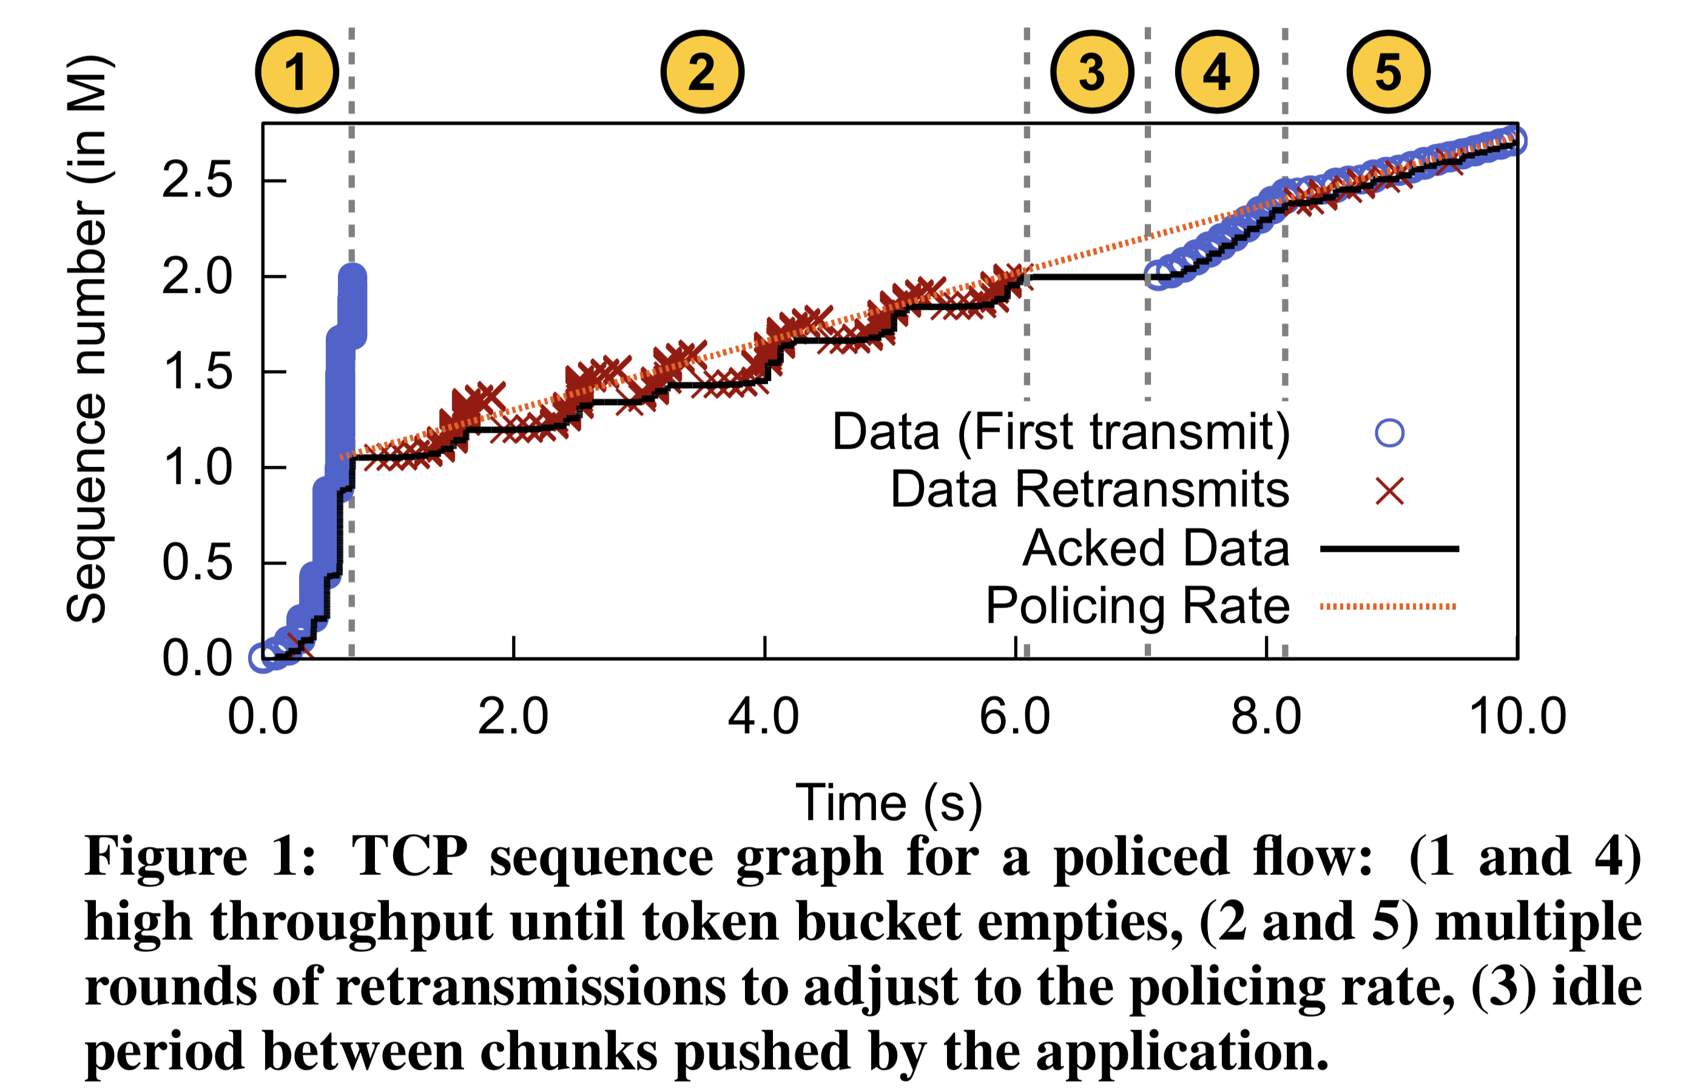
Impact on TCP
Policers drop multiple packets in a burst: causing RTOs and retransmissions after emptying of token bucket
Slow start period: burst allowed with a full bucket of tokens

Slide 20
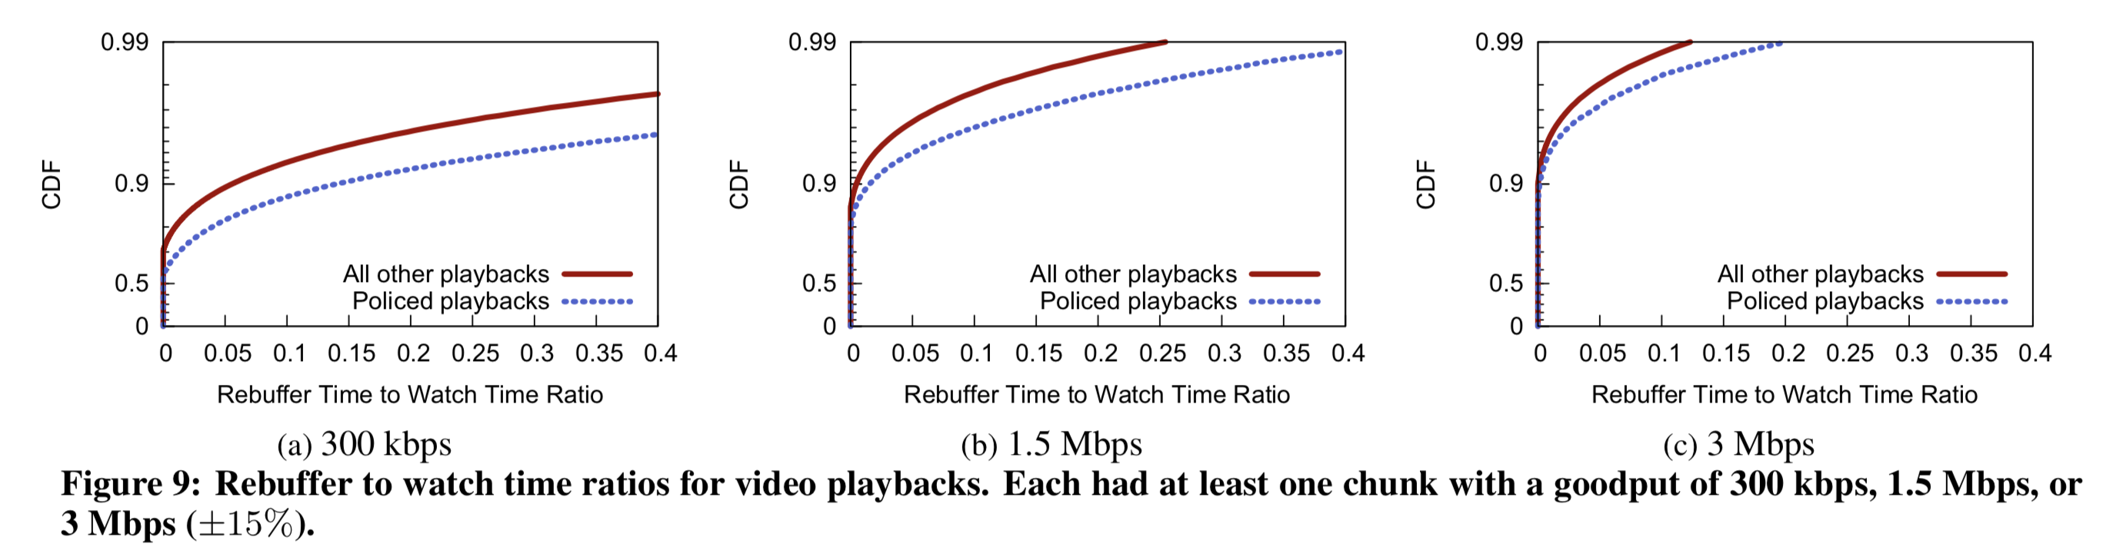
Effect on actual apps: YouTube
Video rebuffer rate: rebuffer time / overall watch time

Slide 21
Summary of rate limiting
Rate limiting is a useful mechanism to isolate traffic classes from each other
Two strategies: policing and shaping
Leaky bucket and token bucket
The Internet has a lot of token bucket policers, causing real impact on TCP connections and app performance
Understand how ISPs treat consumer Internet traffic

Slide 22
Synthesis of protocols

Slide 23
Synthesis: a day in the life of a web request
Goal: identify, review, understand protocols (at all layers) involved in seemingly simple scenario: requesting www page
Scenario: student attaches laptop to campus network, requests/receives www.google.com

Slide 24




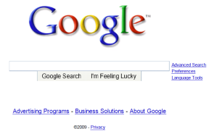
A day in the life: scenario
browser
DNS server
Comcast network
68.80.0.0/13
school network
68.80.2.0/24
web page
web server
Google’s network
64.233.160.0/19
64.233.169.105

Slide 25
A day in the life… connecting to the Internet
DHCP
DHCP
UDP
IP
Eth
Phy
connecting laptop needs to get its own IP address, addr of first-hop router, addr of DNS server: use DHCP
DHCP
DHCP
DHCP
DHCP
DHCP request encapsulated in UDP, encapsulated in IP, encapsulated in link layer Ethernet
DHCP
DHCP
UDP
IP
Eth
Phy
DHCP
DHCP
DHCP
DHCP
router
(runs DHCP)
Packet broadcast (dest: FFFFFFFFFFFF) on the local network, received at a router running DHCP server
Ethernet decapsulated to IP decapsulated to UDP decapsulated to DHCP

Slide 26
A day in the life… connecting to the Internet
DHCP
DHCP
UDP
IP
Eth
Phy
DHCP server formulates DHCP ACK containing client’s IP address, IP address of first-hop router for client, name & IP address of DNS server
DHCP
DHCP
DHCP
DHCP client receives DHCP ACK reply
DHCP
DHCP
UDP
IP
Eth
Phy
DHCP
DHCP
DHCP
router
(runs DHCP)
DHCP
Client now has IP address, knows name & addr of DNS
server, IP address of its first-hop router

Slide 27
A day in the life… ARP (before DNS, before HTTP)
DNS
UDP
IP
Eth
Phy
before sending HTTP request, need IP address of www.google.com: DNS
DNS
DNS
DNS
ARP
ARP query
DNS query created, encapsulated in UDP, encapsulated in IP, encapsulated in Eth. To send frame to router, need MAC address of router interface: ARP
ARP
ARP reply
Eth
Phy
ARP query broadcast, received by router, which replies with ARP reply giving MAC address of router interface
router
(runs DHCP)
client now knows MAC address of gateway router, so can now send packet containing DNS query

Slide 28
A day in the life… using DNS
DNS
UDP
IP
Eth
Phy
DNS
DNS server
DNS
UDP
IP
Eth
Phy
DNS
DNS
DNS
DNS
DNS
DNS
DNS
DNS
Comcast network
68.80.0.0/13
IP datagram forwarded from campus network into Comcast network, routed (tables created by EIGRP, OSPF, and/or BGP routing protocols) to DNS server
router
(runs DHCP)
IP datagram containing DNS query from client to gateway router
decapsulated to DNS server
DNS server replies to client with IP address of www.google.com

Slide 29
A day in the life…TCP connection carrying HTTP
HTTP
HTTP
TCP
IP
Eth
Phy
SYNACK
SYN
SYNACK
SYN
SYNACK
SYN
SYN
to send HTTP request, client first opens TCP socket to web server
router
(runs DHCP)
TCP
IP
Eth
Phy
SYNACK
TCP packet routed using inter-domain routing (BGP) and intra-domain routing (OSPF, EIGRP) to web server
SYN
SYNACK
SYN
SYNACK
SYNACK
SYN
web server
64.233.169.105

Slide 30
A day in the life… HTTP request/reply
HTTP
HTTP
TCP
IP
Eth
Phy
web page finally (!!!) displayed
HTTP
HTTP
HTTP
HTTP
HTTP
HTTP
HTTP
HTTP
HTTP request sent into TCP socket
router
(runs DHCP)
IP datagram containing HTTP request routed to www.google.com
HTTP
HTTP
TCP
IP
Eth
Phy
HTTP
HTTP
HTTP
web server responds with HTTP reply (containing web page)
HTTP
web server
64.233.169.105
IP datagram containing HTTP reply routed back to client

Slide 31
Internet Technology

Slide 32
Outro
Computer networks are a stack of layers
Built for modularity
Each layer does one set of functions very well
Each layer depends on the layers beneath it
Many general and useful principles
Applicable to real life (e.g., feedback control)
Applicable to computer system design (e.g., indirection & hierarchy)

Slide 33
Outro: Now what?
Go about life as usual
One difference: enhanced abilities to work with Internet-based tech
Apply your new skills to solve a problem you care about
Tons of free and open-source software and platforms. Opportunities
Deepen your understanding of the Internet and its tech
CS 552 Computer Networks (Fall 2022 - Prof Rich Martin)
CS 553 Internet services (Spring 2023 - me)
Push the boundaries of Internet tech
Talk to me about research

