Slide 1

Streaming multimedia
CS 352, Lecture 22
http://www.cs.rutgers.edu/~sn624/352-S19
Srinivas Narayana
(heavily adapted from slides by Prof. Badri Nath and the textbook authors)

Slide 2




Multimedia networking
Many applications on the Internet use audio or video
IP video traffic will be 82 percent of all IP traffic […] by 2022, up from 75 percent in 2017
Internet video surveillance traffic will increase sevenfold between 2017 to 2022
Internet video to TV will increase threefold between 2017 to 2022.
Consumer Video-on-Demand (VoD) traffic will nearly double by 2022
Source: Cisco visual networking index 2017--22
2

Slide 3
What’s different about these applications?
Traditional applications (HTTP(S), SMTP)
Delay tolerant but not loss tolerant
Data used after transfer complete
But multimedia applications are often “real time”
Data delivery time during transfer has implications
Video/audio streaming
Delay-sensitive
Real-time audio and video
Delays < 150 msec and > 400 ms for audio is a bad user experience
Somewhat loss tolerant
3

Slide 4
Digital representation of audio and video

Slide 5
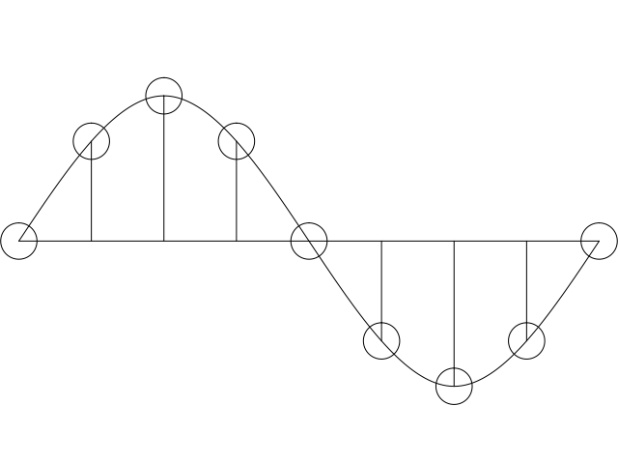
Digital representation of audio
Must convert analog signal to digital representation
Sample
How many times (twice the max frequency in the signal)
Quantize
How many levels or bits to represent each sample
More levels ➔ more accuracy
More levels ➔ more bits to store & more bandwidth to transmit
Compress
Compact representation of quantized values
5

Slide 6
Audio representation
analog audio signal sampled at constant rate
telephone: 8,000 samples/sec
CD music: 44,100 samples/sec
each sample quantized, i.e., rounded
e.g., 2⁸=256 possible quantized values
each quantized value represented by bits, e.g., 8 bits for 256 values
quantization error
quantized value of
analog value
analog
signal
audio signal amplitude
time
sampling rate
(N sample/sec)

Slide 7
Audio representation
example: 8,000 samples/sec, 256 quantized values
Bandwidth needed: 64,000 bps
receiver converts bits back to analog signal:
some quality reduction
Example rates
CD: 1.411 Mbps
MP3: 96, 128, 160 Kbps
Internet telephony: 5.3 Kbps and up
quantization error
quantized value of
analog value
analog
signal
audio signal amplitude
time
sampling rate
(N sample/sec)

Slide 8
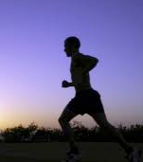
Video representation
spatial coding example: instead of sending N values of same color (all purple), send only two values: color value (purple) and number of repeated values (N)
Video: sequence of images displayed at constant rate
e.g., 24 images/sec
Digital image: array of pixels
each pixel represented by bits
Coding: use redundancy within and between images to decrease # bits used to encode image
spatial (within image)
temporal (from one image to next)
Coding/decoding algorithm often called a codec
……………………...…
……………………...…
frame i
temporal coding example: instead of sending complete frame at i+1, send only differences from frame i
frame i+1

Slide 9
Video representation
spatial coding example: instead of sending N values of same color (all purple), send only two values: color value (purple) and number of repeated values (N)
Video bit rate: effective bits per second of the video after encoding
CBR: (constant bit rate): video encoding rate fixed
VBR: (variable bit rate): video encoding rate changes as amount of spatial, temporal coding changes
examples:
MPEG 1 (CD-ROM) 1.5 Mbps
MPEG2 (DVD) 3-6 Mbps
MPEG4 (often used in Internet, < 1 Mbps)
……………………...…
……………………...…
frame i
temporal coding example: instead of sending complete frame at i+1, send only differences from frame i
frame i+1

Slide 10
Multimedia networking: 3 application types
streaming, stored audio, video
streaming: can begin playout before downloading entire file
stored (at server): can transmit faster than audio/video will be rendered (implies storing/buffering at client)
e.g., YouTube, Netflix, Hulu
conversational voice/video over IP
interactive nature of human-to-human conversation limits delay tolerance
e.g., Skype
streaming live audio, video
e.g., live sporting event (futbol)

Slide 11
Streaming video

Slide 12
Streaming stored content
Media is prerecorded
Client downloads an initial portion and starts viewing
Rest downloaded as time progresses
No need to wait for entire content to be downloaded
Can change content sites mid-stream based on network conditions

Slide 13


Streaming stored video:
Cumulative data
2. video
sent
video
recorded (e.g., 30 frames/sec)
3. video received,
played out at client
(30 frames/sec)
network delay
(fixed in this example)
time
streaming: at this time, client
playing out early part of video,
while server still sending later
part of video

Slide 14
Streaming stored video: challenges
continuous playout constraint: once client playout begins, playback must match original timing
… but network delays are variable (jitter), so will need client-side buffer to match playout requirements
other challenges:
client interactivity: pause, fast-forward, rewind, jump through video
video packets may be lost, retransmitted

Slide 15
Streaming stored video: revisited
constant bit
rate video
transmission
client video
reception
constant bit
rate video
playout at client
Cumulative data
variable
network
delay
buffered
video
client playout
delay
time
client-side buffering and playout delay: compensate for network-added delay, delay jitter

Slide 16

Client-side buffering, playout
buffer fill level, Q(t)
variable fill
rate, x(t)
playout rate,
e.g., CBR r
video server
client application
buffer, size B
client

Slide 17
Client-side buffering, playout
buffer fill level, Q(t)
variable fill
rate, x(t)
playout rate,
e.g., CBR r
video server
client application
buffer, size B
client
1. Initial fill of buffer until playout begins at t_{p}
2. playout begins at t_{p,}
3. buffer fill level varies over time as fill rate x(t) varies and playout rate r is constant

Slide 18
Client-side buffering, playout
buffer fill level, Q(t)
variable fill
rate, x(t)
playout rate,
e.g., CBR r
video server
client application
buffer, size B
playout buffering: average fill rate (x), playout rate (r):
x < r: buffer eventually empties (causing freezing of video playout until buffer again fills)
x > r: buffer will not empty, provided initial playout delay is large enough to absorb variability in x(t)
initial playout delay tradeoff: buffer starvation less likely with larger delay, but larger delay until user begins watching

Slide 19
Streaming multimedia: UDP
server sends at rate appropriate for client
often: send rate = encoding rate = constant rate
transmission rate can be oblivious to congestion levels
short playout delay (2-5 seconds) to remove network jitter
error recovery: application-level, time permitting
RTP [RFC 2326]: multimedia payload types
UDP traffic may not get through firewalls

Slide 20
Streaming multimedia: HTTP/TCP
multimedia file retrieved via HTTP GET
send at maximum possible rate under TCP
fill rate fluctuates due to TCP congestion control, retransmissions (in-order delivery)
larger playout delay: smooth TCP delivery rate
HTTP/TCP passes more easily through firewalls
variable rate, x(t)
video
file
TCP send buffer
TCP receive buffer
application playout buffer
server
client

Slide 21
Streaming multimedia with DASH
Dynamic Adaptive Streaming over HTTP
Used by Netflix and other video streaming services
Client-centric approach to video delivery
Adaptive: Client performs video bit rate adaptation
Dynamic: Can retrieve a single video from multiple sources
Retain benefits of existing Internet and end host systems
Server is standard HTTP server
Provides video/audio content in multiple formats and encodings
DASH allows the use of CDNs for data delivery

Slide 22
Dynamic Adaptive Streaming over HTTP (DASH)

Slide 23
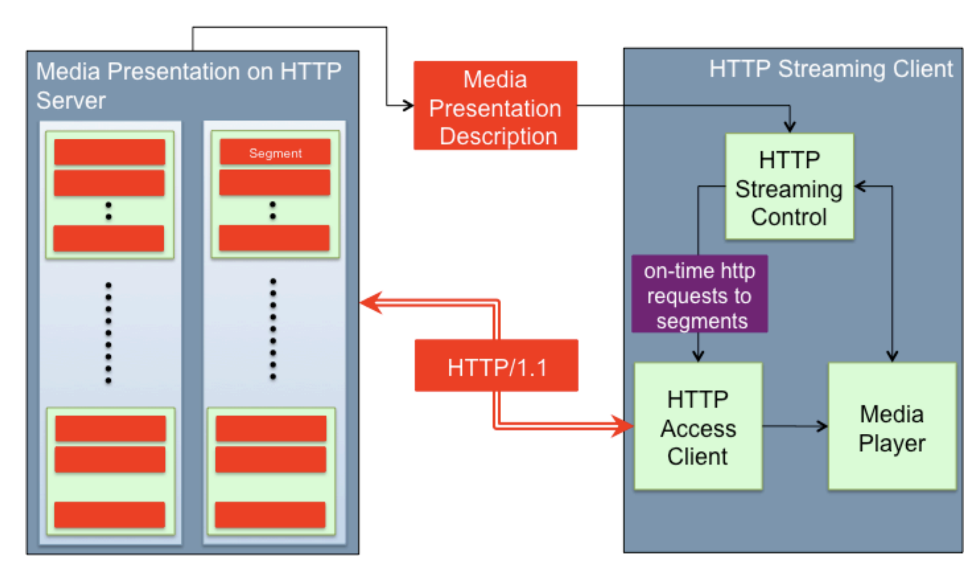
DASH: Key ideas
Content chunks
Each chunk can be independently retrieved
Client-side algorithms to determine and request a varying bit rate for each chunk
Goal: ensure good quality of service
Source: Stockhammer MMSys 2011

Slide 24
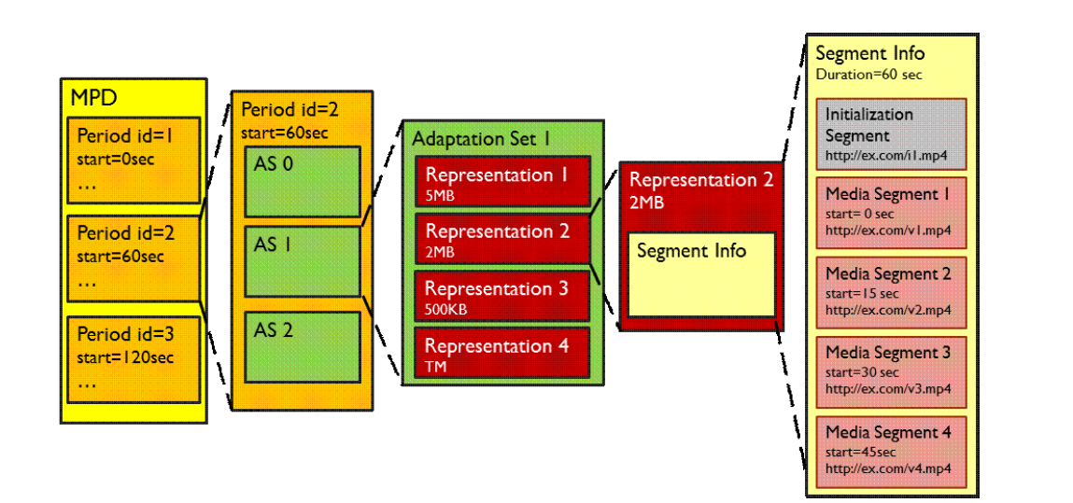
DASH Data model
Media has several periods
Each period has several Adaptation Sets: Audio, video, close caption
Several Representations (ex: codecs, bit rates) per Adaptation set
Several Chunks/Segments per Representation

Slide 25
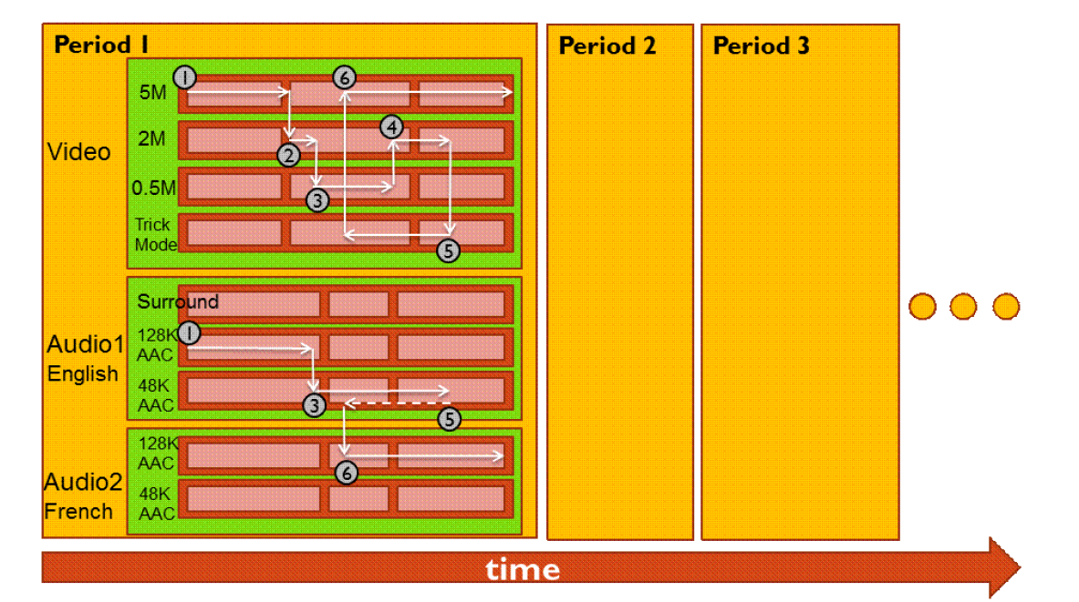
Dynamic bit rate changing of streams

Slide 26
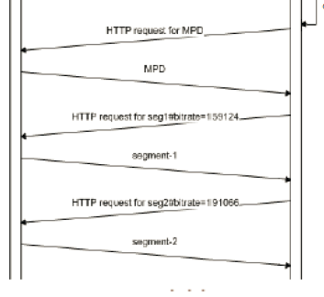
Media Presentation Descriptor (MPD)
MPD requested over http
Also called “manifest”
Describes all segments
Timing information and byte ranges of chunks
Client uses HTTP GET RANGE from a given AS + representation to ask a given bit rate
Client could use a different URL for each AS + representation

Slide 27




Video Delivery using CDN
2. HTTP reply containing html to construct the web page and a link to stream, say FLV file
4. HTTP reply
FLV stream
Video-servers
(front end)
Front end
web-servers
Internet
1. HTTP GET request for video URL
3. HTTP GET request
for FLV stream
User

Slide 28
Server Selection
File → server mapping done in at least three ways
Dynamic DNS resolution
DNS returns different IP addresses for a given DNS name
HTTP redirect
Use HTTP status code 3xx [with new URL]
Web browser does a GET from the new site
IP anycast
Use BGP to announce the same IP address from different locations
Client reaches “nearest” location according to inter-domain routing

Slide 29
DASH Summary
Widely used in video streaming services
Allows independent requests per segment
Hence, independent segment quality and data sizes
Encoded through separate HTTP objects and corresponding HTTP byte ranges
Combined or separate audio & video streams
Works well with CDNs
Independent representations or chunks can be queried from different locations if needed

