Slide 1

Flow Control; Congestion Control
Lecture 16
http://www.cs.rutgers.edu/~sn624/352-F24
Srinivas Narayana

Slide 2
How much data to keep in flight?
= window size
Proportional to throughput
SEQ 0
SEQ 1
SEQ 2
Stop and Wait
SEQ 3
SEQ 0
RTT
ACK 1
ACK 2
ACK 3
ACK 4
RTT
ACK
SEQ 1
Pipelined Reliability
RTO
Retransmit

Slide 3



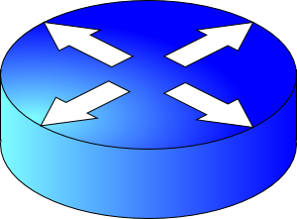
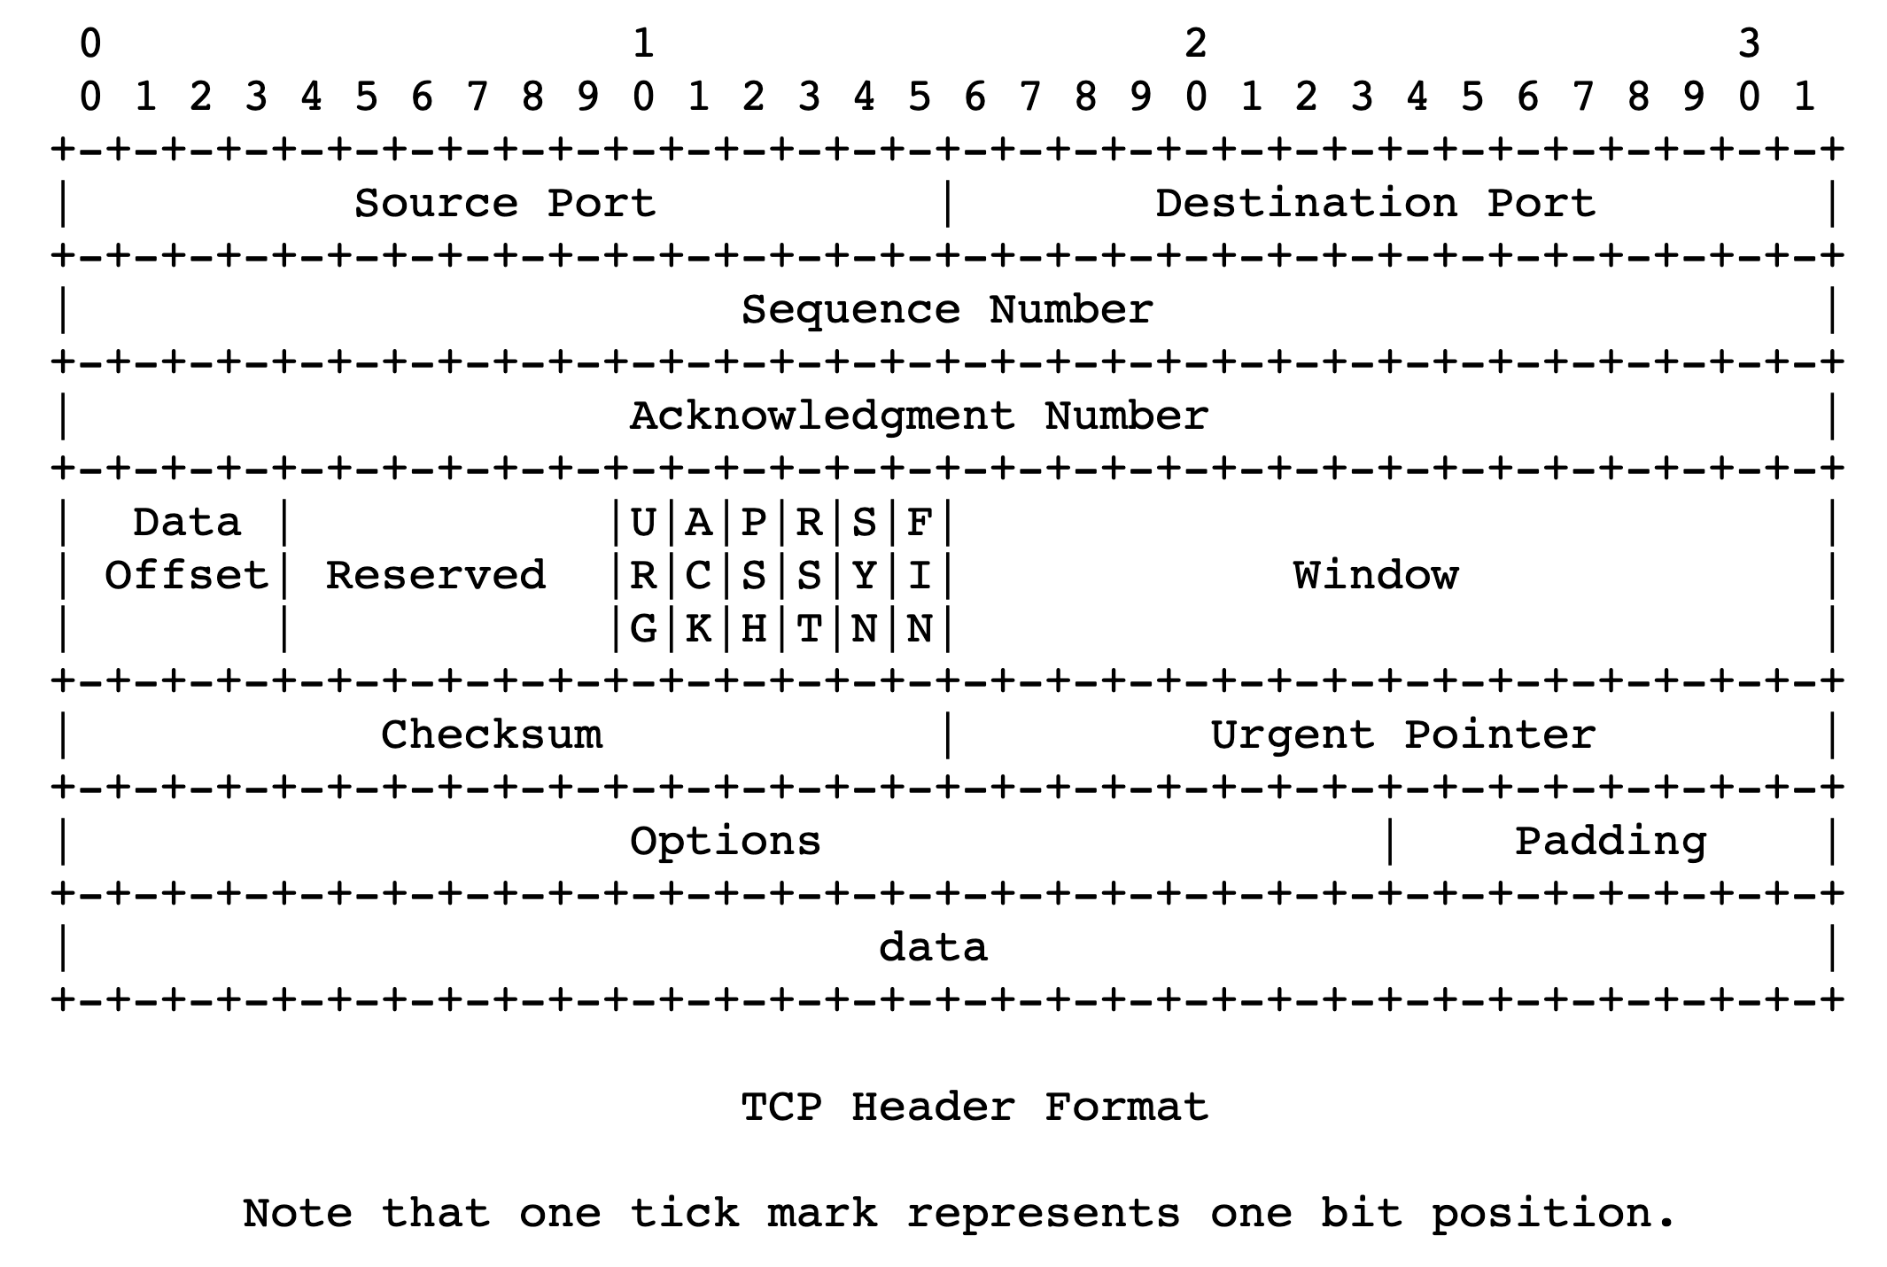
sender
Multiple locations for bottlenecks
application
process
recv()
Congestion Control
TCP socket
receiver buffers
Flow Control
What’s the bottleneck? How to adapt how much data to keep in flight?
TCP
code
from sender
Flow Control: Receiver informs sender free buffer over time
Last transmitted
seq #
receiver
Last cumulative
ACK’ed seq #
How to size this buffer?
Sender’s view:
0
1
2
3
4
5
6
7
0
1
Window <= Advertised window

Slide 4
TCP flow control
If receiver app is too slow reading data:
receiver socket buffer fills up
=> advertised window shrinks
=> sender’s window (sending rate) reduces
=> sender’s socket buffer fills up
=> sender process put to sleep upon send()
Sender
Receiver
1
2
3
4
1
2
3
Window <= Advertised window
4
5
Sender’s view:
0
1
2
3
4
5
6
7
0
1
Last cumulative
ACK’ed seq #
Last transmitted
seq #

Slide 5
TCP flow control
Flow control matches the sending process’s write speed to the receiving process’s read speed.
Sender
Receiver
1
2
3
4
1
2
3
Window <= Advertised window
4
5
Sender’s view:
0
1
2
3
4
5
6
7
0
1
Last cumulative
ACK’ed seq #
Last transmitted
seq #

Slide 6
Sizing the receiver’s socket buffer
Operating systems have a default receiver socket buffer size
Listed among sysctl –a | grep net.inet.tcp on MAC
Listed among sysctl –a | grep net.ipv4.tcp on Linux
If socket buffer is too small, sender can’t keep too many packets in flight ➔ lower throughput
If socket buffer is too large, too much memory consumed per socket
How big should the receiver socket buffer be?

Slide 7
Sizing the receiver’s socket buffer
Case 1: Suppose the receiving app is reading data too slowly:
No amount of receiver buffer can prevent low throughput (for a long-lived connection).
Flow control matches throughput to the receiving app’s (low) speed

Slide 8
Sizing the receiver’s socket buffer
Case 2: Suppose the receiving app reads sufficiently fast on average to match the sender’s writing speed.
Assume the sender desires a window of size W.
The receiver must use a buffer of size at least W. Why?
Captures two cases:
(1) When the first sequence #s in the window are dropped
Selective repeat: data in window buffered until the “hole” within the window can be filled by the sender. Advertised window reduces sender’s window
(2) When the sender sends a burst of data of size W
The receiver may not keep up with the instantaneous rate of the sender
Set receiver socket buffer size > desired window size

Slide 9
Summary of flow control
Keep memory buffers available at the receiver whenever the sender transmits data
Buffers needed to hold for selective repeat, reassembling data in order, and until applications can read data
Inform available buffer to sender on an ongoing basis, with each ACK
Function: match sender speed to receiver speed
Correct socket buffer sizing is important for TCP throughput
Throughput = window size / RTT <= receiver socket buffer / RTT

Slide 10
Info on (tuning) TCP stack parameters
https://www.ibm.com/support/knowledgecenter/linuxonibm/liaag/wkvm/wkvm_c_tune_tcpip.htm
https://cloud.google.com/solutions/tcp-optimization-for-network-performance-in-gcp-and-hybrid

Slide 11
Playing around with socket buffer sizes
iperf –s ; iperf –c localhost –i 1
ping localhost
sudo tc qdisc add dev lo root netem delay 100ms
sudo sysctl net.ipv4.tcp_rmem # min, default, max
Default buffer size 128KB; change e.g., 2.56MB by using
sudo sysctl net.ipv4.tcp_rmem=“4096 2621440 6291456”
Clean up and restore to defaults
sudo tc qdisc del dev lo root netem
If needed:
sudo sysctl net.ipv4.tcp_rmem=“4096 131072 6291456”

Slide 12
Congestion Control

Slide 13

Congestion
Routers have buffers which accommodate queued packets.
∞
Max amount of useful data that link can support, ie. link bandwidth
Packets get dropped beyond max buffer
Too many retransmissions due to packet drops!
The amount of useful (fresh) data plummets.
Congestion collapse
(occurred for real on the Internet in the last 80s)
Amount of useful data that gets across to the receiver
Queueing delay
~100%
~100%
Link load
Fraction of link used (link load)
https://en.wikipedia.org/wiki/Network_congestion#Congestive_collapse

Slide 14
How should multiple endpoints share net?
It is difficult to know where the bottleneck link is
It is difficult to know how many other endpoints are using that link
Endpoints may join and leave at any time
Network paths may change over time, leading to different bottleneck links (with different link rates) over time

Slide 15
The approach that the Internet takes is to use a distributed algorithm to converge to an efficient and fair outcome.

Slide 16
The approach that the Internet takes is to use a distributed algorithm to converge to an efficient and fair outcome.
No one can centrally view or control all the endpoints and bottlenecks in the Internet.
Every endpoint must try to reach a globally good outcome by itself: i.e., in a distributed fashion.
This also puts a lot of trust in endpoints.

Slide 17
The approach that the Internet takes is to use a distributed algorithm to converge to an efficient and fair outcome.
If there is spare capacity in the bottleneck link, the endpoints should use it.

Slide 18
The approach that the Internet takes is to use a distributed algorithm to converge to an efficient and fair outcome.
If there are N endpoints sharing a bottleneck link, they should be able to get equitable shares of the link’s capacity.
For example: 1/N’th of the link capacity.

Slide 19
Flow Control vs. Congestion Control
Avoid overwhelming the receiving application
Sender is managing the receiver’s socket buffer
Avoid overwhelming the bottleneck network link
Sender is managing the bottleneck link capacity and bottleneck router buffers

Slide 20
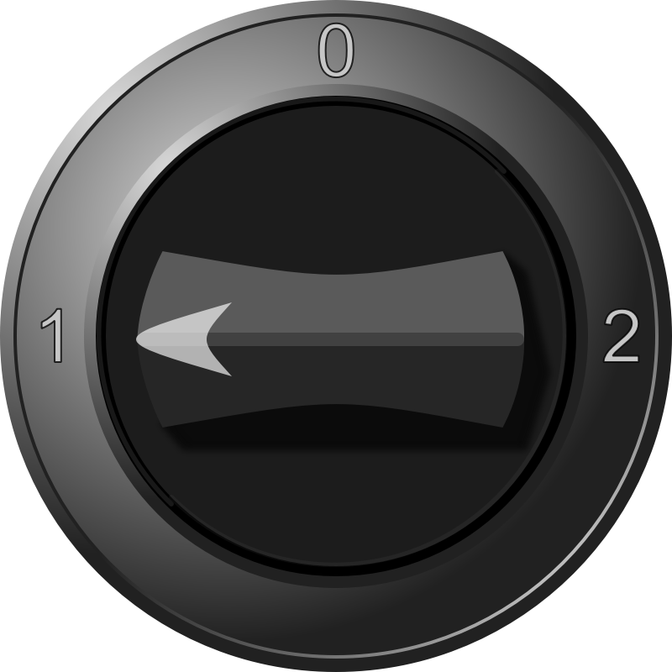


The approach that the Internet takes is to use a distributed algorithm to converge to an efficient and fair outcome.
H
C
How to achieve this?
Approach: sense and react
Example: showering: Want “just right” water
Use a feedback loop with signals and knobs

Slide 21
Signals and Knobs in Congestion Control
Signals
Packets being ACK’ed
Packets being dropped (e.g. RTO fires)
Packets being delayed (RTT)
Rate of incoming ACKs
Knobs
What can you change to “probe” the available bottleneck capacity?
Window size
Suppose the receiver socket buffer size is unbounded
Congestion window: window size used for congestion control
Increase window/sending rate: e.g., add x or multiply by a factor of x
Decrease window/sending rate: e.g., subtract x or reduce by a factor of x
Implicit feedback signals measured directly at sender.
(There are also explicit signals that the network might provide.)

Slide 22
Sense and react, sure…but how?
H
Where do you want to be?
The steady state
How do you get there?
Congestion control algorithms
Sense accurately & react accordingly
C

Slide 23
The Steady State
Efficiency for a single TCP connection

Slide 24
What does efficiency look like?
Suppose we want to achieve an efficient outcome for one TCP connection by observing network signals from the endpoint
Q: How should the endpoint behave at steady state?
Challenge: bottleneck link is remotely located

Slide 25
Steady state: Ideal goal
High sending rate: Use the full capacity of the bottleneck link
Low delay: Minimize the overall delay of packets to get to the receiver
Overall delay = propagation + queueing + transmission
Assume propagation and transmission components fixed
“Low delay” reduces to low queueing delay
i.e., don’t push so much data into the network that packets have to wait in queues
Key question: When to send the next packet?

Slide 26
When to send the next packet?
T
Fast link
Bottleneck link
1. Send packet burst (as allowed by window)
Inter-packet delay T
2. Receive data packet
5. Send data packet on ACK
Data
Sender
T
T
Receiver
T
4. Receive ACK
3. Send ACK
ACKs

Slide 27
Rationale
When the sender receives an ACK, that’s a signal that the previous packet has left the bottleneck link (and the rest of the network)
Hence, it must be safe to send another packet without congesting the bottleneck link
Such transmissions are said to follow packet conservation
ACK clocking: “Clock” of ACKs governs packet transmissions

Slide 28
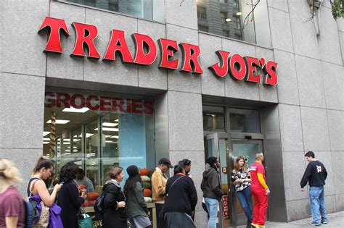
ACK clocking: analogy
How to avoid crowding a grocery store?
Strategy: Send the next waiting customer exactly when a customer exits the store
However, this strategy alone can lead to inefficient use of resources…

Slide 29
ACK clocking alone can be inefficient
Sender pushing data slowly
T
Large delay T
Send data packet on ACK
Data
Sender
T
T
Receiver
T
ACKs

Slide 30
ACK clocking alone can be inefficient
Sender pushing data slowly
T
Large delay T
Send data packet on ACK
Data
Sender
Receiver
The sending rate should be high enough to keep the “pipe” full
Analogy: a grocery store with only 1 customer in entire store
If the store isn’t “full”, you’re using store space inefficiently

Slide 31
Steady State of Congestion Control
Send at the highest rate possible (to keep the pipe full)
while being ACK-clocked (to avoid congesting the pipe)
So, how to get to steady state?

Slide 32
Finding the Right Congestion Window

Slide 33
Let’s play a game
Suppose I’m thinking of a number (positive integer). You need to guess the number I have in mind.
Each time you guess, I will tell you whether your number is smaller or larger than (or the same as) the one I’m thinking of
My number can be very large or small
How would you go about guessing the number?

Slide 34
Finding the right congestion window
TCP congestion control algorithms solve a similar problem!
There is an unknown bottleneck link rate that the sender must match
If sender sends more than the bottleneck link rate:
packet loss, delays, etc.
If sender sends less than the bottleneck link rate:
all packets get through; successful ACKs

Slide 35
Quickly finding a rate: TCP slow start
L
N
T
Payload
Initially cwnd = 1 MSS
MSS is “maximum segment size”
Upon receiving an ACK of each MSS, increase the cwnd by 1 MSS
Effectively, double cwnd every RTT
Initial rate is slow but ramps up exponentially fast
On loss (RTO), restart from cwnd := 1 MSS
Host A
Host B
MSS
one segment
RTT
two segments
four segments
time

Slide 36
Behavior of slow start
Packet drops/
RTO
Congestion Window
Slow start
Slow start
Slow start
1 MSS
Time

Slide 37
Slow start has problems
Congestion window increases too rapidly
Example: suppose the “right” window size cwnd is 17
cwnd would go from 16 to 32 and then dropping down to 1
Result: massive packet drops
Congestion window decreases too rapidly
Suppose the right cwnd is 31, and there is a loss when cwnd is 32
Slow start will resume all the way back from cwnd 1
Result: unnecessarily low throughput
Instead, perform finer adjustments of cwnd based on signals

Slide 38
Use slow start mainly at the beginning
You might accelerate your car a lot when you start, but you want to make only small adjustments after.
Want a smooth ride, not a jerky one
Slow start is a good algorithm to get close to the bottleneck link rate when there is little info available about the bottleneck, e.g., the beginning of a connection
Once close enough to the bottleneck link rate, use a different set of strategies to perform smaller adjustments to the congestion window
Called TCP congestion avoidance

