Slide 1

CS 352 Internet Protocol (IP)
CS 352, Lecture 16.1
http://www.cs.rutgers.edu/~sn624/352
Srinivas Narayana

Slide 2


Network
Application
HTTPS
FTP
HTTP
SMTP
DNS
Transport
TCP
UDP
Network
IP
Host-to-Net
X.25
…
802.11
ATM
The main function of the network layer is to
move packets from one endpoint to another.
The network will make its best effort to deliver packets
but doesn’t guarantee anything.

Slide 3
IP datagram format
IP protocol version
number
32 bits
total datagram
length (bytes)
header length
(bytes)
head.
len
type of
service
ver
length
for
fragmentation/
reassembly
“type” of data
flgs
fragment
offset
16-bit identifier
max number
remaining hops
(decremented at
each router)
time to
live
upper
layer
header
checksum
32 bit source IP address
upper layer protocol
to deliver payload to
32 bit destination IP address
Options (if any)
E.g. timestamp,
record route
taken, specify
list of routers
to visit.
how much overhead with TCP?
20 bytes of TCP
20 bytes of IP
= 40 bytes + app layer overhead
data
(variable length,
typically a TCP
or UDP segment)

Slide 4
IP Fragmentation & Reassembly
network links have MTU (max.transfer size) - largest possible link-level frame.
different link types, different MTUs
large IP datagram divided (“fragmented”) within net
one datagram becomes several datagrams
reassembled only at the destination, at the IP layer
IP header bits used to identify, order related fragments
fragmentation:
in: one large datagram
out: 3 smaller datagrams
reassembly

Slide 5
IP Fragmentation and Reassembly
length
=4000
ID
=x
fragflag
=0
offset
=0
Example
4000 byte datagram
MTU = 1500 bytes
(includes IP headers)
One large datagram becomes
several smaller datagrams
length
=1500
ID
=x
fragflag
=1
offset
=0
1480 bytes in data field
length
=1500
ID
=x
fragflag
=1
offset
=185
offset =
1480/8
length
=1040
ID
=x
fragflag
=0
offset
=370

Slide 7
CS 352 Dynamic Host Configuration
CS 352, Lecture 16.2
http://www.cs.rutgers.edu/~sn624/352
Srinivas Narayana

Slide 8
How does an endpoint gets its IP addr?

Slide 9
IP addresses: how to get one?
Q: How does a host get IP address?
Hard-coded by system admin in a file
UNIX: /etc/network/interfaces
Windows: controlpanel -> network -> configuration -> tcp/ip -> properties
DHCP: Dynamic Host Configuration Protocol: dynamically get address from as server
“plug-and-play”

Slide 10
Similar bootstrapping problems
How does a host get its IP address?
How does a host know its local DNS server?
How does a host know its subnet mask?
How does a host know which router is its “gateway” to other networks?

Slide 11
DHCP: Dynamic Host Configuration Protocol
goal: allow host to dynamically obtain its IP address from network server when it joins network
can renew its lease on address in use
allows reuse of addresses (only hold address while connected/“on”)
support for mobile users who want to join network
DHCP overview:
host broadcasts “DHCP discover” msg [optional]
DHCP server responds with “DHCP offer” msg [optional]
host requests IP address: “DHCP request” msg
DHCP server sends address: “DHCP ack” msg

Slide 12



DHCP client-server scenario
DHCP
server
223.1.1.0/24
223.1.1.1
223.1.2.1
223.1.1.2
arriving DHCP
client needs
address in this
network
223.1.1.4
223.1.2.9
223.1.3.27
223.1.2.2
223.1.1.3
223.1.2.0/24
223.1.3.1
223.1.3.2
223.1.3.0/24

Slide 13
DHCP client-server scenario
DHCP server: 223.1.2.5
DHCP discover
arriving
client
src : 0.0.0.0, 68
dest.: 255.255.255.255,67
yiaddr: 0.0.0.0
transaction ID: 654
Broadcast: is there a DHCP server out there?
DHCP offer
src: 223.1.2.5, 67
dest: 255.255.255.255, 68
yiaddrr: 223.1.2.4
transaction ID: 654
lifetime: 3600 secs
Broadcast: I’m a DHCP server! Here’s an IP address you can use
DHCP request
src: 0.0.0.0, 68
dest:: 255.255.255.255, 67
yiaddrr: 223.1.2.4
transaction ID: 655
lifetime: 3600 secs
Broadcast: OK. I’ll take that IP address!
DHCP ACK
src: 223.1.2.5, 67
dest: 255.255.255.255, 68
yiaddrr: 223.1.2.4
transaction ID: 655
lifetime: 3600 secs
Broadcast: OK. You’ve got that IP address!

Slide 14
DHCP Protocol
Server 1
Client
Server 2
DHCPDISCOVER
DHCPDISCOVER
DHCPOFFER
DHCPOFFER
Collects replies
Selects server 2
DHCPREQUEST
DHCPREQUEST
DHCPACK

Slide 15
DHCP: more than IP addresses
DHCP can return more than just allocated IP address on subnet:
address of first-hop router for client to reach other subnets
Also called the gateway router
name and IP address of the local DNS server
subnet mask of the IP network the host is on
Useful to know whether other endpoint is inside or outside the current IP network

Slide 16
DHCP Relay Agents
DHCP relay agents allow DHCP servers to handle requests from other subnets
Client
DHCP
Relay
Agent
IP
Gateway
Router
IP
Gateway
Router
DHCP
Server

Slide 17


DHCP: An example
connecting laptop needs its IP address, addr of first-hop router, addr of DNS server: use DHCP
DHCP
DHCP
UDP
IP
Eth
Phy
DHCP
DHCP
DHCP request encapsulated in UDP, encapsulated in IP, encapsulated in 802.1 Ethernet
DHCP
DHCP
Ethernet frame broadcast (dest: FFFFFFFFFFFF) on LAN, received at router running DHCP server
DHCP
DHCP
UDP
IP
Eth
Phy
168.1.1.1
DHCP
DHCP
DHCP
DHCP
router with DHCP
server built into
router
Ethernet demuxed to IP demuxed, UDP demuxed to DHCP

Slide 18
DHCP: An example
DHCP server formulates DHCP ACK containing client’s IP address, subnet mask, IP address of first-hop router for client, name & IP address of DNS server
DHCP
DHCP
UDP
IP
Eth
Phy
DHCP
DHCP
DHCP
DHCP
encapsulation of DHCP server, frame forwarded to client, demuxing up to DHCP at client
DHCP
DHCP
UDP
IP
Eth
Phy
168.1.1.1
DHCP
DHCP
DHCP
client now knows its IP address, name and IP address of DNS server, IP address of its first-hop router
DHCP
router with DHCP
server built into
router

Slide 19
Summary
IP addresses don’t have to be manually configured into hosts
DHCP allows “ignorant” hosts to receive IP addresses (and more) at start-up time
DHCP solves important bootstrapping problems in attaching new hosts to a network

Slide 21
CS 352 Internet Control Message Protocol
CS 352, Lecture 16.3
http://www.cs.rutgers.edu/~sn624/352
Srinivas Narayana

Slide 22
ICMP
Protocol for error detection and reporting
tightly coupled with IP, unreliable
ICMP messages delivered in IP packets
ICMP functions:
Announce reachability and network errors
Announce “time exceeded” errors for IP packets
Announce network congestion
ICMP assists network troubleshooting in general

Slide 23
ICMP message
IP header
Source, Destination Address, TTL, ...
ICMP MSG
Message type, Code, Checksum,
Data

Slide 24
ICMP: Internet Control Message Protocol
Type Code description
0 0 echo reply (ping)
3 0 dest. network unreachable
3 1 dest host unreachable
3 2 dest protocol unreachable
3 3 dest port unreachable
3 6 dest network unknown
3 7 dest host unknown
4 0 source quench (congestion
control - not used)
8 0 echo request (ping)
9 0 route advertisement
10 0 router discovery
11 0 TTL expired
12 0 bad IP header
Time for an activity!

Slide 25
Specific uses of ICMP
Echo request reply
Can be used to check if a host is alive
Destination unreachable
Invalid address and/or port
TTL expired
Routing loops, or too far away

Slide 26
Ping
Uses ICMP echo request/reply
Source sends ICMP echo request message to the destination address
Destination replies with an ICMP echo reply message containing the data in the original echo request message
Source can calculate round trip time (RTT) of packets
If no echo reply comes back, then the destination is unreachable

Slide 27
Ping (cont’d)
A
R1
R2
R3
B
Echo request
Time
Echo reply

Slide 28
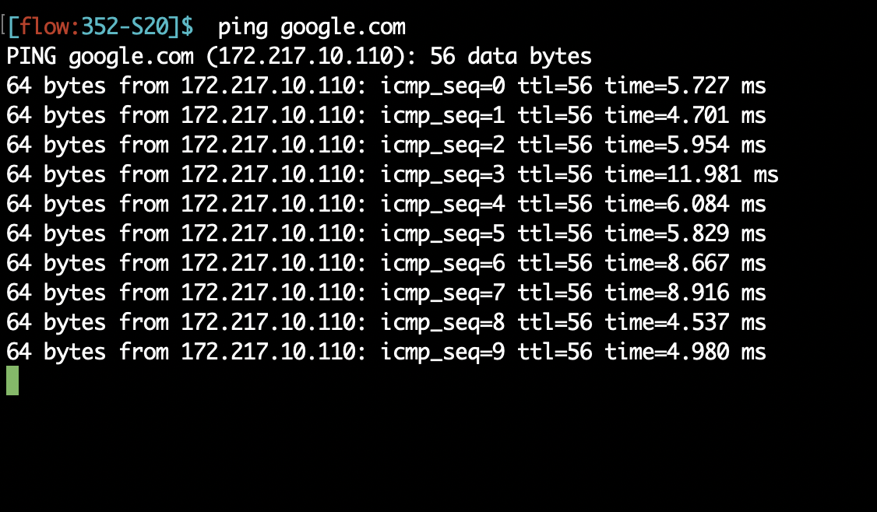
Ping example

Slide 29
Traceroute
Traceroute records the route that packets take
A clever use of the IP TTL (time to live) field
In general, when a router receives a packet, it decrements the TTL on that packet
If TTL=0, router sends an ICMP time exceeded message back to sender
traceroute progressively increases TTL of the packets it sends out
Every time an ICMP time exceeded message is received, record the sender’s (router’s) address
Repeat until the destination host is reached or an error message occurs
If packet reaches the destination, the dest host usually sends an ICMP port unreachable

Slide 30
Traceroute (cont’d)
Te = Time exceeded
Pu = Port unreachable
A
R1
R2
R3
B
TTL=1, Dest = B,
port = invalid
Te (R1)
TTL=2, Dest = B
Time
Te (R2)
TTL=3, Dest = B
Te (R3)
TTL=4, Dest = B
Pu (B)

Slide 31
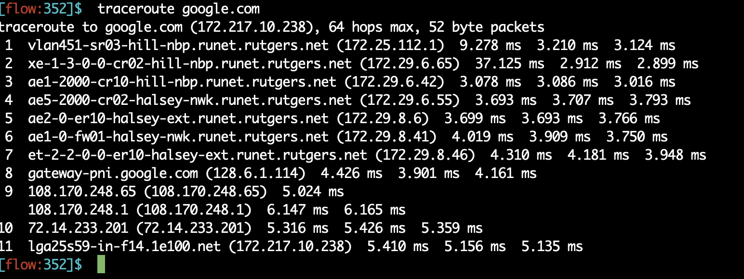
Traceroute example

